Slide 1
PHILIS Mobile Lab Capabilities and Recent Site Activities
Lawrence Kaelin, Chemist
CBRN Consequence Management Advisory Division (CMAD)
Region 2
Regional Response Team Meeting
Jersey City, NJ
June 2018

Slide 2
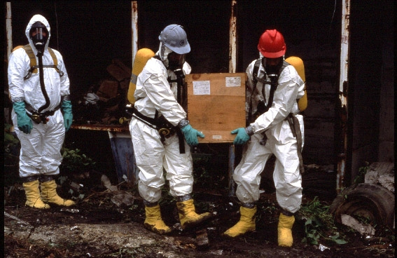
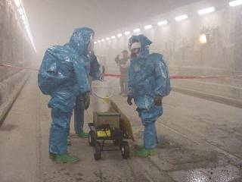
CBRN Consequence Management Advisory Division (CMAD)
US EPA – Special Team for CBRN
Mission: provides scientific and technical expertise for all phases of CBRN consequence management and is available to support the On-Scene Coordinators (OSC) 24/7
Focus: Operational preparedness for CBRN agents. Maintain ASPECT and PHILIS and RAD response assets
Support: All phases of CBRN response, including response, characterization, decontamination, clearance and waste management
CBRN: Response capabilities for biological, chemical and radiological incidents
Buildings, infrastructure, indoor and outdoor environments, transportation sectors
Notes:
National Decontamination Team (NDT), now called CMAT. We work in Partnership……
The CMAT 15 member team is spread through out the country (RTP NC, Washington DC, Erlanger KY, Kansas City KS, Edison NJ, Boston, MA) and provides technical expertise to OSCs on environmental decontamination for radiological, chemical, and biological weapons incidents.
Focus on all phases of CBRN response, including characterization, decontamination, clearance and waste management
Buildings, open spaces, transportation and water systems
Advice on protective cleanup levels
Team includes structural engineers, industrial hygienists, materials and HVAC engineers, health physicists, chemists, toxicologists, environmental scientists, and disposal experts.
CMAT also manages and focuses on EPA’s ASPECT aircraft, which provides chemical/radiological mapping capability, and the PHILIS TIC and CWA labs.

Slide 3

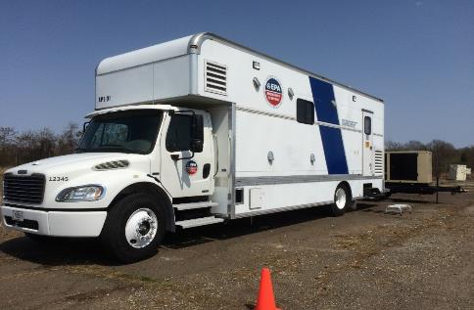
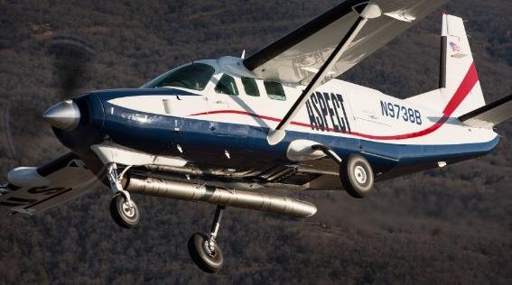
CBRN CMAD Mobile Assets
Unique Field Operational Assets – All Hazards
-Available to ALL EPA Regions & Interagency Partners-
TICs and CWAs
High Throughput Mobile Analysis
-Remote-Sensing & Imagery-
Chemical, Radiological & Situational Awareness
PHILIS Mobile Labs
ASPECT Airborne Detection Platform
Notes:
Portable High-Throughput Integrated Identification System (PHILIS)

Slide 4
CMAD’s Mobile Labs
TICs and CWAs - High Throughput Mobile Analysis
The Portable High-throughput Integrated Laboratory Identification System (PHILIS) Mobile Analytical Laboratories

Slide 5
PHILIS Background & Mission
PHILIS Designed Through DHS S&T Project (2004)
  Original Mission – Analysis of Chemical Warfare Agents (CWA) and Toxic Industrial Chemicals (TICS). National lack of CWA labs in the civilian sector for Consequence Management, remediation and Recovery
  Transferred to EPA in 2007
  CMAD coordinated with National Homeland Security Research Center (NHSRC) and selected Regional laboratories to develop and validate method for CWA – used by PHILIS and Regional Labs
Under EPA/OEM PHILIS Mission Expanded
Current Mission is for Dual Use Applications
Support to all EPA Regions , Other EPA Offices and federal, state and local entities
Part of EPA’s Environmental Response Laboratory Network (ERLN)
  140 laboratory network (EPA, private, commercial labs) offering rapid access to Chem, Bio and Radiochemical laboratories
  Subset of the Nation’s Integrated Consortium of Laboratory Networks (ICLN)

Slide 6
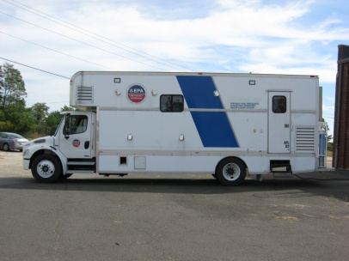
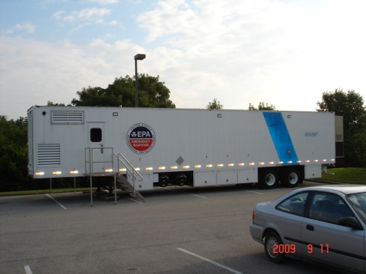
PHILIS Mobile Laboratory Vehicles
Edison, New Jersey
APL01 & APL02 –
Analytical Laboratories
SPA01 & SPA02 - Sample Preparation

Slide 7
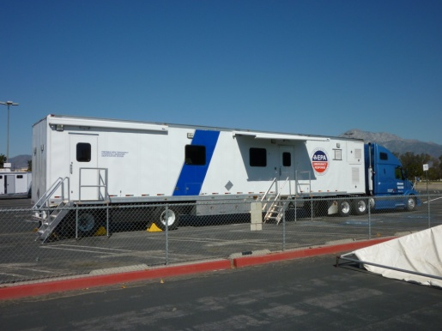
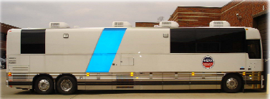
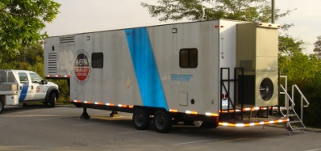
PHILIS Laboratory Vehicles
Castle Rock, Colorado
PAL - Analytical Laboratory
PHILIS LU –
PHILIS Laboratory Unit
SLA - Sample Log-In
SPA - Sample Preparation

Slide 8
PHILIS Analytical Methods
SVOCs via 8270D – NELAP accredited, all matrices
  Includes PAH (18) subset method
  Low, med & high range methods, rapid prep methods
VOCs via 8260C – NELAP accredited, all matrices
  Includes BTEX subset method
  Rapid head space VOC method
  Low, med & high range methods
PCBs via 8082A – NELAP accredited, all matrices (9 Aroclors)
Air toxics via TO17 (VOCs/BTEX) – NELAP certification
  Sorption tubes, Tedlar bags, SUMMA canisters
Carbamates via ASTM D7645-10, LC/MSMS
CWA breakdown products by LC/MSMS
  Ethanolamines (4), Nitrogen Mustard breakdown products
  Organophosphates (7), Nerve agent breakdown products
Chlorinated and Organo-Phosphorous Pesticides by GC/ECD & LC/MSMS
PFAS by LC/MSMS – method 537
Volatile GC/MS, GC/MS SIM, Organics: GC/MS TOF
Semivolatile GC/MS, GC/MS SIM, Organics GC/MS TOF
PAH GC/MS, GC/MS SIM
PCB GC/MS, GC/MS SIM, GC/ECD
Carbamates LCMS
Explosives LCMS
CWAs GC/MS TOF, GC/MS, LCMS

Slide 9
PHILIS Data Packages
Promium based LIMS
  Connected via encrypted wireless modem
  Remote access, data sharing via FTP site
Electronic Data Deliverables - Flexibility
  Daily Prelims via Excel Spreadsheets
  Tier 1, 2 & 3 EDD
Scribe compatible – this is now a big deal!
  Recent OLEM directive to use SCRIBE at all emergency responses
Can Generate a “CLP-reviewable” Data Package
  Generates html files for CLP EXES tool

Slide 10
Recent PHILIS Mobile Lab Site Activities
Field Exercises with EPA Regional, CSTs and federal, state and local response partners
On-site Analytical Support of EPA Regions
  Deployed to regions 1,2,3,4,5 & 6
Analytical Support for National Responses
  On-site deployment
  Reach-back Support via PHILIS or sub-contractor lab
In-place or “Stationary” mode, Analytical Support of EPA Regions
Methods Development

Slide 11
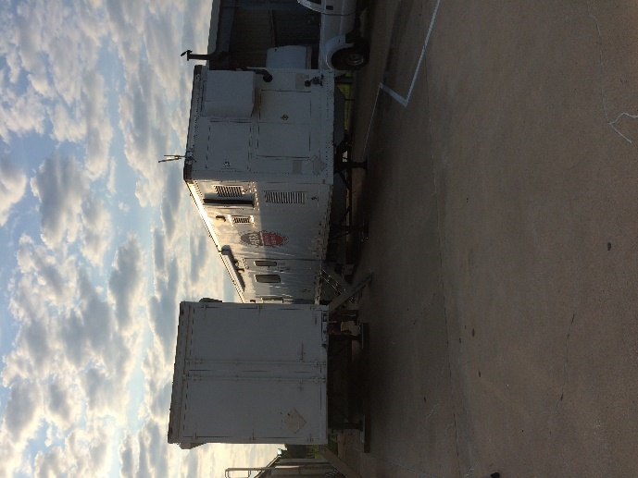
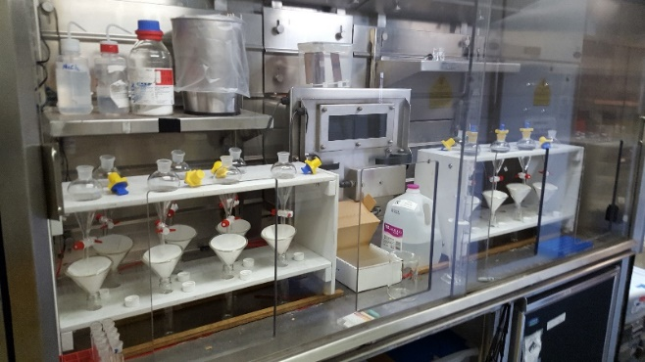
Hurricane Harvey Response
Region 6
Deployed PHILIS mobile assets to Region 6 laboratory local in Houston, TX, arrived on site on August 31, 2017, operated on site until September 14th.
PHILIS labs configured to run 8260, 8270 on soils, waters and sediments
Prelims within 24-hours of receipt, Scribe EDD delivered to Incident Command & EU
Tier 2, QA package within 48-hours
CLP-reviewable data packages with 10-14 working days
Over 60 samples run, first ARKEMA plant fire, soil & water samples run
Only lab operational in impacted area during first weeks
of the Hurricane Harvey response

Slide 12
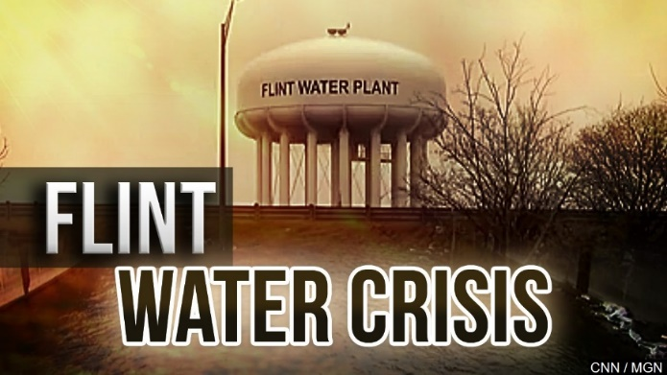
Flint Water Crisis Response
Region 5 Support
Direct request from R5 and HQ for CMAD support the with the Flint River drinking water crisis
CMAD providing both in-house PHILIS lab (stationary) and reach-back analytical support through the PHILIS contract and it’s subcontractor lab, Test America (TA)
PHILIS reach back via TA Subcontract support for metal analysis
PHILIS labs provided in-house support for organic analysis
PHILIS obtained NELAP certification on several drinking water methods to run Flint samples: VOCs, TTHM, Halo-AA
3000 samples analyzed (mostly <5 day turnaround)

Slide 13
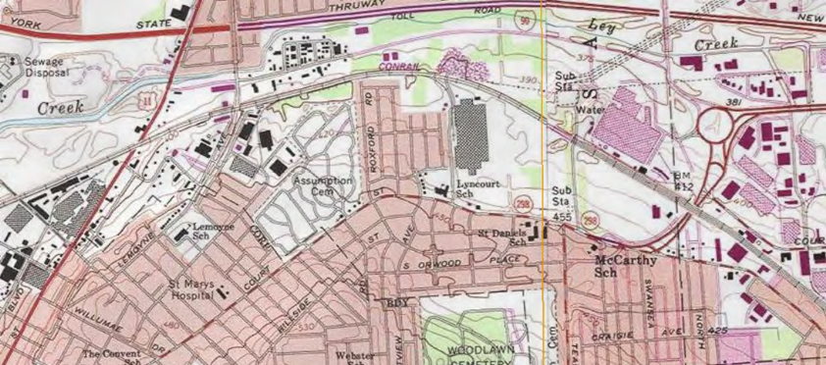
Region 2 On-site Analytical Support
RACER Trust Site
Region 2 RPM requested use of CMAD’s mobile assets to provide 24-hr turn-around analysis of soils for PCBs to expedite residential excavation activities
Joint effort of CMAD, Region 2, RACER Trust Fund, NYS DEC & DOH
PHILIS lab assets from NJ deployed to RACER site in Salina, NY for 6-8 weeks, deployment started September 6th, 2016
NELAP and NYS Lab certified method 8082A, for 9 Arochlors
PHILIS providing prelims within 24Hrs, QA’d data with 48Hrs and a CLP B data reviewable package format with 2 weeks after submission

Slide 14
Region 2 Support for the Mackenzie Site
Analytical support to Region 2 RPM site, Mackenzie
Samples brought to PHILIS warehouse in Edison, NJ
Analysis performed from warehouse
Method 8260 run on soils and water matrices
Over 70 samples run during 2 sampling events
Prelims with-in 24-hours of receipts. Scribe EDD delivered
Tier 2 QA data delivered with 48-hours of receipt
CLP-reviewable data package delivered within 7-10 working days

Slide 15
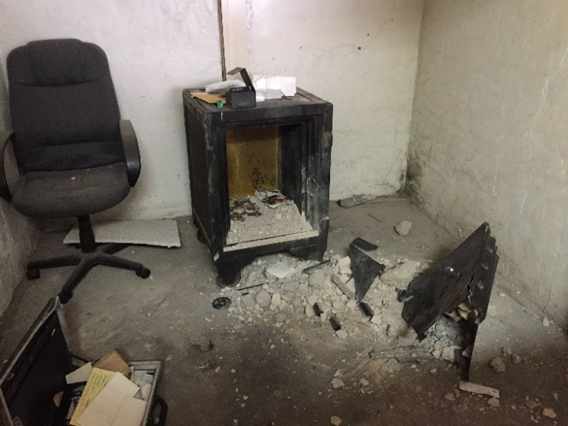
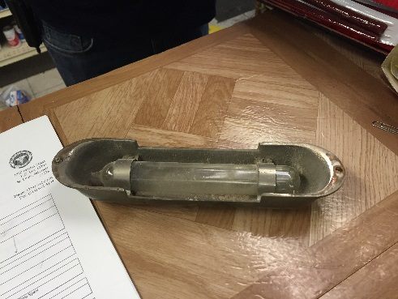
A True Unknown
Region 7 - Abandoned Agent in “Deterrent Safe”
An abandoned “deterrent” safe found during building renovations, may have been booby-trapped with sulfur mustard or other toxic chemical materials
  In the 1920-40’s commercial safes were often booby trapped with toxic chemicals to discourage thieves
Region 7 requested rapid analysis of wipe samples from safe and room and intact vials for chemical agents and/or related materials. Region 7 support to City of St. Louis
  Referral via R7 OSC, who is a member of the CWA Prep WG lead by CMAD
Exact nature of samples unknown – allowed PHILIS to exercise SOPs on “real world” unknown sample with potential CWA
Provided sampling “kits” to local HAZMAT sample teams to collect samples for PHILIS
Same day analysis was obtained via PHILIS in Castle Rock, CO
No CWAs or related toxic compounds – City was able to have the safe released to building owner
“Deterrent” safe
Glass ampule
w/deterrent chemicals

Slide 16
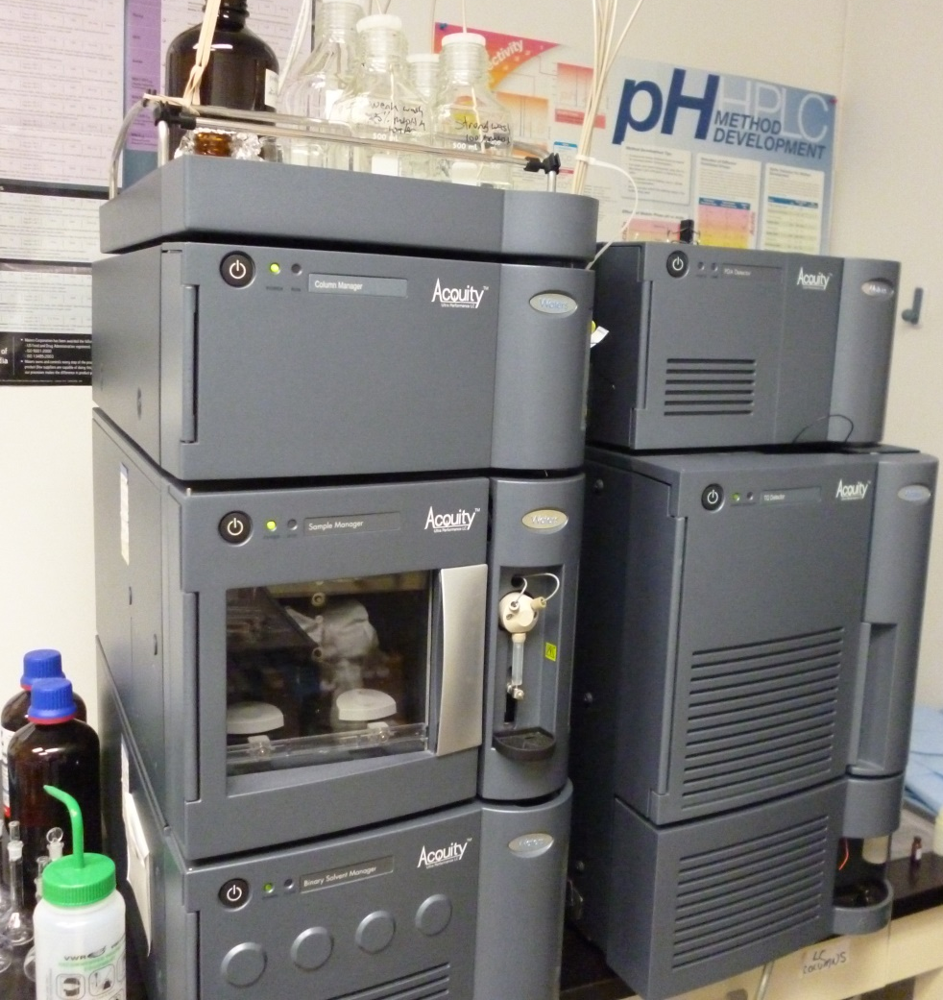
Region 7 Dicamba Investigation w/NEIC and State Stakeholders
PHILIS is working with NEIC in Lakewood to investigate the misuse of Dicamba on farmlands in Region 7
PHILIS deployed its Castle Rock units to operate in the NEIC parking lot
A method was developed for detecting of Dicamba in soil and vegetation matrices using LC/MS/MS.
Vegetative samples will be processed in blender. All samples will be extracted into water using a pressure solvent extractor
Analytes of interest are Dicamba, 2,4-D, 2,4-DCP, and associated breakdown products 5-hydroxydicamba, and 3,6-Dichlorosalicyclic acid

Slide 17
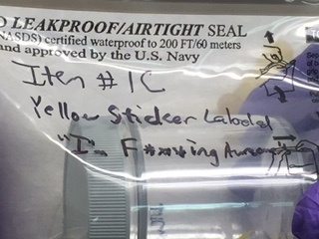
Support to Region 5 at the RNC Incident: “Psycho Stickers”
CMAD set up PHILIS for CWA analysis as well as VOCs & SVOCs for all matrices and provided “just in time” training for OSCs in CWA sampling and response
A demonstrator placed stickers on several people including local law enforcement staff - one who felt a tingling, burning sensation upon removal. Needed rapid on-site identification of so-called “psycho stickers”
PHILIS was the only on-site lab operational close to the RNC
PHILIS ran several stickers and wipes for G-agents, HD and VX, associated breakdown products and ran a spectral library search for controlled substances. Was the only lab in RNC local set up, running and able to run CWA analysis
No CWAs, controlled substances or related toxic compounds were detected

Slide 18
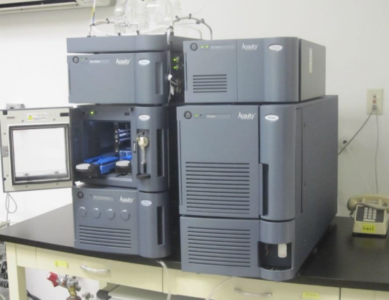
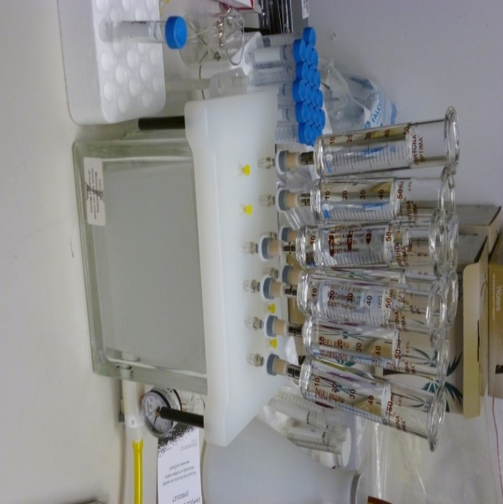
Methods Development for PFCs in Water
The CMAD and PHILIS staff are participating members of the EPA’s PFC Methods Development Work Group headed by OSTRI
The PHILIS team developed a method to determine PFCs using a hybrid method based on EPA 537 for analysis of PFCs in drinking water by UPLC/MSMS
Samples are prepared using solid phase extraction procedure
The method includes 24 target PFC compounds and 17 isotopes standards for a total of 41 target compounds
Current work includes evaluating procedures, such as isotopic dilution to improve accuracy of the calibration method at low quantitation levels
The method is able to see target analytes in the range of 5 to 15 pg/L

Slide 19
Region 6 Support
National Guard Civilian Support Teams
CMAD participation with 64th CST in El Paso, TX exercise – Summer 2017
CMAD Prepared unknown phosgene precursor substance (dimethylaniline) for CST to analyze through established “unknown substance” protocols using hand-held and GC/MS Hapsite via CST’s AWL mobile labs
PHILIS mobile labs provided on-site analysis of the precursor for comparison to CST analysis
Support to Region 6 OSC, and State of TX National Guard CST teams as well as CSX rail road stakeholders

Slide 20
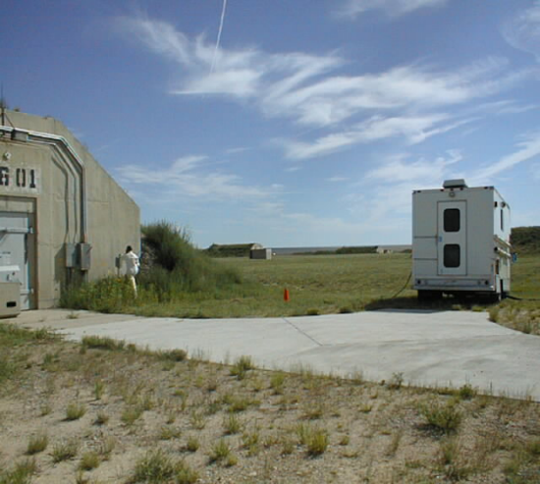
Current & Future Work w/DoD
Chemical Material Agency
CMAD is working with DoD/Chemical Materials Agency in CO & MD to provide air analysis during chem/demil activities at the Pueblo Army Chemical Depot (PCAD) facility – starting in 2018
PHILIS labs in Castle Rock, CO have performed all DoD’s prescribed Performance and Assessment (P&A) protocols to be able to accept CWA CASARM standards directly from the DoD. This is in addition to the PHILIS lab’s accreditation to handle EPA’s Ultra-dilute CWA standards under the EPA’s ERLN
PHILIS will be the only EPA mobile lab to have both DoD and EPA-ERLN approval to run both EPA/ERLN and DoD standards and methods
Work at PCAD scheduled to start FALL 2018 and may continue into 2023!!
PCAD munitions “igloo” to be decommissioned

Slide 21
Access to Analytical Capability
PHILIS Mobile Lab
  Access PHILIS Directly by contacting POCs:
  POCs
    Paul Kudarauskas/CMAD/ FOB Branch Chief: (o) 202-654-2415, (cell) 202-344-5382, Kudarauskas.Paul@epa.gov
    Larry Kaelin/ CMAD/FOB: (o) 732-321-6625, (cell) 513-675-4751, Kaelin.Lawrence@epa.gov
    David Bright/CMAD/FOB: (o) 913-551-7897, (cell) 913-549-7127, Bright.David@epa.gov
    EOC Hotline: 202-564-3850

Slide 22
Other CMAD Analytical Support Capabilities and Assets for CBRN
The EPA’s ERLN
CMAD’s BSL 2+ Bio-Analytical Lab
ASPECT – airborne analytical platform
RAD RTFL training

Slide 23
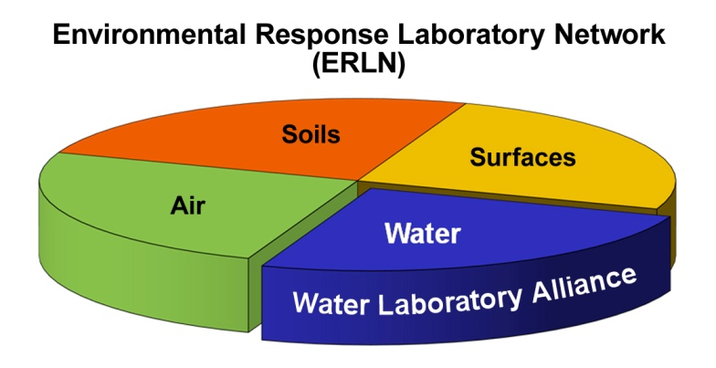
The EPA’s Environmental Response
Laboratory Network (ERLN)
Currently 143 Laboratories
An all hazards/all environmental media laboratory network for chemical (including CWA), biological and radiological Agents supporting the needs of the response community
Allow for day-to-day use supporting incidents of any scale during preparedness, response, remediation.
Coordinated Partnership with National Homeland Security Research Center (NHSRC) and Office of Resource Conservation and Recovery (ORCR) for methods and method development
Partnership with Office of Water’s Water Laboratory Alliance (WLA) and ORIA Radiological Laboratory program

Slide 24
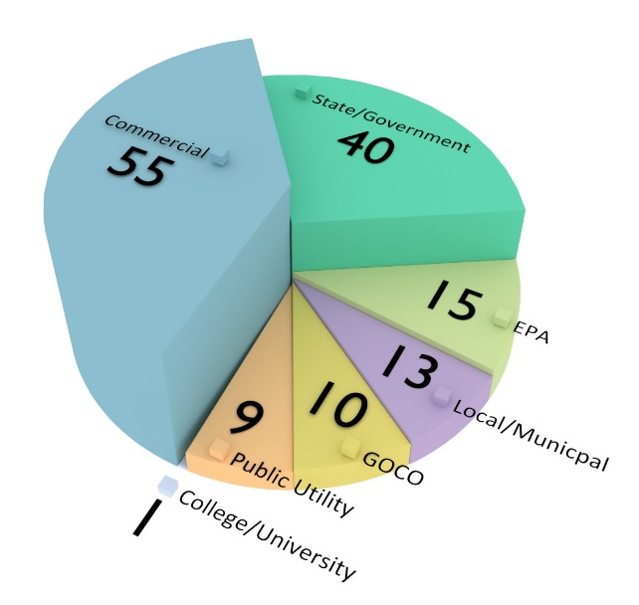
Environmental Response Laboratory Network
(ERLN)
  Instant access to over 140 public and private sector laboratories with a broad spectrum) of analytical capabilities;
  Provides an organized and consistent approach to obtaining laboratory analytical services;
  Provides reliable analytical data of known quality;
  Offers a streamlined paperless process to assess data from one or multiple laboratories; and
  Designed to reduce project cost and improve data delivery and management

Slide 25
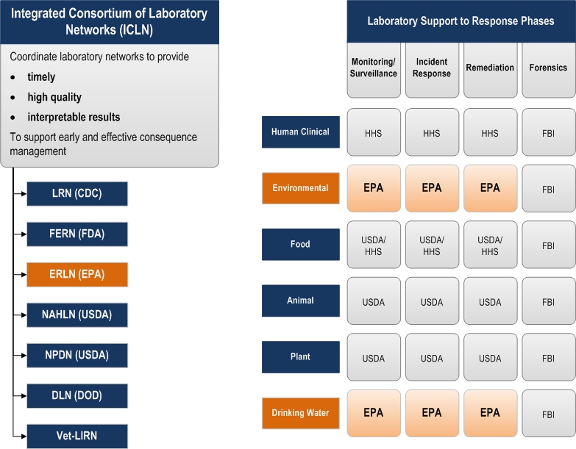
ERLN National Role
The EPA’s ERLN is Part of the Integrated Consortium of Laboratory Networks (ICLN)

Slide 26
ERLN Tools
EPA Laboratory Compendium - Searchable Database of Laboratory Information
Capability
Certifications
Instrumentation
Personnel
URL: https://cfext.epa.gov/cetl

Slide 27
CMAD Bio-Analytical Laboratory (CBL)
Bio-Safety Level Two Enhanced (BSL-2E)
  Capable of safely analyzing environmental samples contaminated with biological Select Agents such as Bacillus anthracis and ricin toxin
Location: Lakewood, CO (NEIC Facility)
Purpose
  Provide emergency analytical services to EPA emergency response community when faced with a biological incident
  Provide support to partners at the National Homeland Security Research Center (NHSRC) in developing analytical methods for analyzing environmental samples
  Using Select Bio-agent reagents obtained from DoD’s ECBC Laboratories

Slide 28
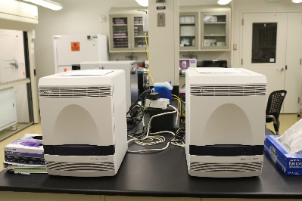
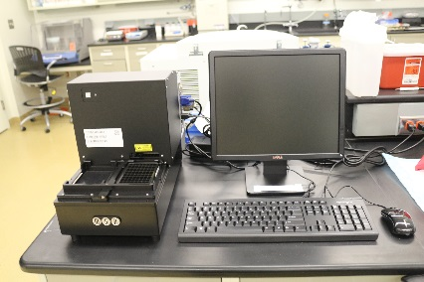
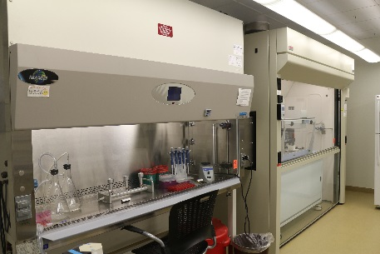
CBL Capabilities
Environmental sample analysis
Microbiological and molecular biology equipment
Methods include:
  Bacterial culture methods
  Polymerase Chain Reaction (PCR)
    Real-Time PCR
    Rapid Viability PCR (RV-PCR)
  Electrochemiluminescence (ECL)
    Biotoxin analysis

Slide 29
Organism Specific Capabilities
Pathogen BSL Detection Method Samples/24 hrs.
Cryptosporidium 2 qPCR ~40
Giardia 2 qPCR ~40
Toxoplasma 2 qPCR ~40
E. coli 1 qPCR/culture ~40
E. coli OH:157 2 qPCR ~40
Legionella spp. 2 qPCR ~40
Listeria monocytogenes 2 qPCR ~40
B. globigii (anthrax surrogate) 1 qPCR/culture ~40/60
B. thuringiensis (anthrax surrogate) 1 qPCR/culture ~40/60
Microbial Source Tracking 1 qPCR ~40

Slide 30
CBL Projects
Assisting NHSRC to collect performance data on RV-PCR
  Eventually make RV-PCR the standard analysis over culture method
  RV-PCR gives results in 15 hours rather than the 36 hours required for culture method
Ensuring data quality of ECL analysis for ricin samples
Assisting in operational studies
  In 2016, CBL analyzed over 600 samples in one month via culture method as part of the Operational Technology Demonstration
Developing relationships with DOD to facilitate acquisition of reagents needed for biological agent analysis

Slide 31
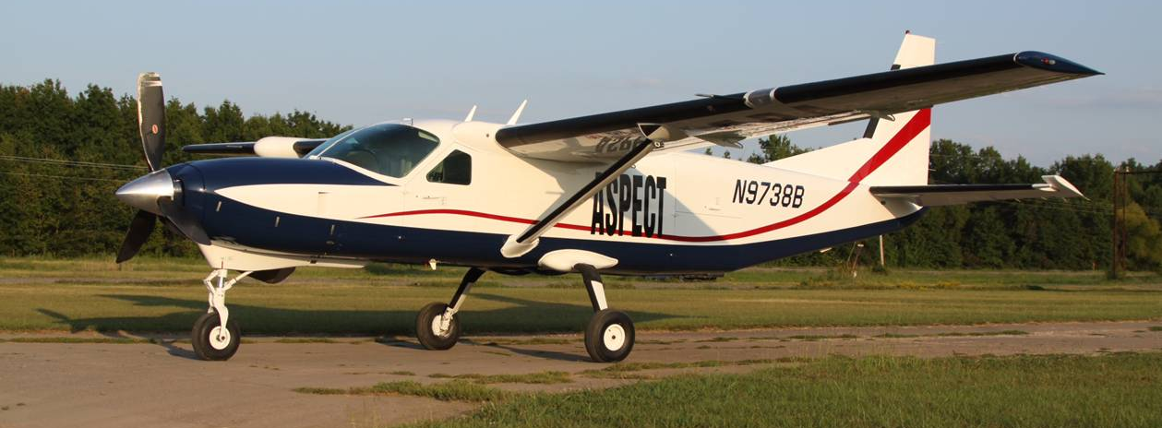
USEPA ASPECT Program
Airborne Spectral Photometric Environmental Collection Technology
NATION’S ONLY
-Remote-Sensing & Imagery-
Chemical, Radiological & Situational Awareness

Slide 32
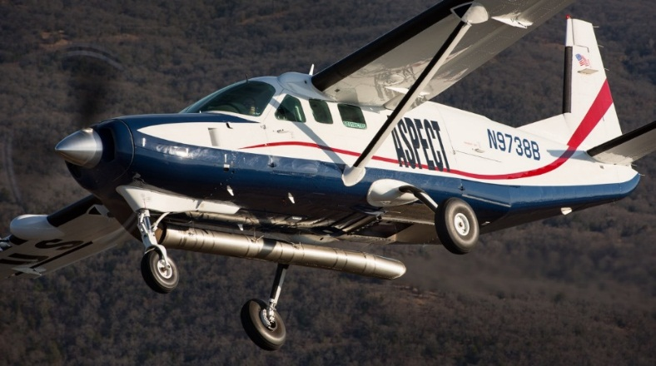

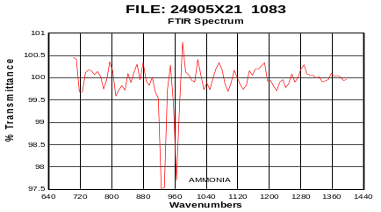

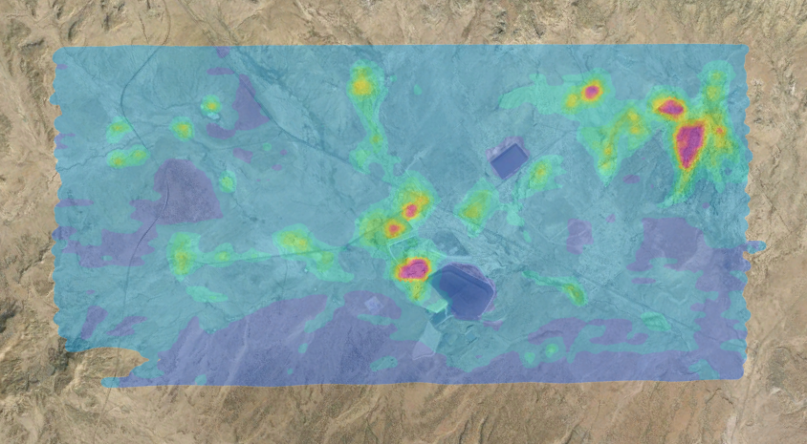
ASPECT
Multi-Role Operational Concept
Emergency Response
Homeland Security
Site Characterization
Atmospheric Characterization
Automated airborne processing
and data transmission via satellite
One phone call activation
Wheels up -- 1 hour
5 Minute turn on data once on-site
  Chemical, Radiological, Situational
  Real-time data processing
  All data QA/QC validated
  >150 Deployments/Responses
Data package extracted by reach back team, analyzed and QA/QC validation
System FULLY OPERATIONAL
24/7/365 Readiness
Validated data released for client use

Slide 33
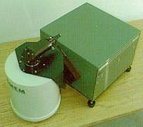
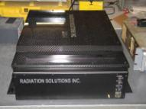
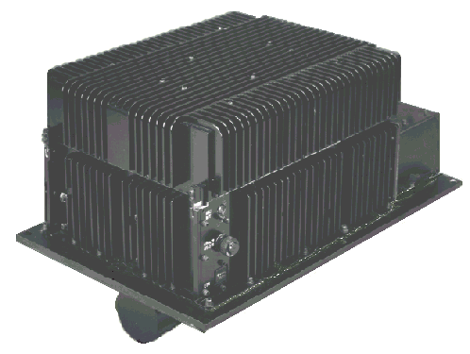
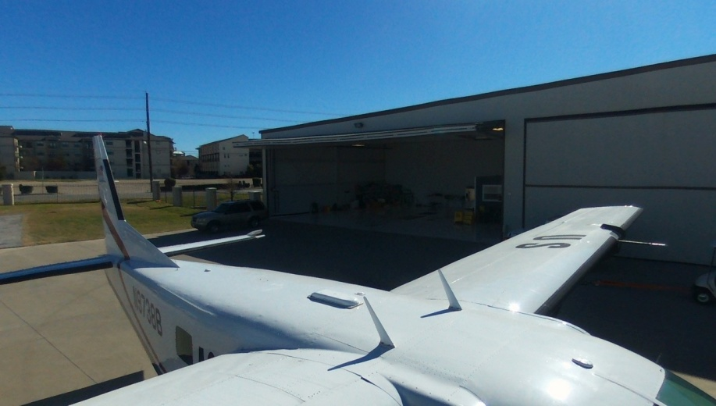
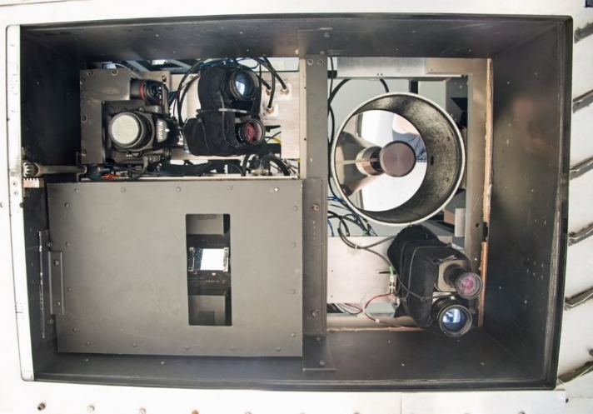
ASPECT – Current Systems
Gamma-Ray Spectrometer packs and neutron detectors for radiological detection
A High Speed Infrared Spectrometer* to identify and quantify the composition of the plume
Infrared Line Scanner* to image the plume
Broadband Satellite Data System provides real-time link with the ground
High Resolution Digital Aerial Cameras*; full GIS ready

Slide 34
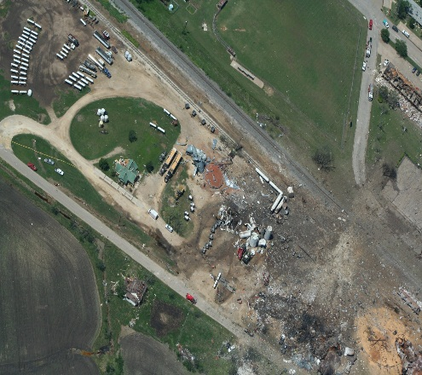
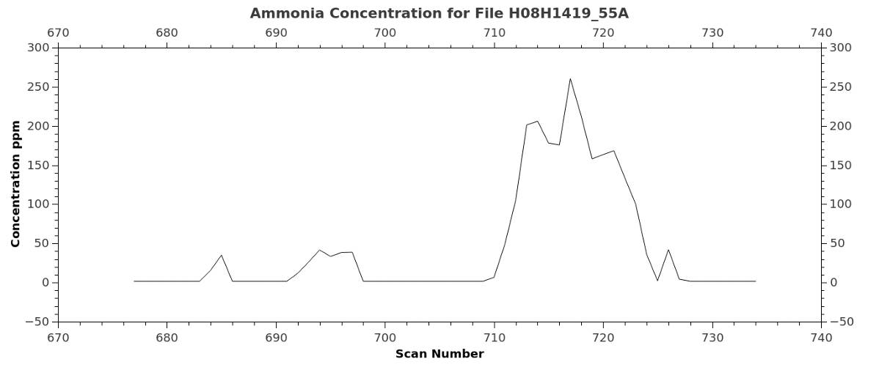
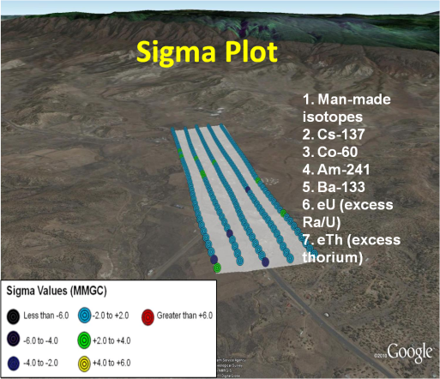
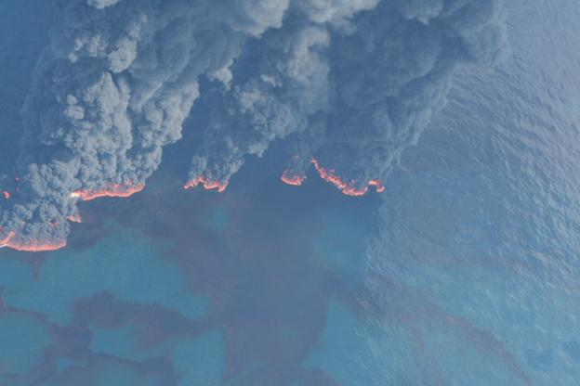
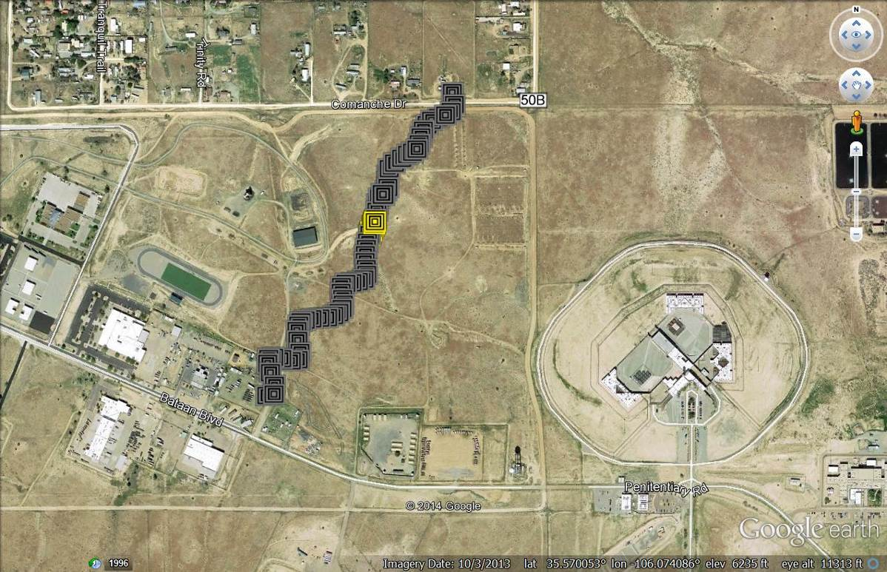
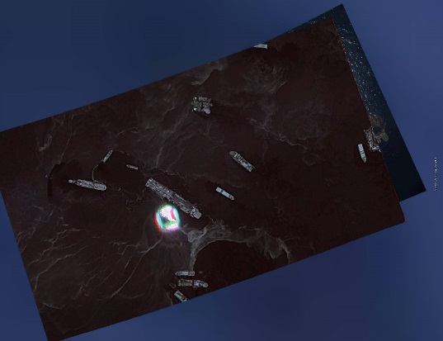
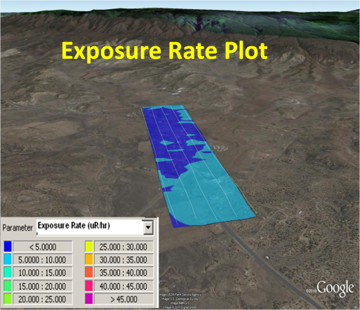
ASPECT – Data Products
Situational Awareness
Chemical
Aerial Photo
Radiological
Oblique Photo
IR Image

Slide 35
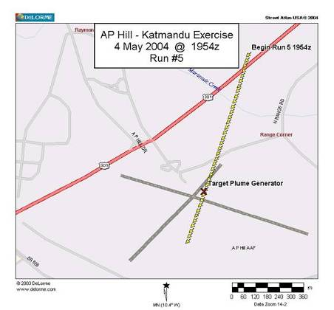
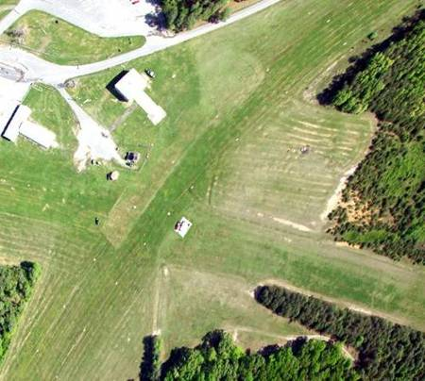
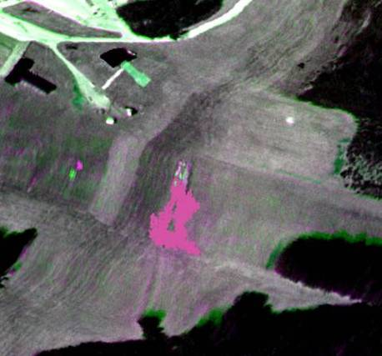
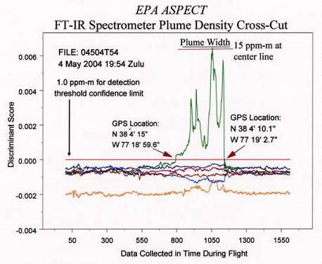
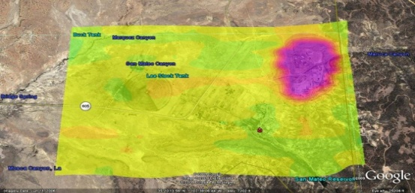
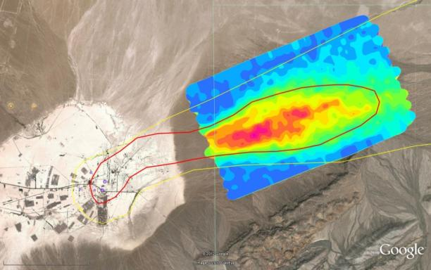
ASPECT – Software and Automation
Simplify Operations, Improve Data Quality and Reduce Costs
Current software provides automated detection, GIS treatment, and Data Management while the aircraft is in flight
Automated Radiation Detection -- Background suppressed pattern recognition techniques developed for chemical detection are being applied to radiological detection. Filters and coefficients have been developed and tested for Cs-137, Co-60. Cs-134, Am-241, I-131, and Eu-152 are being generated.

Slide 36
ASPECT – Contact and Readiness
Dr. Mark J. Thomas, ASPECT Program Manager
Field Operations Branch
CBRN Consequence Management Advisory Division
US EPA Office of Emergency Management
513-675-4753 thomas.markj@epa.gov
Mr. Paul G. Kudarauskas, Chief
Field Operations Branch
CBRN Consequence Management Advisory Division
US EPA Office of Emergency Management
202-564-2415 kudarauskas.paul@epa.gov

Slide 37
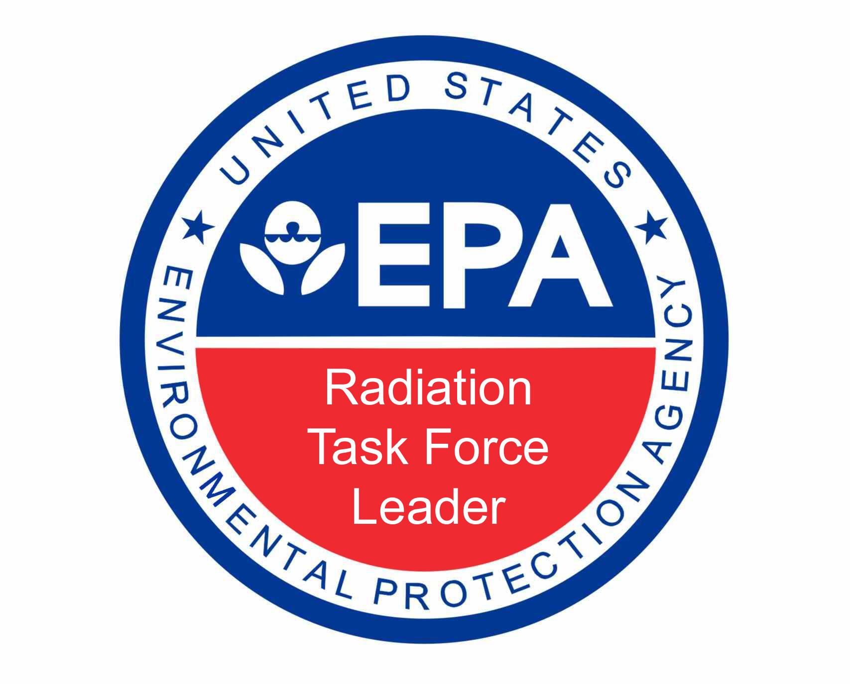

Slide 38
Radiation Task Force Leaders
RTFL members provide additional, as needed RAD support to Region RAD responders and assets
2017 refresher classes held in Las Vegas (6) and Erlanger (6)
Planned for 2018
  Edison (25-29 June) and
  Las Vegas (15-19 Oct)
Participants – 43 trained w/about 15 -20 continuous
Notable
  R6 HP now annually gets their RTFLs out to a NPP or related exercise (counts for annual training)
  R4 often uses RTFLs for surveys at remedial sites

Slide 39
Training Responders for RTFL abilities
Use detection equipment
  Ludlum 2350 w/ 44-9, 44-10 and 43-90 probes
  Thermo 451B ion chamber
  Siemens EPD II dosimeter
Collect samples according to SOP (soil, water, air)
Wear Level C PPE and operate safely in a contaminated environment
Operate a decon line (up to Level B) for other responders
Group Supervisor for RTFL teams

Slide 40
RTFL Training Program Contacts
Scott Hudson, Health Physicist
Field Operations Branch
CBRN Consequence Management Advisory Division
US EPA Office of Emergency Management
859-594-6531 hudson.scott@epa.gov
Mr. Paul G. Kudarauskas, Chief
Field Operations Branch
CBRN Consequence Management Advisory Division
US EPA Office of Emergency Management
202-564-2415 kudarauskas.paul@epa.gov

Slide 41
Questions??
Lawrence Kaelin, Chemist
US EPA/OEM-CMAD
PHILIS Mobile Labs P.O.
Edison, NJ
732-321-6625 (o)
513-675-4751 (c)
Kaelin.Lawrence@epa.gov

