Slide 1


Dwayne Harrington
USEPA Region 2
Response and Prevention Branch
Emergency and Remedial Response Division
harrington.dwayne@epa.gov
Ammonium Nitrate Facilities CAA 112(r) General Duty Clause
(GDC) Inspections
                Zimmerman Fertilizer
                WHR Services

Slide 2
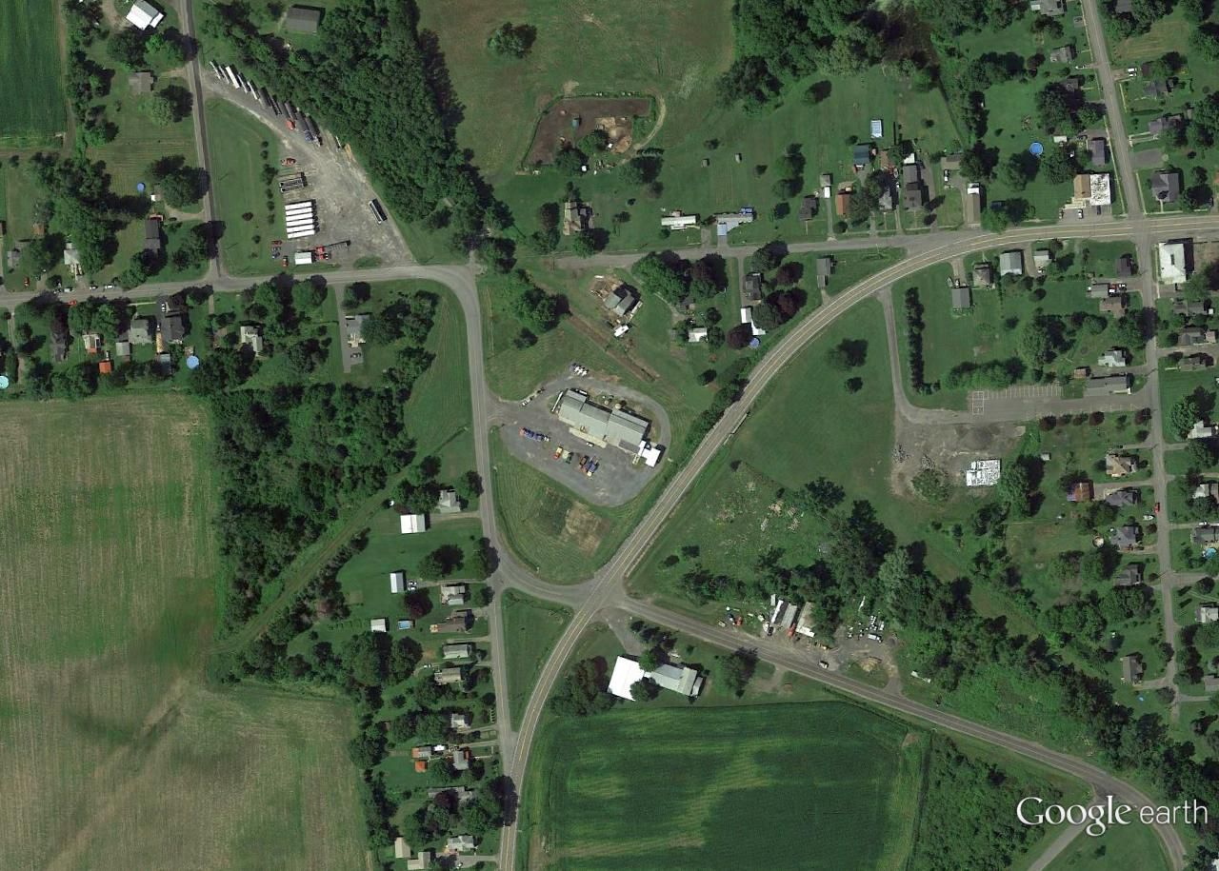
Zimmerman Fertilizer GDC Inspection
Stanley, Ontario County, NY
Blending Facility
Storage Facility

Slide 3
Zimmerman Fertilizer GDC Inspection
Stanley, Ontario County, NY
Blending Facility
Storage Facility
~ 200 tons of ammonium nitrate fertilizer

Slide 4
Zimmerman Fertilizer GDC Inspection
Stanley, Ontario County, NY
Blending Facility
Storage Facility
~ 200 tons of ammonium nitrate fertilizer
DHS request for EPA GDC Inspection

Slide 5
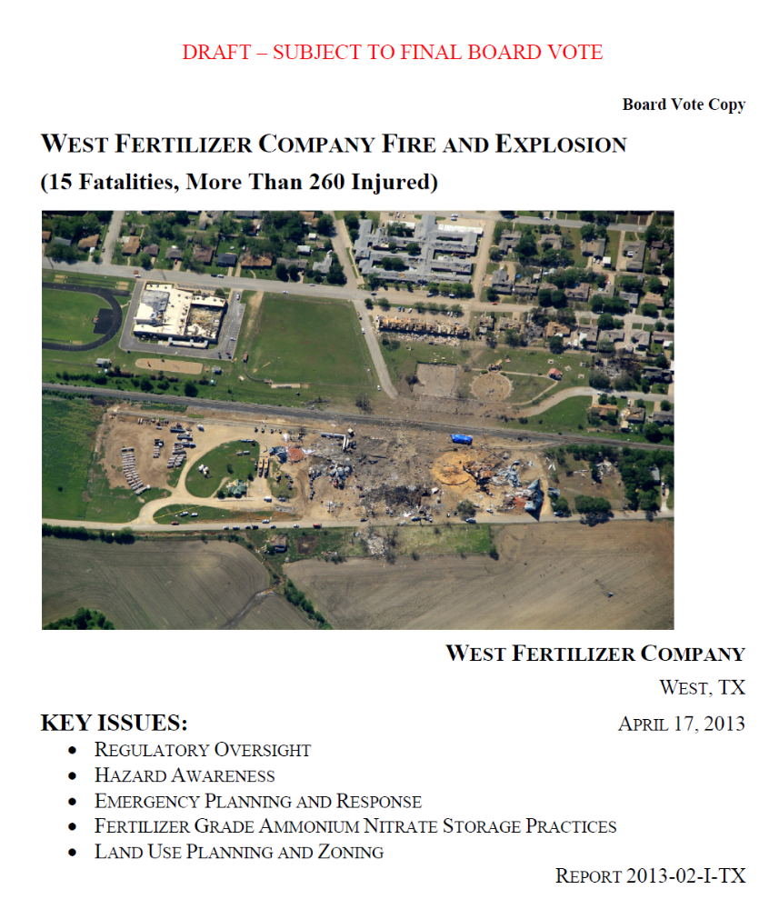
Executive Order 13650: Improving Chemical Facility Safety and Security (EO 13650)
Directs the government to conduct a number of tasks, including modernizing regulations and strengthening community planning and preparedness
Aimed at preventing chemical accidents, such as the explosion in West, Texas on April 17, 2013

Slide 6
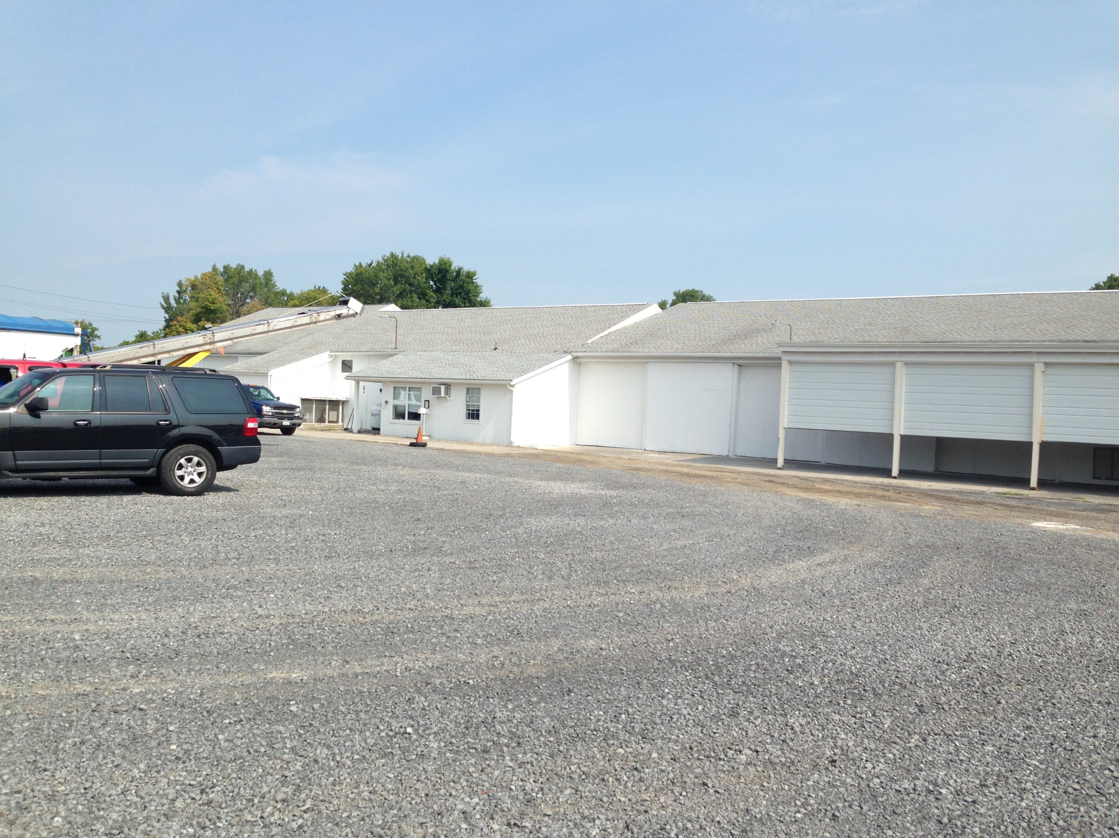
Zimmerman Fertilizer
Blending Facility

Slide 7
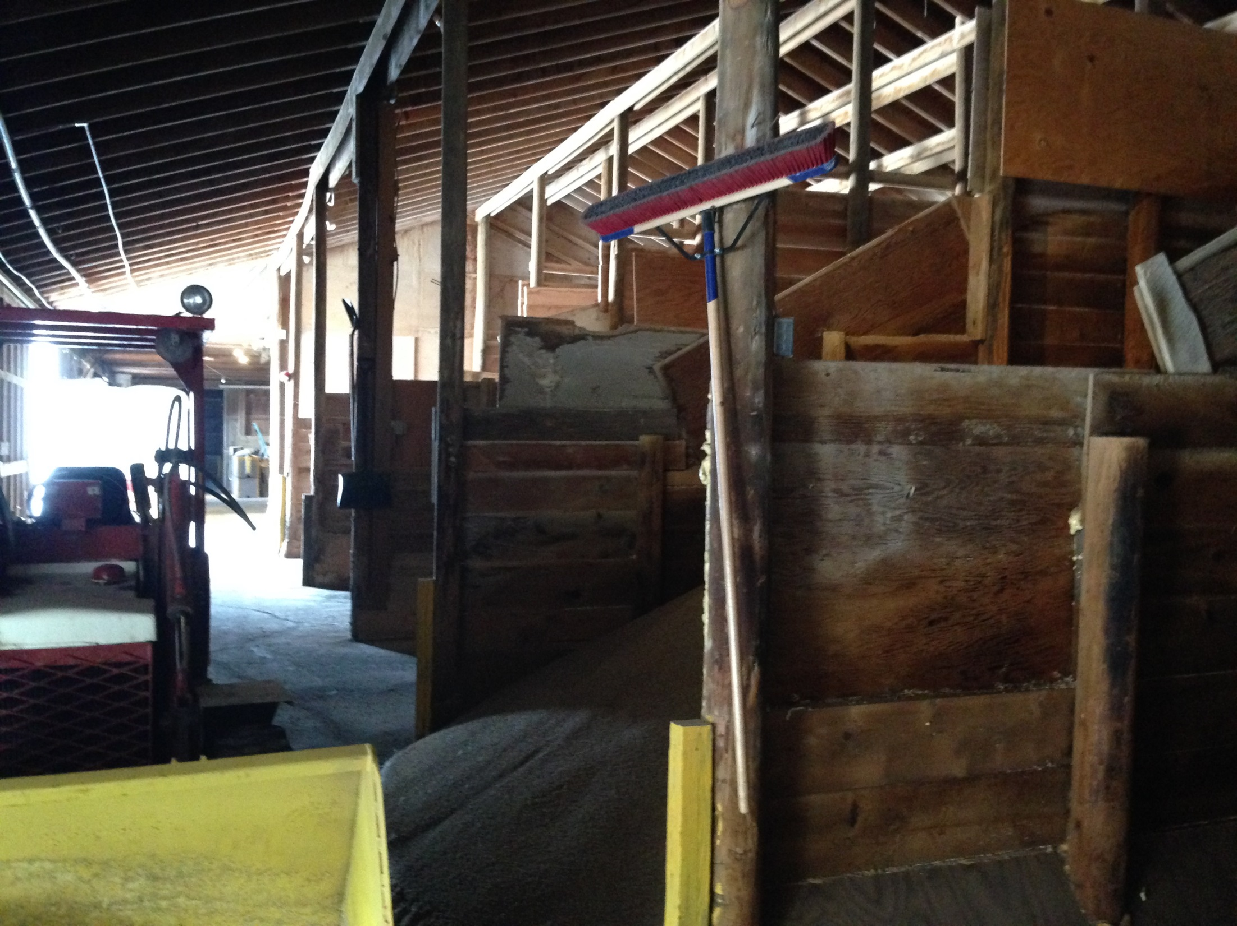

Slide 8
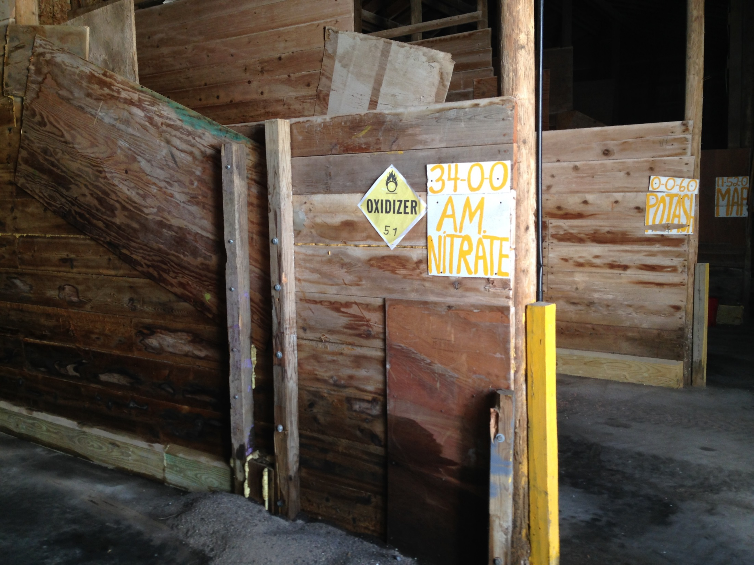

Slide 9
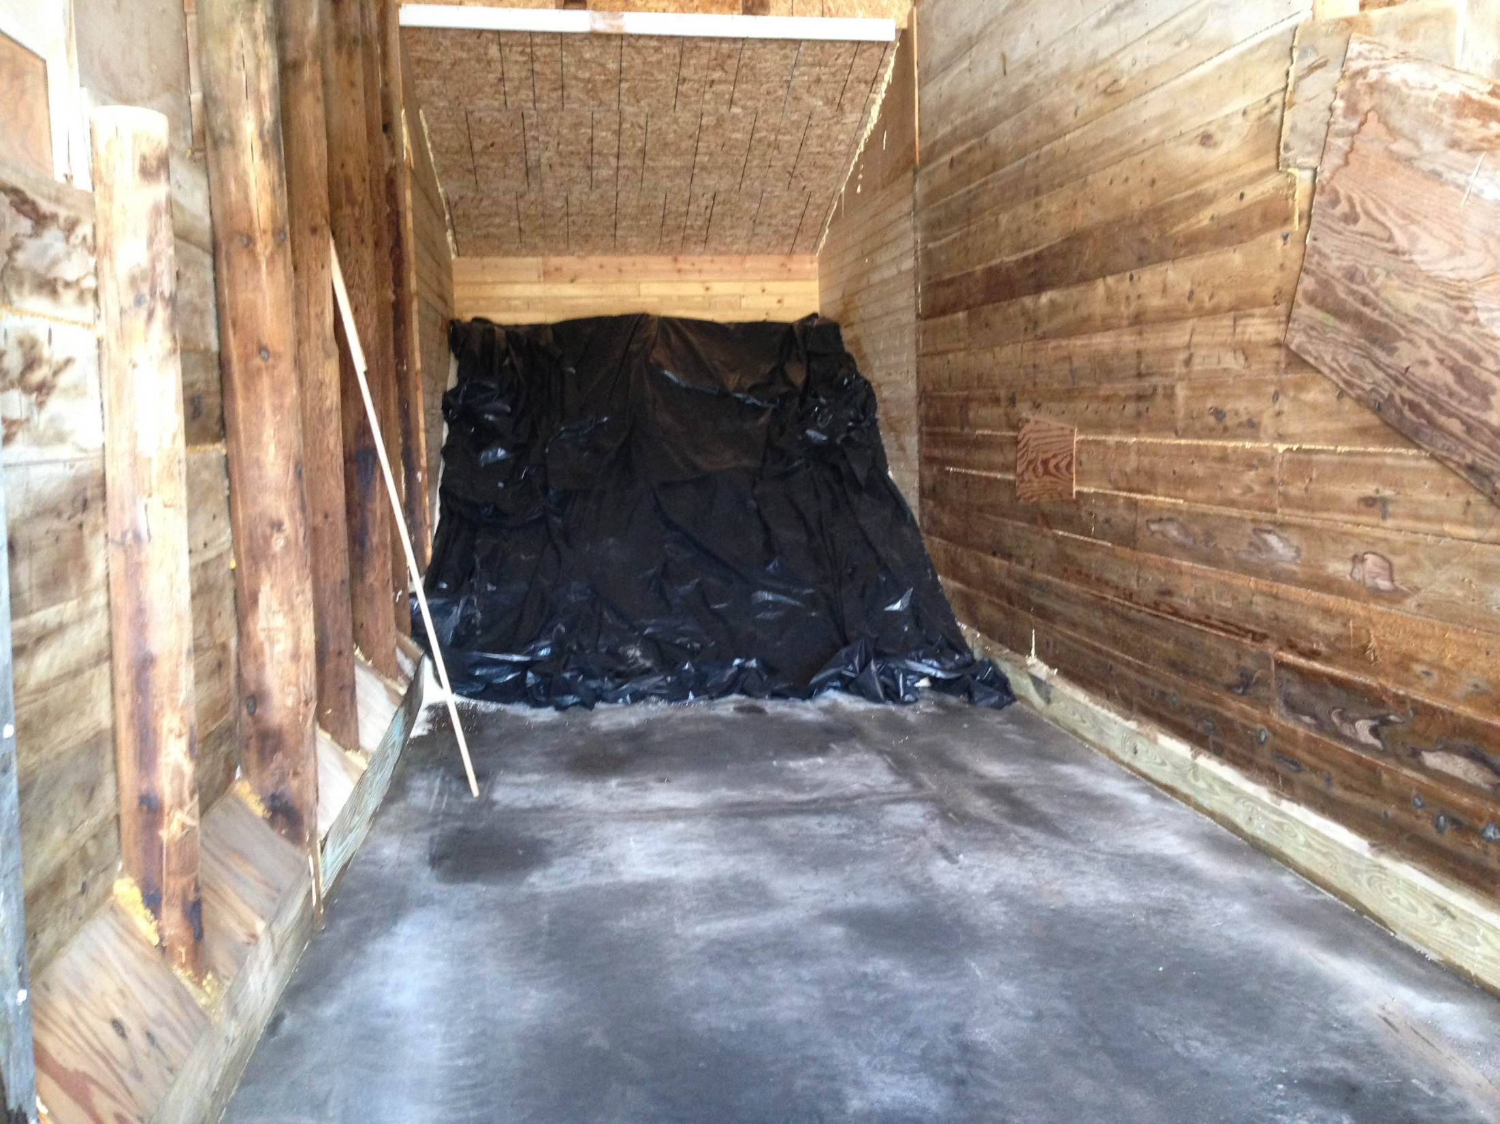

Slide 10
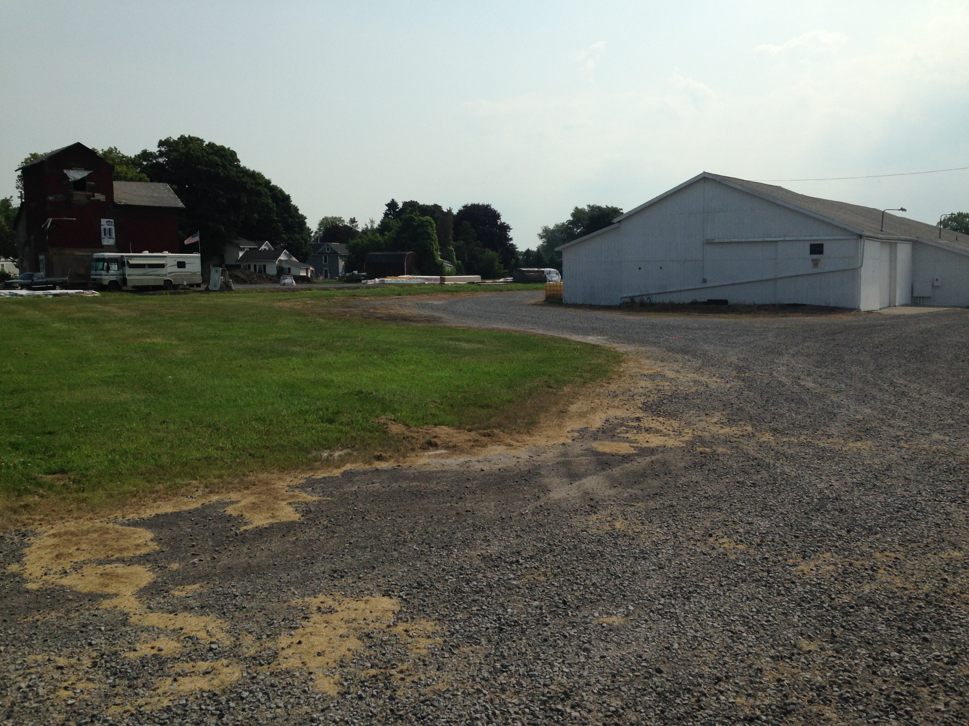

Slide 11
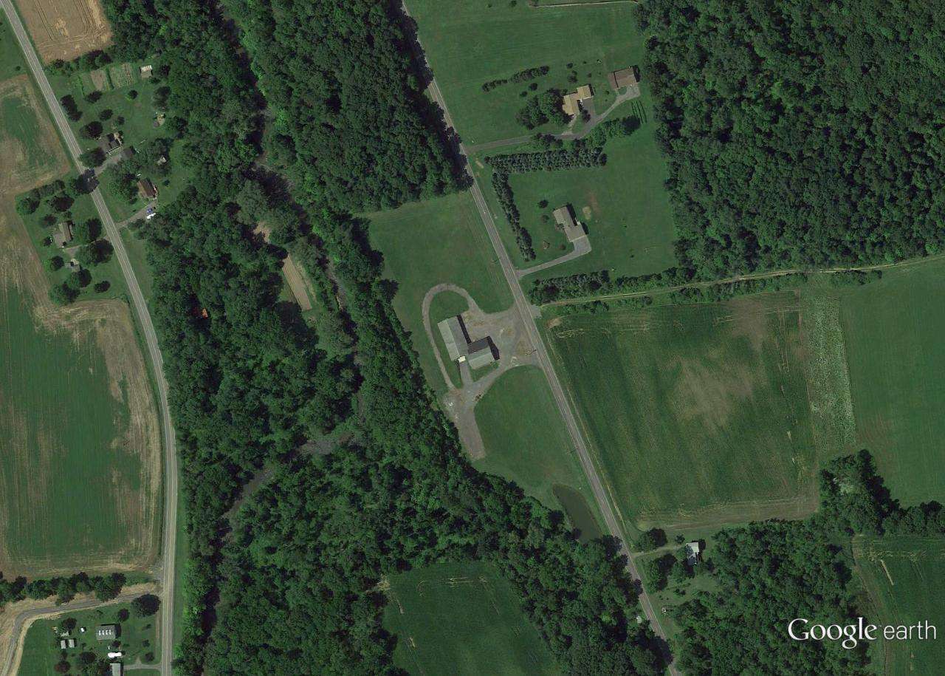
Storage Facility

Slide 12
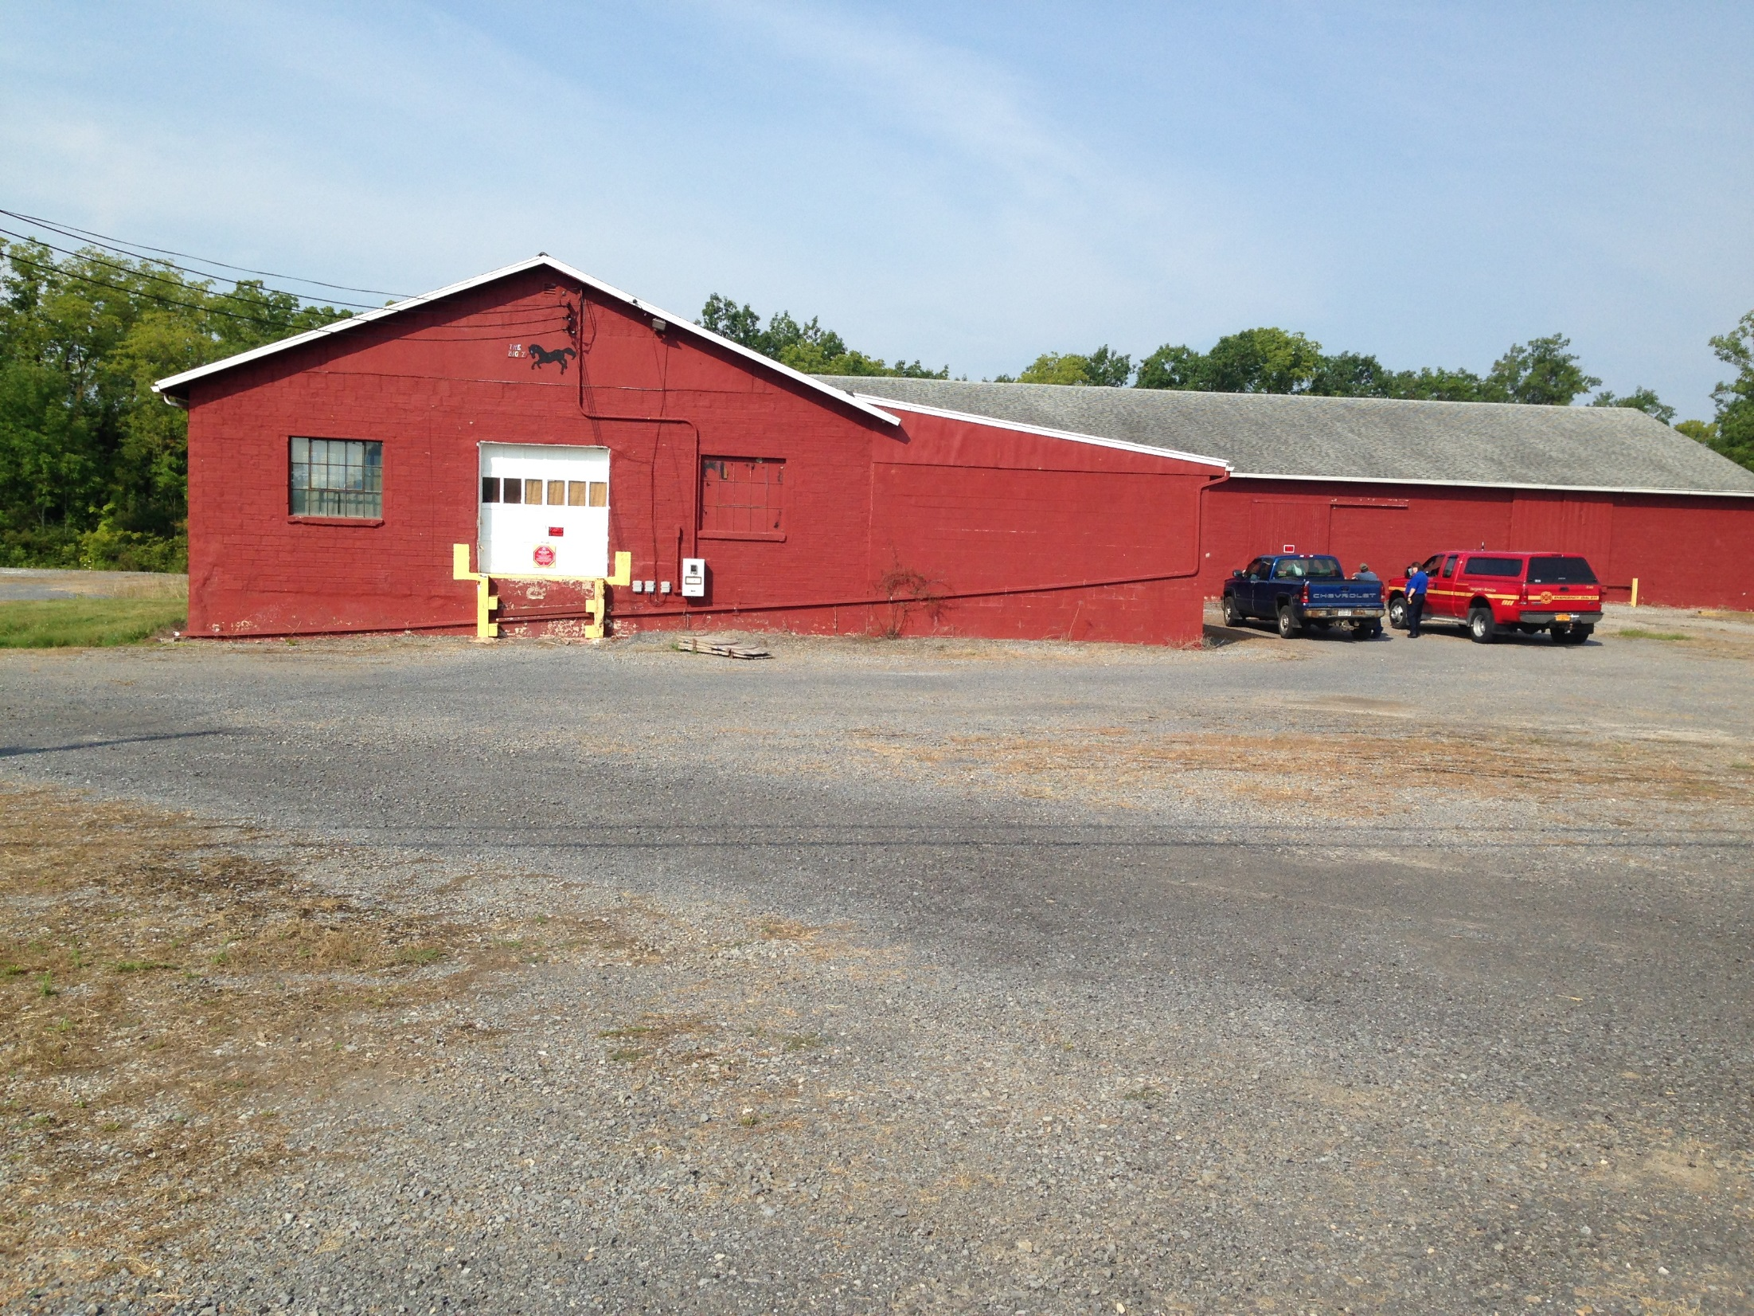
Zimmerman Storage Facility

Slide 13
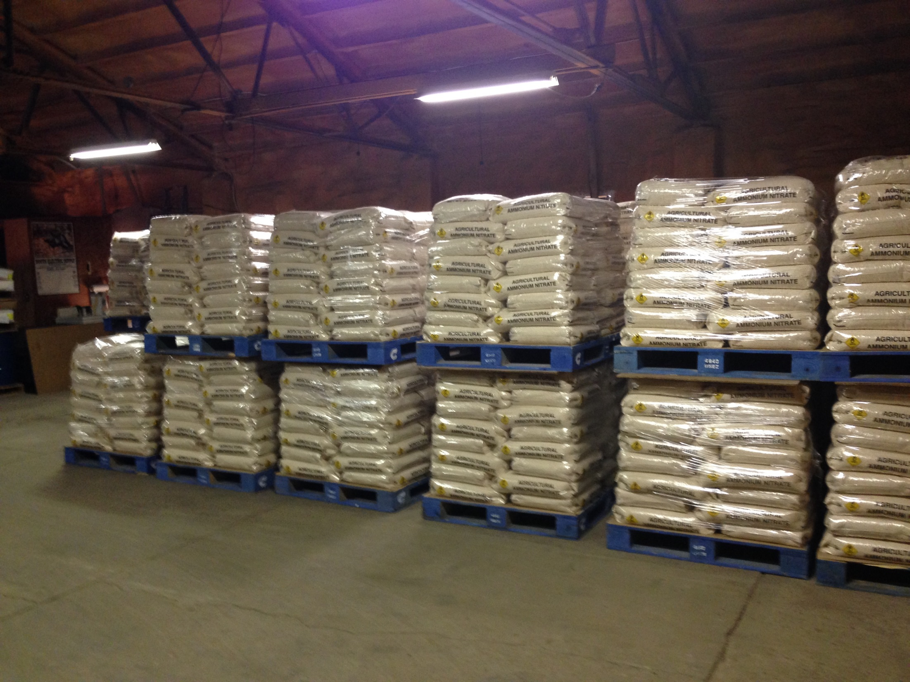
200 – 400 tons AN

Slide 14
Zimmerman Fertilizer:
Facility management unfamiliar with applicable codes, regulations, and industry standards for ammonium nitrate storage and handling, including:
    OSHA Hazard Communication Standard
    employee training
    fire detection and alarm systems
Facility did not submit Tier II chemical inventory forms to local emergency services
Local first responders not aware of the hazards at the facilities
No community response plan for either facility
EPA GDC Consent Order

Slide 15
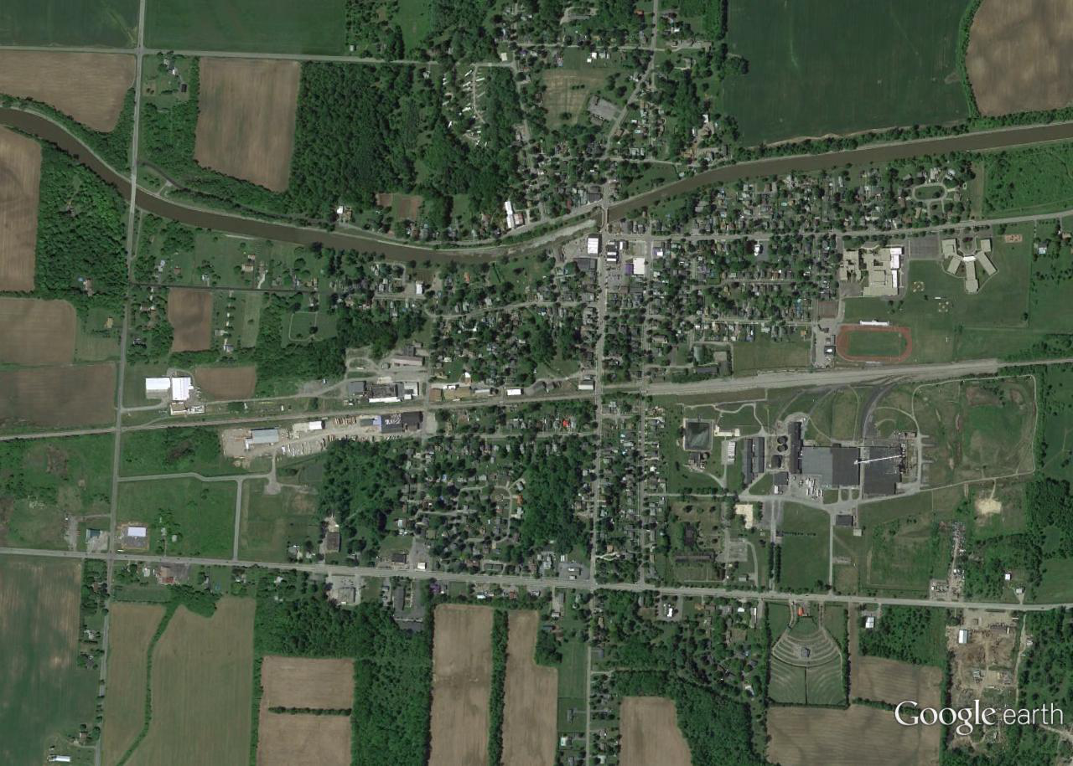
WHR Services, Middleport,
Niagara County, NY

Slide 16
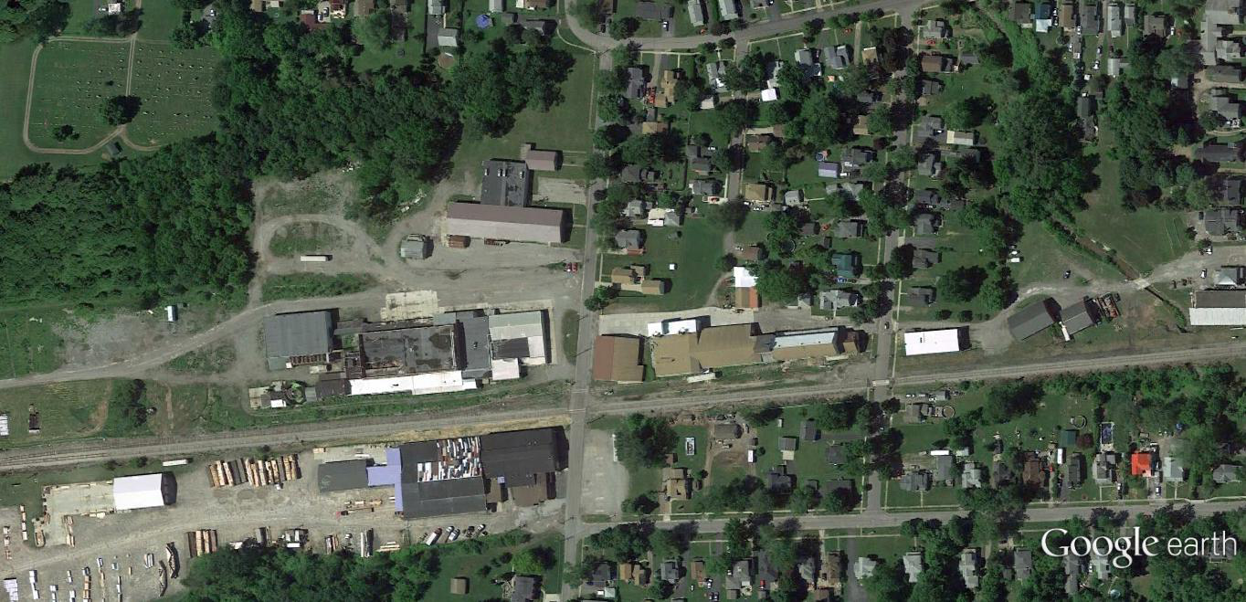

Slide 17
~ 2,000 tons ammonium nitrate fertilizer

Slide 18
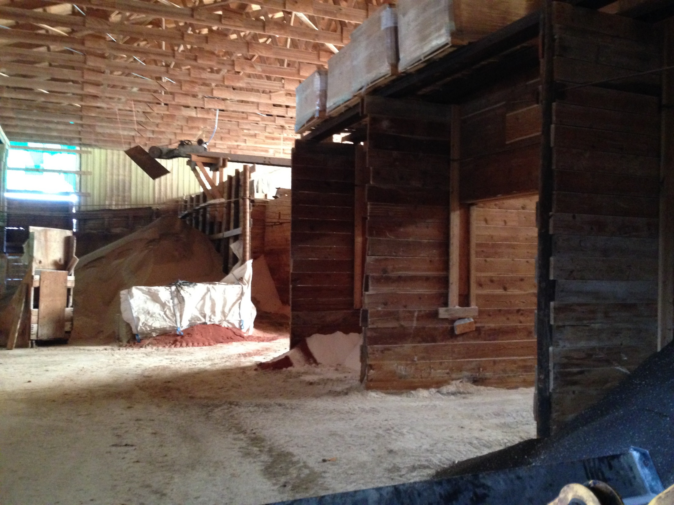

Slide 19
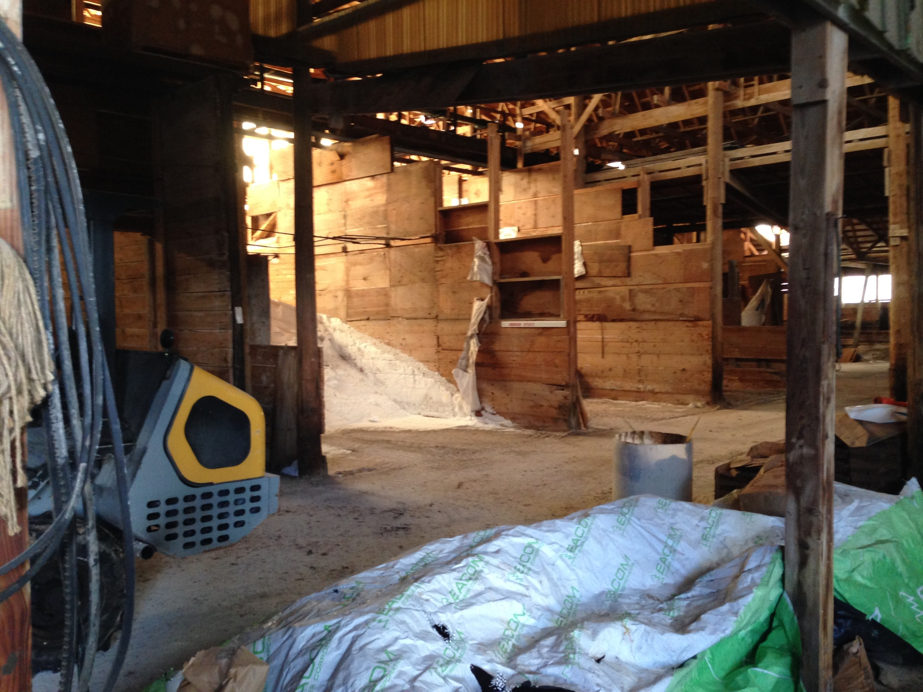

Slide 20
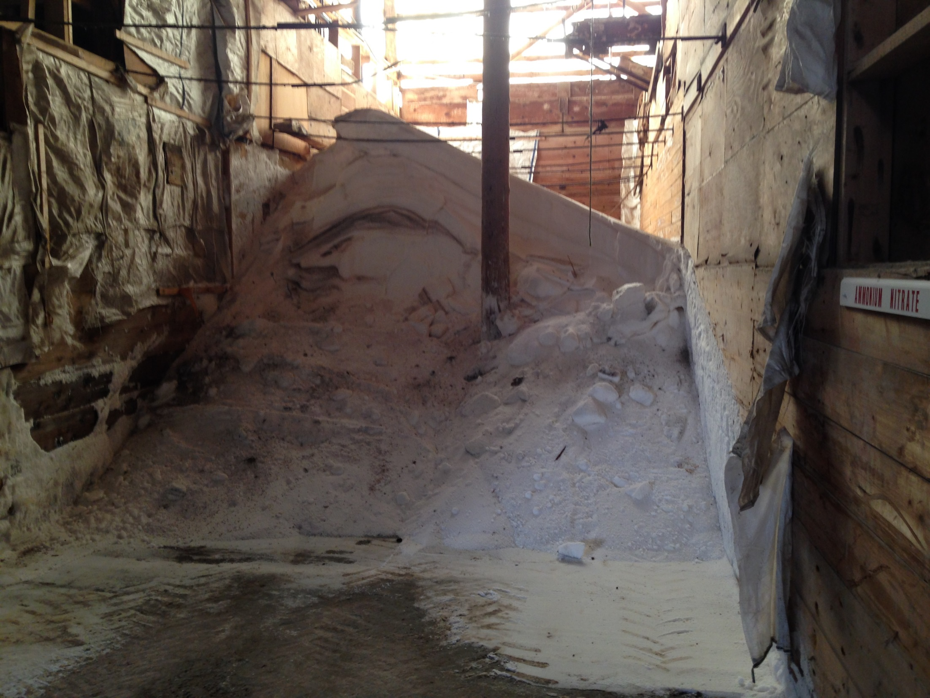

Slide 21
AN Safety and Security Plan:
Handling and Storage SOPs
Inspections
Security
Emergency Response Plan
Local Hazmat Response
Plan (non-specific)
No Community Protection Plan

Slide 22
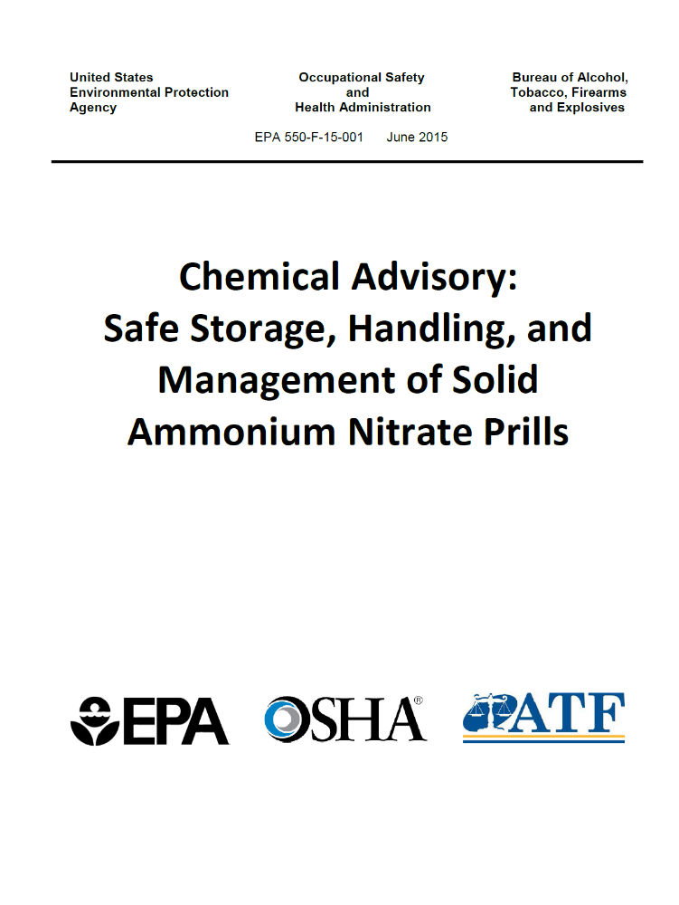
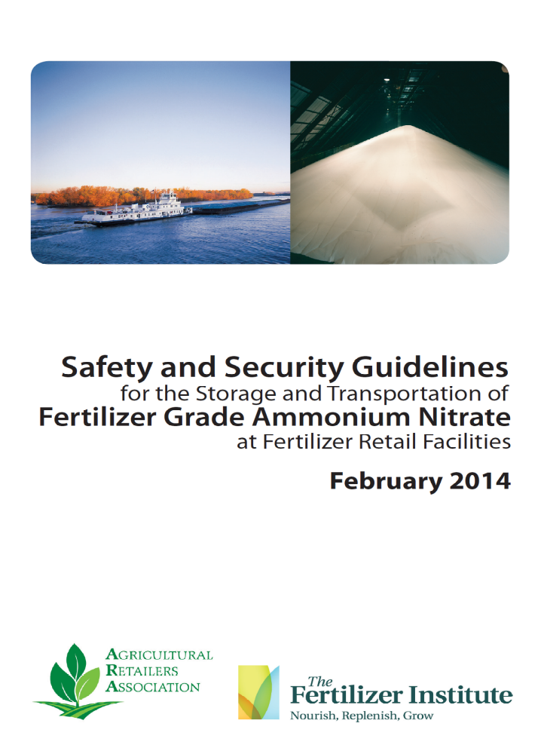
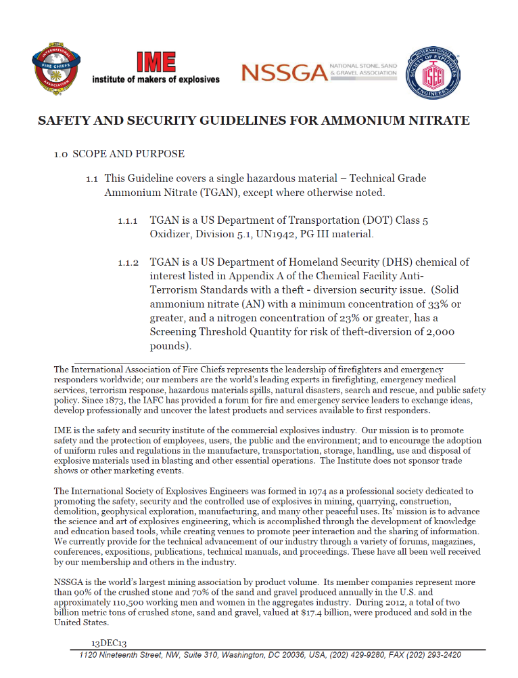
Current AN Guidelines

Slide 23
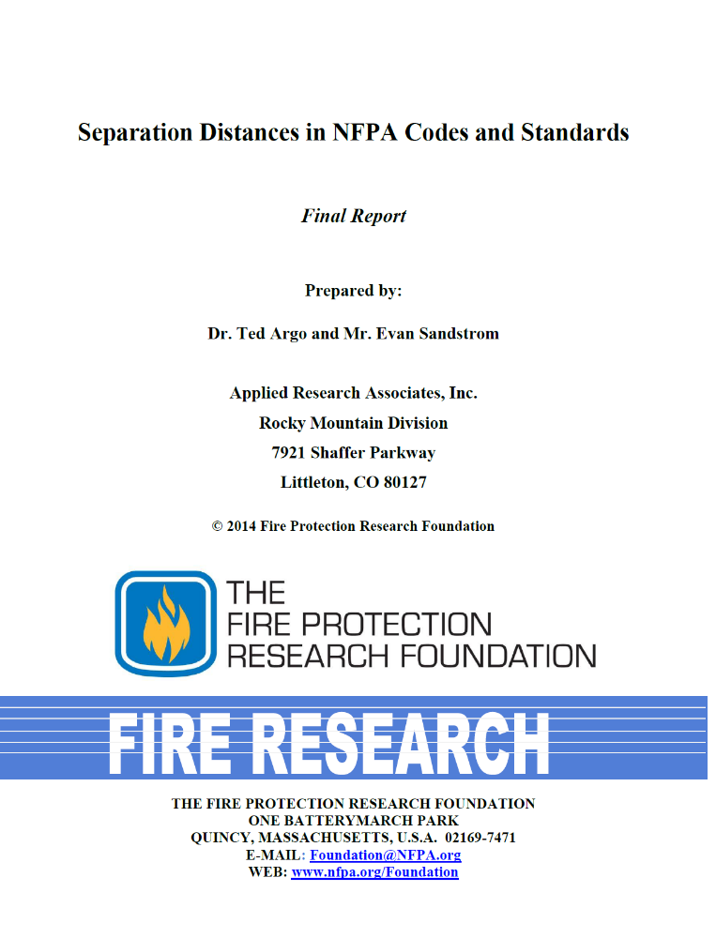
NFPA 2014
Separation Distances for AN
Percussive force
Shrapnel

Slide 24
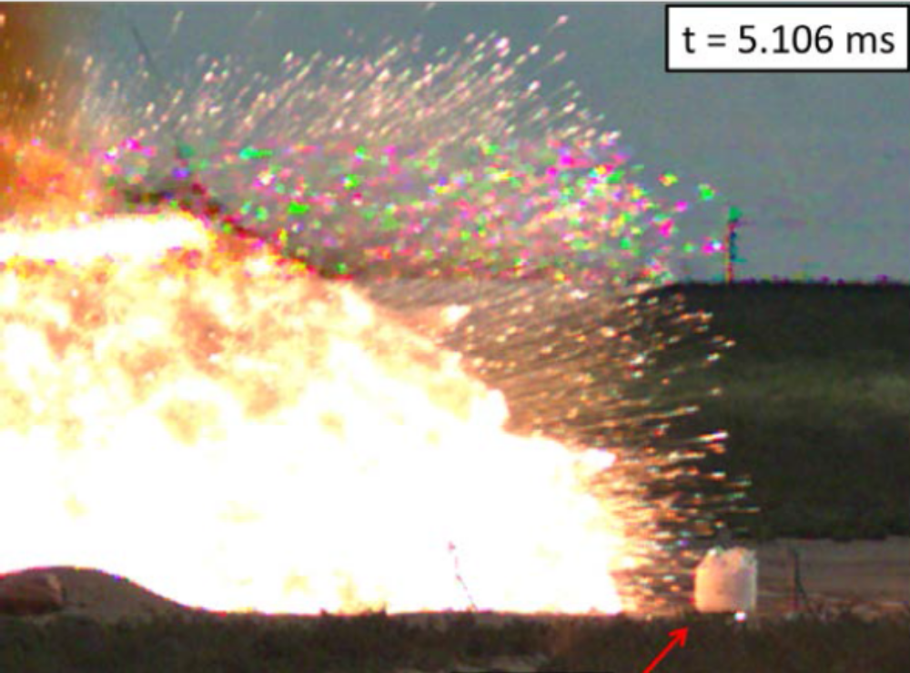

Slide 25
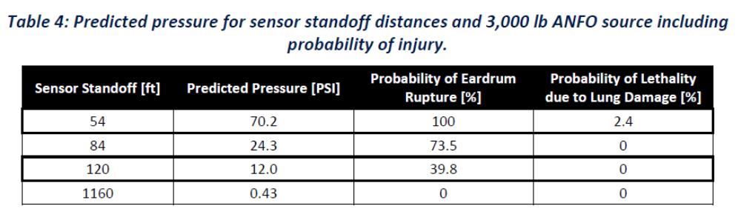

Slide 26
Projectile Debris: ~ 1 pallet AN = 1/4 mile of-site impact

Slide 28
Projectile debris

Slide 29
Shock wave
Projectile debris

Slide 30
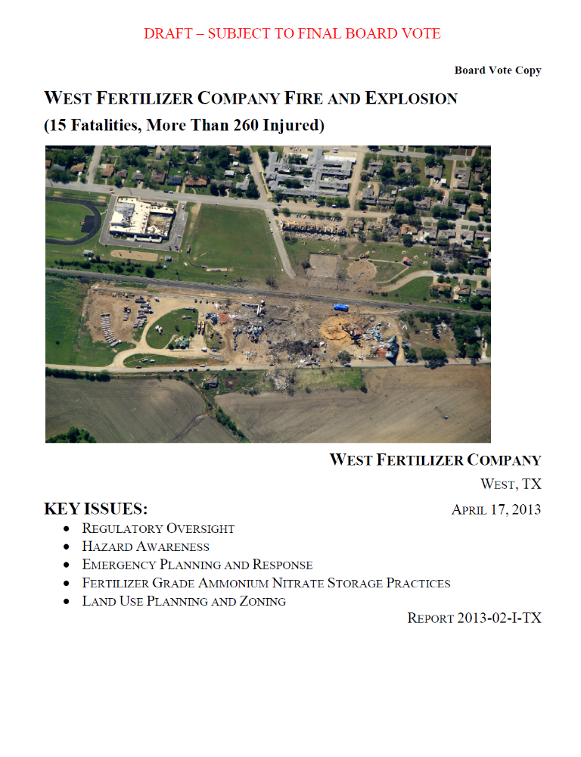
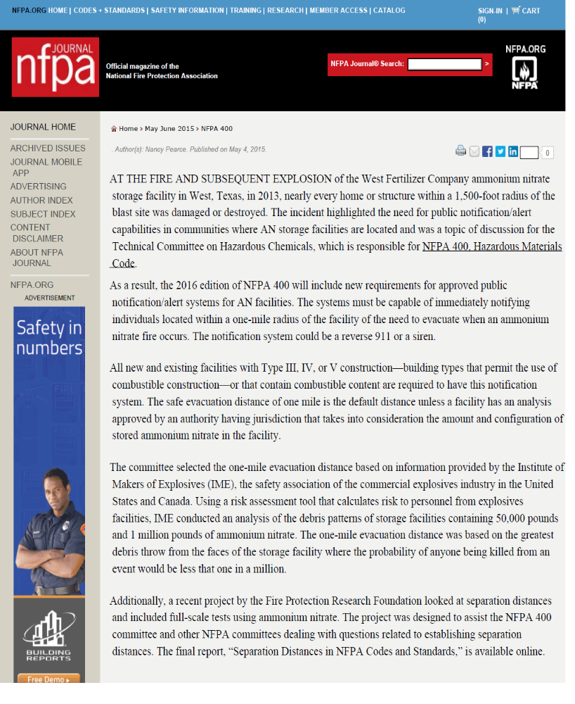

Slide 31
NFPA 400 2016 requirements for AN facilities of combustible construction:
public notification systems capable of immediately notifying individuals within a one-mile radius of the facility of the need to evacuate when an ammonium nitrate fire occurs.
notification system could be a reverse 911 or a siren.
one-mile evacuation distance based on information provided by the Institute of Makers of Explosives (IME) for 10⁻⁶ likelihood of death for 25 tons of AN

Slide 32
NFPA 400 2016
Shock wave
Projectile debris

Slide 33
NFPA 400 2016
Airborne debris
Shock wave
Projectile debris

Slide 34
NFPA 400 2016
Airborne debris
25 Tons AN = ~ 16 cubic yards 1 mile evacuation
Shock wave
Projectile debris

Slide 36
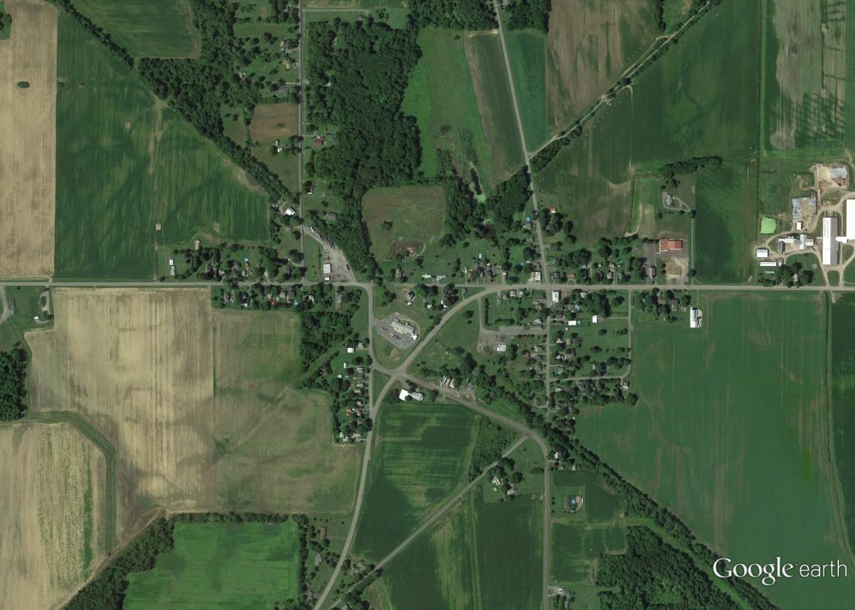

Slide 37
Blast Impact Radius

Slide 38
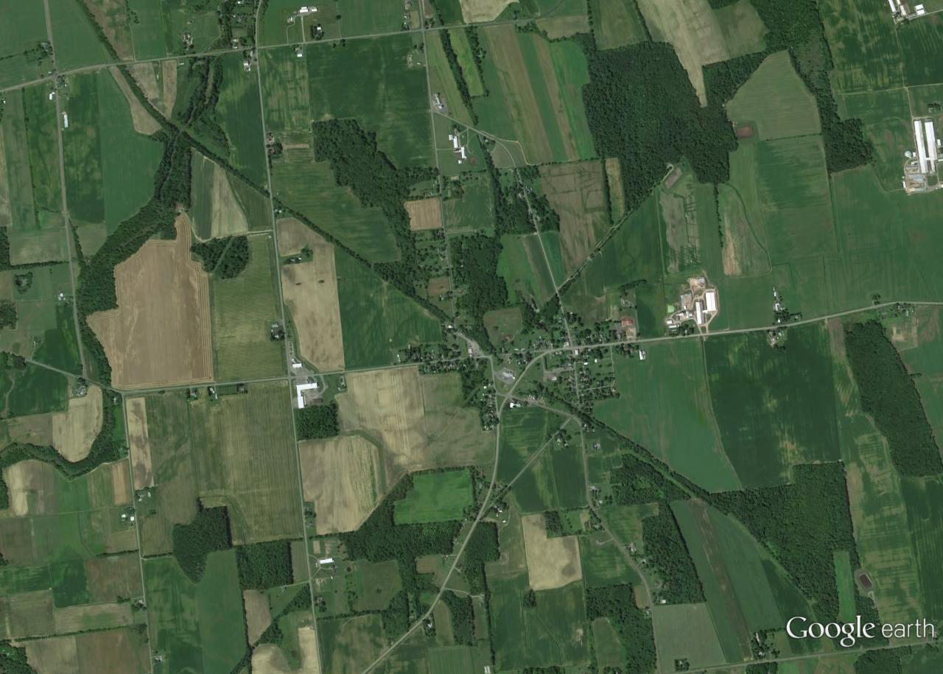
Evacuation Zone

Slide 40
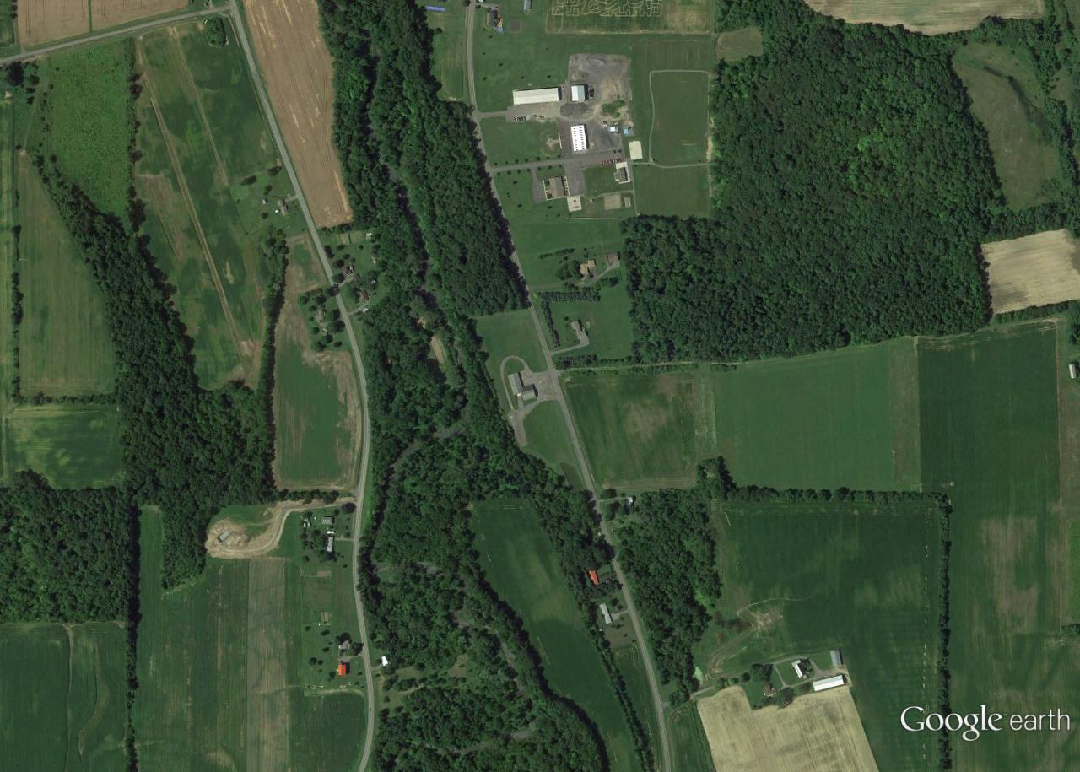
Blast Impact Radius

Slide 41
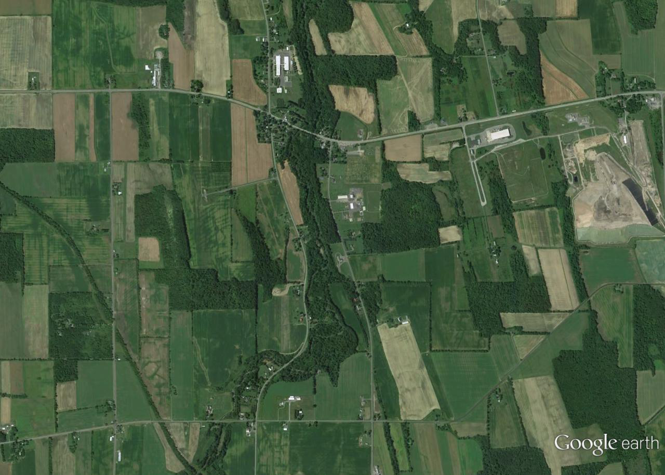
Evacuation Zone

Slide 42
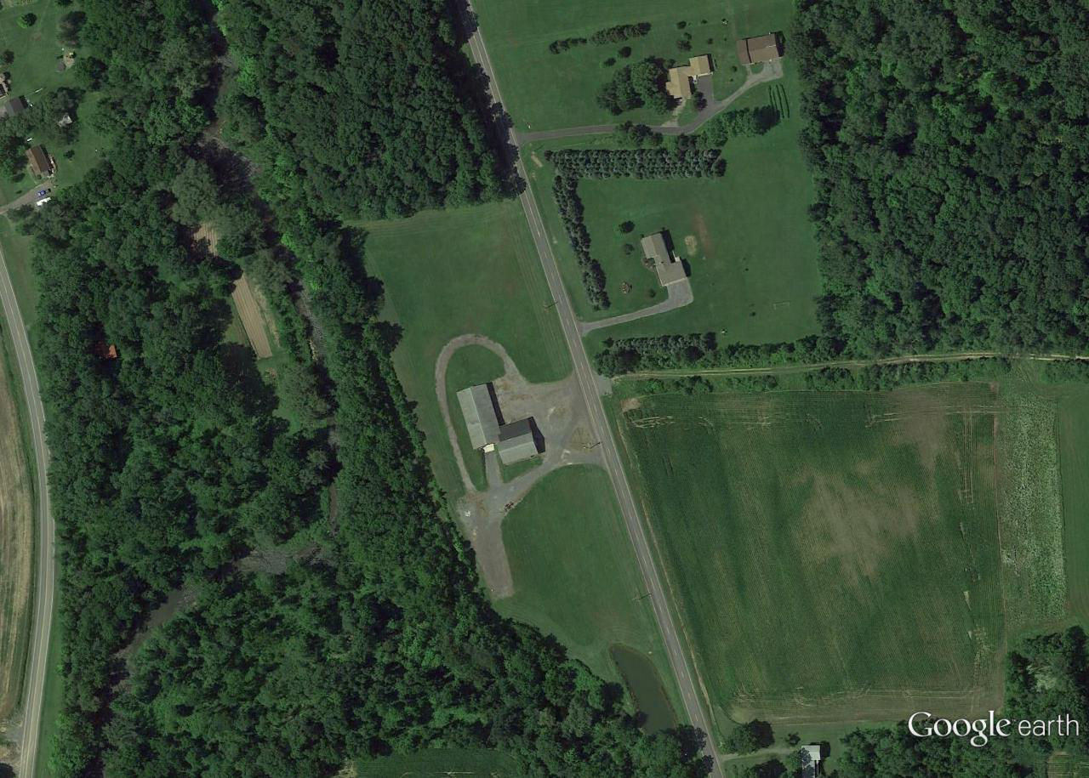

Slide 43
Blast Impact
Radius

Slide 44
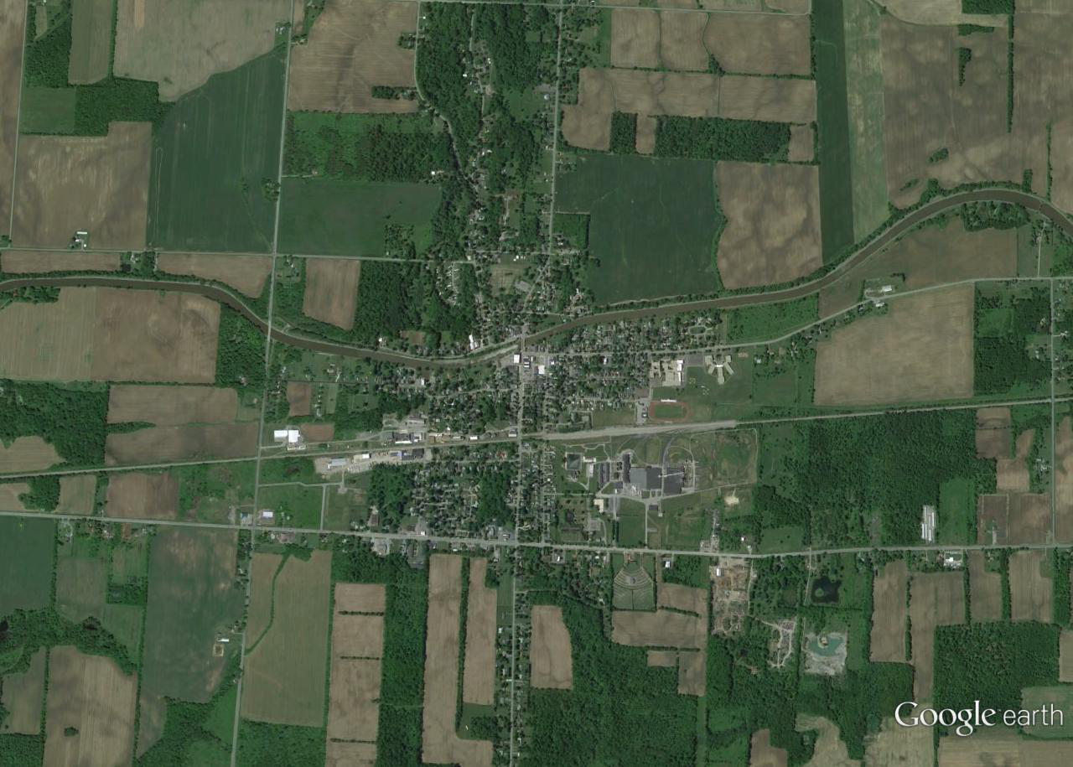
Evacuation Zone

Slide 45
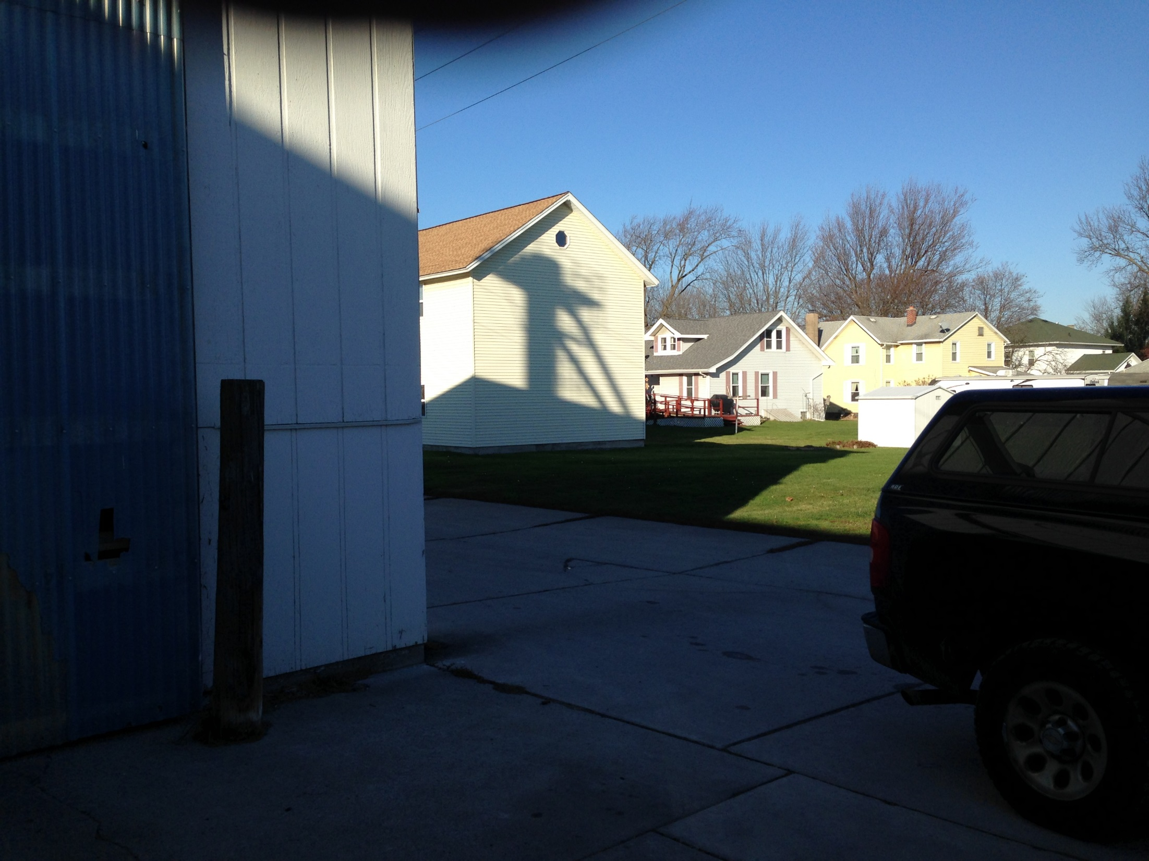

Slide 46
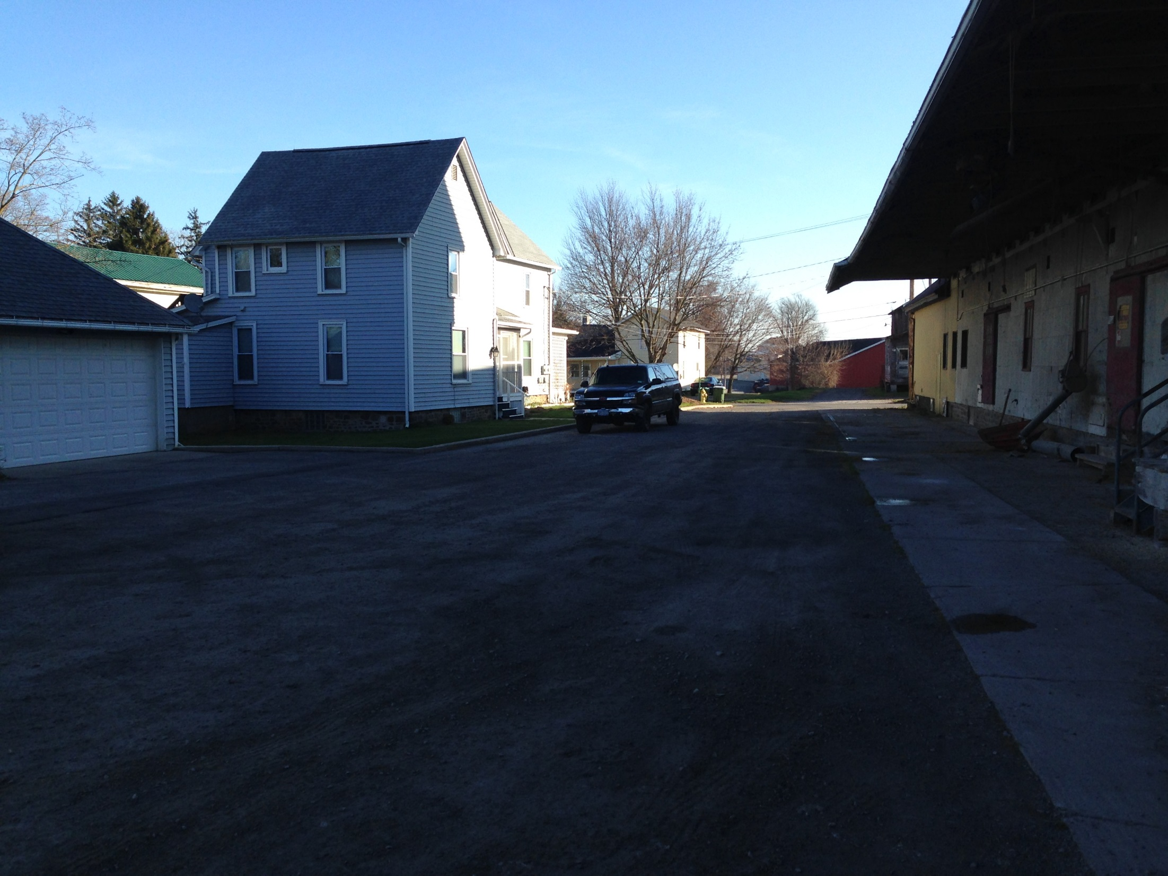

Slide 47
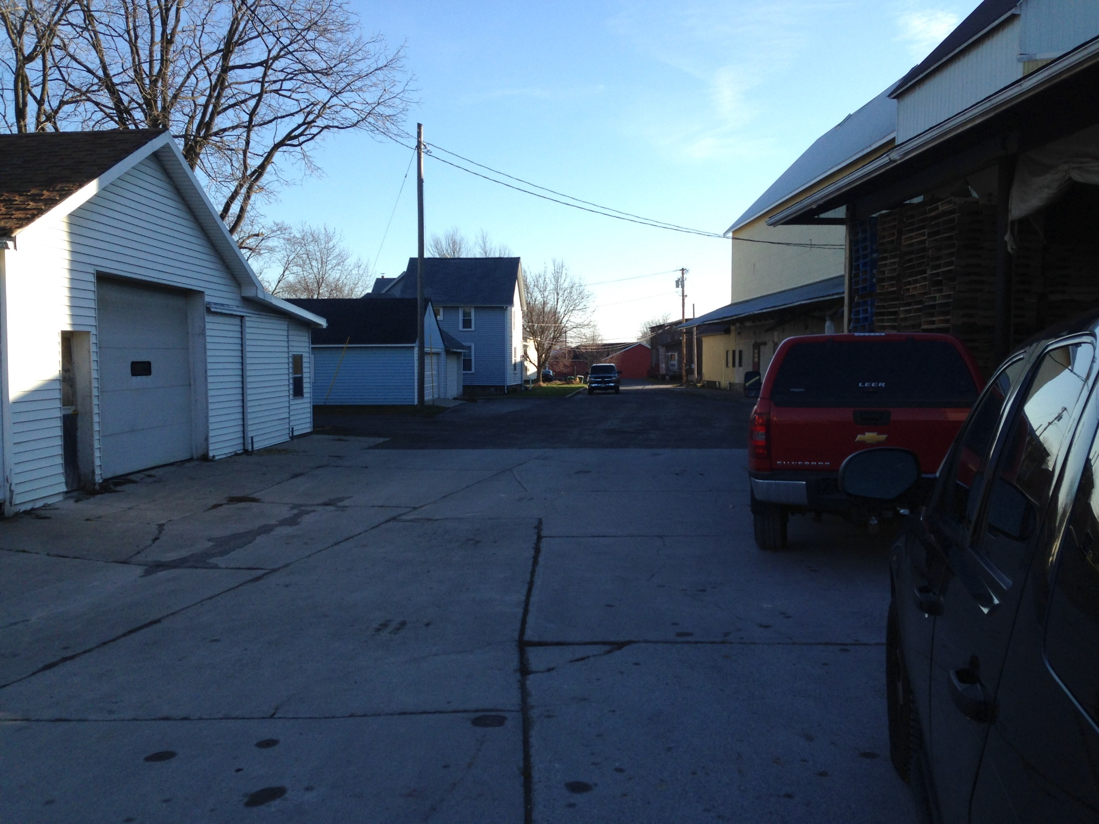

Slide 48
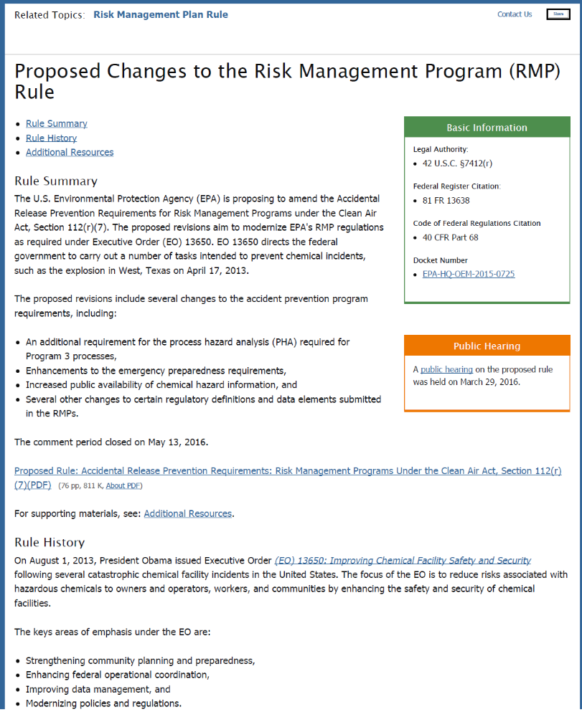
EPA Proposed RMP
Regulation Modernization
NFPA 400 2016: Fire detection,
alarm, and suppression system;
no grandfather clause

