Slide 1
Role of FEMA EHP During Response Activities
Richard Myers, Deputy Regional Environmental Office
Portia Ross, Senior Environmental Specialist

Slide 2

EHP’s Role in FEMA
What we do?
Support DHS/FEMA Programs by providing expertise in Environmental Compliance
Why we do it?
Because it’s FEMA’s Policy to insure that “all practical means and measures are used to protect, restore, and enhance the quality of the environment.” (44 CFR 10.4)

Slide 3
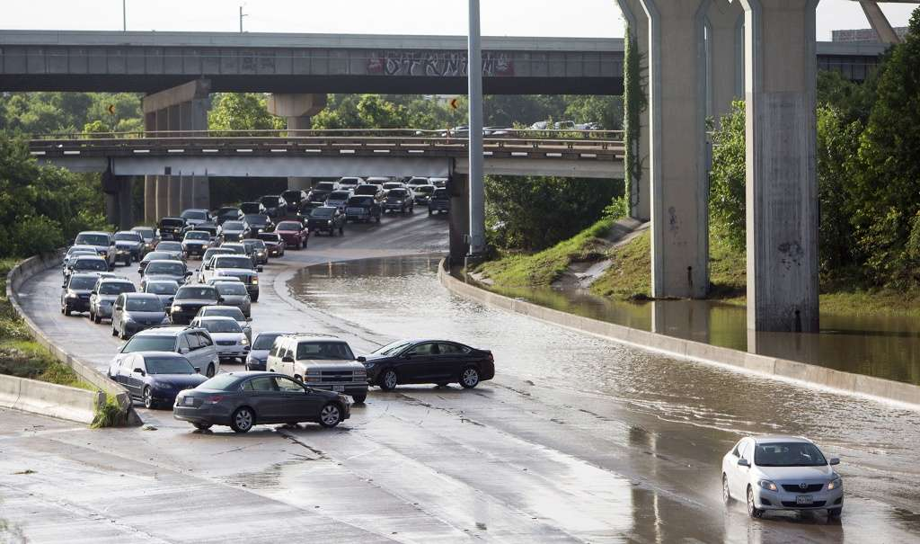
Response Phase EHP
In the response phase the primary goal of EHP is to lay the ground work for how EHP compliance will be achieved and integrated in all decisions across the entirety of the event.

Slide 4
Operational Tasks and Objectives
EHP identifies Response activities that have the potential for EHP compliance actions, including but not limited to:
Technical assistance to grantees and sub-grantees prior to declaration
Logistics actions related to establishing IOF/JFO/AFO sites and staging areas.
DEC actions to establish emergency communications sites
Any activities involving ground disturbance or demolition of damaged structures

Slide 5
Operational Tasks and Objectives
EHP is responsible for assuring compliance related to Direct Federal Assistance (DFA), including but not limited to:
Large scale debris removal, staging, and disposal
Health and safety demolitions
Hazmat disposal
Impacts to museums, historic properties, cultural resources, and tribal coordination
Placement of THUs, construction of group housing sites and responder base camps
Construction of temporary levees, roads, bridges, etc.

Slide 6
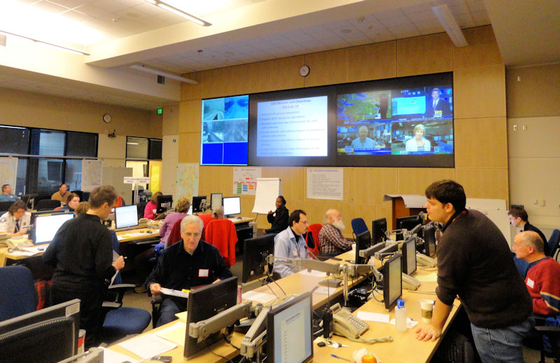
Regional Response Coordination Center
EHP liaison is deployed upon an activation request from the Regional Administrator/RRCC Director
The Technical Specialist-EHP resides in the Situation Awareness Section
The technical specialist coordinates with all RRCC sections on their actions with potential EHP implications

Slide 7
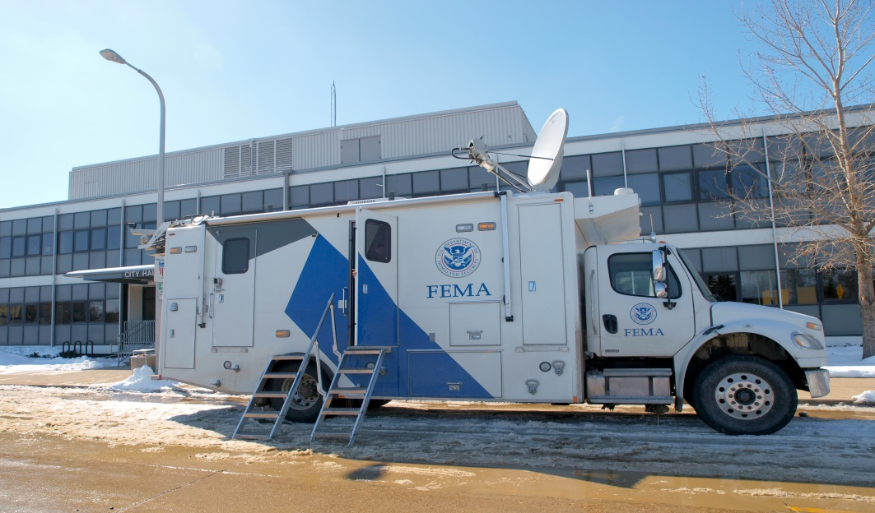
IMAT Support
EHP support for the IMAT is provided by the technical specialist in the RRCC
EHP Liaison may be requested to co-locate with IMAT

Slide 8




ESF Coordination
ESF 3: construction of temporary roads, bridges, levees, etc.
ESF 6: floodplain review of shelters
ESF 10: coordination with EPA and state environmental regulatory agencies
ESF 11: coordination with DOI and state historic preservation entities

