Slide 1

REGIONAL RESPONSE TEAM MEETING
REGION VIII
U.S. DOT / PHMSA
EMERGENCY RESPONSE
PREVENTION & PREPAREDNESS
May 11, 2016
Terry Larson
PHMSA, Western Region

Slide 2
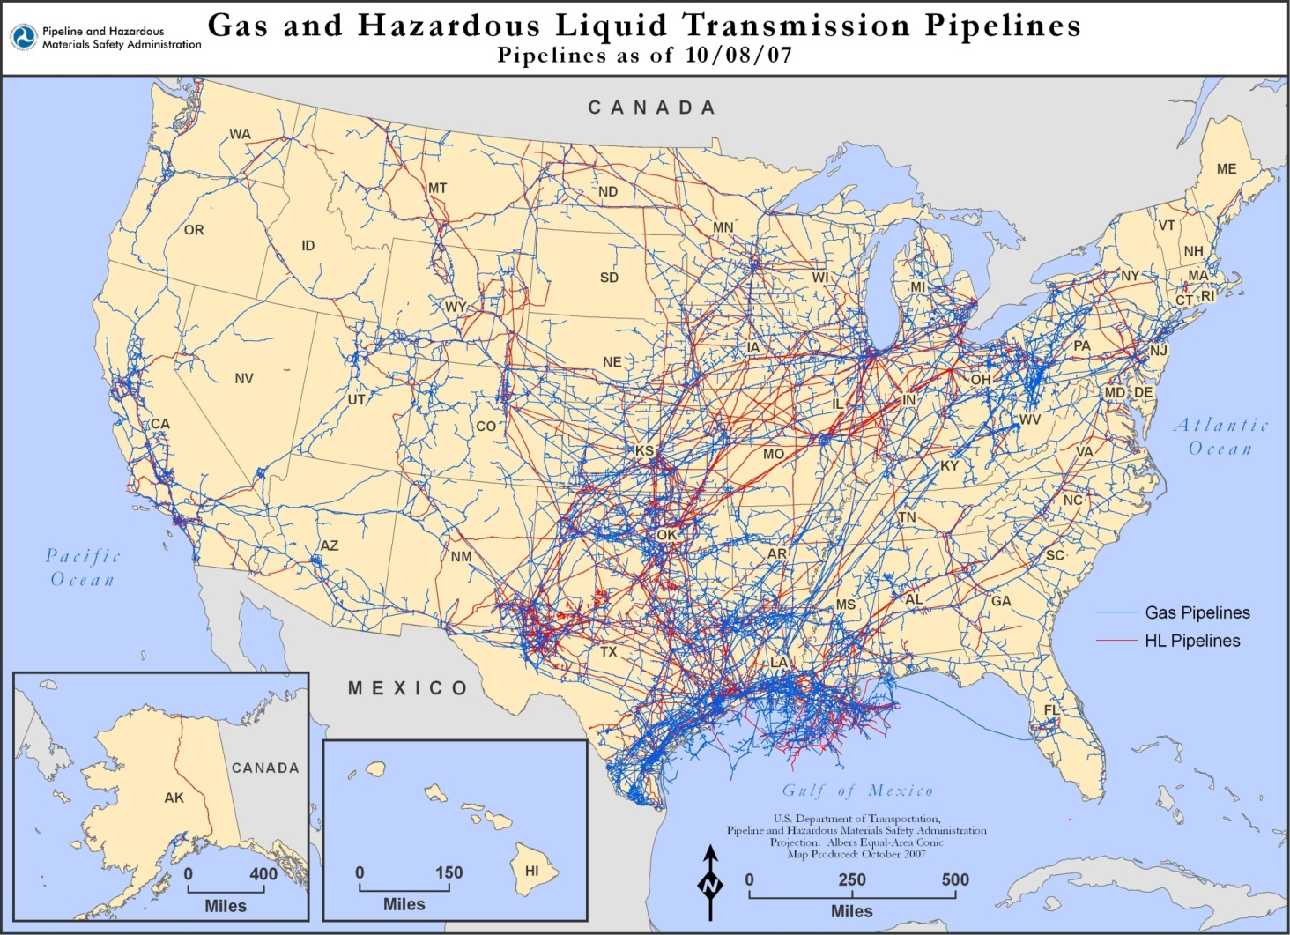
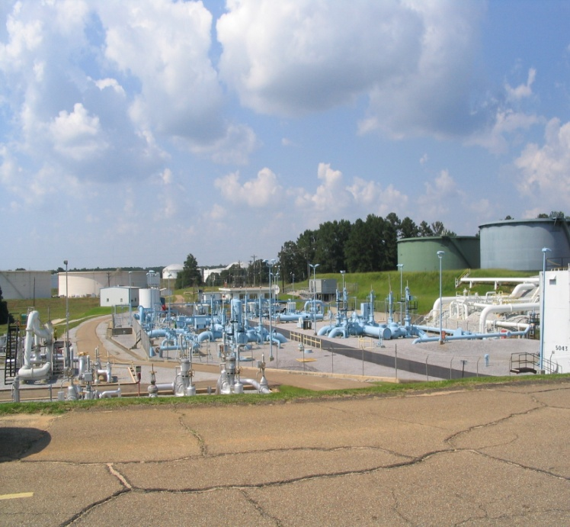
Mission:
To ensure the safe, reliable, and environmentally sound operation of the
Nation’s pipeline transportation system.
Notes:
2
Pipeline Technology
Pipeline Regulations
The University of Texas • PETEX
2

Slide 3
PHMSA Regions/Offices
Western Region
Eastern Region
Central Region
Trenton
Lakewood
Kansas City
HQ
Washington, D.C.
T&Q
Oklahoma City
Atlanta
Southern Region
Southwest Region
Houston

Slide 4
Pipeline Safety Regulations
The rules governing pipeline safety are included in Title 49 of the Code of Federal Regulations (CFR), Parts 190-199.
Individual states may have additional or more stringent pipeline safety regulations.

Slide 5
49 CFR Parts 190-199
Part 190 - procedures used by OPS to carry out regulatory duties.
Part 191 - requirements on operators of gas pipelines
Part 192 - requirements for gas pipelines. These regulations contain sections applicable to gas gathering, transmission, and distribution lines.
Part 193 - safety standards for liquefied natural gas (LNG) facilities.
Part 194 - requirements for oil spill response plans.
Part 195 - safety standards and reporting requirements for oil and carbon dioxide pipelines.
Parts 196-197 are currently reserved for future use.
Part 198 – establishes grants for State pipeline safety programs.
Part 199 – drug and alcohol programs

Slide 6
PREPAREDNESS

Slide 7
Part 194 – Response Plans
Operators required to submit Response Plans
  Some exceptions
  State Programs
Substantial Harm or Significant and Substantial Harm to environment by discharge of oil to navigable waters or shorelines
Worst Case Discharge
Certify that response plan is consistent with NCP and ACP

Slide 8
PART 194 – Appendix A
Guidelines for Preparation of Response Plans
Section 1. Information Summary for Core Plan
  Name and address of the operator
  Qualified Individual ID
  Response Zone ID
  Certification of Significant and Substantial Harm
  Type of oil and volume of Worst Case Discharge
  Certification the operator has personnel, equipment, and means (internal or by contract) to respond to Worst Case Discharge

Slide 9
PART 194 – Appendix A (cont.)
Section 2. Notification Procedures
  Notifications to federal, state and local officials
  Notifications to Qualified Individuals
  Internal Notification Call Down Tree

Slide 10
PART 194 – Appendix A (cont.)
Section 3. Spill Detection and On-Scene Spill Mitigation Procedures
  Methods of Initial Discharge Detection:
    Procedures by priority
    Equipment List
    External response equipment information
    Personnel contact information

Slide 11
PART 194 – Appendix A (cont.)
Section 4. Response Activities
  Operating personnel response responsibilities and actions i.e. first responder
  Qualified Individual Responsibilities
  Procedures for coordinating with OSC
  Oil Spill Contractor information
    Available under contract or other approved means
    Equipment and supplies
    Personnel and response time

Slide 12
PART 194 – Appendix A (cont.)
Section 5. List of Contacts
  24 Hour Contact information for:
    Operator response personnel
    Qualified Individuals
    Insurance, lawyers, etc.
    Persons or organizations for activation or response

Slide 13
PART 194 – Appendix A (cont.)
Section 6. Training Procedures
  Description of Training procedures and Programs of the operator i.e. knowledge of:
    Assignment in Incident Command Structure
    Product characteristics
    Response actions including priority
    Other emergencies – fire, security, etc.
  Evaluate performance annually not to exceed 15 months for supervisors and personnel

Slide 14
PART 194 – Appendix A (cont.)
Section 7. Drill Procedures
  Drill Program and Procedures (FOLLOW PREP)
    Announced and unannounced drills:
      Quarterly Notification and Action Drills for both manned and unmanned facilities – QI, Key OPS Personnel
      Annual table top drills
      Annual equipment deployment drills
      Every 3 years conduct a drill that exercises entire response plan.

Slide 15
PART 194 – Appendix A (cont.)
Section 8. Response Plan Review and Update Procedures
  If substantial new condition or information submit change within 30 days i.e. change in:
    Worst Case Scenario
    OSRO/QI
    Response Procedures
    Significant change in NCP or ACP
  Review, update and resubmit Response Plan every 5 years
  Evaluate response plans effectiveness after a release

Slide 16
PART 194 – Appendix A (cont.)
Section 9. Response Zone Appendices
  Provide information on:
    Zone worst case discharge
    Operator personnel information
    Response equipment and supplies
    Response contractors
    Potentially affected environmentally sensitive areas
    Piping diagrams and alignment sheets
    Product transported

Slide 17
STATE PROGRAMS
PHMSA Western Region and EPA Region 8 are different
Colorado, Wyoming, Montana, N. Dakota, S. Dakota, and Utah have Intrastate Natural Gas Pipeline Programs
None have Interstate Hazardous Liquid Programs
PHMSA coordinates with State Agencies regarding Clean Up, Accidents, and other Incidents
Final Note: PHMSA approved Facility Response Plans are available to EPA and other government agencies upon request

Slide 18

Questions

