Slide 1
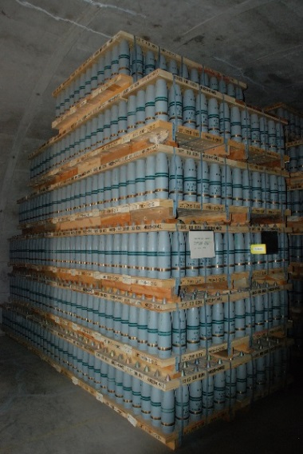
Pueblo Chemical Depot Update
#1 Priority: Protect community, workforce and environment
A Team-of-Teams: Pueblo Chemical Depot staff, Assembled Chemical Weapons Alternatives (ACWA) Field Office, Defense Threat Reduction Agency (DTRA) and Systems Contractor
Explosive Destruction System (EDS): Recently completed destruction of 560 mustard filled munitions
Pueblo Chemical Agent-Destruction Pilot Plant (PCAPP):
  Initiation of PCAPP Grand Opening Ceremony June 14, 2016
  PCAPP Operations anticipated no later than June 2016
PCD Property Transition: Transition of Parcel 1 (5,449
acres) to the Local Reuse Authority (PuebloPlex) planned
for 2017
Environmental Restoration: Plan to execute ~$10M of environmental restoration on PCD this year

Slide 2
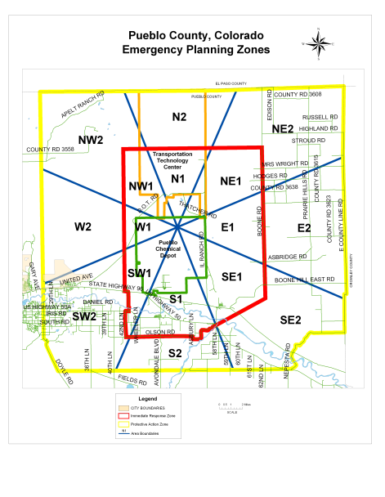
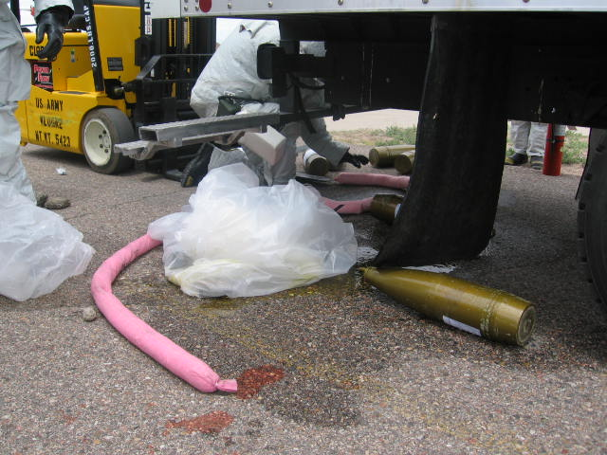
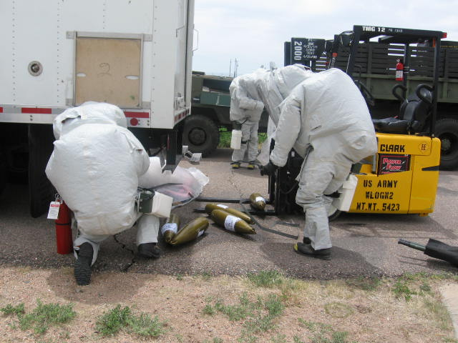
2016 Pueblo CSEPP Community Exercise
Who: Pueblo Chemical Depot (PCD) and the Pueblo, Colorado CSEPP Community.
  What: The Chemical Stockpile Emergency Preparedness Program (CSEPP) Exercise is a Full Scale Community Exercise held annually; with participation from PCD, other Army agencies, DHS, FEMA, Pueblo County Emergency Management Officials, Colorado Division of Homeland Security and Emergency Management, and multiple local Emergency Management support agencies.
When: 04 May 2016
Where: Pueblo, CO 81006
Why: Defense Authorization Act of 1986 (Public Law 99-145) - “Maximum Protection for the Environment, the General Public and the Personnel Who are Involved in the Destruction of the Chemical Stockpile”.
Summary: Approximately 2,000 personnel participated in the 2016 Pueblo CSEPP Community Exercise in concurrent scenarios, with a simulated Chemical Accident/Incident Response and Assistance (CAIRA) event on PCD and a separate, off-post incident located in Pueblo County. These scenarios are designed to exercise Mutual Aid Agreements and objectives to test and validate CSEPP Benchmarks through Emergency Response Outcomes (EROs) in Preparedness, Emergency Assessment, Emergency Management, Hazard Mitigation, Protection, Victim Care, Emergency Public Information, and Planning for Remediation and Recovery.
Pueblo County, Colorado Emergency Planning Zones
Decon Crew cleaning up Chemical spill from M105mm Mustard Munitions
Decon crew member containing Chemical spill with absorbent PIG sock

Slide 3
PCD On-Scene Coordinators
Coast Guard FOSC Certifications:
  Colonel Thomas Duncan II
  Mr. Dan Hancock
  Mr. Kevin Blose
  Ms. Kari Otto
  Ms. Kathryn Cain
Chemical Accident or Incident On-Scene Coordinator Basic Concepts and Concept Implementation Course Certifications:
  Mr. Vincent Blunn
  Mr. Carlos Estrada
  Fire Chief Wes Huntley

Slide 4
PHILIS ISA
Cost reimbursement Inter-service Support Agreement (ISA) with EPA’s PHILIS to provide sampling analysis:
  PCD working with PHILIS to establish ISA for support
  PHILIS staged in Castle Rock, Colorado, within 100 miles of PCD
  Analysis of samples for PCD through closure in 2020-2022
    833 samples planned
    Approximately 150 structures
  Monitoring for Distilled Mustard Agent (HD) to GPL
Chemical Materials Activity Certification:
  PCD Ordering additional HD standards to assist with PHILIS certification

