Slide 1
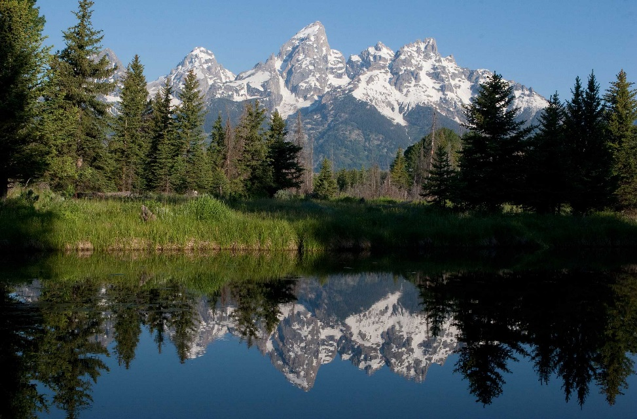
US Environmental Protection Agency
Region 8
RRT Notification Exercise
Regional Response Team
May 12, 2016
Denver, Colorado
Gina Cristiano and Luke Chavez
Emergency Response and Preparedness Program

Slide 2

WHY?
EPA OSWER AA directive – “conduct at least one exercise of its downstream notification procedures by March 31, 2016.”
(8-10 Minutes)

Slide 3
WHAT?
Identified exercise objectives (what capability are we testing or seeking to improve?):
Determine agencies’ downstream notifications of an oil release for all Region 8 states within the first 24 hours.
Determine agencies’ downstream notifications of an oil release for two Region 8 tribes within the first 24 hours.
Determine consistency of notification within the Sub-Area Contingency Plans and the Regional Contingency Plan.
(8-10 Minutes)

Slide 4
WHAT? (continued)
Evaluate the EPA Region 8 Phone Duty Officer’s notifications of a release within the first 24 hours.
Developed exercise scenarios for each R8 state and two tribes (8 total).
Contacted the state 24hr spill line.
Explained ourselves and posed scenario to Duty Officer.
All scenarios were WCDs per FRP plans or otherwise very large, very bad spills.
(8-10 Minutes)

Slide 5
GENERAL FINDINGS
All R8 states have written procedures of some form.
All Duty Officers recognized the significance of spill posed in scenario (all were worst case discharges and/or sizeable discharges).
All Duty Officers would call the affected counties, either the Emergency Manager, Coordinator or Health Departments; thus, contact with locals is nearly immediate.
All states, except Wyoming (Wyoming does not have primacy for SDWA), would contact their respective Water Quality Divisions to contact downstream public water supplies .
(8-10 Minutes)

Slide 6
GENERAL FINDINGS (continued)
All Duty Officers have means of escalating notification (many discussed who would contact the Governor).
All states have ability to notify agricultural users via the State Dept of Agriculture .
Some states have relationships and means of contacting neighboring states (and even Canada!); however this is not in written procedures for all states.
All Duty Officers were well versed & experienced in addressing notifications to the appropriate entities.
Both tribal exercises were unsuccessful – unable to contact tribes (caveats to this).
(8-10 Minutes)

Slide 7
EPA LESSONS LEARNED
EPA will finalize RCP language and institute formal procedures to contact our Drinking Water Direct Implementation Team for spills in Wyoming and on Tribal land to ensure public water supplies are notified, as needed
EPA has instituted formal procedures to contact downstream EPA Regions (5, 6, 7, 9, or 10) via their EOC 24hr number if a spill could impact the neighboring region. All downstream regions have agreed and will make subsequent notifications when necessary.
EPA must continue to work with its Tribal Assistance Program and R8 Tribes to further develop notification protocols for incidents that affect Tribal lands.
(8-10 Minutes)

Slide 8
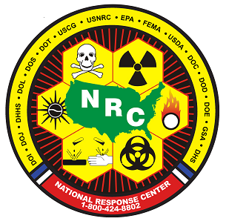
Questions?
  Gina Cristiano
  303-312-6688
  Cristiano.gina@epa.gov
  Luke Chavez
  303-312-6512
  chavez.luke@epa.gov
  THANK YOU!
  National Response Center:
  800-424-8802
  EPA Region 8 Duty OSC (24/7):
  303-293-1788

