Slide 1

EO 13650 Update

Slide 2
Strengthening Community Planning and Preparedness
EPA released EPCRA Training for States, Tribes, LEPCs, Local Planners and Responders (Non-Section 313)
DHS/FEMA is working with the 10 counties with the highest combination of Chemical Facility Anti-Terrorism Standards (CFATS) and Risk Management Program (RMP) facilities to ensure they are using the Integrated Public Alert and Warning System (IPAWS),
ATF Transmitting Explosives contacts to SERCs
OSHA held meetings on emergency response
Senate Committee on Health, Education Labor, and Pensions Staff held meetings on emergency responder health and safety in the workplace
EPA released How to Better Prepare Your Community for a Chemical Emergency: A Guide for State, Tribal and Local Agencies Factsheet

Slide 3

Enhancing Federal Operational Coordination
National Working Group established
Regional Working Groups established
Pilot Project in NY/NJ, led to regional SOPs

Slide 4



Improving Data Management
Interagency work group of data and information technology experts is working to create a unified chemical facility data clearinghouse. The first major milestone is the incorporation of data into the EPA’s facility registry system (FRS)
The work group has completed the integration of chemical facility data sets, totaling over 300,000 records, and has assigned each facility under a single EPA identifier

Slide 5
Modernizing Policies and Regulations
Ongoing rulemaking and changes:
  EPA NPRM on RMP – Stay tuned!
  OSHA RFI on PSM: still in progress
  OSHA issued new policies clarifying interpretations on chemicals without concentrations listed in Appendix A and defining RAGAGEP
  Both EPA and OSHA are considering new requirements for safer technology and alternatives; issued a joint alert promoting their use

Slide 6
Modernizing Policies and Regulations, cont.
  In December 2014, the President signed into law the Protecting and Securing Chemical Facilities from Terrorist Attacks Act, establishing a multiyear authorization for CFATs
  On August 8, 2014, DHS issued an ANPRM to collect information on updates to CFATs and held listening sessions
  ATF has initiated a NPRM to amend the Federal explosives regulation that currently requires explosives licensees and permittees to report explosives storage to local fire authorities when they commence storage. The amendment proposes to require annual notification, which will ensure that local fire authorities are better informed and prepared in case of an accident.

Slide 7
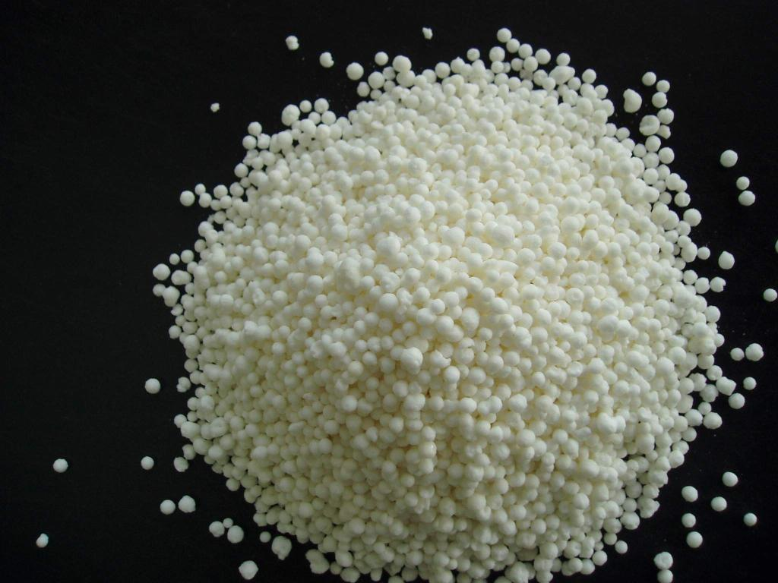
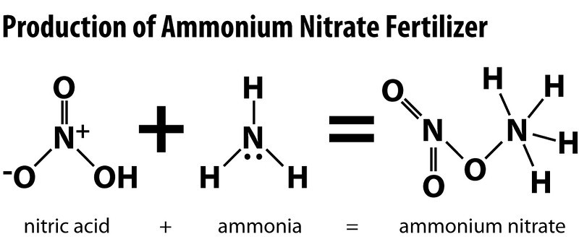
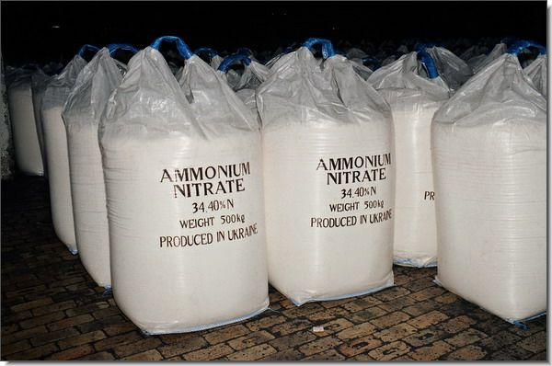
Ammonium Nitrate Safety and Security
EPA, OSHA, and ATF have updated and reissued the Chemical Advisory on Safe Storage, Handling, and Management of Ammonium Nitrate
OSHA issued a letter and additional materials to major stakeholders in the fertilizer industry to emphasize current requirements for AN storage
Formed Fertilizer Safety and Health Partners Alliance between OSHA and the fertilizer industry, emergency response organizations, and others to provide guidance and training
OSHA issued guidance to Regional Administrators on enforcement of the Explosives and Blasting Agents Standard and is in the process of developing emphasis programs

Slide 8

Incorporating Stakeholder Feedback and Developing Best Practices
Activities:
  Docket established to collect comments
  Working Group met with more than 100 organizations and companies, reaching nearly 4,500 attendees.
  A web-based repository created to collect
  industry best practices
  More than 600 individuals, including representatives from Congress, GAO, and the media, participated in a public webinar update on November 10, 2014.
  Webinar held on June 19, 2015 to update stakeholders and the public on progress since the release of the Executive Order.

Slide 9


Information Sharing
CAMEO updated
Substance Registry System (SRS) updated to include PSM-covered substances.
ATF List of Explosive Materials is now linked to records in the SRS
RMP NPRM adds information sharing with the public
DHS continues to collaborate with State and Local officials and first responders to educate them on the CFATS program and discuss information sharing opportunities
DHS developed a permission-based system for CFATS to allow mission partners to access a large range of integrated IP tools, capabilities, and information and view facilities in their area
More interagency referrals.

Slide 10
Available Documents
How to Better Prepare Your Community for a Chemical Emergency: A Guide for State, Tribal and Local Agencies
Chemical Safety Alert: Safer Technology and Alternatives introduces safer technology concepts and general approaches, explains concepts and principles, and gives brief examples of the integration of safer technologies into facility risk management activities
Revised Chemical Advisory: Safe Storage, Handling, and Management of Ammonium Nitrate OSHA and ATF issued revised chemical advisory with information on the hazards of AN storage, handling and management. It also provides lessons learned for facility owners, operators, emergency planners and first responders from recent incidents involving AN

Slide 11
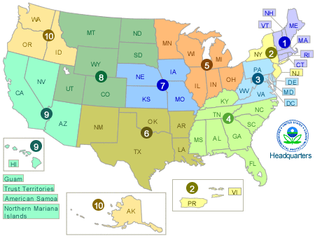

R8 Activities: Western Regions Conference
  First one held in San Diego, CA in February, 2016
  50 attendees
  Next meeting will be held in Denver, CO at EPA Region 8 office January 31 – February 1, 2017
  Registration: https://westernregions.eventbrite.com
  Agenda in the next few months
  Inviting Tribes

Slide 12
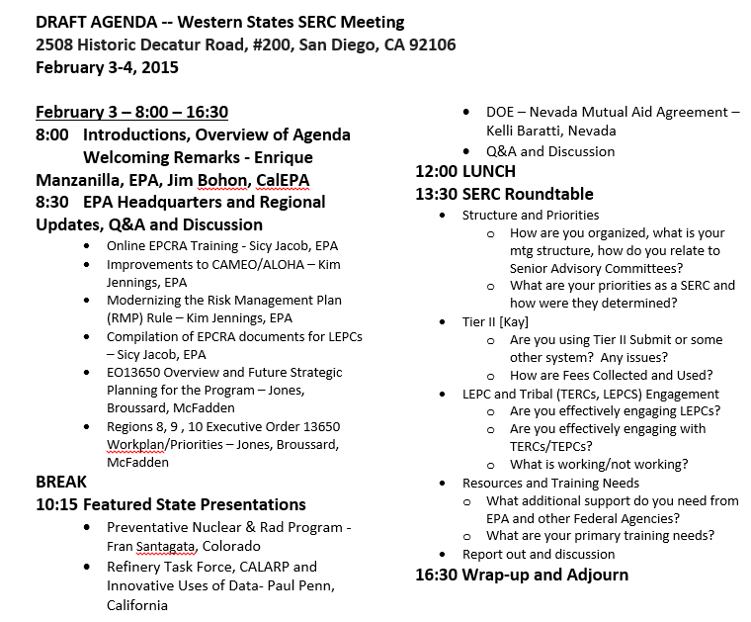

Slide 13
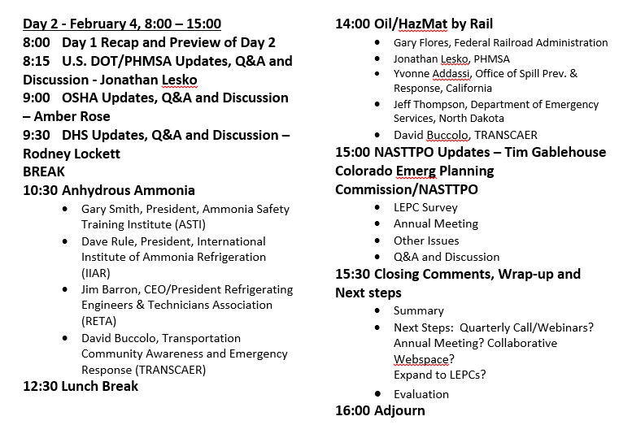

Slide 14

R8 Activities: SD Chemical Facility Safety Industry Workshops
Format from Colorado workshops last year with EPA, DHS, OSHA
Currently, almost 350 people registered for 3 hour sessions
Six presentations in five locations:
  Sioux Falls
  Huron
  Aberdeen
  Pierre
  Rapid City (x2)
Agenda will cover:
  EPCRA
  Tier II reporting
  RMP
  SPCC
  FRP
  GIUEs
  PSM
  CFATs
  Spill reporting requirements
  Participating in LEPCs
  West, TX & EO 13650

Slide 15
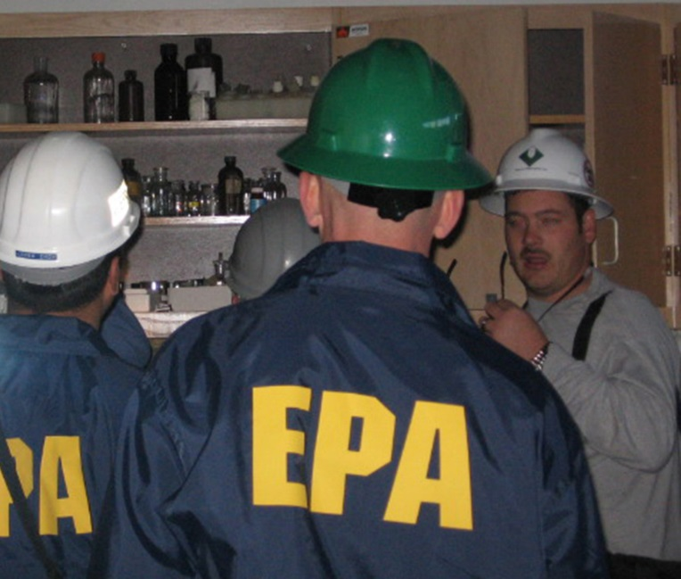

R8 Activities: In Progress
Currently in progress:
  Hazard Analysis Toolkit
  RMP*Submit Tutorial (Tier II complete)
  Tier II Submit webinar and recording
  Coordinate inspections and share outcomes

Slide 16
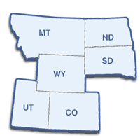

R8 Activities: Ongoing
Currently ongoing
  Monthly Tri-Chairs calls
  Quarterly Western Regions conference calls
  Caste studies/FAQs featured in newsletter
  Best practices collection/sharing
  CAMEO training
  LEPC 101 training

Slide 17
Risk Management Modernization Rule

Slide 18
Agenda
Background
Overview of proposed rule provisions and costs
Additional resources
Questions
18

Slide 19
Background
On August 1, 2013, President Obama issued Executive Order (EO) 13650: Improving Chemical Facility Safety and Security following several catastrophic chemical facility incidents in the United States.
  Focus is to reduce risks associated with hazardous chemicals to owners and operators, workers, and communities by enhancing the safety and security of chemical facilities.
The keys areas of emphasis under the EO are:
  Strengthening community planning and preparedness,
  Enhancing federal operational coordination,
  Improving data management, and
  Modernizing policies and regulations.
    EPA issued a request for information (RFI) on July 31, 2014, and
    Convened a Small Business Advocacy Review panel on November 4, 2015.
19

Slide 20
Existing regulatory framework
The Risk Management Program is one of several programs that address chemical facility safety and security:
  OSHA Process Safety Management (PSM) standard-Management program for highly hazardous chemicals aimed at preventing and minimizing occupational/onsite exposure
  Emergency Planning and Community Right-to-know (EPCRA) requirements Local emergency planning and preparedness, emergency release notification, community right-to-know: provision of hazardous chemical storage inventory and toxic chemical release inventory to the community and first responders
  CAA Section 112(r)(1) general duty clause-Facility owner/operators have a general duty to prevent and minimize releases
  Chemical Facility Anti-terrorism Standards (CFATS)-DHS security requirements
  ATF requirements for explosives
  State/local requirements (e.g., NJ, Contra Costa County, CA regulations)
20
Notes:
The RMP program closely aligns with OSHA’s PSM standard in content, policy interpretations, Agency guidance, and enforcement in order to avoid redundancy, conflict, and extra burden to industry.
The RMP program expands upon the information provided to States and Local Emergency Planning Committees (LEPCs) under EPCRA.

Slide 21
Risk Management Program rule
  Promulgated in 1996 under Section 112(r) of the Clean Air Act Amendments
  Applies to all stationary sources with processes that contain more than a threshold quantity of a regulated substance (approx. 12,500 sources)
    Includes a wide variety of industry sectors, including: refining, chemical manufacturing, energy production, ammonia refrigeration, water treatment, bulk storage, chemical distribution, agricultural retail, and chemical warehouses
  Requires the source to develop a Risk Management Plan (RMP)
    Addresses elements aimed at preventing accidental releases and reducing the severity of releases that occur
    Prepare and submit an RMP to EPA at least every 5 years
  Covered processes fall within one of three prevention program levels based on:
    The potential for offsite consequences from a worst-case accidental release;
    Accident history; and
    Regulation under OSHA PSM
21

Slide 22
Program levels
Program 1
642 Facilities
Program 2
1,272 Facilities*
Program 3
10,628 Facilities*
Processes that would not affect the public in the event of a worst-case release & no accidents with offsite consequences in the last five years
    Small quantities of flammables, less volatile toxics
    Limited accident prevention including hazard assessment and emergency response requirements
Processes not eligible for Program 1, not subject to Program 3
    Mainly water & wastewater treatment in Federal OSHA states
    Additional hazard assessment, accident prevention, management, and emergency response requirements
Processes subject to OSHA’s PSM or in one of 10 specified NAICS codes
    Larger facilities or those with complex processes
    Examples include: refining, chemical manufacturing, energy production, water treatment
    Must use OSHA’s PSM as accident prevention program and include additional hazard assessment,
    management, and emergency response requirements
*Analysis reflects OSHA change to PSM retail exemption issued July 2015
22

Slide 23
Program level comparison
Program 1 | Program 2 | Program 3
Worst case analysis 5-year accident history Document management system | Worst case analysis 5-year accident history Document management system | Worst case analysis 5-year accident history Document management system
Prevention Program
Certify no additional prevention steps needed | Safety information Hazard review Operating procedures Training Maintenance Incident investigation Compliance audit | Process safety information Process hazard analysis (PHA) Operating procedures Training Maintenance Incident investigation Compliance audit Management of change Pre-startup review Contractors Employee participation Hot work permits
Emergency Response Program
Coordinate with local responders | Develop plan/program and coordinate with local responders | Develop plan/program and coordinate with local responders
23

Slide 24
Overview of Proposed Revisions
 | P1 | P2 | P3
Third-party audits (applies to the next scheduled audit after an accident) [Estimated 150/year] |  | √ | √
Incident Root Cause Analysis (only for facilities with accidents/near misses) [Estimated 150/year] |  | √ | √
Safer Alternatives Analysis (applies to a subset of P3 in certain NAICS codes) [Estimated 1,692 Facilities/4,308 Processes] |  |  | √
Coordinating Emergency Response Program Requirements with Local Responders |  | √ | √
Emergency Response Exercises |  | √ | √
Information Sharing | √ | √ | √
24

Slide 25
Third-party compliance audits
Proposed revisions require all P2 and P3 facilities to conduct a third-party audit in lieu of a compliance audit following an RMP reportable accident.*
  Must be completed within 12 months of an RMP reportable accident or within 3 years of completion of the previous compliance audit, whichever is sooner.
    Note that this audit and its schedule are independent of the incident investigation requirement and its schedule.
  Same scope as the current compliance audit provisions (i.e., audit prevention program implementation for all covered processes).
  EPA is proposing criteria for auditor independence, impartiality, and competence.
* RMP reportable accident means an accidental release meeting the criteria in §68.42(a) from a covered process at a stationary source.
25
Notes:
Current Requirements: Facility owners/operators must perform compliance audits every three years. (Applies to all P2 and P3)
Issue to Address: Self-auditing may be insufficient to ensure compliance with RMP requirements and promote safe stationary source operation and accident prevention.
Criteria and standards for third-party auditor competence include:
Knowledgeable with the requirements of the RMP Prevention program requirements;
Experienced with the facility type and processes being audited and the applicable recognized and generally accepted good engineering practices (RAGAGEP);
Trained or certified in proper auditing techniques; and
Be a licensed Professional Engineer (PE), or include a licensed PE on the audit team
Independence and impartiality requirements for third party auditors and audit teams include:
Acting impartially when performing all third-party audit activities;
Receiving no financial benefit from the outcome of the audit, apart from payment for auditing services;
Not having conducted past research, development, design, construction services, or consulting ( Note- participation in third-party audits does not constitute “consulting” and “future employment” for the purposes of this requirement) for the owner or operator within the last 3 years (including any “associated” third-party auditors);
Not providing other business or consulting services to the owner or operator, including advice or assistance to implement the findings or recommendations in an audit report, for a period of at least 3 years following submission of the final audit report;
Ensuring all personnel involved on the audit team sign and date a conflict of interest statement certify that the audit followed the requirements of the rule and contains not false statements; and
Ensuring all personnel involved in the audit do not accept future employment* with the owner or operator of the facility for a period of at least 3 years following submission of the final audit report.

Slide 26
Incident investigations and root cause analysis
Proposed Revisions (Applies to P2 and P3):
  Revise incident investigation requirements to:
    Clarify that it applies to a catastrophic release (i.e., an RMP reportable accident) or an incident that could reasonably have resulted in a catastrophic release (i.e. a near miss)
    Require a root cause investigation (i.e. identify the fundamental reasons why an incident occurred and the correctable failures in management systems)
    Require a report be completed within 12 months (unless extension approved, in writing, by implementing agency)
  Clarify the definition of catastrophic release to be consistent with reportable accidental release, i.e. an accident with deaths, injuries, evacuations, sheltering in place, property damage, or environmental damage
  Add a definition of root cause to mean a fundamental, underlying, system-related reason why an incident occurred that identifies correctable failure(s) in management systems
26
Notes:
Current Requirements: Facility owners/operators must conduct incident investigations following an incident that resulted in or could have resulted in a catastrophic release (includes a “near miss”). (Applies to all P2 and P3)
Issue to Address:
Strengthening incident investigation requirements to identify the underlying reasons for a chemical accident which would lead to preventing future accidents and ensuring compliance. Eliminates the risk of reoccurrence of a particular accident and similar accidents that could result from the same system-wide root causes
Current catastrophic release definition (includes a “near miss”) not well defined and misinterpreted.
CSB, industry good safety practices/guidance, EPA and state and local programs have all cited support for root cause investigations
Examples of near misses include:
Events or unsafe situations that under slightly different circumstances could have resulted in a catastrophic release or had reasonable potential to escalate
Runaway reactions, fires, explosions, or vapor cloud releases that did not result in impacts
Some process upsets, such as:
Excursions of process parameters beyond pre-established critical control limits;
Activation of layers of protection such as relief valves, interlocks, rupture discs, blowdown systems, halon systems, vapor release alarms, and fixed vapor spray systems; and
Activation of emergency shutdowns.
EPA will coordinate with OSHA and other agencies as appropriate on explaining the term “near-miss” by continuing staff-level collaboration during rule development and the interagency review process.

Slide 27
Safer technology and alternatives analysis (STAA)
  Proposed revisions to require the source to conduct a STAA and determine feasibility of inherently safer technologies and designs considered:
Would apply to P3 facilities in NAICS codes:
  322 (paper manufacturing),
  324 (petroleum & coal products manufacturing), and
  325 (chemical manufacturing)
The STAA would consider, in the following order of preference:
  Inherently safer technology (IST) or design,
  Passive measures,
  Active measures, and
  Procedural measures
ISTs are those measures that reduce or eliminate the hazards and include minimization, substitution of less hazardous chemicals, moderation of the process, and simplification of the process/procedures
  Owner/operator would not be required to implement any prescribed technology, however EPA is requesting comment on whether the rule
  should require implementation
EPA is proposing several
definitions including feasible
27
Notes:
Current Requirements: Facility owners/operators must develop a PHA to identify, evaluate, and control process hazards involving regulated substances. (Applies to all P3)
Issue to Address:
Many RFI comments urged EPA to incorporate safer technologies into the Risk Management Program to prevent or minimize the effects of chemical accidents
Center for Chemical Process Safety (CCPS) guidelines support the use of safer technologies to improve chemical safety and reduce risk of chemical accidents
Various CSB investigations and EPA inspections have indicated that incorporating IST measures could have prevented serious accidents
Inherently safer technologies are more robust and reliable measures and should be used, if feasible, to improve safety
There are many opportunities for making processes safer and should be seriously considered
Advances in IST and safer alternatives
Adopted by some state and local governments
Adopted by some companies
Strengthening PHA requirements to incorporate the full hierarchy of hazard controls
could prevent or minimize the effects of chemical accidents on the local communities, the environment, and consumers as well as employees at the facility
The PHA would include a description of how the analysis was done, findings and recommendations, and this information should be documented and retained at the facility. EPA is not specifying a prescribed level of risk reduction and analysis can be done using existing PHA methods (currently in regulations) or other recognized methods for analyzing safer technology and alternatives.

Slide 28
Local coordination
Proposed revisions require facilities all P2 and P3 to:
  Coordinate annually with the LEPC/emergency responders and ensure response capabilities exist
  Document coordination
  LEPC/emergency responders can request source to prepare an emergency response (ER) program
What is “coordination”?
  Facility and local responders meet & discuss response needs, capabilities, and roles:
    Determine resources needed to appropriately respond to regulated substance releases at facility
    Determine resources available from facility & local responders
    Identify capability gaps and develop plans to address
    Decide whether facility or local responders will respond to releases of regulated substances
    Assign response action roles and responsibilities
  What are the outcomes of “coordination”?
    “Non-responding” source – coordination indicates that local public response capabilities are adequate to respond, appropriate notification mechanisms are in place, and local authorities have not requested that owner develop ER program
    “Responding” source –coordination indicates that local public response capabilities are not adequate to respond, or local authorities request that owner develop ER program
      Facility must develop an emergency response program following § 68.95
28
Notes:
Current Requirements: Facilities must develop an emergency response program except when the community emergency response plan addresses toxic substances at the facility, or owner/operator has coordinated response actions for flammable substances with local fire department. (Applies to all P2 and P3)
Issues to Address:
States and locals have indicated that some RMP facilities have not adequately coordinated with Local Emergency Planning Committees (LEPCs) and local emergency responders.
CSB accident investigations have identified poor coordination between RMP facilities and local responders
Provisions intended to clarify existing RMP coordination requirement and supplement existing EPCRA requirements for local emergency planning
EPCRA requires LEPC to develop local emergency plan
RMP requires regulated facilities to coordinate with local responders and,
if necessary, develop facility emergency response program & plan
Document coordination (Include names & contact information for individuals involved, dates of coordination, and any conclusions/next steps).

Slide 29
Exercises
Proposed Revisions: Require facilities to test their emergency response program through notification, tabletop, and field exercises (Applies to all P2 and P3)
  Require “responding” and “non-responding” facilities to conduct an annual notification exercise
  Require “responding” facilities to conduct the field and tabletop exercises and invite local responders to participate:
Field exercise
  Frequency: Every 5 years and within one year following a reportable accident
  Scope: Test procedures for notification, evacuation, medical treatment, communications systems, emergency response personnel mobilization (including contractors, if appropriate), coordination with local responders, equipment deployment, and other actions identified in ER program as appropriate
Tabletop exercise
  Frequency: Annually except in the year of a field exercise
  Scope: Same as field exercise without actual mobilization of personnel & equipment
  An exercise evaluation report must be completed within 90 days
  of each exercise.
29
Notes:
Current Requirements: No RMP requirement for facilities to exercise their emergency response program or plan.
Issues to Address:
CSB accident investigations indicate that poor emergency response planning and execution by RMP facility owners/operators has increased the severity of accidents
Requiring exercises is likely to improve emergency response by facilities and community responders and reduce the consequences of an accident on the community

Slide 30
Information sharing
Proposed revisions add new disclosure elements for all facilities:
  To LEPCs and emergency responders
  To general public
  Public meetings within 30 days of an RMP reportable accident
  The information should be conveyed without revealing CBI or trade secret information.
  Any summary information should adequately explain the findings, results, or analysis being provided while avoiding technical jargon
30
Notes:
Current Requirements: Facility RMP must be made available to the public and LEPC/first responders (data restrictions apply based on security concerns). (Applies to all facilities)
Issue to Address: LEPCs, first responders, and members of the public have indicated that:
Chemical facility information and data-sharing efforts, at the local level, needs significant improvement
Improve access and understanding,
Ensure greater transparency without compromising security
LEPCs and first responders need access to the most relevant and actionable chemical hazard and risk information for their needs, in an easily accessible format, to better support planning and preparedness efforts
Community residents and organizations need basic information regarding chemical risks at facilities, presented in a clear and consistent manner

Slide 31
Information sharing-LEPC
Require summaries of chemical hazard information to be provided to LEPC or local emergency response official, upon request:
  Information on RMP regulated substances−names and quantities of regulated substances held in a process
  Five-year accident history information (reported under §68.42)
  Compliance audits
  Incident investigation reports (with root cause findings)
  IST implemented or planned to be implemented, if applicable
    No requirement to implement, but if a source does implement ISTs it is useful information for LEPCs/first responders to have in their local emergency planning efforts
  Exercises, including schedules and reports
31

Slide 32

Information sharing-public
  Require chemical hazard information to be provided in an easily accessible manner (i.e. posting on a company website, public file sharing website, or social media website, or placing a file at a public library or local government office)
  Names of RMP regulated substances held in a process
  Safety data sheets (SDS) for all regulated substances located at the facility
  Emergency response program summary information
  Five-year accident history information reported under §68.42
  Exercise summary information
  LEPC contact information
32
Notes:
Emergency response program summary information including:
Whether the source is a responding stationary source or a non-responding stationary source;
Name and phone number of local emergency response organizations with which the owner or operator last coordinated emergency response efforts; and
For “responding stationary sources,” procedures for informing the public and local emergency response agencies about accidental releases
Exercise summary information including:
Schedules for upcoming exercises,
Reports for completed exercises as described in §68.96(b)(3), and
Any other related information

Slide 33
Information sharing- public meetings
Proposed revisions would require a public meeting to be held within 30 days of an RMP reportable accident and addresses:
  Information about the accident;
  Other relevant chemical hazard information (such as what would be provided to the public)
Can be held in concurrence with a regularly scheduled LEPC meeting that is open to the public
Facilities must notify the community about the public meeting and can use various methods including:
  Publishing a notice in a local paper,
  Social media, and/or
  Fliers in public places, like the
  local library
33

Slide 34
Estimated unit costs (in actual $)*
Type of Cost | Estimated Compliance Cost* | Notes
Third-party Compliance Audits | $18,000 to $49,000 | Applies to facilities with P2 and P3 processes after an RMP reportable accident.
Incident Investigation Root Cause Analysis | $2,000 to $5,000 | Applies to facilities with P2 and P3 processes only after an RMP reportable accident or a near miss.
STAA | $29,000 to $49,000 per process | Applies to facilities in select NAICS codes with P3 processes. Occurs once every 5 years.
Coordination with local responders | $300 to $400 | Applies to P2 and P3 facilities. Occurs annually.
New Responder Costs (estimated costs that may apply if a current non-responding facility becomes a responding facility as a result of local coordination activities)
Develop Plan | $2,000 to $8,000 | Initial year costs. New responders will also be subject to exercises costs below.
Train employees | $11,000 to $65,000
Purchase equipment | $50,000 to $60,000
Emergency Response Exercises (P2 and P3)
Notification drills | $100 to $200 | Applies to both responders and non-responders. Occurs annually.
Tabletop exercises | $5,000 to $24,000 | Applies to responding facilities. Tabletop exercises occur annually except in the year of a field exercises which occurs once every five years.
Field exercises | $8,000 to $66,000
Information Sharing (All RMP facilities)
LEPC/local responders | $4,000 to $10,000 | These ranges represent the combined costs for all required reports. Costs will vary on an annual basis based on which reports must be submitted.
Public | $200 to $1,600 | Update annually.
Public meetings | $2,000 to $4,000 | After an RMP reportable accident.
* Sources for estimates include technical literature, public comments, other similar programs, RMP database, and EPA labor models
34

Slide 35
Additional resources
RMP rule webpage: http://www.epa.gov/rmp/proposed-changes-risk-management-program-rmp-rule
EO activities under EO 13650: http://www.epa.gov/rmp/executive-order-improving-chemical-facility-safety-and-security
A copy of EO 13650 is available at: https://www.osha.gov/chemicalexecutiveorder/index.html.
A copy of the Report to the President: Actions to Improve Chemical Facility Safety and Security–A Shared Commitment is available at https://www.osha.gov/chemicalexecutiveorder/index.html.
A copy of the EPA RFI is available at
https://federalregister.gov/a/2014-18037.
35

Slide 36
Questions?
Rebecca Broussard broussard.rebecca@epa.gov
303-312-6568
36

