Slide 1
Region VIII RRT Meeting
Army OSC Basic Concepts and Concept Implementation Course Overview
Bruce Young October 2016
Argonne National Laboratory
630-252-7097
bmyoung@anl.gov

Slide 2
Topics
Regulatory Structure/Complexity driving Army OSC Course
Course Purpose and Scope
Instructional Staff
Students
Course Development
Current Modules

Slide 3
Guiding Authorities and Regulations
NCP
(1968 et seq.)
Identify legal responsibilities as the “removal response authority” for HAZMAT “releases or threatened releases” when an Army facility is the sole source of the releases into the community or when the release remains on the facility.
Provides guidance to the Army (through DoD) of its emergency management roles and responsibilities as a department within the Federal government.
HSPDs
AR 50-6
CERCLA
(1980)
PPD-8
AR 200-1
EPCRA
(SARA III)
(1986)
NIMS
AR & DA PAM
525-27
Executive
Order 12580
(1987)
National
Frameworks
NCP: National Oil and Hazardous Substances Pollution Contingency Plan (National Contingency Plan) (40 CFR 300)
CERCLA: Comprehensive Environmental Response Compensation and Liability Act
EPCRA (SARA III): Superfund Amendments and Reauthorization Act, Title III (Emergency Planning and Community Right-to-Know)
HSPDs: Homeland Security Presidential Directives
PPD-8: Presidential Policy Directive-8 (National Preparedness)
NIMS: National Incident Management System
National Frameworks: One for each for each emergency management phase (response, preparedness, recovery, and mitigation) and planning

Slide 4
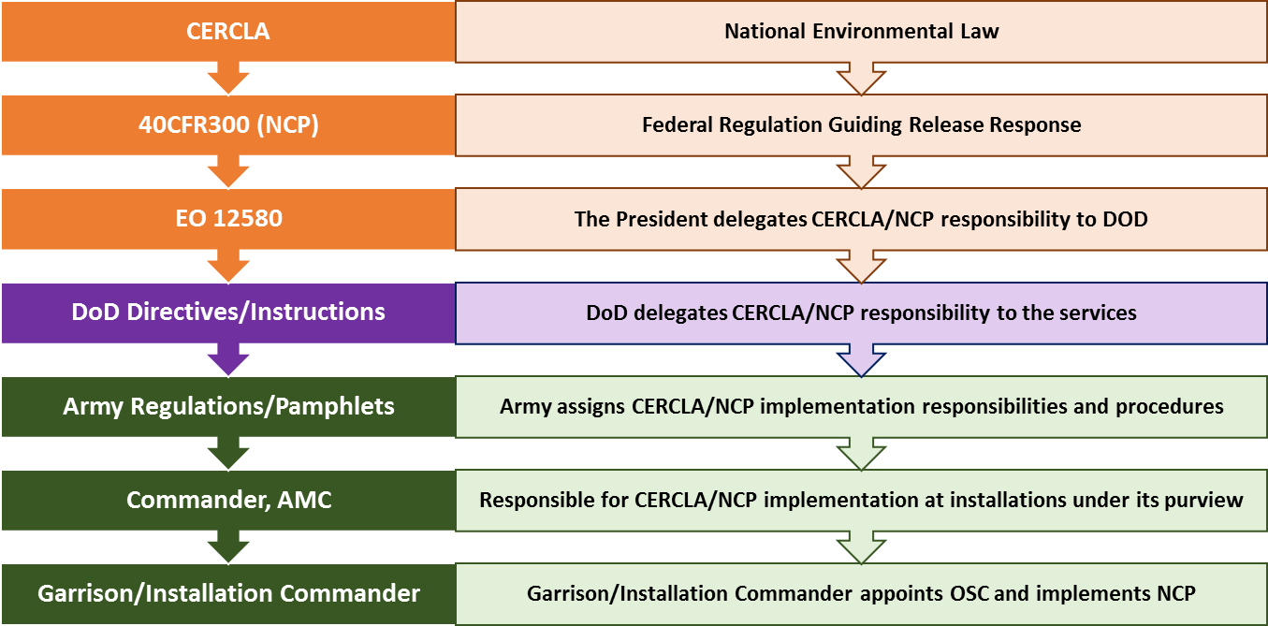
NCP Delegations and Responsibilities

Slide 5
Hypothetical Model for a CWA Event
OSC (Coordinating Army and other Federal Support)
Depot/Activity
Capability
&
Capacity
Incident
Severity
Political
Response
Hazard
Response
Time
Notes:
PCD, BGCA and BGAD have significant capabilities and capacity to respond to a chemical accident/incident. However, in the event of a catastrophic event the response may exceed the installations' assets. Additionally, a long term event has the potential to erode these response efforts over time. This is the primary role for CMA and JMC - to provide the necessary support to the installations. Note that the emergency response we are addressing is not only the on post response but also the response that the depots must provide to the off post jurisdictions as the Federal On Scene Coordinator. The political aspects may be more challenging than locating, obtaining, and deploying resources.
Occurring almost simultaneously to the emergency response will be a public – political response. This is shown separately in the diagram. It is more an information response with the potential to peak at a higher severity then the actual on the ground situation. It also has the potential to interfere with the on the ground responses. CMA has an important role in the amelioration of the public/political response.
In short, we see JMC/CMA’s role as one of being a buffer from political influences and as the procurer of external resources needed by but otherwise not readily available to the depots.

Slide 6
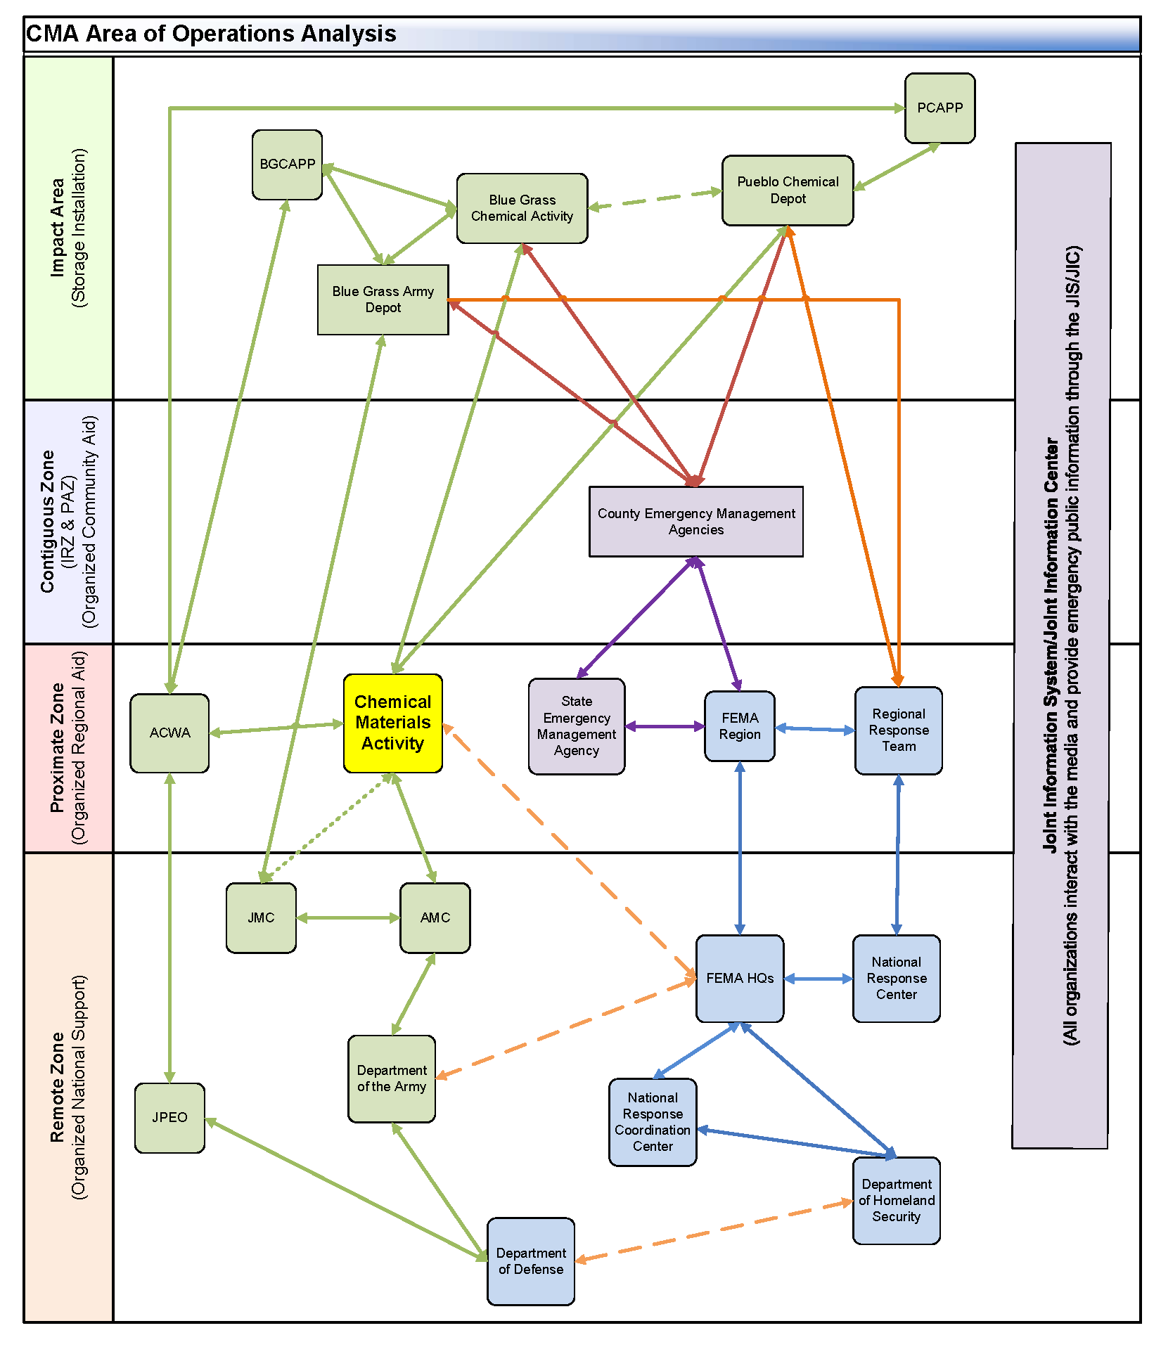
Complex Notification and Coordination

Slide 7

Factors more important because “Army”
Political Climate
Appropriate Authority
Future Uses
How Clean?
PRPs
Community
Science
Cost
Government Partners

Slide 8
Course Purpose and Scope
PURPOSE:
To provide leaders and managers at Army installations with the basic knowledge and skills needed for performing the functions of a federal on-scene coordinator (OSC) in the event of the release of a hazardous substance.
SCOPE:
  For Army personnel and Department of the Army civilians who are assigned or will be assigned to positions that may cause them to act as an OSC.
  Course emphasizes critical OSC duties (40CFR300 Subparts A, B, C, and E) in the context of Army response and removal capabilites.

Slide 9
Instructors
Course Manager:
Bruce Young, Argonne National Laboratory
Instructors:
  Paul Hewett, Argonne National Laboratory
  Craig Myers, U.S. Environmental Protection Agency
  Paul Peronard, U.S. Environmental Protection Agency
  Leo Francendese, U.S. Environmental Protection Agency
  CAPT Verne Gifford, U.S. Coast Guard
  CAPT (ret) Larry Hewett, U.S. Coast Guard
  Chris Machenberg, CSX
  Ryan Prewitt, CSX
  Holly Hardin, Argonne National Laboratory
  Mark Basnight, Argonne National Laboratory
  Don Hanscom, Argonne National Laboratory
  Eric Singer, Argonne National Laboratory
  Brian Dahlberg, Argonne National Laboratory

Slide 10
Our Students
Joint Munitions Command (JMC): 14
Chemical Materials Activity (CMA): 4
Tank-Automotive and Armaments Command (TACOM): 3
U.S. Army Aviation and Missile Command (AMCOM): 2
Surface Deployment and Distribution Command (SDDC): 2
Communications-Electronics Command (CECOM): 1
Observers;
  US Coast Guard Training Center
  US Navy Facilities and Engineering Command (NAVFAC)
  US Army Installation Management Command (IMCOM)

Slide 11
Course Development
June 2015 OSC Course (beta)
  Focused on challenges of being an OSC for a chemical weapons storage installation
  Held to meet requirements of Army chemical weapons regulations
October 2016 Course (alpha)
  Updated beta course modules to meet broader Army needs – focus is on JMC industrial and storage installations
  Established a course web site for students and instructors
  Added a social media component to the public information and communications modules
  Developed new practical exercises
  Expanded Instructor pool, added SMEs to support practical exercise

Slide 12
Student Prerequisites
Students must be assigned or will be assigned to positions as noted in the Eligibility Requirements.
Familiarity with chemical accident or incident response and assistance (CAIRA) operations is mandatory for personnel assigned to a chemical weapons storage installation.
Successful completion of Incident Command System (ICS) and National Incident Management System (NIMS) courses listed below:
  ICS 100 through 400
  IS-700 (NIMS) and 800 (NRF)
Completion of pre-course reading assignment.

Slide 13
Current Course Modules
Unit | Topic | Time (hours) | Percent of Total Instruction
1 | Introduction and Course Overview | 0.5 | 1.25
2 | Regulatory and Statutory Authorities | 1.0 | 2.5
3 | The National Response System | 2.0 | 5
4 | The RRT | 2.0 | 5
5 | Who is in Charge? | 0.5 | 1.25
6 | Incident Assessment | 2.0 | 5
7 | Case Study #1: DOD Actions under EO 12580 | 2.0 | 5
8 | Site Strategy Model | 2.0 | 5
9 | OSC Documentation Responsibilities | 1.0 | 2.5
10 | Funding, Contracting, Cost Recovery, Claims and Reimbursement | 0.5 | 1.25
11 | Case Study #2: Incident Assessment and Site Strategy | 2.0 | 5
12 | Transitioning from Removal to Remediation | 0.5 | 1.25
13 | Public Information and Communications | 12.0 | 30
14 | The OSC as a Spokesperson | 8.0 | 20
15 | Capstone Practical Exercise | 3.5 | 8.75
16 | End of Course Activities | 0.5 | 1.25
 | TOTAL | 40 Hours | 100

Slide 14
Thanks
Without the help and assistance from our partners at EPA Region VIII we could not have developed and executed this Army OSC Course.
Thank You

Slide 15

Comments/Questions

