Slide 1
Executive Briefing
[Agency]
The National Response System
[Speaker]
Notes:
Information for Presenter:
This presentation was developed by the National Response Team (NRT) for use by members in conducting Executive Level briefings. Agency-specific slides are to be generated by the subject agency.
Members of the NRT are encouraged to use and adapt this presentation to meet their individual needs. - Speakers should evaluate talking points ahead of presentation and tailor to address level of detail needed and agency specific references. Presentation includes optional information on a number of slides, various levels of detail, and additional optional slides.
Target Audience: Executives of Federal agencies with NRS equities.
Talking Points:
The National Response System is a well established structure and process for responding to spills of oil, hazardous substances, radiological releases, and other pollutants and contaminants.
The National Response Team is a integral component of the NRS, and I/We are here representing the NRT.
Today’s presentation will provide an overview of the NRS, the role of the NRT, the specific role of [XXXX] department in the NRS. We’ll also be discussing how the department may need to participate in an oil or hazmat incident at the Senior Executive Level.

Slide 2
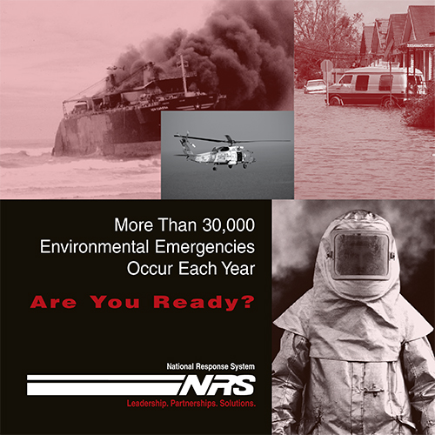
Presentation Overview
Oil and Hazardous Substances Response Landscape
Introduction to the National Response Team (NRT)
Authorities
National Response System (NRS)
Response Structure in the Field
Role of the Responsible Party
Response Funding
Spills of National Significance (SONS)
The Relationship to PPD-8 and the National Response Framework
Information Sharing and Coordination
[Agency] specific role(s)
Notes:
Specifically, we will address the following topics.
The governing authorities for oil and hazardous substances response
The components of National Response System (NRS) – including the National Response Team
The response structure in the field
The unique and important role of the Responsible Party
How responses are funded
What constitutes a Spill of National Significance (SONS) and why it’s important
The Relationship of the NRS to Presidential Policy Directive-8 and the National Response Framework
Information sharing and coordination during significant events
The specific roles of [AGENCY/DEPARTMENT] and how information flows through the agency

Slide 3
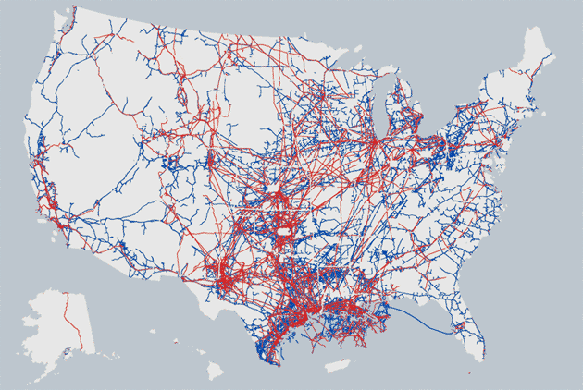

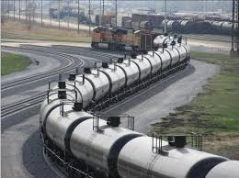
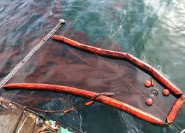
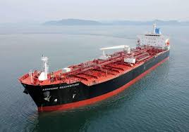

The Oil Response Landscape
>135,000 miles
of pipeline
> 7 M b/d transported
>140,000 mi
of rail
>700 Th b/d transported
>16,000
Oil Spills in 2016*
>1.5M B/d transported Between U.S. Ports
>2,000 Platforms Outer continental Shelf
17% total U.S. crude production
Crude Oil Imports > 9 M b/d
Crude Oil Exports >4.5 M b/d
* Reports to the National Response Center
Notes:
Key point: Magnitude of oil products being transported, along with how, and where. Frequency of reported spills
Talking Points: mention NRC
As I mentioned, the NRS responds to both oil and hazardous substance spills.
With regard to oil, it is largely transportation that poses the greatest risk of accidental spills. As you can see in the slide, the energy sector transports an enormous quantity of oil as well as other fossil fuels.
With the recent energy renaissance, the risks are changing and the response community is adapting to those changes. For example, transportation by rail and pipeline have increased dramatically.
New products have entered the market, including highly volatile shale oils – that have resulted in numerous explosive accidents – like the devastating train derailment that destroyed downtown Lac Megantic, Quebec in 2013 killing over 40 people and destroying 30 buildings.
And non-floating oils, like the diluted bitumen from the Athabasca Oil Sands, pose new response challenges and can result in environmentally devastating spills. For example, the Enbridge Pipeline rupture in 2010 spilled an estimated one million gallons of diluted bitumen in a tributary to the Kalamazoo River in Michigan at a clean up cost of over $750 Million and penalties of $177 Million.
The National Response Center is the nation’s single point of contact for reporting oil spills and hazardous substances releases. In 2016, more than 16,000 oil spills were reported to the NRC.
Note for speaker: if asked - Technically, the NRC should be notified of ‘oil spills causing sheens’ and releases of hazardous substances that are listed and exceeding ‘reportable quantities’
___________________________
2016 Stats (for Oil):
Total Reported Incidents of Oil Spills 16,012
Rail: 718 Incidents, Average size 203 gal (5 bbl)
Pipelines: 448 Incidents, Average size 10,225 gal (243 bbl)
Vessels: 3883 Incidents 2,945 gal (70 bbl)
Note: background graphic depicts pipeline network

Slide 4
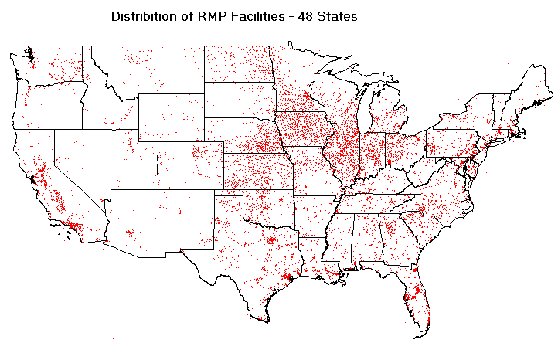
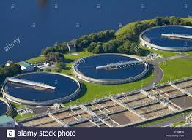

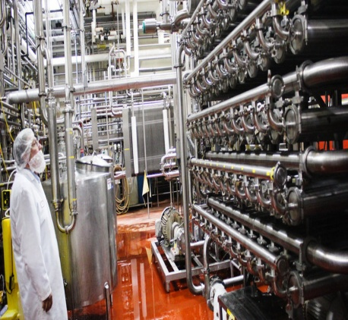

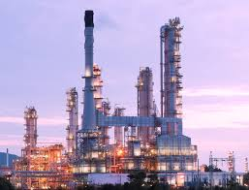
The Hazardous Substances
Response Landscape
~1,900
Water & Wastewater Facilities
~4,000 Agricultural Facilities
Reported Releases 2016*
~6,000 from fixed facilities
and storage tanks
~2,100 transportation related
> 2,400 Food and Beverage Facilities
~1,800 Chemical Manufacturing Facilities
>1,600 Energy Facilities
*Reports of “non-oil” releases to National Response Center
4
Notes:
Key Point: Magnitude and distribution of facilities with hazardous substances; frequency of reported releases
Talking Points:
In contrast to reported oil spills, which are most commonly associated with transportation, hazardous substance releases are most frequently reported from fixed manufacturing or other types of processing facilities.
This slide shows just some of the facilities in the U.S. that manage hazardous substances. The Clean Air Act requires facilities that manage certain hazardous chemicals, in quantities above a certain amount, to have plans for managing those chemicals safely in order to prevent accidental releases. The slide shows the types and numbers of facilities that come under this Clean Air Act requirement, and provides an example of the range of facilities that could potentially cause hazardous substance releases.
A recent example of a significant chemical release was the West Fertilizer Company ammonium nitrate explosion in 2013. That explosion killed 15 people, injured more than 160 people, and damaged or destroyed more than 150 buildings.
In 2016, over 8,000 releases of hazardous substances and other non-oil pollutants were reported to the National Response Center.
The National Response System we’ll be talking about today was created to address the unavoidable risk of oil and chemical spills illustrated in these slides.
_______________________
Top 10 Chemicals at Clean Air Act Risk Most Frequently Reported Releases
Management Plan Facilities by Volume of Non-Oil Materials
Flammable Mixture UNKNOWN MATERIAL
Propane Ammonia (anhydrous) AMMONIA, ANHYDROUS
Butane NATURAL GAS
Ethane ETHYLENE GLYCOL
Isobutane [Propane, 2-methyl] BENZENE
Propylene [1-Propene] RAW SEWAGE
Ethylene [Ethene] SEWAGE
Chlorine POLYCHLORINATED BIPHENYLS
2-Methylpropene [1-Propene, 2-methyl-] SULFUR DIOXIDE

Slide 5

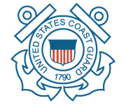

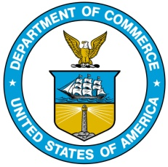




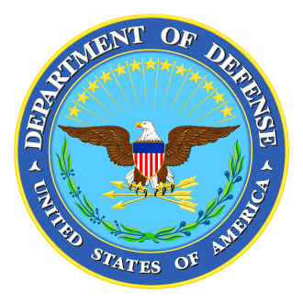
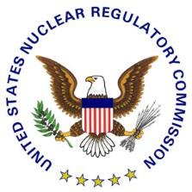
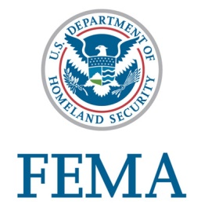


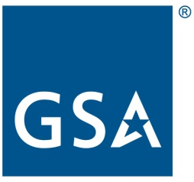

National Response Team (NRT)
Mission: To provide technical assistance, resources and coordination on preparedness, planning, and response activities for emergencies involving hazardous substances, pollutants and contaminants, hazmat, oil, weapons of mass destruction in natural and technological disasters and other environmental nationally significant incidents.
Comprised of 15 federal agencies/departments
EPA – Chair, USCG – Vice Chair
National-level planning, policy, and coordinating body
Provides policy advice and national-level assistance to the On-Scene Coordinator (OSC) and Regional Response Team(s) (RRT) during a response
Notes:
Key point: The NRT is a permanent existing interagency body that meets regularly to address response planning and preparedness at the national level. The NRT is ready and available to manage national level issues at the time of a response. HOWEVER, THE NRT IS THE INTERAGENCY COORDINATION POINT AT THE HQ/FEDERAL LEVEL. It is NOT a field level response organization, although it supports those responders.
Talking Points:
At the head of the National Response System is the U.S. National Response Team (NRT) - an organization of the 15 Federal departments and agencies that are responsible for coordinating emergency preparedness and response to oil and hazardous substance pollution incidents.
The Environment Protection Agency (EPA) and the U.S. Coast Guard (USCG) serve as Chair and Vice Chair respectively.
The NRT meets regularly and has a robust organization of chartered committees and subcommittees preparing response guidance and other resources for the field and reviewing oil and hazmat responses to determine how to improve future responses.
The NRT provides its assistance to the regional and on-scene components of the NRS -- the On-Scene Coordinator and Regional Response Teams -- which we'll be discussing shortly.
The NRT and your NRT members are the subject matter experts on national response policy and should be a key resource that Senior Executives in the agency rely on and coordinate with when an oil/hazmat incident is significant enough to warrant participation by your senior leadership. During significant oil/hazmat incidents, we expect that regional or on-scene components may request the NRT convene to coordinate interagency actions at the Washington DC/HQ level, so we want to be sure that NRT members in each NRT agency are linked to their senior leadership
If possible, be prepared with some examples of past or current NRT activities that are important to the specific agency being briefed.

Slide 6
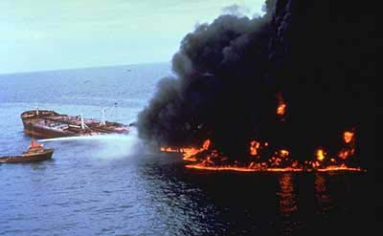
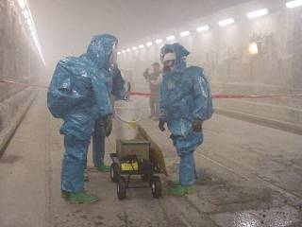
Authorities
Clean Water Act (CWA)
Section 311,
as amended by Oil Pollution Act
(OPA 90)
Comprehensive Environmental Response, Compensation, and Liability Act (CERCLA)
(aka Superfund)
Response
Planning and Preparedness
Enforcement
National Oil & Hazardous Substances Pollution Contingency Plan (NCP)
Regulation at 40 CFR part 300 that implements the oil/hazmat response authorities in these laws
Notes:
Key Point: The NRS is written into law. The authorities with regard to Response, Planning and Preparedness, and Enforcement are well defined.
Talking Points:
The National Response System is written in law.
These laws are: (1) section 311 of the Clean Water Act (CWA), as amended by the Oil Pollution Act (OPA) of 1990, and (2) Comprehensive Environmental Response, Compensation, and Liability Act (CERCLA), which is better known as the Superfund law.
In general, the purpose of these laws is to address releases or threatened releases into the environment of oil and other hazardous materials in order to protect public health, welfare, and the environment.
The CWA/OPA addresses authorities with regard to oil.
CERCLA addresses authorities with regard to hazardous substances, excluding oil.
Both laws give the federal government enforcement authorities over the parties responsible for spills and require polluters to pay for cleanup.
Both laws have planning and preparedness components, and both laws established Trust Funds that can pay for federal responses (and some other costs) when needed. We’ll talk more about these components later.
The implementing regulations for these statutes are found in the National Oil and Hazardous Substances Pollution Contingency Plan, or NCP. The NCP describes the organizational structure and procedures for “preparing for” and “responding to” an oil or hazmat incident – this system is called the National Response System, or NRS.

Slide 7
NRS Family of Plans
International
Joint Plans
National Oil and Hazardous Substances
Pollution Contingency Plan (NCP)
National Response
Framework (NRF)
Regional Contingency
Plans (RCPs)
Federal Agency
Internal Plans
Facility
Response
Plans (FRPs)
Area Contingency
Plans (ACPs)
State/Local Plans
Vessel Response
Plans (VRPs)
Notes:
Key Point: The NRS includes a comprehensive system of response plans that link together -- from the facility level up to the national level -- to provide an integrated approach to responding to oil/hazmat incidents. All plans must be consistent with each other. The ACP is the center of the planning solar system and where the agency-industry relationship is nurtured.
Talking Points:
The NRS provides a framework for coordination among federal, state, and local responders and responsible parties to respond effectively on-scene to oil discharges and releases of hazardous substances, pollutants and contaminants -- whether accidental or deliberate. Coordinating planning requires integrating elements of a host of federal and state statutes and implementing regulations with different purposes.
The NRS accomplishes this through the development and maintenance of a family of layered and interlocking contingency plans. Plans required under the NRS authorities are shown here with solid lines. These plans are required under regulation to be consistent. The family of plans includes multiple levels to provide an integrated approach to responding to oil/hazmat incidents.
The Area Contingency Plan is the center of the solar-system of plans and the ACP and its associated Area Committee is where the agency-industry relationship is nurtured. This is important as industry plans are an integral component of the NRS, and the NCP provides for unique responsibilities of entities responsible for a spill – referred to as the Responsible Party or RP – which I’ll talk more about shortly.
This family of oil/hazmat plans integrates with and supports the National Response Framework (NRF), which is issued by DHS under presidential directive. We’ll be discussing the NRF later in this presentation.
KEY FOR CHART:
Larger solid lines = Plans of the NRS
Small solid lines = Plans integrated with the ACP
Dotted lines = Points of coordination with the NRS

Slide 8
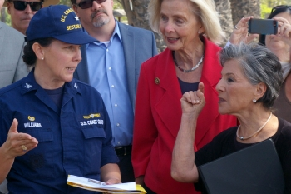
Federal On-Scene Coordinators (OSCs)
USCG for coastal zone
EPA for inland zone
36 pre-designated OSCs
~ 230 pre-designated OSCs
Authority to conduct, direct, and coordinate all response efforts at the incident scene
Protect the environment, public health, as well as worker safety & health
Responsible for developing ACPs and Chairing Area Committees
Notes:
Key Point: OSC is the federal incident commander
Talking Points:
EPA and USCG are the primary agencies that coordinate NCP preparedness and response activities and provide Federal On-Scene Coordinators (OSCs).
EPA is the lead agency and provides OSCs for the inland area.
USCG is the lead agency and provides OSCs for the coastal area.
Other federal agencies with oil and hazmat jurisdiction and expertise support EPA and USCG.
The OSC is the federal incident commander during an emergency response. OSCs are highly skilled men and women who conduct, direct, and coordinate emergency response actions as needed - taking whatever actions are necessary and consistent with federal law to remove the pollution or contamination threat.
There are approximately 230 pre-designated EPA OSCs and 36 pre-designated USCG OSCs. They are located in and deploy from EPA regional offices and USCG Sectors.
________________________________________
[OPTIONAL] DOE and DOD are the other two agencies that have the authority and responsibility to provide the federal OSC for emergency hazardous substance releases specifically from DOE and DOD facilities and materials. (They do not have OSC authority for their oil releases – EPA or USCG would be the federal OSC for oil spills from DOE and DOD facilities/materials.)

Slide 9
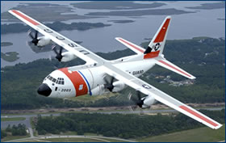
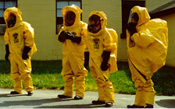
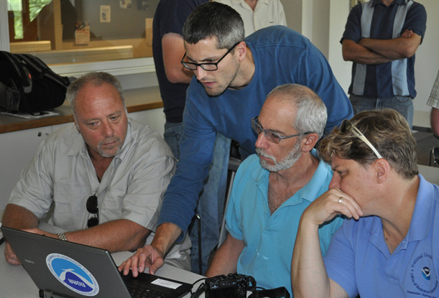
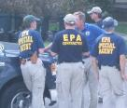
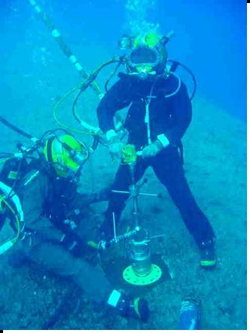
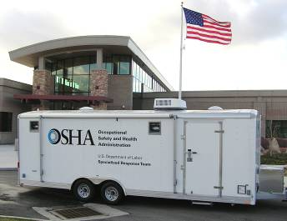
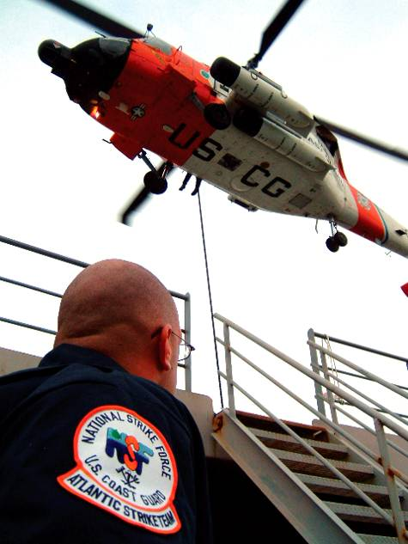
NRS Special Teams
EPA USCG NOAA OSHA
BSEE DOE USN-SUPSALV
Notes:
Key Point: Special Teams are standing preparedness and response bodies of highly skilled responders from various NRT federal agencies, available by direct request by the OSC.
Talking Points:
To help the OSCs, the NRS includes a variety of federal “Special Teams” that can provide OSCs with more in-depth expertise in certain technical and response capabilities. As you can see, these teams come from several of the federal agencies on the NRT.
It’s important to understand that during an NCP response, the Special Teams respond to support the OSCs; they do not lead NCP responses. Additionally, these are “national” resources under the NRS and identified in the NCP.
[For briefings in agencies that provide Special Teams that will be described further in Agency-specific section, mention here that the Agency rep will be talking about the Agency's team in more detail later.]
_______________________________________________________________
USCG - National Strike Force (NSF) – includes the NSFCC and three Strike Teams (Pacific, Atlantic, and Gulf); Incident Management Assist Team (IMAT); Public Information Assist Team (PIAT); District Response Groups (DRGs); National Pollution Fund Center (NPFC)
EPA - Environmental Response Team (ERT); Radiological Emergency Response Team (RERT); National Criminal Enforcement Response Team (NCERT); CBRN Consequence Management Advisory Team (CMAT); and Scientific Support Coordinators (SSCs)
DOL OSHA - Specialized Response Team – chemical, biological, radiological, and structural collapse
DOC NOAA - Scientific Support Coordinators (SSCs)
DOD Navy Supervisor of Salvage (SUPSALV) – underwater salvage technical support
DOI Bureau of Safety & Environmental Enforcement (BSEE) – Source Control Support Coordinator (SCSC)
DOE – Assorted Radiological Response Teams

Slide 10
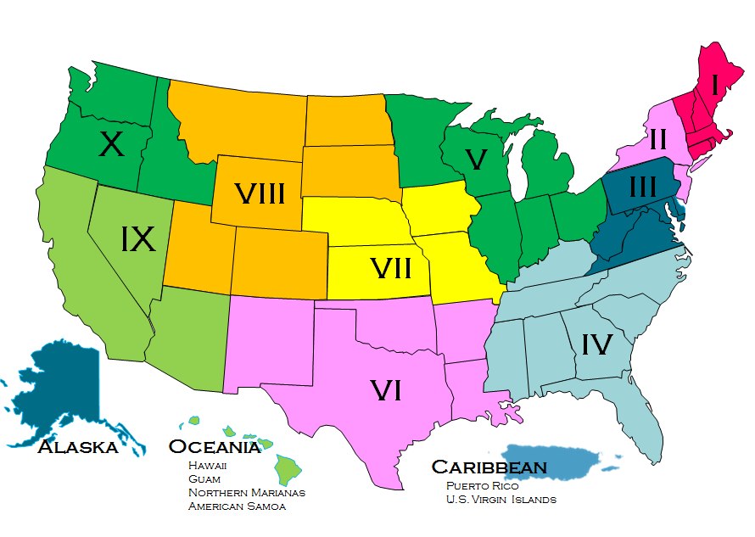











NRT and RRTs
National Response Team
National-level planning, policy, & coordinating body
Provide advice & assistance to the OSC and RRT(s) during a response
Regional Response Teams - 13
Co-chaired by EPA & USCG
15 Federal agencies plus State/Territorial & Tribal representatives
Engage in planning & training activities year-round
Coordinate decision making process for alternative cleanup operations
Provide technical expertise & resources to the OSC during a response
Notes:
Key Point: The NRT and RRTs provide support to the OSC as needed. They do not “give direction” to the OSC.
Talking Points:
As a reminder: Although called a “response team,” the NRT does not deploy as a team to an incident site, but provides national-level interagency coordination and policy support, and reach-back support from the member agencies to assist the OSC and Regional Response Teams.
There are 13 Regional Response Teams, one for each EPA region plus teams for the Caribbean, Oceania (Pacific Islands), and Alaska.
The RRTs are made up of the same Federal agencies of the NRT, along with the States and territories within the region, and may also include federally recognized tribes and local governments.
The role of the standing RRT includes communications systems and procedures, planning, coordination, training, evaluation, preparedness and related matters at the regional level.
The RRTs develop the Regional Contingency Plans you saw on the slide with the family of plans, and coordinate across Area Committees in their respective regions.
During a response, RRTs may activate to provide resource and technical support to the OSC. For the federal agencies represented on the NRT, the RRT is typically the first level of engagement with the OSC and the response. If additional guidance or resources are needed, the NRT may be activated.

Slide 11


Role of the Responsible Party
Responsible for:
  Cleaning up the spill
  Response costs
  Certain damages
  Environmental restoration
Often a response partner and part of the Unified Command
Notes:
Key Point: RP is responsible for response under the direction and oversight of OSC
Talking Points:
One of the unique characteristics of the National Contingency Plan is the role of the Responsible Party.
The RP is responsible for cleaning up the spill, paying for the response, paying for certain damages as a result of the spill, and environmental restoration following the response. If the RP cannot be identified or is not capable of conducting an adequate response, a federal response may be needed.
Commonly, the RP works cooperatively with the On-Scene Coordinator as a response partner – providing an integrated joint response effort.
You can probably remember the Deepwater Horizon Spill in 2010 and the prominent role BP played in the response effort and claims payment.
However, it is important to note that although the RP is responsible for the clean up, it is still the federal OSC that directs and oversees the response.

Slide 12
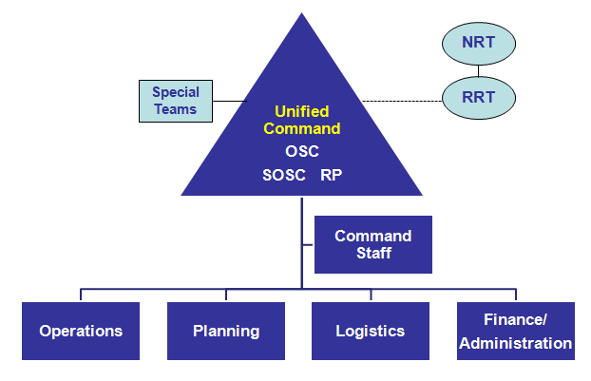
Response Structure in the Field
The NRS employs the
National Incident Management System (NIMS)
The Unified Command is responsible for overall incident management and is typically made up of the federal On-Scene Coordinator (OSC), State On-Scene Coordinator (SOSC), and Responsible Party (RP)
Notes:
Key Point: Defined structure for field response
Talking Points:
Presidential directive requires federal agencies to follow NIMS for planning for and managing emergencies -- so the NRS adopted NIMS, which includes an "Incident Command System" for organizing a response.
The Incident Command System is a scalable, flexible construct not unique to pollution response. ICS is a standardized approach to the command, control, and coordination of emergency response providing a common hierarchy within which responders from multiple agencies can be effective.
All NRT agencies have personnel trained and certified to plug into the ICS structure as needed during a response.
Please note that this is a simplified graphic - Under each of the sections there can be and generally are many cascading components.
Also important is the concept of a Unified Command. We talked about the federal OSC directing and overseeing a response. In a unified command, those with response authorities collectively manage the overall response. For NCP responses this typically includes the federal OSC, the state OSC, and the RP. However the federal OSC always maintains 51% of the vote.

Slide 13
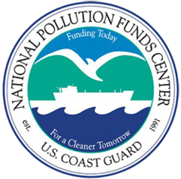
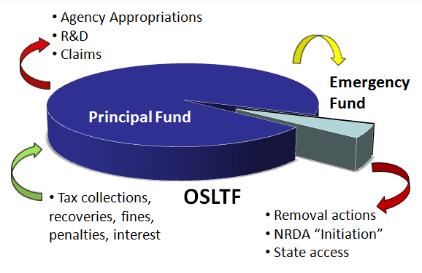
NRS Response Funding
Oils
OPA 90
  Oil Spill Liability
  Trust Fund (OSLTF)
Hazardous Substances
CERCLA (aka Superfund)
- Superfund Trust Fund
Notes:
Key Point: Although the Responsible Party is responsible for paying for response costs – when the RP can be identified and is financially viable - there are also funds available to facilitate the federal/state response and efficient claims payment.
Talking Points:
In addition to providing the federal government with authorities and responsibilities for responding to oil spills or hazardous substance releases, both OPA90 and Superfund provide a number of mechanisms and funding options to pay for emergency response activities.
Most importantly, both laws hold the Responsible Party liable for paying for response costs – when the RP can be identified and is financially viable. However, both laws establish funds to ensure a rapid, effective response.
The Oil Spill Liability Trust Fund, administered by the National Pollution Funds Center, is used for response to spills of oil and oil products.
The Superfund Trust Fund is used for releases of hazardous substances -- not oil.
EPA administers the Superfund Trust Fund, in cooperation with individual states and tribal governments.
Additionally, the NPFC administers Superfund cases in the coastal zone through Regional IAGs (Interagency Agreements)
It is important to remember that responsibility for payment lies with the Responsible Party -- when the RP can be identified and is financially viable. Even when response expenses, claims, and damage assessment initiation are paid from funds, the NPFC or EPA will seek reimbursement from the RP.
____________________________
[Optional]
There are two primary components to the OSLTF, the Emergency Fund and the Principal Fund.
The Emergency Fund receives a transfer of up to $50 million each year from the principal fund for removal activities and initiation of Natural Resource Damage Assessments.
The Principal Fund contains the balance of the Fund, and is used to fund: third party claims, Research and Development, and annual appropriations to federal agencies (e.g. USCG, EPA, DOI, DOT) to administer and enforce OPA and Federal response authority.
Per incident expenditures from the OSLTF are limited to $1 billion, of which available funds for Natural Resources Damage Assessments and Natural Resource Damage claims are limited to $500M.
The total OSLTF Fund balance is $5.1 billion as of 31 Dec 2016
Superfund removal responses are limited to $2 Million/12 months unless certain findings described in the law can be made

Slide 14
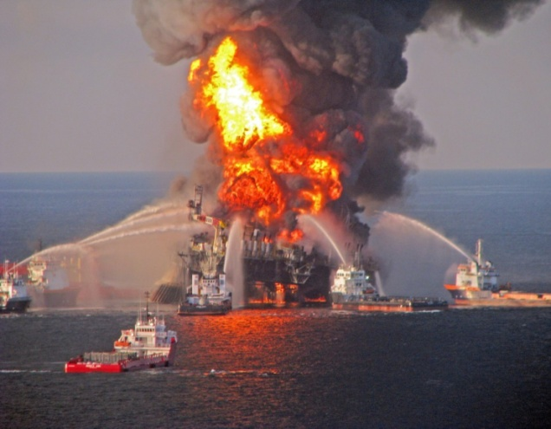
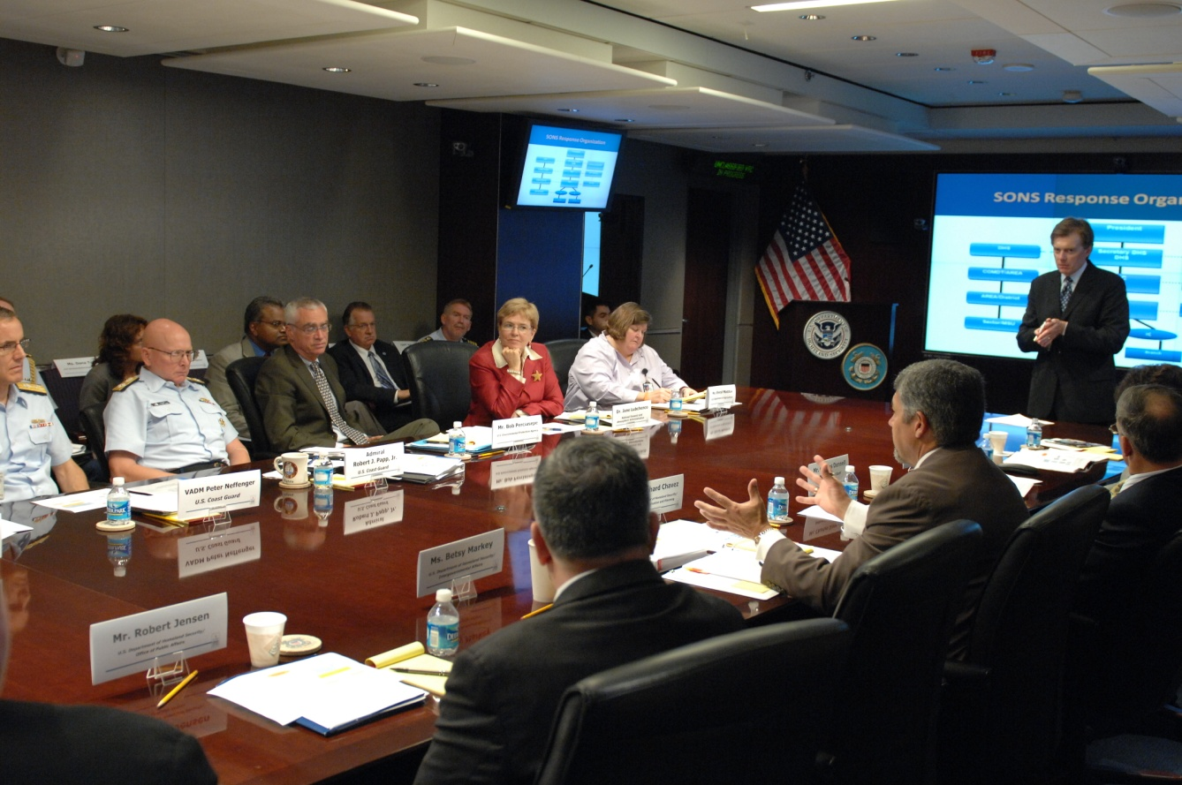
Spill of National Significance (SONS)
A SONS is an oil spill of such complexity or scope that it requires exceptional coordination
A USCG National Incident Commander (NIC) or EPA Senior Agency Official (SAO) will be appointed to assume/assist the OSC with communications and coordination
The NRT plays a significant role assisting the NIC/SAO and OSC as requested to bridge policy gaps and address other interagency issues
A SONS exercise series focuses on policy and strategic seminars for senior agency executives
Notes:
Key Point: A SONS is a situation where the NRT and Senior Executives are expected to be heavily engaged. It is important for the senior agency executives to coordinate with their NRT Member for information and input, as NRT members are key subject matter experts in how the NRS works and their agency’s role in an oil/hazmat response.
Talking Points:
An oil spill of great complexity or scope may be declared a “Spill of National Significance” or SONS by EPA or USCG.
The Deepwater Horizon spill in 2010 was the first and only declared SONS (though the Exxon Valdez spill of 1998 was the impetus for writing SONS regulations into the NCP). In the DWH case, the uncontained release from the well-head lasted 87 days, releasing over 200 Million gallons (4.9 million barrels) of oil; oiling 1,300 miles of shoreline, and employing over 47,000 responders.
During a SONS, the USCG may appoint an National Incident Commander or EPA a Senior Agency Official to assume the role of or assist the OSC with regard to communications and resource coordination.
It is during a SONS, or similar hazardous substances release of national significance, that Senior Executives are most likely to engage in a response - with regard to communications, interagency coordination, and identifying available department/agency resources.
It such cases, it is critical that Senior Executives be in direct contact with their NRT Member and help ensure that their department/agency is providing appropriate resource support to assist the OSC and NIC/SAO as requested.
For a SONS or significant hazmat response, Senior Executives may also be asked to participate through meetings of the Domestic Resilience Group (interagency policy group under National Security Council); the Deputies; or the Principals -- if such meetings are called for the response.
A SONS Exercise series has been developed to educate Senior Executives on the complexities of a SONS and the types of policy and strategic considerations likely to be encountered.
The next SONS Executive Seminar is scheduled for [March 2018]
_______________________________________________
Additional Stats from DWH:
Almost all NRT agencies were involved to some extent in the response
Estimated released of 4.9 M barrels (206 M gallons) of oil; Oily water mixture recovered 826,988 barrels (35 M gallons)
More than 47,000 responders
12.6 Million feet of boom (2,382 miles); 835 Skimmers; 6,131 Vessels (3,190 Vessels of Opportunity; 2,475 other vessels)
123 aircraft --78 rotary wing and 45 fixed wing
Subsea dispersants applied: 771,272 gallons; Aerial & Vessel Surface dispersants applied :1,072,514 gallons
Received 68 offers of assistance from foreign governments; Accepted 47 offers for critical resources
Incident Command Posts in 4 states with 17 subordinate branches; 18 Staging Areas for equipment
At its maximum extent, oil covered 15,300 square miles, an area about 10 times larger than Rhode Island
Contaminated over 1,300 miles of shorelines from Texas to the Florida Panhandle.
State Coordination: TX, LA, MS, AL, FL

Slide 15
NCP and Presidential Policy Directive 8: National Preparedness
National Preparedness Goal
-- Core Capabilities for 5 Mission Areas --
National Planning Frameworks
Prevention
Protection
Response
Recovery
Mitigation
14 Emergency Support Function (ESF) Annexes
NCP
Federal Interagency Operational Plans (FIOPs)
Prevention
Protection
Response
Recovery
Mitigation
Incident Annexes
Oil/Chemical
Nuclear/
Radiological
Biological
Others
Notes:
Key points: PPD-8 established a comprehensive national planning system for managing emergency incidents. Your agency may have various roles and responsibilities under PPD-8. Today we’re going to show you how the NCP and National Response System fit into PPD-8.
PPD-8 is a presidential policy directive signed by the President in 2011. It created a comprehensive system of planning documents to describe and guide how the Nation manages emergency incidents.
As you can see, it covers 5 mission areas – from prevention of terrorist attacks, to protection of the Nation’s critical infrastructure, to responding and recovering from incidents, to taking actions to mitigate the impacts of incidents.
Your agency may have various roles and responsibilities under this PPD-8 framework. Today we’re going to just talk about how the NCP and National Response System fits into PPD-8.
We’re going to explain how the NCP fits into the Response mission area of PPD-8 that is outlined in red.

Slide 16

NCP and Presidential Policy Directive 8: National Preparedness
National Response Framework (NRF)
National response to all-hazard emergencies -- natural disasters, terrorist attacks, oil/chemical incidents, public health emergencies, etc.
Federal government responses may be led by various federal agencies, under various federal authorities, including:
    EPA/USCG under NCP
    FEMA under Stafford Act
NCP
Stafford Act
EPA/USCG lead NCP oil/hazmat responses
NCP supplements NRF and serves as federal interagency ops plan for NCP responses
FEMA coordinates the overall federal response
14 Emergency Support Functions (ESFs) support FEMA
Each ESF led by federal agency that coordinates multiple agencies to provide a certain type of federal support -- under FEMA-issued “Mission Assignments”
ESF #10 – Oil & Hazmat Response
NRS
Led by EPA
Together with USCG and other NRT agencies, uses NRS resources/structures to provide environmental response to oil/hazmat releases
Notes:
Key points: The National Response Framework recognizes that federal responses to emergencies may be led by various agencies, under various federal authorities. Your agency may be asked to provide support to a National Response System response under several authorities. The 2 key authorities are the NCP, as we’ve been discussing, and the Stafford Act.
[Speaker note: Tailor the amount of explanation provided to the knowledge level of the specific audience. Talking points assume audience is not familiar with NRF, Stafford Act, and ESFs.]
The National Response Framework is issued by the Department of Homeland Security.
The National Response Framework describes how the Nation responds to “all-hazard” incidents.
All-hazard incidents include natural disasters – like hurricanes and tornadoes; terrorist and other intentional acts; oil/chemical incidents; public health emergencies -- like the Ebola and Zika viruses; and other emergencies.
“Nation” includes federal, state, and local governments and the private sector
For the Federal Government, the Framework recognizes that federal responses may be led by various federal agencies, under various federal authorities
These include responses to oil/hazmat incidents led by EPA/USCG under the NCP, which we’ve been discussing. The NCP serves as the federal interagency ops plan under the Framework, for responses carried out under the NCP.
The Framework also recognizes that FEMA may coordinate federal responses under the Stafford Act. In this case, the National Response System may also have a role to play in providing support to FEMA through activation of ESF #10.
When FEMA coordinates a federal response under the Stafford Act, FEMA is supported by a broad spectrum of federal agencies, whose support is organized into “Emergency Support Functions” or ESFs. There are 14 ESFs – and each ESF can provide a different type of federal support during an incident. ESFs are led by the federal agency with the most expertise or authority in providing that type of support, but the lead agency is supported by other federal agencies that also have authorities and expertise in that area.
EPA is the lead agency for “ESF #10 – Oil & Hazmat Response.” EPA uses the resources and structures of National Response System to provide the ESF #10 response. So NRT agencies may be asked to provide support to EPA during ESF #10 responses, and the NRT may be activated as a national level interagency coordination mechanism for ESF #10 responses if necessary. ESF #10 is usually activated multiple times each year for natural disasters that result in oil/hazmat releases, like Hurricanes Sandy and Katrina.
One difference to note between an NCP response and an ESF #10 Stafford Act response: Under the Stafford Act, states or tribes ask FEMA for the specific types of federal help they need, and FEMA then activates the ESFs that can provide that support and issues them “Mission Assignments” that task the ESFs to do the specific work requested. FEMA then reimburses the ESF agencies from the Stafford disaster fund. So when ESF #10 is activated, we are responding to the specific tasks we’ve been assigned in the FEMA Mission Assignment.
However, EPA and USCG still maintain their ability to exercise their independent NCP authorities if needed during a Stafford Act response. So it is possible to have both an ESF #10 and NCP response to a Stafford Act incident.
___________________________________________________
Notes for speaker:
If asked how the NCP relates to Response FIOP on previous slide: The Response FIOP focuses on federal response to catastrophic Stafford Act disasters, not NCP incidents.
If your specific briefing will include a discussion of ESF #15 – External Affairs, and you are asked why it is ESF #15 if there are only 14 total ESFs, the answer is: The ESFs are numbered #1-#13, and #15. There is no ESF #14 – was superseded by National Disaster Recovery Framework.

Slide 17
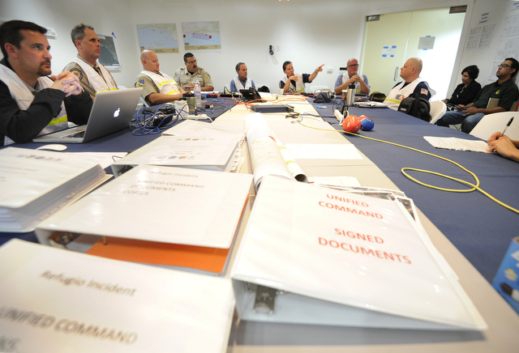
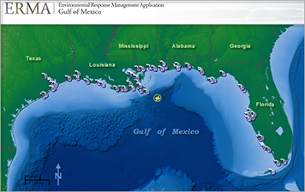
Response Information Management
Important to maintain integrity and timeliness of response information
For large incidents, a web-based Common Operating Picture (COP) will be utilized
COP and scheduled briefings provide most reliable response information
NRT Member can advise on information coordination protocols for incident
Photo credit: Santa Barbara Independent
Notes:
Key Point: Under both the NCP and NRF, there are well defined processes for information coordination, which are tailored to the specific incident and are defined by the lead agency for the response. It is important for participating agencies to follow the established processes for response information management to ensure the best quality information is being used by the agencies, and to avoid outdated or misinformation being briefed up the management chain.
Talking Points:
During a major spill event, managing the integrity and timeliness of response information are critical parts of a successful response.
The lead agency will establish the process for information sharing and management.
This process will include defining an Operational Planning Cycle -- which might be, for example, every 12 hours or every 24 hours. For each cycle, the Unified Command will develop a new “Incident Action Plan” that:
Analyzes the data and information collected so far in the response, and
Uses that up-to-date information to determine and define the specific response activities to be taken during that planning cycle.
A new “Incident Action Plan” is created for each Operational Planning Cycle – in this way, the latest response information is always used to determine the appropriate next steps in the response. The Operational Planning Cycle is an important concept because it sets the battle rhythm for a response – it determines when information will be collected from the field; when response decisions will be made; and when public information will be disseminated.
When an emergency response has high visibility, it can be challenging when senior agency leadership, the White House, or the press want requested information upon demand. If the response to these information requests isn’t allowed to be synced up with the operational planning periods, then:
The RFIs can disrupt the response operations, and
The information provided may be of lesser quality -- e.g., information may be released without adequate QA/QC; decisions may be made without adequate information.
So whenever possible, it is best when the response to RFIs regarding on-site response operations is allowed to be synced up with the operational planning process. And information provided during planned briefings will be more reliable and complete than response information released off-cycle.
Another aspect of managing response information involves information-sharing. For large responses, the lead agency will establish a Common Operating Picture, or COP -- a web-based platform where response information is posted and updated to provide participating responders and agencies with the same information on the same schedule.
Regularly scheduled briefings and COP access can provide leadership with reliable response specific information to answer the bulk of RFIs.
During an incident, NRT Members can advise their senior leaders on the information management protocols for that specific incident, and can identify what platforms are available for accessing real-time response information.
_________________________________________
References available for NRT Members to provide additional information to their senior leaders on response information/coordination processes include:
NRT-RRT SONS Coordination Guidance
USCG COMMANDANT INSTRUCTION 3100.8B Critical Incident Communication (CIC)
SONS Senior Reference Guide

Slide 18
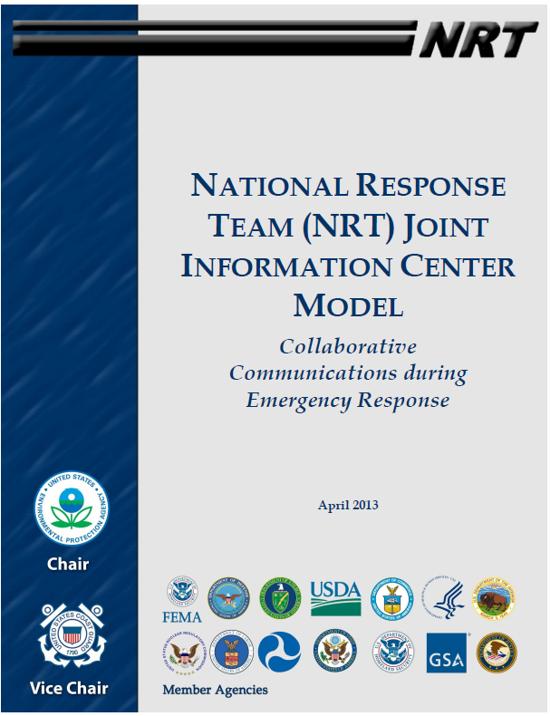
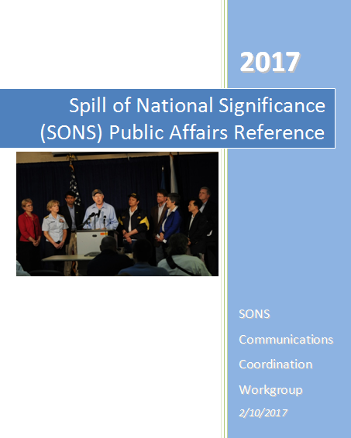
Public Information
HOW, WHEN, and WHAT information is shared is one of the biggest public affairs challenges during a response
Important to be transparent, credible, and consistent
Joint Information Center (JIC) may be established as hub for information dissemination to the public
Be cognizant of, and respect, established process of public response communication during an incident
Notes:
Key Point: Under both the NCP and NRF, there are well defined processes for the coordination and approval of external communications, which are tailored to the specific incident. It is important for participating agencies to follow the established processes for external communications in order to avoid outdated or misinformation -- which may lead to an erosion of public confidence in the response and disruptions to response operations.
Talking Points:
During a major spill event, integrity and timeliness of external communications is paramount.
A response is only as successful as the public perceives it to be.
There are well established mechanisms for external communications under both the NCP and NRF. For smaller incidents, a Public Affairs Officer in the Command Staff may be assigned to help coordinate external communications. For larger incidents, a Joint Information Center may be established to coordinate external communications across all participating agencies.
Under the NRF, there is also an ESF focused on coordination of external affairs, led by either the DHS or FEMA public affairs office. This ESF may be activated for a SONS or significant hazmat response under the NCP or for a federal response under the Stafford Act, in support of the lead agency for the response. DHS external communications tools that may be used include coordinated telephone conferencing capabilities at the national, state, and private sector levels during an emergency (NICCL/SICCL/PICCL).
All public information should be released in accordance with the processes established for the particular incident. Agencies should not be releasing information outside of the defined process.
Again, during an incident, NRT Members can advise their senior leaders on the public information procedures for the specific incident.
__________________________________________
References available for NRT Members to provide additional information to their senior leaders on public communications include:
NRT’s JIC Model
SONS Public Affairs Reference (SPAR)
ESF 15 – External Affairs (including information on NICCL/SICCL/PICCL calls)

Slide 19
[AGENCY] Role in Response
Insert logo(s)
  Primary concerns during a response
  Role in a response operation
  Assets and how they are accessed
  Concerns/Issues most likely to be raised or addressed at the Senior Executive level
  How information flows within [the department/agency]
Insert a picture or two of agency in action during a response
Notes:
Talking Points:
Each member agency on the NRT plays a significant role in response and preparedness.
Now [I or name of agency rep if not the speaker to this point] is going to discuss the:
Agency/Department’s primary concerns during a response
Agency/Department’s role in a response
Agency/Department’s assets and how they are accessed
Concerns/Issues most likely to be raised or addressed at the Executive level
And how information flows within the agency

Slide 20
Agency Slide(s) – how fit in
To be added at the time of customizing presentation for audience
  Agency/Department’s primary concerns during a response
  Agency/Department’s role in a response
  Agency/Department’s assets and how they are accessed
  Concerns/Issues most likely to be raised or addressed at the Senior Executive level

Slide 21
Agency Slide(s) – How information flows within agency
To be added at time of customizing presentation for audience

Slide 22

Questions

Slide 23
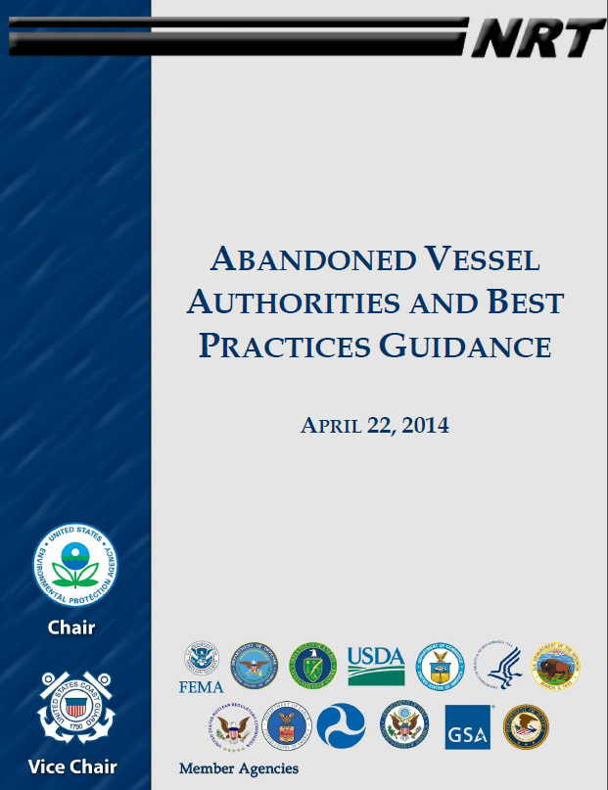
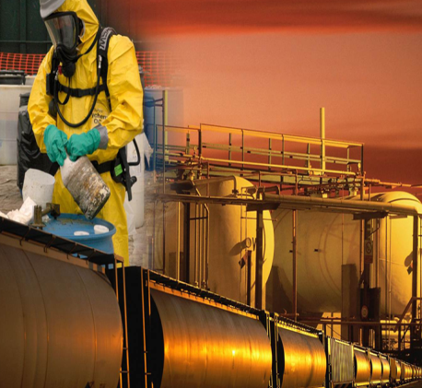
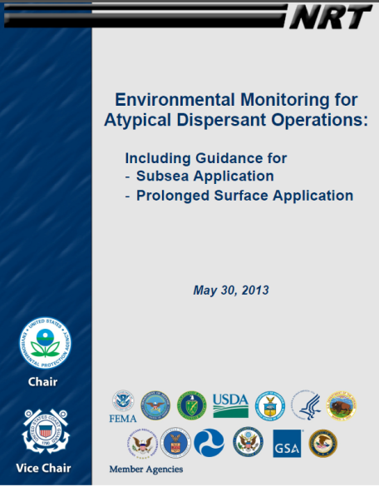
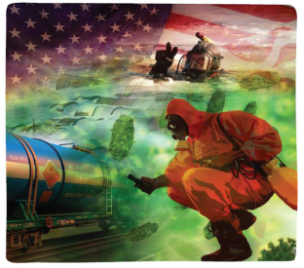
NRT Structure and Products
NRT Members
Executive Secretariat
Response Committee
Preparedness Committee
Science & Technology Committee
Worker Safety & Health Subcommittee
NRC Advisory Group
National Environmental Compliance Subcommittee
NRT- ACPanama Subcommittee
NRT- ACPlanning Workgroup
Weapons of Mass Destruction Subcommittee
Training Subcommittee
Emerging Risks: Responder Awareness Training
Chemical and Biological Warfare Agents
Quick Reference Guides
WS&H Technical Conference
Notes:
Key Point: The NRT is made up of a robust structure of committees which develop national guidance, training products, and response tools for use throughout the National Response System
Talking Points:
As remarked earlier, the National Response Team meets regularly and has a robust organization of chartered committees and subcommittees, preparing response guidance and other resources for the field and reviewing oil and hazmat responses to determine how to improve future responses.
The NRT consists of three primary Committees – Preparedness, Response, and Science & Technology. Each committee has one or more chartered subcommittees and/or workgroups. All committees, subcommittees, and workgroups are inherently interagency in nature and all of the developed products are created collaboratively with an end goal of consensus approval by the NRT Membership before publication.
Agency participation for all committees is coordinated by the NRT Member. Agency representatives from all levels of the organization (Headquarters to Field Office) are welcome to participate as subject matter experts, though all requests for participation should be directed through the NRT Member.

Slide 24
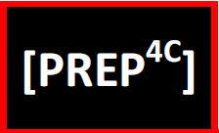
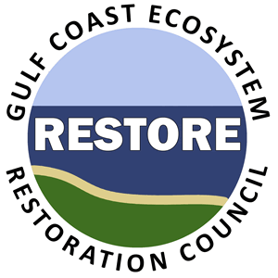
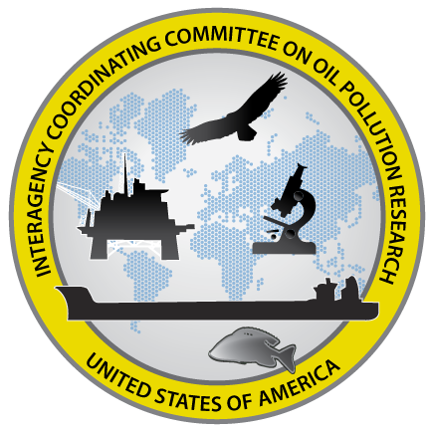

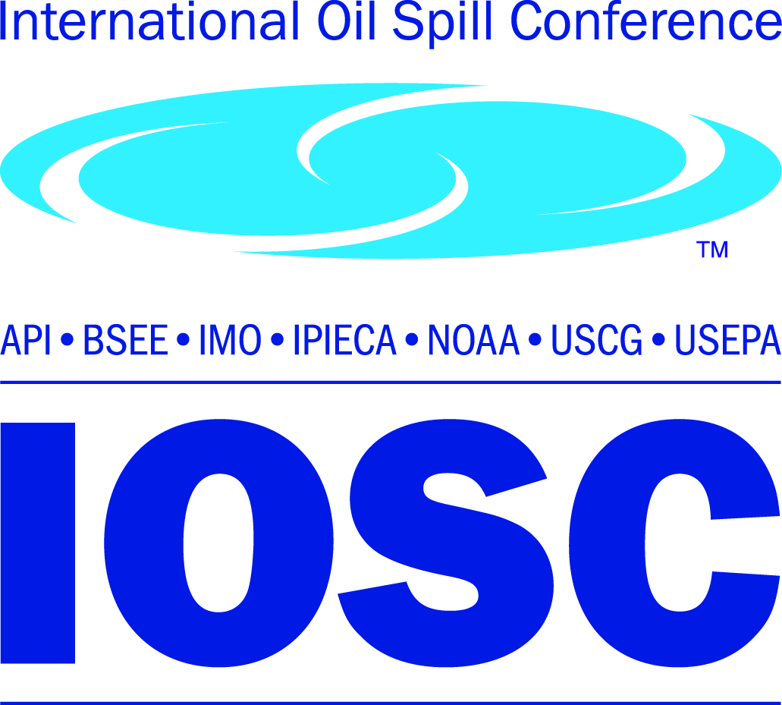
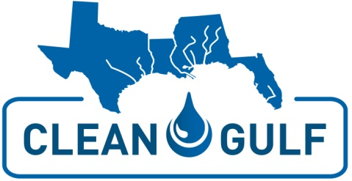
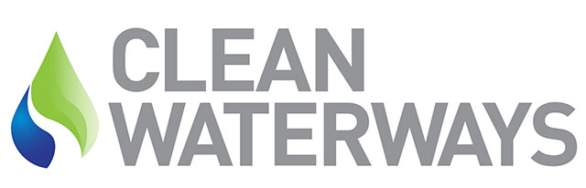
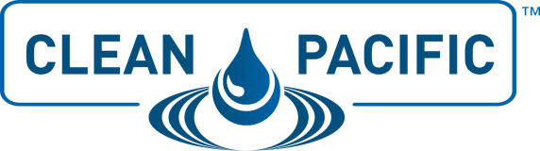
Related Organizations
Notes:
Note to Presenter: Mention of some or all of the above may be advisable if your agency participates as a committee member or is a regular participant and awareness is important at the Senior Executive level to garner support
Talking Points:
There are several related interagency organizations and regularly scheduled conferences for which our agency plays a vital role or finds vital for our professional development
ICCOPR – Interagency Coordinating Committee on Oil Pollution Research
15-member interagency committee established by OPA90 to “coordinate a comprehensive program of oil pollution research, technology development, and demonstration among the federal agencies, in cooperation and coordination with industry, universities, research institutions, state governments, and other nations, as appropriate, and shall foster cost-effective research mechanisms, including the joint funding of the research.”
Chaired by USCG, rotating vice among EPA, NOAA, BSEE
Members: USCG, EPA, NOAA, BSEE, USACE, PHMSA, USFWS, NAVY-SUPSALV, NASA, DOE, USFA, MARAD, NIST, BOEM, USARC
PREP4C – National Preparedness for Response Exercise Program: Compliance, Coordination, and Consistency Committee
Co-own and Co-author the PREP Guidelines – a conglomeration of OPA90 exercise requirements and associated policies consolidated into one guidebook.
Chaired by USCG
Members: USCG, EPA, PHMSA, BSEE
RESTORE – Gulf Coast Ecosystem Restoration Council
Administers 60% of the funds made available from the Gulf Restoration Trust Fund established by the RESTORE Act [from Civil Penalties associated with the 2010 Deepwater Horizon spill] for coastal restoration to improve the ecologic and economic health and resiliency of the Gulf ecosystem and Gulf dependent communities
Chaired by USDA
Members: USDA, DOI, USACE, DOC, EPA, DHS, LA, MS, AL, FL, TX
Conferences:
IOSC – International Oil Spill Conference – triennial event in U.S
The world's largest oil spill conference bringing together experts from academia, government, and industry to discuss oil spills, address emerging issues and present the latest technologies for mitigating oil pollution
Permanent Conference Committee: IMP, NOAA, EPA, API, USCG, BSEE, IPIECA, PHMSA
Includes platform presentation consisting of ~300 papers, a poster session, technical demonstration, photo and film festival, and exhibitions
Sister conferences in interval years: Interspill (Europe), SpillCon (Asia)
Clean Gulf/Clean Pacific/ Clean Waterways – annual or biennial regional spill response conferences
Annual events that brings together the spill prevention, preparedness and response community, including State and Federal regulators, to establish and build successful interagency relationships crucial to a successful response on land or water

Slide 25
Federal Facility Responses
Source of CERCLA release or oil discharge | CERCLA Emergency Removal Actions* | CERCLA Non-emergency Removal Actions* | Oil Removal Actions*
CERCLA release on, or sole source from, DOE facility or vessel | DOE | DOE
CERCLA release on, or sole source from, DOD facility or vessel | DOD | DOD
CERCLA incidents involving DOD weapons/munitions or weapons/ munitions under DOD control | DOD | DOD
CERCLA release on, or sole source from, a federal agency facility/vessel other than DOE/DOD | EPA – inland USCG - coastal | Federal agency
Oil discharge from any federal agency facility/vessel |  |  | EPA – inland USCG - coastal
*Responsible for on-site and off-site removal actions
Notes:
This table provides a summary of responsibilities under the NCP for CERCLA releases and oil discharges involving federal facilities (NCP §300.120)
DOE and DOD are responsible for all removal actions for CERCLA releases that are on, or when the sole source of the release is from, their facilities or vessels. “Facility” includes pipelines, motor vehicles, rolling stock, and aircraft.
DOD is also responsible for all CERCLA removal actions for incidents involving DOD weapons and munitions, and for weapons and munitions under the jurisdiction, custody, or control of DOD.
For CERCLA releases that are on, or the sole source is from, a facility or vessel of another federal agency, the responsibility for taking CERCLA removal actions is split. EPA or USCG are responsible for taking “emergency” removal actions, and the federal agency with jurisdiction, custody, or control is responsible for taking any removals that are not “emergencies.”
For oil discharges from any federal facility or vessel, only EPA and USCG have NCP removal response authority.
Note that in all cases, whenever an agency is responsible under the NCP, they are responsible for taking both on-site and off-site actions.

