Slide 1

Wildfire Response Panel Discussion
USCG at Lahaina Harbor
W. Timothy DeWald, CIH
Industrial Hygienist
Atlantic Strike Team
JBMDL, NJ
William.t.dewald@uscg.mil
609-351-7148

Slide 2
Wildfire Response Panel Discussion
Job Hazard Analysis
USCG work sites involved tasking had low probability in generating hazardous particulates
The harbor benefitted from on-shore winds
Primary routes of exposure identified as wind- swept particulates and work activities in adjacent areas

Slide 3
Wildfire Response Panel Discussion
Information Gathering
Attend Unified Safety Meetings
Reached out to participating agencies (e.g., FEMA, USACE, EPA, HI DOH, County of Maui, etc.)
Literature Review of Past Responses

Slide 4
Wildfire Response Panel Discussion
Formulate Sampling Plan
Personal Air Sampling
Asbestos, Lead, Cadmium, Arsenic
Results inform additional sampling as appropriate
Evaluate data utilizing AIHA exposure decision analysis protocols
Real-time Particulate Monitoring

Slide 5
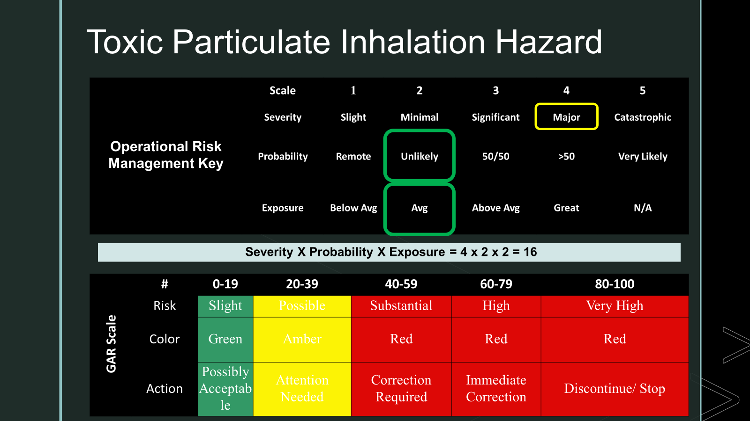
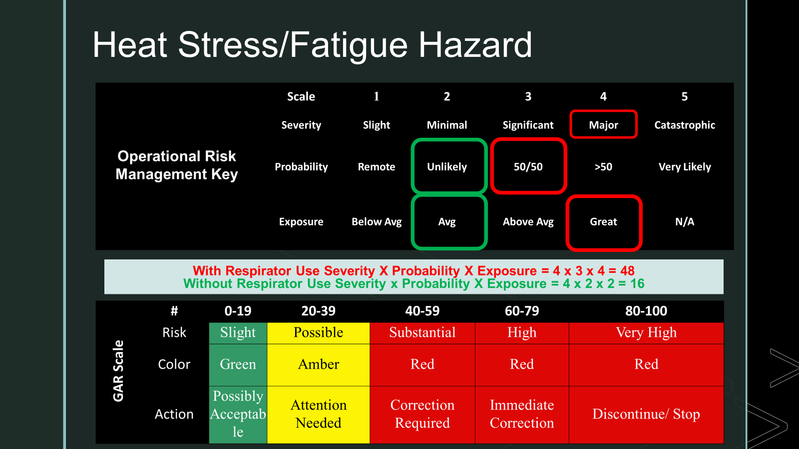
Wildfire Response Panel Discussion
Data Driven, Risk Based Hazard Controls

Slide 6
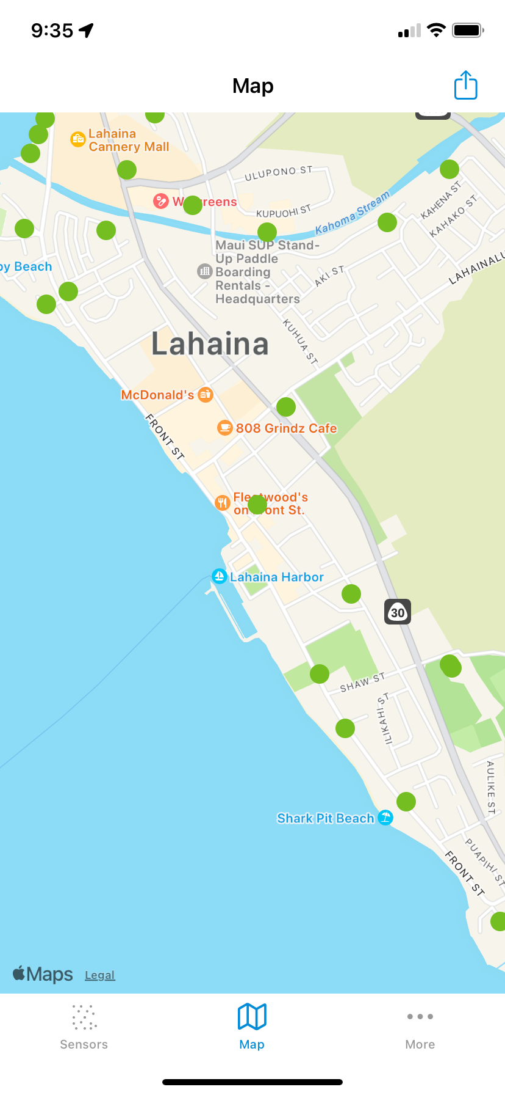
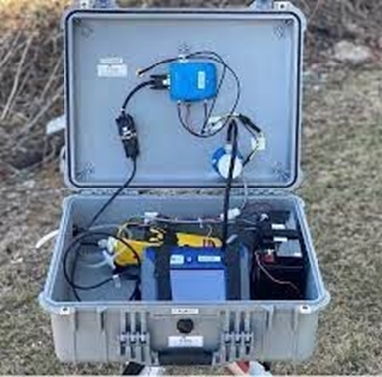
Wildfire Response Panel Discussion
Continue Monitoring
Real-time Particulate Monitoring (Dustrak)
Other Agency Monitoring

Slide 7
Wildfire Response Panel Discussion
Exposure Recordkeeping
Establishment of SEG’s
Provide all Responders with exposure data

Slide 8
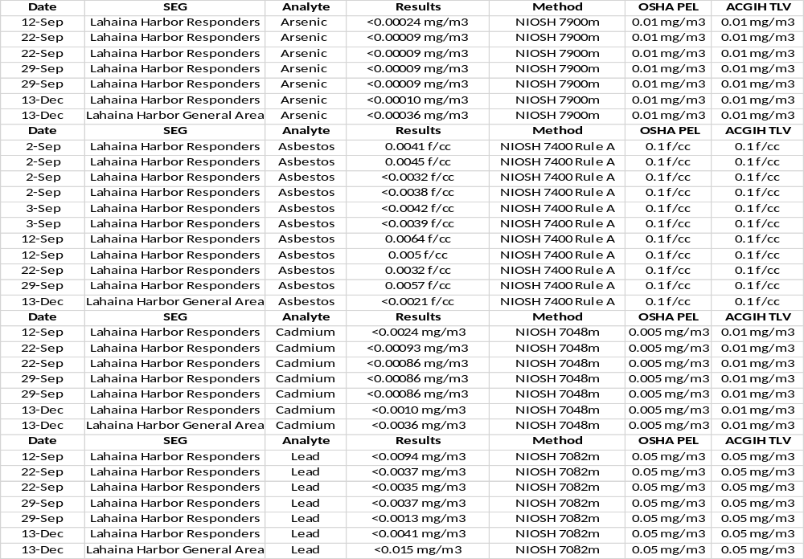
Wildfire Response Panel Discussion

Slide 9
Wildfire Response Panel Discussion
Questions?

