Slide 1

Quantifying Outdoor Heat Exposure: Findings from an Occupational Safety and Health Administration (OSHA) Data Collection Pilot, June-September 2022
Rebecca Jackson, Julie Kebisek, Andre Taylor, Bill White, and Michael Hodgson
Occupational Safety and Health Administration
Directorate of Technical Support and Emergency Management
March 14, 2024

Slide 2
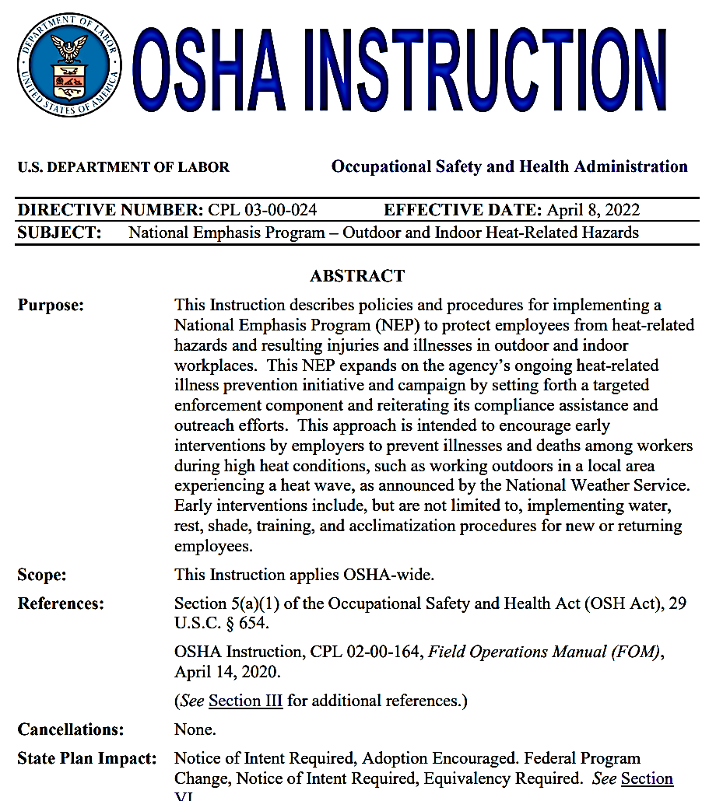
Data Collection Pilot Goals:
Identify key elements of employer heat illness prevention programs associated with inspections under the Heat NEP
Quantify workplace heat exposure using Kestrels and compare with the OSHA-NIOSH Heat Safety Tool application readings
Model ways of improving the Heat NEP in 2023
Notes:
In response to the recognized threat of heat-related illness facing workers, the Occupational Safety and Health Administration (OSHA) launched the Outdoor and Indoor Heat-Related Hazards National Emphasis Program (Heat NEP) on April 22, 2022. The Heat NEP created a nationwide enforcement and compliance assistance mechanism for OSHA to proactively inspect workplaces for heat-related hazards
Goal - To increase the likelihood of preventing heat-related illnesses and deaths

Slide 3
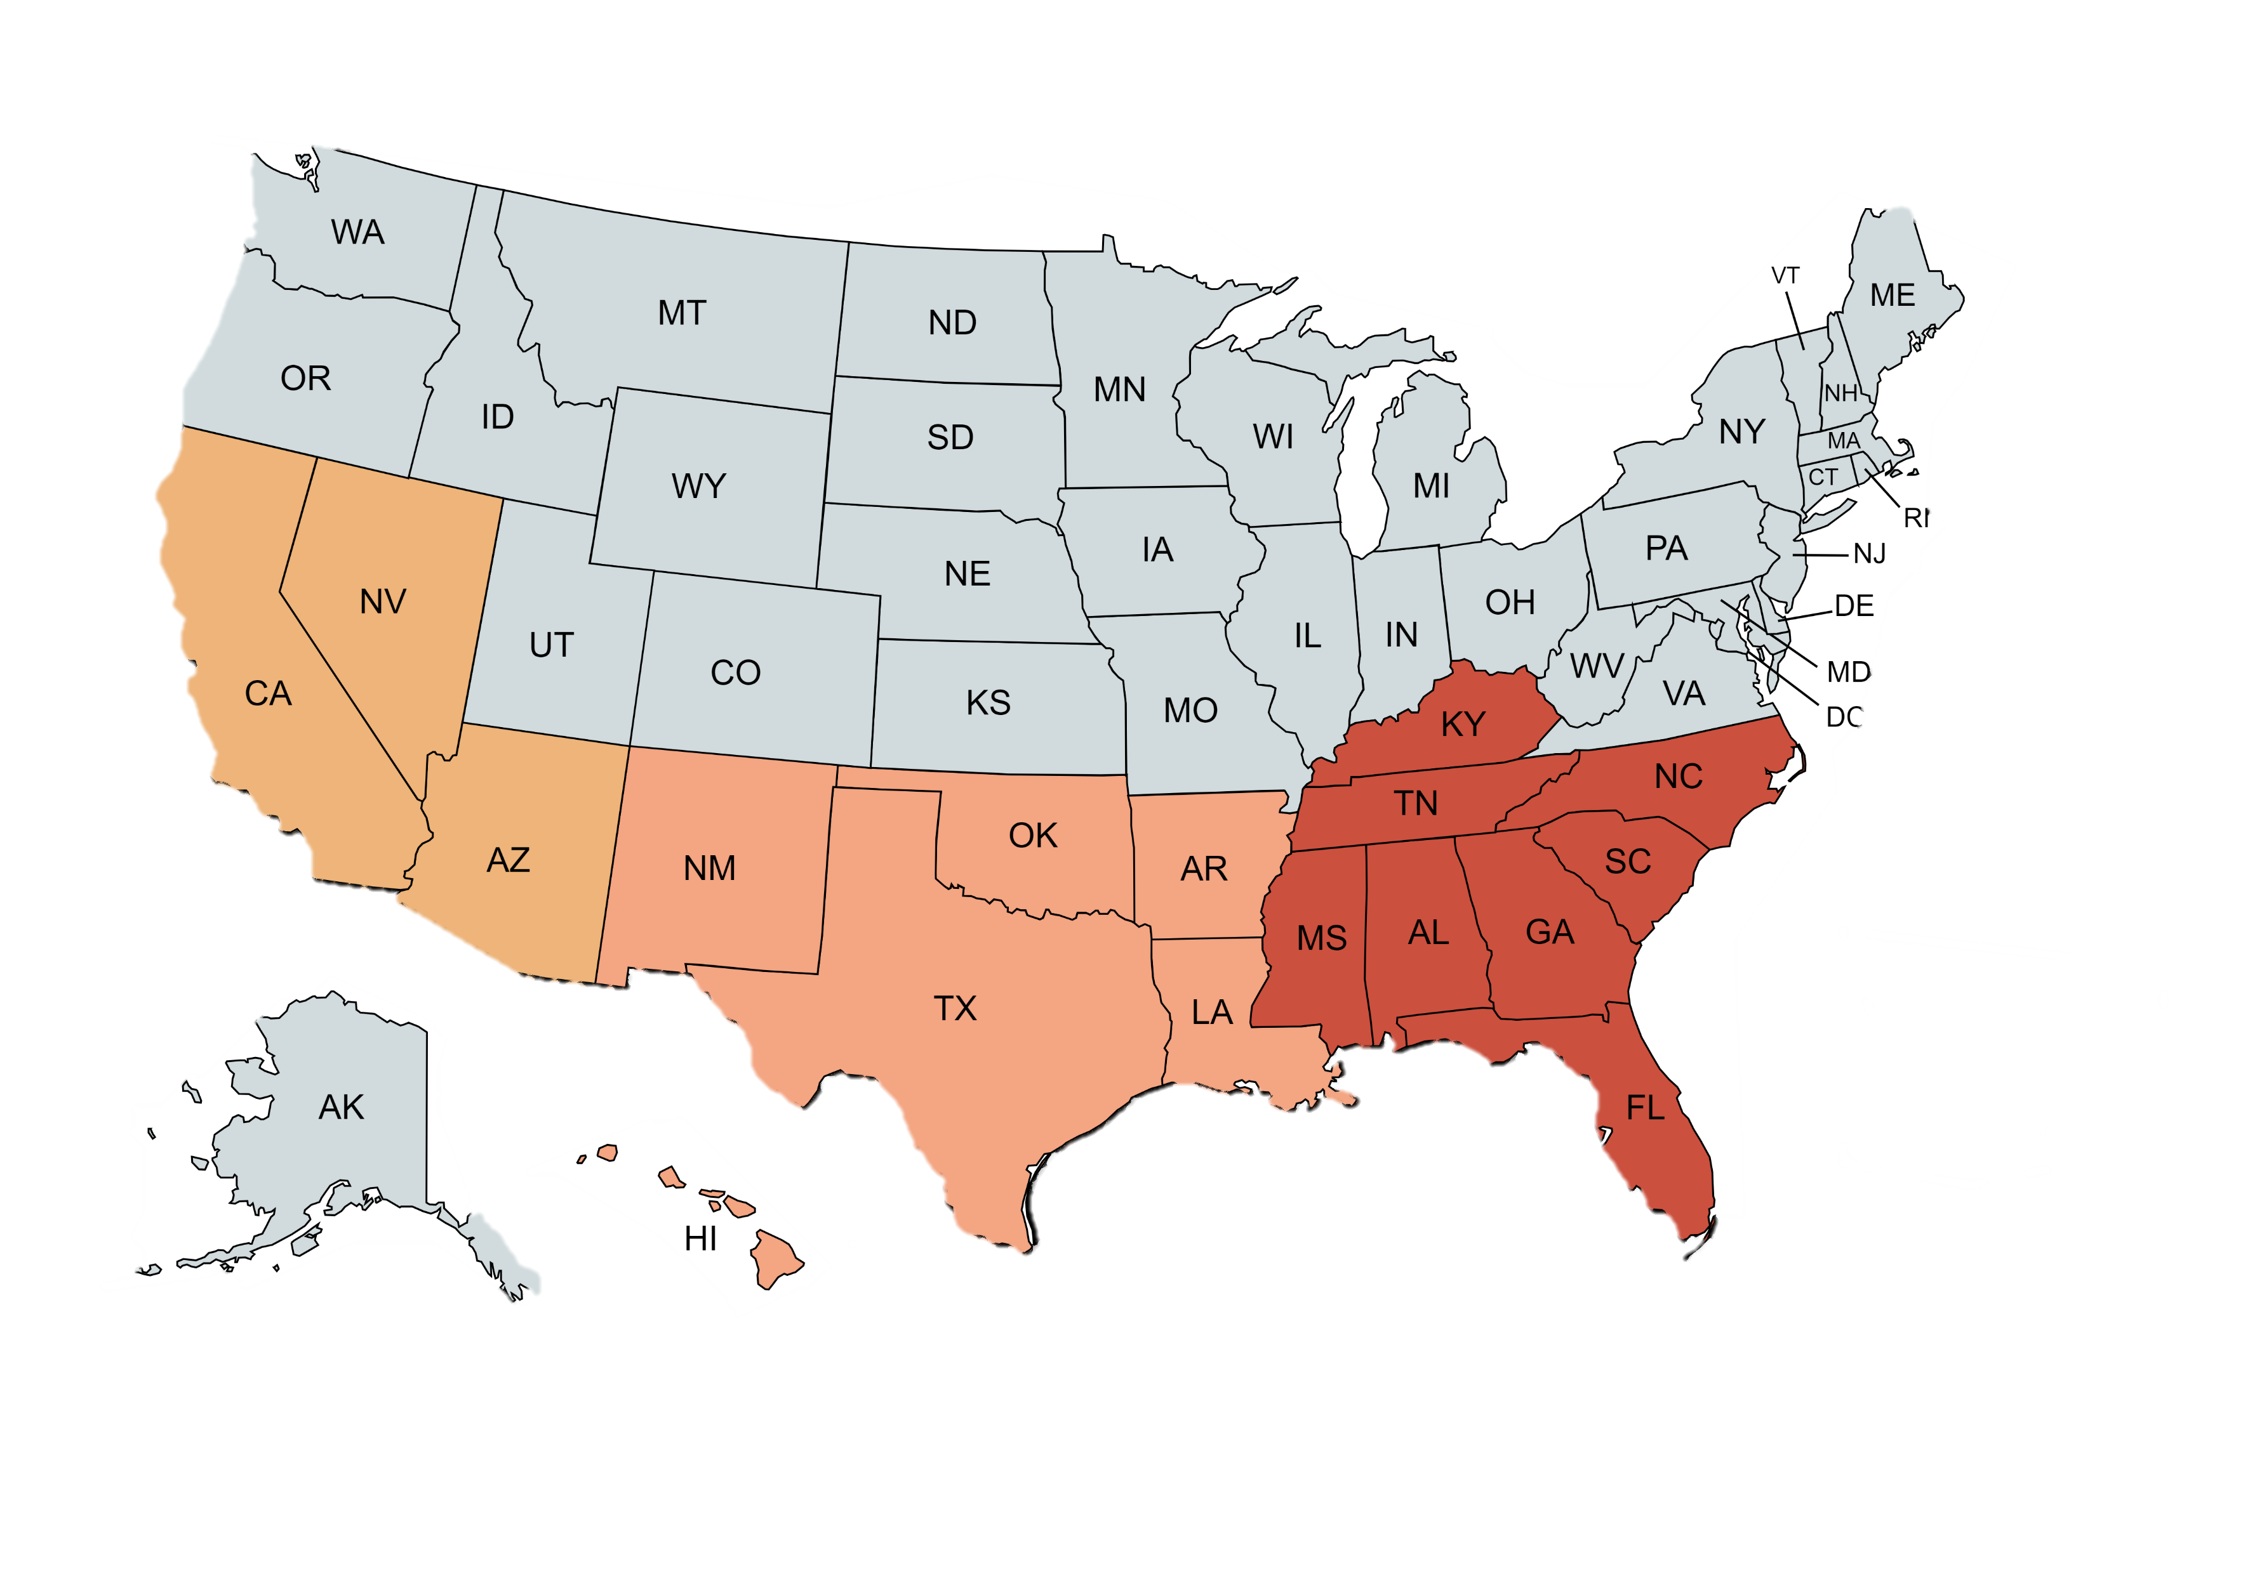
Participating Offices
Region 4
  Mobile
  Jacksonville
  Tampa
  Ft Lauderdale
Region 6
  Oklahoma City
  Houston South
Region 9
  Phoenix
  San Diego
  Las Vegas
  Honolulu
  Oakland
Notes:
OSHA has 10 regions, and each region is made up of several area offices regions 4 (southest – in red) all area offices in FL participated, 6 (south central – OK City and Houston S), and Region 9 –made up of state plan states so fed OSHA jurisdiction is limited. All Area offices participate
Voluntary participation – cannot change nature of work w/out bargaining
These offices had a wide geographic range, include Region 9 that has many state plan states, and includes offices that were interested in heat illness prevention as well as inspectors with less experience conducting heat investigations.

Slide 4
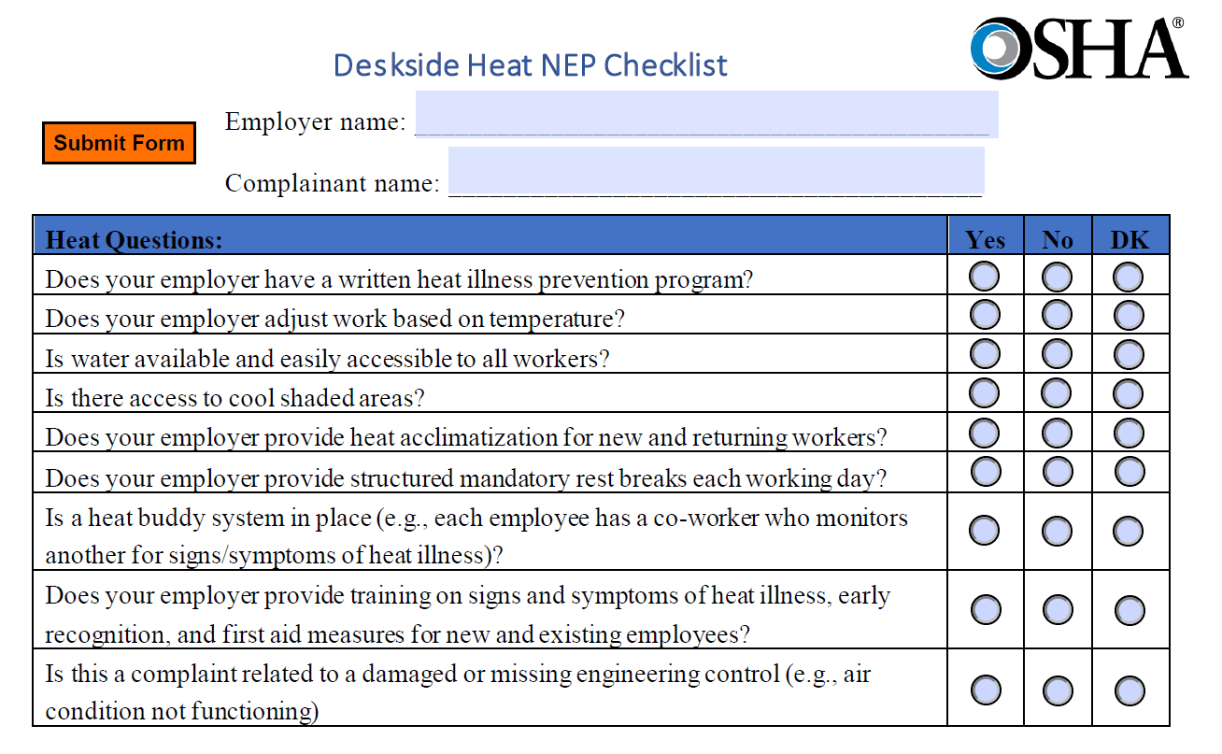
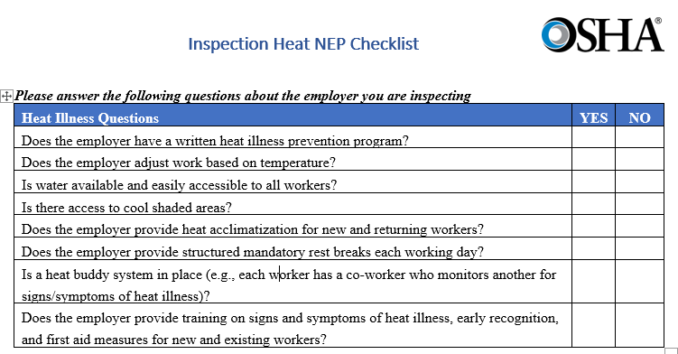
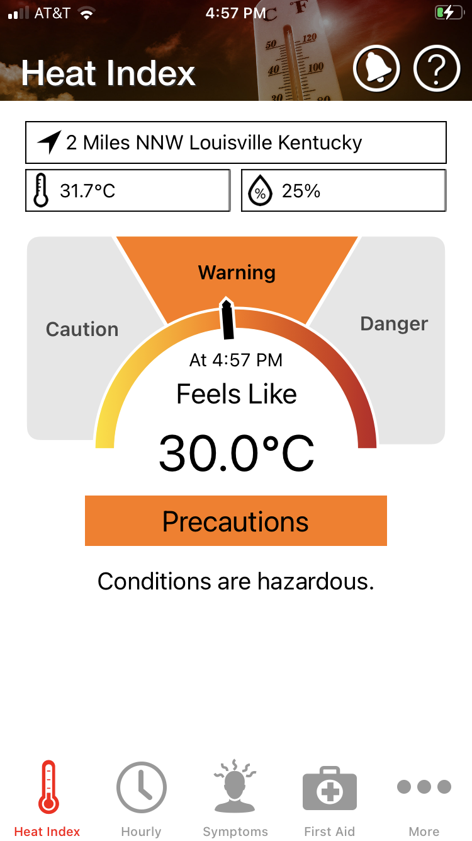
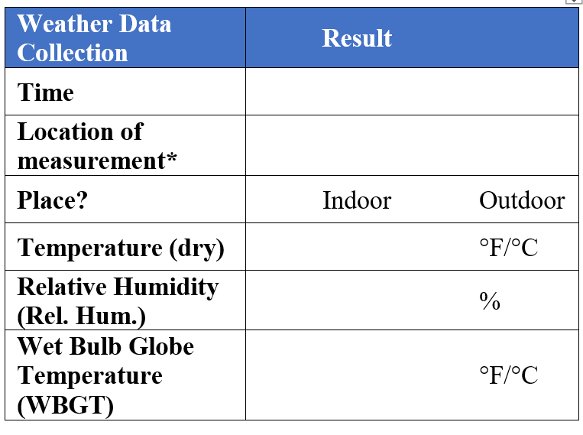
Two Pilot Arms
Desk Aid (Complaint)
Inspection (NEP)
Notes:
We recruited area offices to participate in two pilot arms – a desk aid for when complaints came in and an inspection form for during inspections.
Both pilot arms have 8 questions about employer heat illness prevention programs
The desk aid form also collected whether the call was regarding heat in an indoor, outdoor, or vehicular workplace; whether there were additional sources of heat at the job site; and if the complaint was related to a damaged or missing engineering control
Inspection form also has collection of temperature data three possible ways– heat index from osha/niosh heat safety app, whether heat alert/warning was in place, and place to record measurements taken with kestrel or quest, including wet bulb.
For both forms there are two ways of doing online data collection – Office Forms and Fillable PDF. Also option to send in.

Slide 5
Support Activities
Kickoff Calls
(April-May)
Collect data
(July-Nov)
Regional and Area Office Training (June)
Analyze and Disseminate Data
(Nov-Dec)
Notes:
To support participating CSHOs and Area Offices, DTSEM offered Weekly Office Hours with OOMN and OSTA (WOHOO) meetings throughout the pilot process. During these meetings heat pilot staff provided additional information about heat and the pilot, answered questions, and gathered qualitative feedback from participants. The 10 WOHOO meetings ranged from 10 to 50 attendees. Specifically, we provided updates on data collection at each meeting, conducted training on recreating temperature, and discussed heat enforcement cases. Allowed for qualitative data capture in addition to quantitative
Have you completed any forms this week? If so, what went well, what could be improved?
What (if anything) would you change in the forms before adding them into OIS?
Have you captured temperature data? Using which device(s)?
We ask for the heat index using the OSHA-NIOSH heat safety tool app. Did you find the app easy to use? Did the reading make sense?
Do you have any questions about capturing temperature data with the Kestrels? Have you noticed anything unexpected?

Slide 6
Pilot Forms Received
July-September 2022
Region | Desk Aid (Complaint) | Inspection (NEP)
Region 4 | 10 (33%) | 29 (66%)
Region 6 | 17 (57%) | 8 (18%)
Region 9 | 3 (10%) | 7 (16%)
Total | 30 | 44
Notes:
There were 151 heat NEP inspections during the study period in these offices, so this represents a completion rate of 29%. High completion rate in Region 4 of 72%.

Slide 7

Location: Desk Aid and Inspection
(n=30) (n=41)
Notes:
Asked on all desk aids. Only asked when measurement was taken so lower n
Desk aid 63% indoors, 30% outdoors, 7% vehicle
Inspection 22% indoors and 78% outdoors

Slide 8
Complaints related to an engineering control: Desk Aid (n=30)
Notes:
About a third of complaints were related to a damaged, broken, or missing engineering control, like air conditioning.

Slide 9
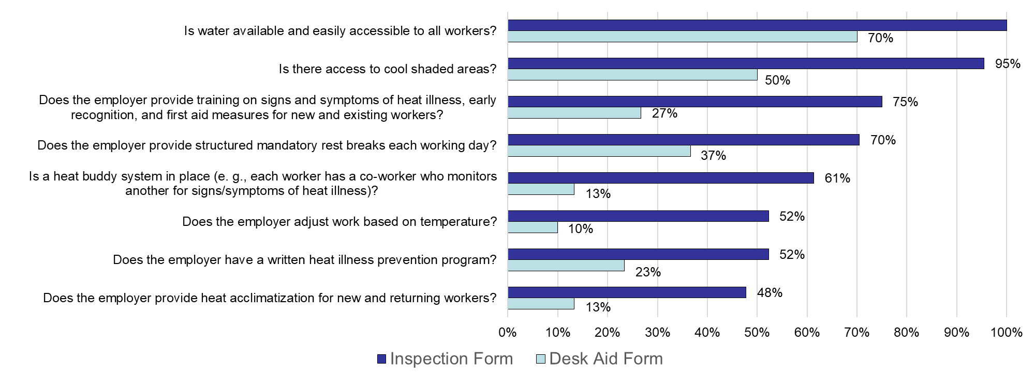
Employer Heat Illness Program Elements
July - September 2022
Notes:
These are the main findings of the survey – presence of a given employer heat illness program element at the workplace being inspecting (darker blue color on top in each pair of results), or from the desk aid form (lighter blue bars on bottom). These employer heat illness prevention program elements are ordered by percent of employers who had a given element during inspections, so the elements at the top include water, shade, and training had a higher percentage of employers providing the element, while the employer elements on the bottom, including adjusting work based on temp, a written heat illness prevention program, and acclimatization for new and returning workers were being implemented less frequently of employers. Likewise, you’ll note that for every employer program element, a higher percentage of CSHOs found the element during an inspection than was reported during calls. This is expected – we receive DO calls when something has gone wrong at a workplace, and so would expect these workplaces might have less robust heat illness prevention programs.

Slide 10
Inspection Heat Index
OSHA/NIOSH Heat App Reading | Total
Caution (60-79) | 4
Warning (80-94) | 12
Danger (≥95) | 13
Missing | 15
Total | 44
Most inspections were done on days when the Heat App reading was warning or danger
Notes:
Asked participating CSHOs to record temperature two ways – with OSHA NIOSH heat safety tool app and with a WBGT device (either kestrel or quest)
Heat index recoded 66% of the time
Most commonly reported temperature measurement
When it was recorded – majority of inspections were done on warning or danger
Unknown why it wasn’t recorded – limited our ability to make conclusions about app vs. measurement

Slide 11
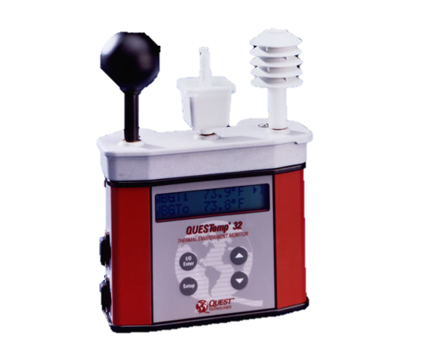
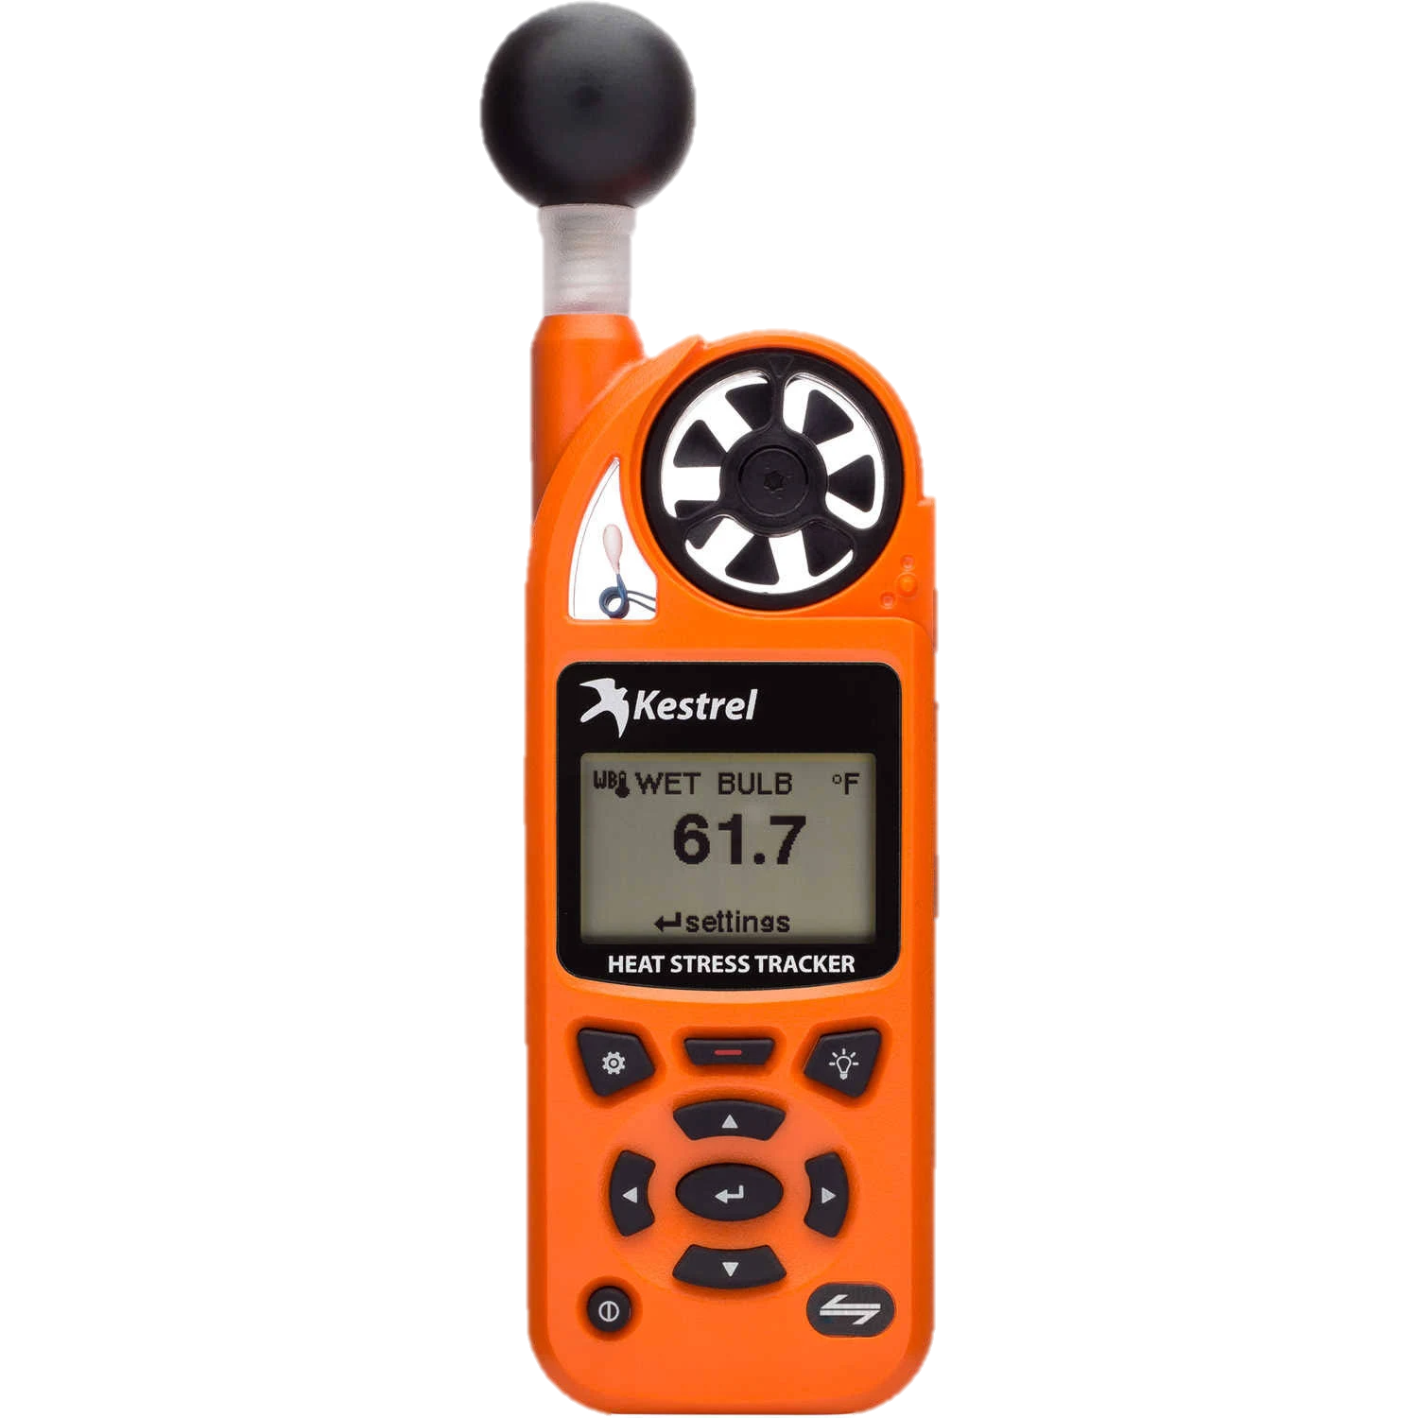
55% of inspection forms included measurement of environment heat (n=24)
42%
33%
25%
Notes:
Second source of inspection temperature measurement was from kestrels or quests – 55% included at least one
Did not receive the data in a way that is easy to analyze
Bandwidth to do duel measurements
10 QT only
6 Both
8 Kestrel only

Slide 12
Heat Index Category Comparison between Kestrel and OSHA/NIOSH Heat Safety App (n=21)
 | Kestrel/Quest Reading Average Heat Index 92 (Range: 74-106)
OSHA/NIOSH Heat App Reading Average Heat Index 91 (Range:70-102) | Caution | Warning | Danger
Caution (60-79) | 3 |  | 1
Warning (80-94) |  | 1 | 3
Danger (≥95) |  | 3 | 10
Notes:
This chart shows how often the environmental measurement and the heat safety tool agreed about the heat index
Agreement 15/21 = 71% - Simple Kappa Statistic of .49 (0.14-.84)
Eleven (n=11) obs did not have app calculation but did have kestrel/quest measurement.
Note that here when both were done used Kestrel as comparison.
Three reasons for discordant pairs
First – indoor inspections. Both times when app reading was higher than kestrel and one when kestrel was danger and app was warning. Discord 3/5 are indoor measurements. Concerning – Kestrel is not well validated up for indoor measurement.
Caution/Danger doesn’t make sense (App HI reading lower than daily min obs temp), One is 93 and 95, within what we would think could occur based on sun/radiant heat, or due to timing

Slide 13
Key Heat Pilot Takeaways
Successfully captured details about employer heat illness prevention programs during calls and inspections
Higher percentage of desk aid forms were responses to indoor heat than inspection forms
Many employers were providing rest, water, and shade, but were not adjusting work based on temperature or implementing acclimatization programs
Heat Safety App and Kestrel had general agreement about heat index in outdoor environments
Notes:
This pilot successfully captured the prevalence of heat illness prevention program elements during heat-related complaint calls and inspections. These elements are key parts of employer heat illness prevention programs, and their presence or absence is an important step in understanding how well workers are protected from heat. In followup to the pilot, these questions have been added to the OSHA information system and are available for all inspectors when completing a heat NEP.
In both - Many employers were not adjusting work based on temperature or implementing acclimatization programs
Program elements differed between desk aid and inspection form – programs, – training/structured breaks
Voluntary
No standardized data entry of temperature data
Limited temperature data was uploaded
Difficult to determine source of errors

Slide 14
Next Steps
Continue collection and analysis of employer heat illness prevention program data
Implemented Regional Heat Coordinators Calls and Coordinated Heat Intraoffice Listen and Learn (CHILL) office hours

Slide 15
Update
On April 1, 2023, eight questions about employer heat illness prevention programs were added to OIS for voluntary use during Heat NEP duty officer calls and Heat NEP programmed and unprogrammed inspections.
CSHOs answered at least one employer heat illness prevention program question during 85% of the Heat NEP inspections and answered all questions during 80% of Heat NEP inspections.
During duty officer calls, CSHOs answered at least one employer heat illness prevention program question 73% of the time and answered all questions 69% of the time.
Notes:
Data from October 4th – plan to update soon
FedOSHA and State Plan OSHA states conducted 2,664 Heat NEP inspections and 1,420 Heat NEP UPAs between April 1 – September 30, 2023.
CSHOs answered at least one employer heat illness prevention program question during 85% of the Heat NEP inspections and answered all questions during 80% of Heat NEP inspections.
During duty officer calls, CSHOs answered at least one employer heat illness prevention program question 73% of the time and answered all questions 70% of the time.

Slide 16
Location
Notes:
Respondents could check multiple locations, and 20% of inspections involved more than one location. Therefore these

Slide 17
Employer Heat Illness Prevention Program Elements
Notes:
Percentage who answered yes to question. Looked at – high percent of people inputting data. PPL who took time to answer questions in OIS are helping us more clearly see what’s going on in the workplaces you are visiting. Can see these questions put in for a Heat NEP and see people answer them. Interested in using these data to inform Note – percentages when known (exclude missing and DK)

Slide 18
Conclusion
OSHA uses data as a strategic asset to inform heat illness prevention work including enforcement, rulemaking, and compliance assistance
During Heat NEP inspections, employers commonly provided water and shade. Employers less commonly utilized a buddy system, acclimatization, training, and a written heat illness prevention plan were less common.
Employer heat illness prevention program questions will remain in OIS for 2024 heat season.

Slide 19
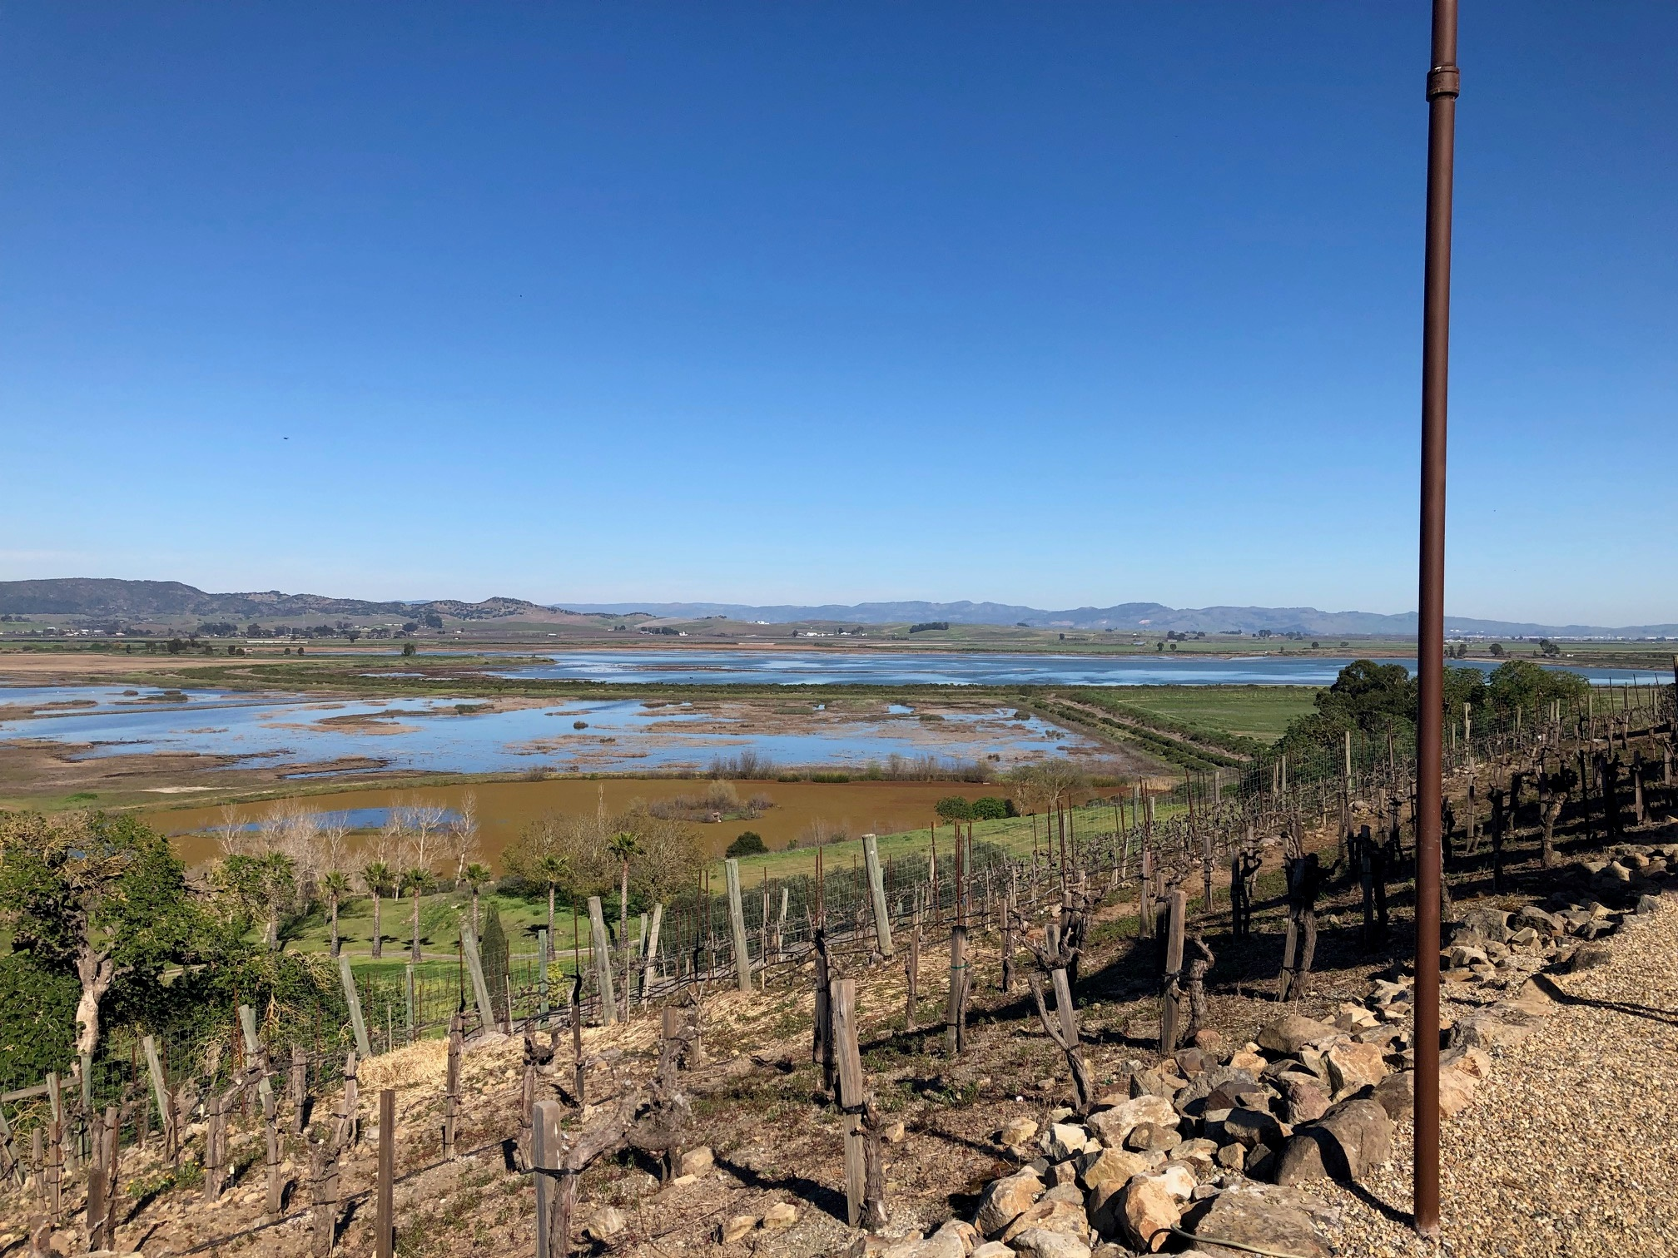
Contact Information
Beki Jackson
Jackson.Rebecca.A@dol.gov
Directorate of Technical Support and Emergency Management
Occupational Safety and Health Administration

Slide 20
Extra Slides

Slide 21
Inspection Form Completion Rate by Area Office
Area Office | Pilot Forms Received | NEP Inspections (OIS)* | Completion Rate
Mobile | 8 | 13 | 62%
Jacksonville | 20 | 26 | 77%
Tampa | 1 | 15 | 7%
Houston South | 3 | 13 | 23%
Oklahoma City | 5 | 23 | 22%
Las Vegas | 1 | 9 | 11%
San Diego | 3 | 23 | 13%
Phoenix | 0 | 29 | 0%
Total | 44 | 151 | 29%
Notes:
*Total NEP inspections done during pilot July 1 – Sept 30, preliminary, numbers, might change
+Region 9 submitted forms from non-participating Aos
UPAS are a bit harder to track but
17%
68%
60%
34%

Slide 22
Discordant Pairs
OSHA/NIOSH Heat App Reading | Kestrel/Quest Reading | Number of Pairs | Observation
Danger (≥95) | Warning | 2 | Indoor inspections (n=2)
Caution (60-79) | Danger | 1 | Possible technology challenge (n=1)
Warning (80-94) | Danger | 3 | Possible technology challenge (n=1) Indoor inspection (n=1) Possible timing / category boundary (n=1)
Notes:
Three reasons for discordant pairs
First – indoor inspections. Both times when app reading was higher than kestrel and one when kestrel was danger and app was warning. Discord 3/5 are indoor measurements. Concerning – Kestrel is not well validated up for indoor measurement.
Caution/Danger doesn’t make sense (App HI reading lower than daily min obs temp), One is 93 and 95, within what we would think could occur based on sun/radiant heat, or due to timing

