Slide 1
MISSION ASSIGNMENT
PROCESS
OVERVIEW
Arnie Gonzalez
Mission Assignment Program
FEMA HQ, Response Directorate
Operations Division

Slide 2
What is a Mission Assignment?
A Mission Assignment is a work order issued to a Federal agency by FEMA, directing completion by that agency of a specified task and setting forth funding, other managerial controls, and guidance
Broad in scope
Quickly save lives, protect
property
Not acquisition based
Single approach for federal agency coordination
Short term, temporary
Notes:
FUN FACT – Since 2005, FEMA has issued over 30 mission assignments to OSHA to provide personnel for various OSHA related needs. Like support and assistance to provide specialized safety and health expertise and technical assistance for Worker Safety and Health.
What is an MA:
Presidential Directive
Authorized by National Response Framework, Robert T. Stafford Act, 44 CFR
Unique – Response Mechanism – directive vs. award - No acceptance
ORR Leads – not OCPO
With or without reimbursement
Created for Response – ESF lead by agency experts, broad, quick, effective
Still follows Treasury Requirements in way of Billing and Reporting

Slide 3
Organization
Mission Assignment Program organizationally falls under the Operations Division, Response Directorate at HQ, under Operation Integration Branch, Regionally and under Operations in the JFO

Slide 4
Authority
The Robert T. Stafford Disaster Relief and Emergency Assistance Act {Stafford Act) authorizes the President to "direct any Federal agency, with or without reimbursement, to utilize its authorities and the resources granted to it under Federal law" in support of Federal, state, tribal, and territorial {STT} government response efforts for emergencies (42 U.S.C. § 5192[a}[l}} and major disasters (42 U.S.C. § 5170a{l)).
This tasking authority, delegated to the FEMA Administrator through the Secretary of the Department of Homeland Security, is carried out through a Mission Assignment {MA}.
Notes:
In response to a declaration of an emergency or major disaster, Regional Administrators may further delegate this authority in writing to others including Federal Coordinating Officers (FCOs) and Federal Disaster Recovery Coordinators (FDRCs). FEMA is the only agency that has the president authority to task other Fed agencies

Slide 5
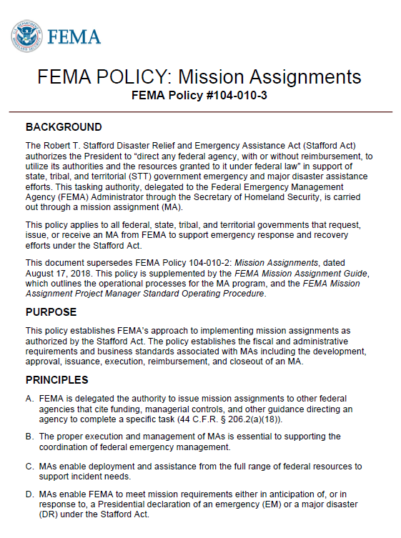
Mission Assignment Policy
Describes how FEMA implements the Mission Assignment (MA) program as authorized by the Robert T. Stafford Disaster Relief and Emergency Assistance Act (Stafford Act)
Describes the categories of MAs
Outlines policy related to the fiscal/administrative requirements and business standards associated with the MA program
Notes:
In addition to the Authorities previously mentioned, there is also the FEMA MA Policy which deciphers the Stafford Act and 44CFR and sets internal processes and limitations. The MA Policy also incorporates other supporting doctrine such as FEMA Directives and CFO Bulletins.

Slide 6
A Mission Assignment Is NOT. . .
Interagency Agreement
  Used by any agency under the Economy Act
Memorandum of Understanding/Agreement
  Non-binding agreement on
  responsibilities and procedures
  No funding involved
Contract
Grant
Notes:
What is an IAA:
Acquisition Based
OCPO=CO/COR Lead
Acceptance Required
Lengthy Review (all parties)
Very Specific Provisions
Best if Used during Recovery vs. Response (time to finalize and award)
Vulnerable during Response – life saving/life sustaining requires timely directive
What is an MA:
Presidential Directive
Authorized by National Response Framework, Robert T. Stafford Act, 44 CFR
Unique – Response Mechanism – directive vs. award - No acceptance
ORR Leads – not OCPO
With or without reimbursement
Created for Response – ESF lead by agency experts, broad, quick, effective
Still follows Treasury Requirements in way of Billing and Reporting

Slide 7

Categories of Mission Assignments
Federal Operations Support (FOS)
Direct Federal Assistance (DFA)

Slide 8
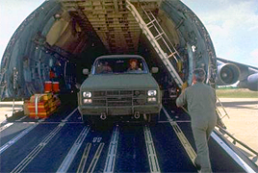
Categories of Mission Assignments
Federal Operations Support (FOS):
  For any type of support to Federal responders
  Requested by the Federal government
  100% federally funded
  Pre-staging teams and commodities
  Eligible before or after declaration
  Term FOS only found in FEMA policies
EXAMPLE: Mission Assignment
to transport DHS/FEMA assets
to X Location

Slide 9

Categories of Mission Assignments
Direct Federal Assistance (DFA)
  For goods and services beyond the
  State’s capability to provide
  Requested by the State
  Subject to State cost share
  Eligible after declaration
  EXAMPLE: Mission Assignment
  to U.S. Army Corp of Engineers
  to perform debris removal

Slide 10
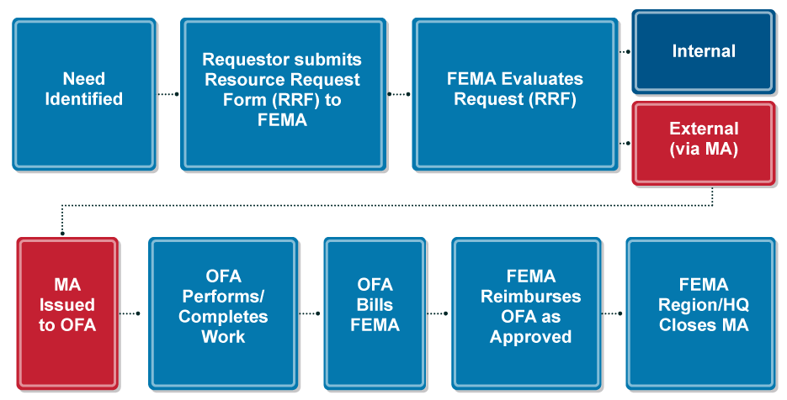
Request to MA Process Flowchart

Slide 11

Where Can Mission Assignments
Be Issued?
National Response
Coordination Center (NRCC)
Regional Response
Coordination Center (RRCC)
Joint Field Office (JFO)

Slide 12
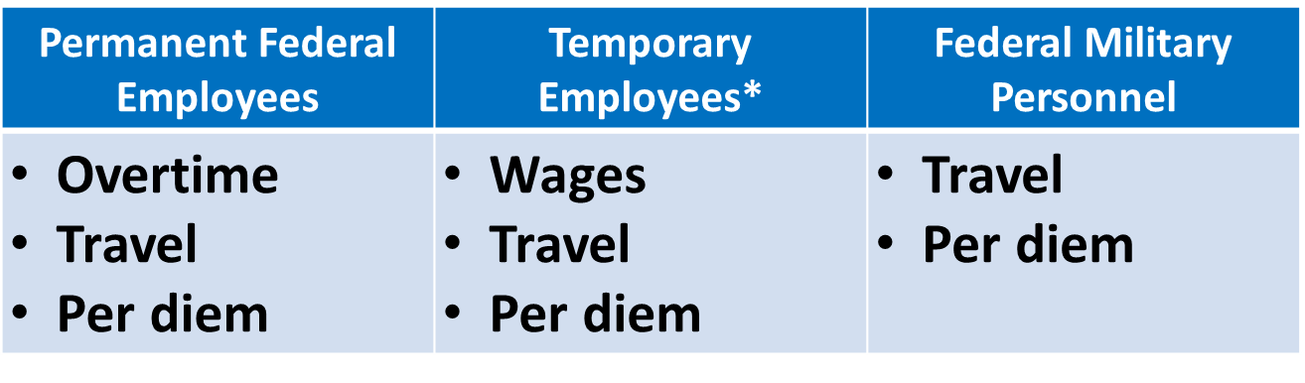
What Are Eligible Costs?
*Temporary employees performing work solely in support of the MA
Notes:
Appropriated salary only

Slide 13
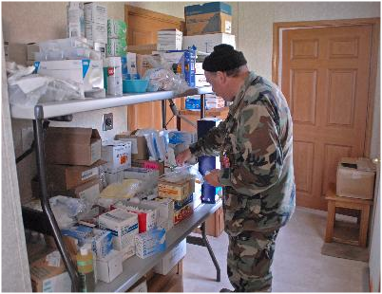
Other Eligible Costs
Cost of contracts to provide work, services,
and materials
Cost of materials, equipment, and supplies
from regular stocks
Costs paid from trust
and revolving funds
Other justified and
approved costs
Notes:
All eligible costs must have FEMA approval prior to reimbursement

Slide 14
Questions
Email:
FEMA-MissionAssignments@fema.dhs.gov

