Slide 1
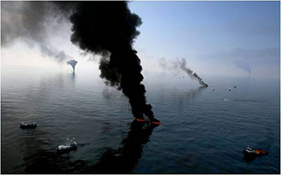

In-Situ-Burn Safety
Considerations for Responders and the Public
NOAA, Office of Response & Restoration
Savannah Turner, Safety Officer
March 13, 2024
response.restoration.noaa.gov

Slide 2
Disclosure
The information presented reflects only the views of the presenter, and does not necessarily reflect the official positions or policies of NOAA or the Department of Commerce.

Slide 3
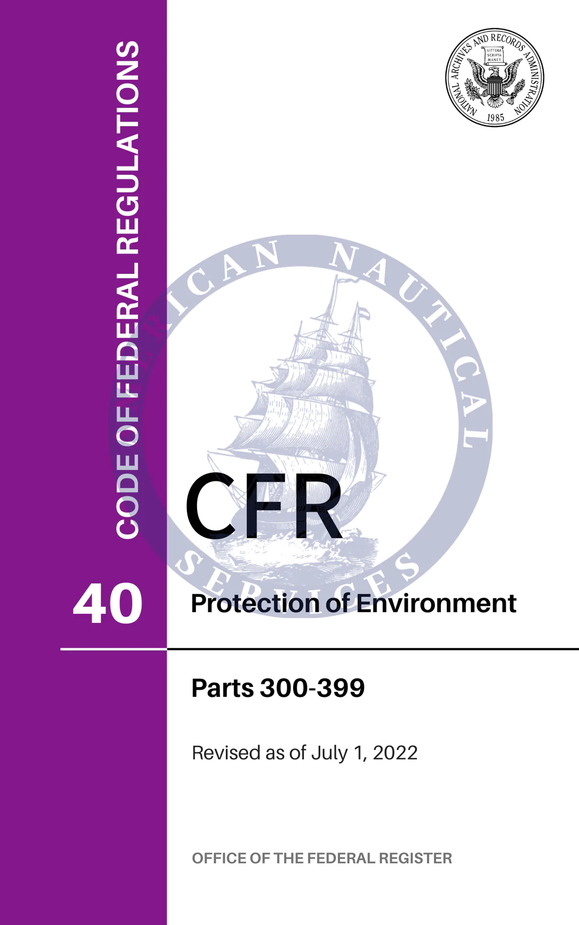
300.317 National Response Priorities
Safety of human life must be given the top priority during every response action.
Stabilizing the situation...
… minimizes adverse impact to the environment.
All parts of this national response strategy should be addressed concurrently, but safety and stabilization are the highest priorities.

Slide 4
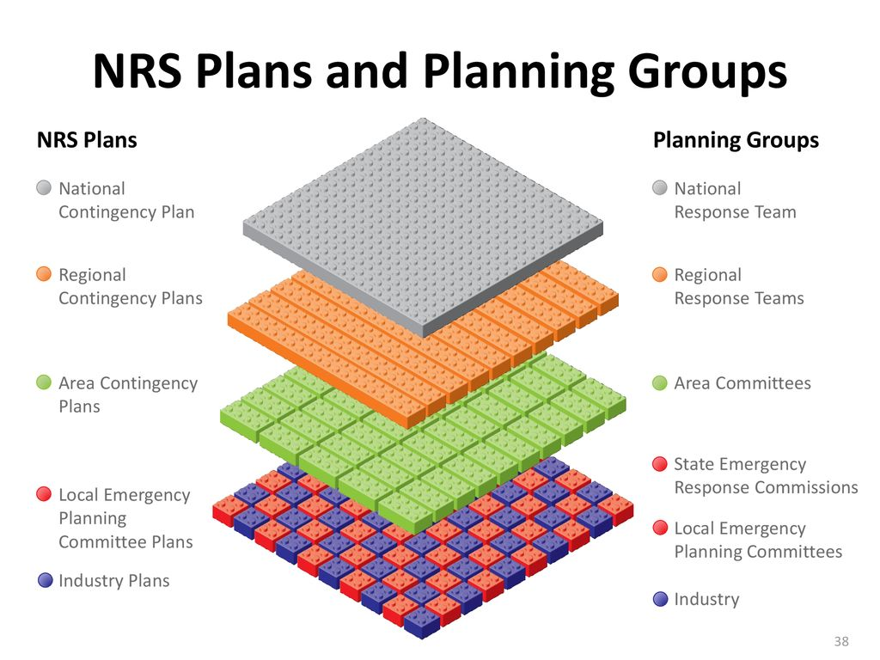
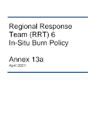
Oil Spill Response Tactics
Signatory agencies “agree that the primary method of controlling discharged oil shall be the physical removal of the oil from the environment”
Specific checklists for operational considerations and decision-making associated with initiating an ISB have been developed by a number of RRTs.

Slide 5
In-Situ-Burning or ISB
ISB involves the controlled burning of spilled oil, at the location of the spill, in a monitored and supervised manner.
ISB of oil can offer a logistically simple, rapid, inexpensive, and relatively safe means for reducing the net environmental impact of an oil spill
In situ burning was employed extensively during the Deepwater Horizon/BP oil spill in 2010. (U.S. Coast Guard)

Slide 6
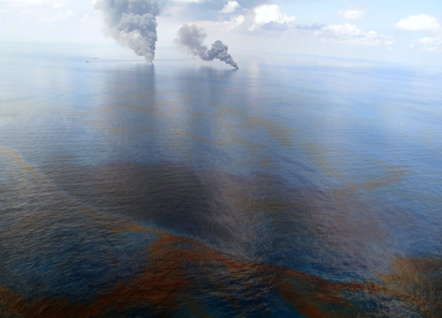
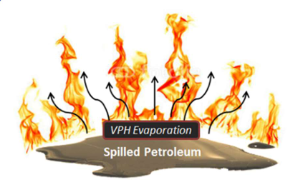
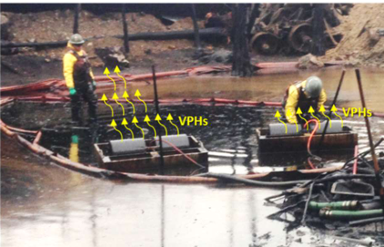
Tradeoffs
Mechanical and Natural
Hazard: Airborne emissions that response workers and the public may come in contact with.
Evaporation of volatile petroleum hydrocarbons (VPHs) is the primary inhalation hazard of concern.
In-Situ Burning of oil
Particulate matter and polycyclic aromatic hydrocarbons (probable human carcinogens), are primary inhalation hazards of concern.
Combustion gases such as carbon monoxide, carbon dioxide and potential sulfur and nitrogen containing oxides can also be produced by burning petroleum, but are of less concern for potential inhalation exposures.
Smoke is visible from controlled burns of the oil released during the Deepwater Horizon oil spill in 2010. This oil well blowout was the largest oil spill in U.S. waters. (NOAA)

Slide 7
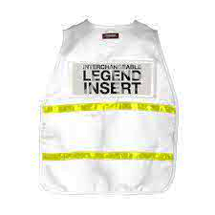
ISB Operations:
Safety
Do weather and environmental conditions indicate low risk of populated areas being exposed to smoke?
Are equipment and trained px available to monitor on-site and in populated areas?
Address
hazards separate from general response ops (risk assessment, controls, comms, coordinate w/ ISB Burn Plan development)
ISB Supplement to the Health and Safety Plan
(ICS-208)
SAFETY OFFICER
ISB SAFETY OFFICER

Slide 8
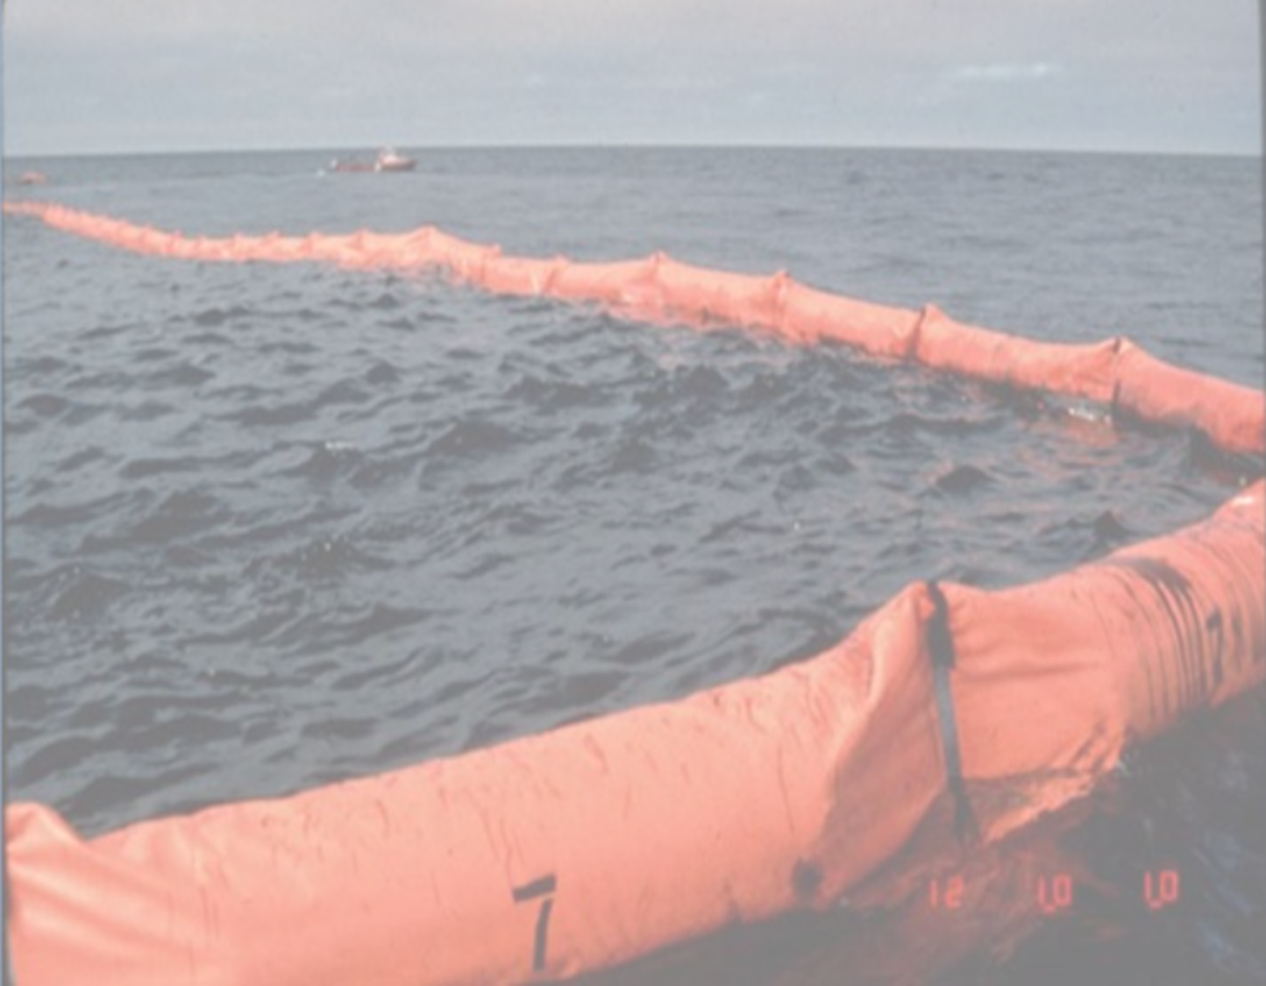
Working Safety Knowledge for ISB
Identify In-Situ Burn (ISB) hazards
Equipment capabilities, quantities and safe operating parameters
Medical emergencies / First Aid
Airborne hazards monitoring
Necessary communication
Spill control agent usage?
Protective actions
Worker exposure
Fire suppression
Exposure limits
Oil behavior
Timeline
Ignition
PPE
response.restoration.noaa.gov
Notes:
ID ISB hazards
ID exposure limits (oil constituents, combustion byproducts)
Behavior of oil in operating environment
Equipment capabilities, quantities and safe operating parameters
Timeline for ISB operations
Protective actions
Spill control agent usage (if used)
PPE
Ignition
Fire suppression during ISB
Medical emergencies / First Aid
Airborne hazards monitoring
Worker exposure
Necessary communication

Slide 9
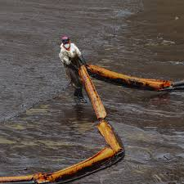
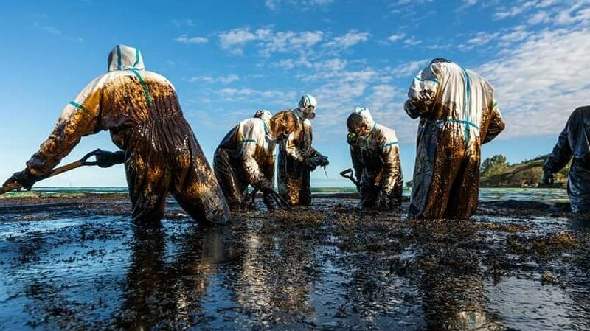
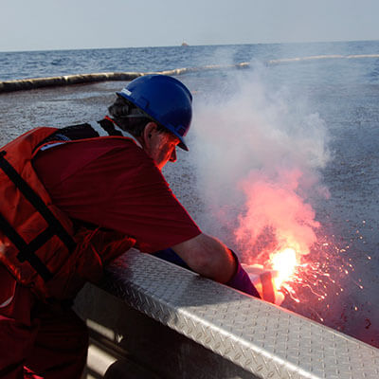
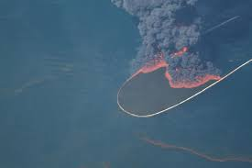
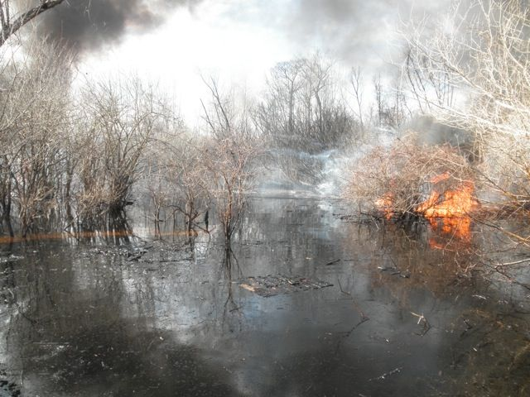
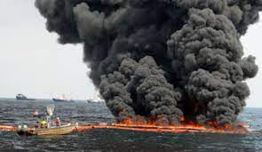
ID Hazards:
Responders
Local volunteers assist with the clean-up from the Wakashio oil spill in Mauritius (Photo: Fawzee Mohamad Barkhut)
Spilled oil - flammability (fire and explosion), toxicity (acute inhalation hazards) and direct contact response activities;
Response activities – vessel and vehicle operation, unique ISB tasks (i.e. use of additives, igniter operations, fire control) as well as residue cleanup and decontamination;
Safe Start Igniter, Elastec, Gulf of Mexico July 10, 2010. credit: USCG
Controlled burn of an oil spill in a LA swamp (Jan 2013 - Bayou Sorrel, LA credit: U.S.C.G.)
Working environment - heat from ISB fire and combustion by-products, particularly smoke particulates;
Inadequate site controls - improper delineation of the burn area and failure to establish “fire-free” zones and traffic control measures.
Alan. A.
Allen, Spilltec

Slide 10
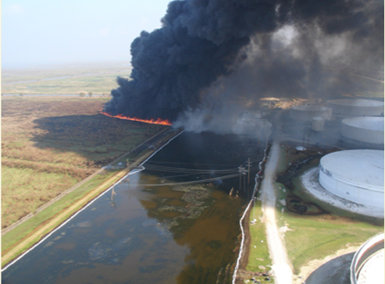
ID Hazards:
The Public
Due to its visibility and size, the smoke plume is often the factor of largest concern for the public.
An oiled marsh being burned after Hurricane Katrina (image credit: NOAA 2005)
Only agent of concern past 1 or 2 miles downwind - Fine PM can be transported from the combustion source, due to wind and environmental stability, and are light enough to stay airborne for longer periods.
Fine carbon particulate matter (PM2.5) represents greatest hazard as they are small enough to be inhaled deeply into the lungs.
Of note, airborne particulate matter is often present as a component of background in many locations.

Slide 11
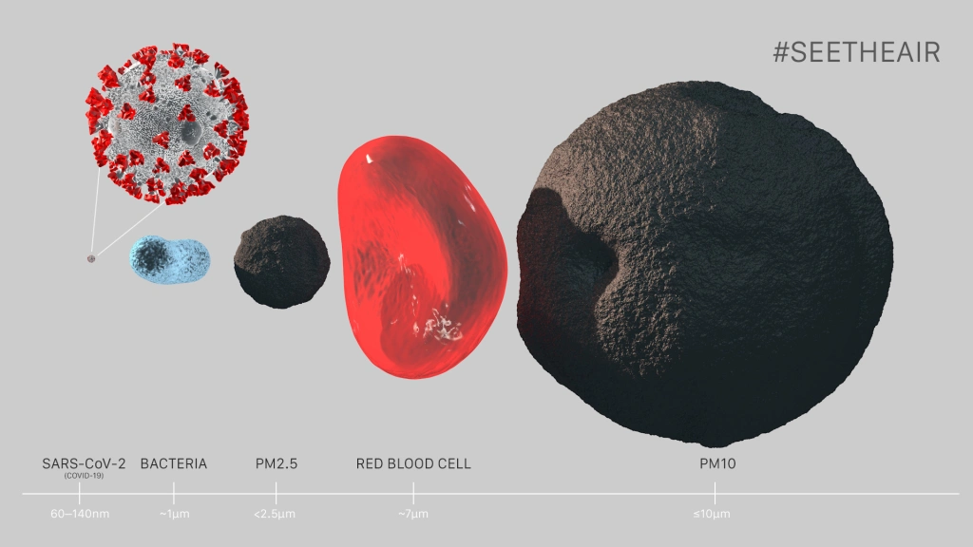

Slide 12
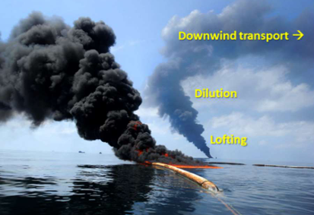

Controls: Smoke Plume
Past spill responses, and academic research, have provided much needed data in the areas of response worker safety issues, response worker and community exposure potentials, smoke plume modeling and air monitoring as it relates to ISB.
Short lived (minutes to hours)
Smoke plumes rise and expand rapidly, so concentrations of gases and particulates are highest near the source at ground level and dissipate with distance.
Safety measures and air quality monitoring are generally required as a condition of regulatory approval for ISB to ensure the protection of public health and the on-going safety of its use.
Smoke is visible from controlled burns of the oil released during the Deepwater Horizon oil spill in 2010. This oil well blowout was the largest oil spill in U.S. waters. (NOAA)

Slide 13
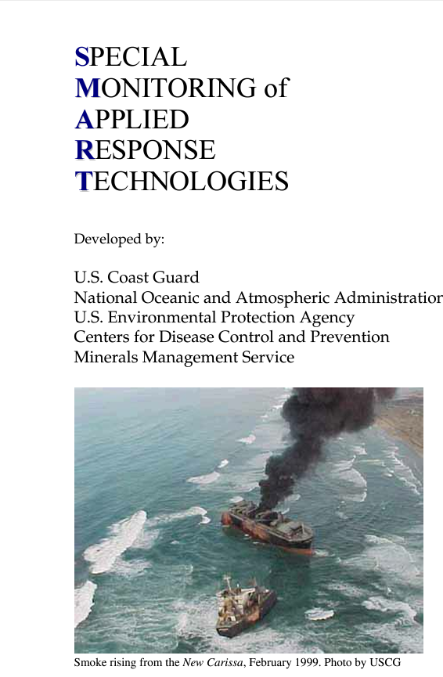
SMART Protocols have been updated for ISB and Dispersants - decided to separate
ISB was updated to address PM2.5 (previous version used PM10)
SMART Protocols designed to support operational decisions, not larger scientific or human health / environmental concerns
NRT review process
Notes:
In the U.S., the Special Monitoring of Applied Response Technologies (SMART) describes protocols for an offshore burn. These protocols include monitoring and evaluating response effectiveness as well as establishing a rapid collection and reporting of real-time data to decision-makers.

Slide 14

Control:
Monitoring
Continual Visual
Sufficient if burn conditions and smoke trajectory are well understood and no public health impact (remote location)
Air monitoring capable of detecting emissions of concern
Surface area of burning oil
Duration of burn
Atmospheric conditions during burn
NOAA worked with the Coast Guard and others to employ in situ burns during the 2010 Deepwater Horizon/BP oil spill in the Gulf of Mexico. (U.S. Coast Guard)

Slide 15
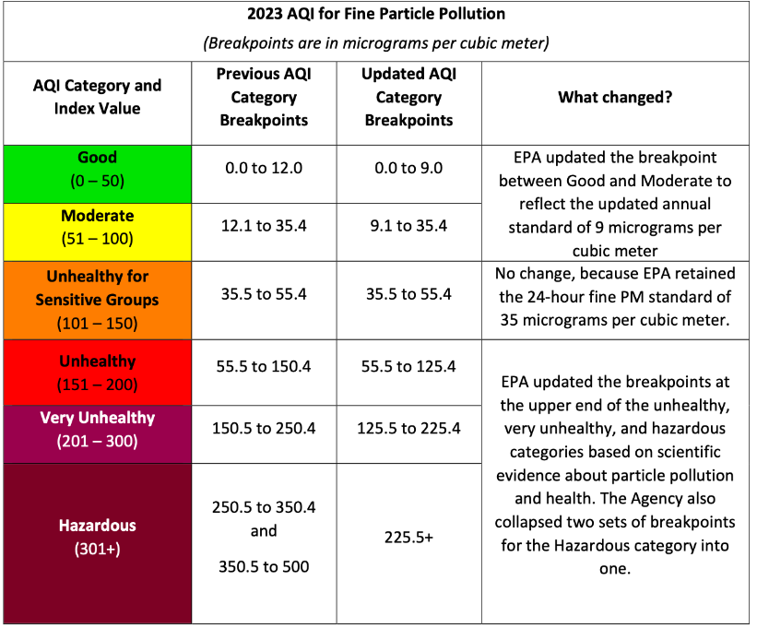
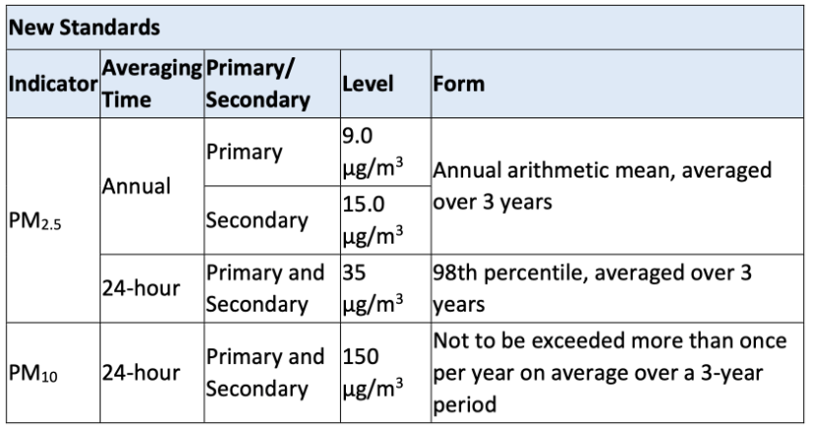
Levels of Concern (LOC) for Particulate Emissions
This table is commonly referred to for guidance on impacts to public health from particulate emissions from wildfires. Rather than establishing set thresholds, this guidance allows users to understand the potential severity of human health impacts and corresponding recommended actions over a range of particulate concentrations and may be well suited to similar use for ISB operations.
Feb 7, 2024: US EPA Finalizes New ANNUAL Standard for Harmful Particulate Matter (PM2.5)
New rule strengthens air quality standards by lowering the allowable level of fine particulate matter from 12 to 9 μg/m³ of air.

Slide 16
Levels of Concern (LOC) for Particulate Emissions
PM_{2.5} Threshold Levels (µg/m³) |  | Level of Health Concern | Meaning | Action
1 Hr. Avg. | 24 Hr. Avg.
Community Action Levels
0.0 – 40.0 | 0.0 – 12.0 | Good | Air quality is considered satisfactory, and air pollution poses little or no risk. | Implement communication plan.
40.1 – 80.0 | 12.1 – 35.4 | Moderate | Air quality is acceptable; however, for some pollutants there may be a moderate health concern for a very small number of people who are unusually sensitive to air pollution. | Issue public announcement about health effects. Stay out of areas with visible smoke.
80.1 – 175.0 | 35.5 – 55.4 | Unhealthy for Sensitive Groups | Members of sensitive groups may experience health effects. The general public is not likely to be affected. | Recommend evacuation or shelter-in-place for Sensitive populations.
175.1 – 300.0 | 55.5 - 150.4 | Unhealthy | Everyone may begin to experience health effects; members of sensitive groups may experience more serious health effects. | Consider closing schools and cancelling outdoor events. Recommend shelter-in-place for affected neighborhoods.
300.1 - 500.0 | 150.5 - 250.4 | Very Unhealthy | Health warnings of emergency conditions. The entire population is more likely to be affected. | Consider closing schools and cancel all outdoor events. Recommend shelter-in-place and/ or evacuation for affected neighborhoods.
> 500.0 | > 250.5 | Hazardous | Health alert: everyone may experience more serious health effects. | Recommend closing schools & cancel outdoor events. Recommend closing workplaces and neighborhood.
AirNOW Community Action Levels and Actions
  Derived from EPA 454/B-18-007 Technical Assistance Document for the Reporting of Daily Air Quality – the Air Quality Index (AQI)].
CDC ATSDR has recommended thresholds for particulate monitoring during emergencies based on the World Health Org. Air Quality Guideline:
  25 ug/m³ for PM_{2.5} and,
  50 ug/m³ for PM₁₀ based on one-hour TWA.
Notes:
ions

Slide 17
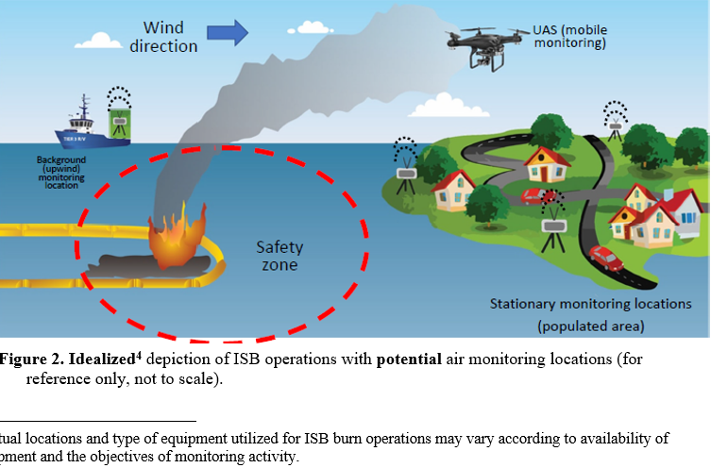
Idealized depiction of ISB operations with potential air monitoring location (for reference only, not to scale)
Actual locations and type of equipment used for ISB burn operations may vary according to availability of equipment and the objectives of the monitoring activity.

Slide 18
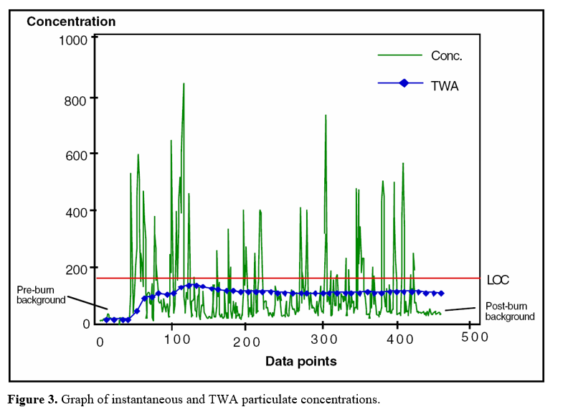
ISB Monitoring Data Sample: Graph
The TWA provides an indication of the concentration trends, which is a more stable and reliable indicator of exposure to particulates.

Slide 19
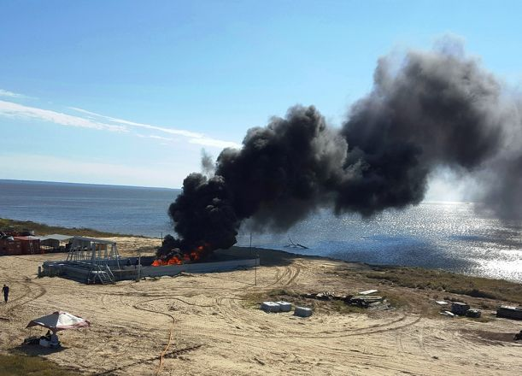
ISB Burn Residue and Unburned Oil Human Health Effects
Consists primarily of heavier hydrocarbon compounds that, with the possible exception of PAHs, are less toxic as they have burned off the more volatile/toxic components.
Residue can range from thick, sticky liquids to semi-solid tar-like or brittle substances.
Health effects are generally from physical contact.
Mitigate with gloves / PPE
Initial testing of burn pan at Joint Maritime Test Facility located in Mobile, Alabama, on Little Sand Island, November 2015. (November 2015 - Little Sand Island, Alabama credit: NOAA)

Slide 20
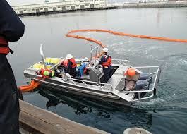
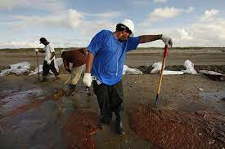
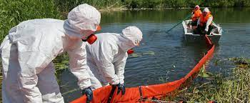
Reality: ISB Safety Hazards for Responders
Despite perceived hazards of ISB ignition, fire, and the smoke plume, these have not been found to present the highest risks to responders.
Lessons learned and injury logs from responses where ISB was used as a countermeasure, show highest hazards were due to: vessel to vessel transfers, thermal stress (i.e., heat stress not from ISB), fatigue, slips, trips and falls (e.g., on small boats or crew vessels) and ergonomics (e.g., hand, arm, back and muscle strain).

Slide 21
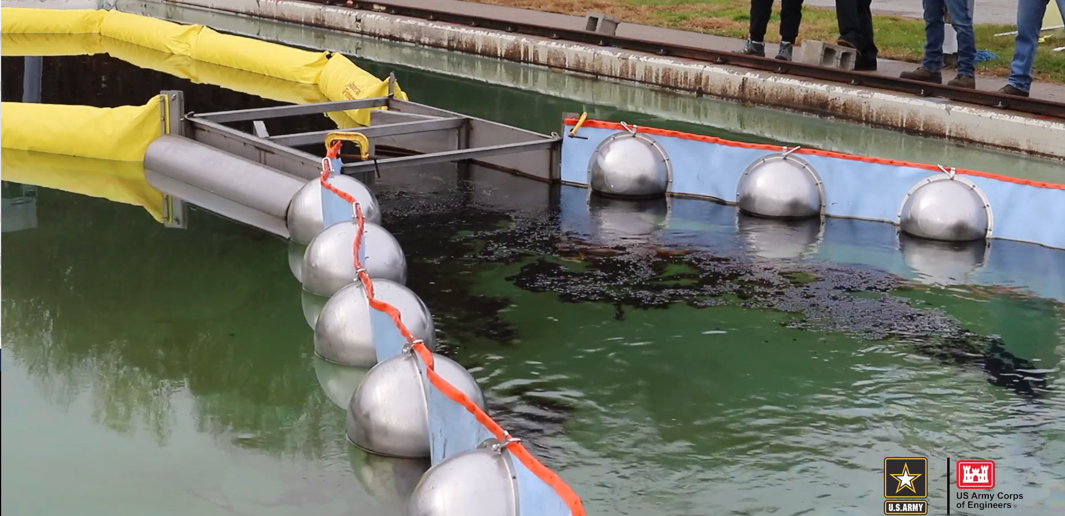
Advancements in technology will lessen responder involvement and reduce human health hazards…
Advances in plume dispersion modeling using emissions data from an Unmanned Aircraft System
New boom configurations designed to allow for a more efficient and cleaner burn = less plume
Autonomous Underwater Oil Spill Igniter – BSEE
Quantitative Measurement of In-Situ Burn Efficiency and Rate Efficient Remediation of Oil Spills over Water
Using Fire Whirls Research and Develop Interface Insulation Systems and Vigorous Burn Inducer to Increase ISB Burn Efficiency and Reduce Residue
Research and Develop a Linear Augmented Fire Boom Configuration to Increase Burn Efficiency and Reduce Emissions of Outer Continental Shelf In Situ Burns
CRREL, BSEE Conduct In Situ Burn Testing for New Oil Spill Cleaning System: with lower third, bug, outro

Slide 22
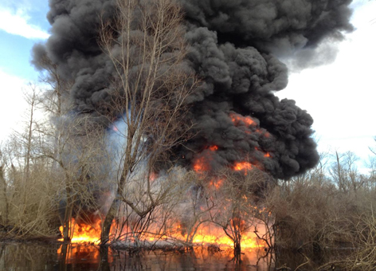
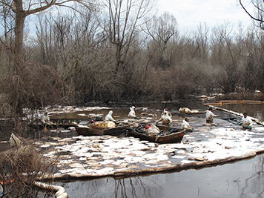
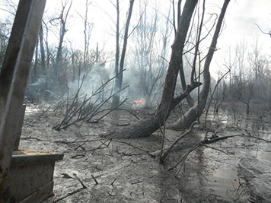
When Setting Fire to an Oil Spill in a Flooded Louisiana Swamp is a Good Thing
Controlled burn of an oil spill in a Louisiana swamp (January 2013 - Bayou Sorrel, Louisiana credit: U.S. Coast Guard)
Oil still remains in part of the flooded Louisiana swamp, where a cleanup crew in boats and hip waders worked to sop up the leftover oil using sorbent pads and boom on February 4, 2013. (NOAA/LTJG Kyle Jellison)
Taken January 19, 2013, after the in situ burn incinerated oil from a wooded swamp at Bayou Sorrel. The landscape may look stark, but the controlled burn removes the oil and allows the vegetation to regenerate in a cleaner environment. (U.S. Coast Guard)

Slide 23
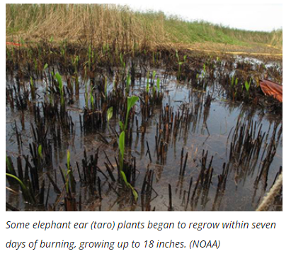
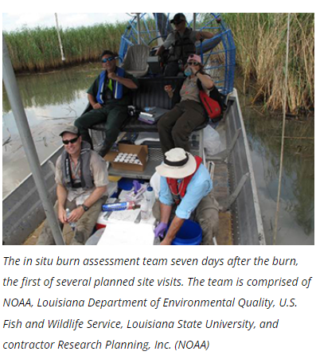

Slide 24
Conclusion
Protection of response personnel can be achieved by adequate training and hierarchy of controls.
Studies of gases produced by oil fires show the concentration of gases during ISB are within safe levels for humans beyond three miles downwind of source. While generating substantial amounts of combustion by-products, mostly CO2, water, and particulates, ISB reduces the amount of VOCs evaporating from spilled oil.
The public can be protected by establishing burning guidelines that prevent any smoke plume over populated areas.
Compared to conventional response methods, ISB can reduce the number of people required to clean the beaches, and reduce potential for injuries associated with this work.
Burning the oil will reduce waste generated by conventional beach cleanup.
ISB has the potential to reduce the destructive impact of oil on the environment, with minimal risk to the responders and to the population downwind.

Slide 25
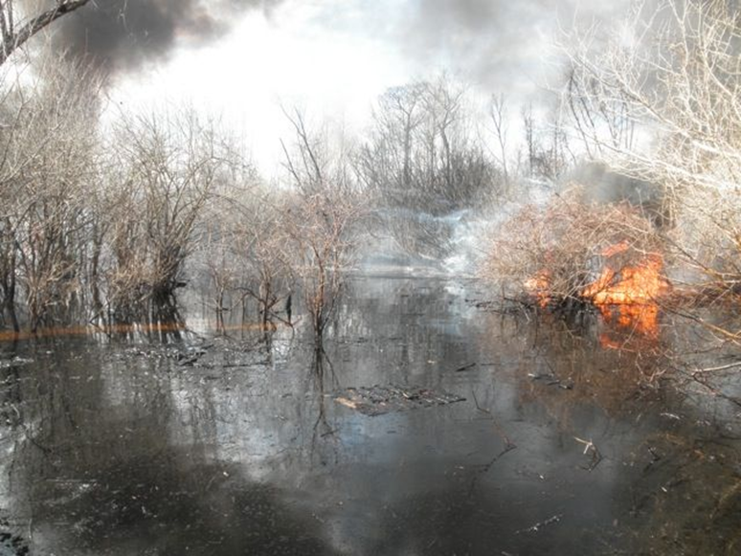
Questions?

