Slide 1
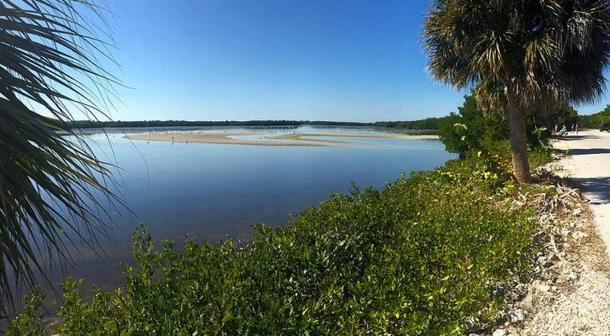

FWS Safety and Health
March 13, 2024
Notes:
Ding Darling NWR

Slide 2
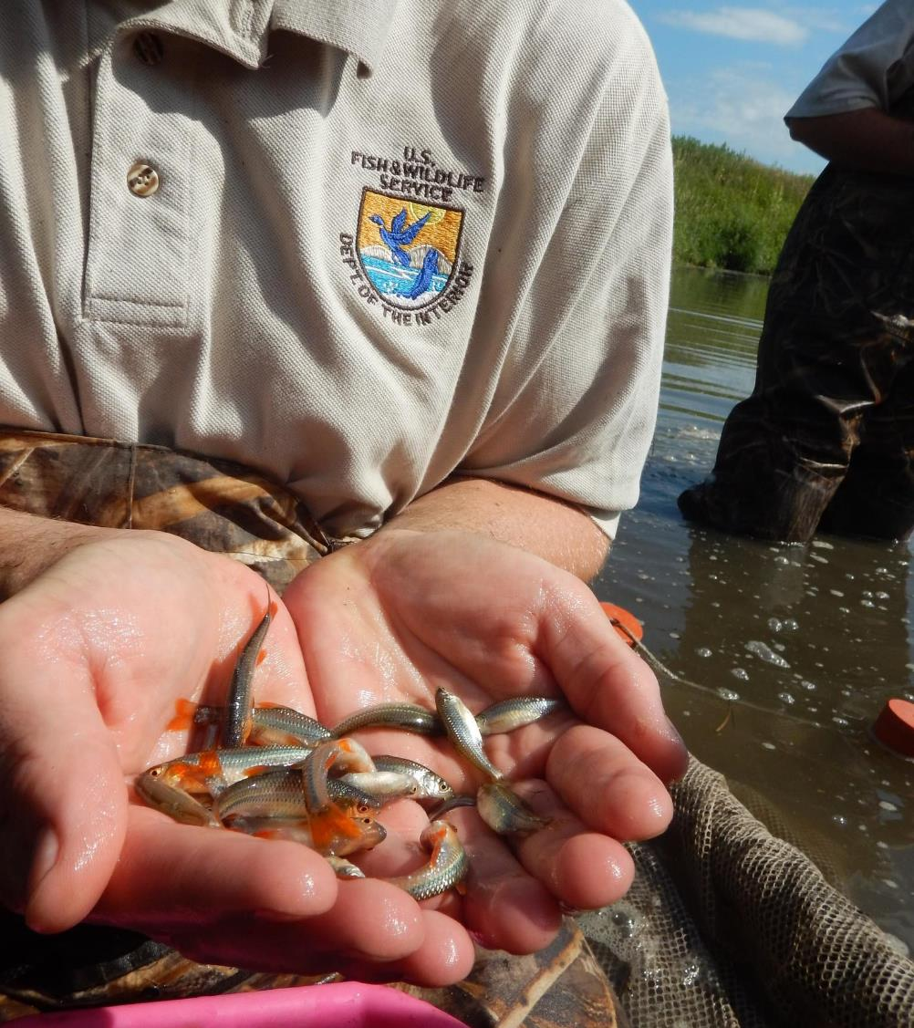
Overview
  Mission/Vision
  Facts about FWS
  FWS Focus
  FWS Programs
  Emergency Response

Slide 3
Fish and Wildlife Service (FWS)
Mission: The mission of the U.S. Fish and Wildlife Service is working with others to conserve, protect, and enhance fish, wildlife, plants, and their habitats for the continuing benefit of the American people.
Our Vision: We will continue to be a leader and trusted partner in fish and wildlife conservation, known for our scientific excellence, stewardship of lands and natural resources, dedicated professionals, and commitment to public service.

Slide 4
Enforcing federal wildlife laws;
Protecting endangered species with 86 field stations across all 50 states;
Managing migratory birds and administering the Duck Stamp program;
Restoring nationally significant fisheries and operating over 70 National Fish Hatcheries and 65 fishery resource offices;
Administering a national network of lands and waters through the National Wildlife Refuge System of 560 refuges and 38 wetland management districts;
Advancing excellence in science and its application to conservation decision-making at landscape scales;
Communicating our conservation priorities, news, and stories to the public, media, Congress, Tribes, partners, and others;
Helping foreign governments with their international conservation efforts;
Distributing hundreds of millions of dollars in excise taxes on fishing and hunting equipment through the Office of Conservation Investment program to State fish and wildlife agencies
Striving to Meet the Mission

Slide 5
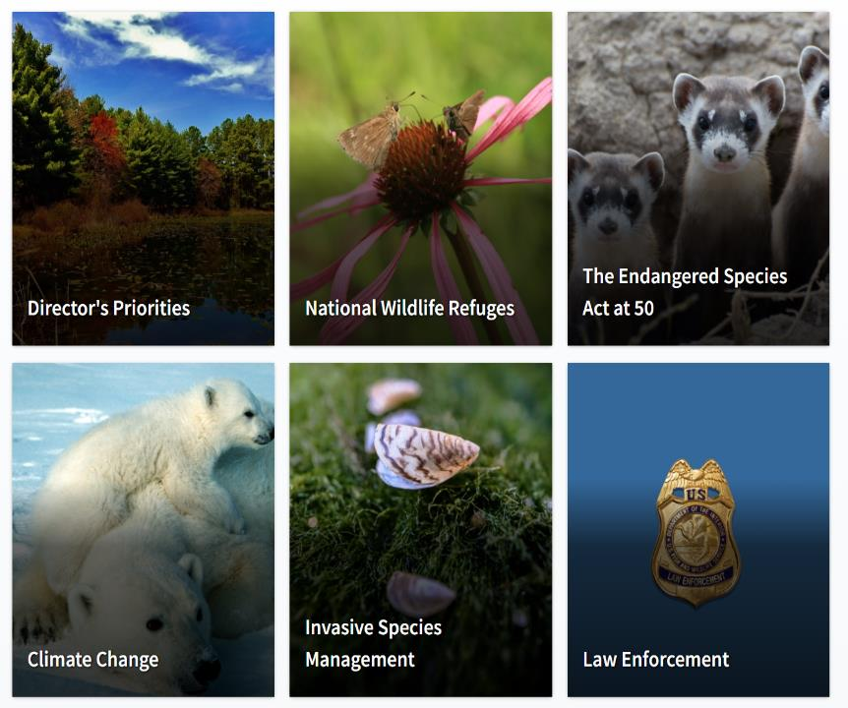
Our Focus
Notes:
The U.S. Fish and Wildlife Service, working with others, is responsible for conserving, protecting, and enhancing fish and wildlife and their habitats for the continuing benefit of the American people through Federal programs relating to migratory birds, endangered species, interjurisdictional fish and marine mammals, and inland sport fisheries.
Acquires, protects and manages unique ecosystems necessary to sustain fish and wildlife such as migratory birds, resident species and endangered species.
Operates a National Fish Hatchery System in support of the restoration of depleted interjurisdictional fish stocks, the recovery of federally listed threatened and endangered species, and the fulfillment of Federal mitigation responsibilities.
Provides protection of fish and wildlife from dislocation or destruction of their habitats, overuse, and industrial, agricultural and domestic pollutants.
Renders financial and professional technical assistance to States through Federal Aid programs for the enhancement and restoration of fish and wildlife resources.
Conducts programs of enforcement, management and professional technical assistance to other agencies for the protection of endangered species.
Promulgates and enforces regulations for the protection of migratory birds, marine mammals, fish and other nonendangered wildlife from illegal taking, transportation or sale within the United States or from foreign countries.
Conducts programs of planning, evaluation, and professional technical assistance to other agencies for the proper use and protection of fish and wildlife habitat that directly benefit the living natural resource and add quality to human life.
Conducts programs of interpretation, education and recreation to foster a stewardship ethic in the American public through high quality fish and wildlife oriented experiences.
Communicates information essential for public awareness and understanding of the importance of fish and wildlife resources and interprets fish and wildlife changes reflecting environmental degradation that ultimately will affect the welfare of human beings.

Slide 6



Facts about FWS
8,875
People working at Fish and Wildlife Service
19,000
Volunteers at FWS
2,362
US and foreign species protected under the ESA

Slide 7
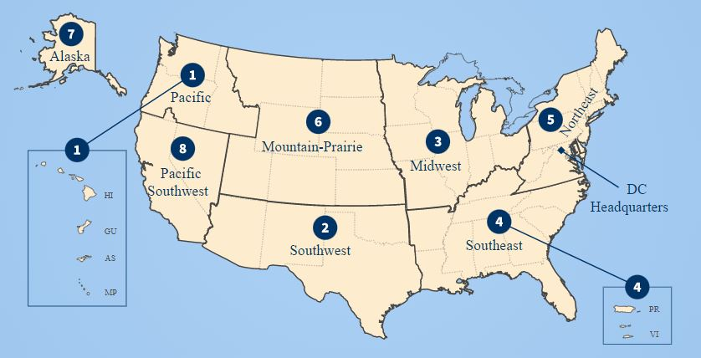

Slide 8
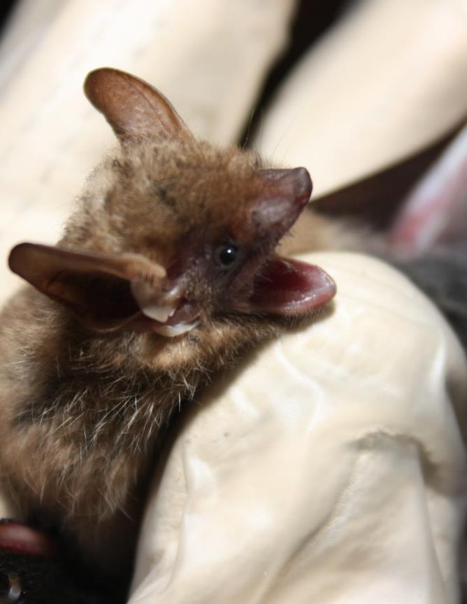
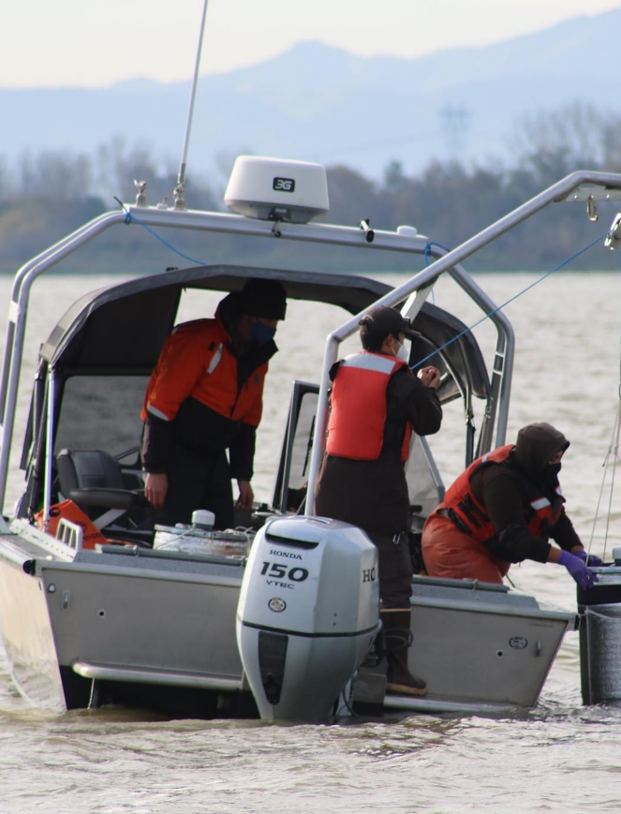
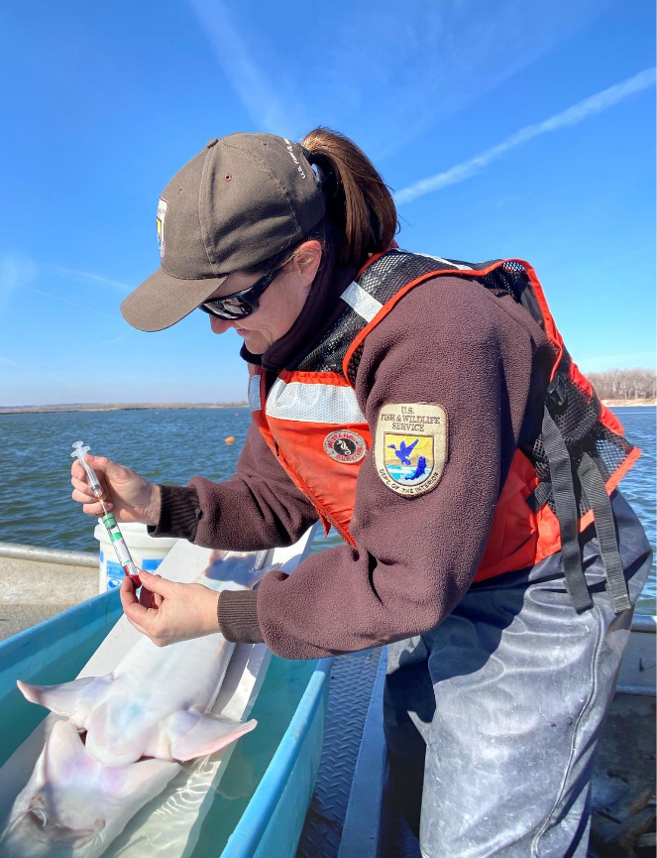
FWS Programs

Slide 9
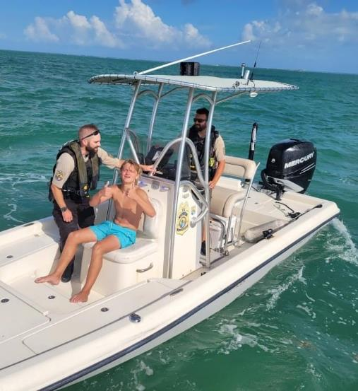
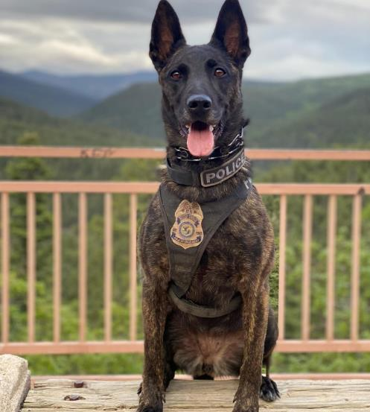
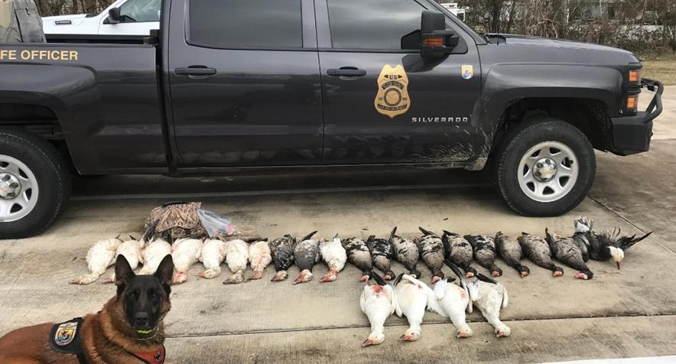
Office of Law Enforcement (OLE/LE)
OLE are composed of special agents, wildlife inspectors, intelligence analysts, forensic scientists, information technology specialists, and support staff who investigate wildlife crimes, regulate the wildlife trade, help the public understand and obey wildlife protections laws, and work in partnership with international, federal, state, local, and Tribal counterparts to conserve wildlife resources.

Slide 10

National Wildlife Refuges
The Service manages public lands and waters called the National Wildlife Refuge System. With more than 560 refuges spanning the country, this system protects iconic species and provides some of the best wildlife viewing opportunities on Earth.
The Refuge System deploys a host of scientifically sound management tools to address biological challenges. These tools, which range from active water management to wilderness character monitoring, all are aimed at ensuring a balanced conservation approach that enables wildlife and people to thrive.

Slide 11
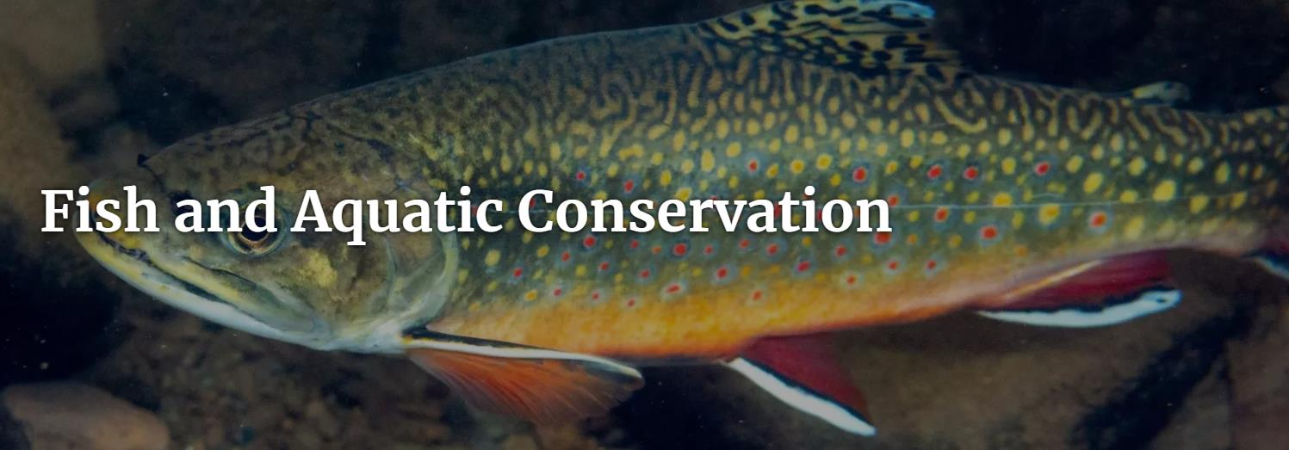
The National Fish Hatchery System raises and stocks over 98 million aquatic species every year to support recreational fishing, Tribal subsistence fisheries, and the recovery and restoration of imperiled species. National fish hatcheries across the country work with states and Tribes to produce and distribute fish for recreational and conservation purposes and provide refuge for endangered species. Every year we raise approximately 73 fish species like walleye, pallid sturgeon, brown trout, and Atlantic salmon.
Notes:
What We Do - Our Projects and Initiatives
Conserve Aquatic Species
Conserve, Restore, and Enhance Aquatic Habitats
Manage Aquatic Invasive Species
Fulfill Tribal Trust and Subsistence Responsibilities
Enhance Recreational Uses of Aquatic Resources
Educate and Engage the Public and our Partners to Advance Conservation

Slide 12
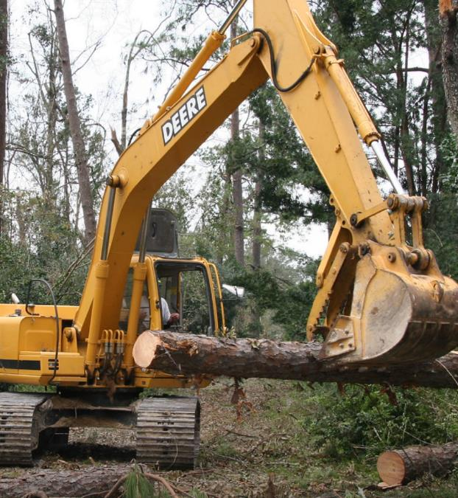
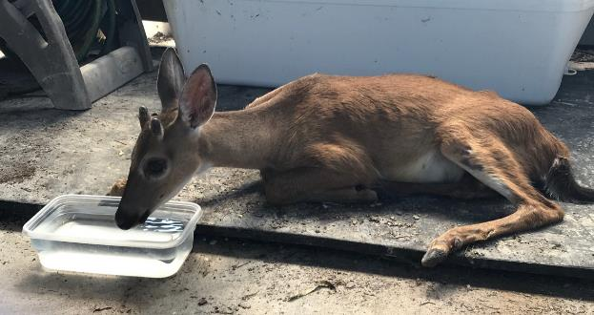
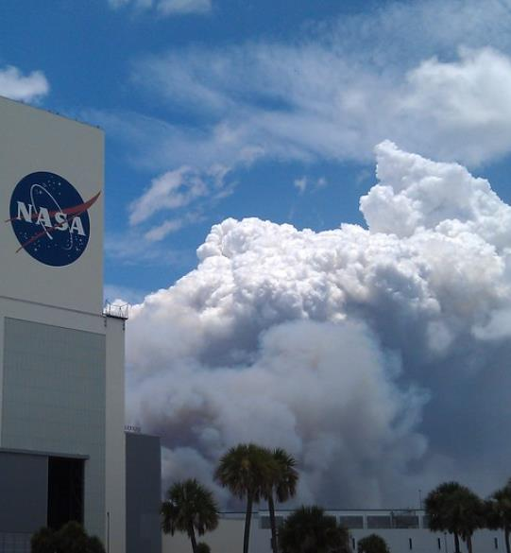
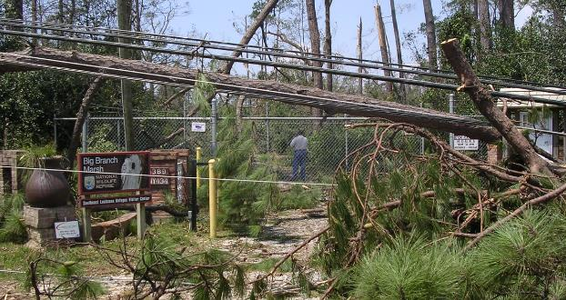
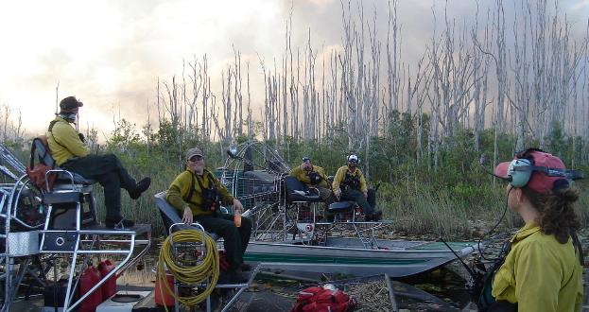
Emergency Response

Slide 13
Emergency Response
Safety and Health supports the FWS emergency management efforts by providing expertise in the safety and health as needed by the service Emergency Management staff, regional leaders, and incident command teams.

Slide 14
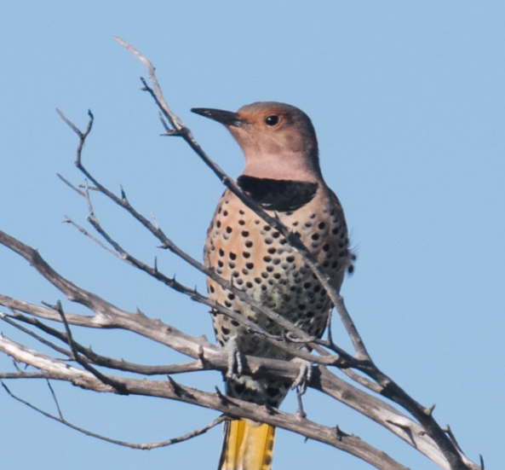
Emergency Response
Safety Operations has the lead within FWS for protecting employees during emergency response operations.
Safety also coordinates with the Geographic Emergency Management and Physical Security Managers (GEMPS).
The GEMPs are in East, West and Central.
Notes:
Northern Flicker
When you think of woodpeckers you might think of tree trunks. But Northern Flickers are woodpeckers who also spend a lot of time on the ground searching for their main diet of beetles & ants. You may find them year 'round on local refuges. When you're on Roanoke Island visit National Wildlife Refuges Visitor Center. Photo credit: Jeff lemons, USFWS

Slide 15
Emergency Response
General responsibilities include:
Educating employees about preparedness
Ensuring the FWS employees are accounted for following an event
Keeping impacted employees and supervisors informed of ongoing preparedness and response efforts
Informing leadership of response efforts and employee status
Working with response teams ensure safe operations

Slide 16
Types of Emergency Response
Most agency types of responses:
Earthquakes
Floods
Hurricanes
Oil Spills
Snowstorms
Tornados
Volcanoes
Reponses specific to FWS: (Not always FEMA ordered/internal to FWS)
Zoonotic Diseases Mortality
Event Response
  Algal Blooms
  Chronic Wasting
Wildland Fires
Wildlife Welfare Emergencies
  Manatees
  Bison Health
Notes:
Zoonotic diseases: (Zebra mussels, magnificent bryozoan, nutria, spotted lanternfly, invasive carp, spotted knapweed, European green crab, Burmese python)

Slide 17
Regional Director’s sends memo guidance in establishing annual All-Hazard Disaster Plans (AHDP) review, updates, and submission to deal with major emergencies/disasters impacting Service assets that include Continuity of Operations Plan (COOP) and Mutual Aid template as well as employee assistance guidance.
Geographical Emergency Managers support regional effort for monitoring and implementing response plans for All-Hazards to include weather events.
Before a Response

Slide 18
Before/During the Response
In the event of tropical weather, emergencies/disasters impacting Service assets:
  Regional Emergency Coordinators schedule general planning and response meetings with GEMPS, Programs Area Leads (PALs) and other keys personnel.
  Stations implement All Hazards Deployment Plans (AHDP) to include employee status reporting.
  FEMA/FWS leadership will appoint the Incident Commander and Incident Management Team (levels vary: Type 1-Type 5)
  FWS will make the determination for mobilizing of Special Operations Response Team (SORT) (if applicable) for employee accountability and initial damage assessment.

Slide 19
Before/During the Response
  Stations in affected area after storm/event clears conduct employee accountability and damage assessment and request assistance as needed. This can be mutual aid from neighboring assets or from IMT mobilized taskforces.
  Regional Emergency Coordinator and GEMPS maintain coordination and communication with FEMA and state agencies in accordance with National Incident Management System (NIMS) for any Emergency Support Functions (ESFs), which consist of federally grouped resources and capabilities into functional areas most frequently needed in a national response.
  Daily operational meeting and status updates.

Slide 20
After/Recovery of the Response
Once the stations and areas are out of immediate threat and stabilizing efforts completed, IMT elements are demobilized.
After-action reports and meetings.
Implement National Disaster Recovery Framework (NDRF) for restorative efforts not only for the physical station but for Service employees.

Slide 21
Pre/Post Response
FWS Staff
FWS Staff and Family
Evacuation travel allowances
Administrative leave
Assist with immediate needs post response

Slide 22
Chainsaw crews
Heavy Equipment Task Force
Law Enforcement Surge Team
Watercraft Strike Team
Response Trailers
Emergency Response Teams and Resources

Slide 23
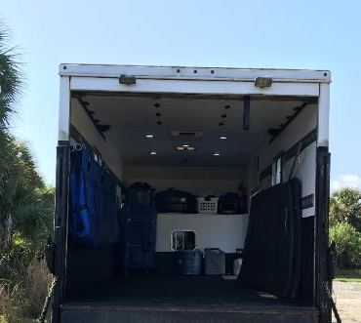
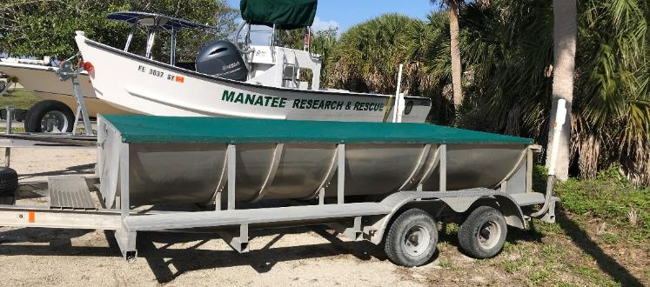
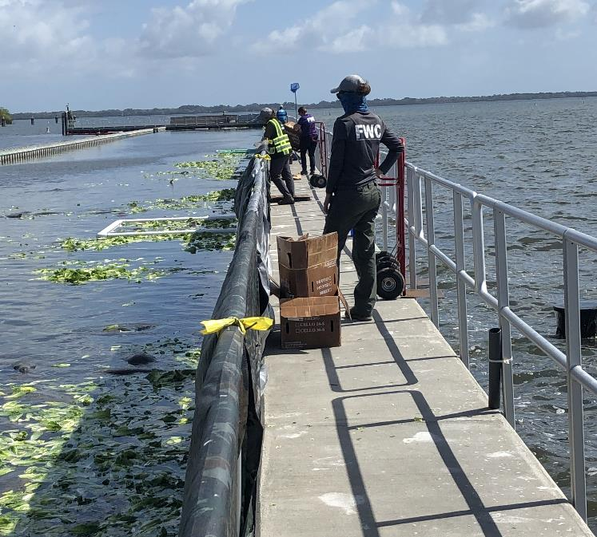
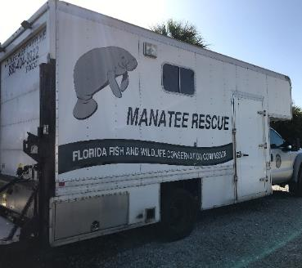
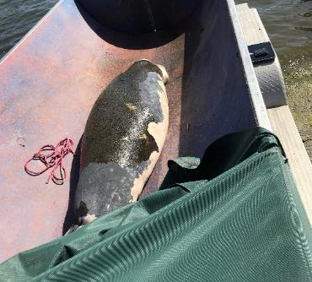
Endangered Species Manatee Rescue Environmental Response
The response had three missions that were carried out daily.
Provisioning (feeding) FWS involved.
Recovery (carcasses – then necropsies)
Rescue (boat; net – then some are transported by box truck to care facilities

Slide 24
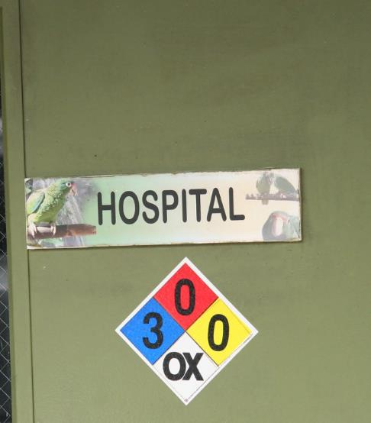
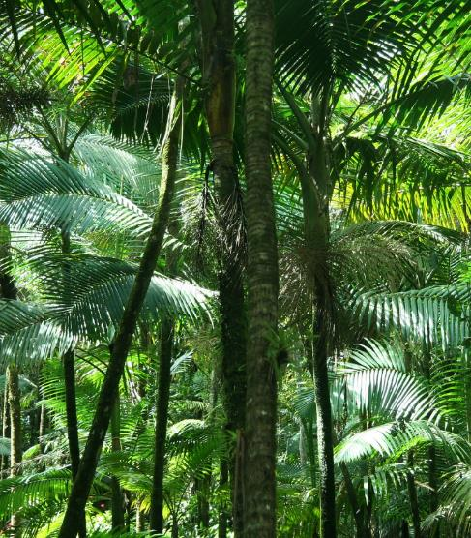
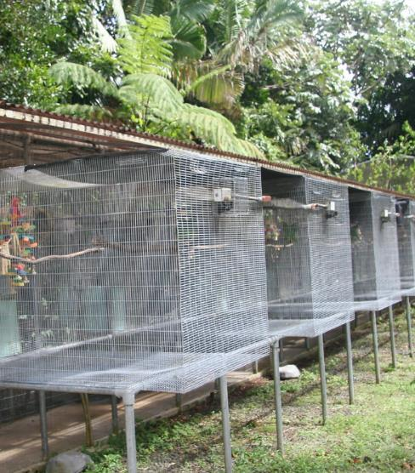
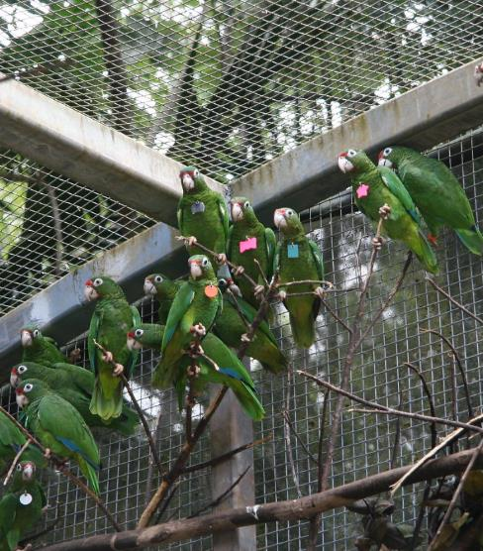
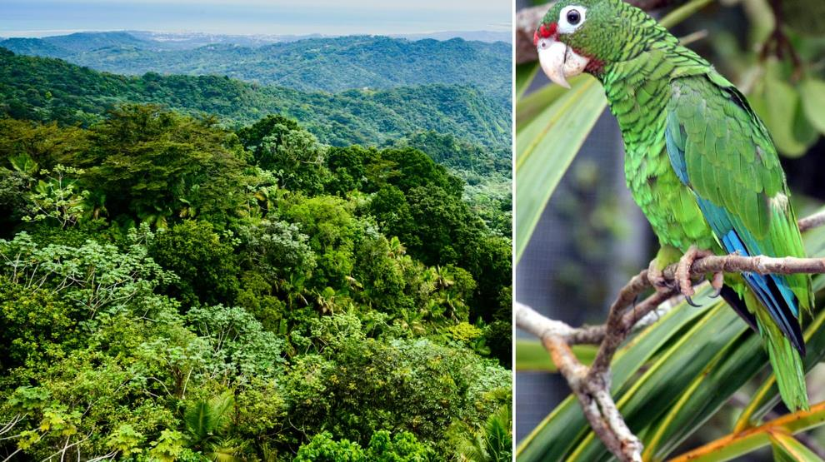
The Puerto Rican parrot recovery program is an effort to conserve, protect and manage wild and captive parrots in order to downlist the species from endangered to threatened.
Notes:
It is hard to overstate the impact that a category 4 storm had on the Puerto Rican parrot, a species limited in range to Puerto Rico and the only native parrot in the United States. Hurricane Maria hit Puerto Rico on Sept. 20, 2017. It knocked out the U.S. territory’s power, prompted flooding across the island and snapped trees like pencils. Its high winds also shredded leafy parrot habitat at El Yunque and elsewhere. A mere two weeks prior, on Sept. 6, 2017, category 5 Hurricane Irma had hit. With back-to-back hurricanes, the parrots' home was decimated.

Slide 25
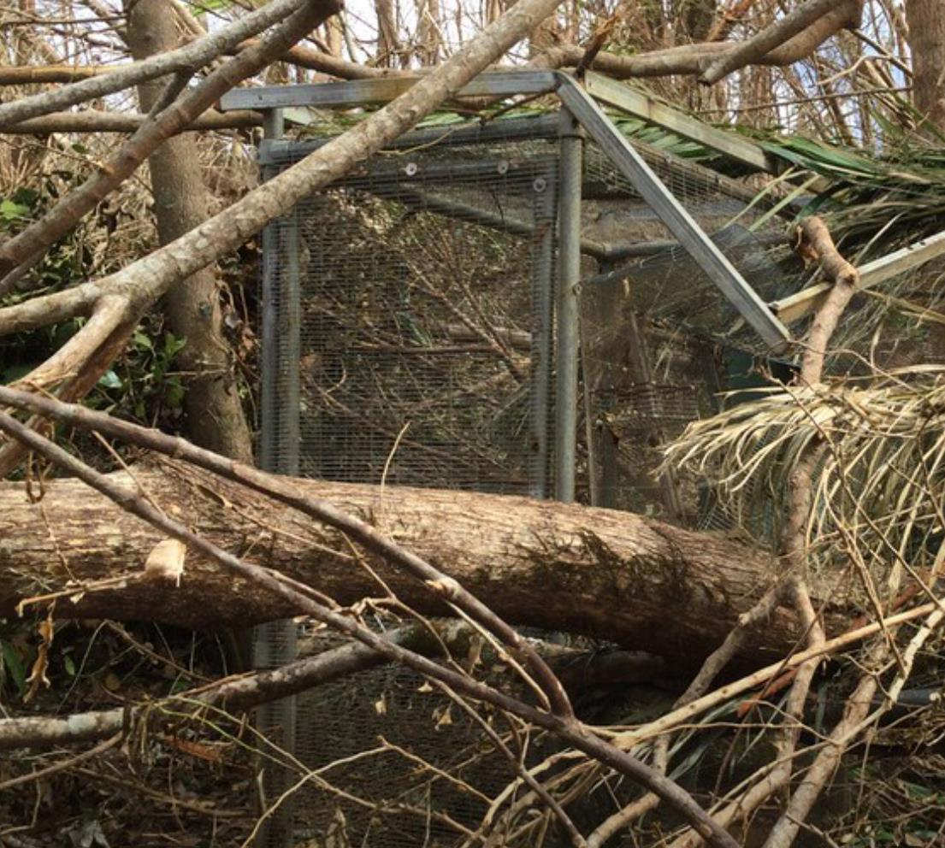
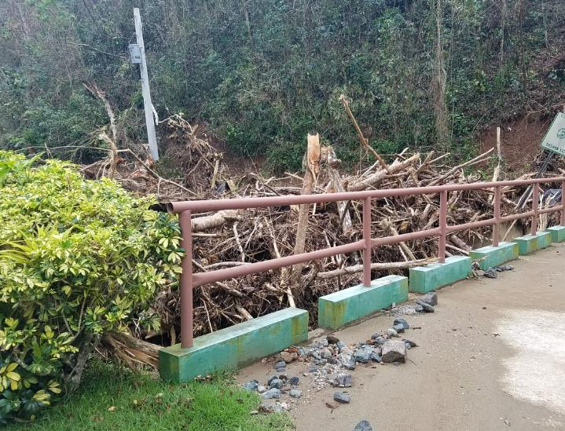
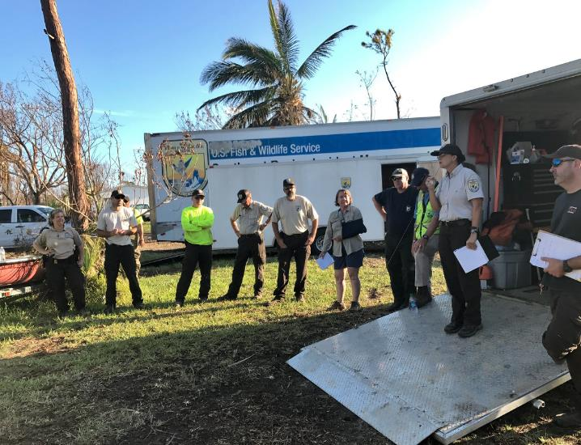
Hurricane Maria made landfall on Puerto Rico as a Category 4 storm on September 20, 2017. At the time of landfall Maria was the fifth strongest hurricane to hit the U.S.

Slide 26
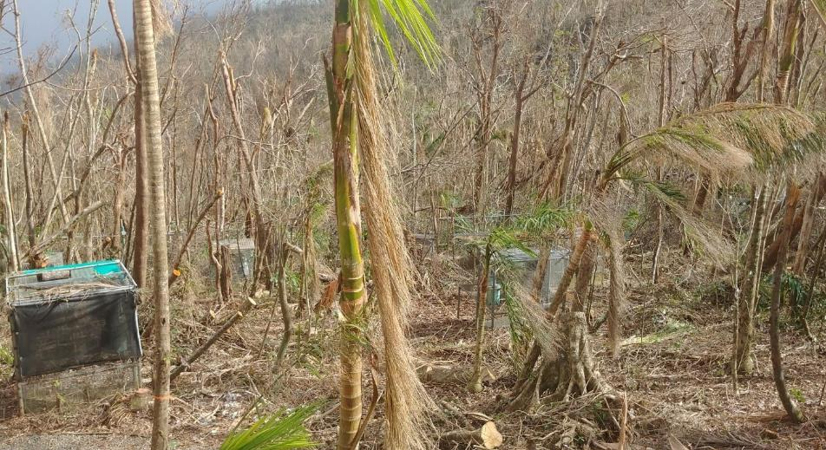
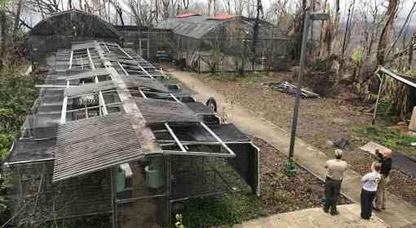
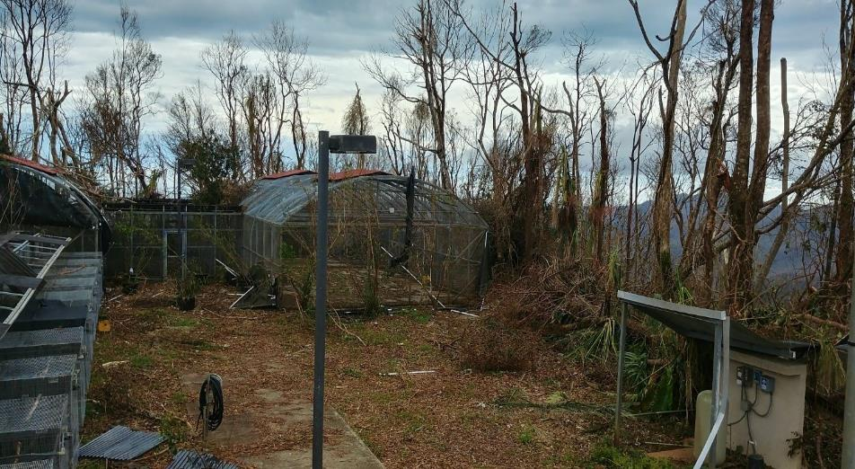
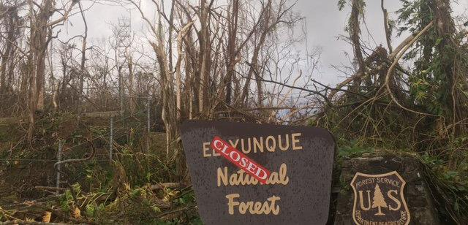
Notes:
Two weeks after category 5 Hurricane Irma hit Puerto Rico, Hurricane Maria swept in on September 20, 2017, and devastated the island—my home. Floods, landslides and intense winds destroyed houses, toppled trees, wiped out critical infrastructure and killed over 4,600 people. I was one of the lucky ones. There were days when my family and I hauled gallons of water from the river and washed our clothes with washing boards. Without electricity, watching the night sky in complete darkness and talking for hours became evening activities. But amid the tragedy and chaos, the Puerto Rican people lifted our communities up, cleared away the debris and delivered supplies to hard-hit areas.
I thought about how the hurricanes impacted the island’s endangered species such as the Puerto Rican parrot—one of the most critically endangered birds in the world with only about 180 in the wild before the hurricanes struck. The parrot is dependent on El Yunque National Forest in eastern Puerto Rico—the only tropical rainforest in the U. S. National Forest System.
Image

Slide 27
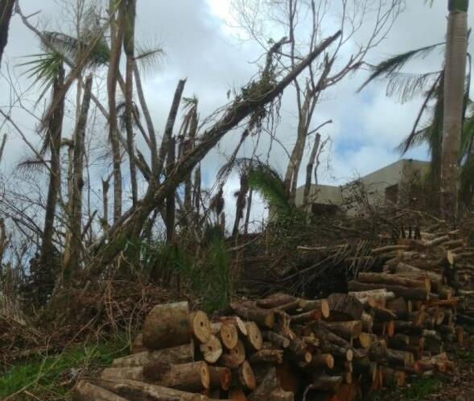
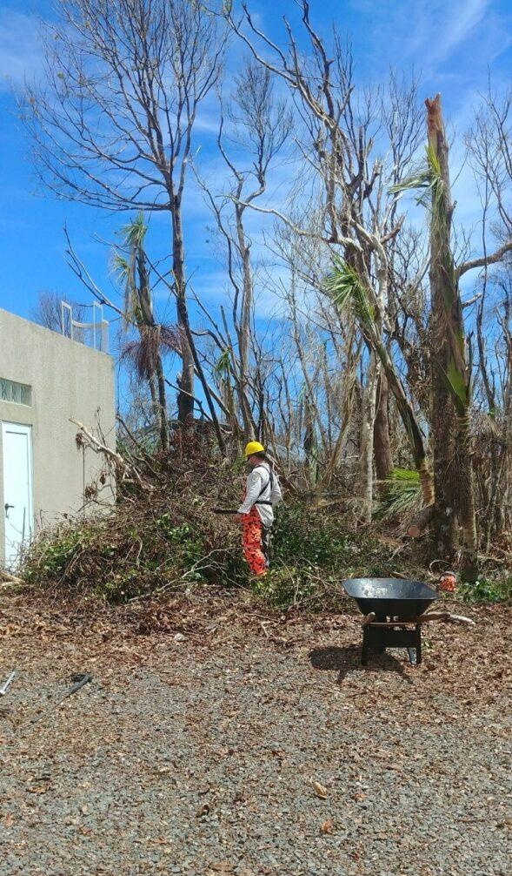
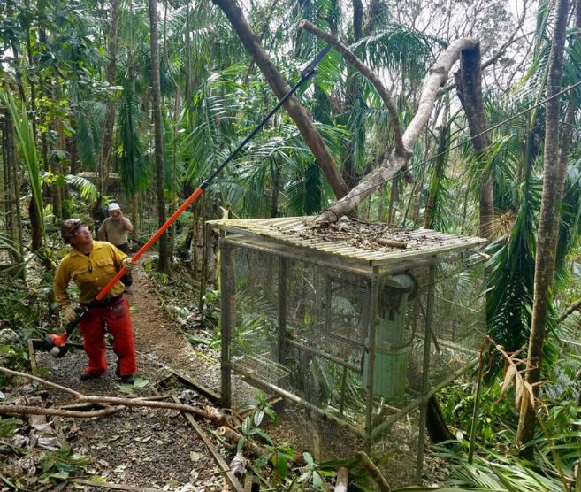
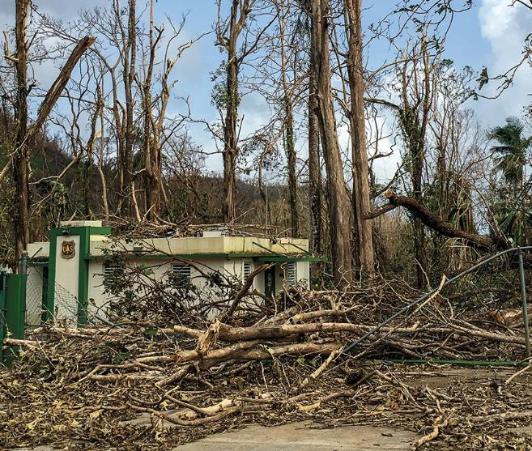
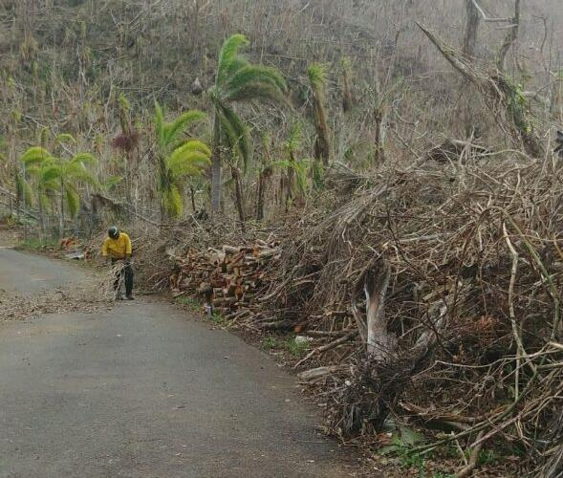

Slide 28
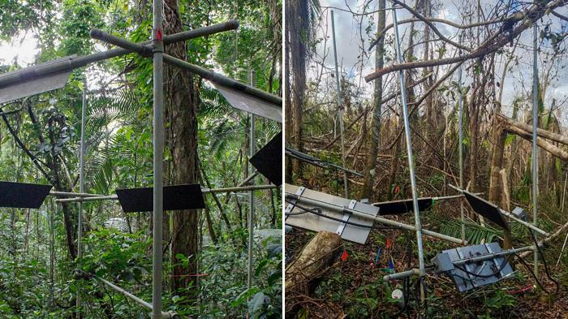

Slide 29
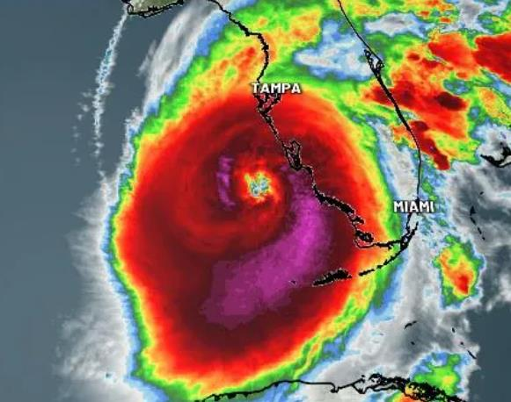
Hurricane Response
J. N. "Ding" Darling National Wildlife Refuge in Sanibel Island, Florida was hit with a devastating blow when Hurricane Ian swept through on September 28, 2022.
Safety Operations deployed in support of Hurricane Ian Response Team to Florida, provided safety and health oversight to 35+ responders, removed debris/branches and assisted the community in need and secured critical FWS assets.

Slide 30
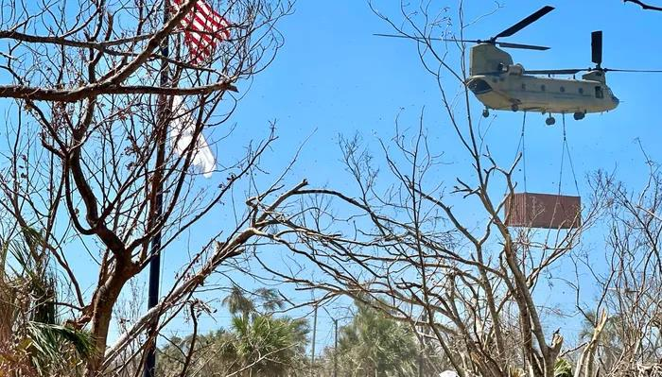
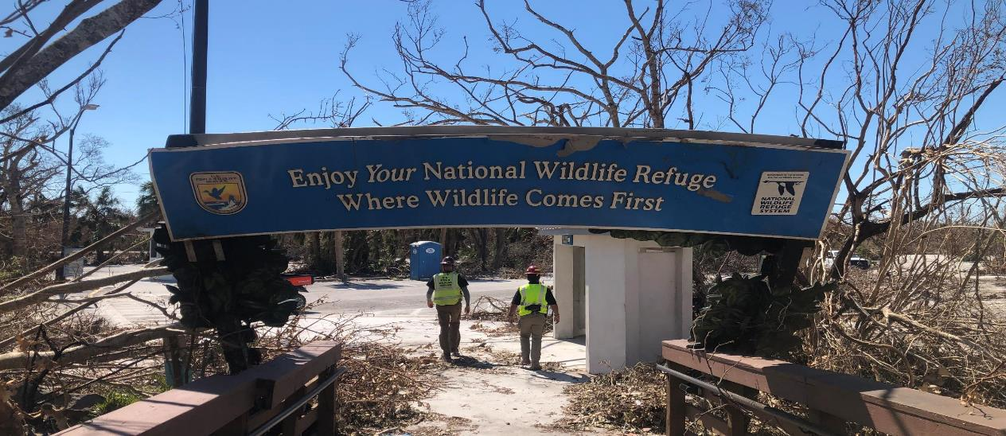
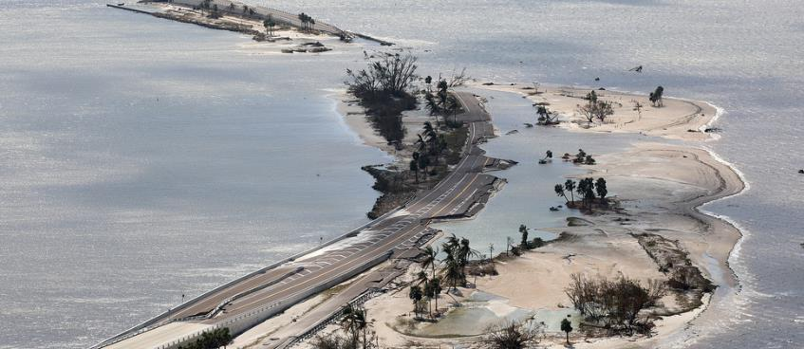
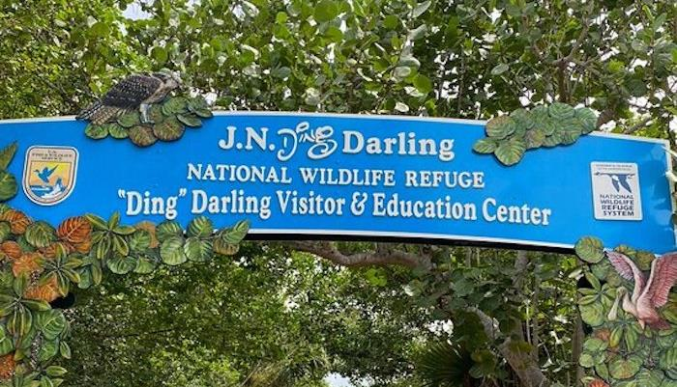

Slide 31
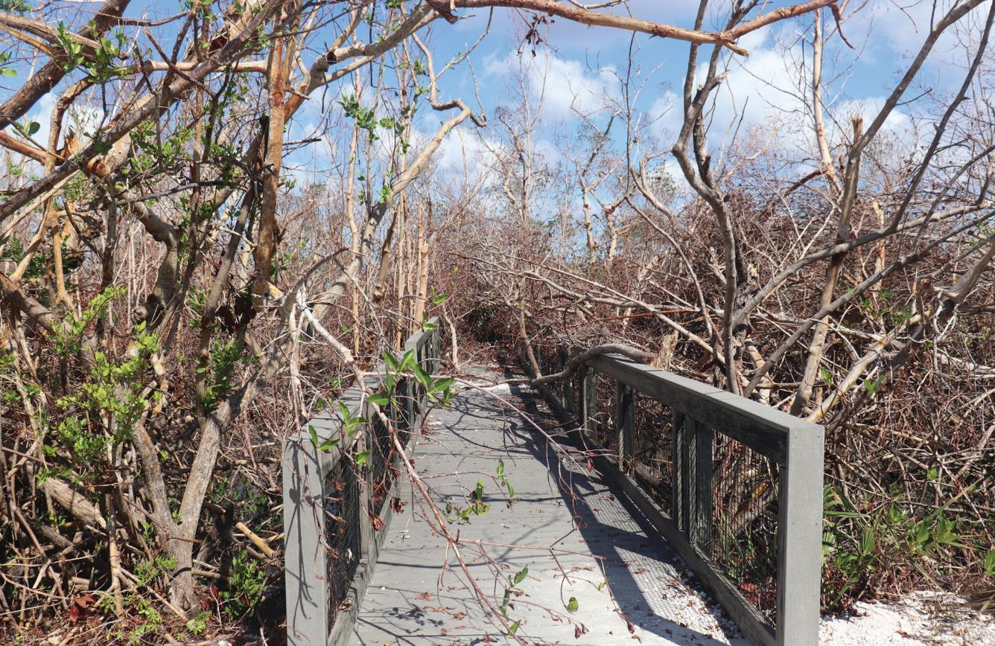
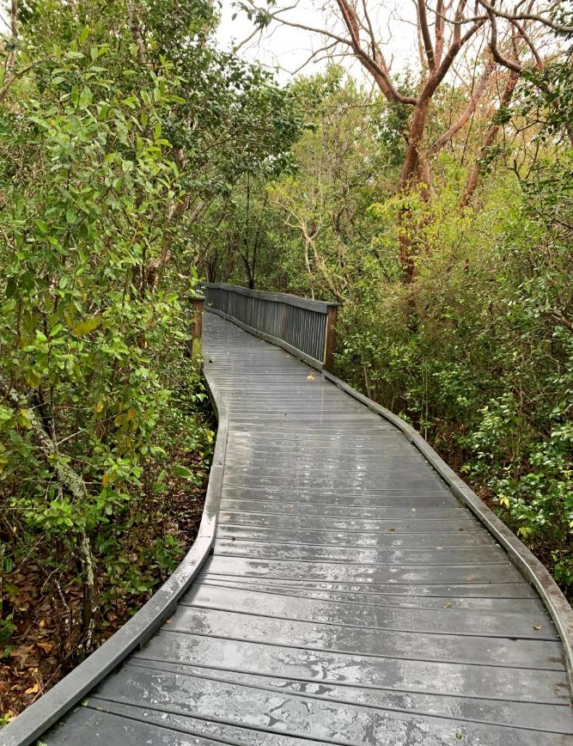
Emergency Response

Slide 32
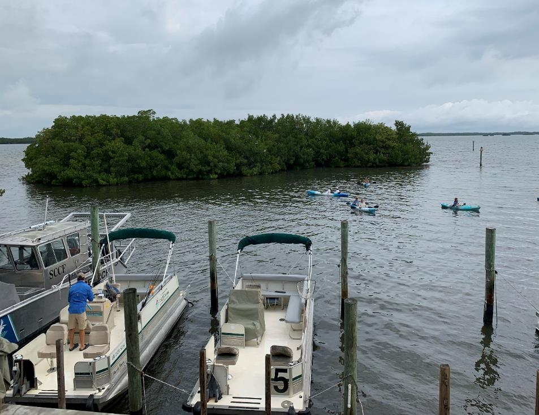
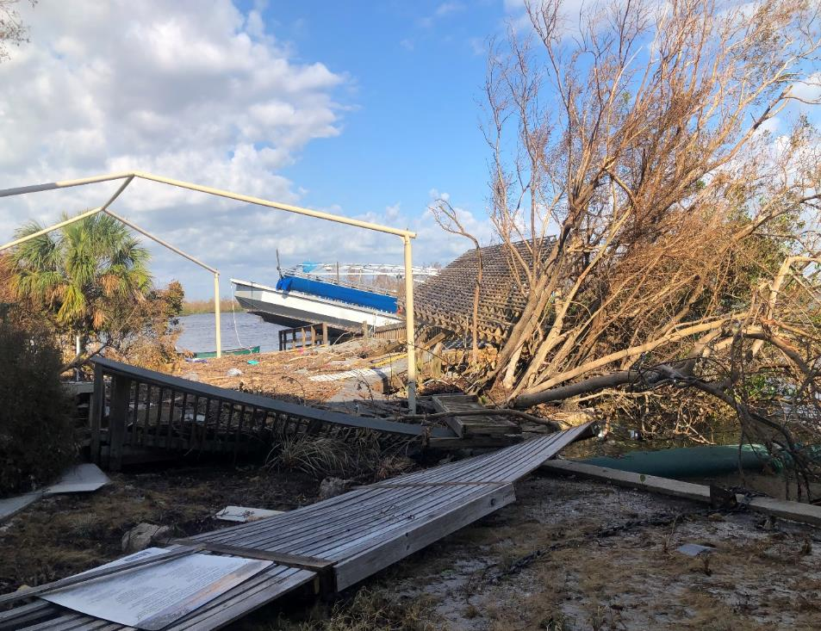
Emergency Response

Slide 33
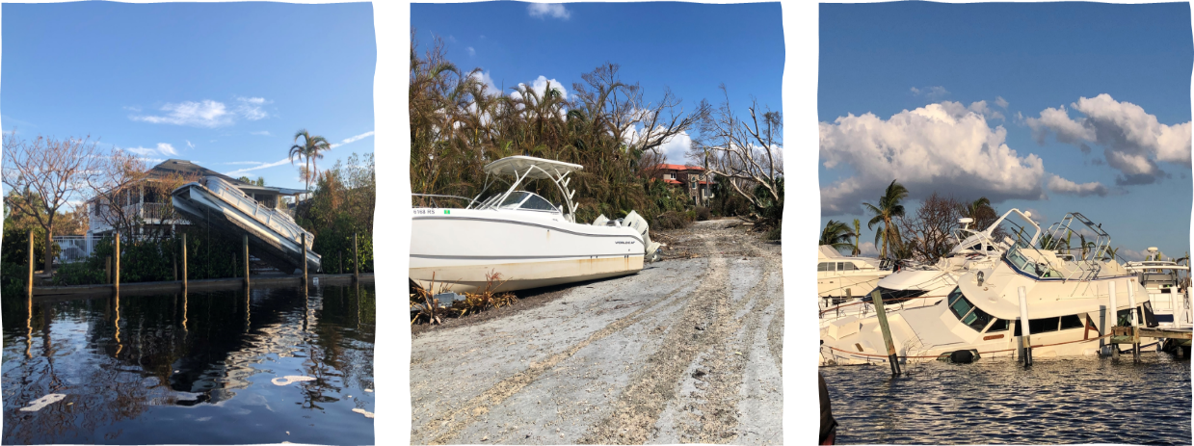
Emergency Response

Slide 34

Emergency Response

Slide 35


Emergency Response

Slide 36






Interagency Fire and Fire Aviation Operations
Fish and Wildlife Service, Indian Affairs, Forrest Service, Bureau of Land Management and National Park Service
Notes:
Reducing wildfire threats and helping wildlife by prescribed burns.

Slide 37
Branch of Fire Management
Service’s Fire Management Program is part of the National Wildlife Refuge System. Since the 1930’s, the Service has utilized fire to maintain healthy ecosystems and lower the risk of catastrophic wildfire.
The program also provides mutual aid to other federal, state and local fire management agencies and is a member of the National Wildfire Coordinating Group (NWCG).
What We Do
​​​​​​Fire management is essential to the FWS, with more than 80 percent of refuge lands being fire-adapted ecosystems comprised of healthy wildlife habitat that depend on periodic fire. The FWS fire program is responsible for protecting more land management units than any other federal agency, with more than 75 million burnable acres. The FWS Service’s fire management program has three main areas of focus: fuels management, wildfire management, and wildfire prevention. Wildfire management demands technical expertise in firefighting and prescribed burning, an understanding of fire ecology, and public education.

Slide 38





Notes:
Reducing wildfire threats and helping wildlife by prescribed burns.

Slide 39
Midway Atoll NWR
Midway Atoll National Wildlife Refuge and Battle of Midway National Memorial directly supports airfield operations and conservation management of the refuge. FWS staff can render aid and provide support.
Halfway between the continental western U.S. and Asia, and is approximately 1,200 miles NW of Honolulu, Hawaii, in the Pacific Ocean.
Henderson Field is a public airport located on Sand Island in Midway Atoll, an unincorporated territory of the United States. The airport is used as an emergency diversion point for ETOPS operations.
Notes:
Extended-range Twin-engine Operation Performance Standards

Slide 40

Snow – Roof Load
Roof has approximately 30 psf of snow load in the two areas. Weight of the ice still needs to be added into the that calculation.
Observed damaged truss connections/gusset plates in a few areas of the original 1976 building.

Slide 41
Damage consisted of the following:
Truss plates that were not totally seated during installation.
Cracked 2x6 top cord members.
Truss plates installed in the lower ½ of the top cord at the end of the truss near the top cord bearing point.
Roof needs to be shoveled. Snow load is recommended to be kept below 15psf until the trusses are evaluated.
All Service employees will not occupy the building due to the potential hazard associated with the roof’s trusses.
Snow –
Roof Load

Slide 42





Slide 43





Deepwater Horizon FWS Response

Slide 44
Deepwater Horizon/Oil Spill Response
Gulf of Mexico is one of the world's most ecologically rich areas and provides habitat for a great diversity of fish, birds, mammals, reptiles and other wildlife. Many species of wildlife, including some that are threatened or endangered, live along the Gulf Coast and have been affected by the oil spill. DOI and its bureaus have responsibility for a spectrum of natural resources in the Gulf that will be impacted by the oil spill, including National Wildlife Refuges, National Park units, migratory birds, and threatened and endangered species, such as manatees, and sea turtles.
The Department manages 36 national wildlife refuges and eight national park units along the Gulf Coast from Texas to Florida's peninsula that cover nearly three million acres of pristine freshwater, tidal and terrestrial habitats. There are 38 federally-listed species protected under the Endangered Species Act along the Gulf Coast for which the Service and National Oceanic and Atmospheric Administration (NOAA) Fisheries are concerned about relative to this spill, and 29 of those are endangered.

Slide 45
Deepwater Horizon/Oil Spill Response
Approximately 1,000 miles of shoreline have been impacted, affecting approximately 275 miles of Department of the Interior lands is experiencing moderate to heavy oil impacts. Nearly 500 miles of shoreline is experiencing light to trace oil impacts in Louisiana, Mississippi, Alabama, and Florida.
To give you a sense of the ecological value of these coastal habitats, consider that the northern Gulf Coast is home to one of every four Laughing Gulls. Nearly half of the southeastern population of Brown Pelicans – lives along the northern Gulf Coast and generally nests on protected coastal islands. The Brown Pelican was taken off the endangered species list along the Gulf Coast prior to the oil spill. More than 35 percent of the southeastern populations of Royal Terns and Least Terns rely on northern Gulf Coast habitats as well.
The impacts so far have been significant.

Slide 46


Deepwater Horizon/Oil Spill Response
FWS R4 Spill Strike Team at full activation within 96 hours.
There were over 3,447 FWS responders throughout the response.
Examples of field operations directly involving FWS, NPS, and USGS staff included:
  Helped deploy and maintain almost 2 million feet of containment boom, with the goal of protecting the most sensitive areas.
  Engaging in multiple over flights to survey for birds, manatees and other wildlife along the coasts.
  Conducting Natural Resource Damage pre/during/post assessments and conducting beach surveys to monitor sea turtle nests and developed protocols for cleanup crews

Slide 47
Deepwater Horizon/Oil Spill Response Continued in 2024
The Service has a responsibility to the public, including our partners, to ensure meaningful conservation outcomes for our shared fish and wildlife goals. While the conservation needs of the Gulf of Mexico are daunting, collectively FWS has the potential to significantly advance Gulf restoration and provide ecological and economic benefits to the American public.
Restore and conserve habitat
Restore water quality
Replenish and protect living coastal and marine species
Enhance community resilience
Restore and revitalize the Gulf economy

Slide 48

15

Slide 49



14

Slide 50






Slide 51







Slide 52






Slide 53





Questions
Notes:
J N Ding Darling NWR

Slide 54

Thank You

