Slide 1
Exposure assessment after wildfire incidents
LCDR Catherine C Beaucham, PhD, CIH, REHS
March 2024

Slide 2
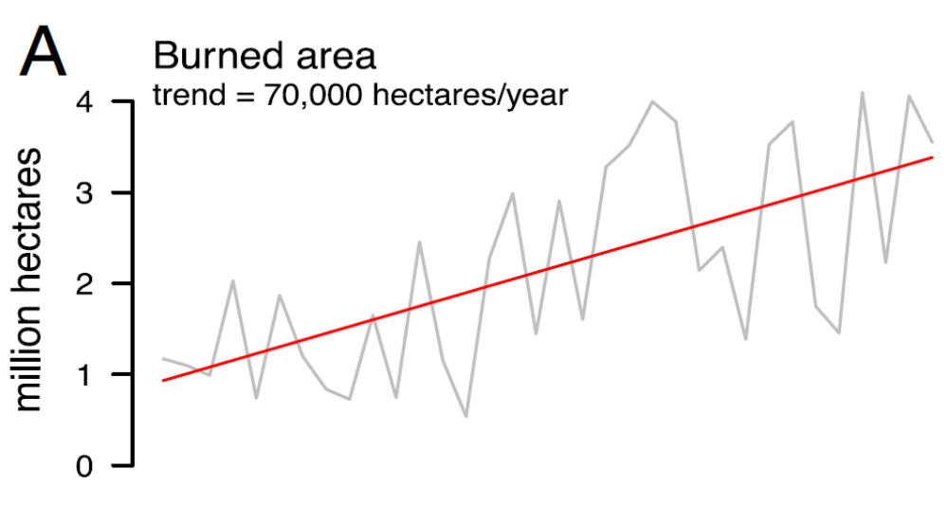

Wildfires
Biomonitoring of Wildfire Responders
National trend in wildfire since 1998 show that each wildfire is burning more land.
In 2017 alone, over 10 million acres of land were ravaged by wildfires.
When wildfires extend into residential areas remnants of burned structures may contain many contaminants in the smoke and ash left behind
Wildland firefighters and debris cleanup crews may be exposed to those contaminants.
Resources:
NIFC [2017]. National report of wildland fires and acres burned by state 2017. Boise, ID: National Interagency Fire Center, https://www.predictiveservices.nifc.gov/intelligence/2017_statssumm/fires_acres17.pdf. NIFC [2018]. National report of wildland fires and acres burned by state 2018. Boise, ID: National Interagency Fire Center, https://www.predictiveservices.nifc.gov/intelligence/2018_statssumm/fires_acres18.pdf.
National Academy of Sciences, 2021: https://www.pnas.org/doi/10.1073/pnas.2011048118

Slide 3

Biomonitoring of Wildfire Responders
Stock internet photo

Slide 4

Maui Wildfires
August 8-12, 2023
Maui County Fire Department and the National Guard were part of the response
NIOSH response was to measure biomarkers of exposure in blood and urine and to collect an exposure history
We arrived September 11, 2023
Photo by NIOSH
Notes:
The 2023 Maui Wildfires, which occurred August 8–August 12 (August 8–9: active fire; August 10–12 residual smoldering), has been declared a National Emergency and a Public Health Emergency. Firefighters from the Maui County Fire Department (MFD) were part of the initial response and were involved in fire suppression, structure protection, and life safety actions. MFD firefighters were also imbedded with Urban Search and Rescue (USAR) teams and had potential exposures to toxic substances in the ensuing days after the wildfire was under control. On August 28th, the Maui Fire Chief requested assisted assistance from the Federal Emergency Management Agency (FEMA) and submitted a Request for Assistance (RFA) which included public health surveillance of potentially exposed employees.

Slide 5
Some of the many materials released during fires
CHEMICAL CLASS | POTENTIAL HEALTH EFFECTS
Polycyclic aromatic hydrocarbons (PAHs) | Carcinogenic (benzo[a]pyrene), Cyclopenta(c,d)pyrene, dibenz(a,h)anthracene, dibenzo(a,l)pyrene
Volatile organic compounds (VOCs) | Carcinogenic (benzene, 1,3-butadiene, vinyl chloride) Styrene. Also has central nervous system effects
Aldehydes | Carcinogenic (formaldehyde), respiratory sensitizer (formaldehyde), pulmonary edema (acrolein)
Acid gases | Respiratory irritation, pulmonary edema, chemical asphyxiation (HCN)
Phthalates/plasticizers | Endocrine disruption, liver tumors in animals (DEHP)
Flame retardants and other Persistent Organic Pollutants | Accumulates in the body, thyroid, liver, immune system effects, neurodevelopmental effects (PBDEs and OPEs), liver tumors in animals (deca-BDE)
Dioxins and furans | Accumulates in the body, similar health effects as PBDEs, carcinogenic (TDCPP)
Per- and polyfluoroalkyl substances (PFAS) | Endocrine disruption, immunotoxicity, carcinogenic, thyroid effects Perfluorooctanoic acid (currently under revision)
Diesel exhaust | Carcinogenic
May be produced when organic materials are burned
May be produced when synthetic materials are burned
Source: Austin 2010 Firefighting Exposure Data http://monographs.iarc.fr/ENG/Monographs/vol98/index.php
HCN = hydrogen cyanide; DEHP = bis(2-ethylhexyl)phthalate; TDCPP = tris(1,3-dichloro-2-propyl)phosphate; PBDE = Polybrominated diphenyl ethers; OPE = Organophosphate Esters
Notes:
Fires are full of contaminants, especially with the newer residential structures containing more plastics and flame retardants. Products of combustion primarily contain things like Polycyclic Aromatic Hydrocarbons (PAHs), and Volatile Organic Compounds (VOCs), many of which are known carcinogens or probable human carcinogens.
PAHs have been measured in several firefighter exposure studies (produced during fire, air, dermal, and biological sampling methods exist)
Note that burning synthetic materials will also produce PAHs, VOCs, aldehydes. Diesel exhaust is its own category really.

Slide 6
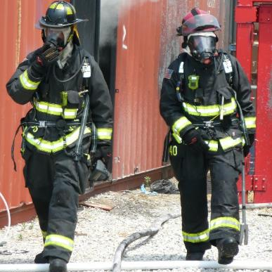
Other materials released during fires
Heavy metals
  Known Carcinogen: Cadmium
  Probable Carcinogen: Lead
Minerals / fibers
  Known Carcinogen: Silica and asbestos
Other flame retardants (brominated, chlorinated, and phosphorylated)
  Probable Carcinogen: Tetrabromobisphenol A
International Agency for Research on Cancer. Agents classified by the IARC monographs, volumes 1–129. [homepage on the internet] Lyon: IARC; [cited 2021 May 19; updated 2021 Mar 26]. Available from: http://monographs.iarc.fr/ENG/Classification/index.php.
Photo by NIOSH
Notes:
Other materials include Heavy Metals (Lead, Cadmium, Nickel, Mercury, Arsenic, and many many more.... Especially during urban/rural interface fires.
Urban/Rural are especially challenging due to the way that Wildland Firefighters work which is often without respiratory protection.

Slide 7
Biomarkers of Exposure
Matrix | Chemical Group | Analyte
Blood | Persistent organic pollutants (POPs) | Per and Polyfluoroalkyl substances (PFAS)
 |  | Polybrominated diphenyl ethers (PBDEs)
 | Metals | Cadmium
 |  | Lead
 |  | Manganese
 |  | Selenium
Urine | Organophosphate esters (OPEs) | Diphenyl phosphate and others
 | Metals | Chromium
 |  | Arsenic
 |  | Nickel
Notes:
For the biomarkers in Maui, we had to consider several factors including:
1.) What type of things are we likely to see in the smoke? Are the buildings old enough that asbestos is likely a significant concern? Silica?
2.) What type of sampling do we want to do? (Urine, Blood, skin wipes, exhaled breath, hair samples, chest X-rays, sputum, feces, etc....) All of these are potentially useful in evaluating exposures.
3.) What analytes are we seeing in the wildfire ash? Is it different in the residential, commercial, forest areas?
3.) How long will the substance remain? What are the biological half-lives of the biomarkers versus when can we get there to collect the samples?
So we decided on these analytes. I kinda wish we had been able to add mercury and lithium to the mix.... BUT... We also collected lipids and creatinine to better understand the results.

Slide 8
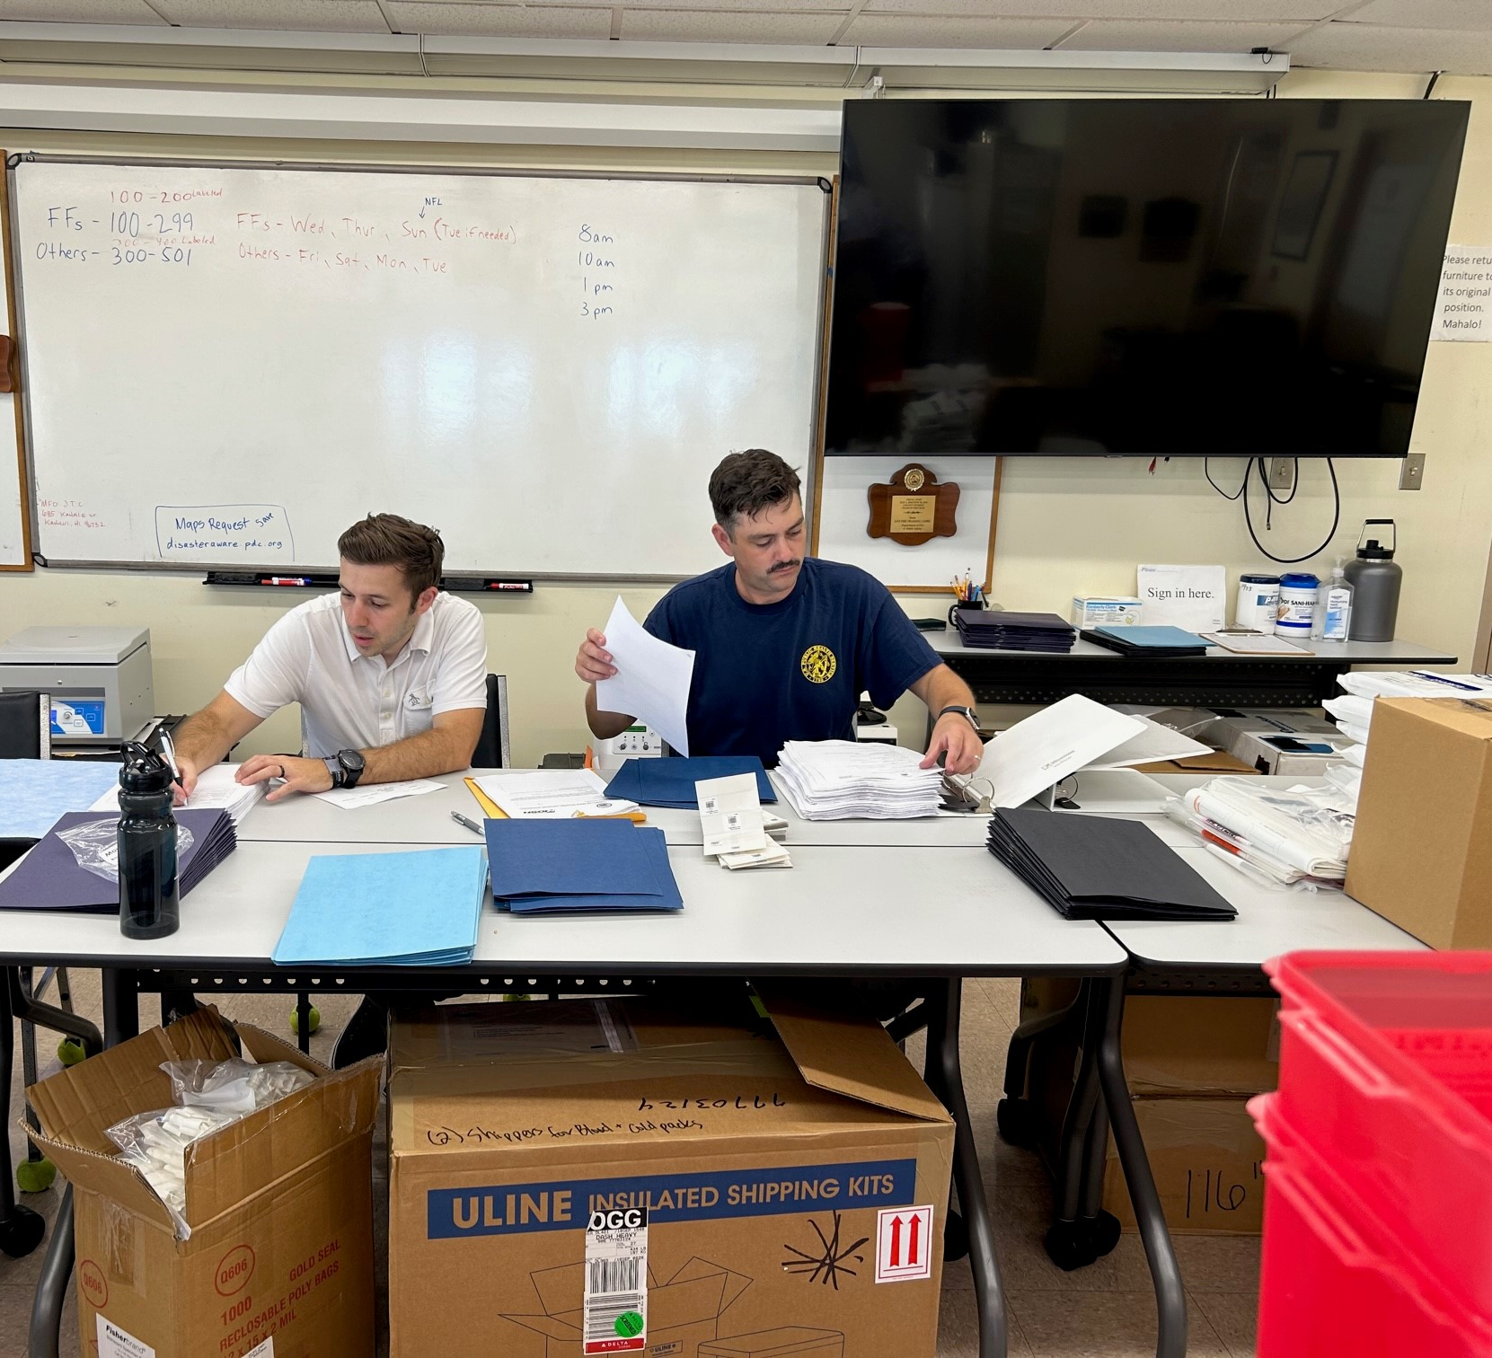
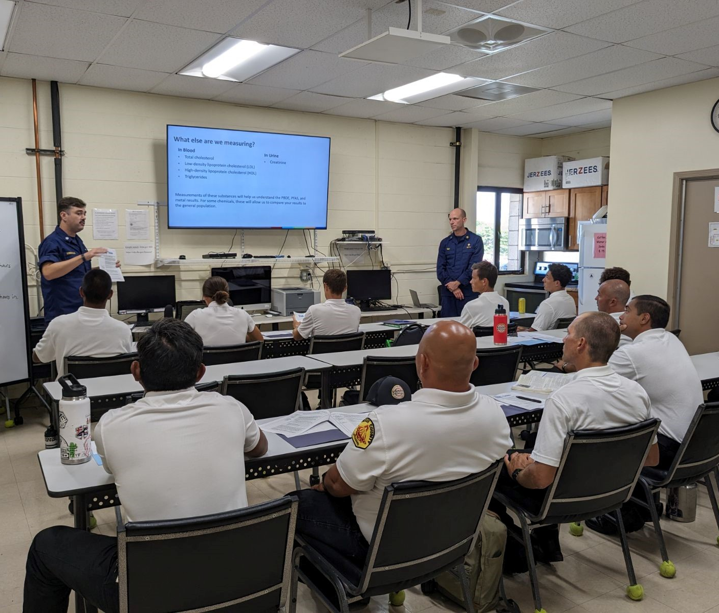
Informed Consent and Questionnaires
Photos by NIOSH
Notes:
The first step was to invite participants meeting the following inclusion criteria:
Inclusion Criteria:
To be included in this investigation, an individual must be either:
A firefighter that was employed by MFD at any time from August 8, 2023 through August 12, 2023, and be currently employed by MFD on the day of initiating participation in this investigation, OR
A non-firefighter Maui County employee that responded to either the Lahaina fire or Kula fire during August 8, 2023-August 12, 2023, and be currently employed by Maui County on the day of initiating participation in this investigation.
After that, we described the project and obtained the participants informed consent.
We did this in groups and delivered a short presentation then had individuals sign their consent.
Then we had the participants complete a questionnaire and an exposure worksheet. The questionnaire focused on demographics, which fire they responded to (Kuai or Lahaina), and when. IT was primarily closed questions using check boxes.
The exposure worksheet contained open ended questions to summarize work activities (including PPE used), time in the impact zone, location, type of fire, and response activities.

Slide 9
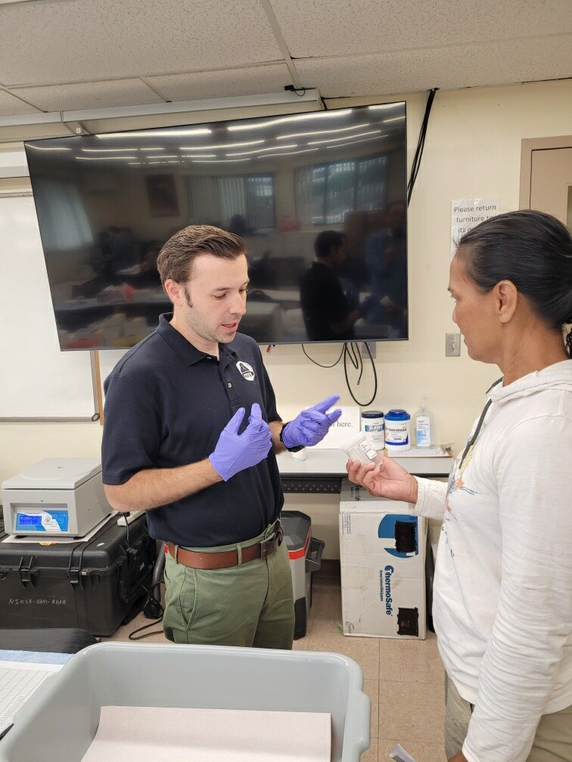
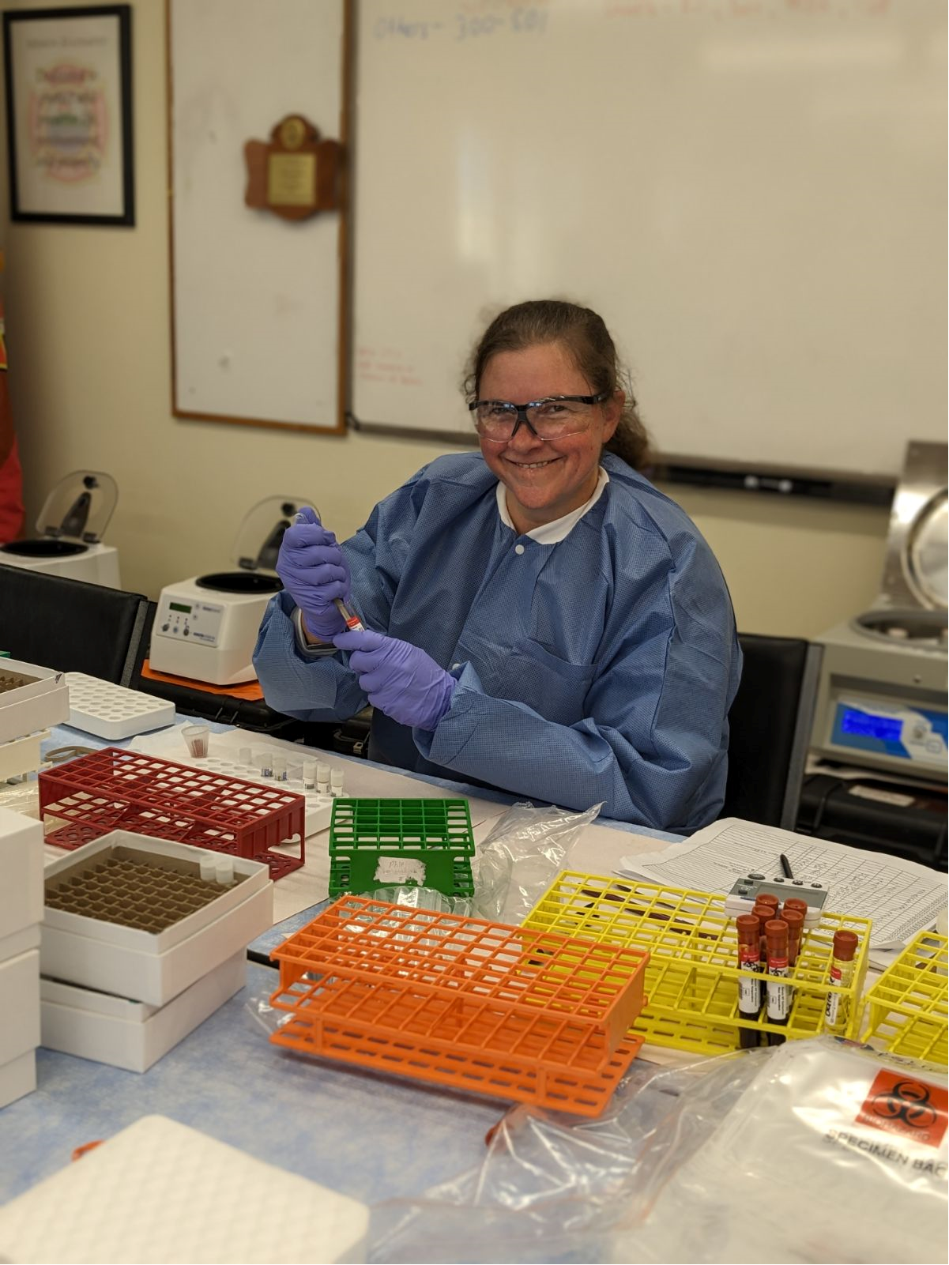
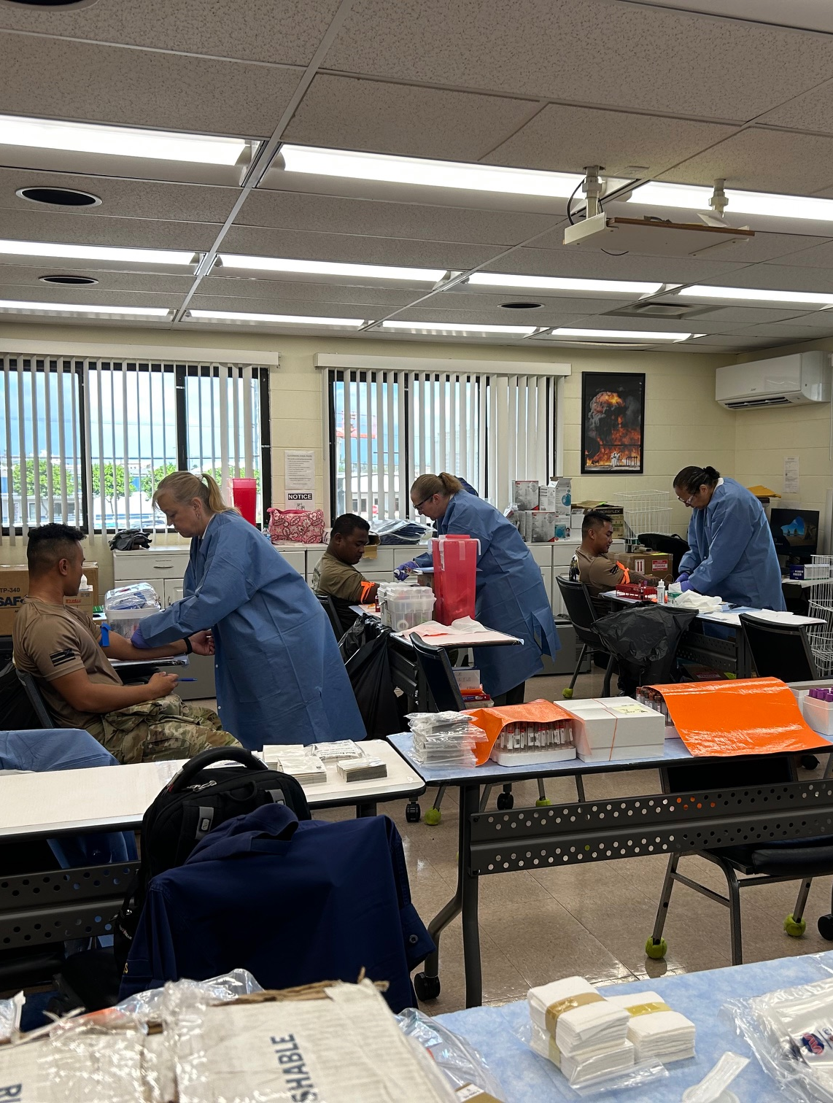
Collecting Samples
Photos by NIOSH
Notes:
Participants then went 2-4 at a time to give a urine sample and a blood collection.

Slide 10
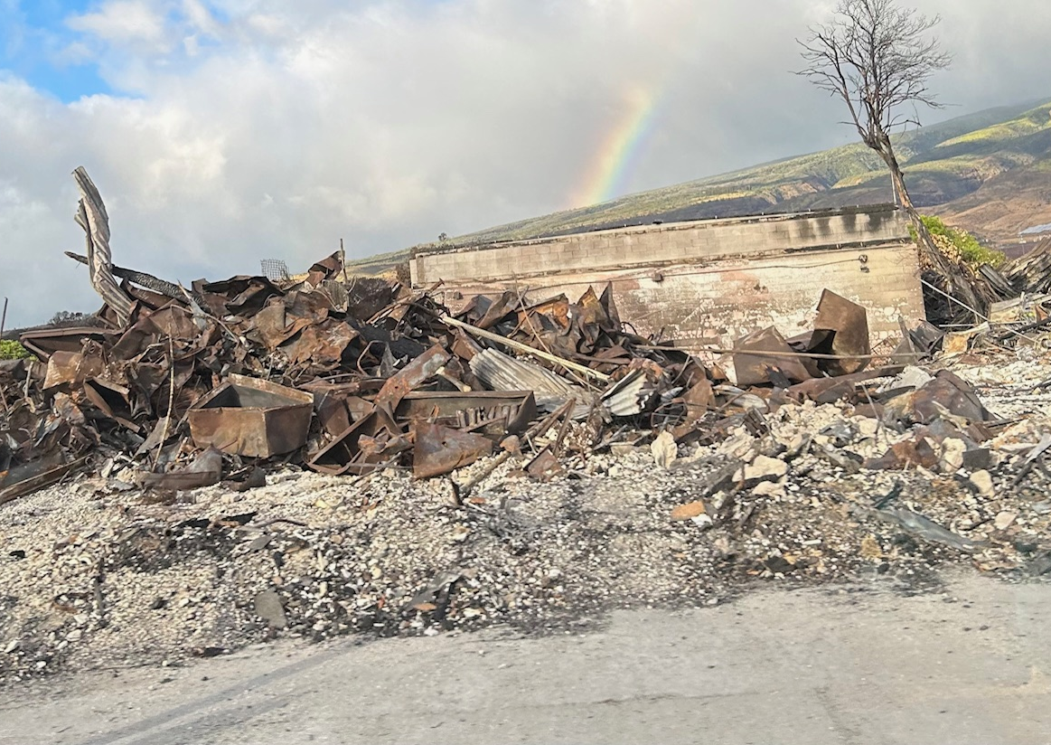
Special considerations
Trauma-informed participation
  PTSD
Logistics
  Island
  Lodging
  Limited supplies
  Timeline
Rapidly evolving
Fixed sample size
Results pending....
Photo by NIOSH
Notes:
Considerations of collecting data during a disaster situation....
1.) Many of the participants in this study lived through the disaster. Some lost their homes. Almost everyone knew someone who passed away. Although firefighters in general are fairly resilient, Post Traumatic Stress Disorder among the participants should NOT be ignored. Therefore, using a trauma-informed approach to questions and the study is essential. In addition, there was some hostility on the island to tourists/foreigners that required respect.
2.) The logistics of working on an Island is challenging. The island is remote and therefore shipping items to the island/from the mainland takes a long time. Lodging was very limited due to the displacement of residents, so careful consideration of where to hold the evaluation was essential. Supplies were very limited as well. So things like dry ice to keep samples cold during shipping, coolers, etc. was difficult to obtain. During typical studies we could utilize local hospital resources (labs, phlebotomists, etc...) however this situation necessitated procuring all necessary supplies and bringing them with us. Also the timeline between the fires and our sampling was a limiting factor.
3.) Although there were no active fires when we arrived, the situation continued to evolve rapidly. USAR teams were still looking for some missing citizens. Ash sampling was ongoing.
4.) The sample size was fixed. We were fortunate to be able to get almost 300 participants, but the fixed sample size limited the power of the study.

Slide 11
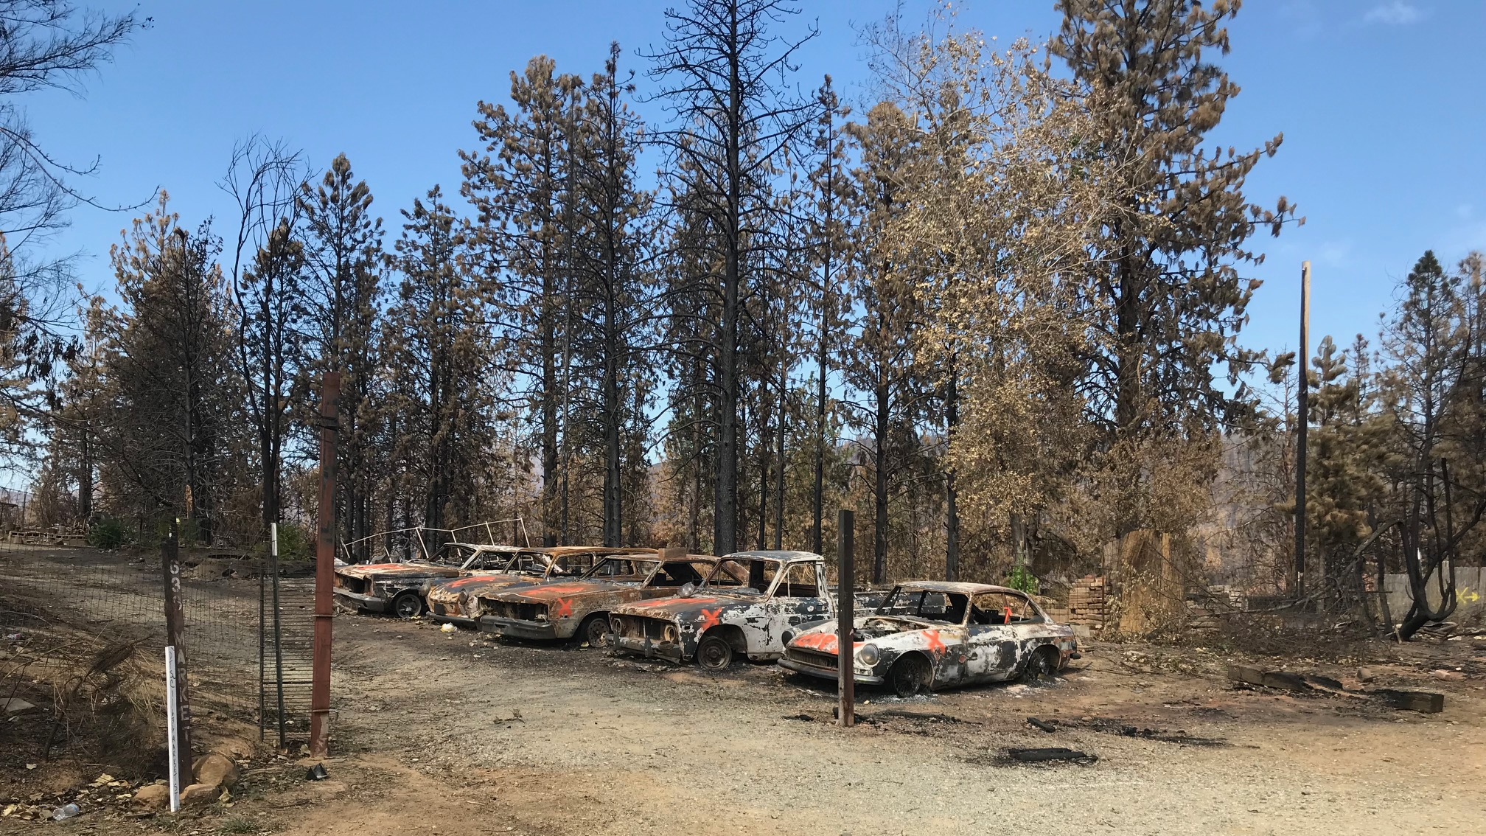
Fire debris cleanup after the California Wildfires
Photo by NIOSH
Notes:
Another important consideration for wildfire exposures include after the fires have been extinguished. What has been left behind can still contain plenty of hazards.

Slide 12
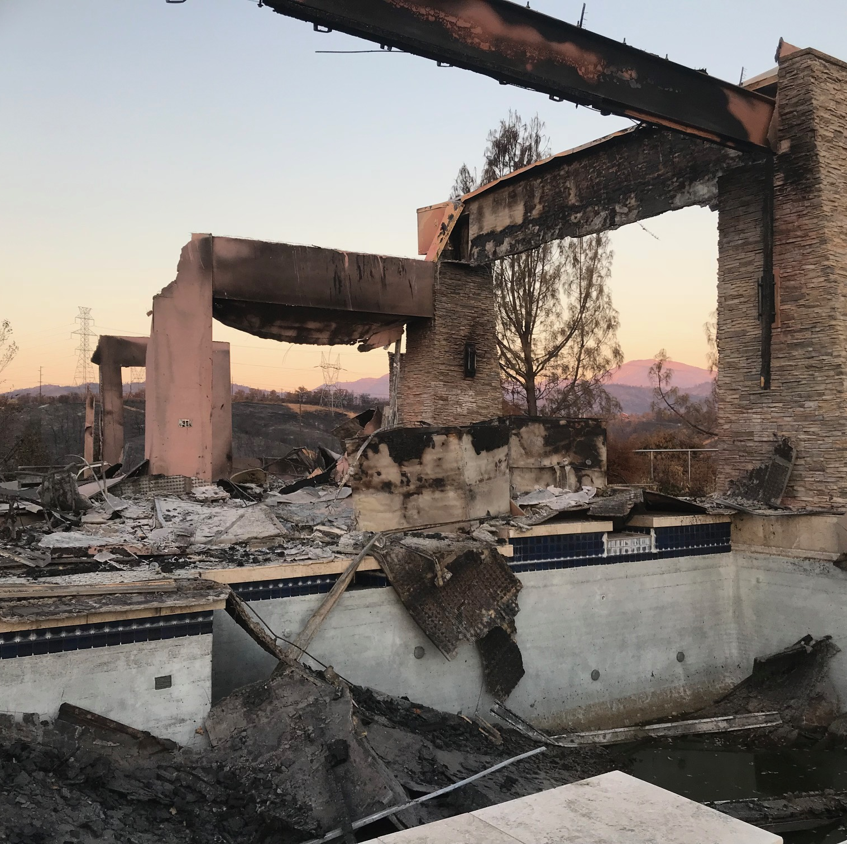
California Wildfire Debris Cleanup
Carr Fire—Shasta and Trinity County California
6th most destructive in California History
  229,651 acres burned
  1,079 residences destroyed
  22 commercial buildings
  503 outbuildings
Fully contained August 30, 2018
Hazardous materials need to be removed to protect the public and the environment
Source: https://www.fire.ca.gov/incidents/2018/7/23/carr-fire
Photo by NIOSH
Notes:
The Carr Fire was the sixth most destructive wildfire in California history burning 229,651 acres and destroying 1,079 residences, 22 commercial buildings, and 503 outbuildings before it was fully contained on August 30, 2018. Hazardous materials left behind in the fire debris should be removed in a safe manner to protect the cleanup workers, general public, and the environment before rebuilding can occur. Debris cleanup is typically done by construction crews consisting of operators and laborers.

Slide 13
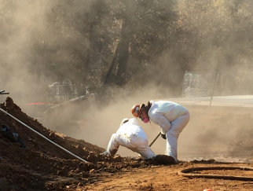
Some of the hazardous materials that may be found in fire debris
Respirable crystalline Silica (RCS)
Asbestos
Metals
  Lead, beryllium, cadmium, lithium, arsenic, mercury, aluminum, etc...
Polycyclic aromatic hydrocarbons (PAHs)
Photo by NIOSH
Notes:
When wildland fires extend into residential areas, after the fire has been extinguished, construction crews must be brought in to clean up the debris that has been left behind. Remnants of burned residential structures may contain respirable crystalline silica (RCS) (typically quartz) from demolished concrete used in foundations, walls, and roofing tiles or naturally occurring in the rocks and soil. Cristobalite (another form of RCS) is typically found in igneous rocks, which are formed as a result of previous volcanic activity. Depending on the age of the building, asbestos can also be present. Home electronics and melted vehicles can leave behind various metals such as lead, cadmium, and aluminum. Additionally, potentially carcinogenic substances found in soot (burn ash) called polyaromatic hydrocarbons (PAHs), also known as polycyclic aromatic hydrocarbons, may also be exposure hazards.
RCS and asbestos exposures may lead to chronic respiratory diseases and lung cancer. Metals, such as lead, beryllium, and cadmium, can damage many organ systems and some have been associated with the development of cancer. Lead exposure may also lead to high blood pressure and kidney problems in adults, and permanent neurological damage in children if brought into the home. Most of the 18 PAHs in soot are suspected or known to cause cancer.

Slide 14
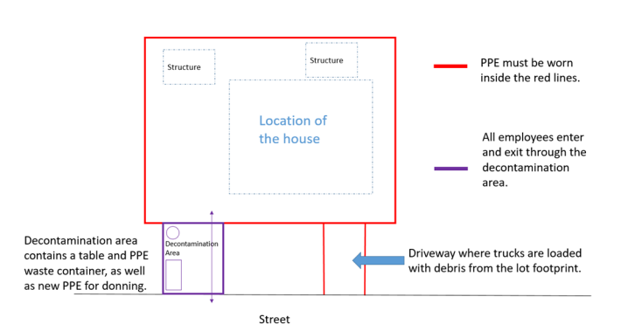
What did we do?
Evaluated exposure to RCS, asbestos, metals, and PAHs in air
Evaluated exposure to metals and PAHs on the skin
Evaluated representative task forces consisting of one task force lead, one equipment operator, and two laborers
Taskforce operated by “lots” which took ~ 3 days to clear
Notes:
Our objective was to evaluate fire debris cleanup employees’ exposure to RCS and asbestos in air, and metals and PAH in air and on the skin.

Slide 15
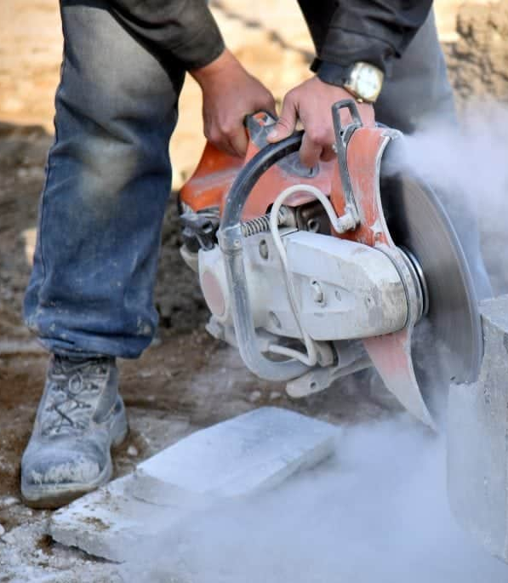
What did we find?
RCS
  We detected RCS in 73% of the samples
  Mean air concentration was 13.2 µg/m³ (Range 2.4 to 76 µg/m³)
  2 of the 7 skid steer operators had airborne exposures above the OSHA Action Level of 25 µg/m³
  One of the 7 was also above the OSHA PEL and NIOSH REL of 50 µg/m³
Asbestos Fibers
  All air samples were below the applicable OELs (0.01 f/cc)
  Likely due to asbestos abatement of destroyed homes prior to debris cleanup
µg/m³ = micrograms per cubic centimeter; f/cc = fibers per cubic centimeter; PEL = Permissible Exposure Limit;
REL = Recommended Exposure Limit
Photo by NIOSH

Slide 16
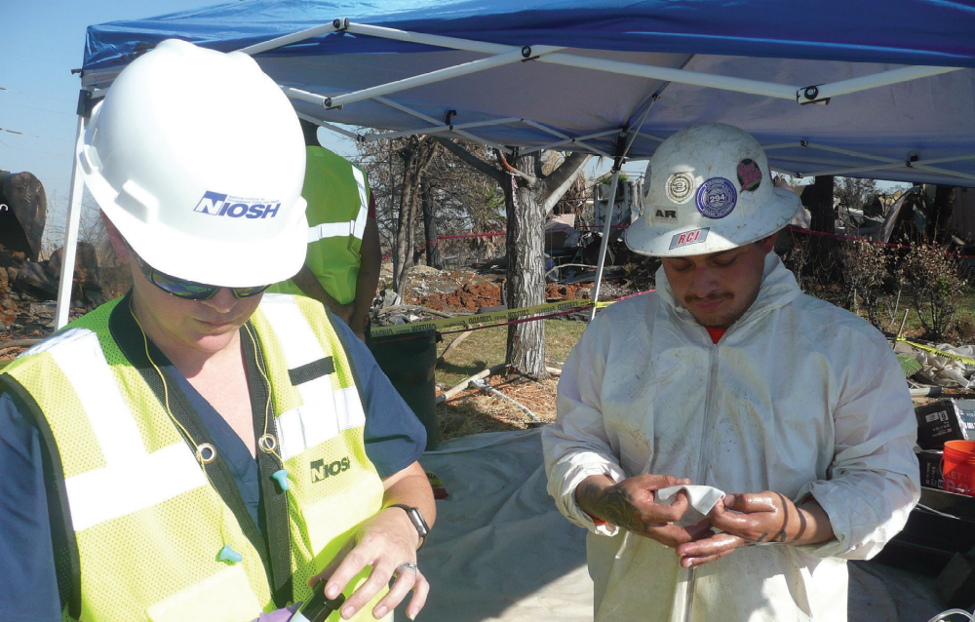
What did we find?
Photo by NIOSH
Metals
  No air samples for metals exceeded applicable OELs
  We found metals on employees’ hands at lunch and just before leaving the worksite
PAHs
  We detected some PAHs in air; all were below applicable OELs
  We detected some PAHs on skin wipes
  Sun/light exposure could have degraded the PAHs in ash
Photo of collecting hand wipe samples for heavy metals

Slide 17
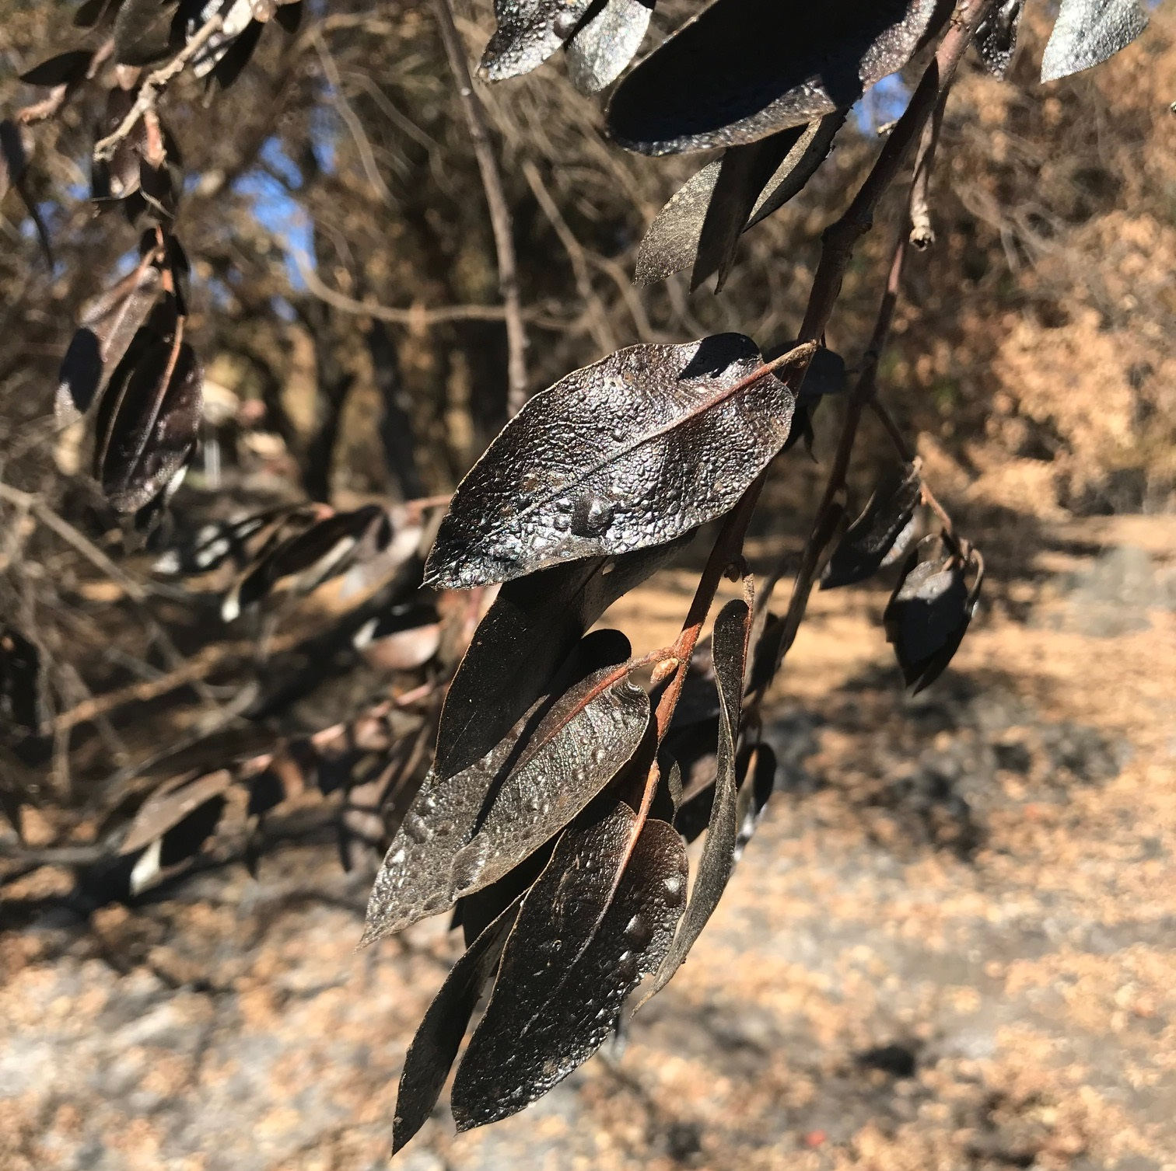
Special Considerations
California has a very clearly described process for debris cleanup and returning the lots to the homeowners
  Other states might not have this
The “skid-steer” operators were more exposed than the closed-cab excavators because they did not have to in-cab filtration
  Not all excavators have in-cab filtration
Utilizing wet methods during dusty operations like sawing helped to reduce exposures
  In some neighborhoods a spray truck could dampen the rubble which helped to reduce exposures
Photo by NIOSH

Slide 18












Recommendations
Reduce employees’ exposures to respirable crystalline silica and educate employees on silica and silicosis
Develop a medical monitoring program
Reduce the amount of lead and other metals on the employees’ hands and work clothes
Require consistent use and enforcement of personal protective equipment and decontamination procedures among all contractors and subcontractors
Notes:
Ensure water spray is consistently used
Improve silica education
Develop a medical monitoring program
Add handwashing facilities and lead-removal handwipes at the decontamination tent
Require employees to wash their hands after leaving the lot footprint and before eating and drinking or smoking
Require employees to change shoes prior to going home to avoid tracking dust containing lead and other heavy metals home
Provide only nitrile gloves to employees
Ensure methods used to decontaminate footwear on exiting the lot are adequate and followed
Ensure all task forces comply with the respiratory protection standard
Ensure all employees who are exposed to hazardous levels of noise are protected.

Slide 19

Questions?

Slide 20
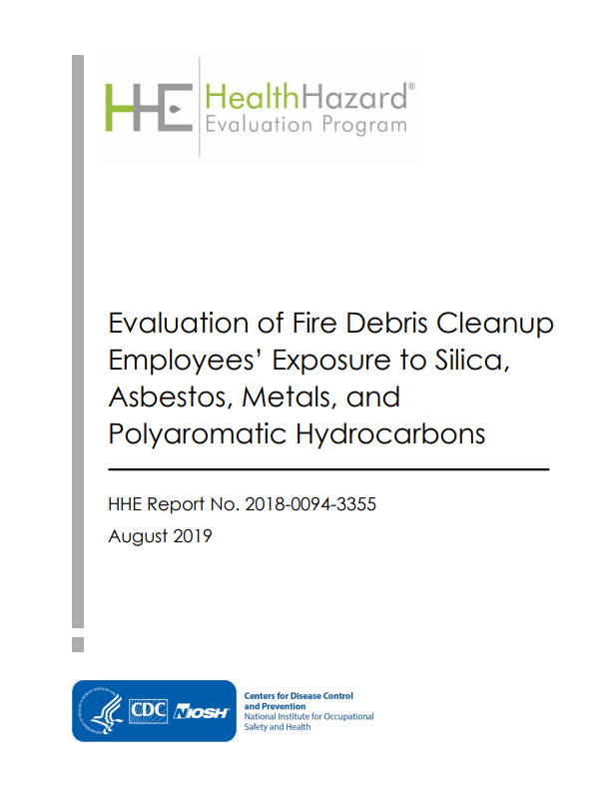

Thank you!
Contact information:
Catherine Beaucham
htn9@cdc.gov
(513) 841-4259
https://www.cdc.gov/niosh/hhe/reports/pdfs/2018-0094-3355.pdf
Notes:
Please let me know if you have any questions, now, or you can contact me at any time. Thank you!

