Slide 1
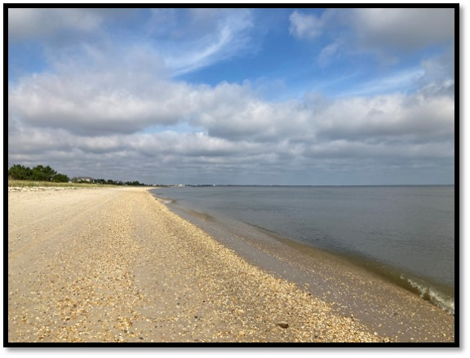
Broadkill Beach Oil Spill
USCG Sector Delaware Bay
RRT Presentation
19OCT2020 – 12NOV2020
Todd Wardwell, USCG
FOSCR (ret), Sector Delaware Bay

Slide 2
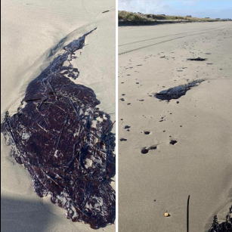
Initial Actions
USCG – Duty FOSCR notified at around 7 pm by USCG Commcen and was grilling on his back porch.
DNREC OSC called the FOSCR directly and stated that this spill was the “real deal” and that a response needed to happen ASAP
FOSCR and SOSC had a long response relationship and if the SOSC said it was legit than the FOSCR did not blink or question his judgement. The FOSCR notified his chain that he was going to open the OSLTF that night and issue an ATP(Authorization To Proceed) to a CG contracted OSRO.

Slide 3
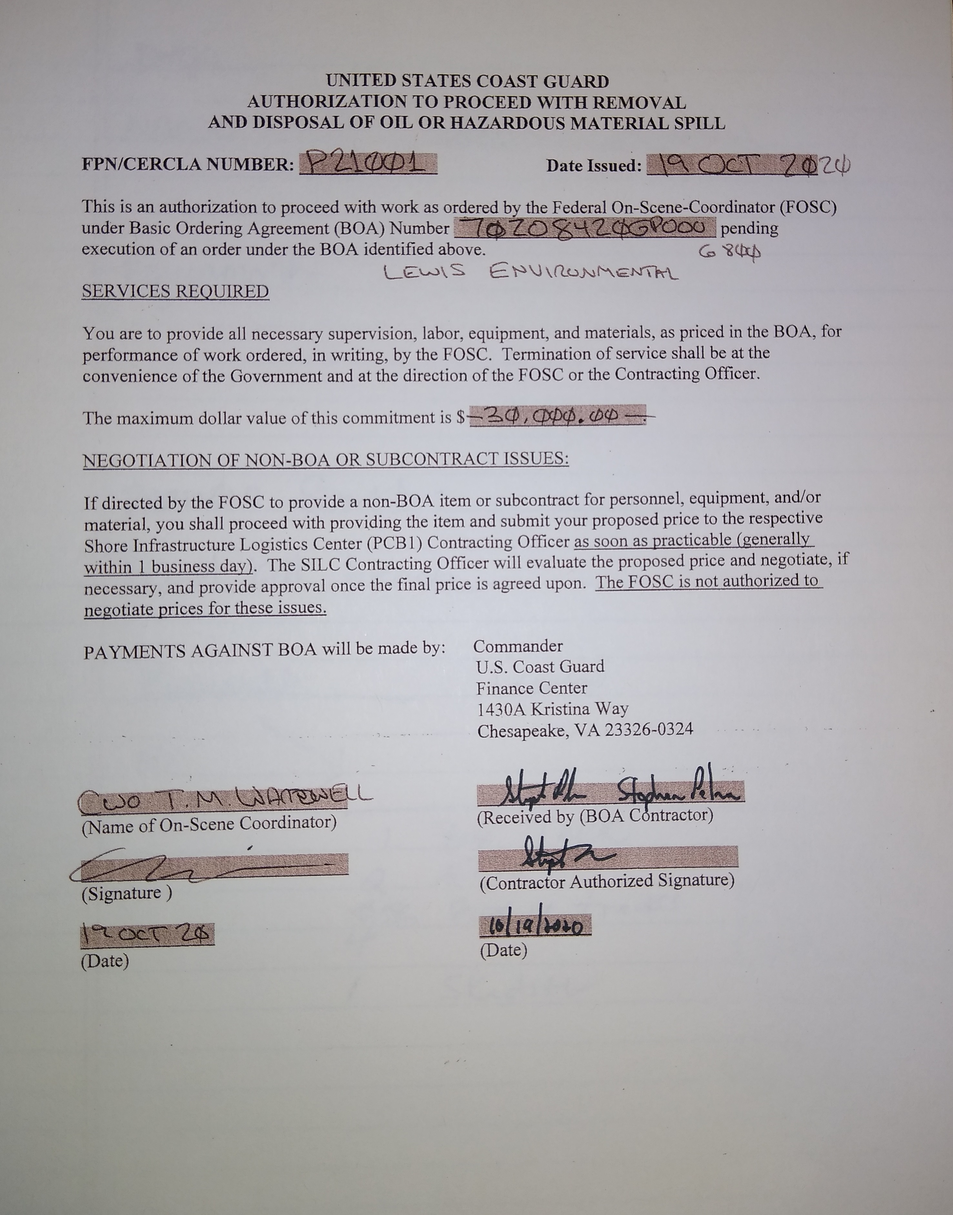
Initial Actions
OSLTF was opened for 30K
Message traffic and notifications were done prior to midnight on 19 Oct 20.
Due to the oil being already impacted on the shoreline and not as much in the surf or floating an OSRO that had more local resources but lesser “on water” assets was chosen.
D5 DRAT and NOAA were requested in advance for consultation. They did not do consultation on the 19th. Just prepped.

Slide 4
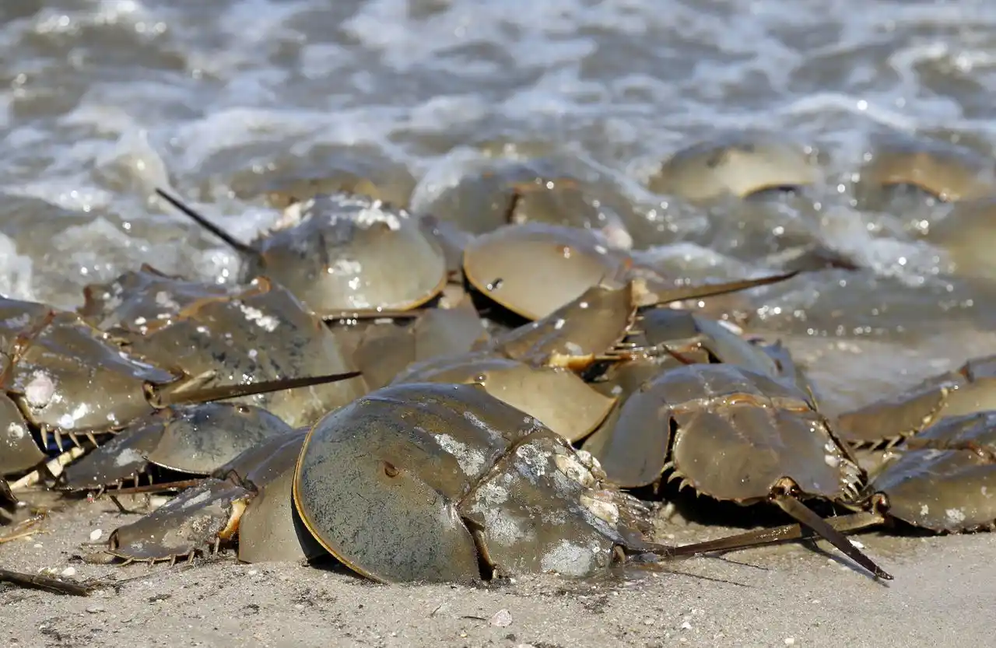
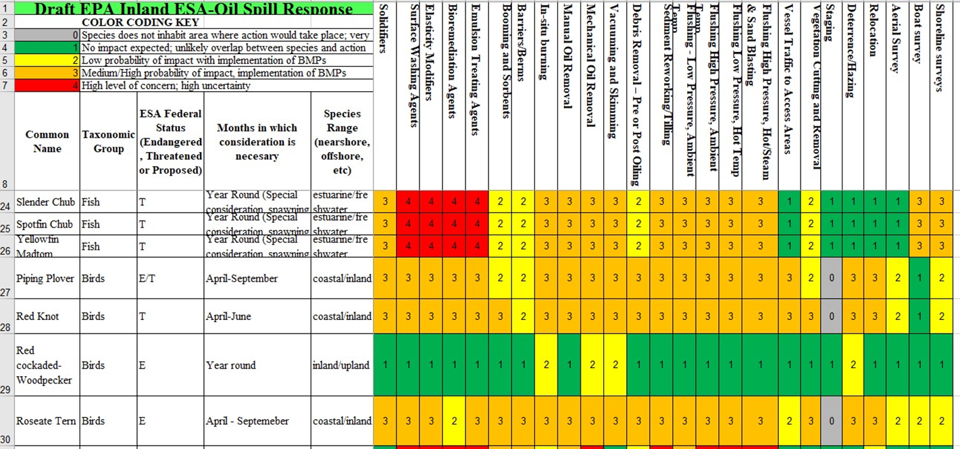
Initial Actions
Local threatened and endangered species matrix was used in advance of the consultation just to get an idea of what to look out for prior to potential SCAT team deployments.
Due to the season and areas affected there were few if any species that needed immediate CIR (Critical Incident Reporting) status on the incident action plan.
MISLE case started. CANAPS was used to request funding. IMSS (Incident Management System Software) used to start an ICS-201 for initial Incident Action Plan.

Slide 5
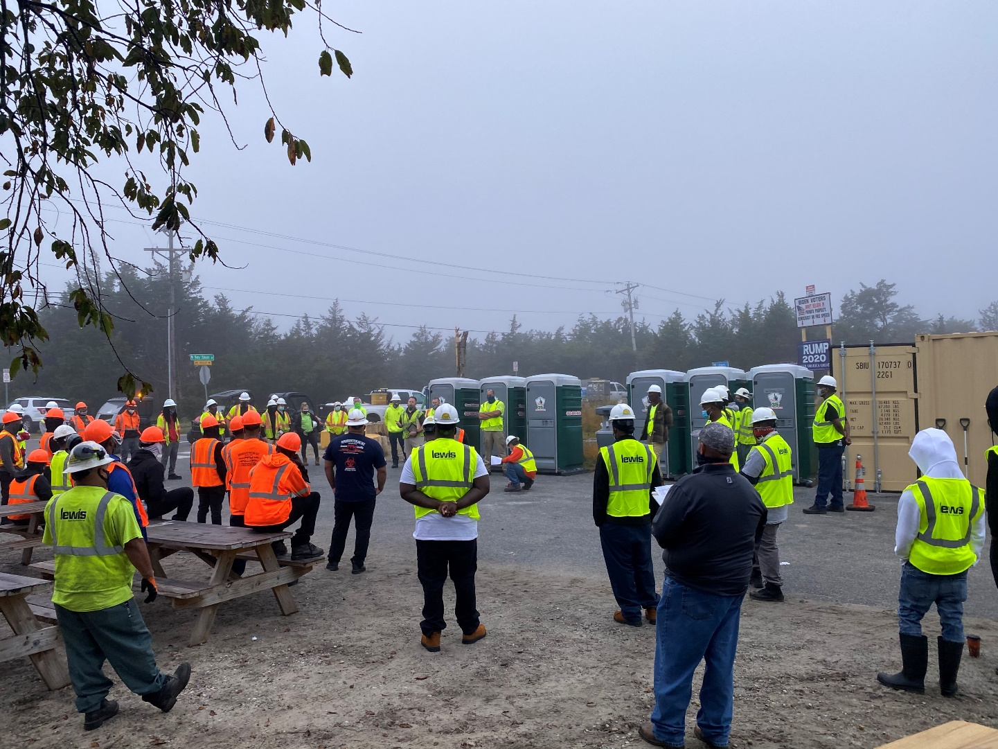
First Day On-Scene
USCG responders from Marine Safety Detachment Lewes and DNREC conducted beach assessments at first light
Up to “Manhole” size oil patches were spotted all over Broadkill beach in random patterns up in the low and high surf line.
FOSCR requested several members of an incident management team to stand up a future Unified Command Post. The initial command post was to be located at the Slaughter Beach Fire House which was located very close to the spill site.
Sector Del Bay members travelled down to the Fire House. Lewis Environmental was asked to stage resources at the beach access at Broadkill to include roll off boxes and response trailers.
Due to distances involved on the beaches and lack of ESA species at risk, the Atlantic Strike Team was requested to provide ATV teams and Cost Documentation assistance.

Slide 6
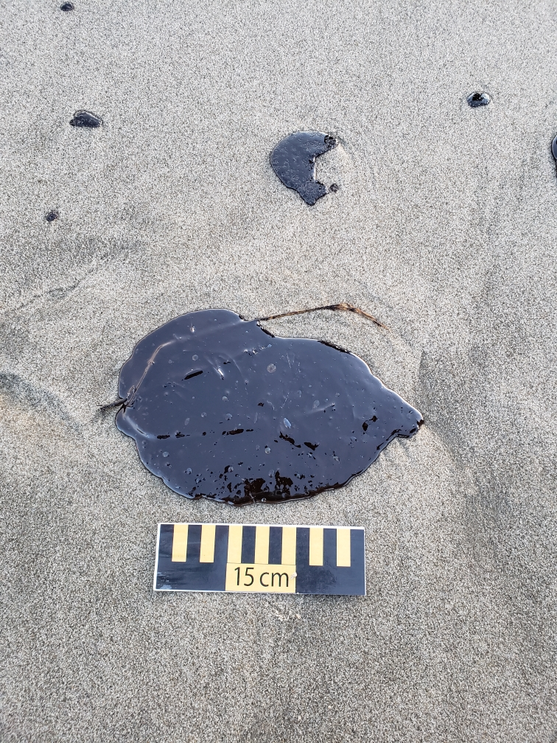
Challenges At the Time:
Hotels were NOT open due to it being the off season in Delaware.
COVID was still in full swing. Many restaurants were not open, and many hotels had limited capacity.
DE state law did not allow the rental of large spaces for above 20 people. (NO ICP available for rent!)
Presidential election was occurring in November. Presidential candidate Biden only lived 30 miles from spill.
Biden Environment center was in the spill path.
Federal agencies other than USCG needed “permission slips” signed by the FOSC due to COVID concerns. CG Aux also needed “hold harmless” certs signed prior to deployment.
Getting contractors brought in from other states which is normal for OSRO’s became VERY problematic due to competing disasters, COVID protocols, worker shortage.

Slide 7
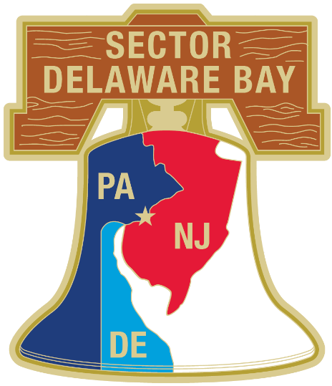



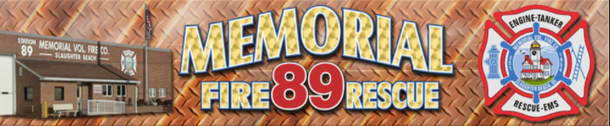
Unified Command Composition
USCG – Sector Delaware Bay
  LCDR F. Pugh
DNREC – Delaware Department of Natural Resources and Environmental Control
  Mr. M. Higgins
USCG – Sector National Capitol Region
  LT S. Sigler
MDE – Maryland Department of the Environment
  Mr. G. Donahue
*USCG Sector VA was deployed to investigate tar balls impacting Assateague National Seashore

Slide 8
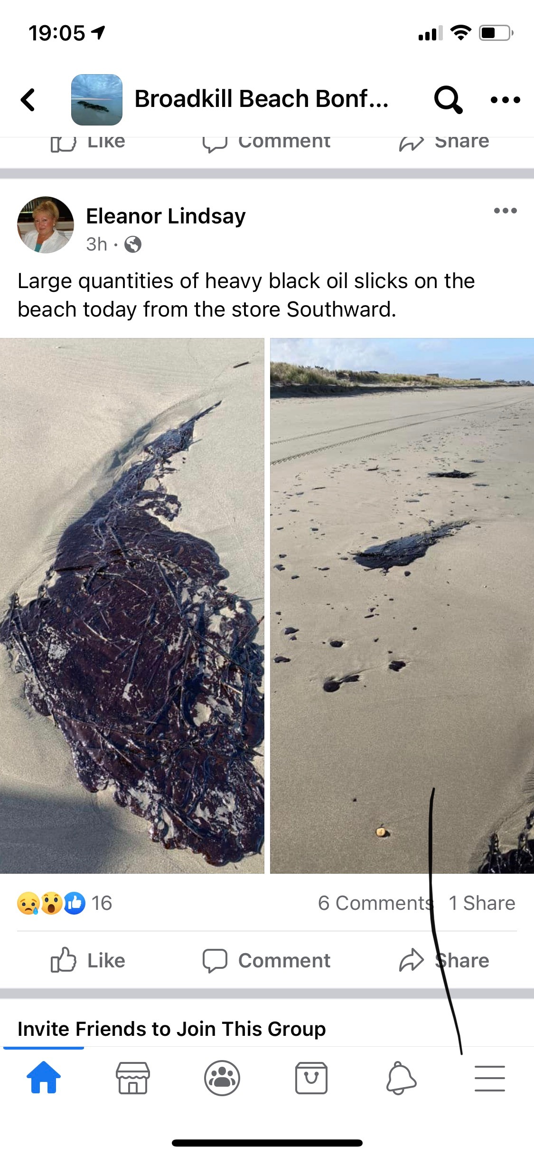
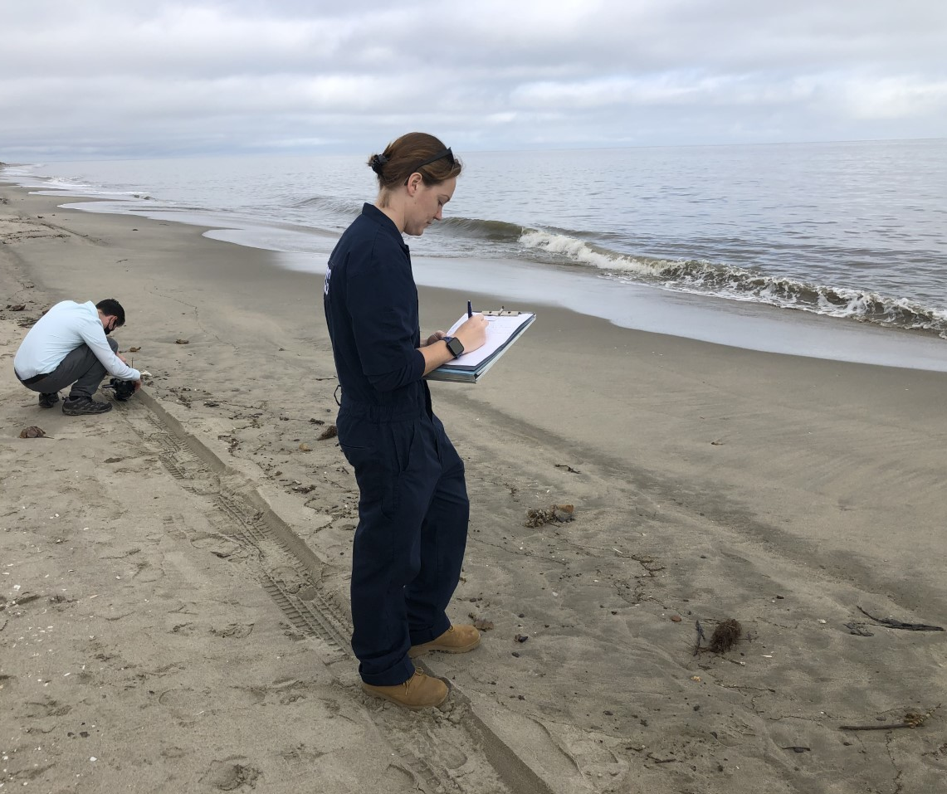
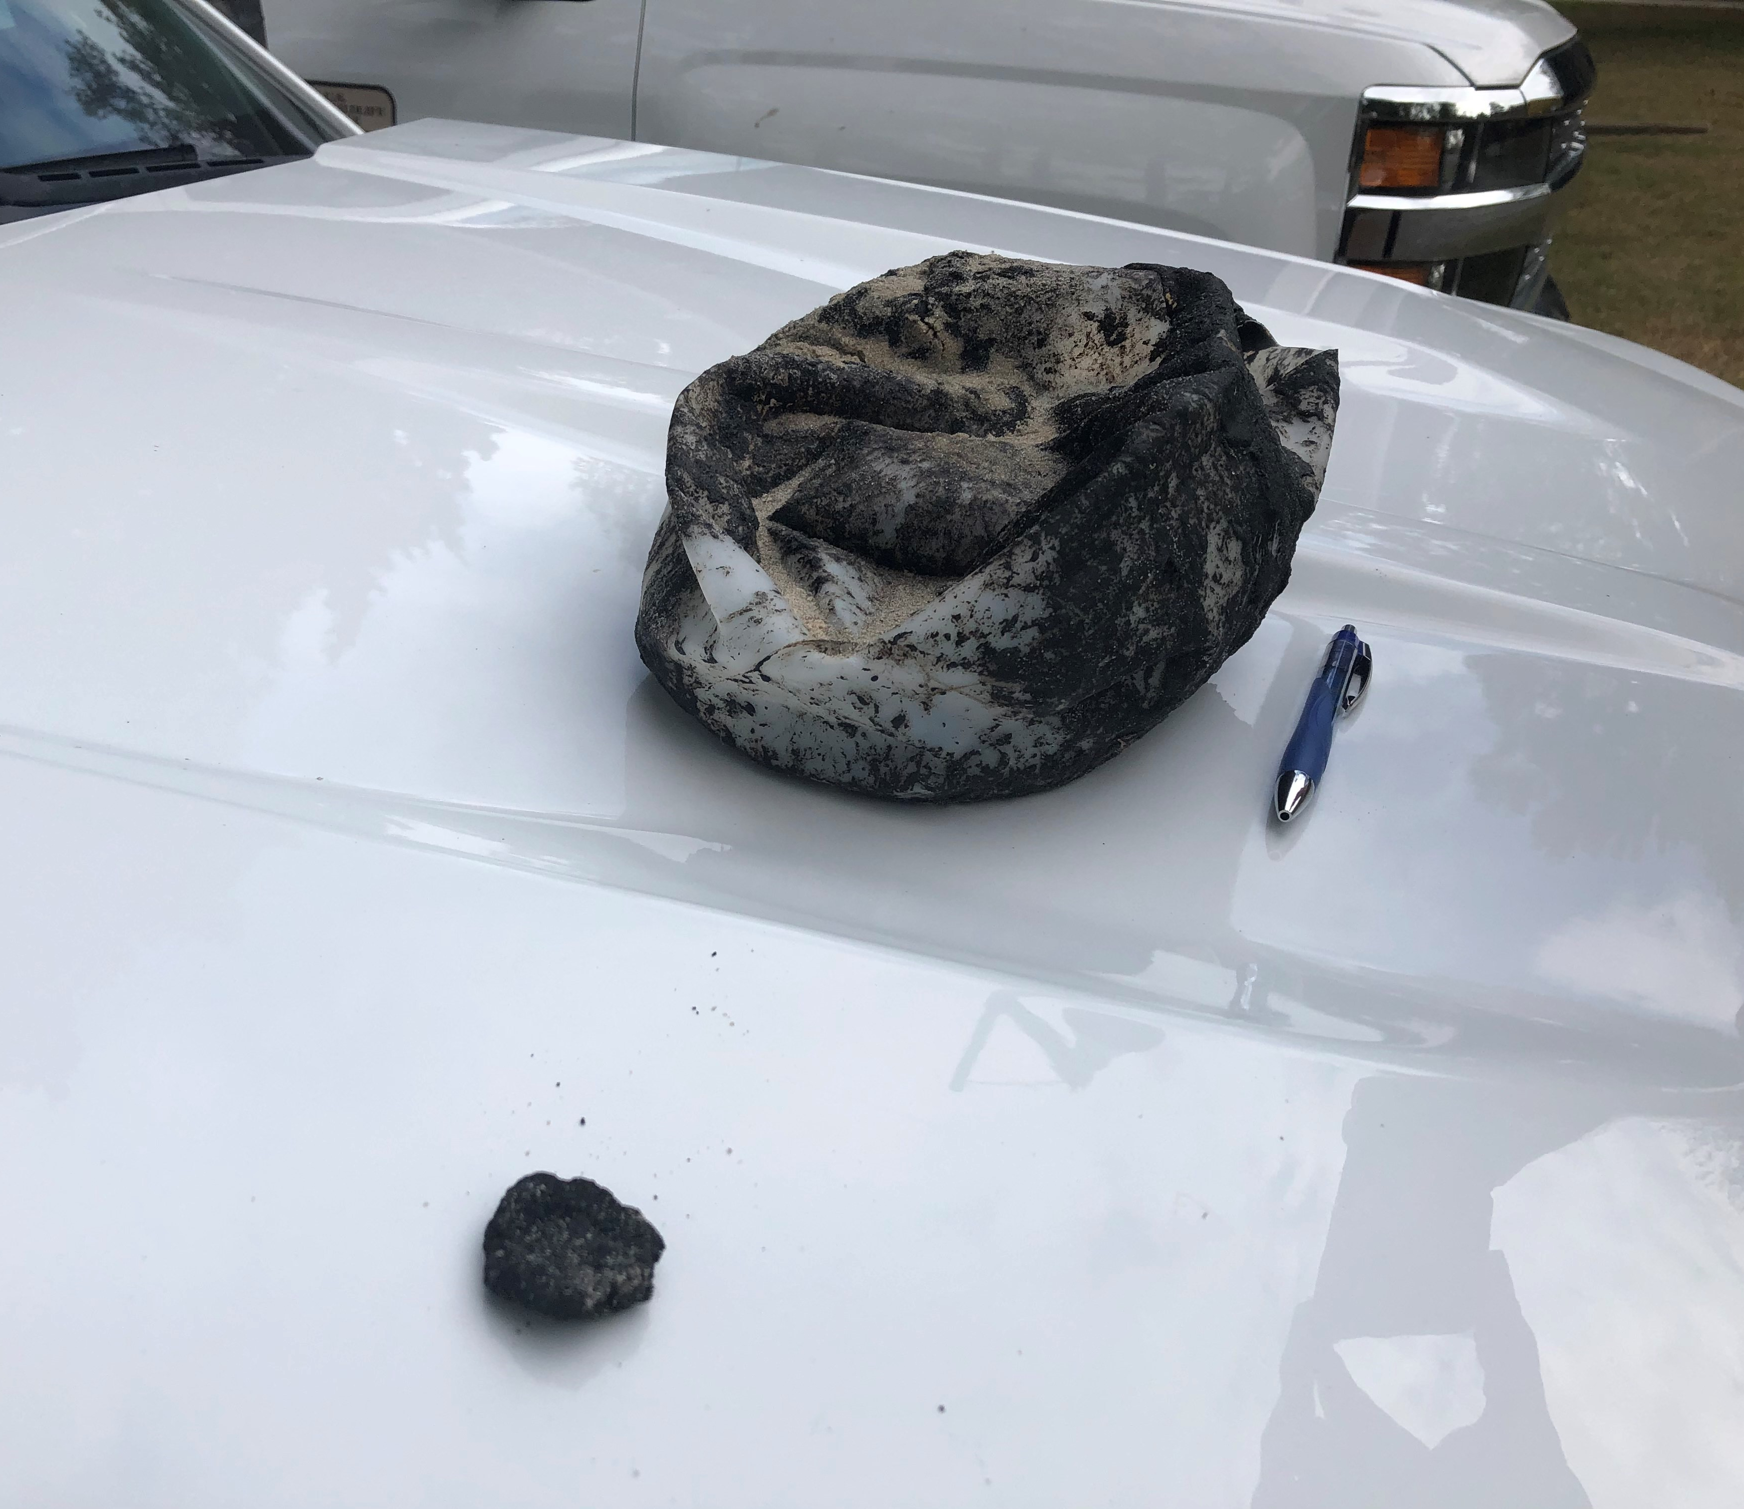
Public Affairs Challenges
The Weather got REALLY warm for the time of year and many people went to the beach….
The many miles of shorelines meant there were lots of towns involved with many property owners.
No RP was involved and there were no leads on finding one.
Sec Del Bay had a Public Affairs detachment in Atlantic City, NJ but it was disbanded in 2019.
There were never enough responders to talk to or respond to residents calling in for someone to come look at their property or clean up their beach.

Slide 9
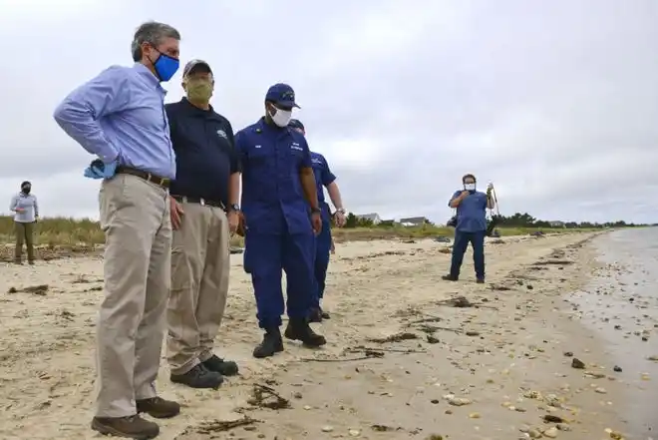
Public Affairs Successes
An immediate resource request went out to D5 Public Affairs for 2 Public Affairs Petty Officers to come manage outreach messages, VIP visits, social media blasts and arrange conference calls. They were invaluable.
The IC decided to take 30 minutes per day and gather up all the mayors of all the affected towns and do a conference call. Some of the larger homeowner's associations were also added. This allowed local governments to answer and take residents questions directly while keeping a local “chain of command”. It worked great.
Gov of Delaware, Matt Higgins, DNREC SOSC, LCDR Pugh (IC)

Slide 10
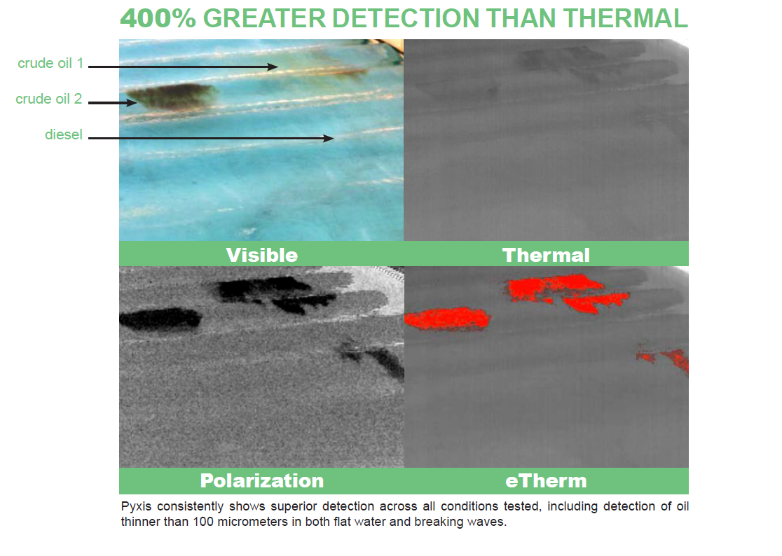
UAS Operations
SEC DEL BAY had spent the previous few years working on UAS operations with commercial companies.
Cape May NJ holds a Certificate of Authorization (COA) to fly UAS beyond visual line of sight that includes most of the shoreline of the lower Delaware Bay
AATI and Skyscape worked on developing a useful "oil spill" camera that could be used to detect and document the spill.
This led to the development of the OSCAR UAS (Oil Spill Clean-up And Response). It uses the very efficient PYXIS multi-spectrum camera system attuned to petroleum products.

Slide 11
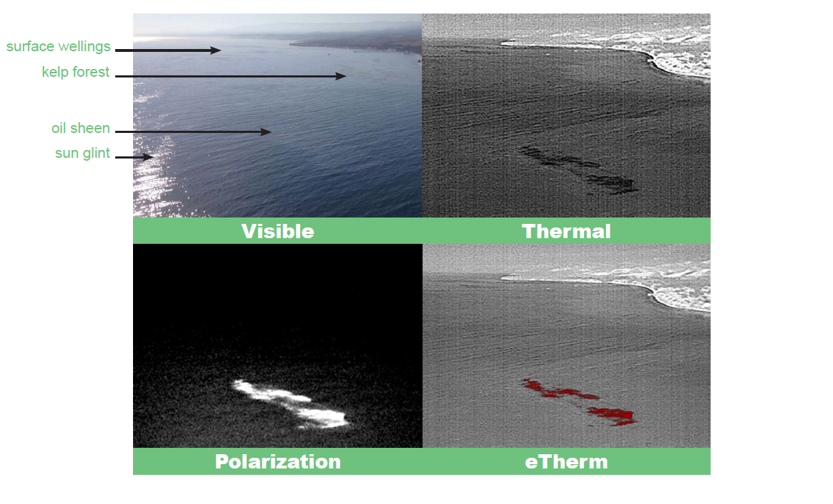
UAS Operations
SEC DEL BAY had spent the previous few years working on UAS operations with commercial companies.
Cape May NJ holds a Certificate of Authorization (COA) to fly UAS beyond visual line of sight that includes most of the shoreline of the lower Delaware Bay
AATI and Skyscape worked on developing a useful "oil spill" camera that could be used to detect and document the spill.
This led to the development of the OSCAR UAS (Oil Spill Clean-up And Response). It uses the very efficient PYXIS multi-spectrum camera system attuned to petroleum products.
Crude Seeps, Santa Barbara, CA

Slide 12
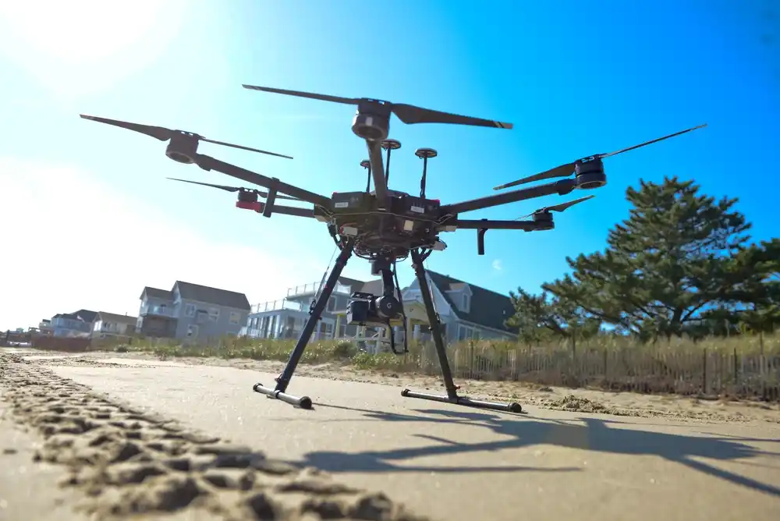
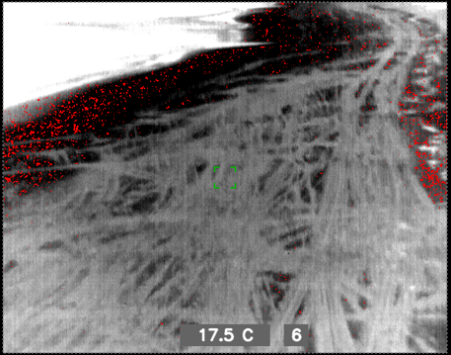
UAS Operations
American Aerospace and Skyscape was brought in to test the OSCAR and to provide aerial oil spotting.
Total cost for 8 HOURS of on-scene flight time was $1200. 2 hours of flight time (30 minutes on-scene) in a USCG HH-65B Dolphin cost $21 K. 2 Hours of flight time (1 hour on-scene) in a civilian helicopter cost $2300.

Slide 13
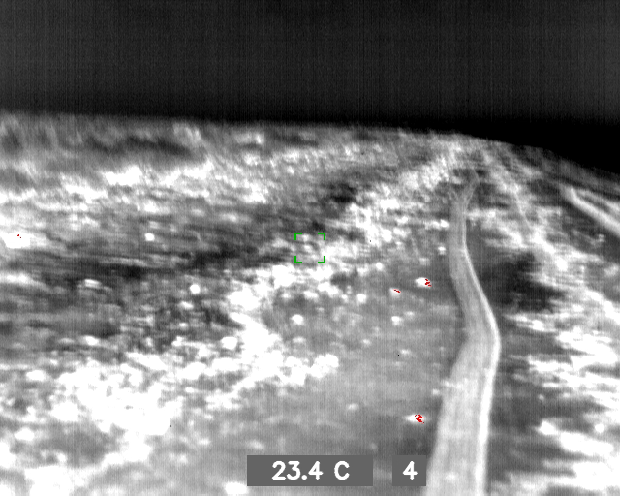
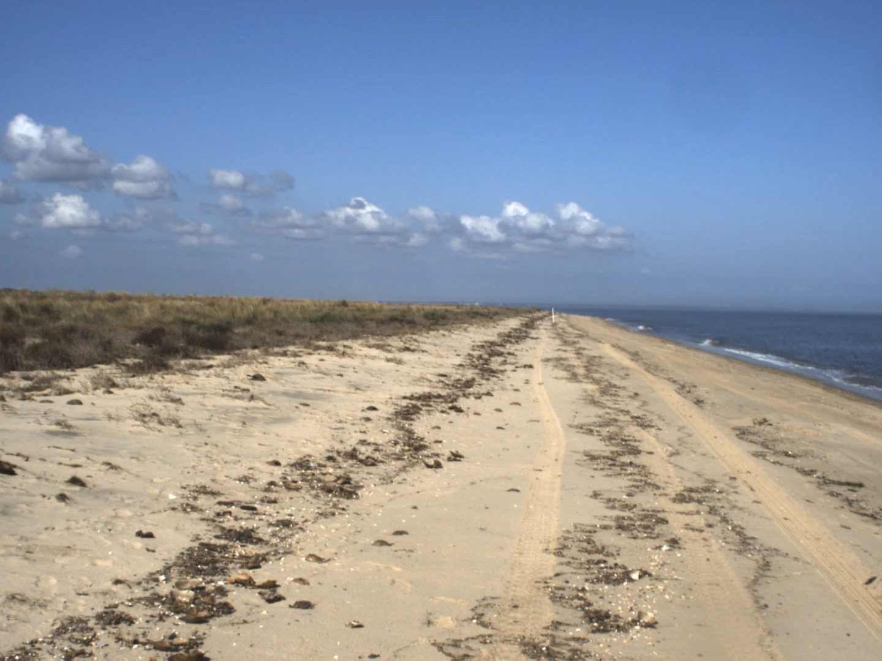
UAS Operations
UAS flights were conducted over 4 days. Weather was prohibitive for several of them.
The UAS was test launched from a 43-foot boat successfully to look for oil in the rack line near a jetty.
OSCAR could see and tag oil targets that were almost impossible for the human eye to distinguish from debris.

Slide 14
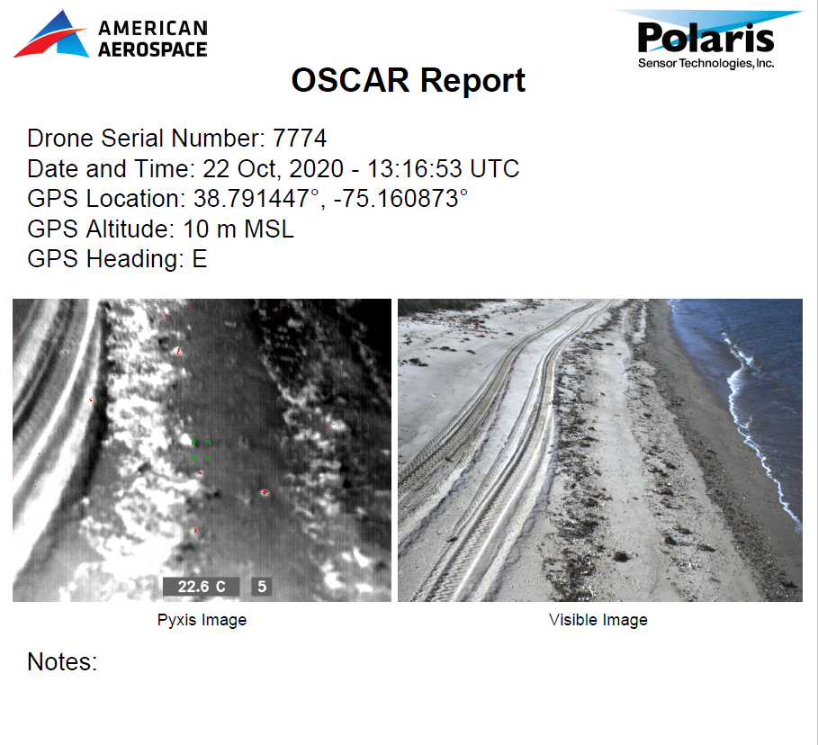
UAS Operations
After each flight an onboard computer would generate a quick .pdf report on each instance that the pyxis camera got a hit on and tag it with a lat/long, heading, date time, etc.

Slide 15
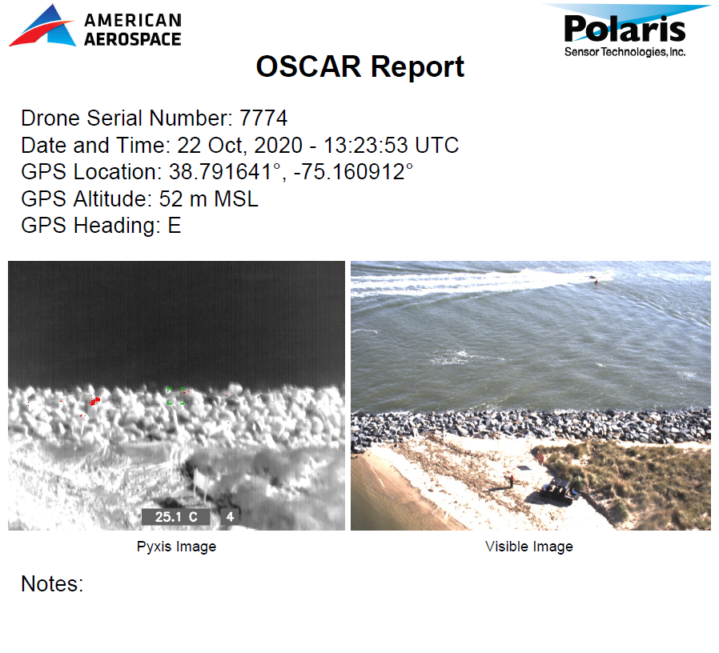
UAS Operations
After each flight an onboard computer would generate a quick .pdf report on each instance that the pyxis camera got a hit on and tag it with a lat/long, heading, date time, etc.

Slide 16
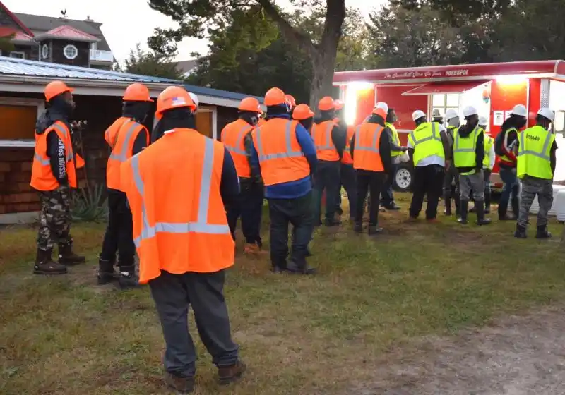
Logistics Hurdles
COVID!
OSRO was not legally allowed to put more than one person per room. This skyrocketed clean-up costs.
Hotels were not open and had fewer rooms.
Contractors came from out of state.
Health departments and other disasters had already scooped up much of the nation’s environmental contractors

Slide 17
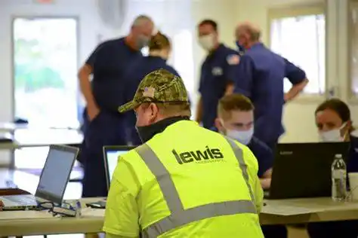
Logistics Hurdles
Unified Command Partners wanted more contractors on the beach. They demanded we hire more OSRO's.
There are only 2 major labor providers for the majority of the East/Gulf Coast to provide clean up contractors.
Hiring another OSRO would have been pointless as the 2 labor providers were "tapped out".

Slide 18
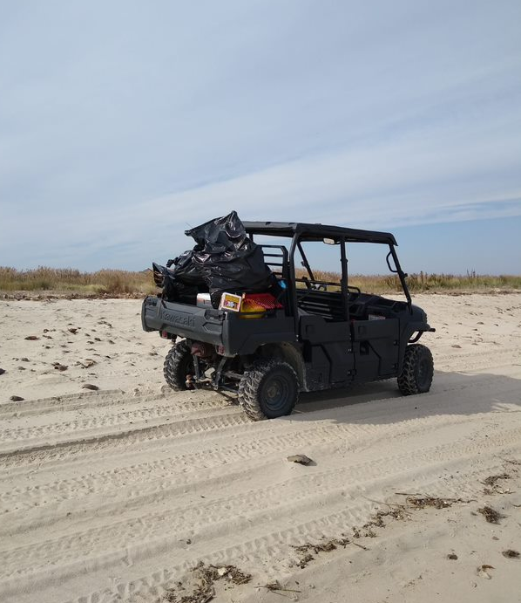
Logistics Hurdles
4x4 off-road vehicles were problematic. Some worked great. Some were awful. Full sized vehicles could not be used. These vehicle required their own maintenance division!
No endorsement implied: The best vehicle of 4 types was the Polaris Ranger. FOR BEACH OPS INVEST IN A WINDSHIELD!

Slide 19
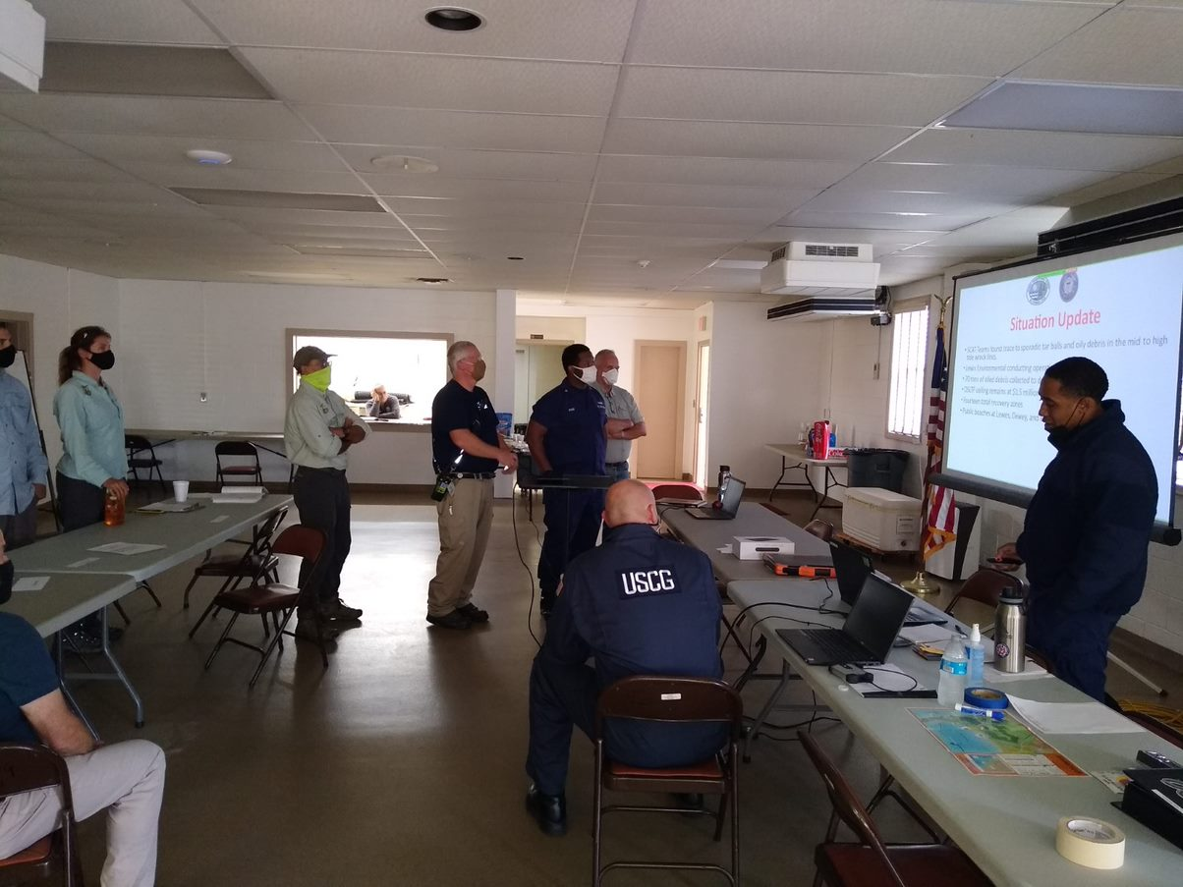
Logistics Hurdles
The Slaughter Beach Fire House was chosen as an Incident Command Post. This location ended up being ideal. No commercial venues would allow us to occupy a space with more than 20 people.
The firehouse provided an on-site EMT as well as coffee, meals, emergency communications, and easy beach access with parking.

Slide 20
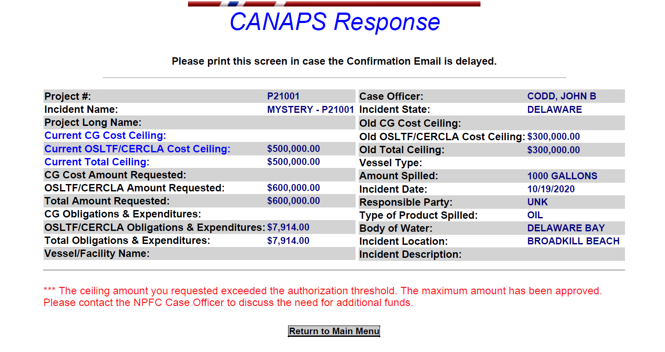
Financial Hurdles
NPFC and CANAPS worked great.
A previous member of the CG IMAT mentioned that the FOSCR should start looking at requesting a Congressional Funding request as we neared 1 million dollars. The FOSCR had not known about this requirement as it was not part of any FOSC guides or training. The Congressional request process had mainly been used during hurricanes under ESF-10 and had not been done recently under a non-RP CG funded spill response.
22, Oct 2020

Slide 21
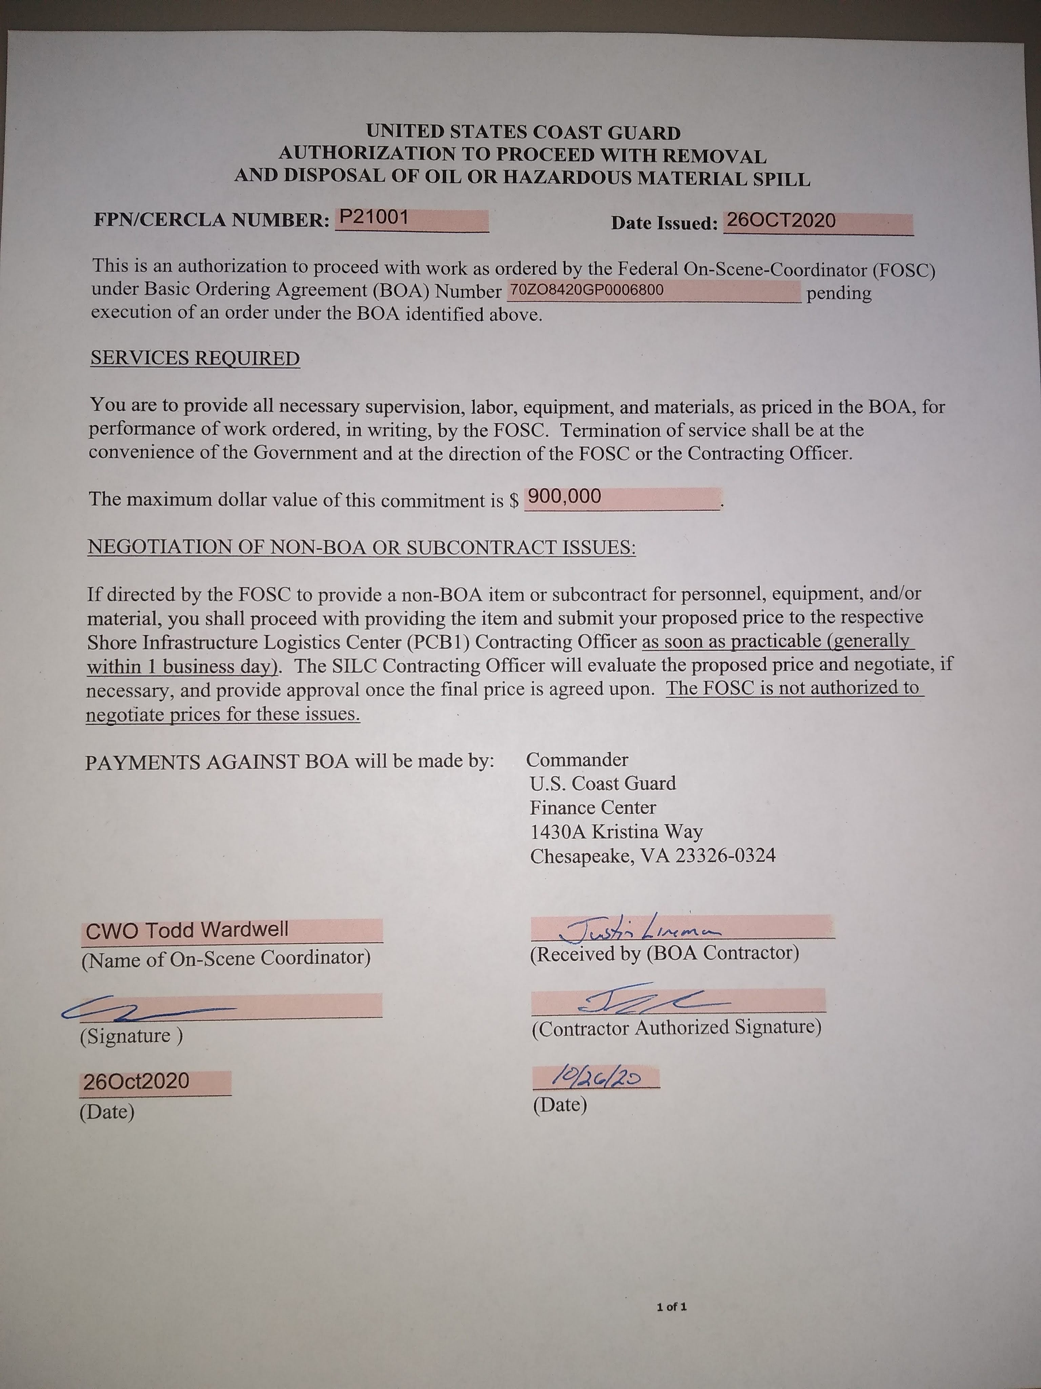
Financial Hurdles
NPFC and CANAPS worked great.
A previous member of the CG IMAT mentioned that the FOSCR should start looking at requesting a Congressional Funding request as we neared 1 million dollars. The FOSCR had not known about this requirement as it was not part of any FOSC guides or training. The Congressional request process had mainly been used during hurricanes under ESF-10 and had not been done recently under a non-RP CG funded spill response.

Slide 22
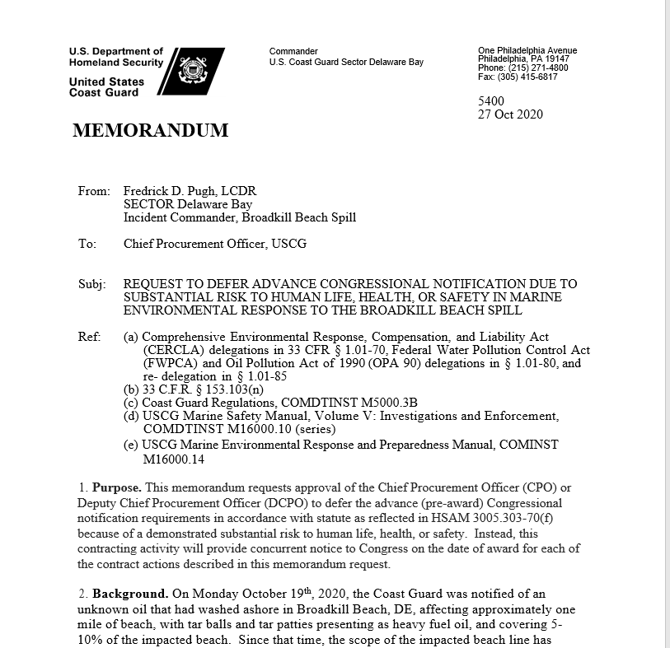
Financial Hurdles
The Congressional request was routed on the 23rd of October. At that point the "burn rate" for the case was over 200K per day.
An ATP for $900 K was authorized to the contractor with a case ceiling of $999,999.99 being the total on 26 October.
On the same day the request was kicked back to us to redo! We resent it on the 27th. The authorization was NOT APPROVED UNTIL the 30th of October!

Slide 23
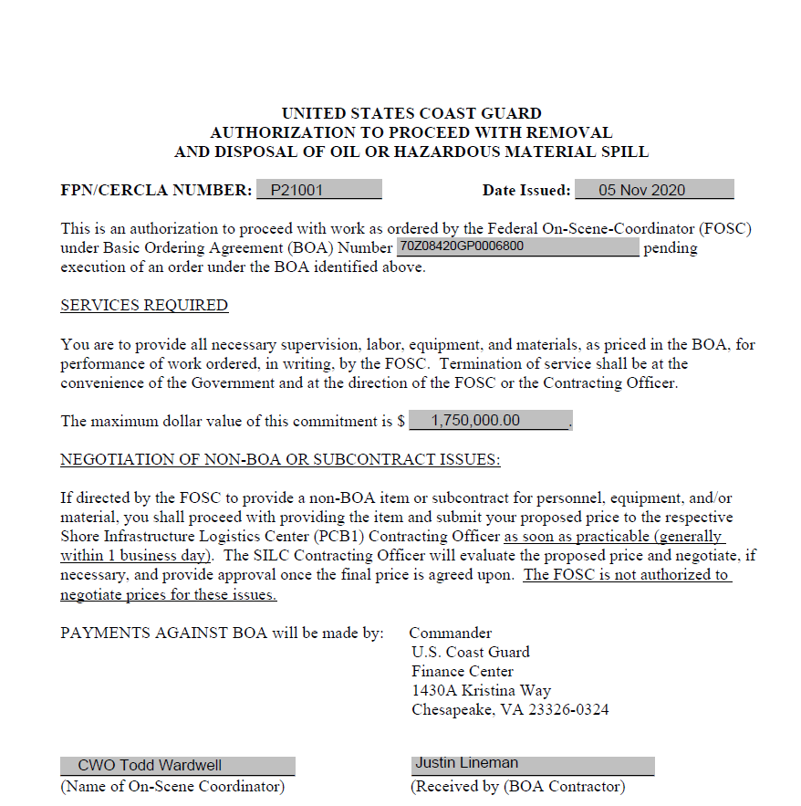
Financial Hurdles
For 3 days the FOSCR had no financial authorization!
Only verbal authorizations were given to the contractor with the hopes that the Congressional would be signed.
If not the FOSCR requested information on the claims process through NPFC to cover the overage costs.
The Congressional Auth was completed, and the Ceiling jumped up to $1.5 million on 30 October then to $1.75 million on 05 Nov.

Slide 24
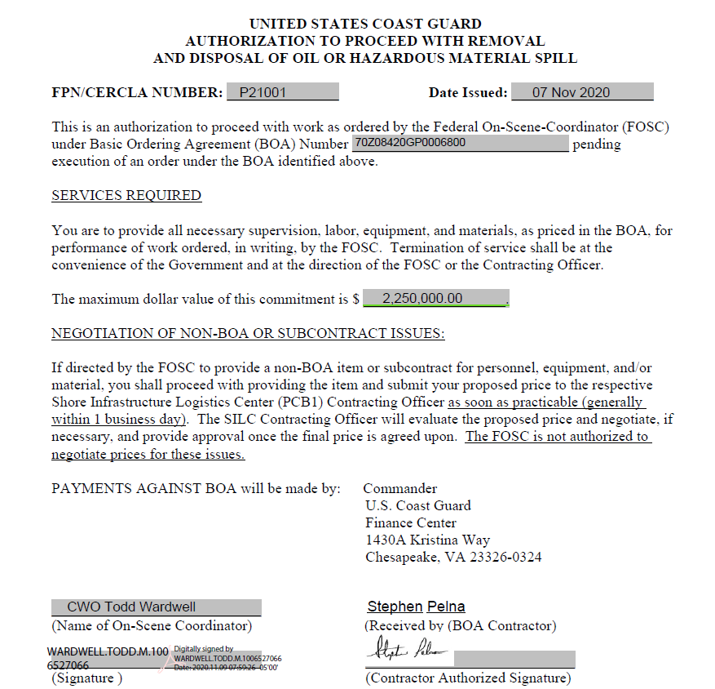
Financial Hurdles
Final ATP was issued for $2.25 million on 07 Nov.
The clean-up was starting to wind backwards with resources
Total commitment was $2.5 million.

Slide 25
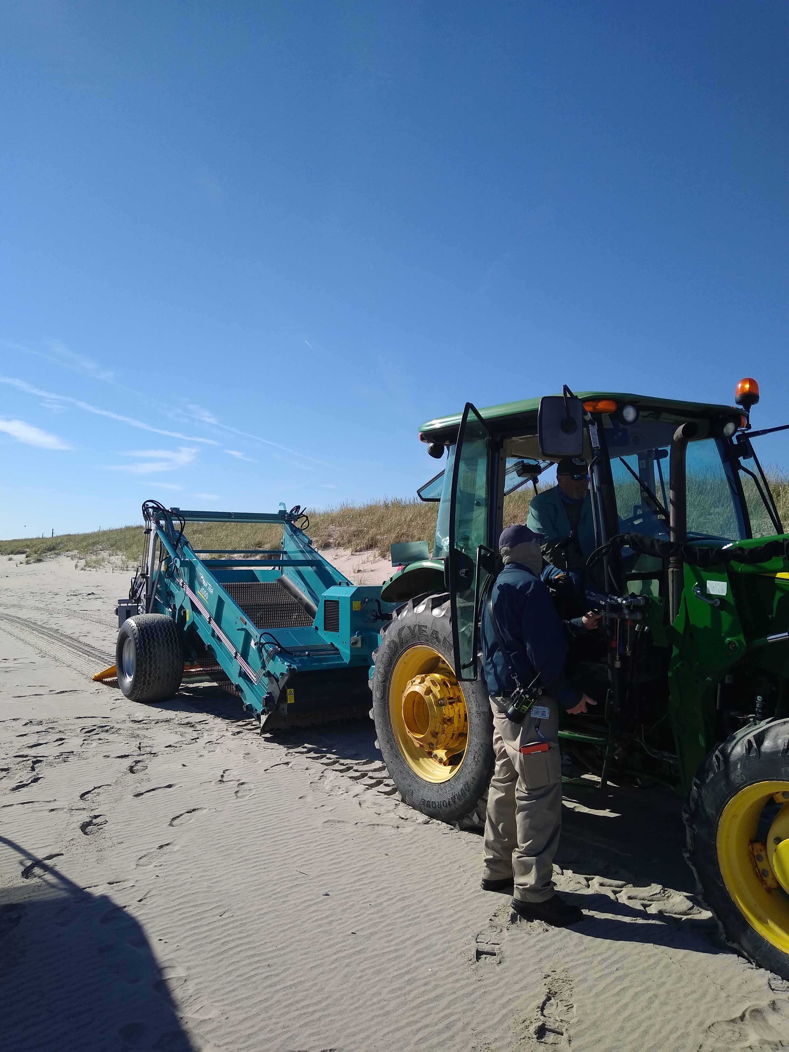
DOT Beach Cleaners
Most Beach towns had a "Beach Rake" or a garbage sifter that was used to remove garbage and debris from the beach.
Many of the DOT workers were on furlough due to Covid. FOSCR wrote up a PRFA to cover costs of hours to utilize the beach rakes to try and recover buried tarballs on large stretches of beach in the upper rack areas.
They were not used initially due to the physical characteristics of the tarballs. As the oil weathered, they became harder and less viscous. The beach rakes were tried out on a small stretch for viability and then green lighted for the rest of the areas.

Slide 26
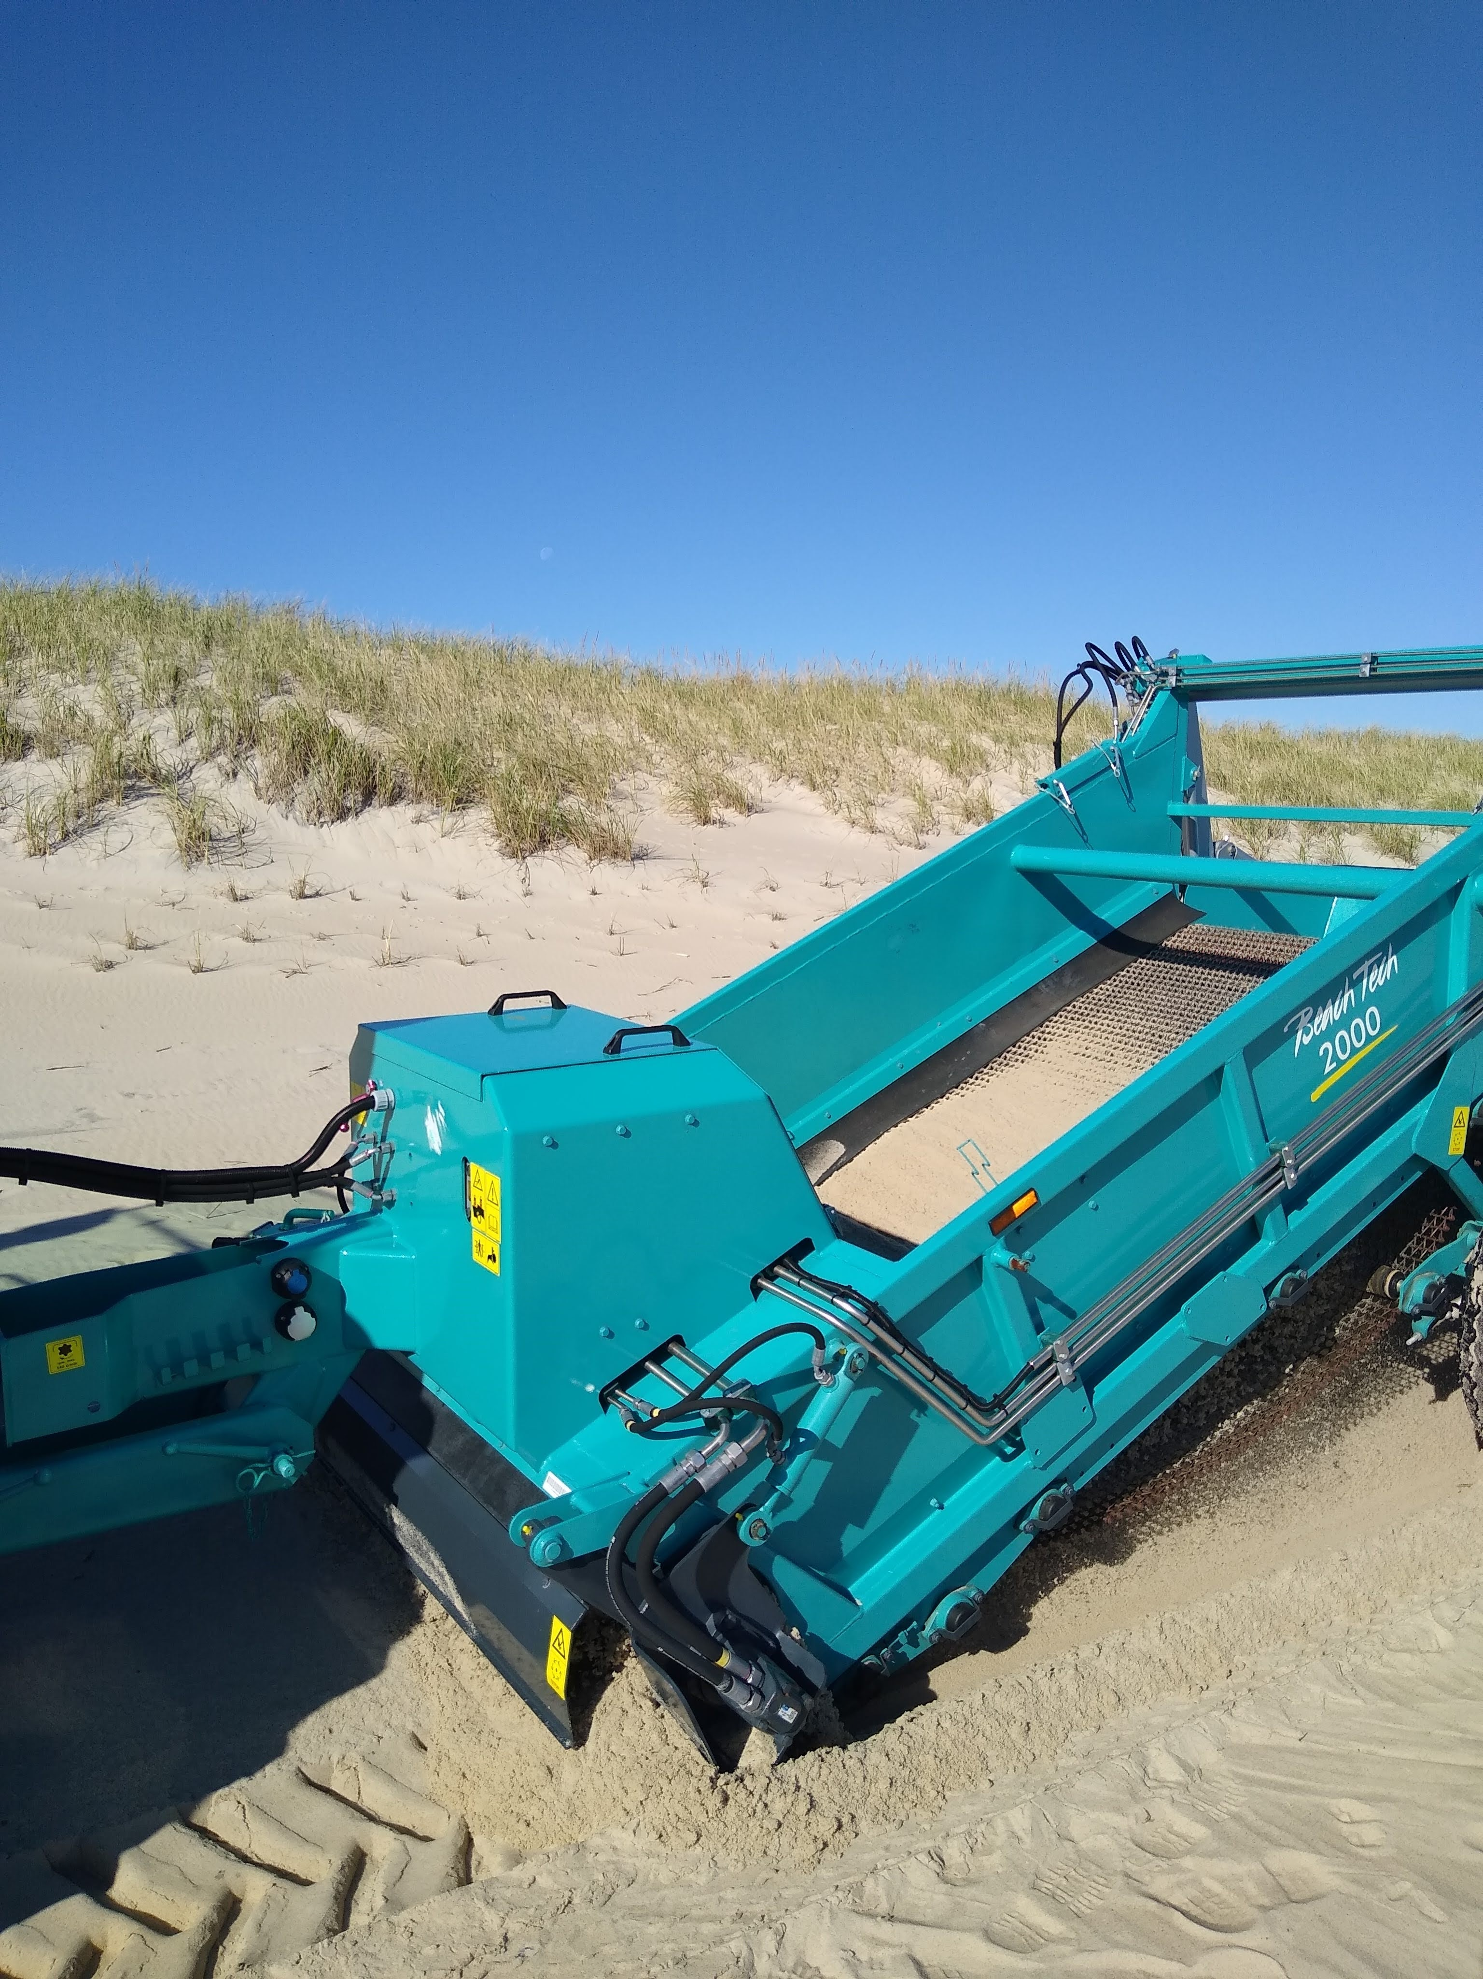
DOT Beach Cleaners
Most Beach towns had a "Beach Rake" or a garbage sifter that was used to remove garbage and debris from the beach.
Many of the DOT workers were on furlough due to Covid. FOSCR wrote up a PRFA to cover costs of hours to utilize the beach rakes to try and recover buried tarballs on large stretches of beach in the upper rack areas.
They were not used initially due to the physical characteristics of the tarballs. As the oil weathered, they became harder and less viscous. The beach rakes were tried out on a small stretch for viability and then green lighted for the rest of the areas.

Slide 27
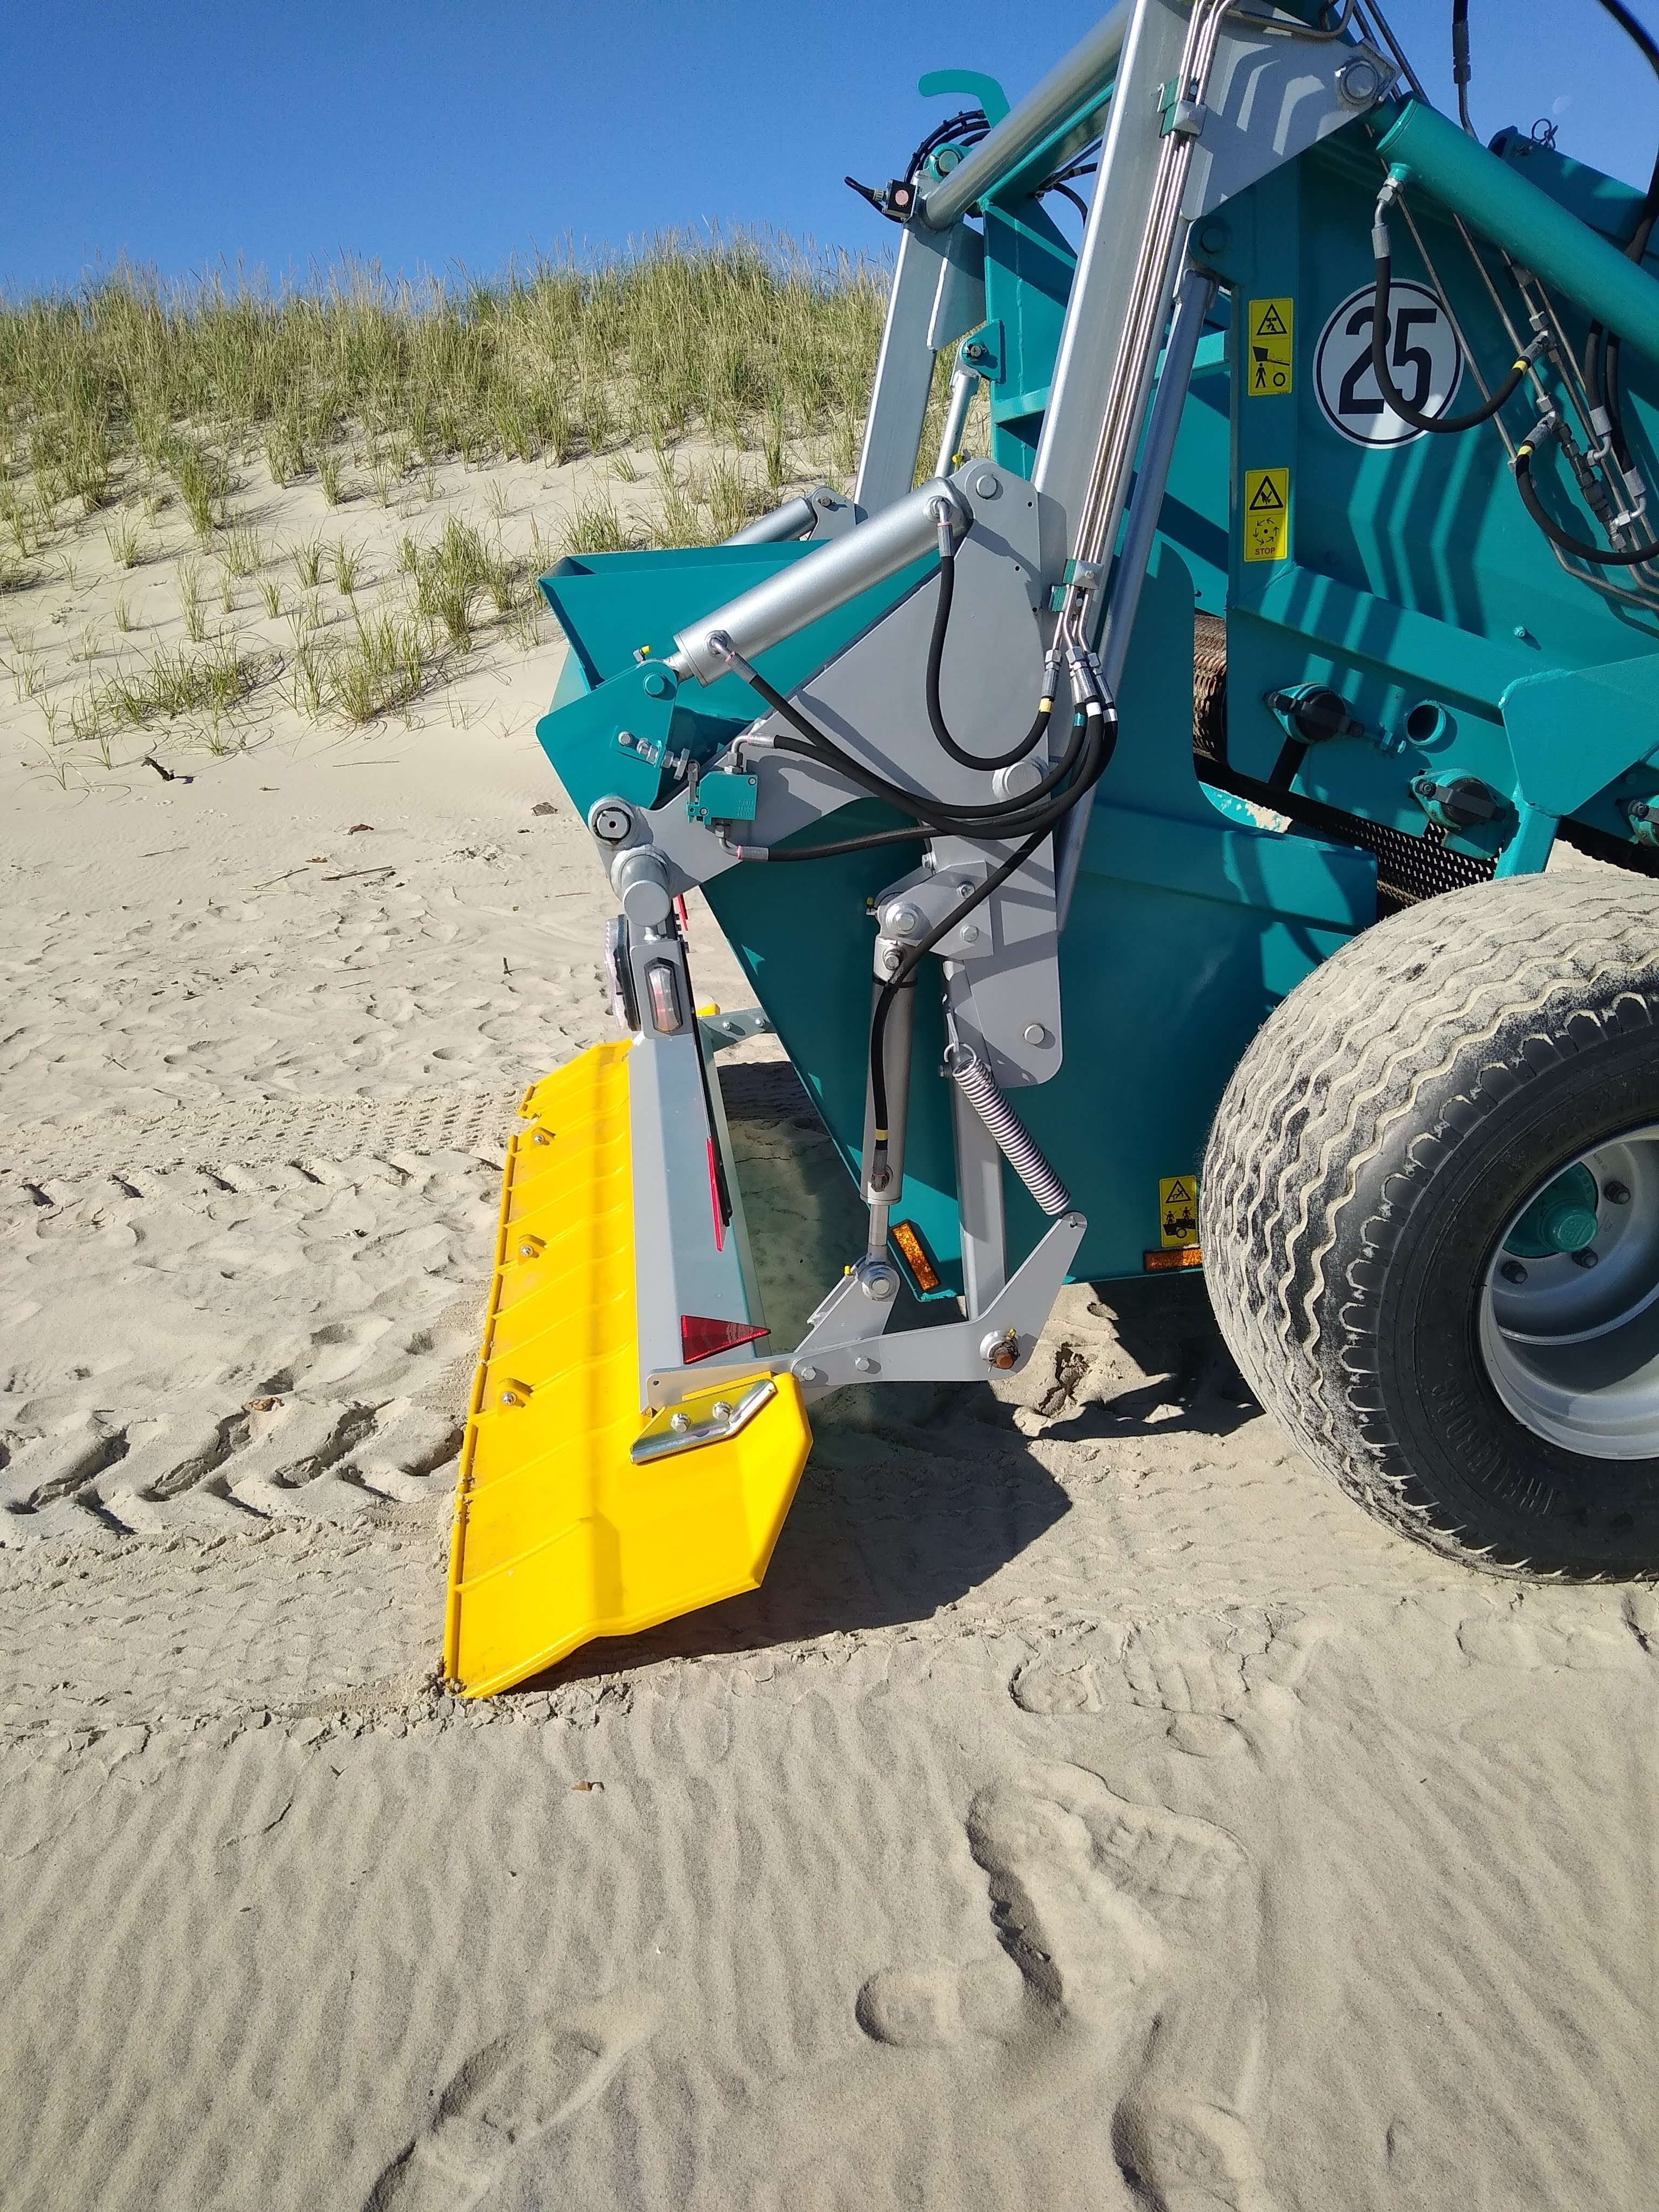
DOT Beach Cleaners
Most Beach towns had a "Beach Rake" or a garbage sifter that was used to remove garbage and debris from the beach.
Many of the DOT workers were on furlough due to Covid. FOSCR wrote up a PRFA to cover costs of hours to utilize the beach rakes to try and recover buried tarballs on large stretches of beach in the upper rack areas.
They were not used initially due to the physical characteristics of the tarballs. As the oil weathered, they became harder and less viscous. The beach rakes were tried out on a small stretch for viability and then green lighted for the rest of the areas.

Slide 28
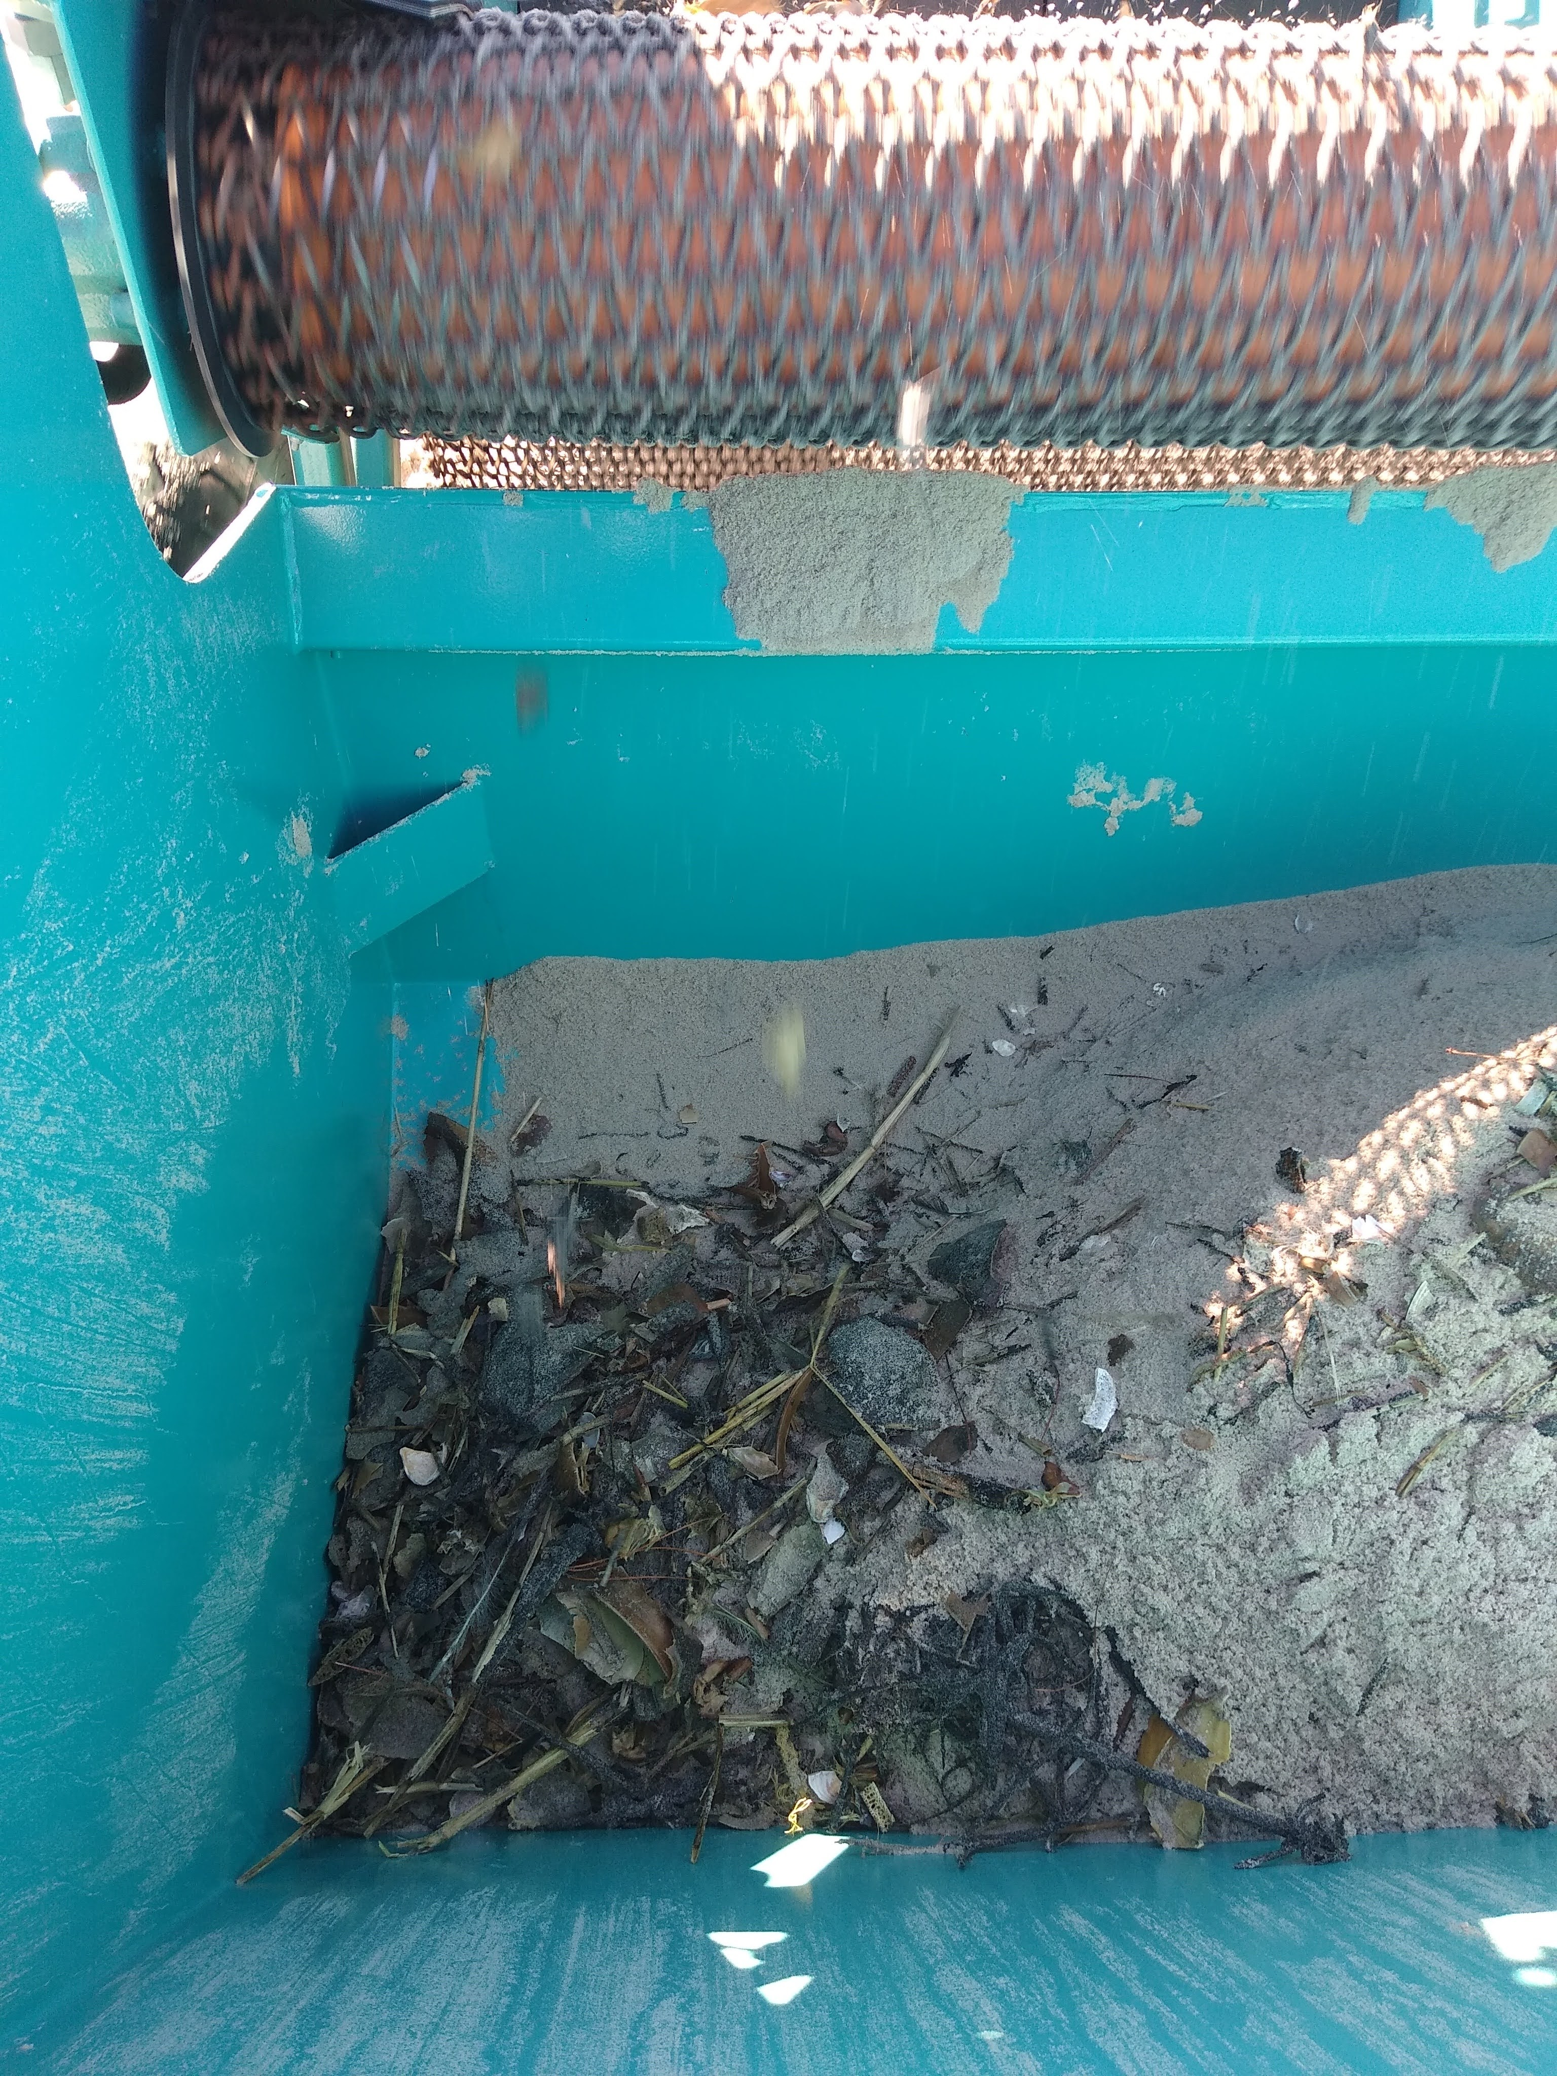
DOT Beach Cleaners
Most Beach towns had a "Beach Rake" or a garbage sifter that was used to remove garbage and debris from the beach.
Many of the DOT workers were on furlough due to Covid. FOSCR wrote up a PRFA to cover costs of hours to utilize the beach rakes to try and recover buried tarballs on large stretches of beach in the upper rack areas.
They were not used initially due to the physical characteristics of the tarballs. As the oil weathered, they became harder and less viscous. The beach rakes were tried out on a small stretch for viability and then green lighted for the rest of the areas.

Slide 29
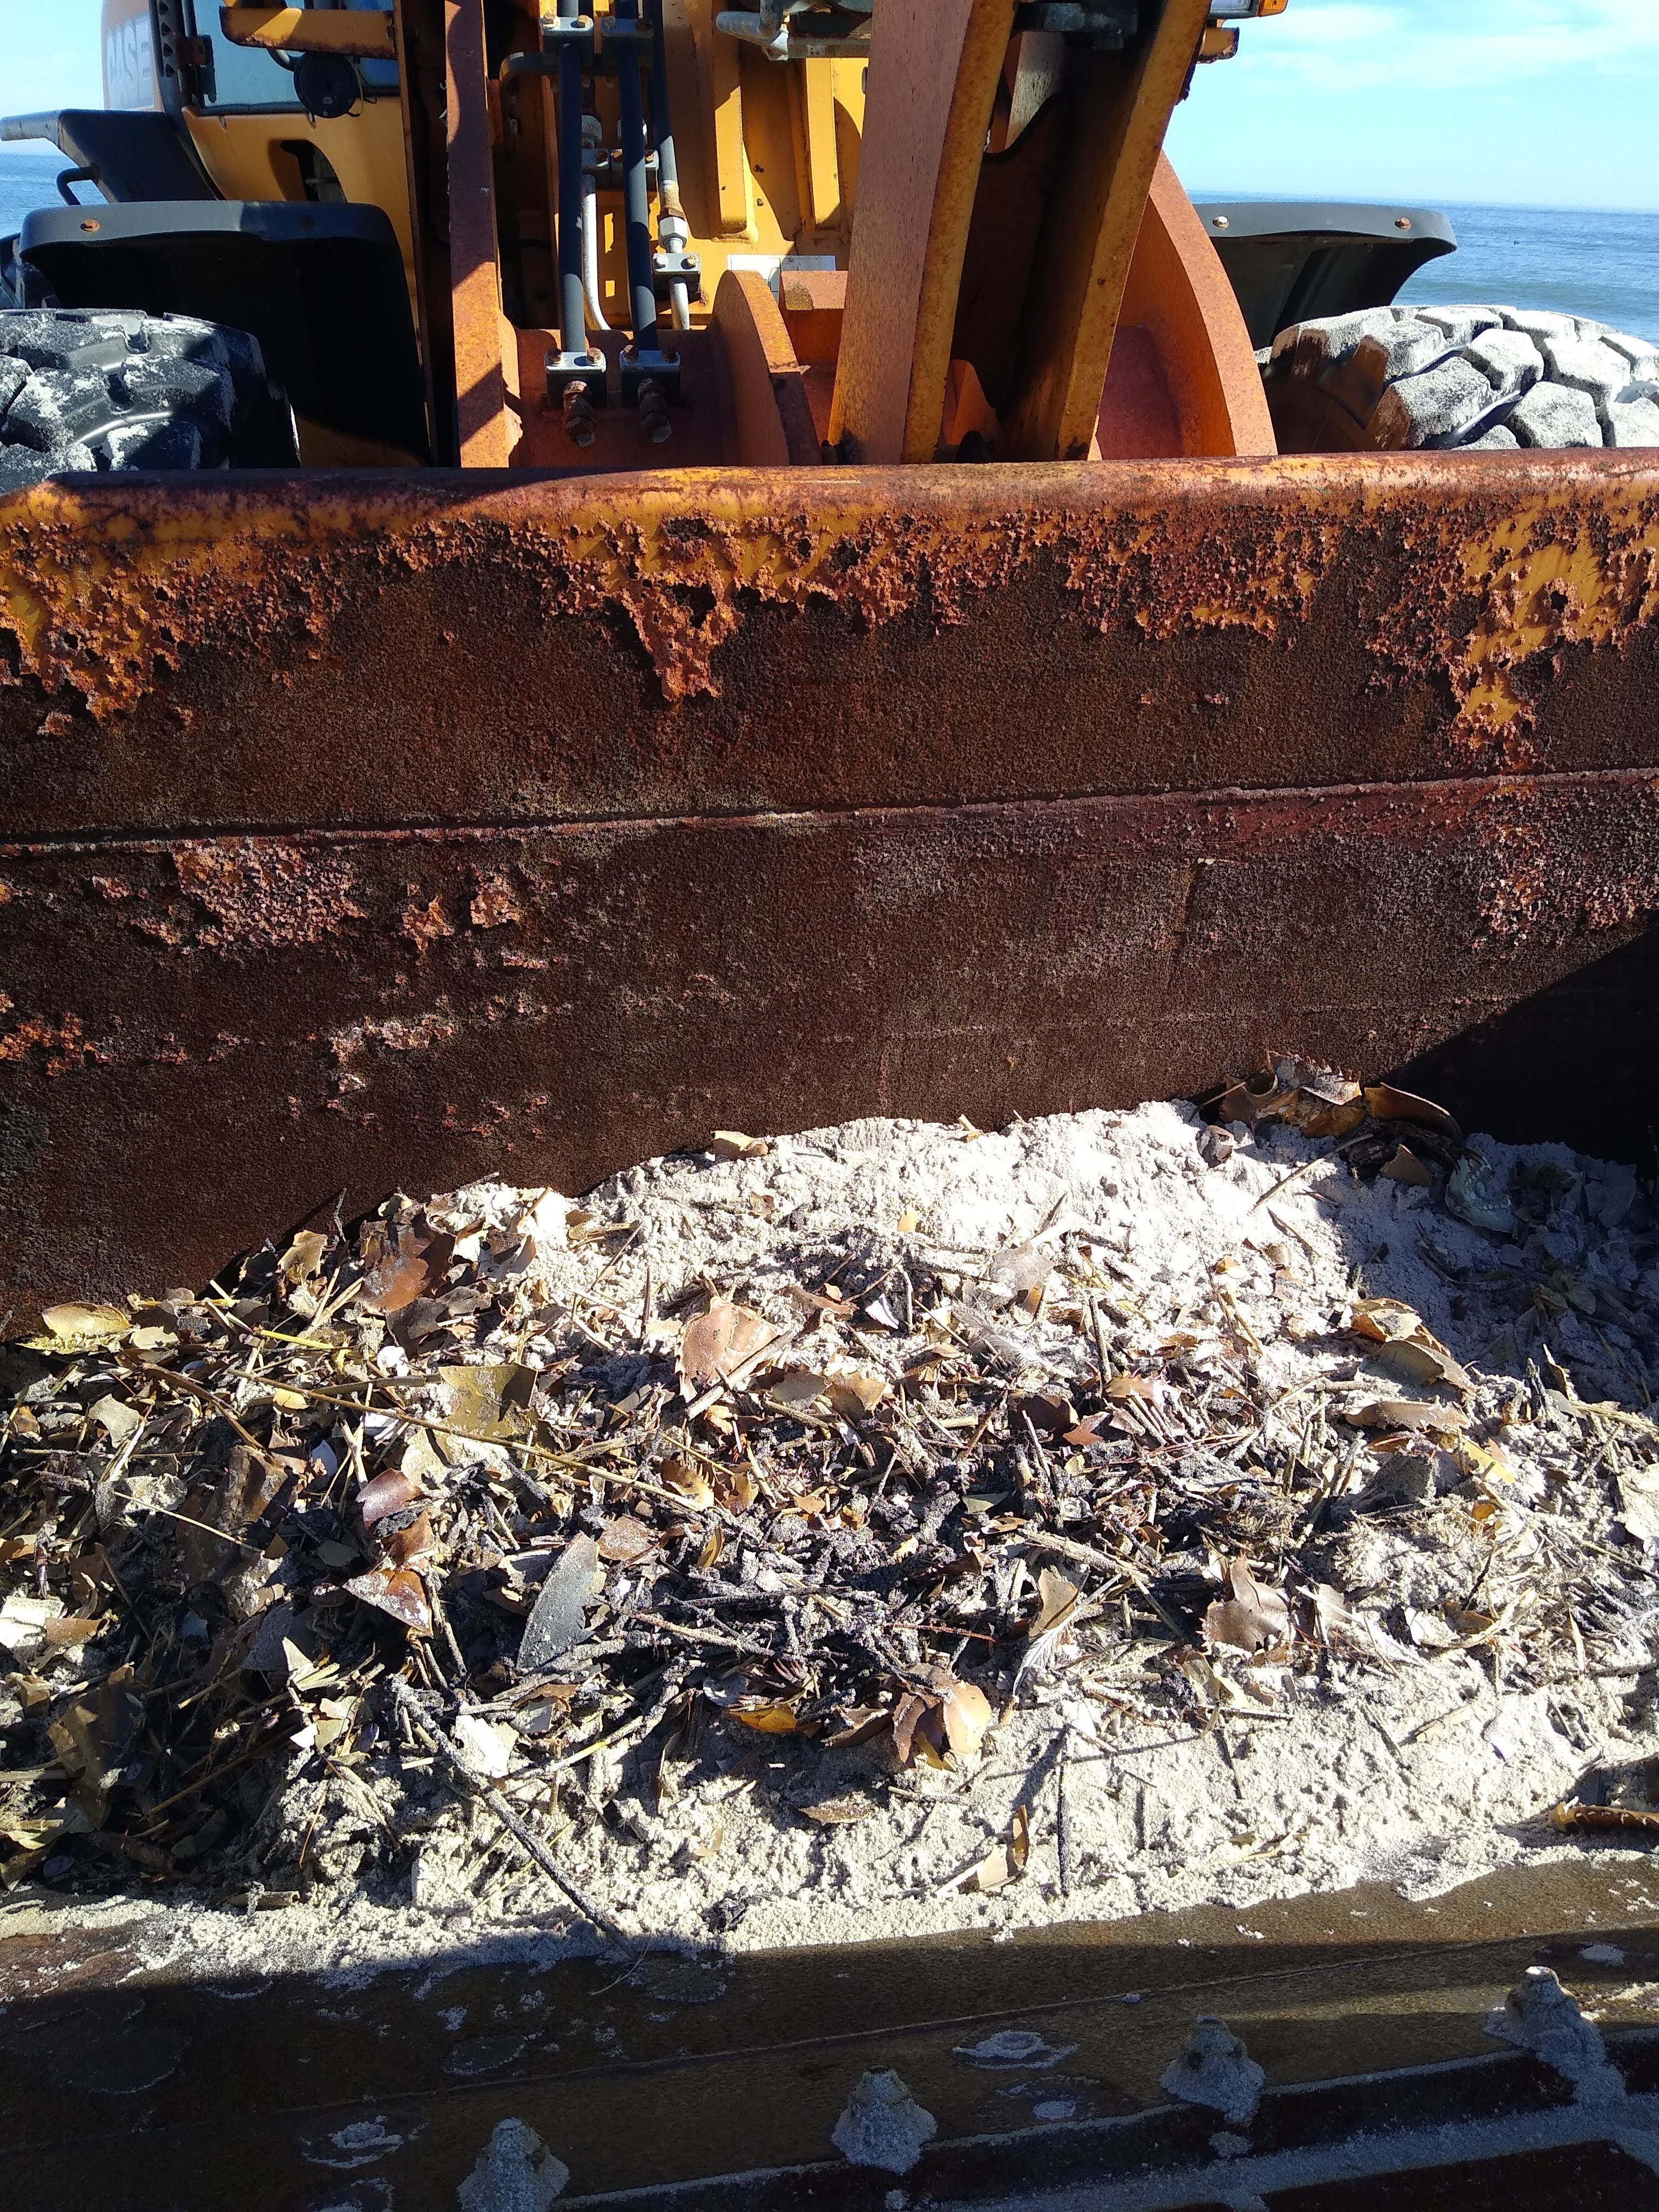
DOT Beach Cleaners
Most Beach towns had a "Beach Rake" or a garbage sifter that was used to remove garbage and debris from the beach.
Many of the DOT workers were on furlough due to Covid. FOSCR wrote up a PRFA to cover costs of hours to utilize the beach rakes to try and recover buried tarballs on large stretches of beach in the upper rack areas.
They were not used initially due to the physical characteristics of the tarballs. As the oil weathered, they became harder and less viscous. The beach rakes were tried out on a small stretch for viability and then green lighted for the rest of the areas.

Slide 30
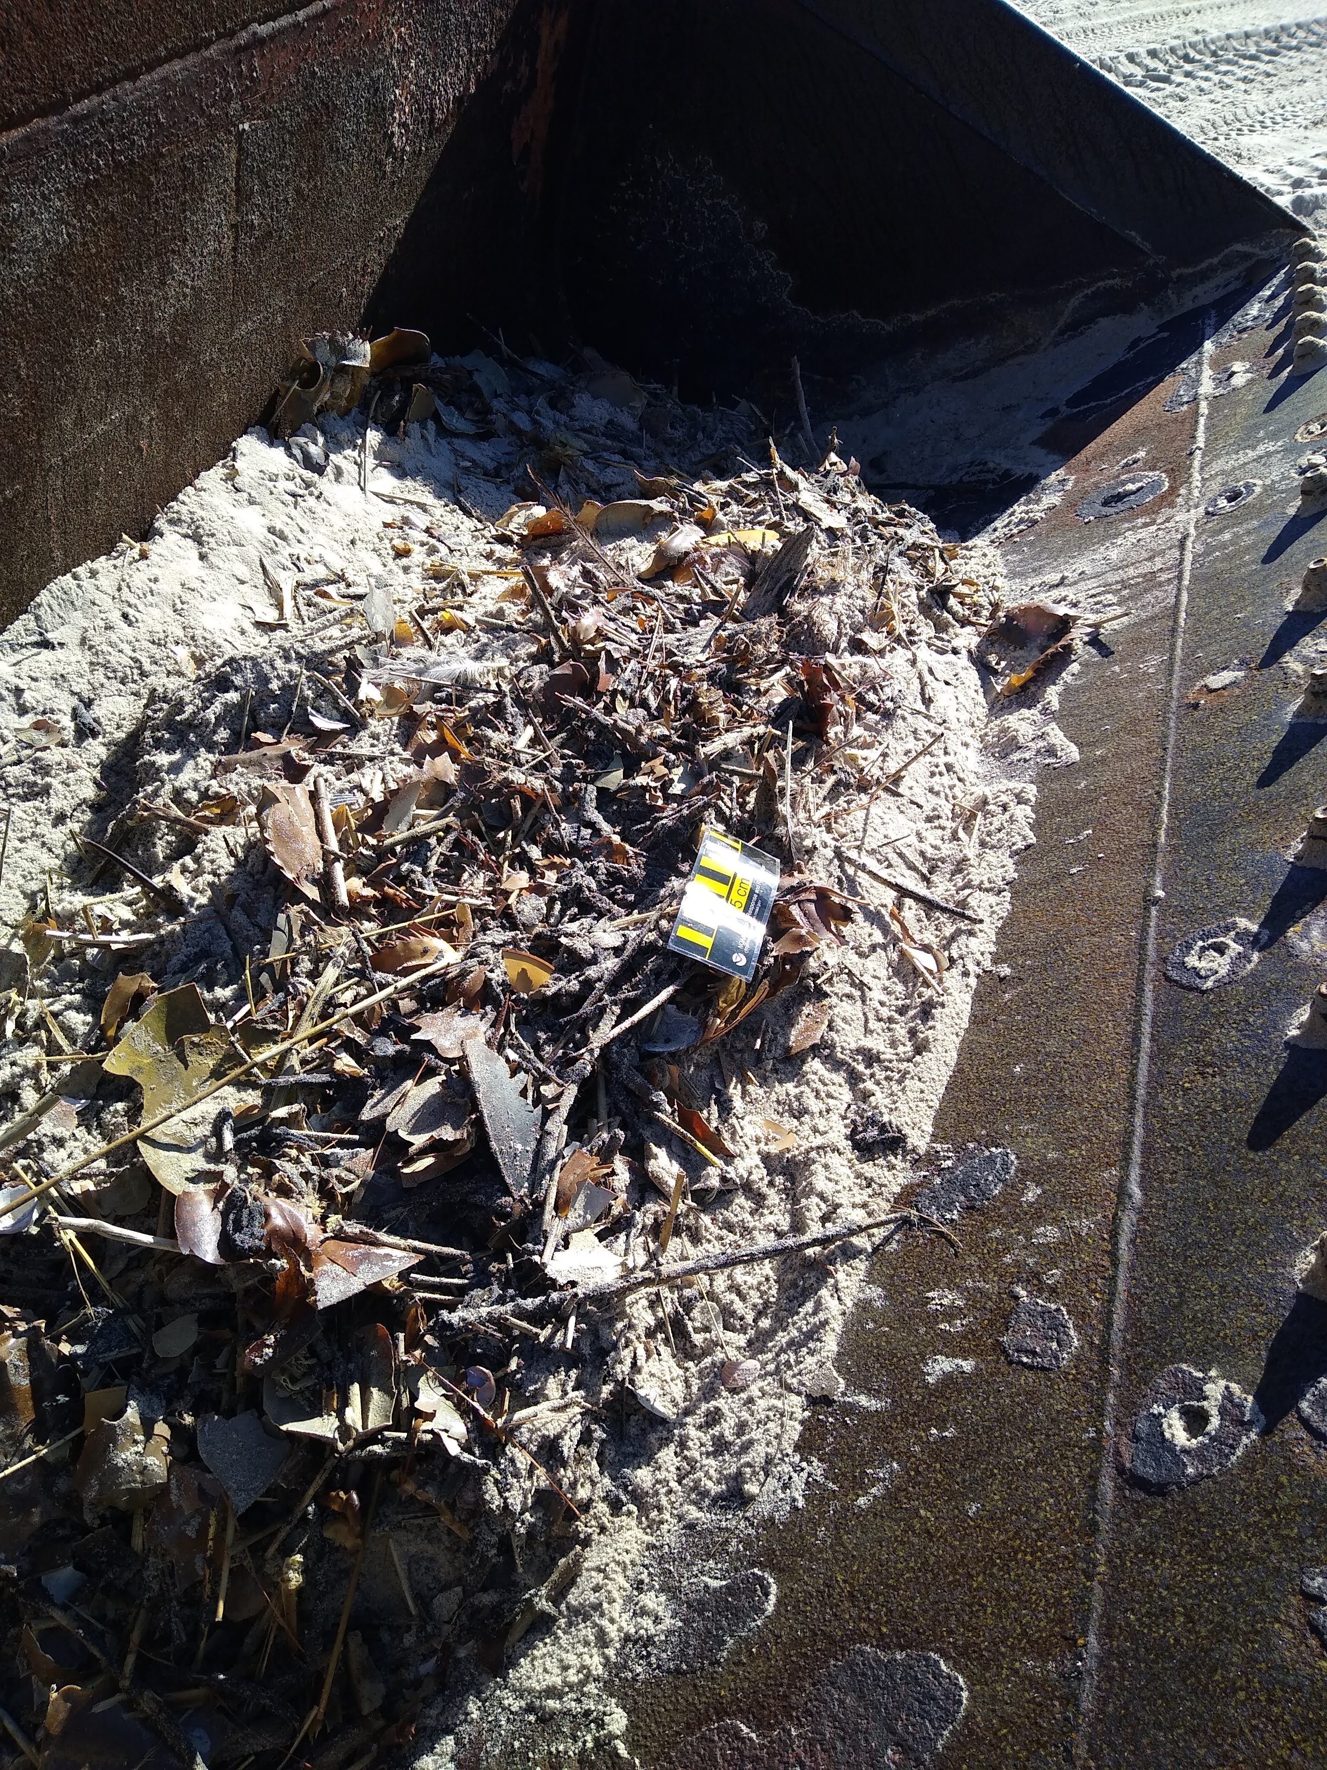
DOT Beach Cleaners
Most Beach towns had a "Beach Rake" or a garbage sifter that was used to remove garbage and debris from the beach.
Many of the DOT workers were on furlough due to Covid. FOSCR wrote up a PRFA to cover costs of hours to utilize the beach rakes to try and recover buried tarballs on large stretches of beach in the upper rack areas.
They were not used initially due to the physical characteristics of the tarballs. As the oil weathered, they became harder and less viscous. The beach rakes were tried out on a small stretch for viability and then green lighted for the rest of the areas.

Slide 31
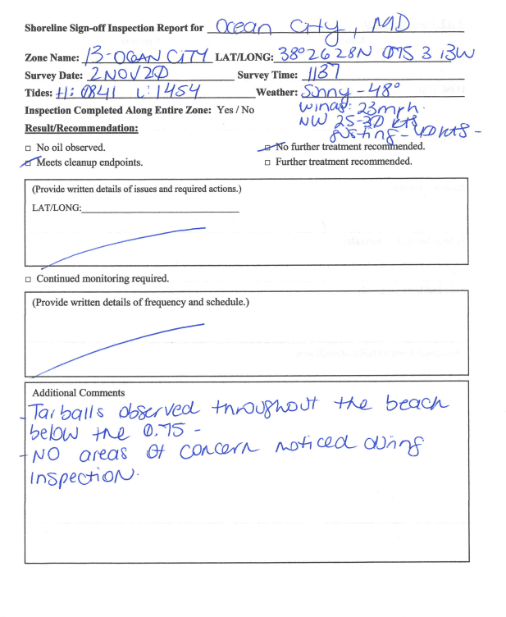
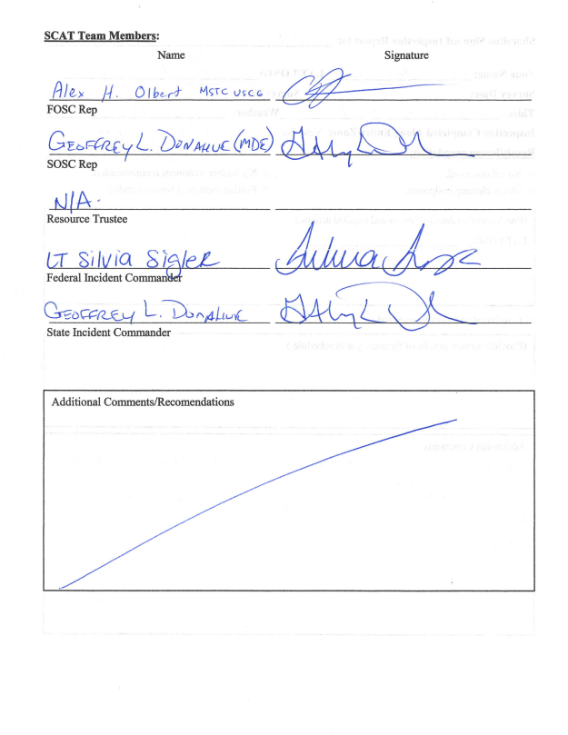
End Points: STR's
Shoreline Treatment Recommendations were used as final sign offs by the final members of the Unified Command. This is an example of an STR signed off from the state of Maryland. VA had no real impact by tarballs from the same spill so no STR's were filed there as no clean-up was performed. All the various Delaware beach segments were delineated by political authorities (towns, refuges, state parks, etc) and were signed off by SOSC, FOSCR, FOSC, and Resource Trustee.

Slide 32
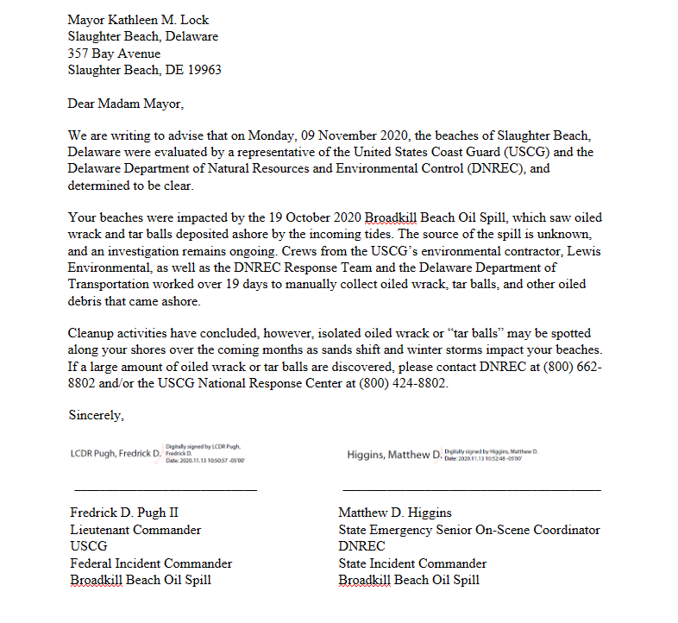
End Points: Beach Clearance Letters
The cognizant authority of each Delaware beach segment was invited to be a part of the STR evaluation. Most declined the invitation except for a few of the Refuge managers. The clearance letters were written by the USCG (FOSC) and signed by the SOSC (DNREC). The conference call conducted by the FOSC each IAP operational period socialized this process and made the beach authorities comfortable with the end of the response.

Slide 33
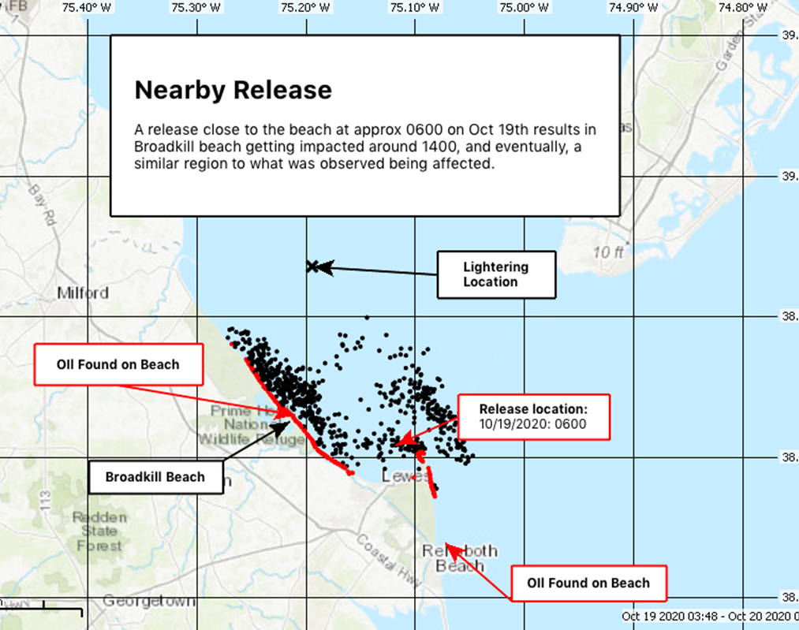
Investigations Summary
Initial reverse trajectory from NOAA on 19OCT2020
Over 100 vessel track lines were cataloged & plotted with information from USCG NAVCEN and AIS Data.
Due to time, location, type of fuel, and various other determining factors; 04 specific vessels were sampled, inspected, and crew interviews were conducted. No match has been found.
Assistance from multiple USCG Sectors took place.
NOAA provided multiple spill trajectories & satellite imagery.

Slide 34
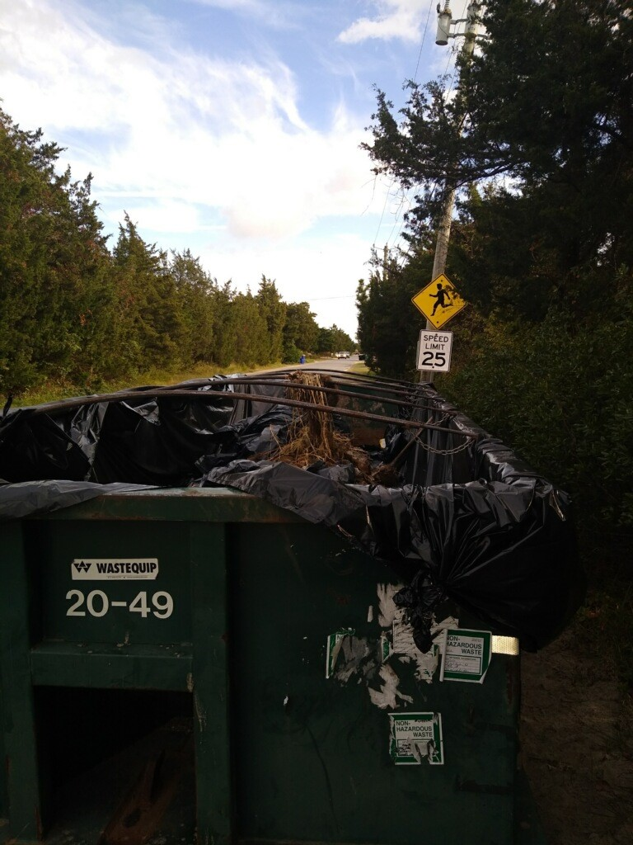
The Bad
(Stuff that happened)
Covid
Lack of SCAT trained personnel (At all levels!)
Lack of nationally available contractors
Lack of HAZWOPER trained CDL drivers nationally
Beach 4x4 maintenance
Tarballs had to be manually cleaned with labor on over 60 miles of shoreline. Personnel tracking is IMPORTANT
Congressional Authorization Process needs to be part of FOSCR training. Clear direction on the process was not given to all personnel working at SILC
Cell and internet coverage was incredibly spotty
Some suspect vessels had left the area and needed to be sampled. This request went out to several other Sectors in D1, D5,D8. Other USCG units were VERY reluctant to get samples and had gaps in training.
Did not find an RP

Slide 35
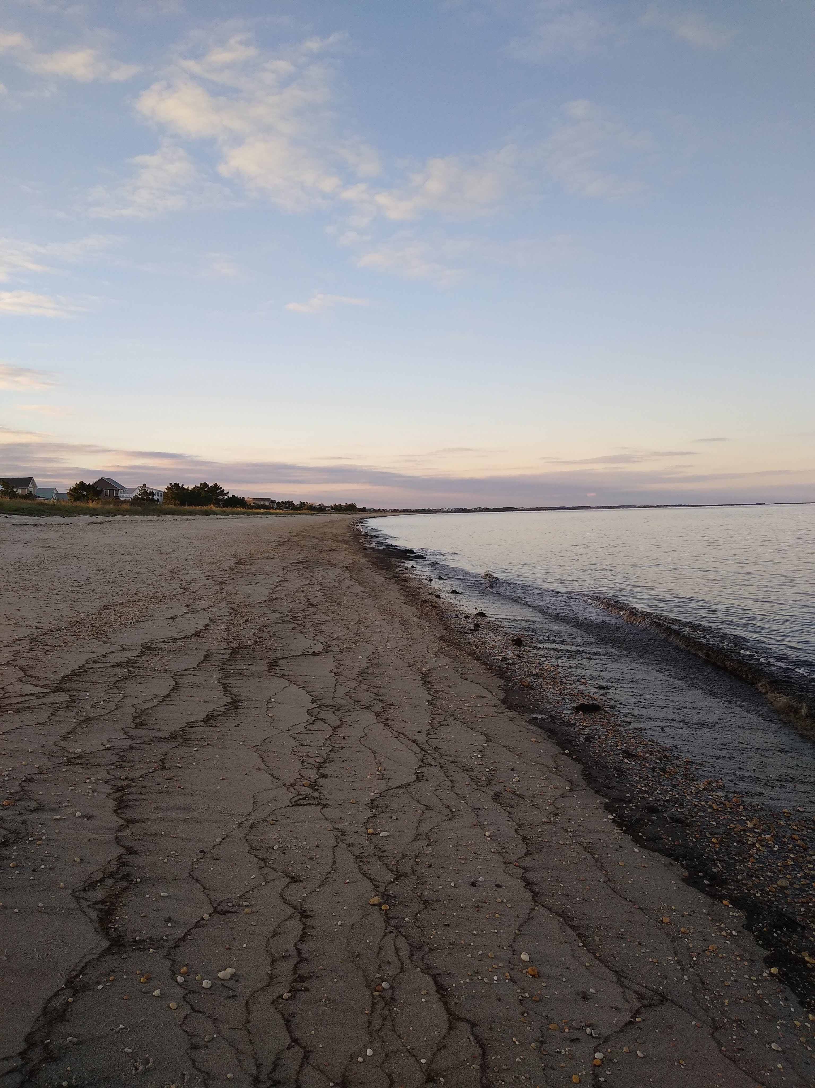
The Ugly
(Stuff that happened and might happen again)
USCG finance system has changed dramatically since this case happened PRFA’s and some FOSCR functions will be VERY difficult with FSMS. You will need NPFC to help you out with it!
There are NO commercial aircraft or UAS companies presently on the Basic Ordering Agreement (BOA) list that can be directly utilized by USCG.
This was a 3-sector single state spill response. A 2-state spill in Sec Del Bay's AOR during Covid would have tapped out the Sector's resources.
This spill did not affect the marine transportation system despite being very close to the main anchorage and lightering areas. If it had it may have escalated to a SONS
Getting other sectors to go onboard vessels that had departed the Del Bay AOR and take samples was and will continue to be challenging
USCG does not charge for USCG Aux members despite the fact that it costs the USCG money to administer the program

Slide 36
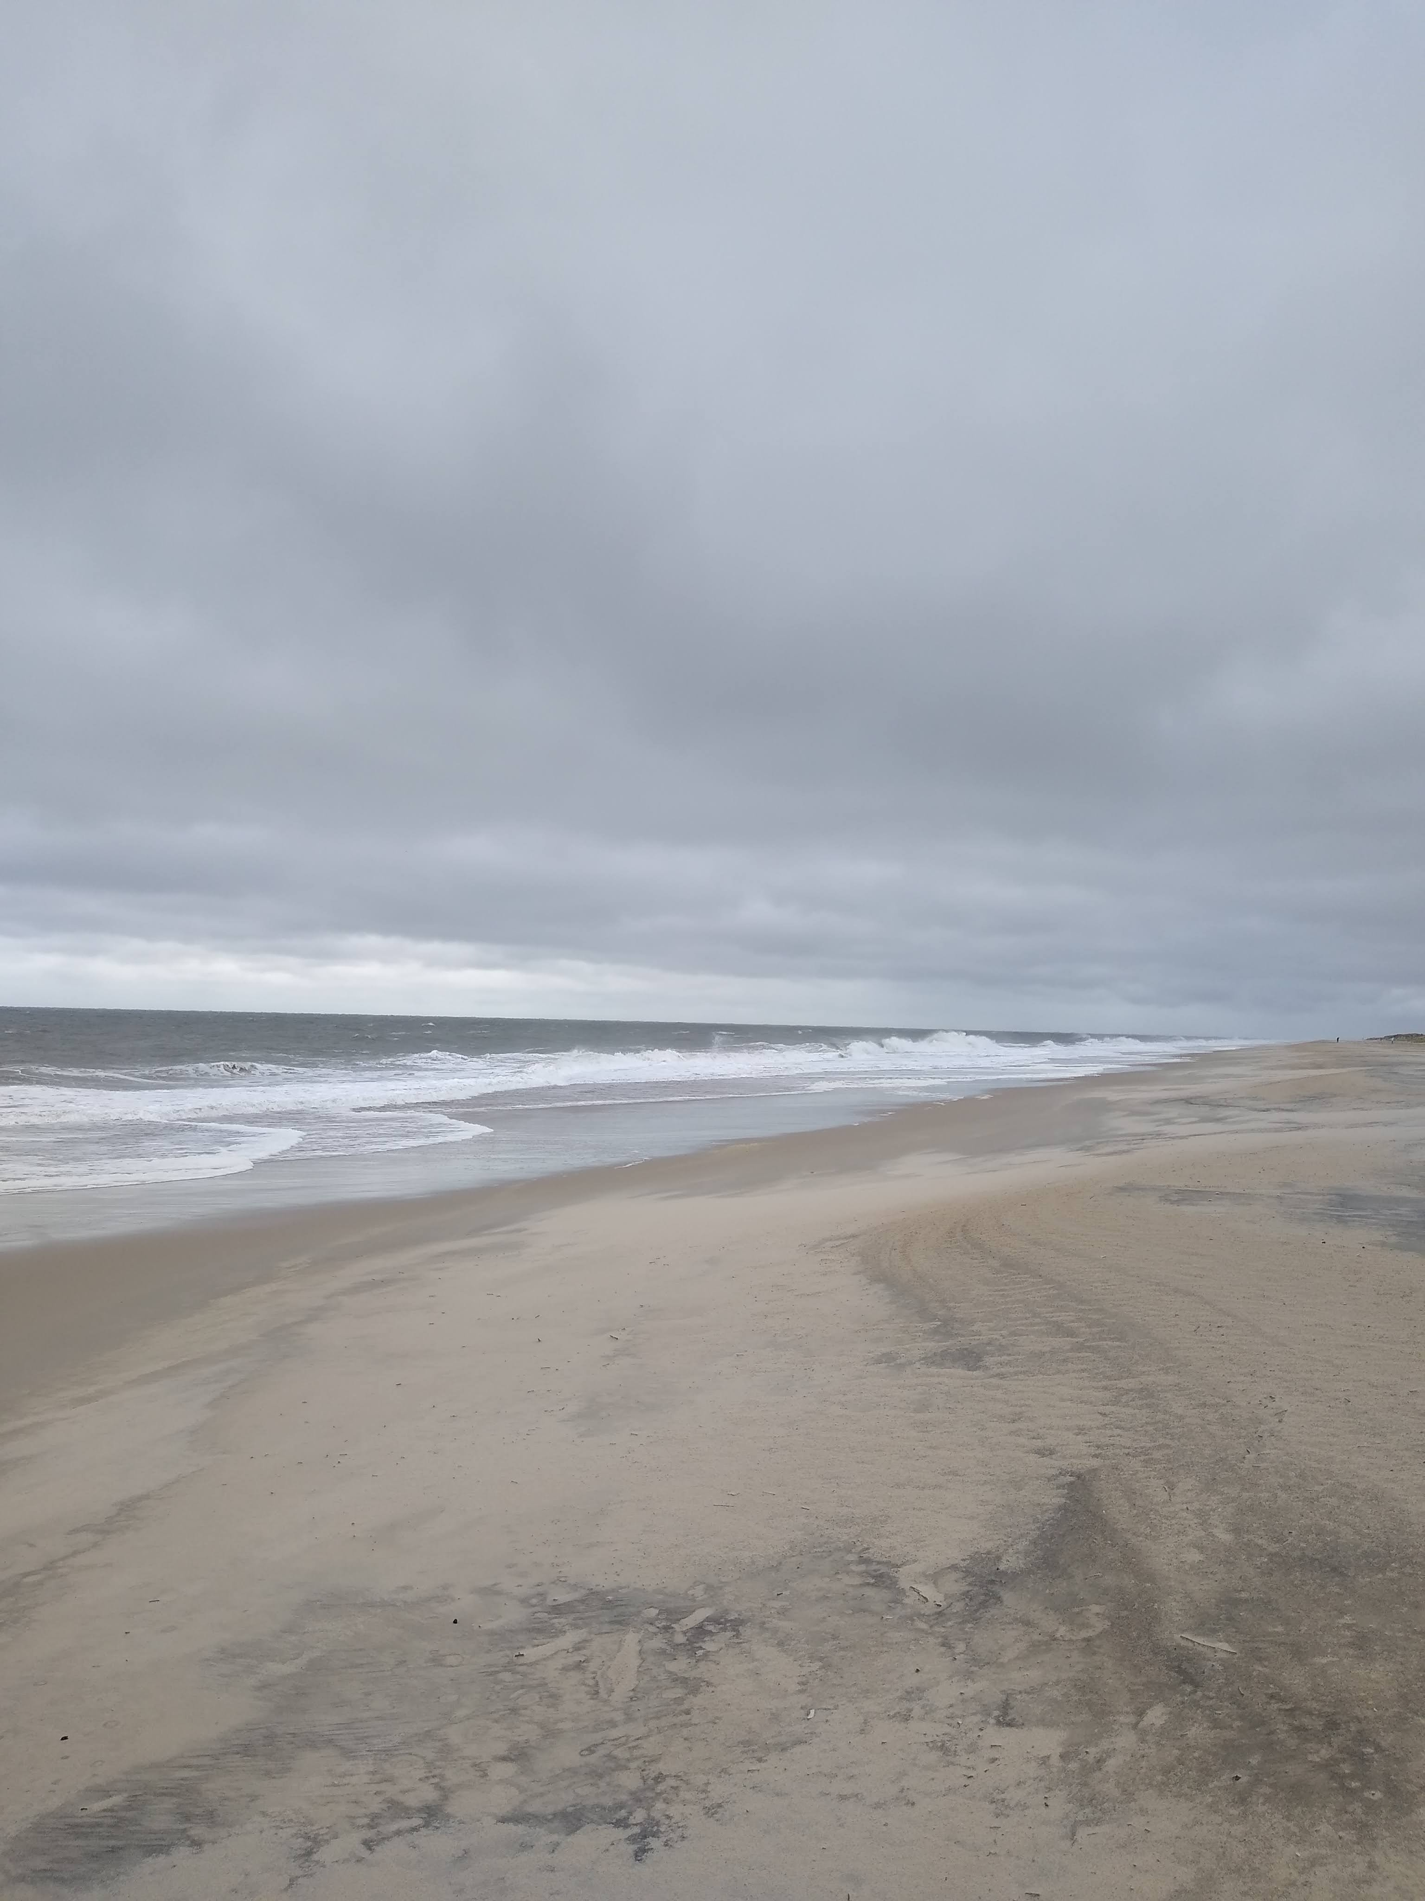
The Good
USCG Sector Del Bay Incident Management Auxiliary Support Team (IMAST) were and continue to be invaluable!
IMSS (Incident Management System Software) was used heavily prior to the spill and was essential to creating the IAP and getting information back to the Sector and Liaison Officers.
Having NOAA (Frank) on-scene was actually cool! He spearheaded the ESA's, the Environmental Unit Calls, WX model assistance, reverse spill trajectory modeling, SCAT quick training, and lastly facilitated information on RULET (Remediation of Underwater Legacy Environmental Threat) vessels as potential suspects. He also facilitated specific analysis through the LSU oil lab to analyze the oil.
Prior UAS exercises and outreach started the OSCAR initiative. This was useful on this case, but data used from it created better operational parameters. The OSCAR is presently on its 3rd generation.
Area Committee relationships are great among partners here. From start to finish there was very little "drama" from the people inside the response.
Tri-State Bird being (geographically) close and the FWS worked well together.
NPFC was incredibly supportive and even when the process with other parts of the USCG went sideways.
Forward leaning Mayor and stakeholder calls were great! D5 Public Affairs personnel were leaned on very heavily.
FOSCR told the contractors that as many supplies and resources as possible should be purchased locally from small businesses. This included food which was primarily sourced from a shutdown restaurant at the staging area. This bought the response a HUGE amount of goodwill from the local community including the local Mayors.
USCG Oil lab was VERY flexible and worked with LSU lab to help identify oil beyond what they normally do. They freely shared digital spectra analysis which cut down on redundant work for LSU.
EMFR had spare stand-alone laptops, ICS supplies, printers and a myriad of other materials ready to go out the door when the spill happened.

Slide 37
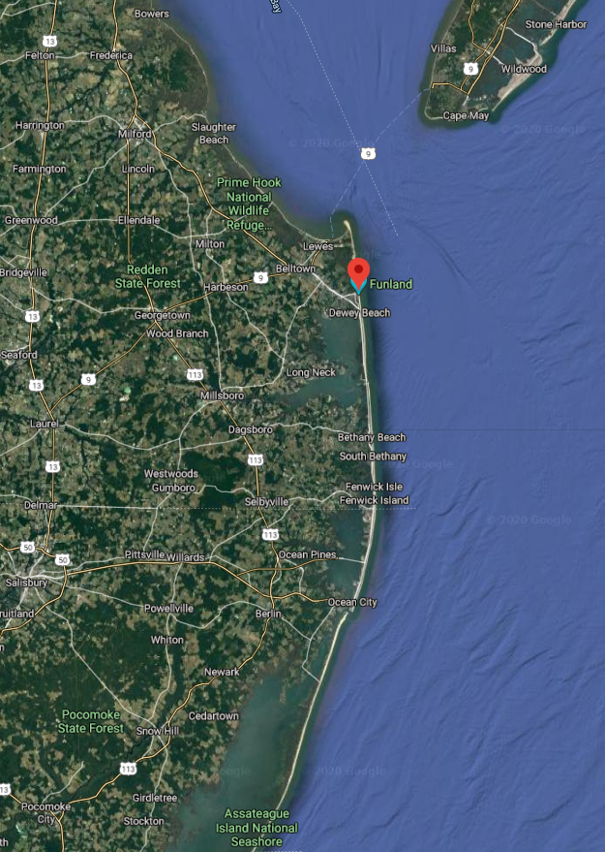
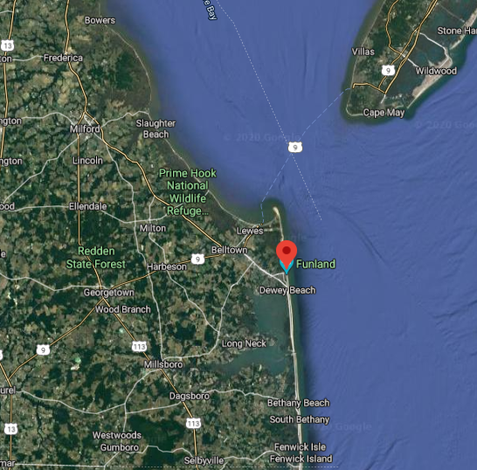
Impacted Area - Overall
Impacted Area - Delaware

Slide 38
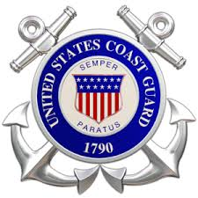




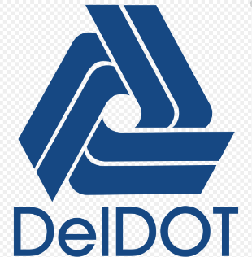
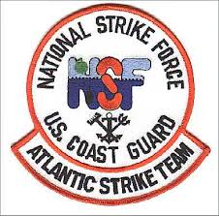




Event Summary
66 miles of shoreline impacted & cleaned IAW STR
  DE – 52 Miles
  MD – 14 Miles
Total Oiled bird count
  117 Gulls and 92 Shorebirds
OSLTF ceiling of $2.5 Million – To remain open for 30 days to monitor impacted areas
Total Pollution Removal Funding Authorizations (PRFA)
  DNREC - $140,000
  Memorial Volunteer Fire Company - $10,000
  NOAA - $10,700
  USFWS - $41,000
Resources Snapshot
  250+ Personnel (FED, State, Local, CTRs)
    25 DELDOT, 13 DNREC, 6 DE State Park personnel
  28 UTVs, 6 Utility Trailers, 2 Beach Rakes, & 200 Hand Tools
  02 Mobile Command Posts and 4 Generators
  18 Role offs totaling 84 tons of oil debris
18 Lessons Learned (Internal to USCG)

Slide 39
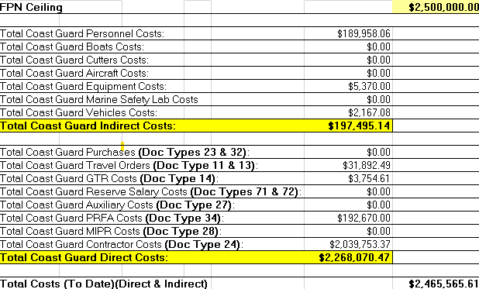
Event Summary

Slide 40
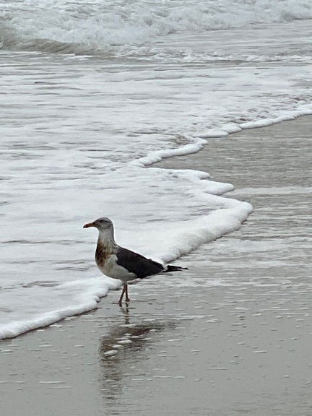






Questions? FINISHED!

