Slide 1


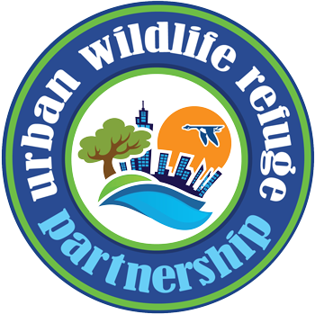
Patuxent Research Refuge

Slide 2
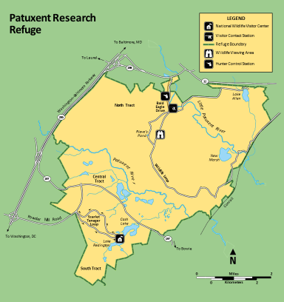
Location
Between Baltimore, MD and Washington DC
Three tracts of land covering ~13,000 acres
  South Tract (between Bowie and Laurel)
  Central Tract (between Bowie and Laurel)
  North Tract (AA County)
Two public entrances
  National Wildlife Visitor Center (Route 197)
  North Tract Information Station (Route 198)
Notes:
Where is Patuxent located / landscape context

Slide 3
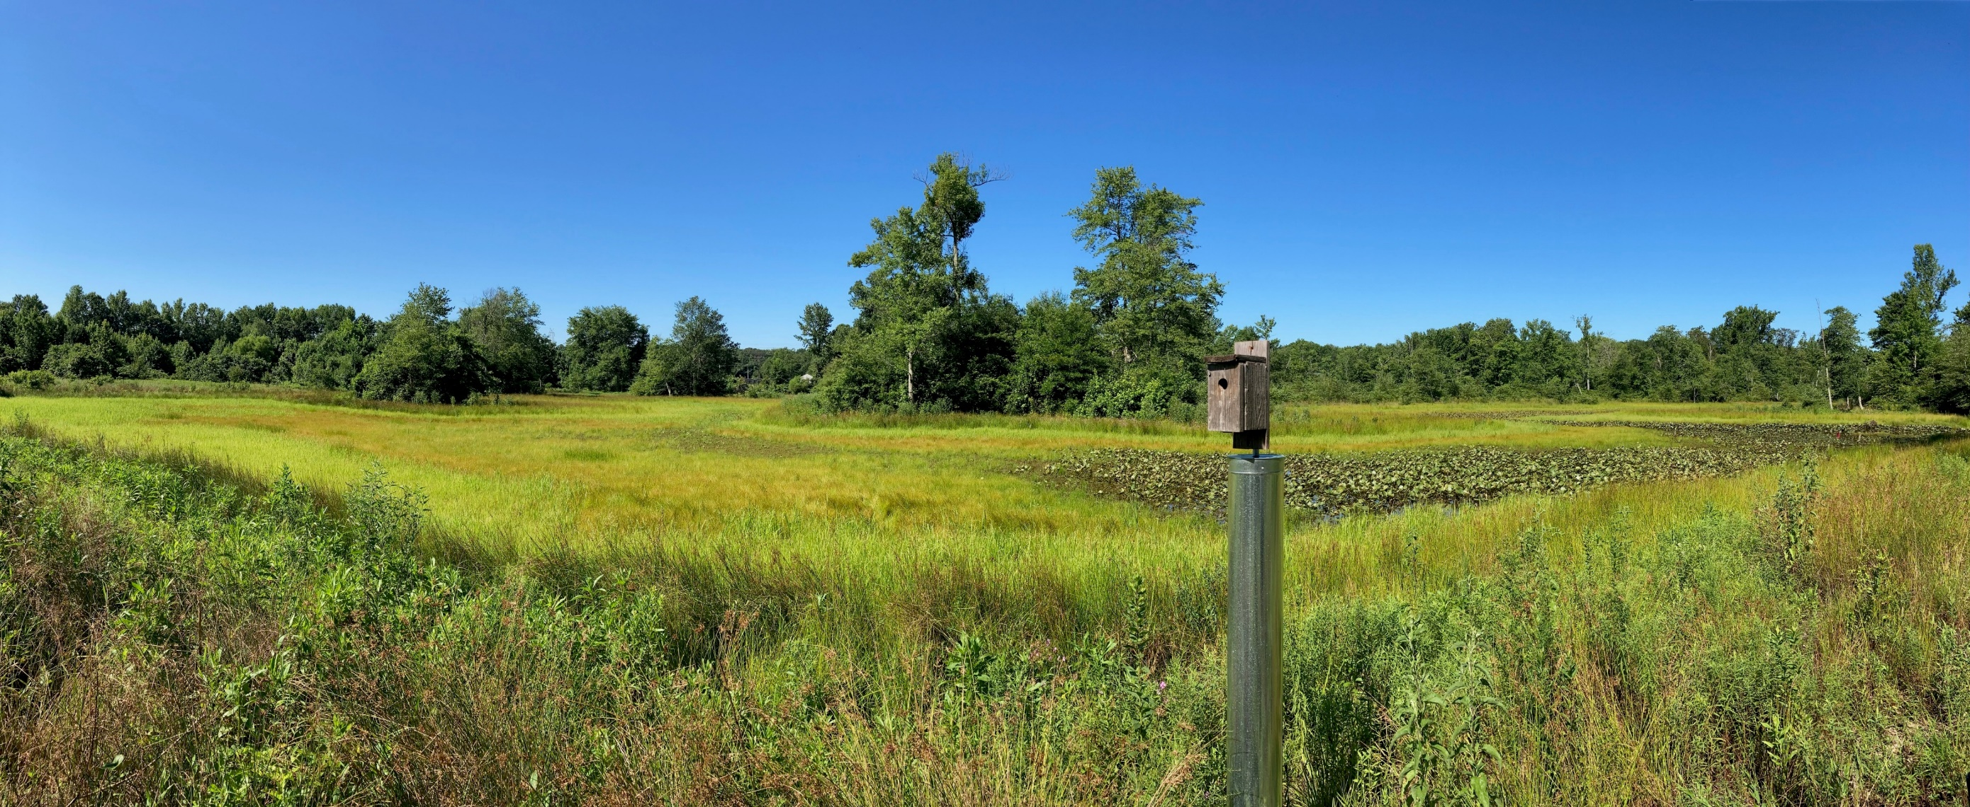
Forests, Wetlands, Meadows

Slide 4
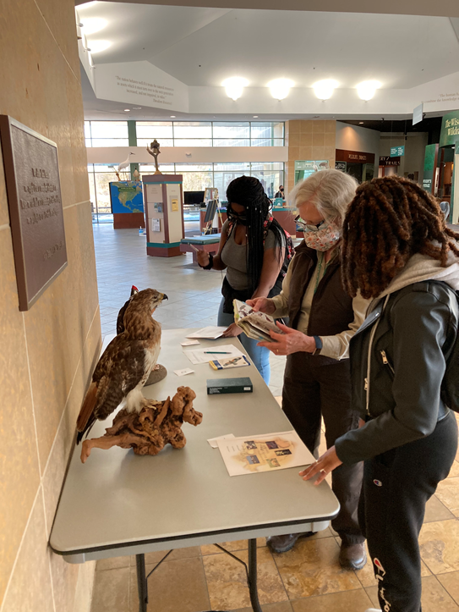
Patuxent is an
Urban Refuge
Within 25 miles of a population of 250,000
>100 “urban refuges” across the Nation
FWS Urban Wildlife Conservation Program:
  Inspire the next generation of outdoor enthusiasts in high population areas
  Identify and address barriers and improve access to the outdoors

Slide 5
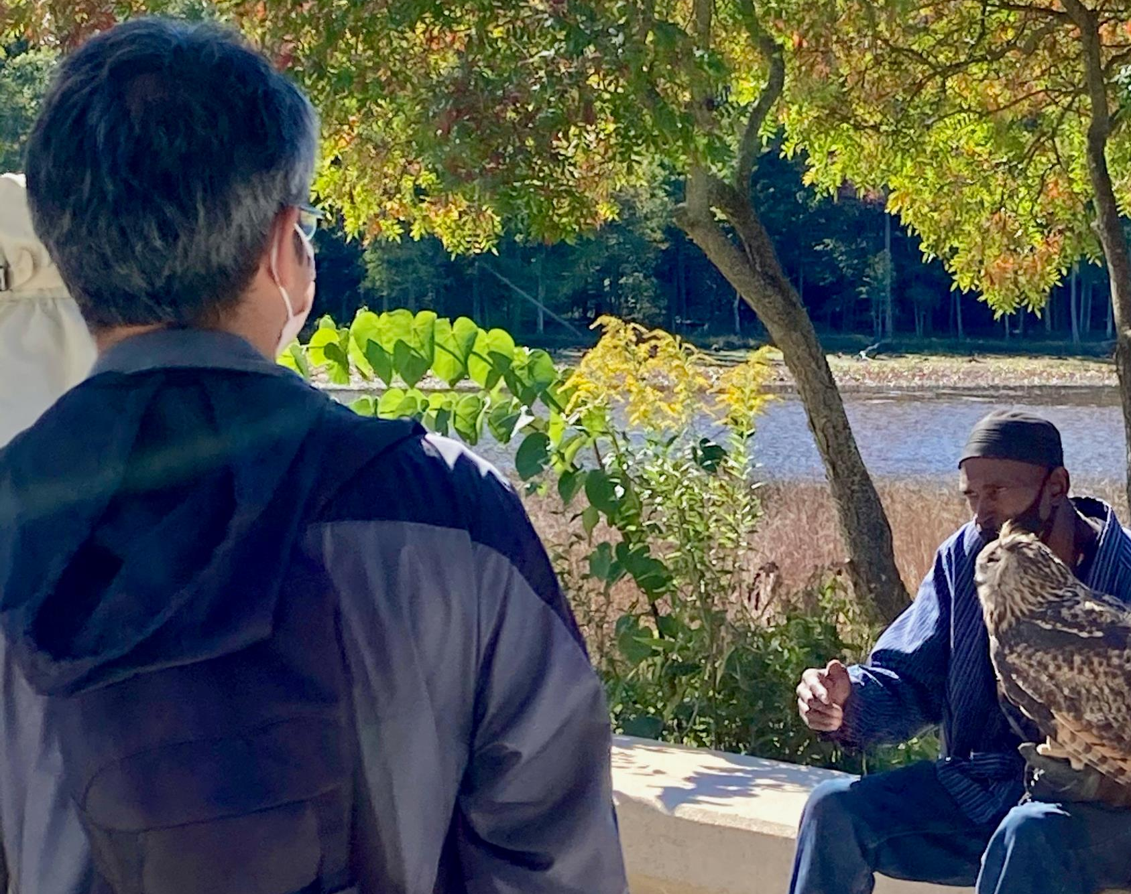
Urban
Standards of Excellence
Know and Relate to the Community
Connect People with Nature via Stepping Stones of Engagement
Build Partnerships
Be a Community Asset
Ensure Adequate Long-Term Resources
Provide Equitable Access
Ensure Visitors Feel Safe and Welcome
Model Sustainability
Notes:
Urban refuges that meet all of these standards are designated as “Flagship” refuges and potentially eligible for enhanced funding support/staff capacity

Slide 6
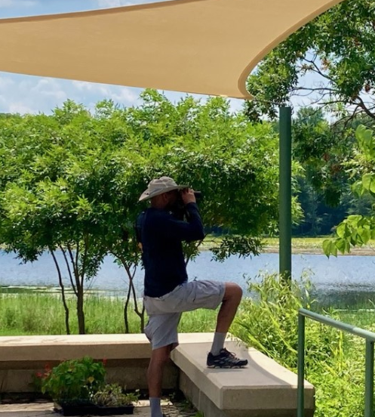
Vision for Patuxent as an Urban Leader
Include, Invite, and Inspire people to connect with nearby nature through community-focused conservation
Notes:
Focus communities: Bowie, Laurel, South Laurel, Greenbelt, Beltsville

Slide 7
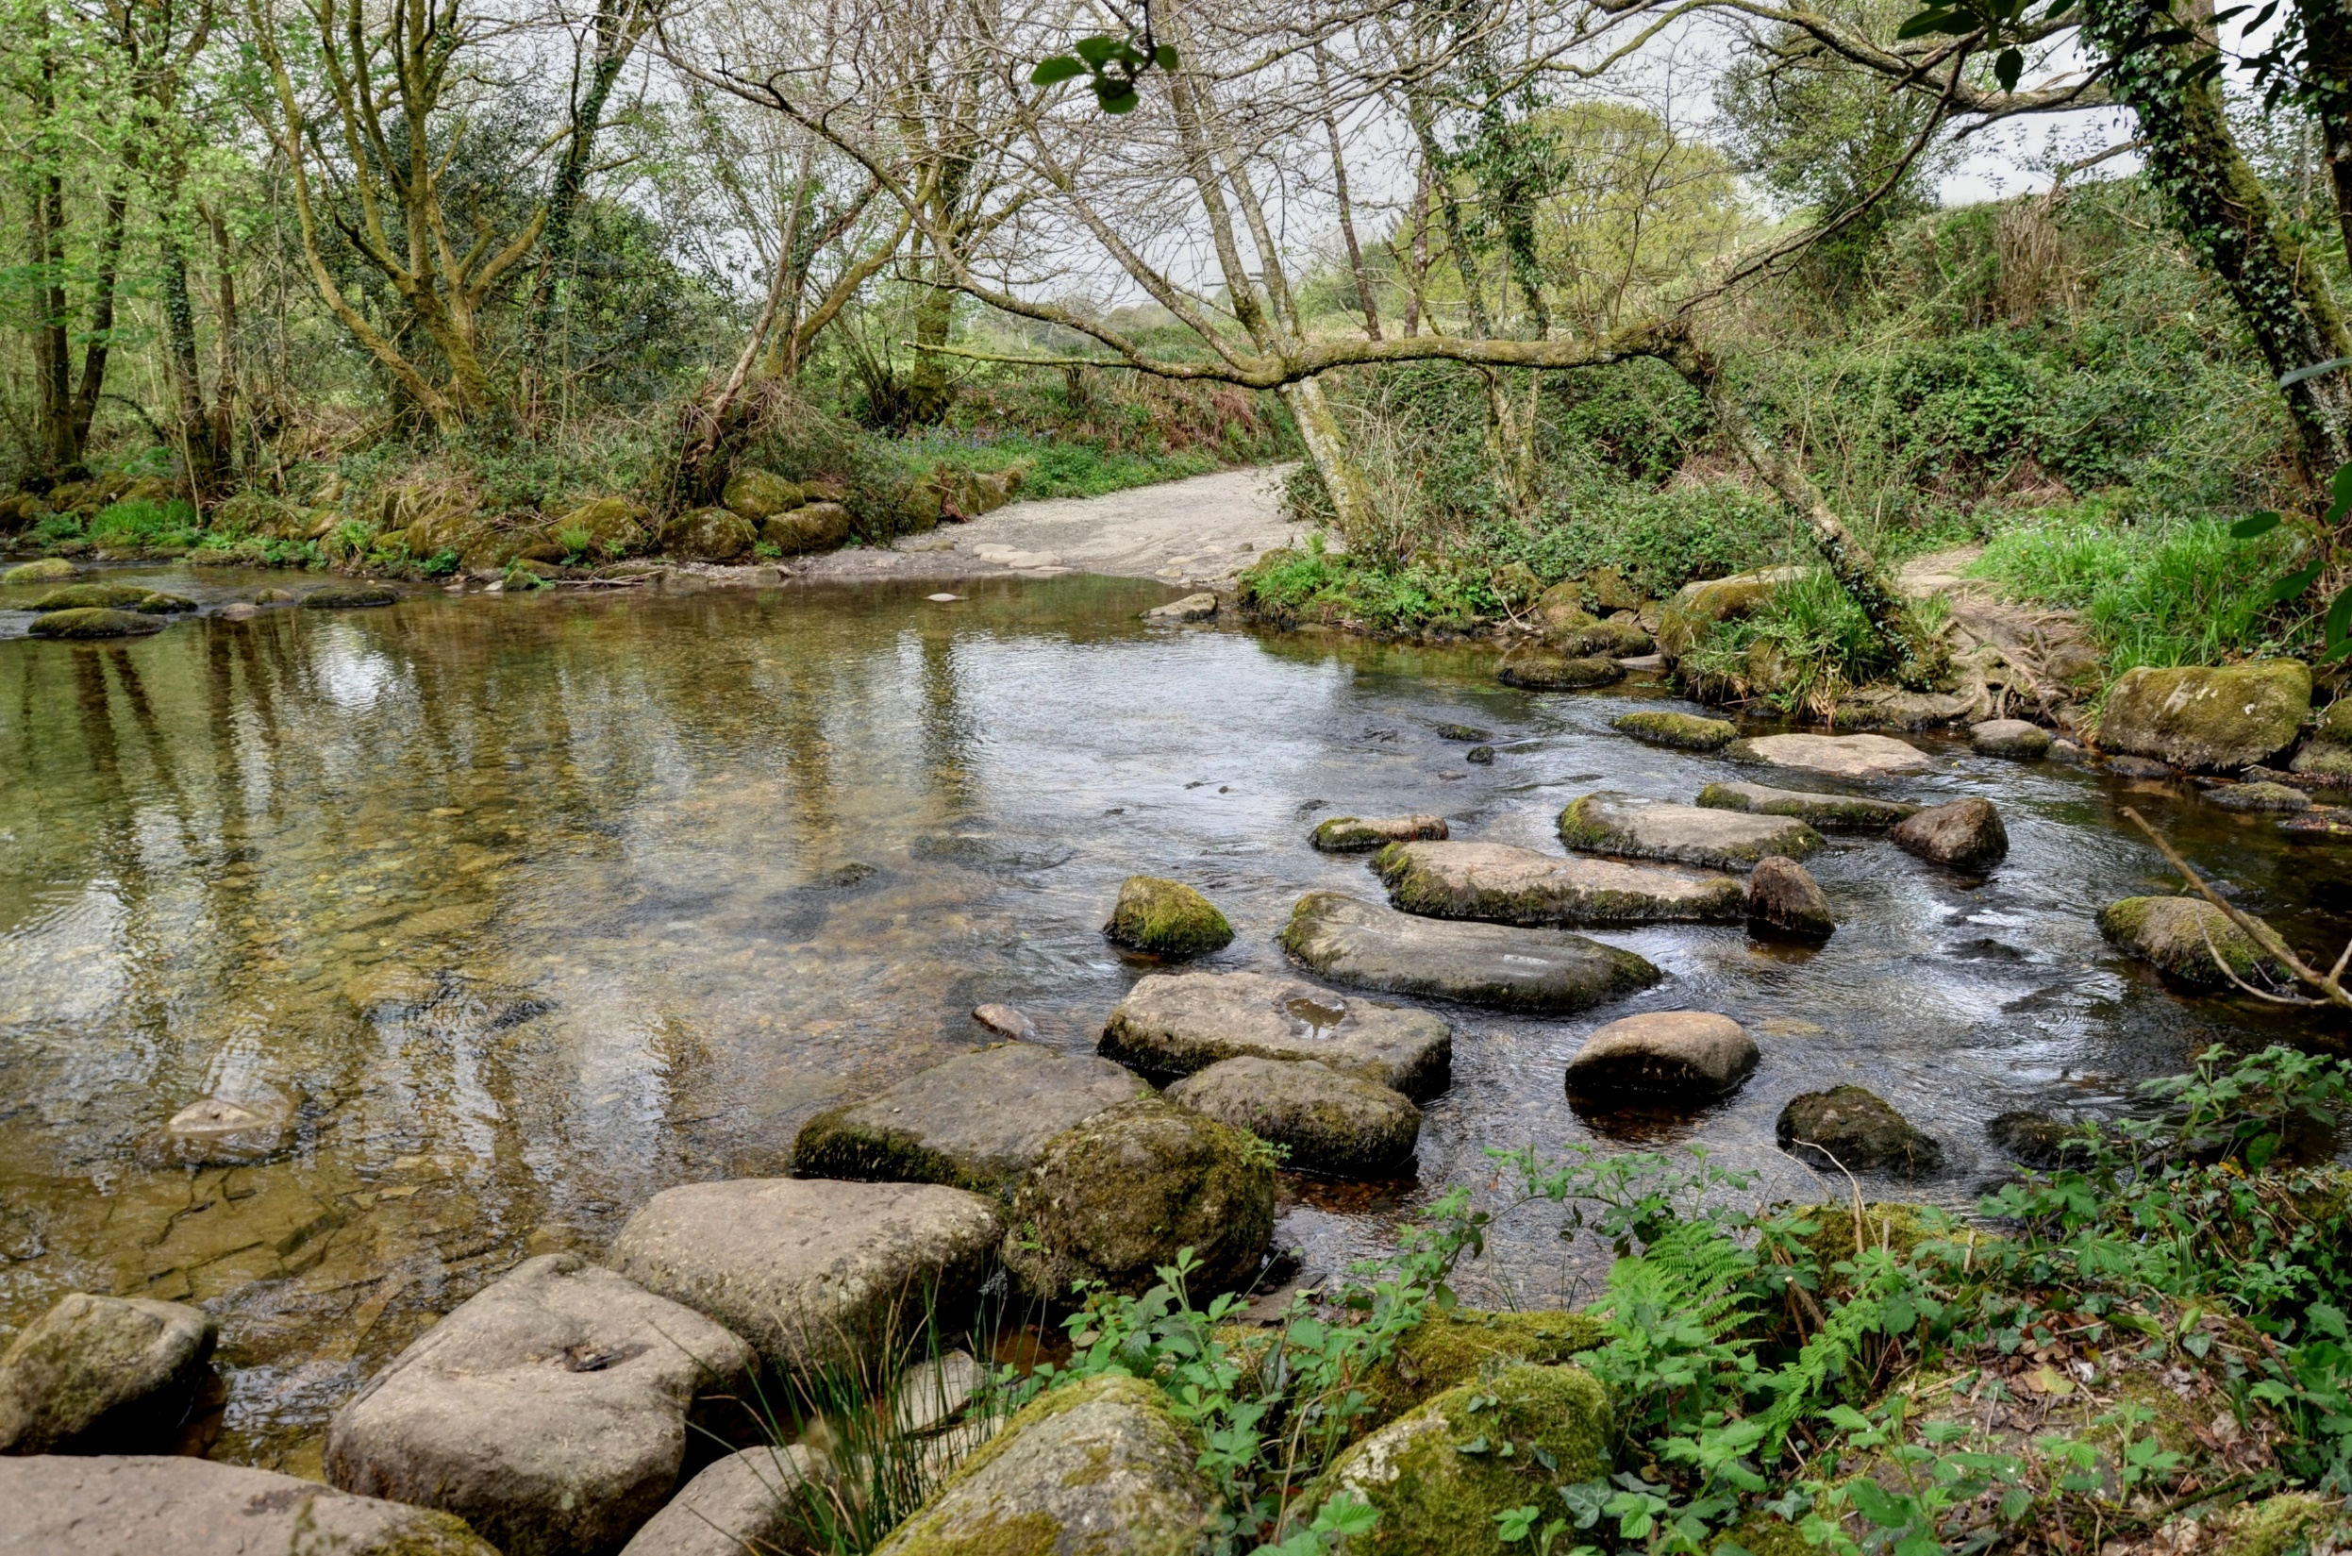









Stepping Stones of Engagement
Notes:
UWCP outlines Stepping Stones of Engagement: All about making people comfortable!
Our plan will focus on ways to:
Include people by offering familiar things like taking a walk, enjoying a meal together… outdoors.
Invite people to try new things, offering guided cycling, birding excursions, and making it easy to try things like fishing/hunting by offering gear, mentored programs…
Inspire people to engage in citizen science activities
Welcoming everyone in to the Refuge, and inspiring them when the go back out

Slide 8
Habitat
Primarily forest (~8,400 acres upland hardwood, ~2,200 acres floodplain)
Some grassland, savannahs
Scrub-shrub habitat
Notes:
One of the largest blocks of contiguous forest in the Baltimore -Washington Corridor

Slide 9
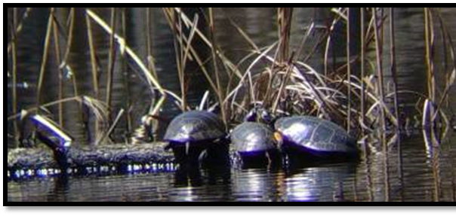
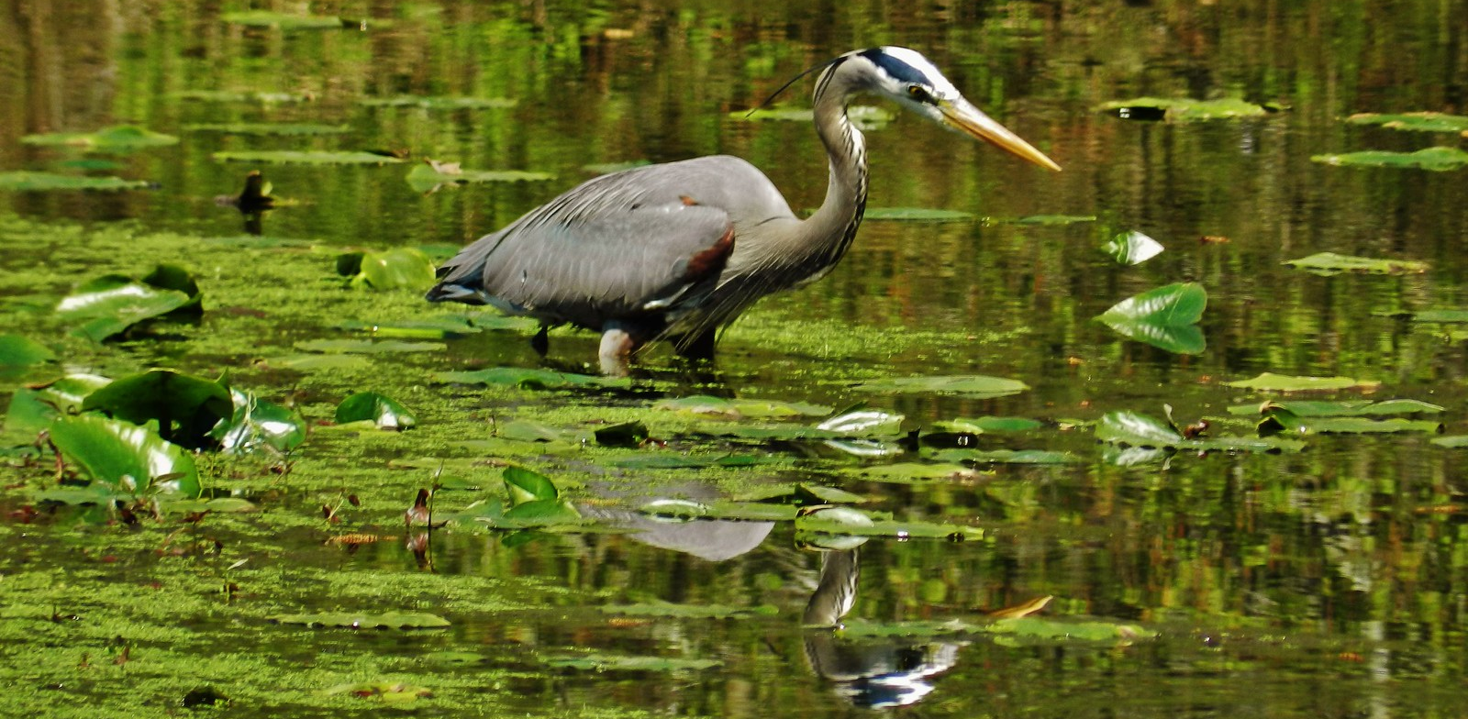
Wildlife
270 species of birds
109 species of dragonflies and damsel flies
49 species of reptiles and amphibians
35 species of mammals
30 species of fish

Slide 10
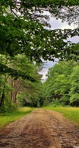
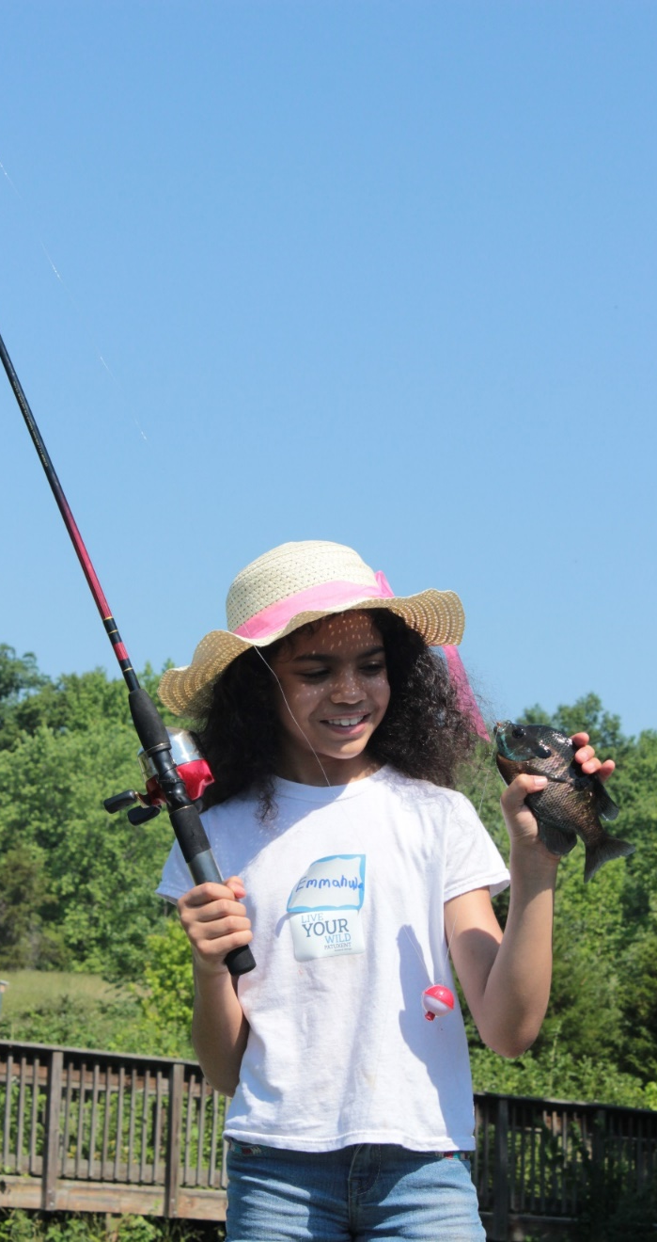
Activities and Trails
“Big 6”: hunting, fishing, wildlife observation, photography, environmental education and interpretation
Over 20 miles of trails
  5 miles on South Tract
  17 miles on North Tract
Trails range from single track to old gravel roads
Hiking allowed on all trails
Biking and horses allowed on some North Tract trails

Slide 11
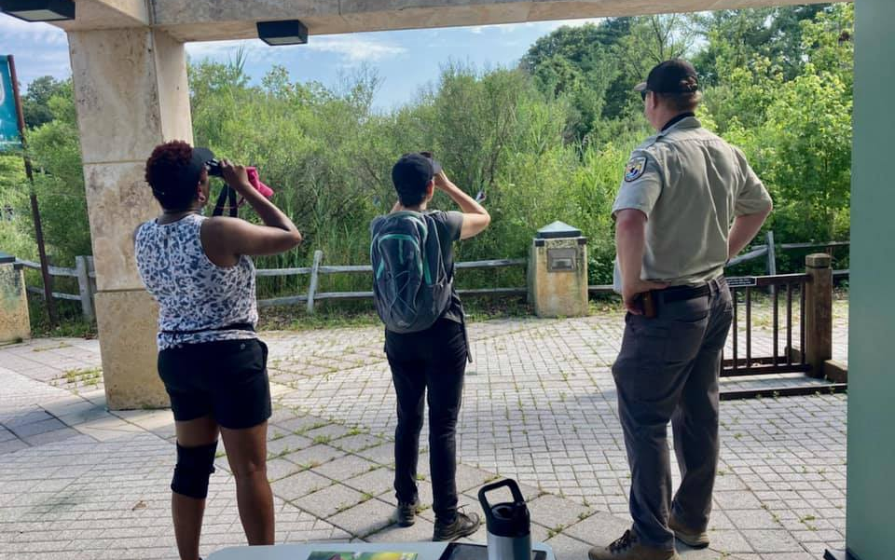
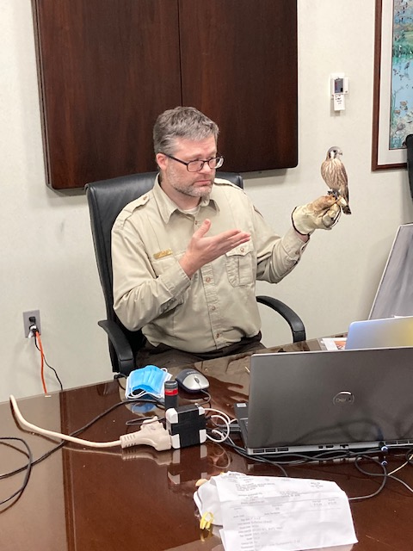
Programs and Events
Programs:
Dragonfly hunt
Night Hikes
Photo Scavenger Hunts
Bicycle Tours
Merit Badge Programs
Wetland Walks
Live Birds of Prey Talks
Virtual Programs
Events:
Winter Bird Count (January)
Youth Fishing Day (June)
Latino Conservation Week, Bird Fest (July)
Outdoor Living Skills Day (August)
Pollinator Festival, FOP (September)
Refuge Conservation Day (October)
FOP Holiday Bazaar (November)

Slide 12
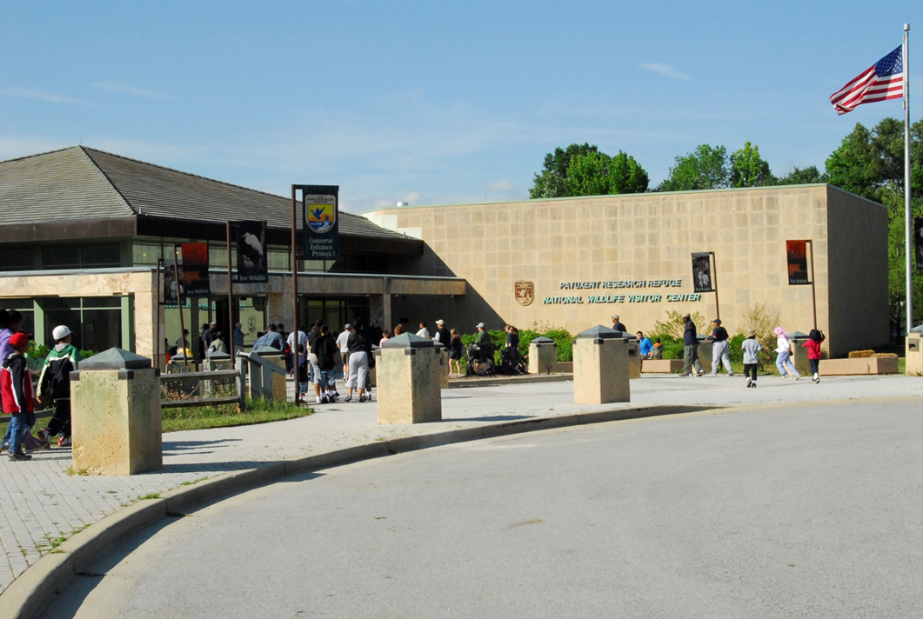
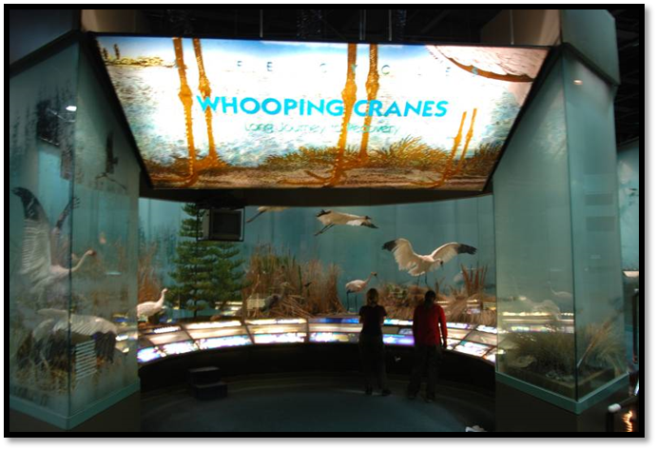
National Wildlife Visitor Center
Exhibits focus on Wildlife Research, Migration, Habitats, Endangered Species, Life Cycles
Open Tuesday through Saturday from 9:00 AM - 4:30 PM
Grounds open sunrise-sunset

Slide 13
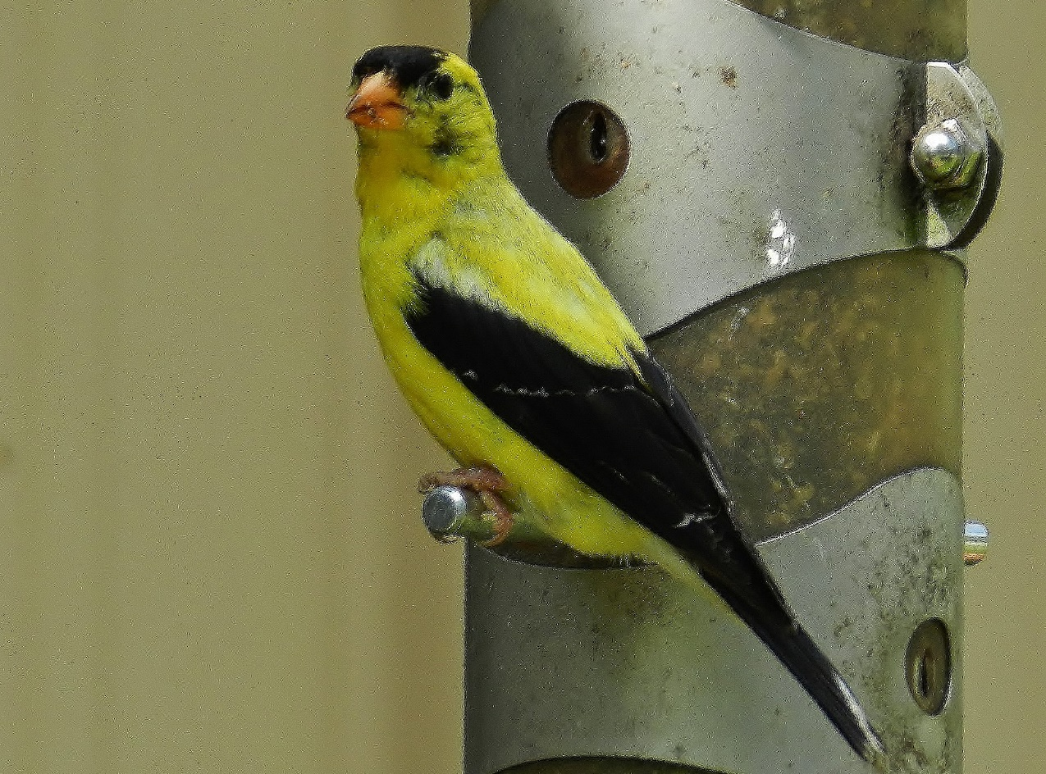
National Wildlife Visitor Center
Gallery: rotating art/photography exhibits
Indoor viewing area / Lake Redington
Large auditorium
Meeting rooms
Wildlife Images bookstore/nature shop
Restrooms
Native plant/pollinator garden
Bird feeding station, benches
Back patio with scopes, tables

Slide 14
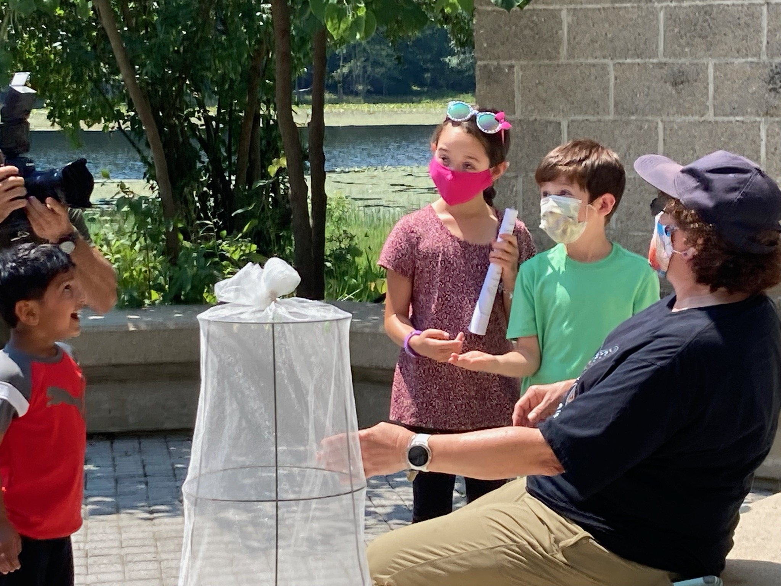
Environmental Education and Interpretation
School Groups, Scouts, 4H, Boys & Girls Clubs
Pollinator container gardening
Programs for children of all ages
  Kids Discovery Center
Monarch Project
Public special events
Birding, Camping, Fishing Workshops
Youth Fishing Events
Binoculars and fishing gear to borrow
Notes:
What we offer:

Slide 15
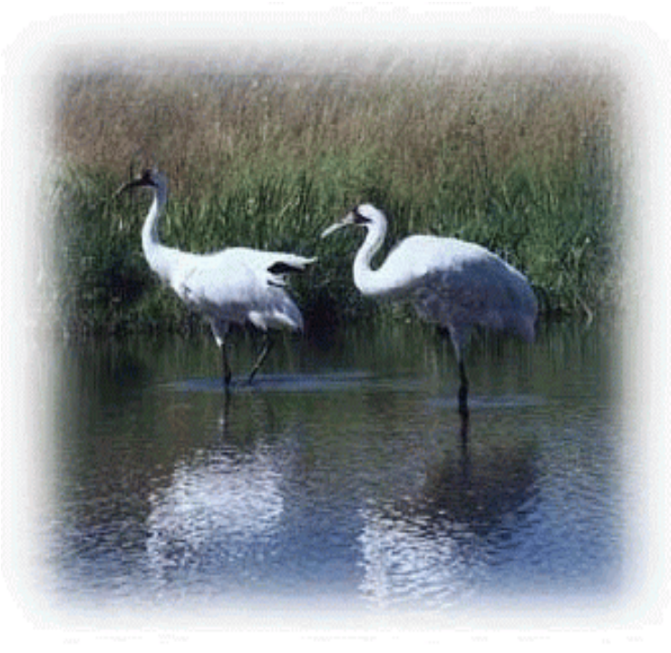
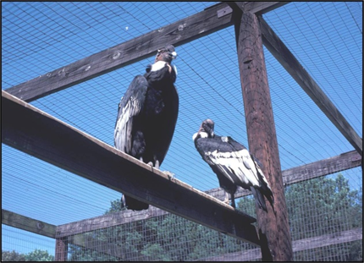
Central Tract: Research
Original 2,670 Acres –designated 1936
Closed to the public
Pioneered captive propagation techniques
Eastern Ecological Science Center (US Geological Survey)
Bird Banding and Pollinator Laboratories
Contaminant Studies
Notes:
What is on the Central Tract:
Most famous: whooping crane recovery (ended in what year?)
Contaminant impacts on wildlife mortality, including DDT on bald eagles and other bird eggs (thin shells)

Slide 16
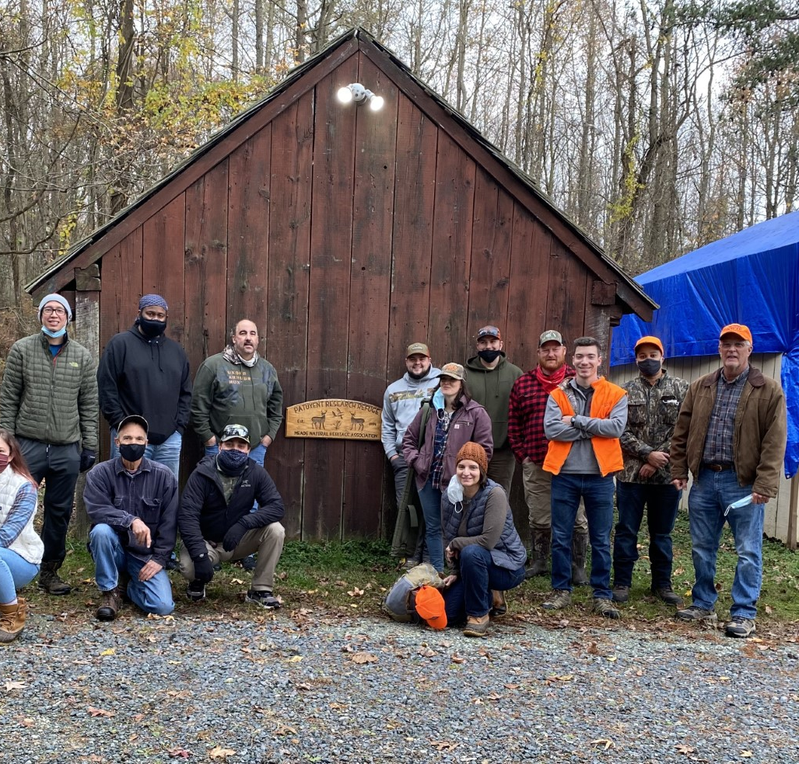
North Tract
8,100 acres transferred from DOD
Quadrupled size of the refuge
Added important wildlife habitat
Wildlife observation, hiking, hunting, fishing, biking, horseback riding
Small visitor info station w/ restrooms
Sign-in required (unexploded munitions)

Slide 17
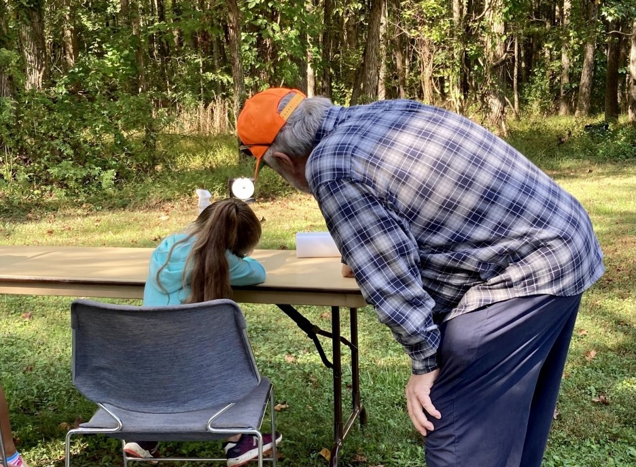
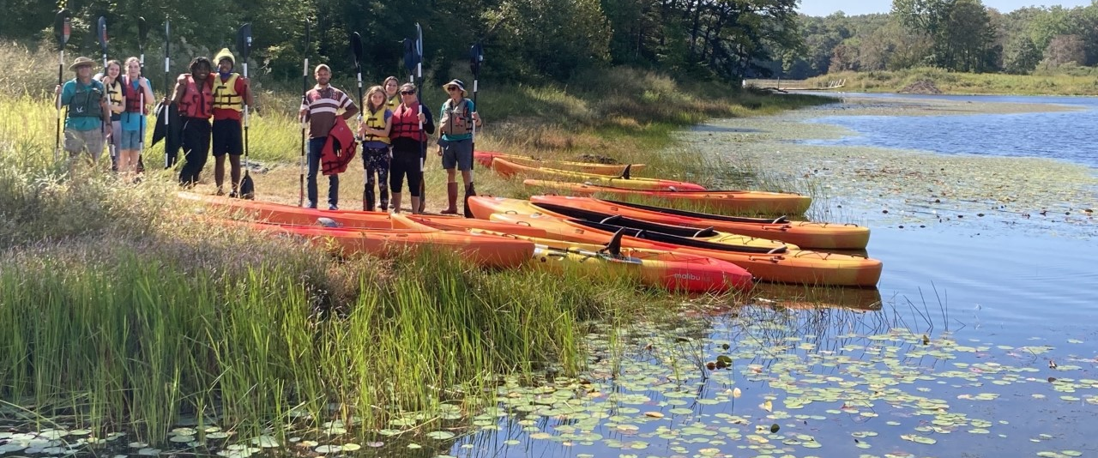
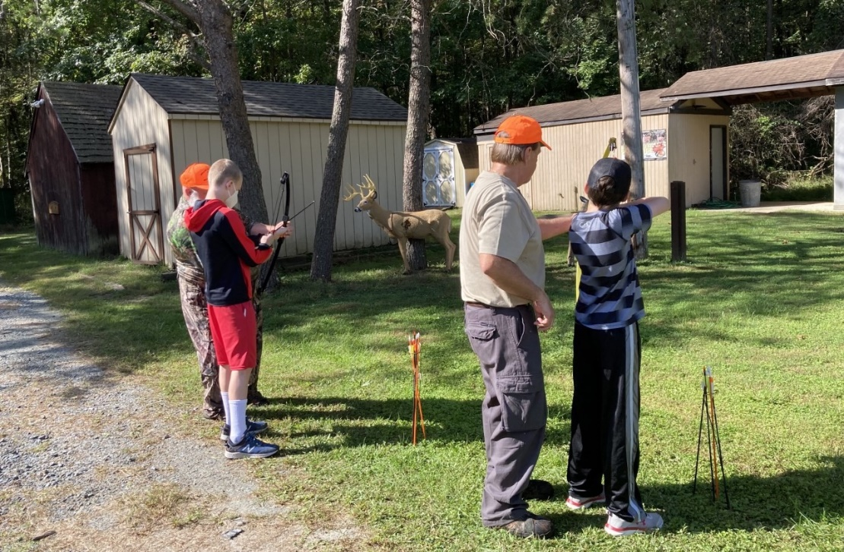
Outdoor Skill Building

Slide 18
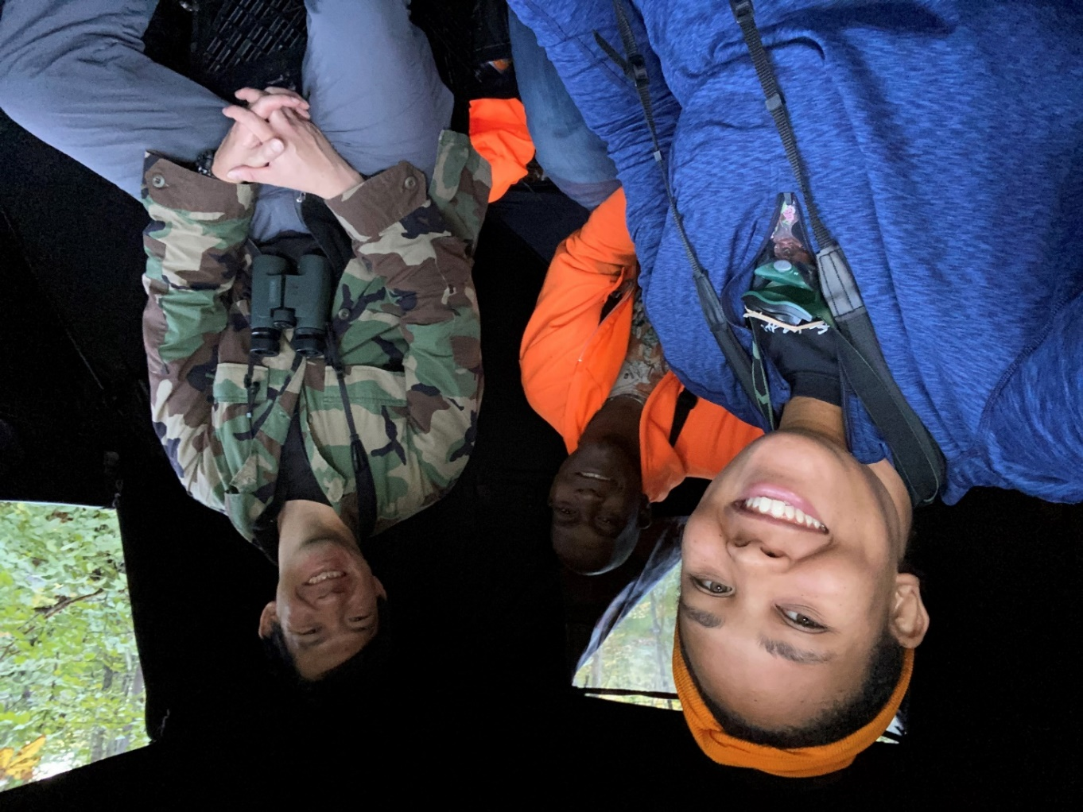
Mentored Hunts
  Going into our 3rd year
  Pair experienced hunting mentors with folks interested in learning to hunt
  Orientation
  Day at the range
  Saturday hunt
Notes:
USFWS provided the campsites at no cost. The goal of the program was to reduce barriers to hunting and we did not want the costs of camping to be a deterrent.
Camping also allowed the group to spend time together and get to know the mentors better.
Shooting range was off site. For DNR mentored hunts we use onsite range.

Slide 19
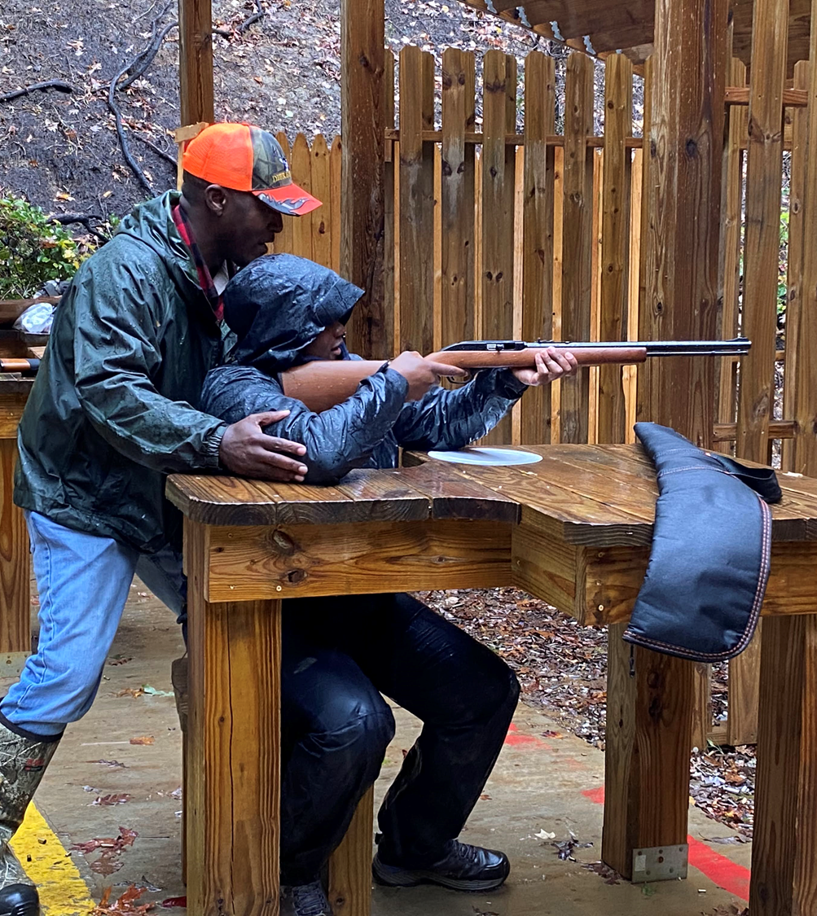
Diversity Hunt
Partnered with Eric Morris, N.onT.ypical Outdoorsman
Paired seven first-time hunters with seasoned mentors
Recruited mentees thru Outdoor Afro
Covered hunting ethics, hunting etiquette, shooting fundamentals, and deer behavior
Notes:
The Refuge partnered with NonT.ypical Outdoorsman Eric Morris, who specializes in promoting diversity in hunting.
Recruitment assistance from the local Outdoor Afro Chapter

Slide 20
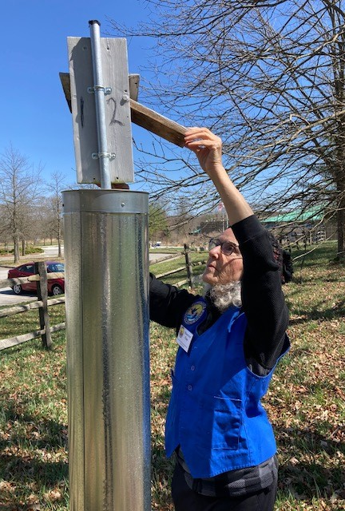
Volunteers and Partner Groups
200 Volunteers provide 25,000+ hours of service/year
Activities include:
  Visitor Services
  Community Science
  Gardening & Landscaping
  Facility Maintenance

Slide 21
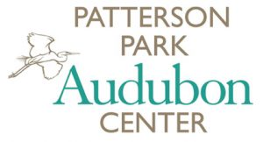
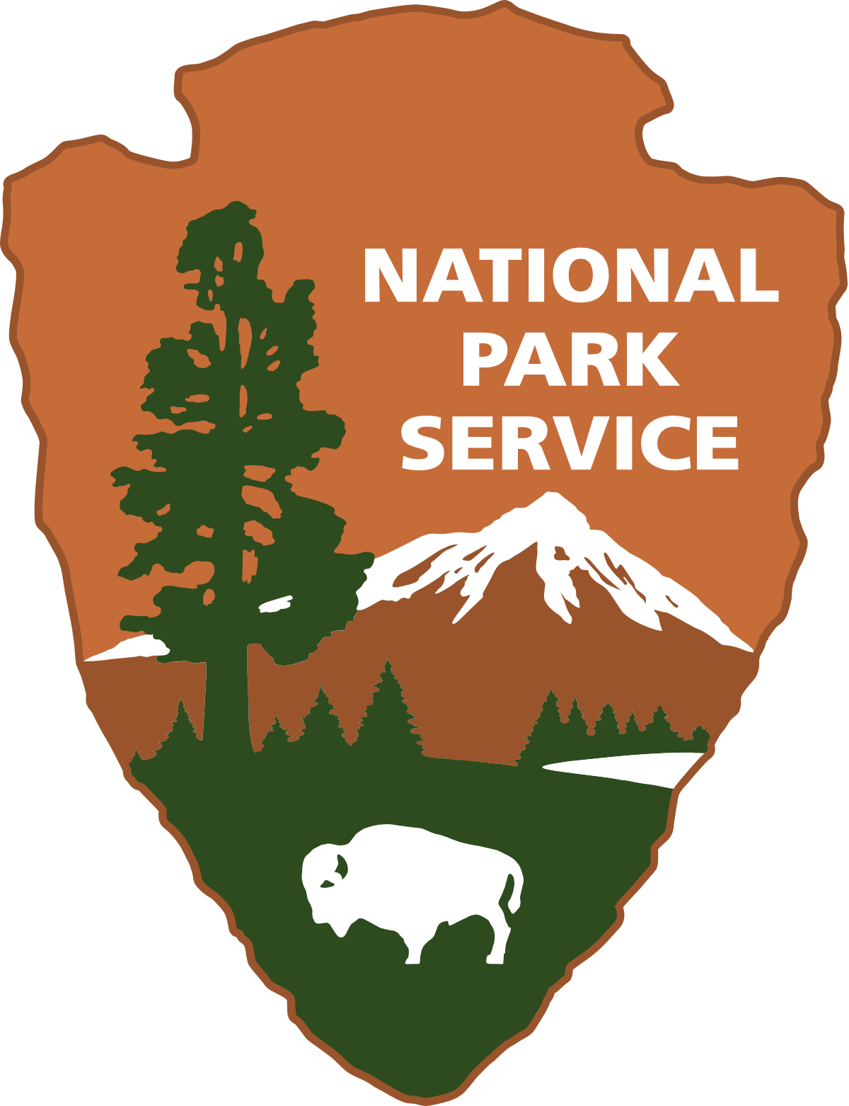
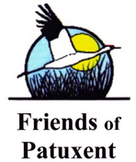

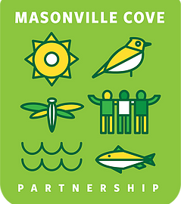



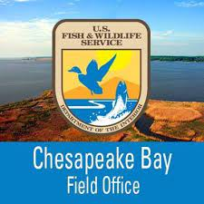



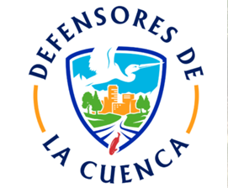






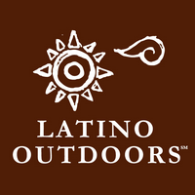


Notes:
Plethora of PARTNERS!

Slide 22
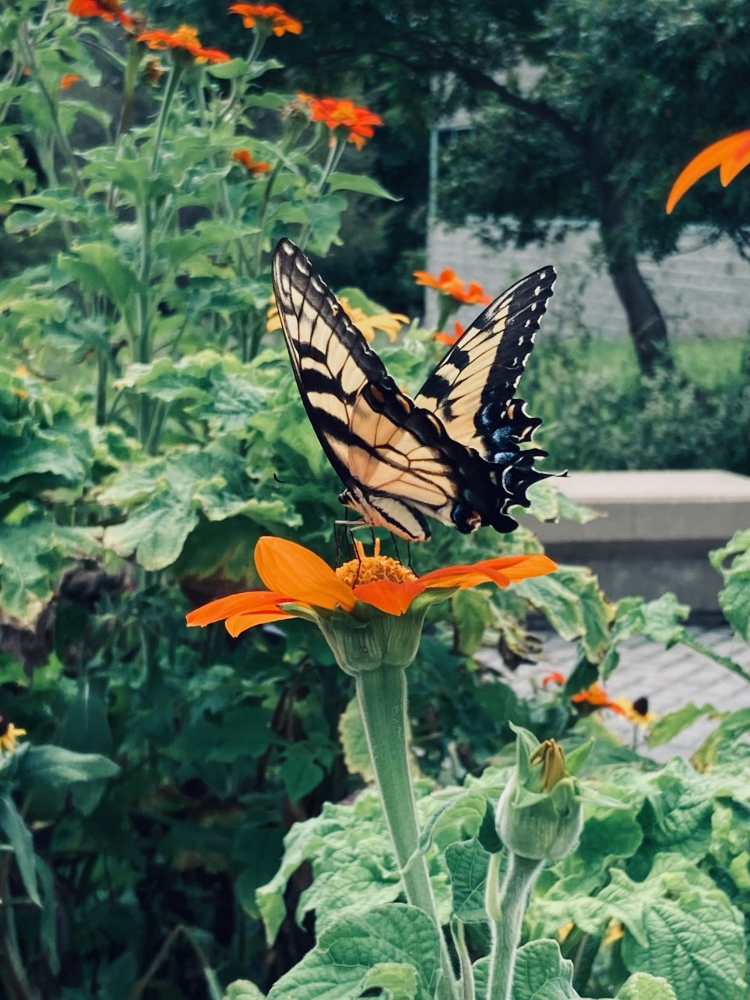
Takeaways
Priorities in 2023:
Connect with local community
Strengthen partnerships
Enhance visitor experience
Diana Ogilvie
301-497-5565
Diana_Ogilvie@fws.gov
Questions?
Notes:
Community engagement: includes positioning refuge for recognition as a $1M Urban Refuge!
Partnerships: formalize new ones and strengthen existing (Community Engagement Specialist?)
Provide a welcoming, safe, inspiring experience (improved access, facilities, signage, programs)

