Slide 1
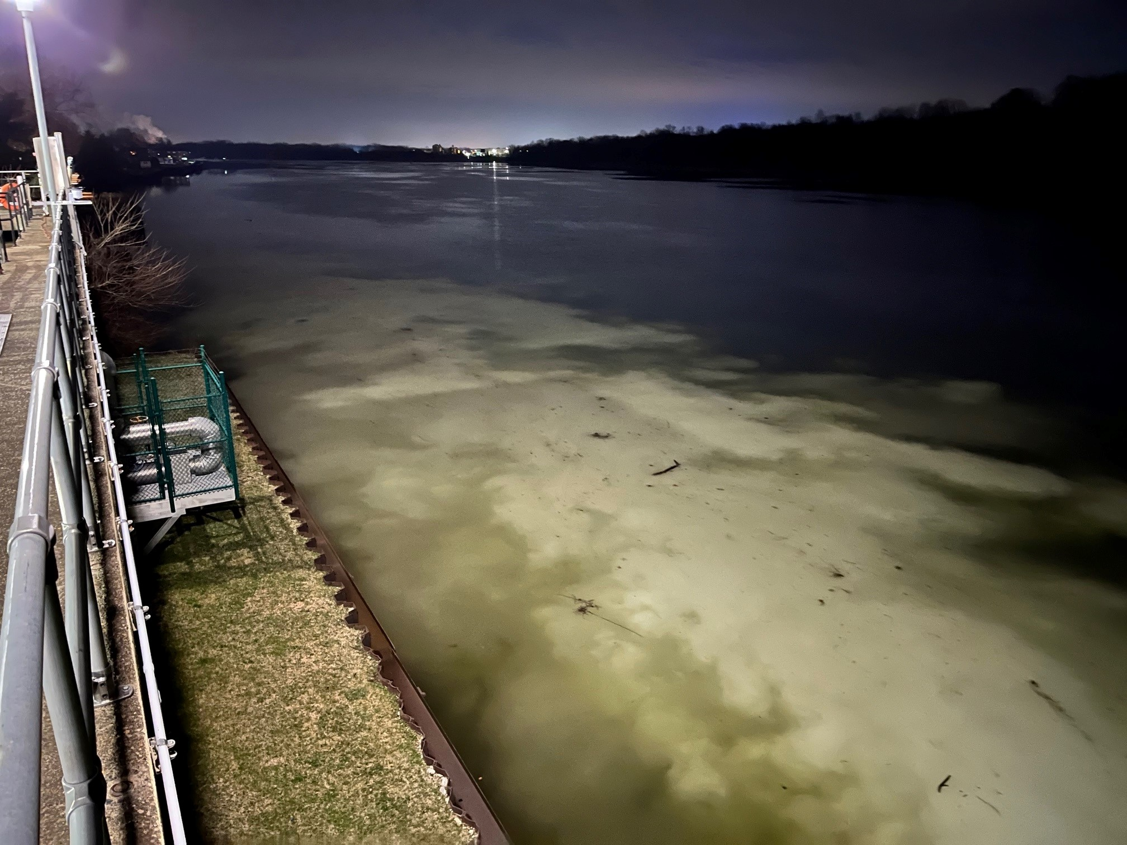
TRINSEO
Acrylic Polymer Release

Slide 2
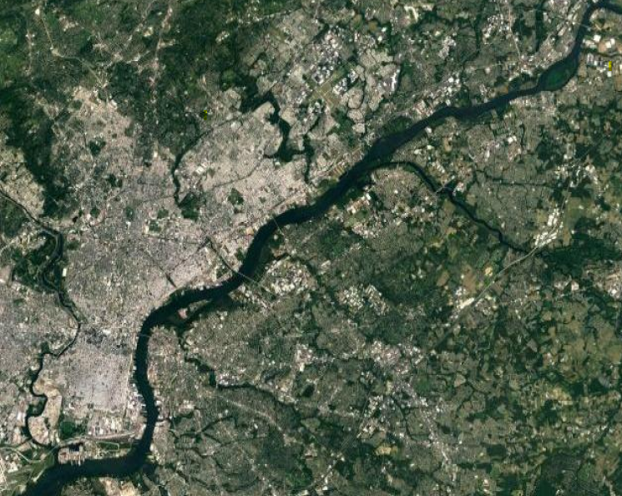
= Potentially Impacted Drinking Water Intakes
Trinseo
Philadelphia
Notes:
- Bristol plant is approximately 17 miles northeast of Philly.
Plant is 72 years old (former Rohm & Haas) but Trinseo has only been there since May of 2021.
Plant produces polymethyl methacrylate (PMMA) chemicals used in the production of colored and translucent plastics.

Slide 3
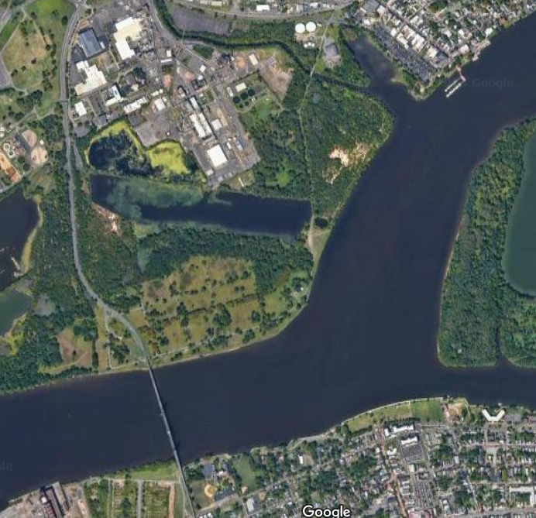
Trinseo
Mill Creek
Otter Creek
Delaware River

Slide 4
Friday, March 24, 2023
9:15-11 p.m.
Trinseo begins transfer of Emulsion 30D-60IE
Trinseo personnel discover ruptured pipe above building. Transfer is secured. Product is found is running down sides of building and gutter system. Max potential is 12,000 gallons; estimated 8,100 gallons released onto building.
11:32 p.m.
Trinseo makes NRC report. “The caller states while transferring finished product, from a process tank to storage, the line ruptured causing a release of finished latex product into the clearwater sewer inlet – otter creek.” “Release was contained on site, site personnel implementing containment procedures”
11:44 p.m.
Bucks County HAZMAT makes NRC report. “The caller states 55,000 lbs of emulsion is leaking into a creek and making its way to the Delaware river.”

Slide 5
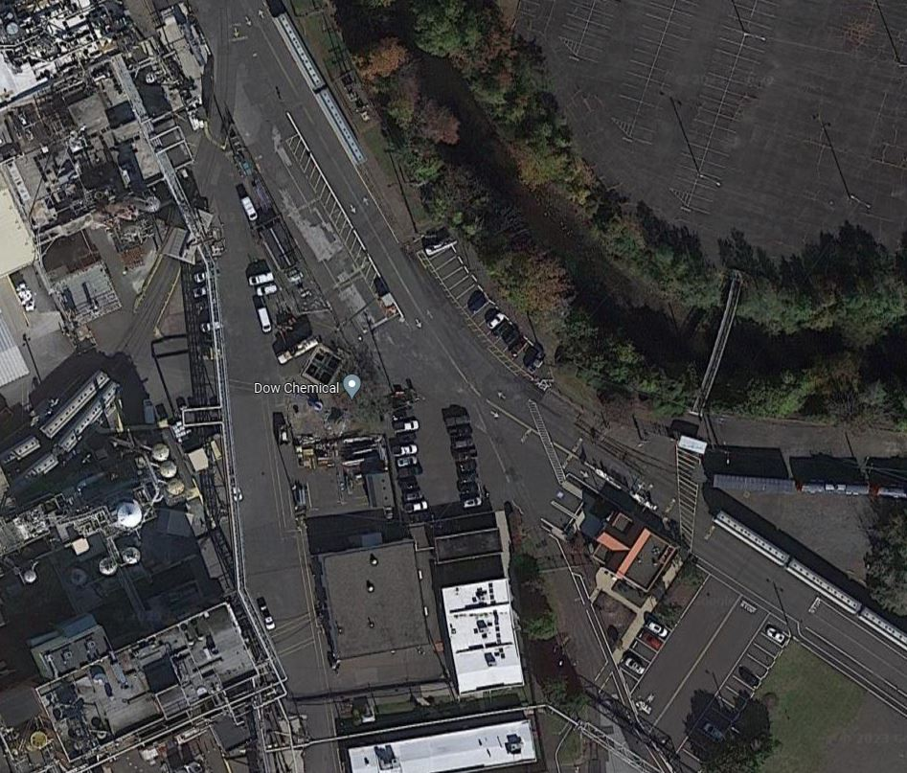
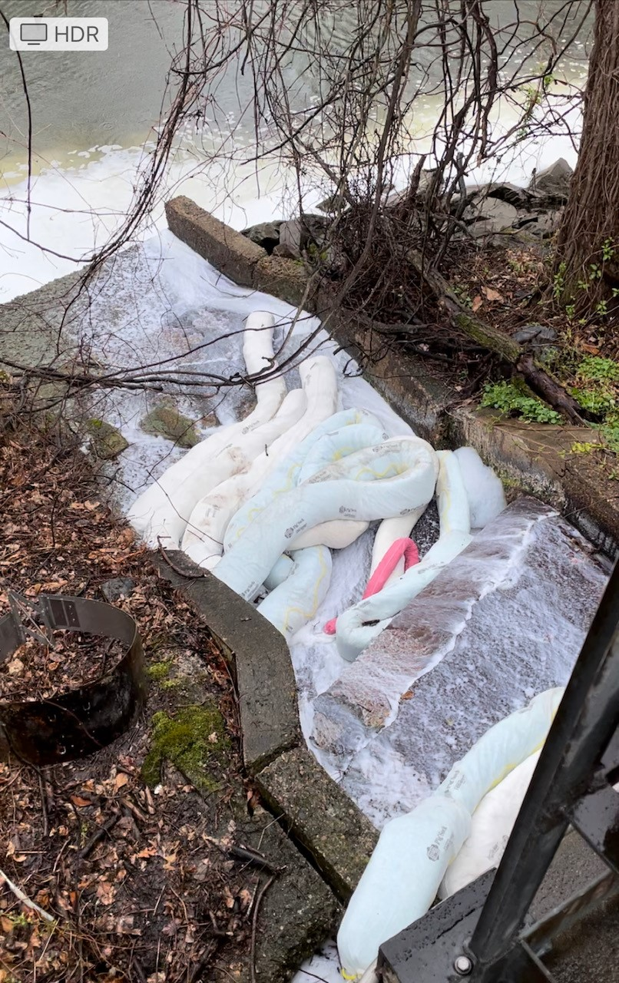
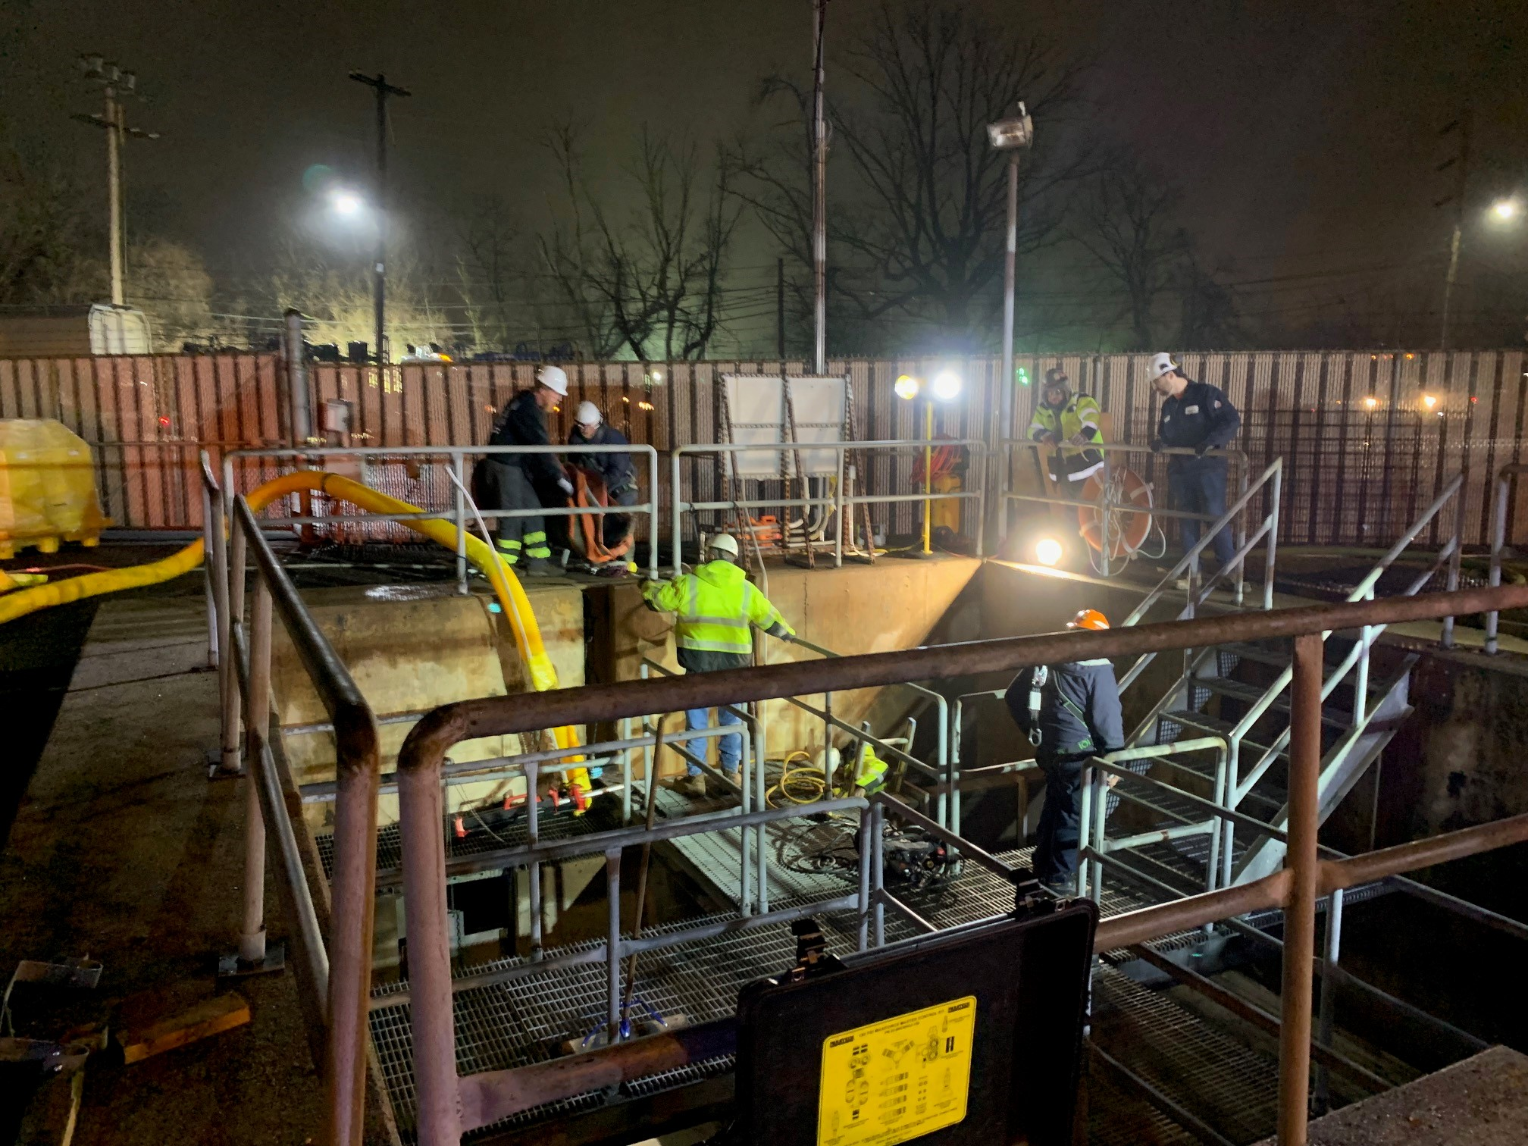
Mill Creek
Sewer Outfall #8
Underground Storm Sewer
Towards Delaware River
Observation Basin
Underground Storm Sewer
Ruptured Pipe Location

Slide 6
Observation Basin Total Capacity 65k gallons (if stormwater system is plugged)
Storm water grate near spill
Sewer Outfall #8
Underground Stormwater System
25k gallon capacity
Underground Stormwater System
Mill Creek

Slide 7
Mill Creek
Sewer Outfall #8
Trinseo
Underground Storm Sewer
Towards Delaware River
Observation Basin
Dow Chemical
Underground Storm Sewer
Ruptured Pipe Location

Slide 8
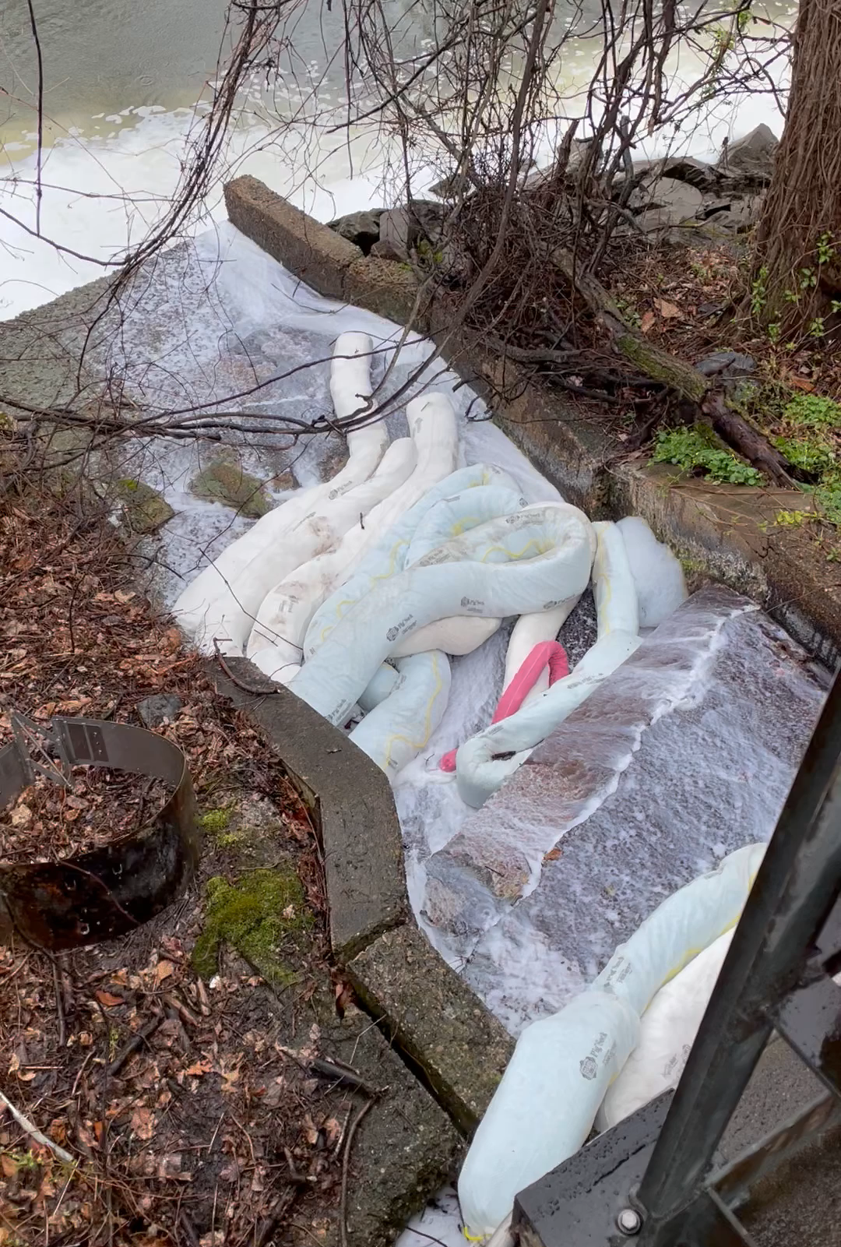

Slide 9
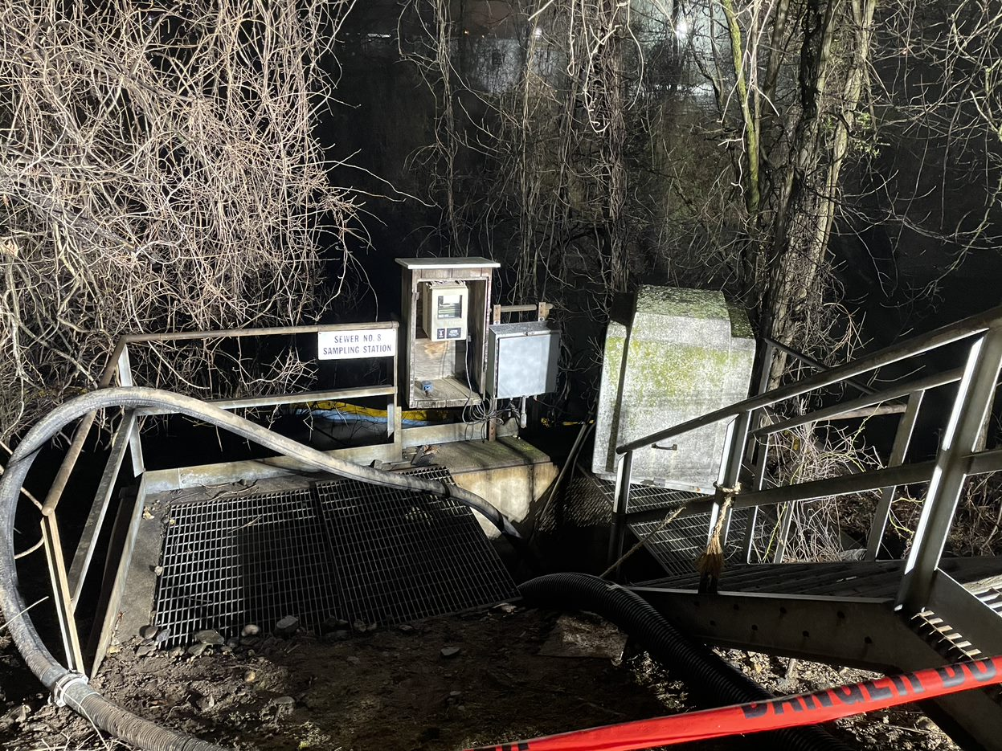

Slide 10
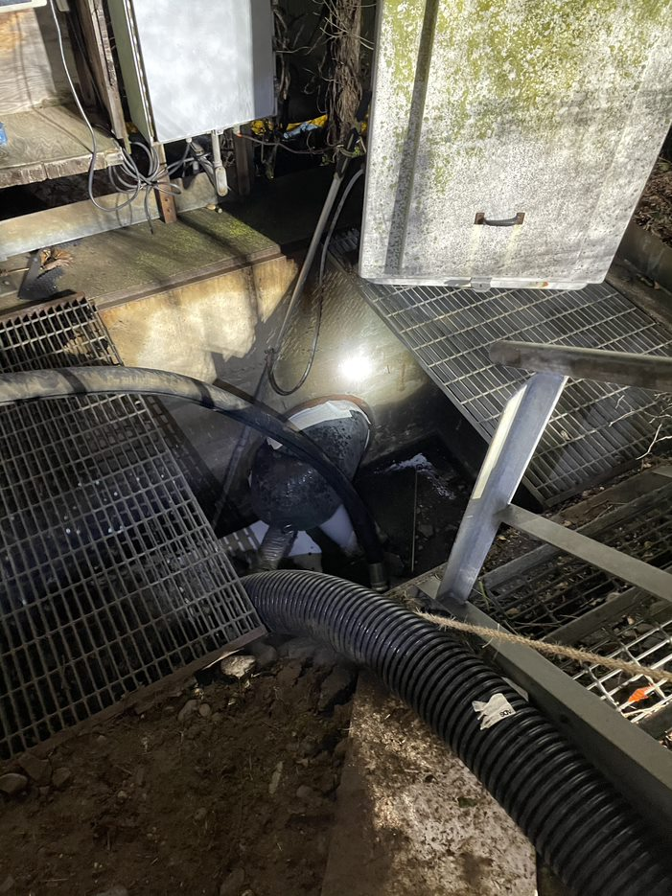

Slide 11
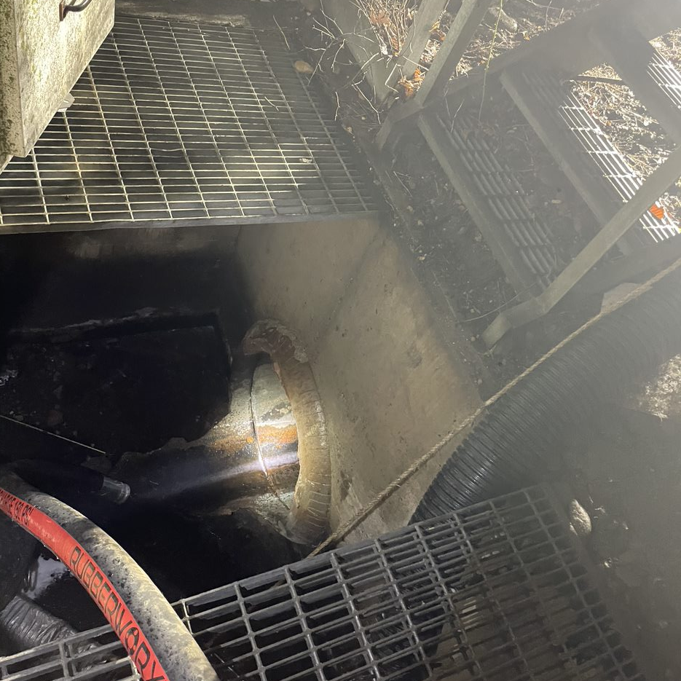

Slide 12
Saturday, March 25, 2023
12:28 a.m.
Delaware River Early Earning System Water Quality Event released notifying all participating water intakes of spill.
2:00 a.m.-11:00 a.m.
Plug inserted at outfall to secure release, storm outfall #8’s concrete is compromised allowing product to leach out through cracks.
CG preliminary investigation determines release is a water-soluble product. EPA/CG determine hazardous substances are included in product.
Efforts begin from Trinseo and Dow Chemical to hire response companies.
Product observed moving north and south with tide, CG Boat crews observe visible product as far south as Neshaminy Creek. Visible product remained constrained to PA side of Delaware River.

Slide 13
Emulsion 30D-60IE Ingredients
Water: 47-50%
  3,800-4,050 gallons
Acrylic Polymer: 50-53%
  4,050-4,300 gallons
Individual Residual Monomer: 0.1%
  8 gallons containing…
    Butyl Acrylate: .04 gallons
    Ethyl Acrylate: 0.21 gallons
    Methyl Methacrylate: 3.49 gallons
    Styrene: .03 gallons

Slide 14
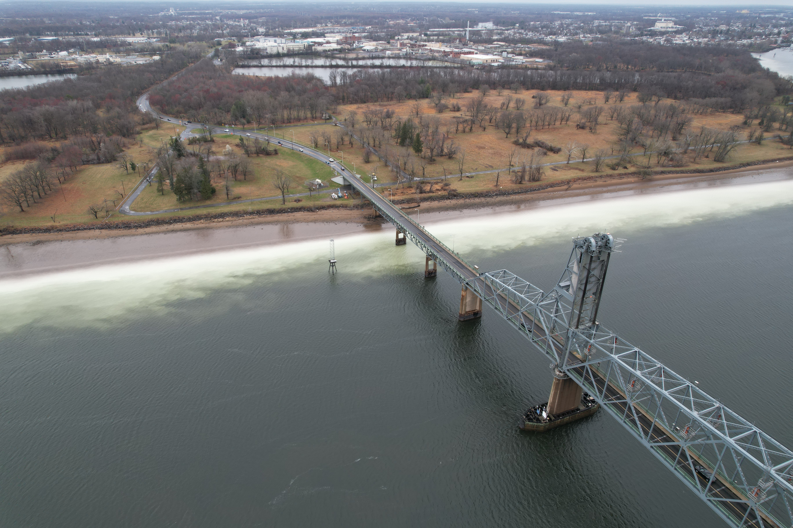

Slide 15
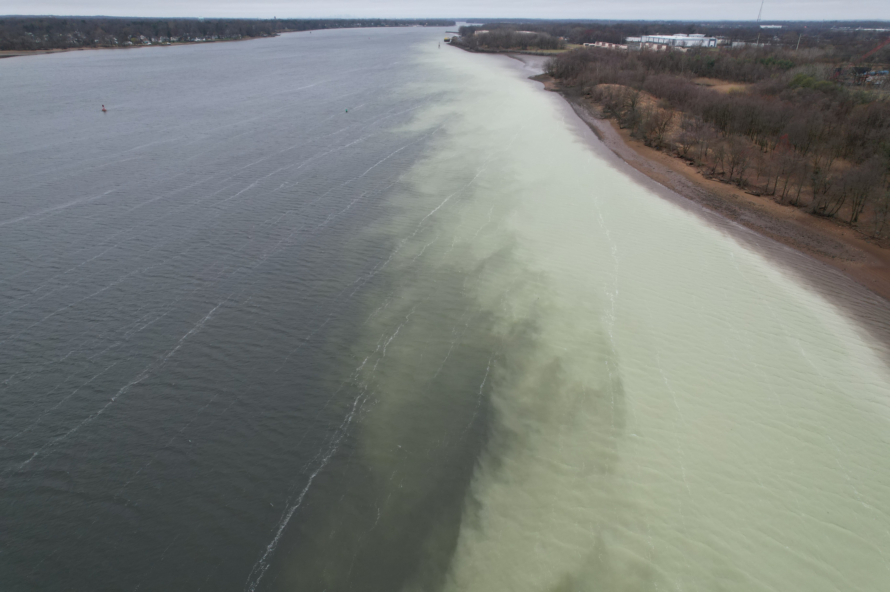

Slide 16
Saturday, March 25, 2023
11:53 a.m.
Coast Guard issues Admin Order requiring Trinseo immediately deploy equipment to contain and recover product form the waterway and facility.
1:00 p.m.
Coast Guard issues Notice of Federal Assumption, opens CERCLA, federalizes response and issues ATP to ACV Enviro for $100k. Unified Command established between USCG, PADEP, Trinseo and Dow Chemical.
CG issues first press release.
~9:00 p.m.
Release secured at observation basin.

Slide 17
Sunday, March 26, 2023
Clean up efforts continued at observation basin and Sewer #8 outfall.
Philadelphia Water Department begins public notification of water quality concerns.
ACV Enviro demobilized and 24/7 operations secured.
USCG and EPA begin testing Delaware River.

Slide 18
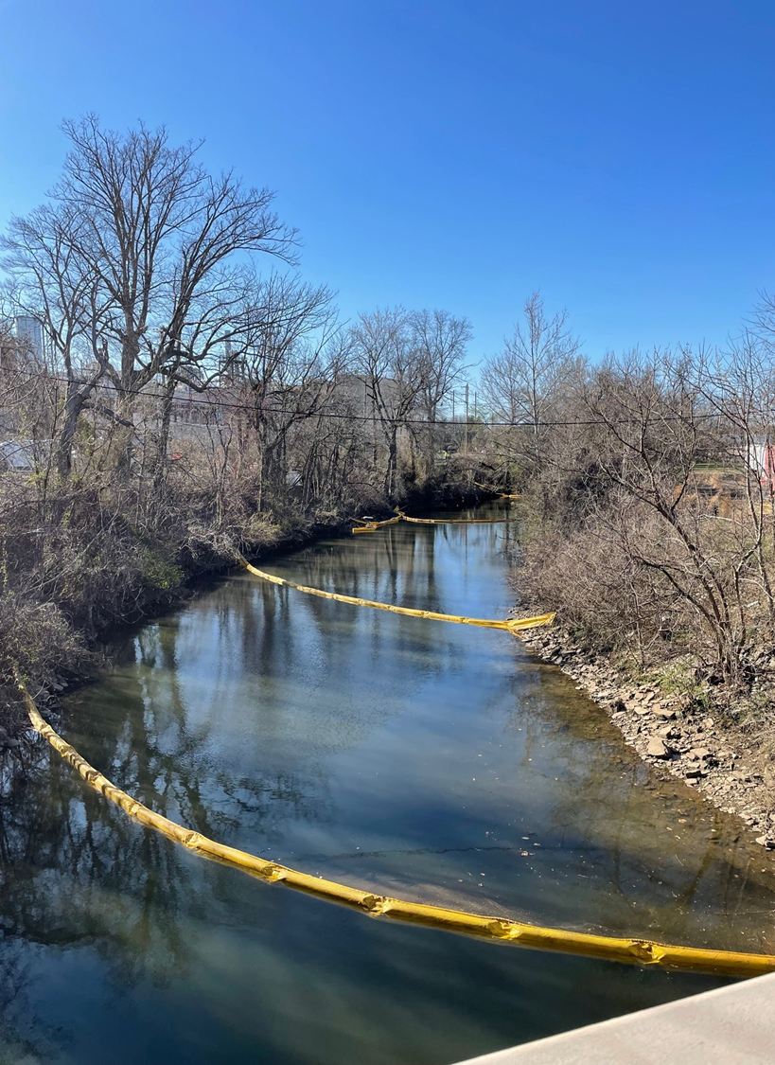

Slide 19
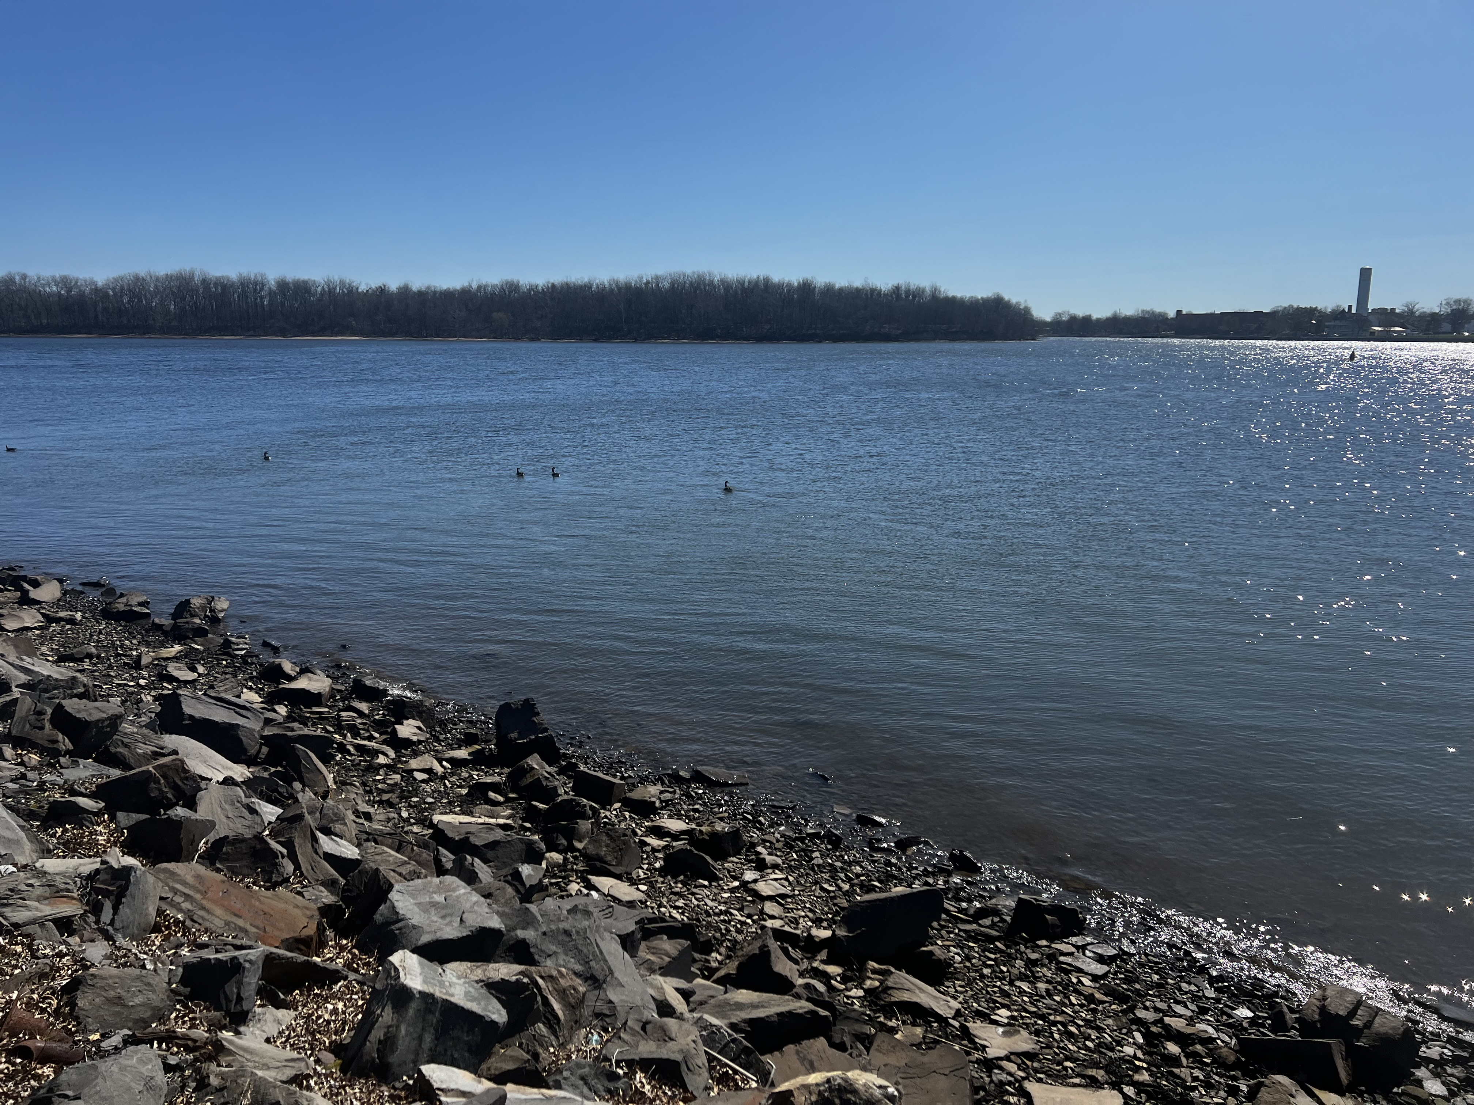

Slide 20
Monday, March 27 - Wednesday, March 29
Concrete at Sewer outfall #8 repaired; outfall remained plugged.
Observation Basin and Sewer system cleaned. Basin able to hold 25,000 gallons of storm water before discharging to Sewer outfall #8.
Pumps installed at Observation Basin to route water away from Sewer Outfall #8.
Completed 26 CG/EPA tests of Delaware River, All tests resulted in No Detect of hazardous substance.
28March: Philadelphia declares water is safe and will not be impacted by spill.
Discoloration of water continues at waters edge near outfall. Discoloration is contained by boom and continuously removed.
Trinseo facility clean of any discolored water.

Slide 21
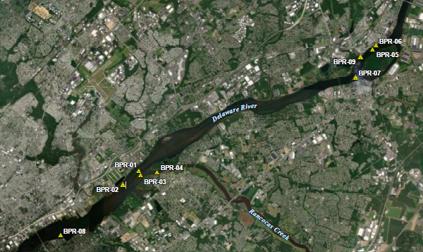

Slide 22
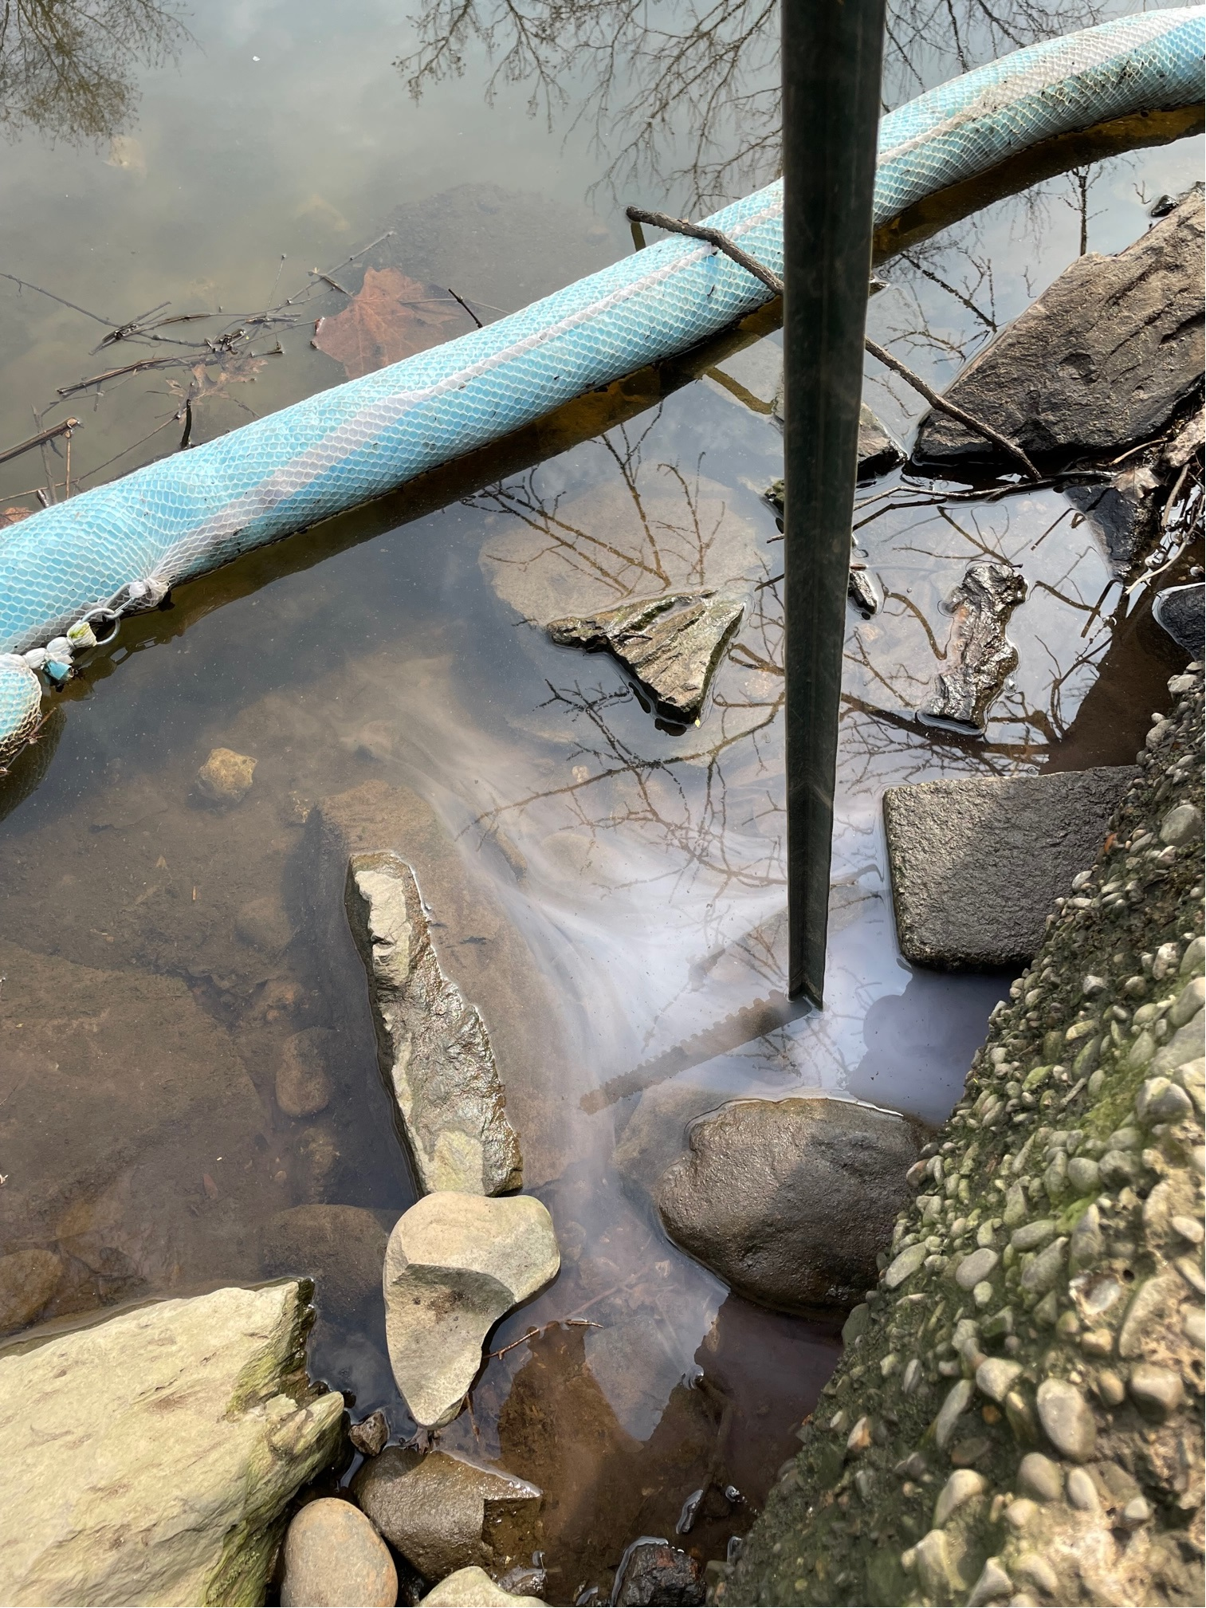

Slide 23
March 27, 2023 - April 20, 2023
Discoloration of water continued at waters edge through April 11th. Discoloration is contained by boom and continuously removed.
Secured Unified Command on April 20th.
Summary of Response Actions
  >200k gallons of contaminated water recovered
  800 ft of boom deployed
  8 vac trucks and 3 frac tanks utilized
  26 tests of River not including hundreds of test taken individually by Water depts.

Slide 24
Coast Guard Enforcement
No enforcement actions by the USCG will be taken against Trinseo for the Mill Creek Chemical Release: Elements not met
Hazardous substances released; Ethyl Acrylate, Methyl Methacrylate, and Styrene
From a known source; Trinseo
Into or upon a navigable water of the United States; Mill Creek, Otter Creek, and Delaware River
The Responsible can be identified; Trinseo
Meeting the Reportable Quantity (RQ) requirements
  Ethyl Acrylate: 1.62 lbs released; RQ=1,000 lbs (from 40CFR302)
  Methyl Methacrylate: 27 lbs released; RQ= 1,000 lbs
  Styrene: 0.26 lbs released; RQ=1,000 lbs

Slide 25
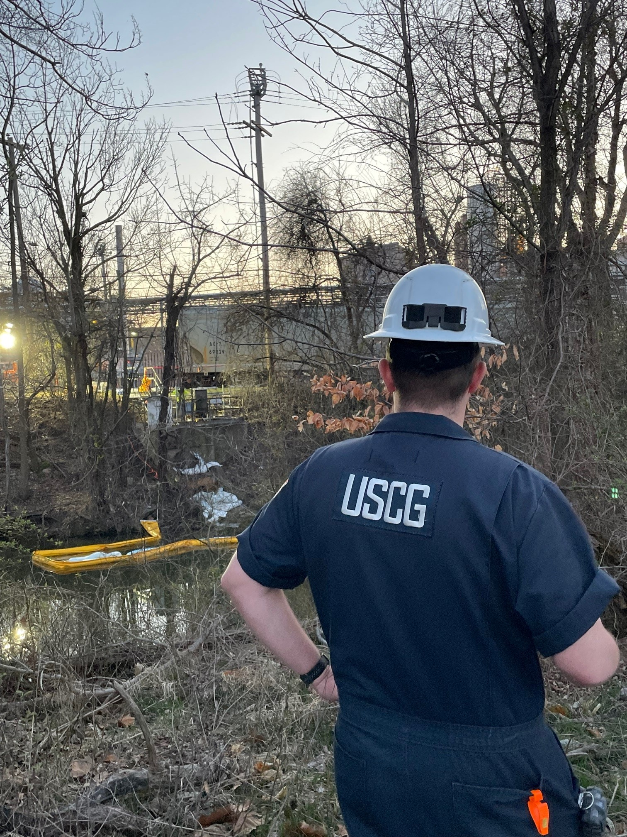
QUESTIONS?

