Slide 1
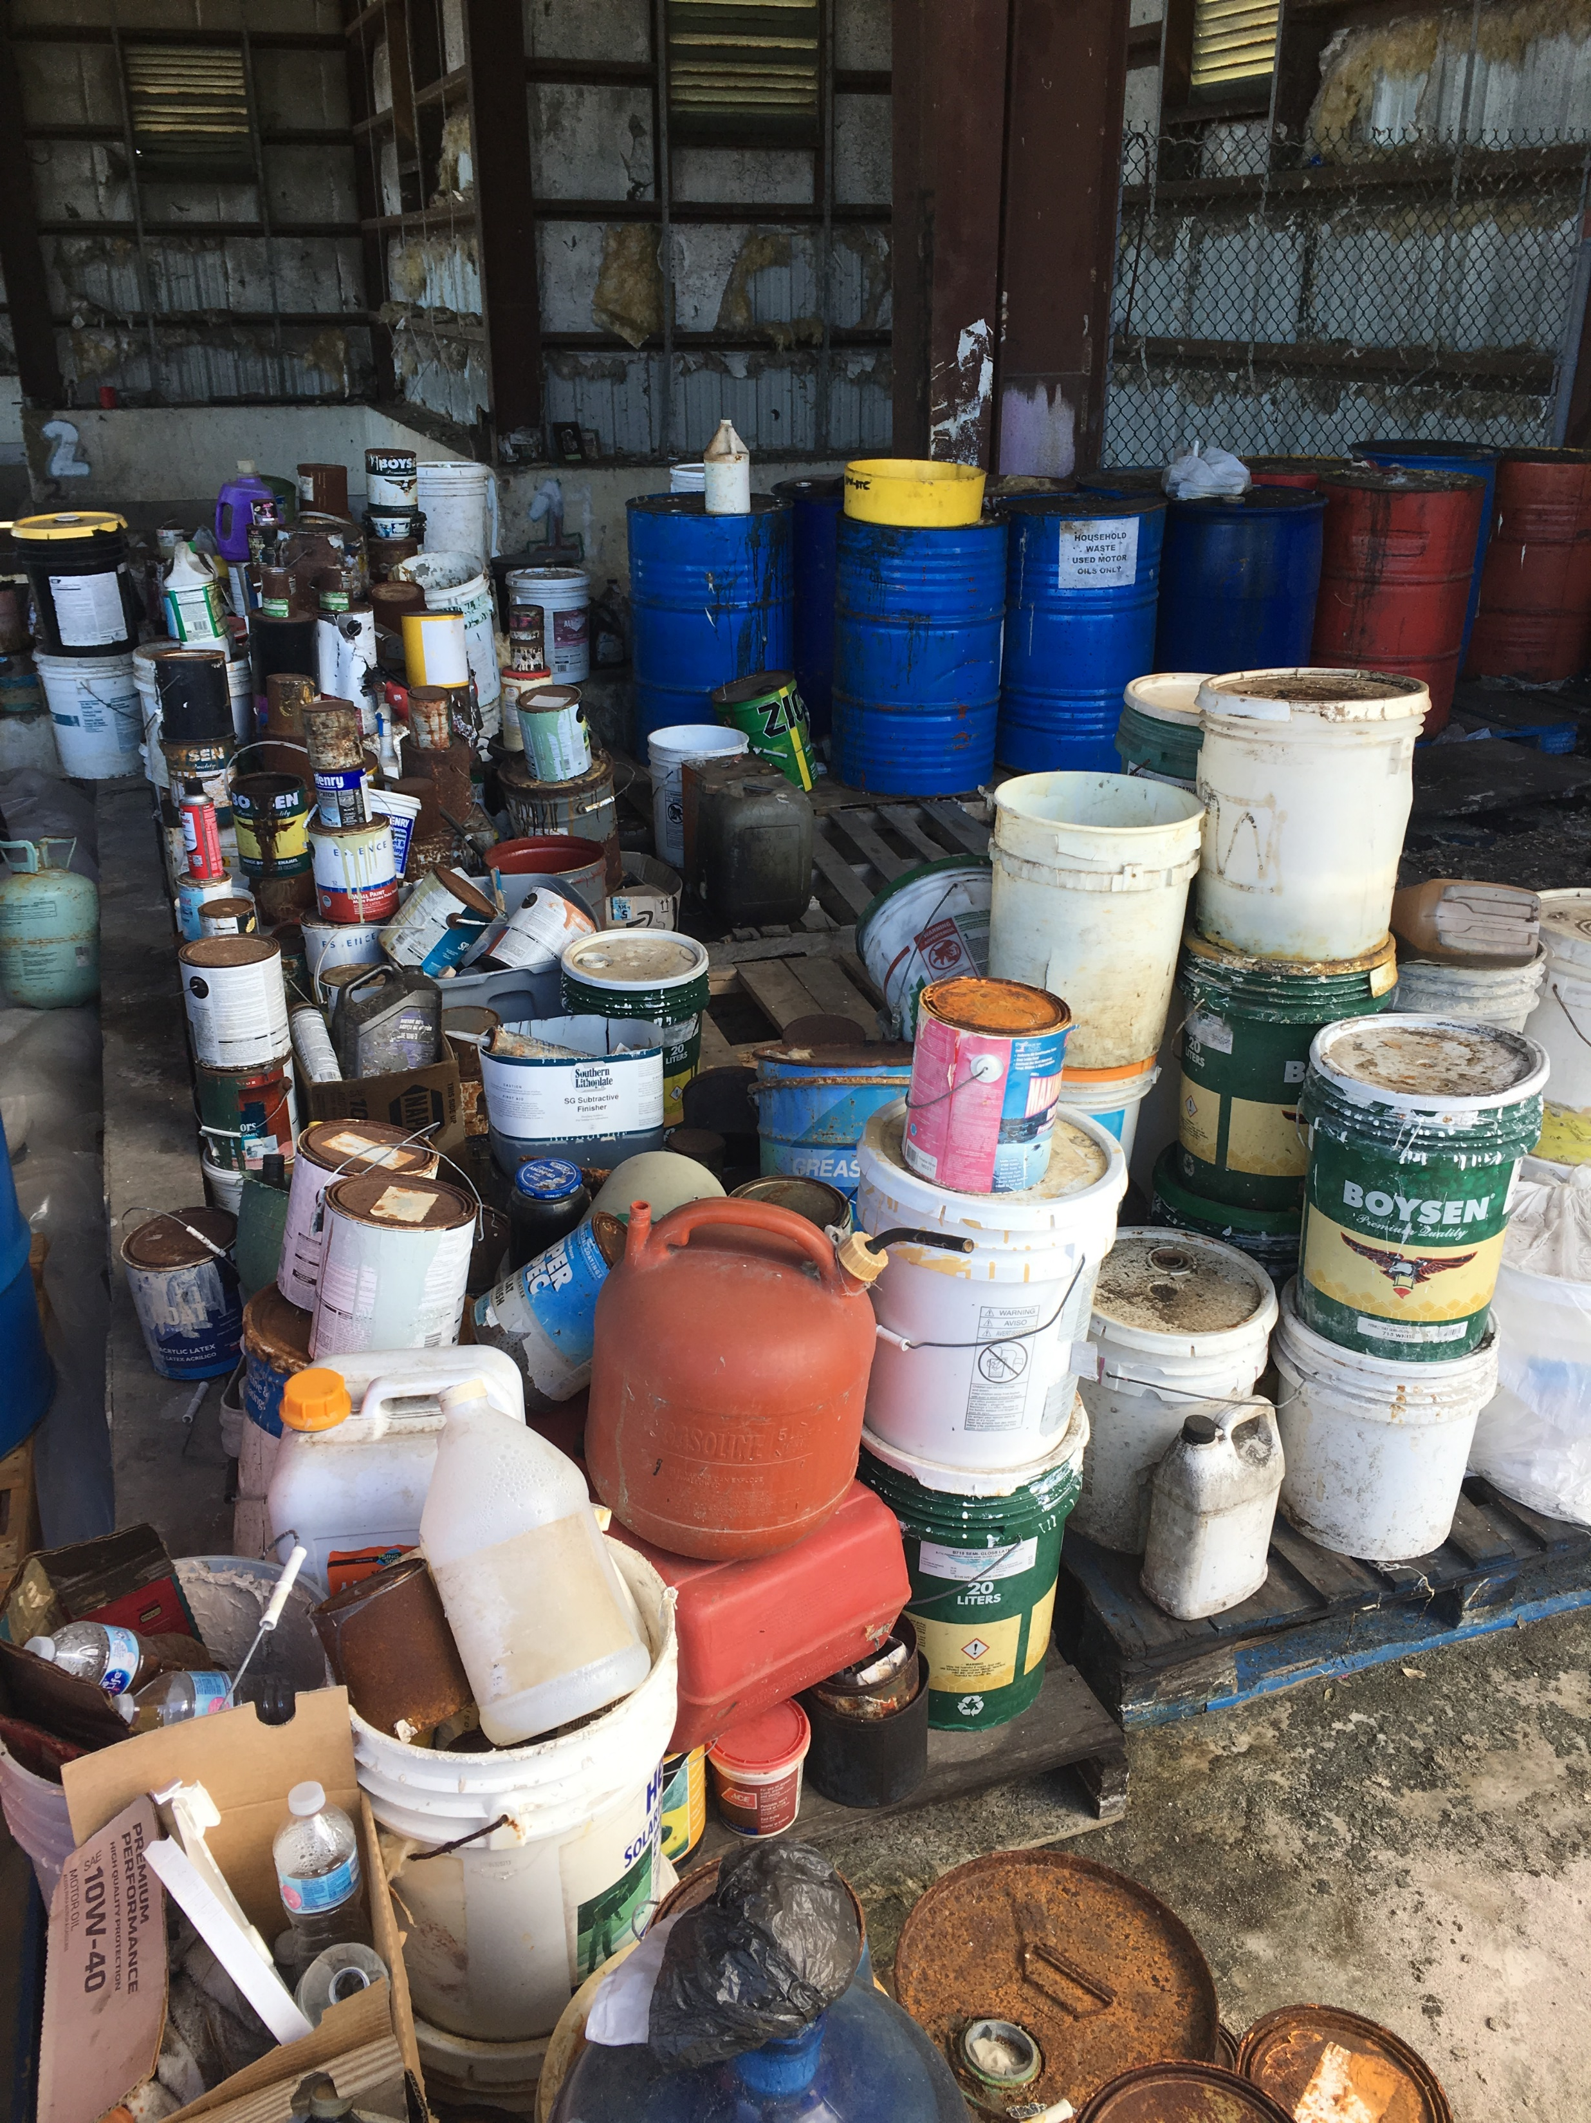
Oceania Regional Response Team Meeting
Superfund Response and Technical Assistance in the Pacific Islands
January 2021

Slide 2
Multi-Site Chemical Removal - American Samoa
Waste chemicals will be evaluated and categorized
Will then be neutralized on-site or packed for transportation and disposal
Waste located at:
  LBJ Hospital
  Dept of Agriculture
  Multiple High Schools
  American Samoa Community College
Work was scheduled for April 2020, new dates TBD

Slide 3
FAS Chemical Waste Removal
Removal of chemical wastes and other hazardous materials from labs and other facilities in Freely Associated States
Republic of the Marshall Islands, Federated States of Micronesia (Yap), Palau
US Department of State funded EPA to conduct this work for disaster resiliency
RMI work was scheduled for March 2020, dates for all locations now TBD

Slide 4
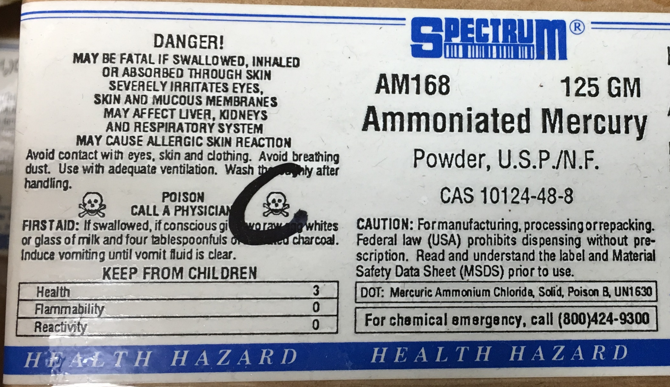
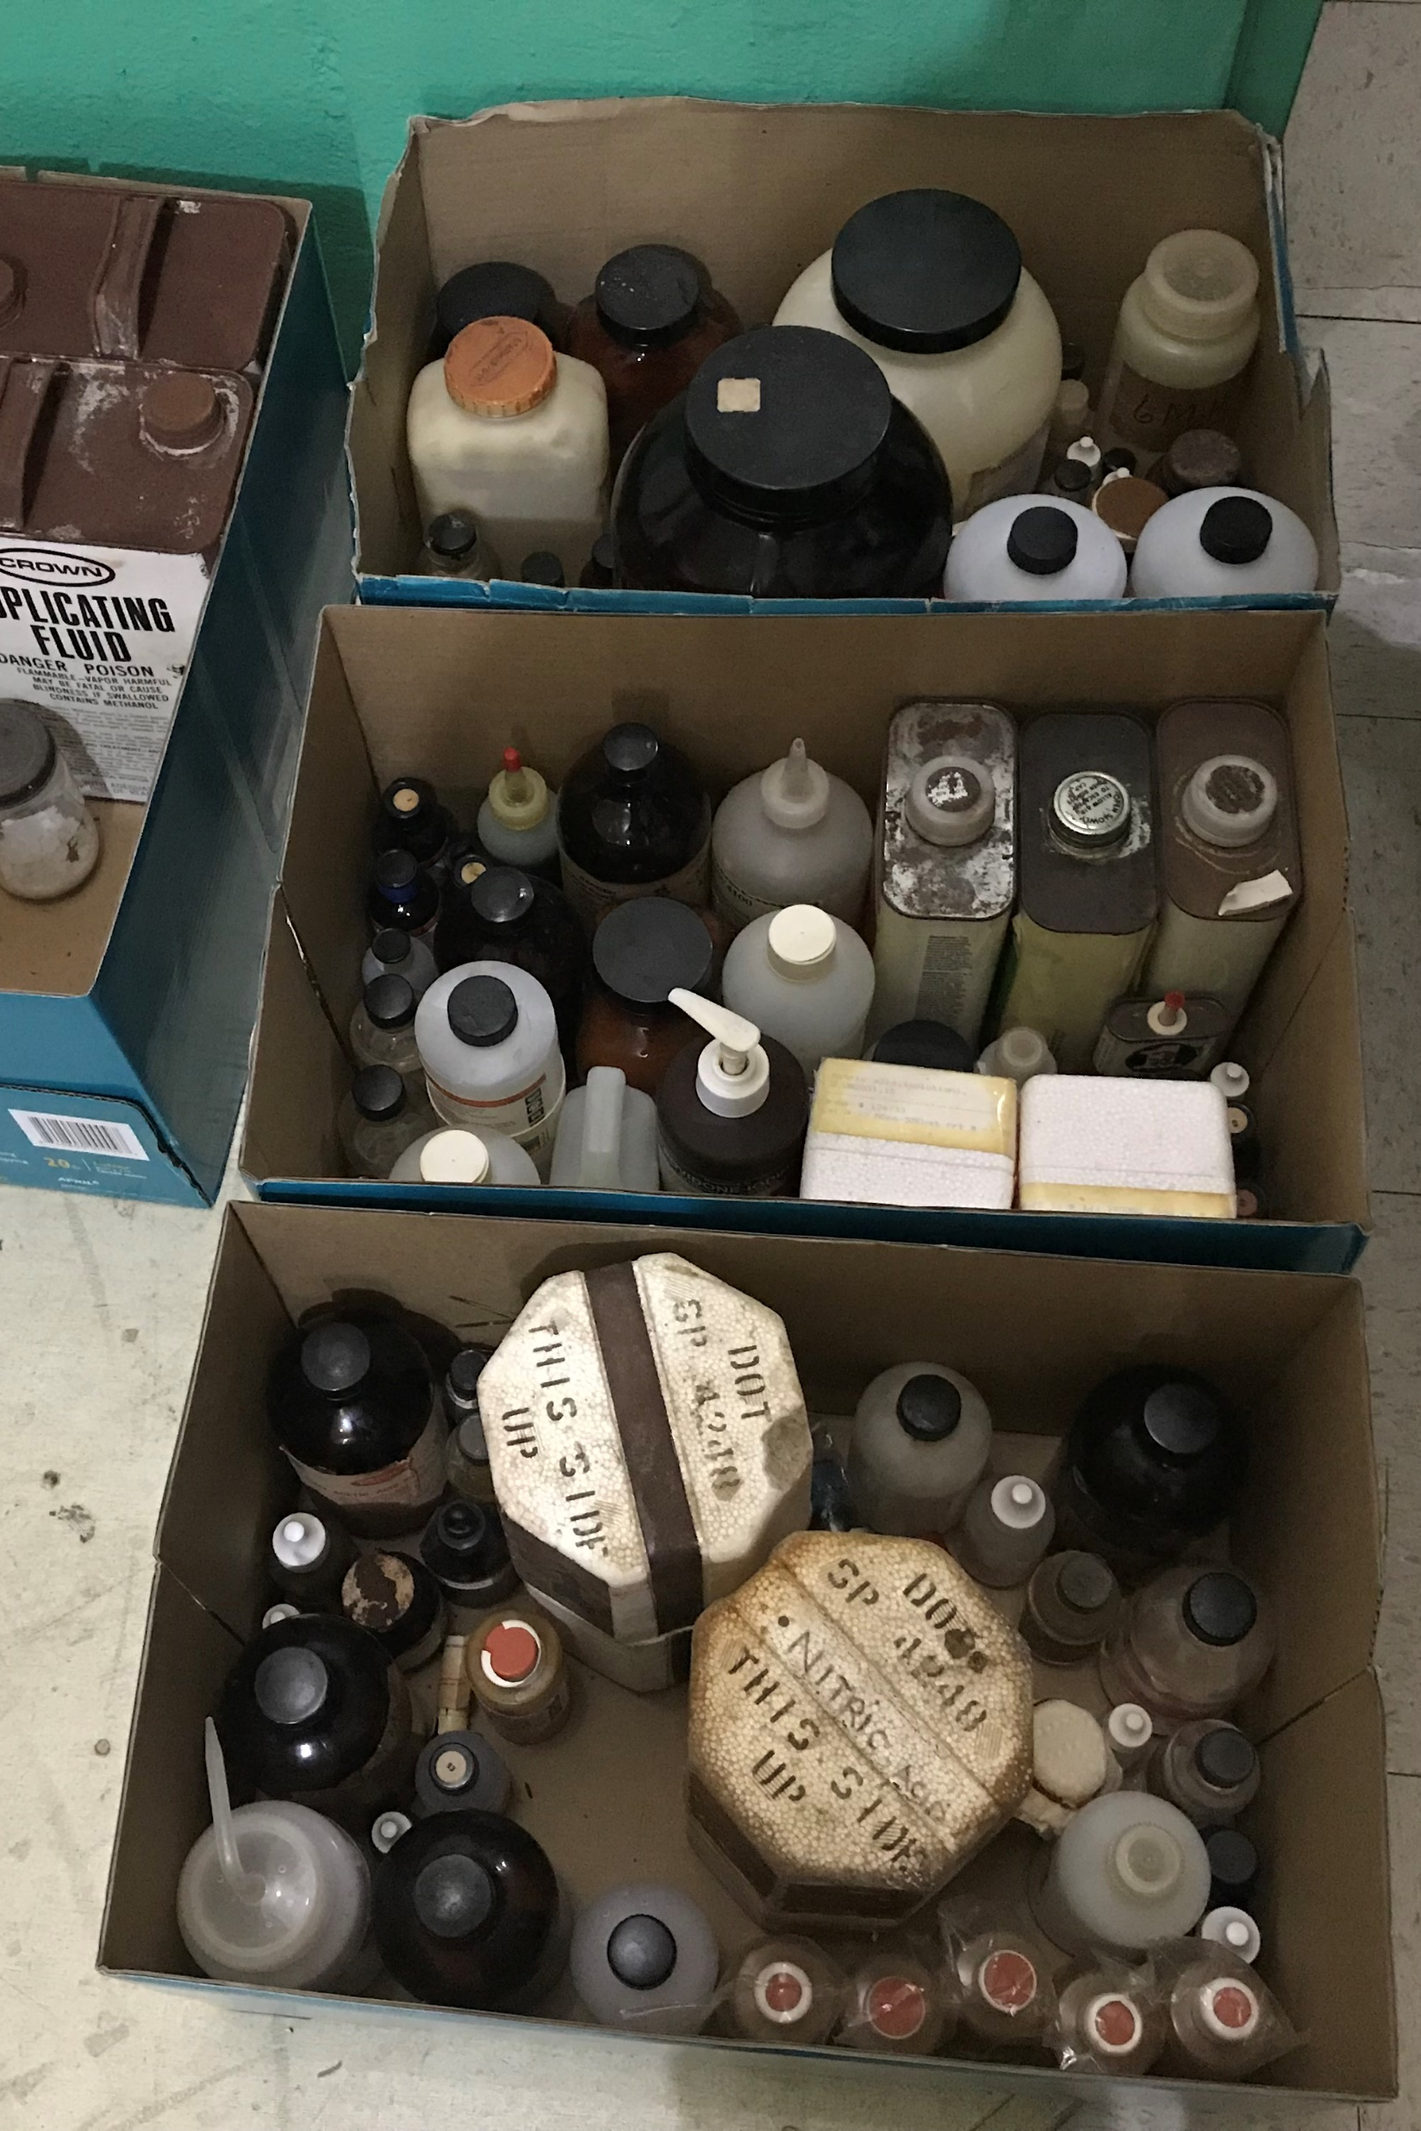
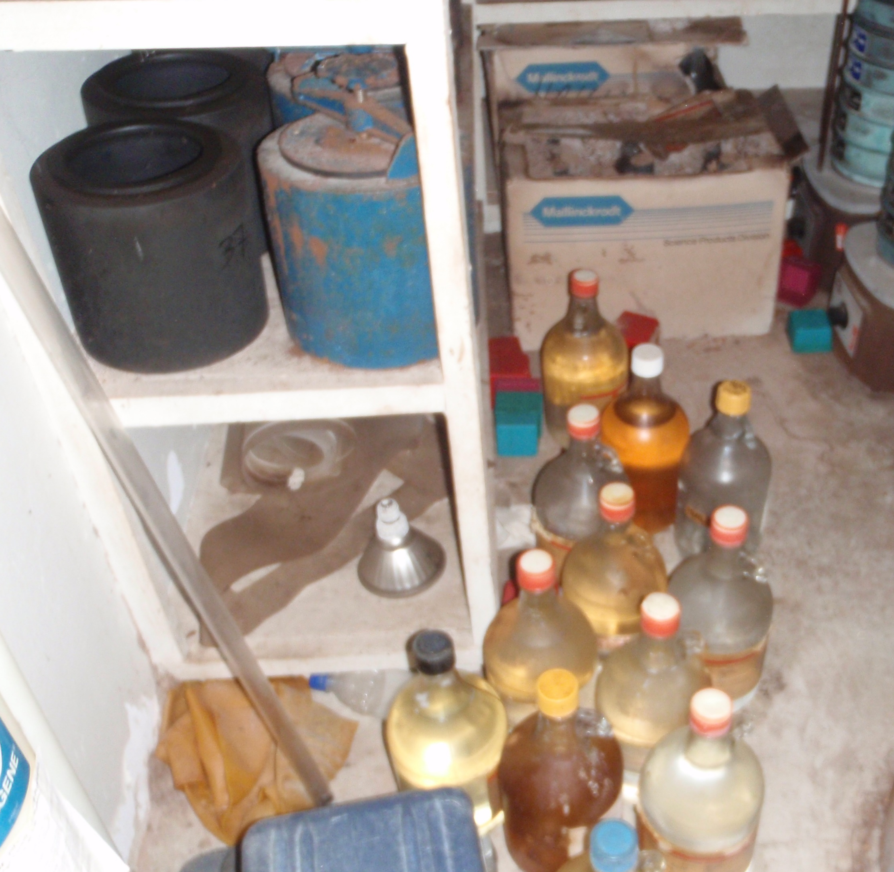
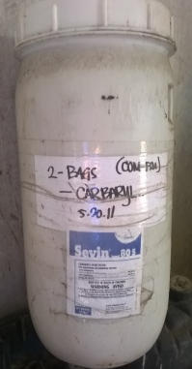
Chemical Waste at Planned Sites

Slide 5
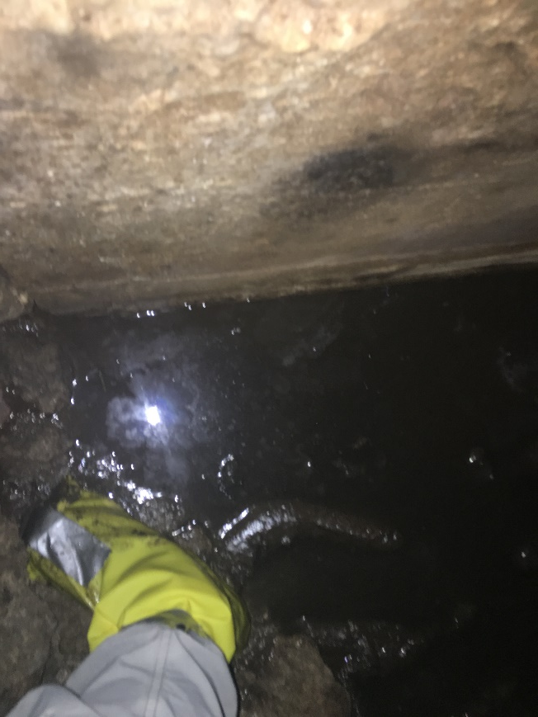
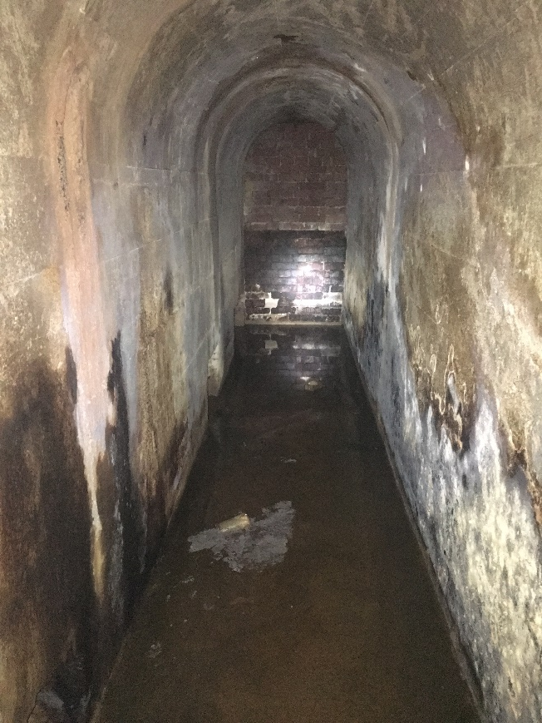
Rota Tunnels Site, CNMI
Historic discharges into Pacific Ocean
EPA Response Action - subsurface containment around shoreline
Tunnels found during construction work
Sampled by EPA in 2020
Oil contaminated with lead
Plan for removal action
Work delayed by COVID

Slide 6
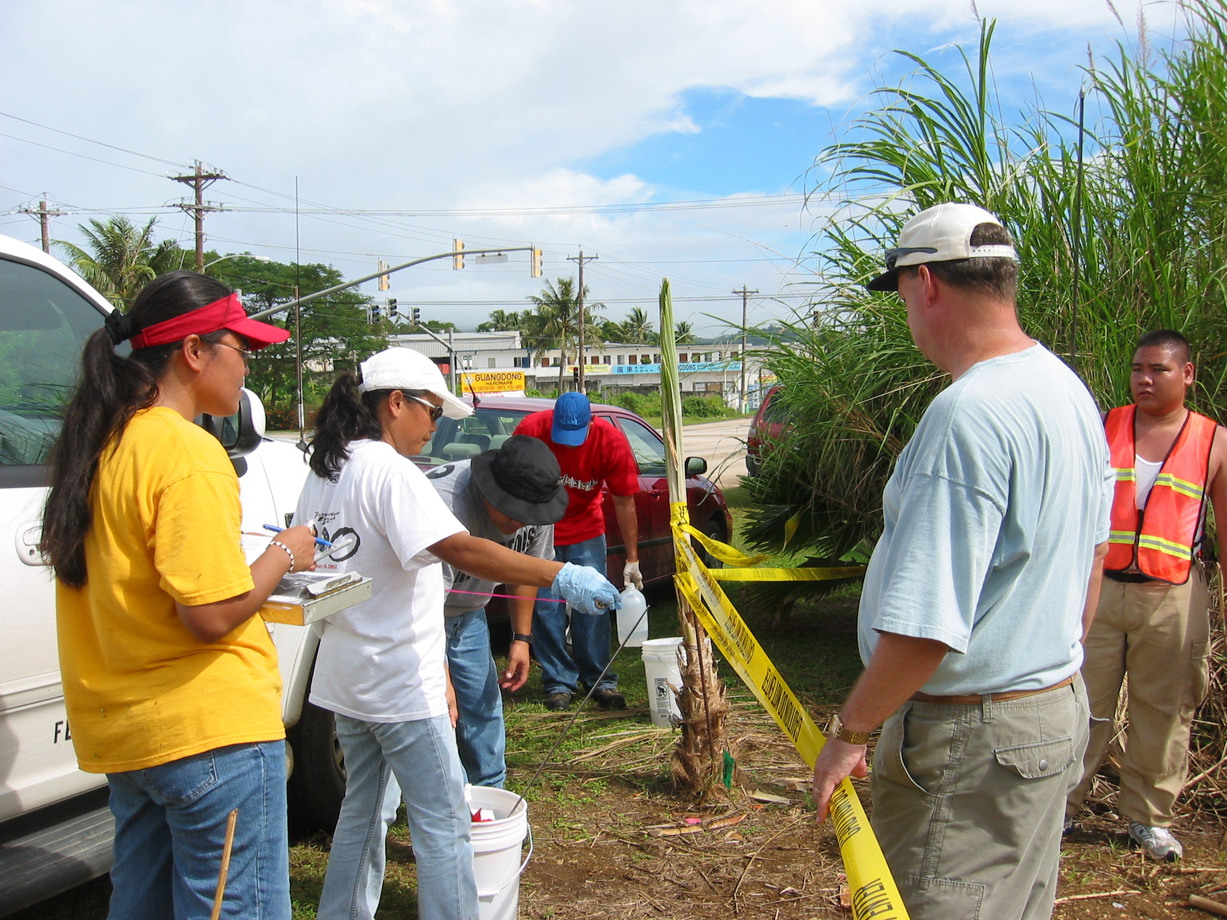
KV-1 Site
As Lito, Saipan, CNMI
Aviation Fuel in drinking water aquifer
15 groundwater monitoring wells
Plume grows in dry season
Plan for mitigation being worked on by EPA

Slide 7
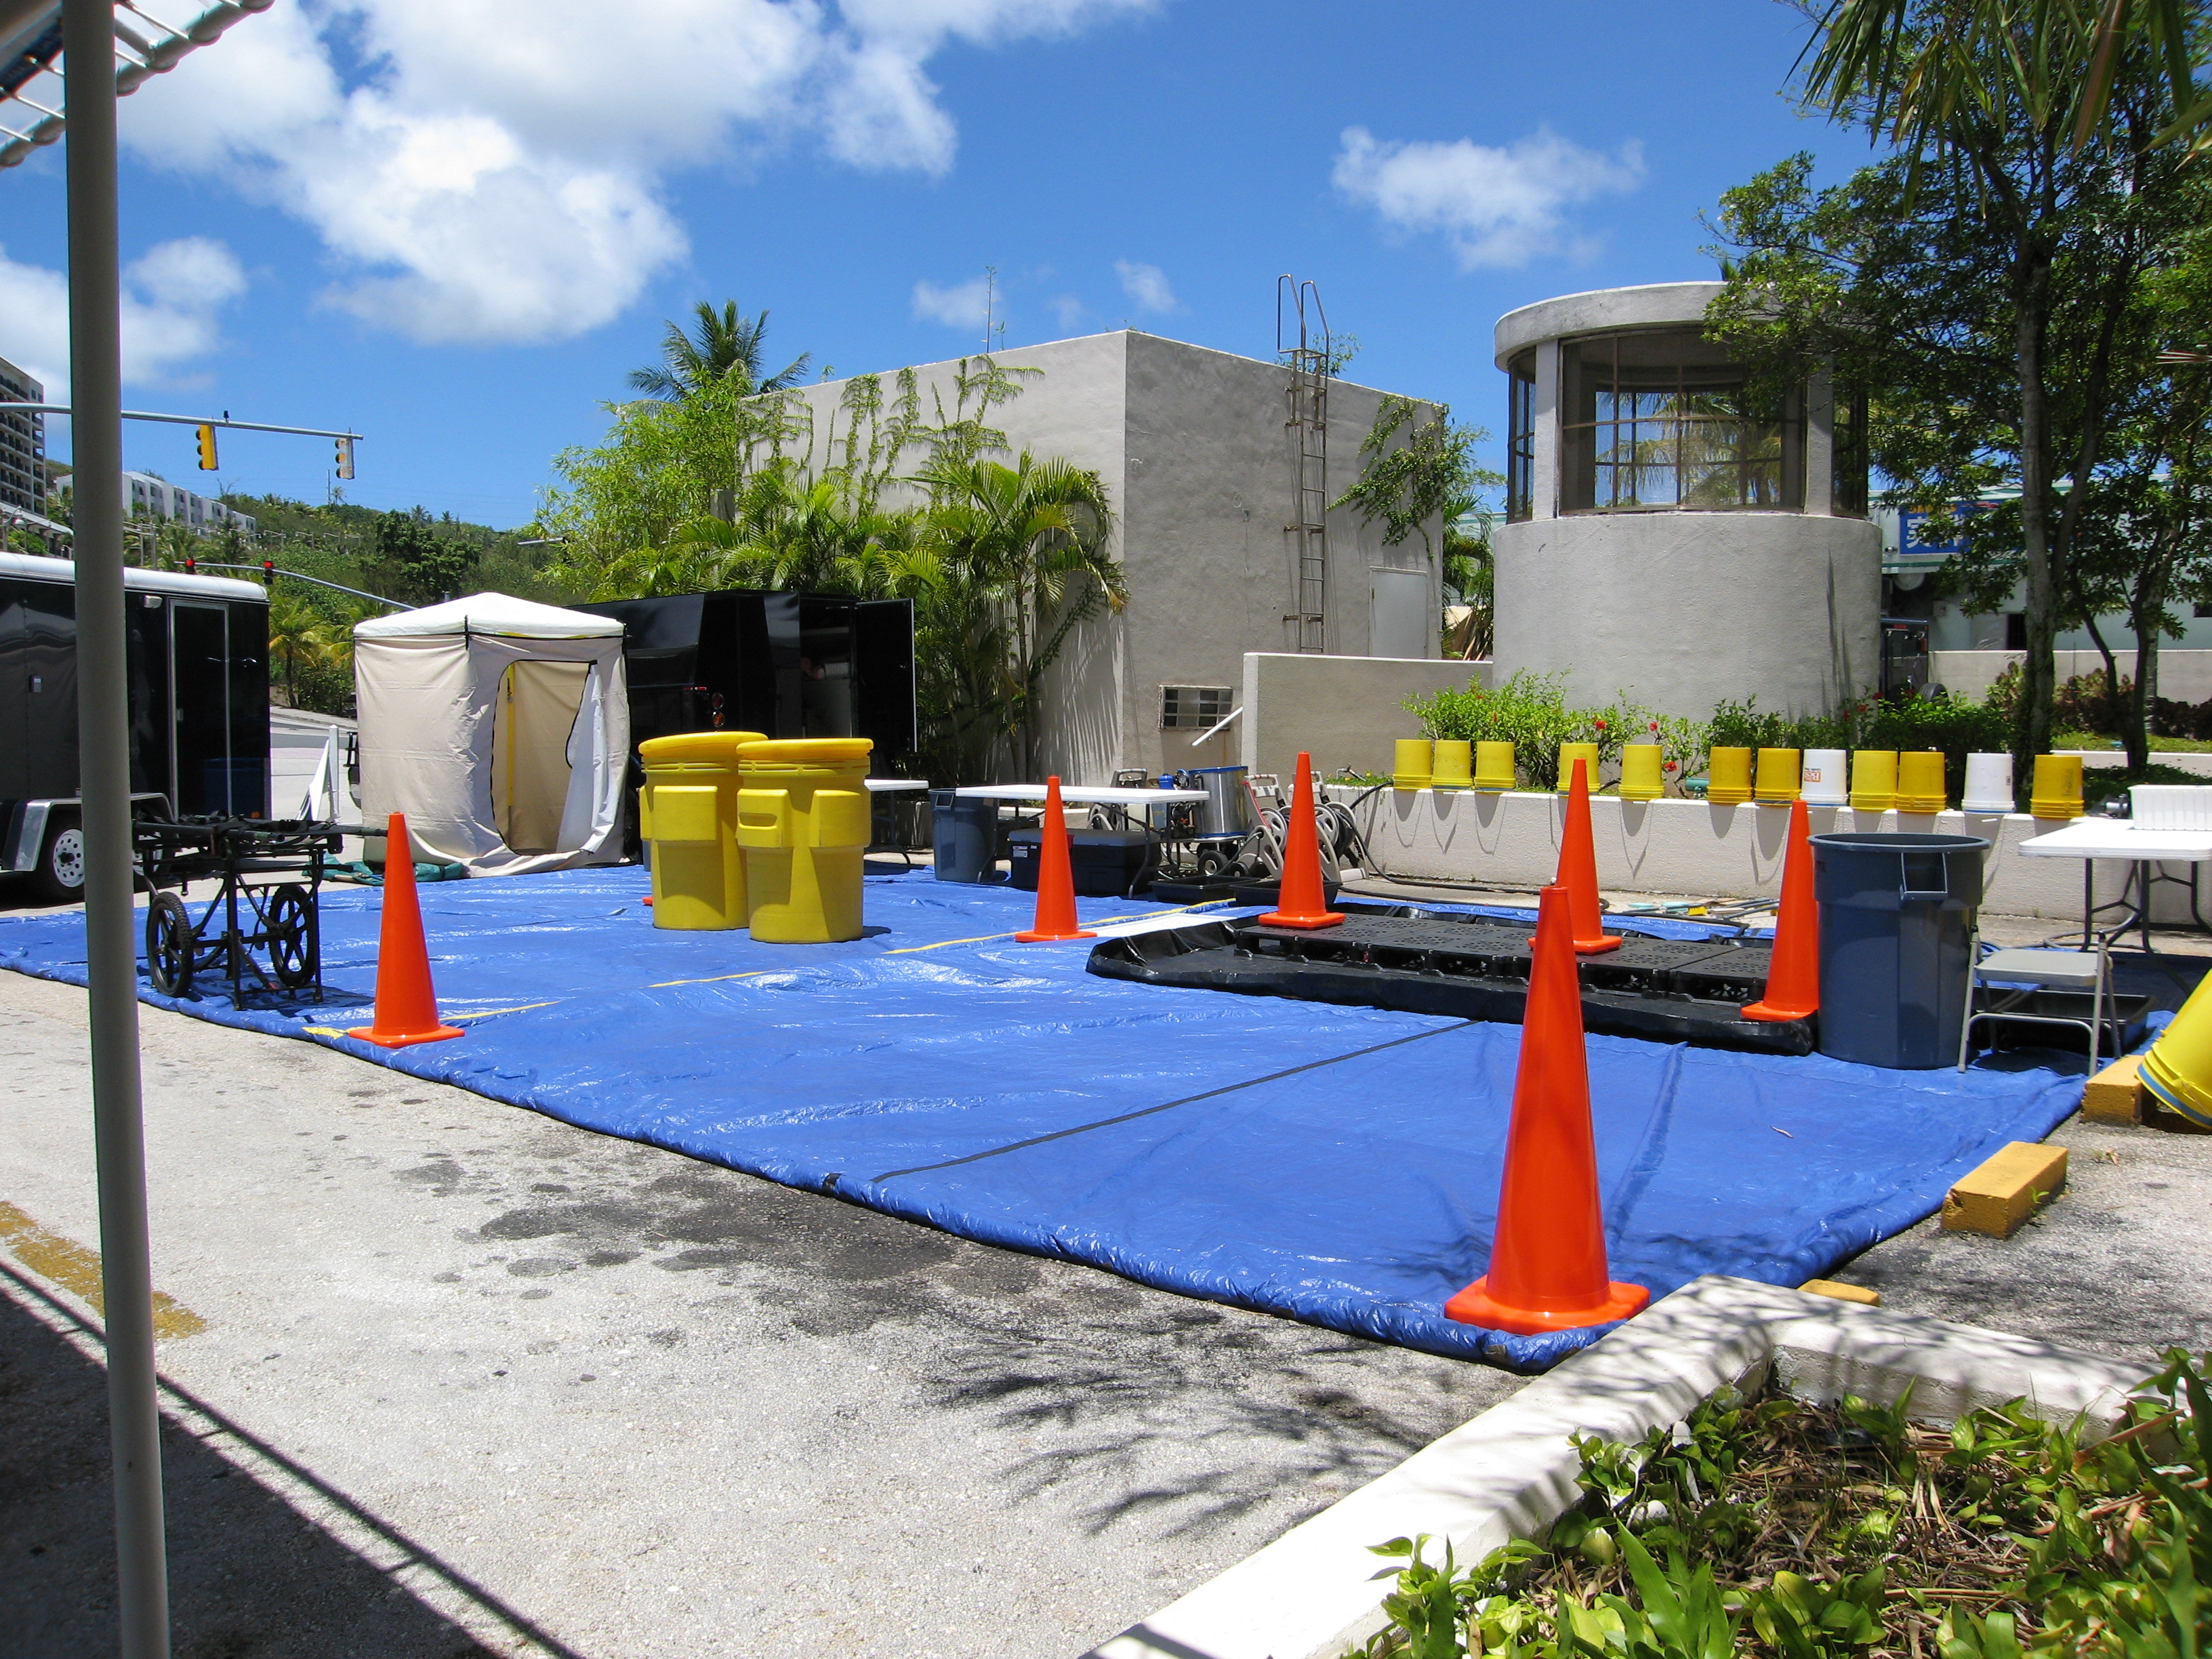
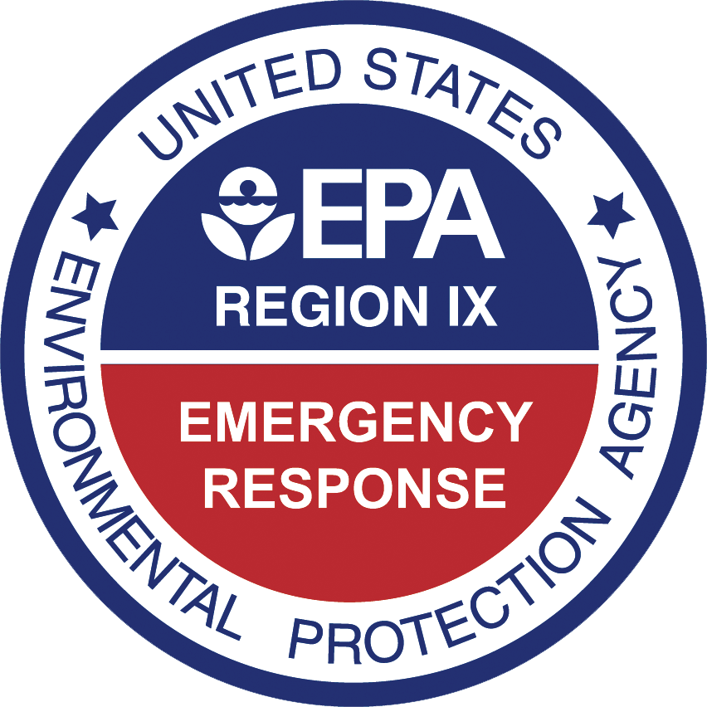
EMERGENCY
PLANNING IN
PACIFIC ISLANDS
Guam Geographic Contingency Plan

Slide 8
Abandoned & Derelict Vessels – Guam
10+ ADVs in Piti, Harbor of Refuge are targeted for salvage
  US Navy requested by Gov Guam to remove vessels
  EPA to address haz waste and provide equipment and supplies under an Action Memorandum
  Regulatory notification is complete
Work start dependent on USN salvage team availability
  COVID travel restrictions may necessitate that USCG Sector Guam personnel assist EPA with field oversight as the OSC representative

Slide 9
Agent Orange Investigation – Guam
Referral from Veteran’s Organization
Coordinated effort between NAVFAC, Guam EPA and US EPA including soil sampling on and off-base along the former fuel pipeline
  Two off-base sampling events were conducted - locations determined from interviews and field visits
  Herbicides and related dioxin congeners detected at trace levels in some samples (not presumed to be AO related)
Final report submitted recommends future soil sampling

Slide 10
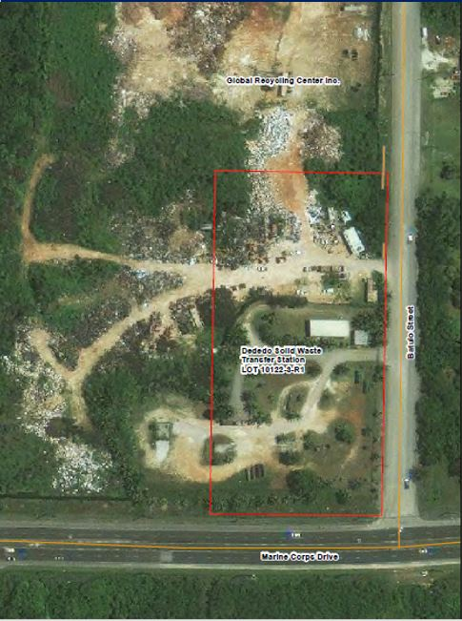
Dededo Waste Piles – Guam
2014 Phase II ESA
  5 areas of concern (waste piles)
2019 EPA Sampling
  PCBs, TCLP metals, TCLP VOCs, TCLP SVOCs, TAL metals, TPH, organochlorine pesticides, ACM
  Main contaminant was Pb above RCRA hazardous waste levels
  Additional metals, Chlordane, TPH, and PCBs above RSLs/TPESLs

Slide 11
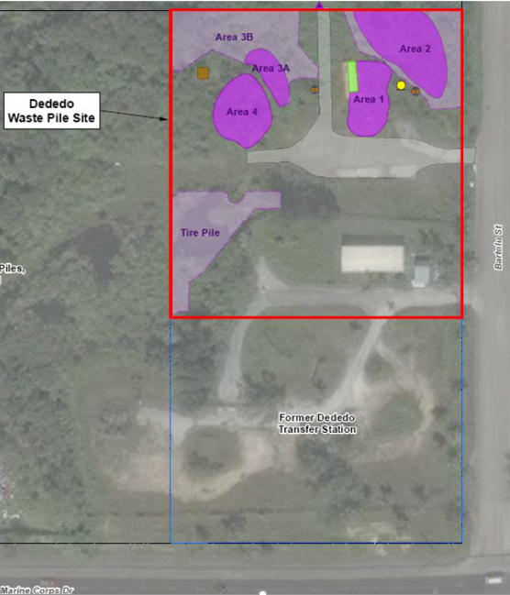
Dededo Waste Piles – Guam
July 2020 GEPA Sampling
  Area 2 treatability samples
Next Steps
  Bench scale treatability study
  Action Memo preparation

Slide 12



EPA R9 Online Training Resources
ad Chemist

Slide 13
EPA R9 Online Training Resources
HAZWOPER 8-hr Refresher
Mercury Response and Cleanup
Mad Chemist

Slide 14
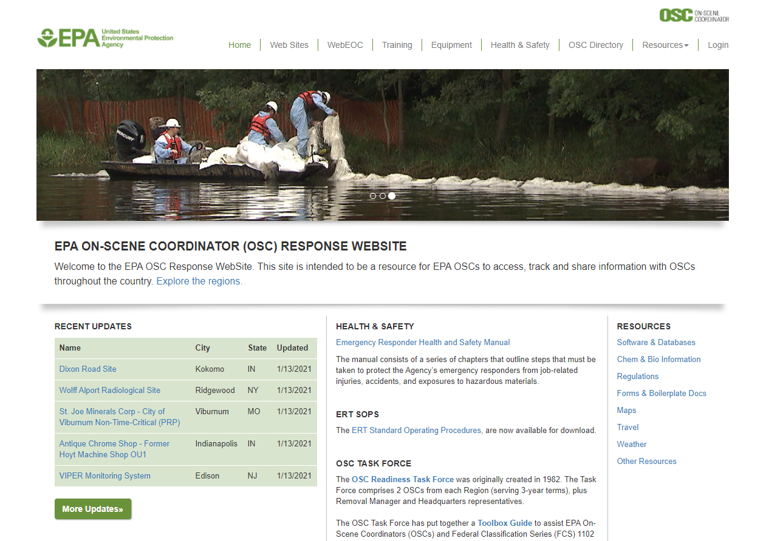
EPA R9 Online Training Resources
www.response.epa.gov

Slide 15
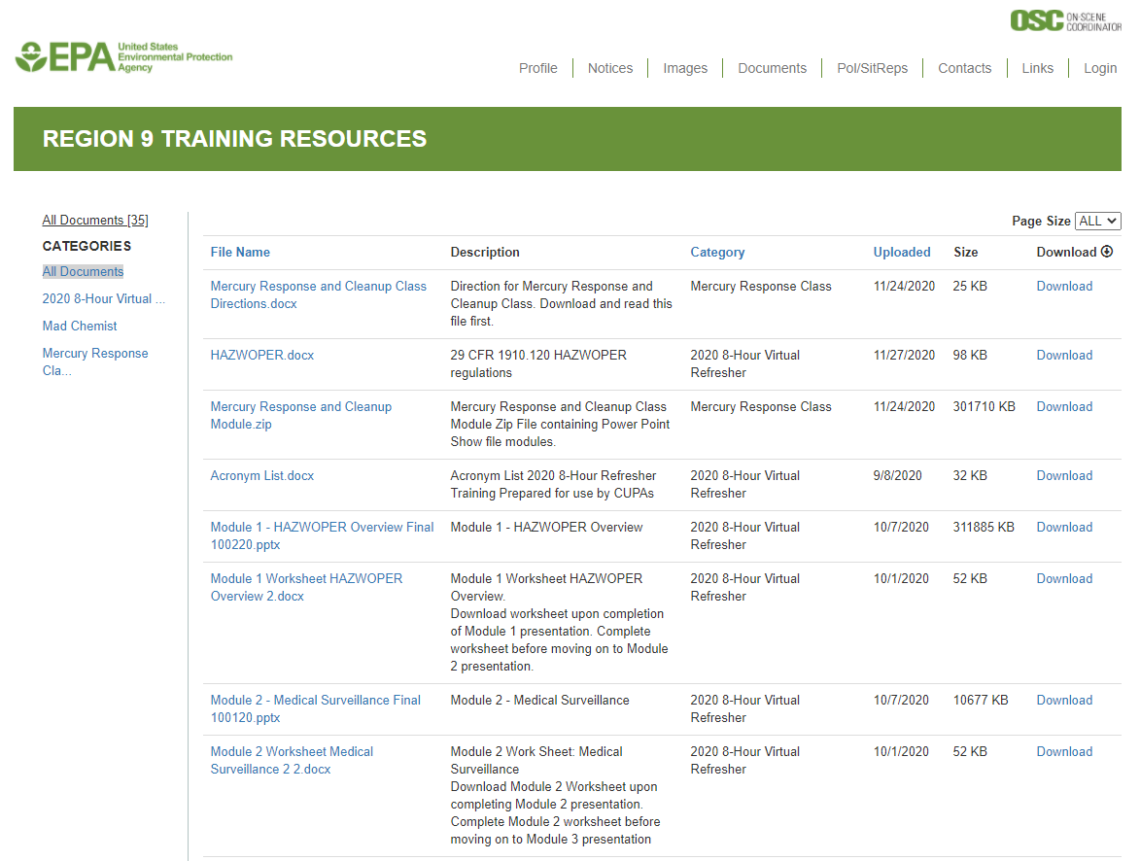
EPA R9 Online Training Resources
Region 9 Training Resources

Slide 16
EPA R9 Online Training Resources
Read-me / Directions files
Training modules
Certificates of completion
Contacts:
  musante.jason@epa.gov
  wise.robert@epa.gov
Region 9 Training Resources

Slide 17

Bundle of Joy (6 months!)

Slide 18
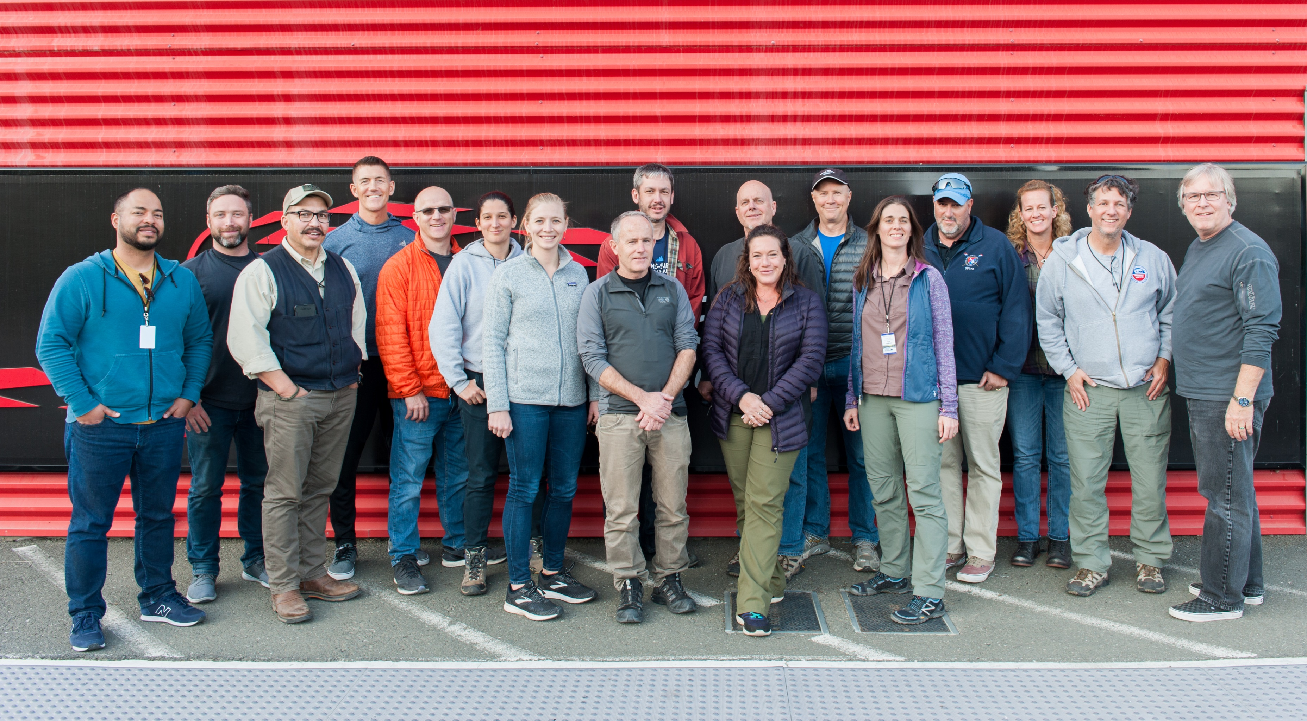
Questions?

