Slide 1

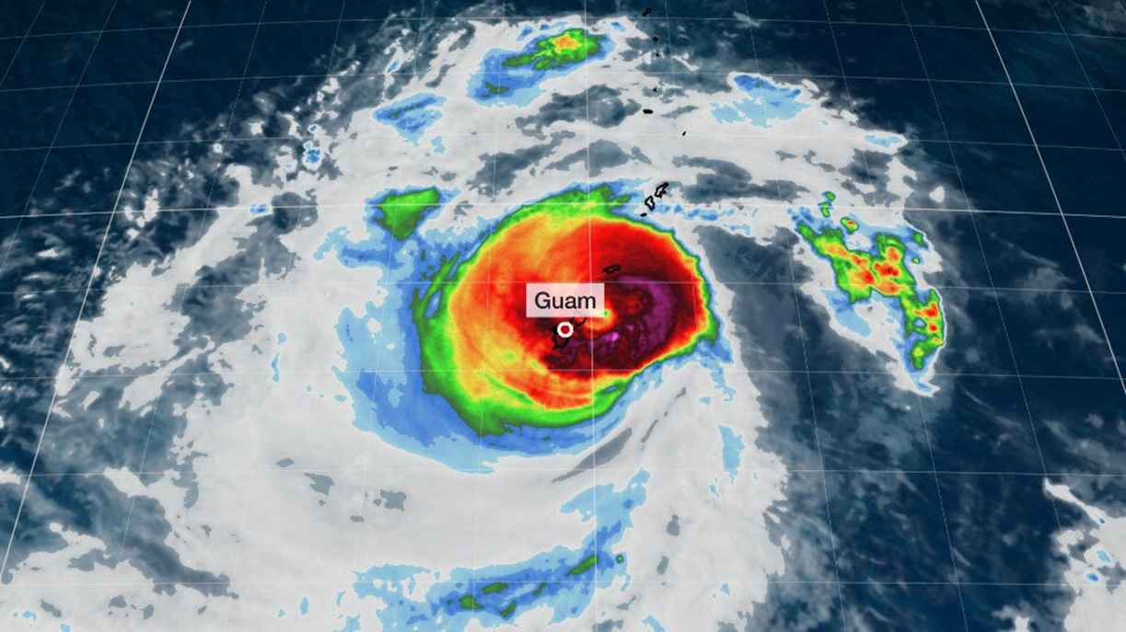
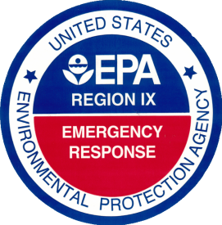
TYPHOON MAWAR RESPONSE
Notes:
Guam and CNMI are U.S. territories in the northwestern Pacific Ocean. Guam is a solitary island with a population of approximately 170,000 inhabitants. CNMI is a series of 14 islands with a total population of approximately 50,000 inhabitants.
The central and northern parts of Guam were the hardest areas hit by the typhoon, receiving winds of up to 140 mph and rainfall of more than 2 feet as the eyewall passed.

Slide 2
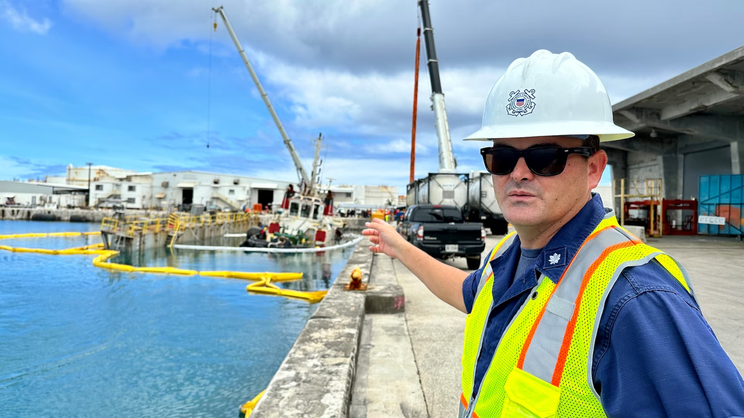
Uscg initial eyes and ears

Slide 3
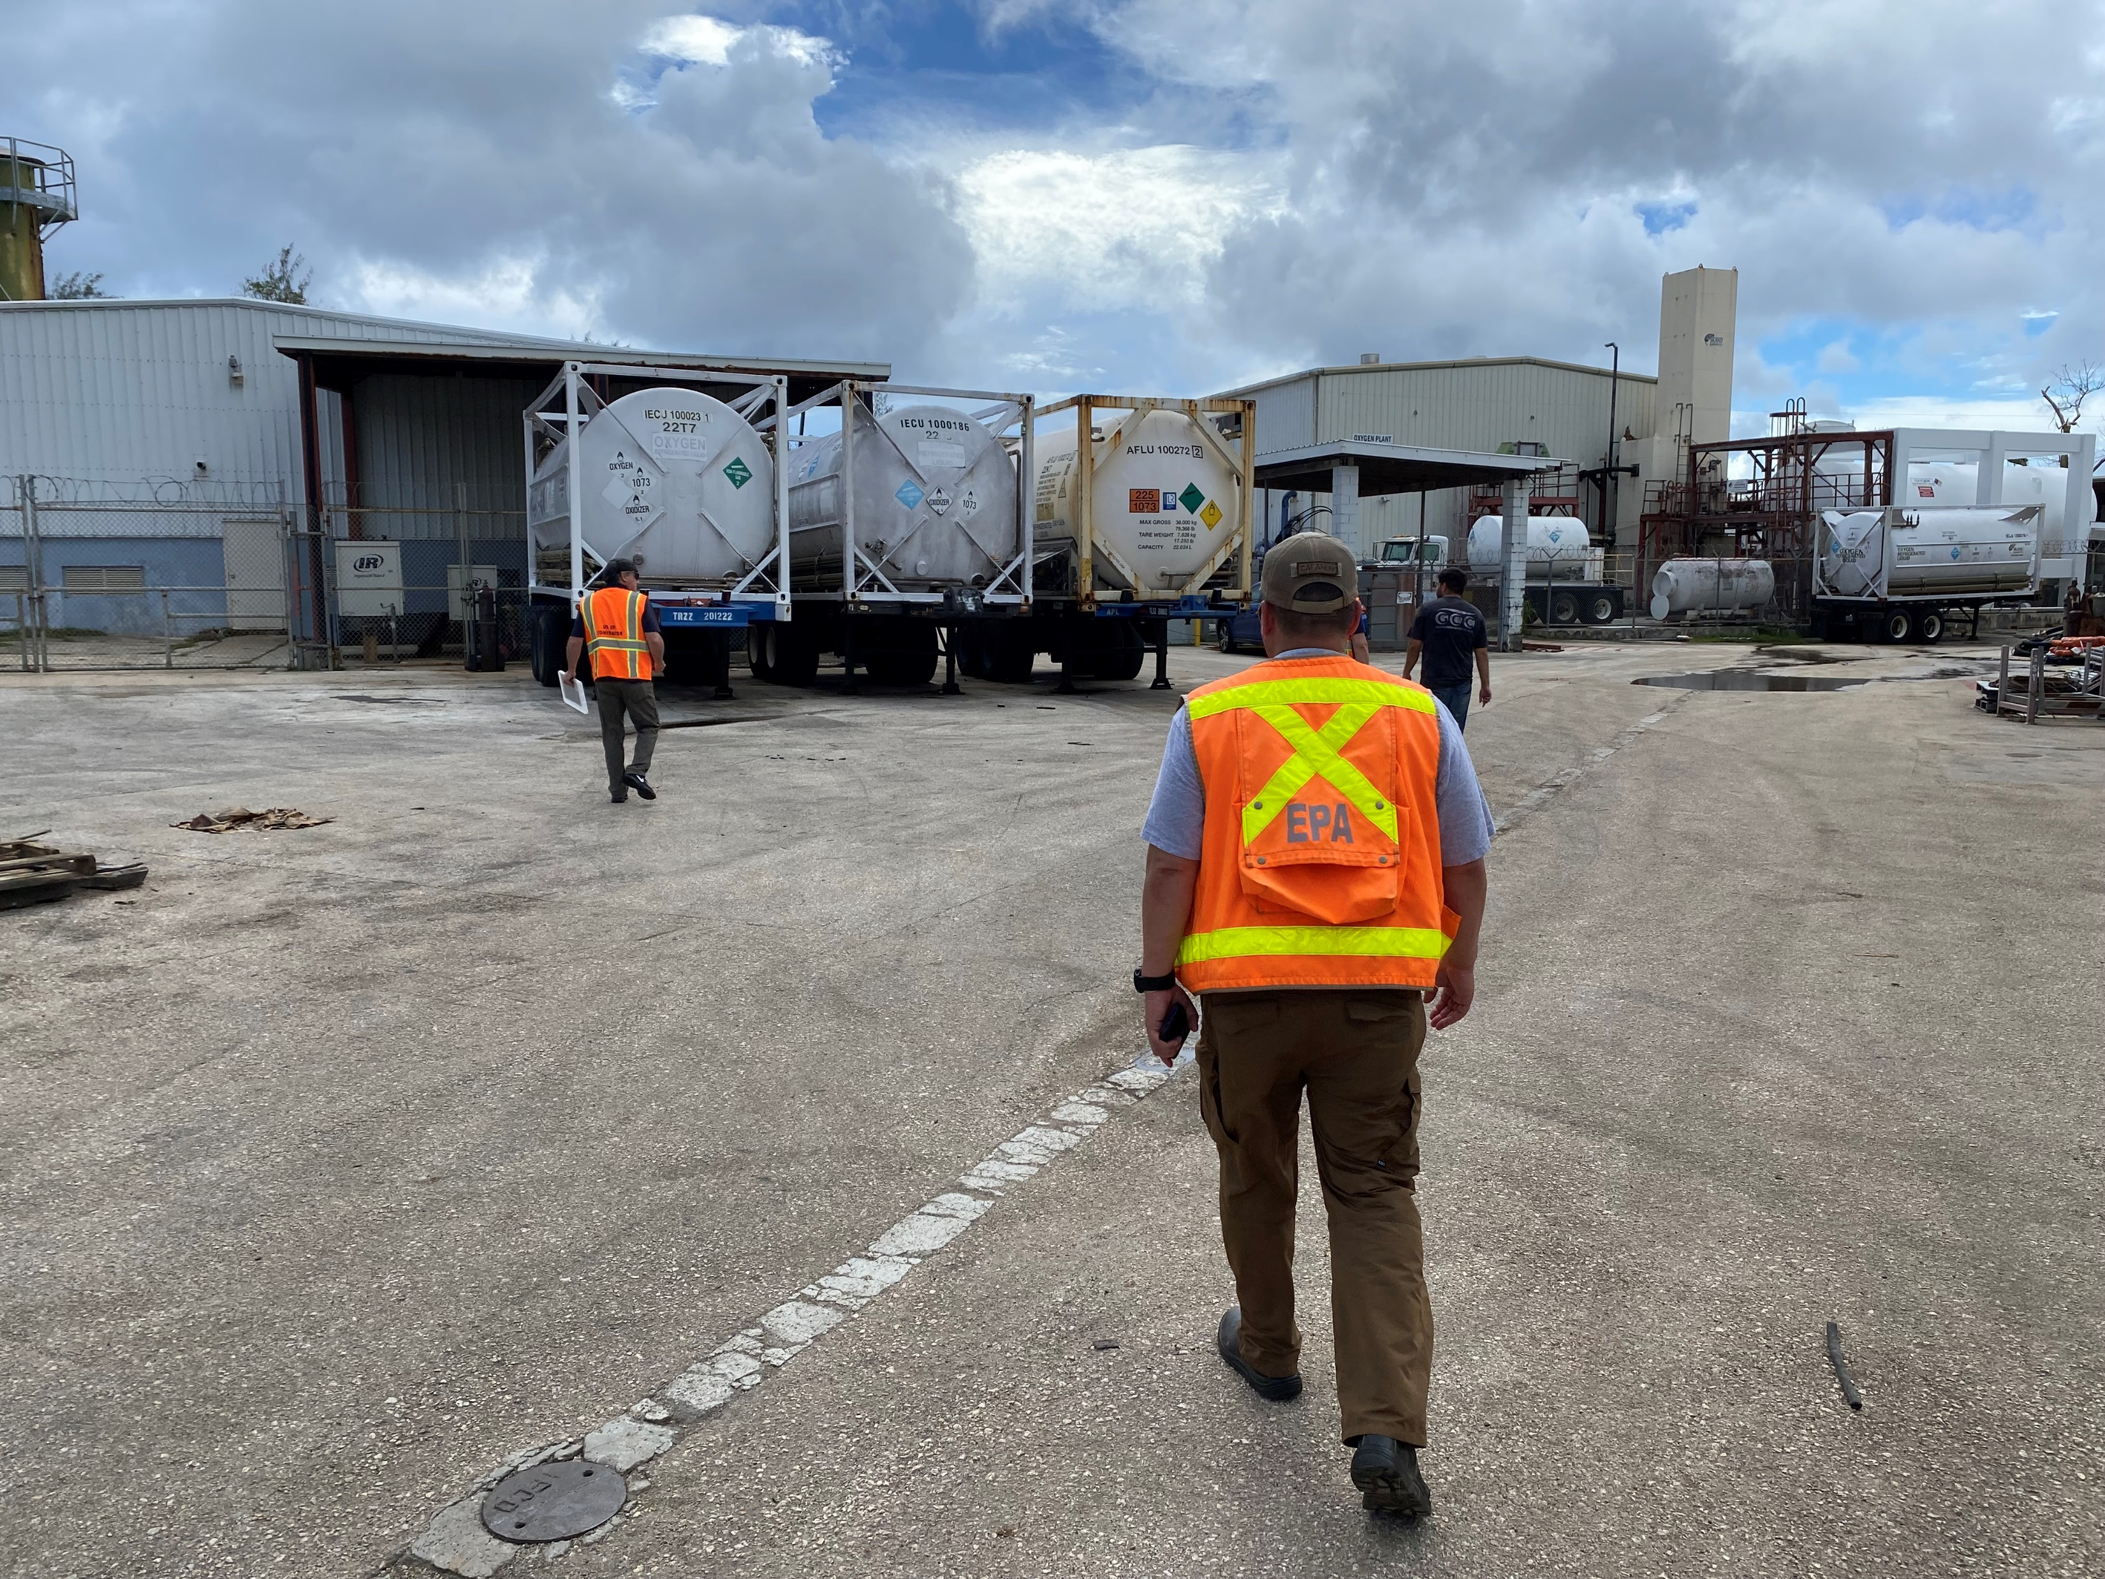
Usepa On Scene Coordinators arrive a few days after the storm

Slide 4
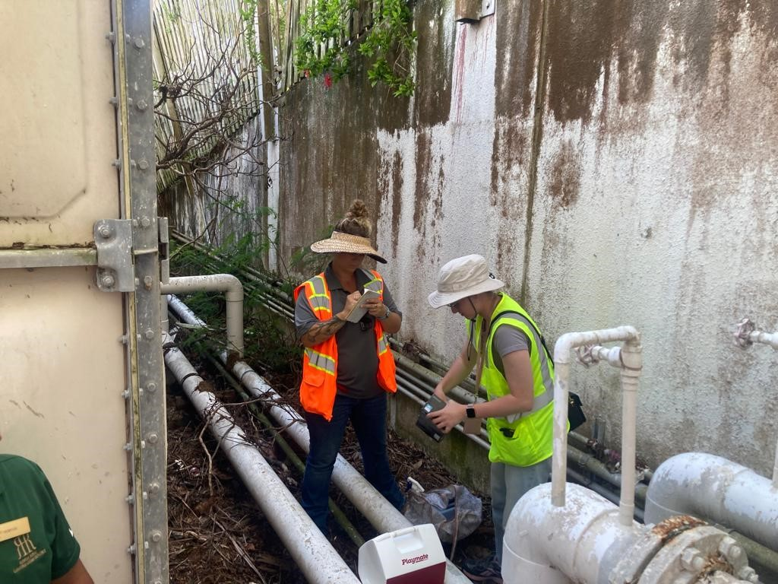
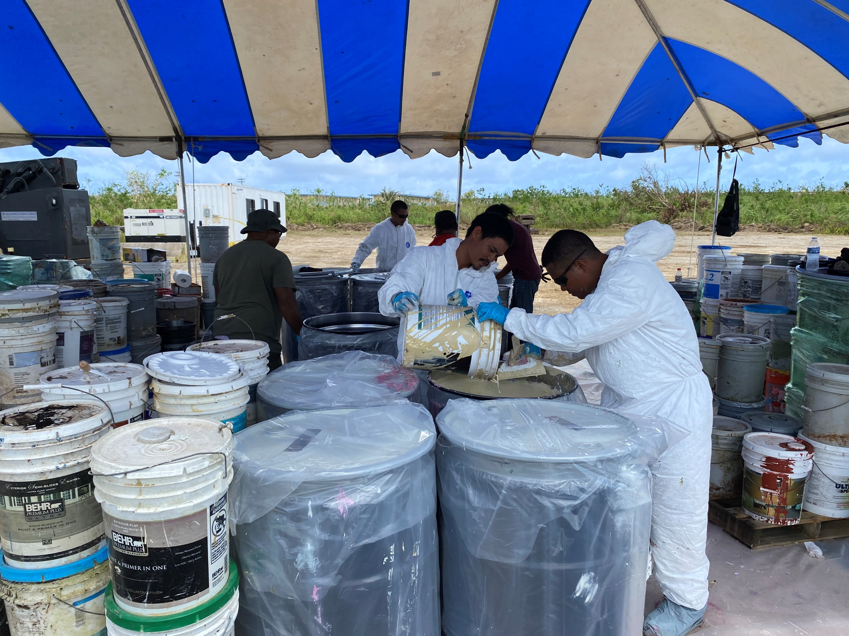
received mission assignments for water systems assessments (ESF3) and household hazardous waste (ESF10)

Slide 5
2023 EPA Typhoon Mawar Response
ICS 207 Organization Chart
Operational Period:
23 June 2023 0700 to 30 June 2023 0700
Date: 26 June 2023 (ChST)
2023 EPA Typhoon Mawar ICP Incident Commander Harry Allen (CP) - [D6/30] Deputy Incident Commander Ramon Albizu (CP)
Region 9 EOC Regional Incident Coordinator (RIC) Pete Guria (V)
Safety Officer Anhtu Nguyen (CP) Karrie-Jo Shell – CISM (V) - [D 6/27] Julie Milazzo – CISM (V) - [M 6/28]
Public Information Officer Dana Barnicoat – PIO (CP) – [D 6/28] Alejandro Diaz – PIO (CP) – [D 6/29] Paul Amato – PIO (CP) – [M 6/29] Sarah Watson – CRS (CP) Joseph Markowski – CRS (CP) Freyja Knapp – CRS (CP)
ESF10 Representative Bill Jones (V)
REOC RSC Coordinator Mary Matthews (V)
Water Emergency Team Branch Emma Young (CP) – [D 7/7] Karl Banks (V) & Corine Le (V)
Liaison Officer
Craig Whitenack - CP
Drone Ops
2 START
Operations Section Chief Olivia Trombadore - CP Deputy Section Chief Joyel Dhieux – CP
Planning Section Chief Todd Campbell (V)
Logistics Section Chief Kyle St. Clair (V) Deputy Section Chief Barbara Lee (V)
Finance Section Chief Howard Kahan (V) – [D 6/26] Jennifer Johnson (V) – [M 6/26]
School & Facility Branch
2 START
HHW Branch
16 ERRS
6 USCG
Air Monitoring Branch
2 START
Resource Unit Leader Amanda Halstead (V)
Situation Unit Leader Becky Geyer (CP)
CP-Unified Command Post
M-Mobilization date
D-Demobilization date
*-Last person in this role
**Note: Virtual (V) position M/D dates are in PDT. Field Command Post (CP) position dates are in ChST time.

Slide 6
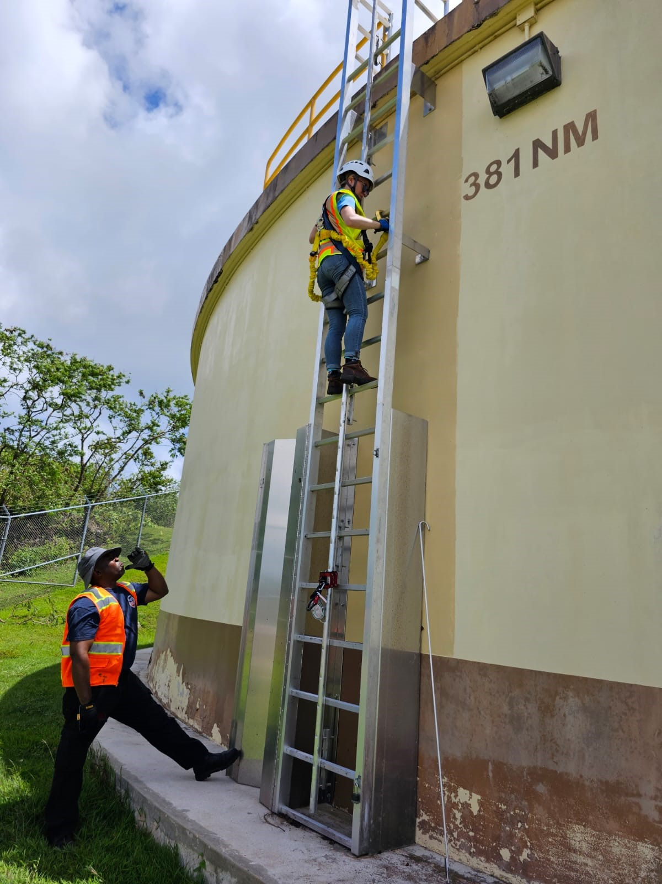
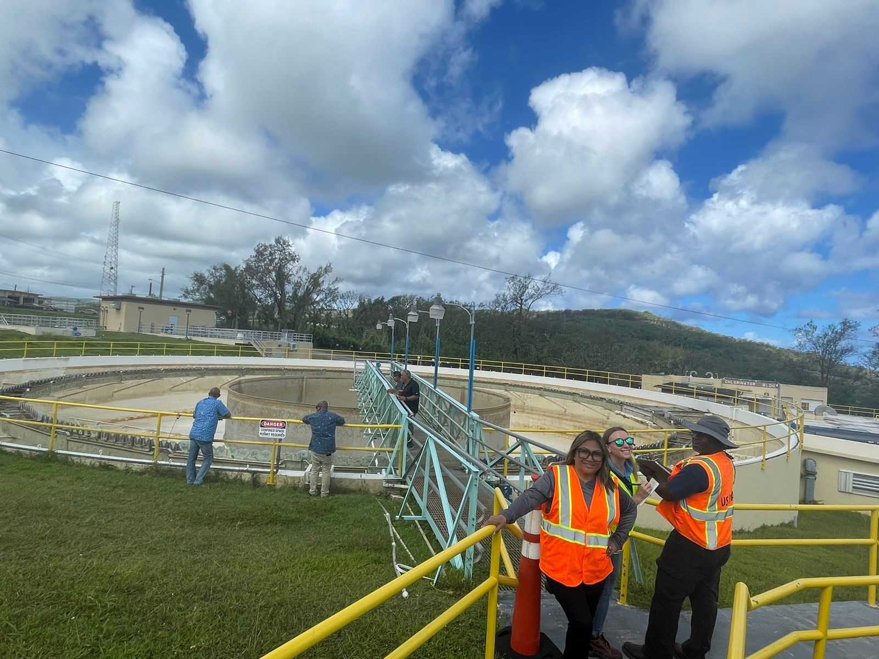
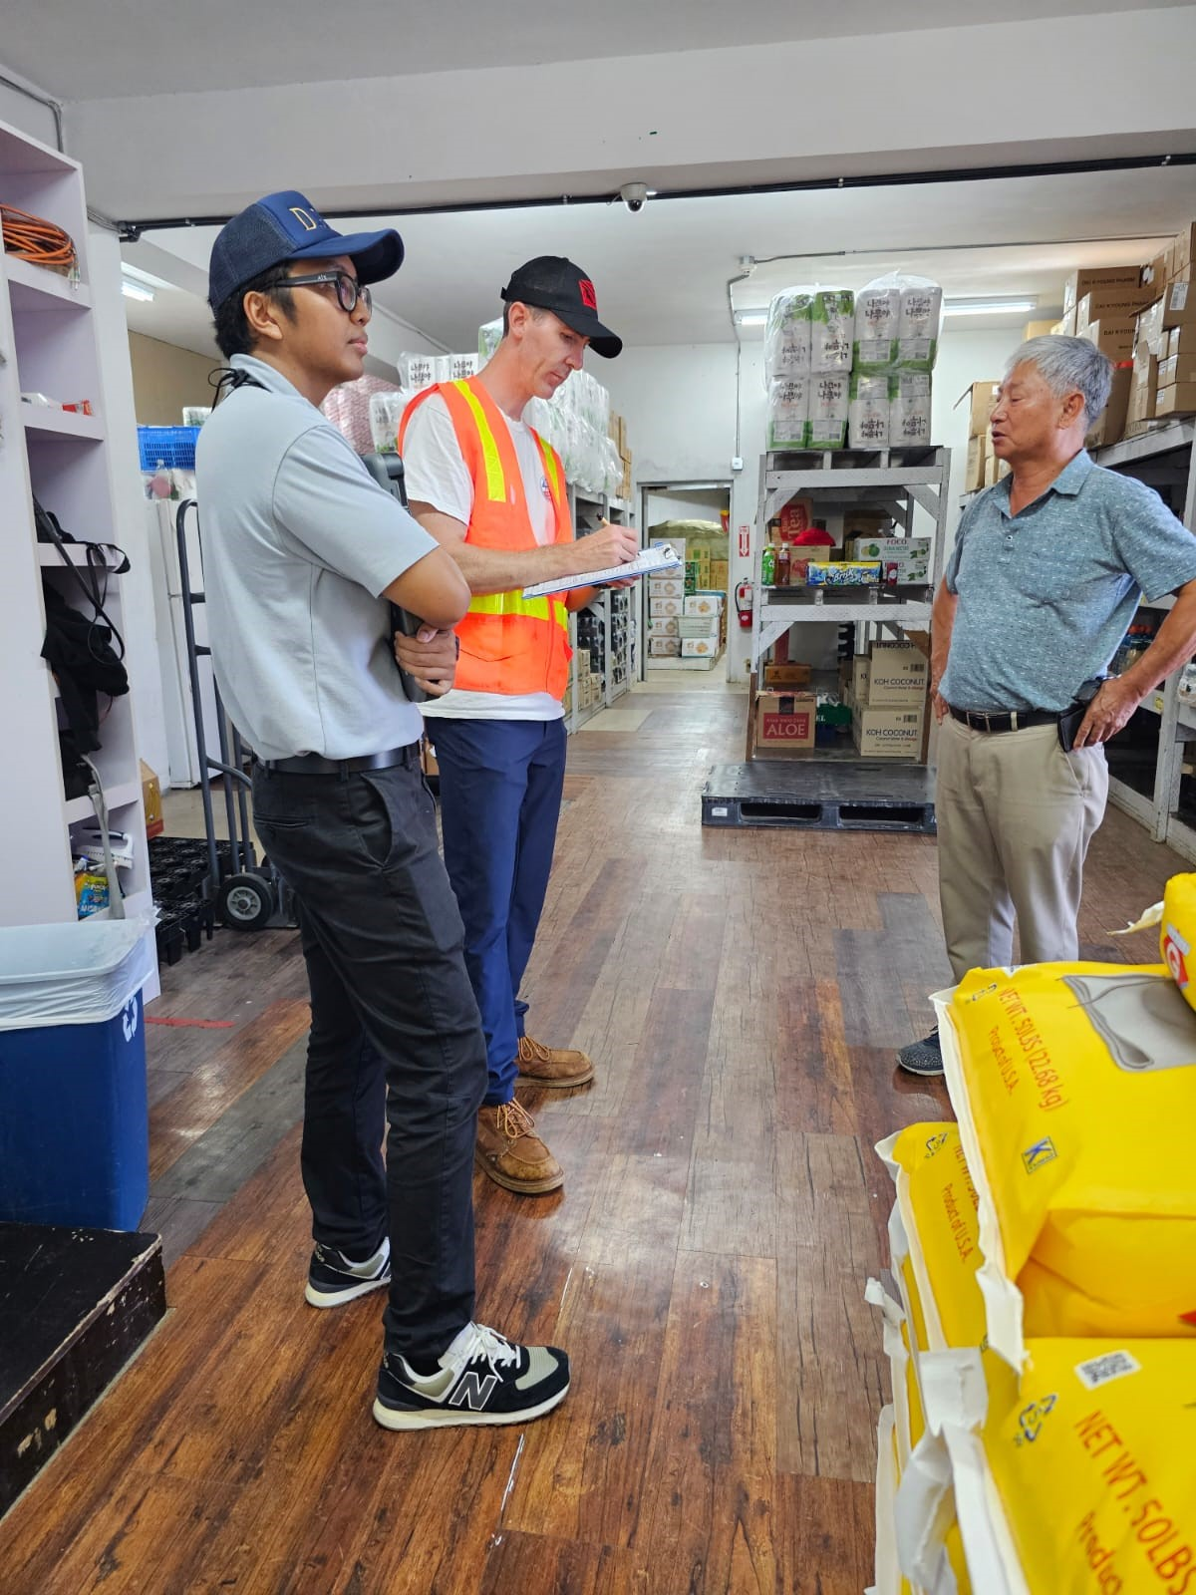
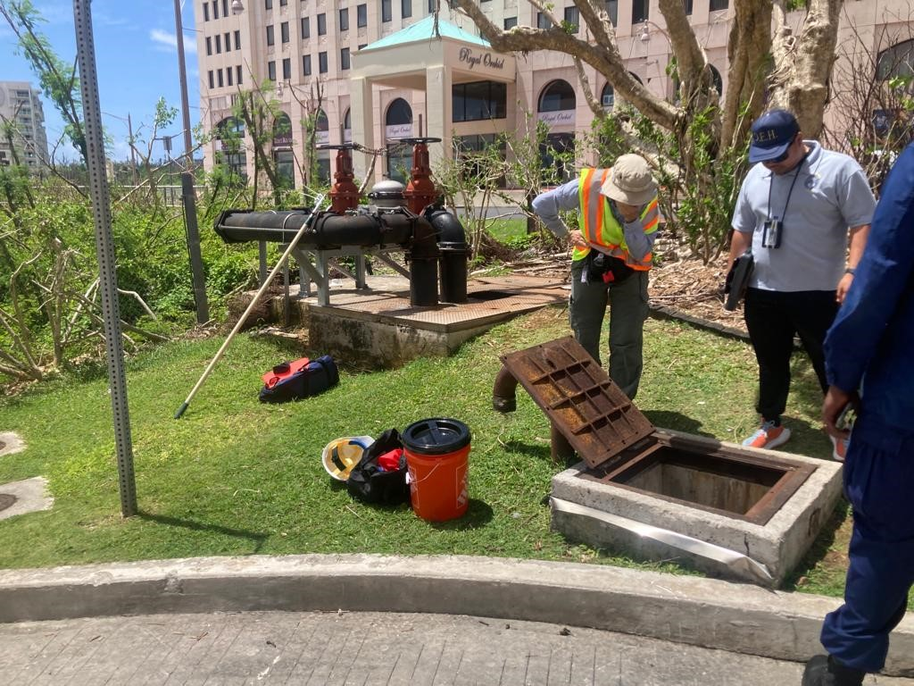
USEPA Water Emergency Team
Support Guam Agencies under ESF3
Notes:
Many drinking water systems lost power as a result of the typhoon. EPA was tasked by FEMA to provide technical assistance to Guam EPA and GWA to get the water infrastructure back online. The eight public drinking water systems on Guam and three public drinking water systems on Rota island (CNMI) were inspected for adequate flow and sampled to ensure water quality of each system. The boil water advisory was lifted for Guam public drinking water systems on June 24.
The surface water treatment plants at Ugum and Navy sustained moderate to minor damage. The EPA conducted assessments on critical infrastructure to ensure full operation of both systems.
EPA helped inspect over 20 water hauling trucks and 126 water and ice vending machines, and sampled and assessed the condition of water storage tanks at 35 hotels, as well as a dozen large water storage tanks affected by the typhoon.
For wastewater, the seven wastewater treatment systems on Guam were inspected and monitored for sewage overflow events. EPA supported the Guam Water Works Authority in assessing moderate damage at the Northern District Wastewater Treatment Plant and determining necessary repairs to ensure its full functionality.

Slide 7
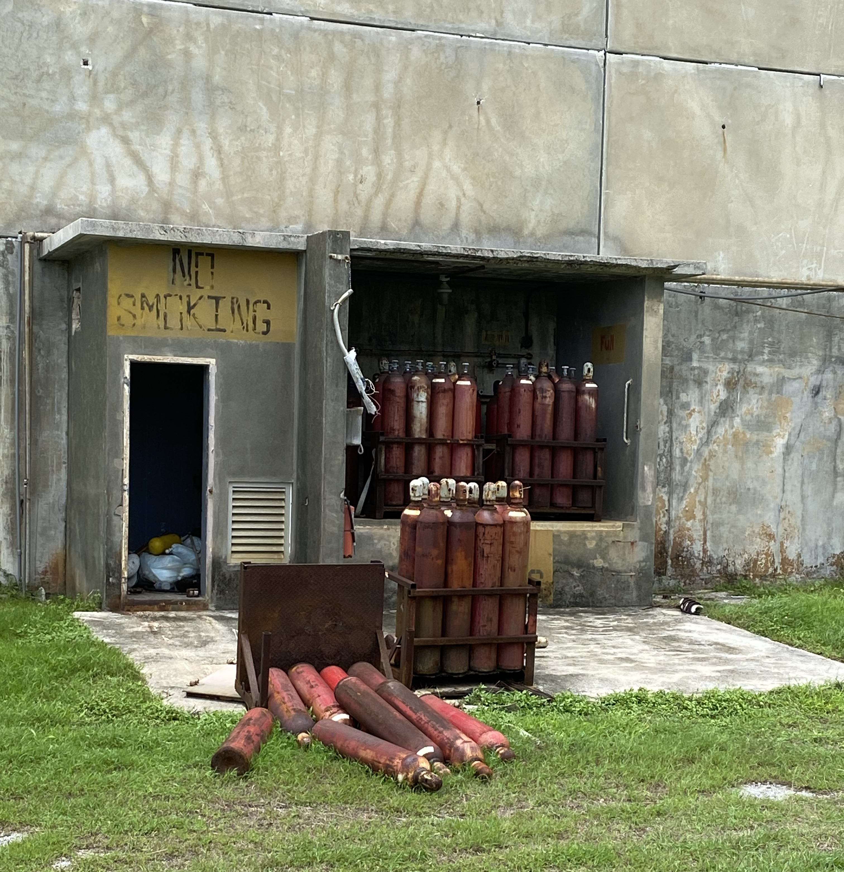
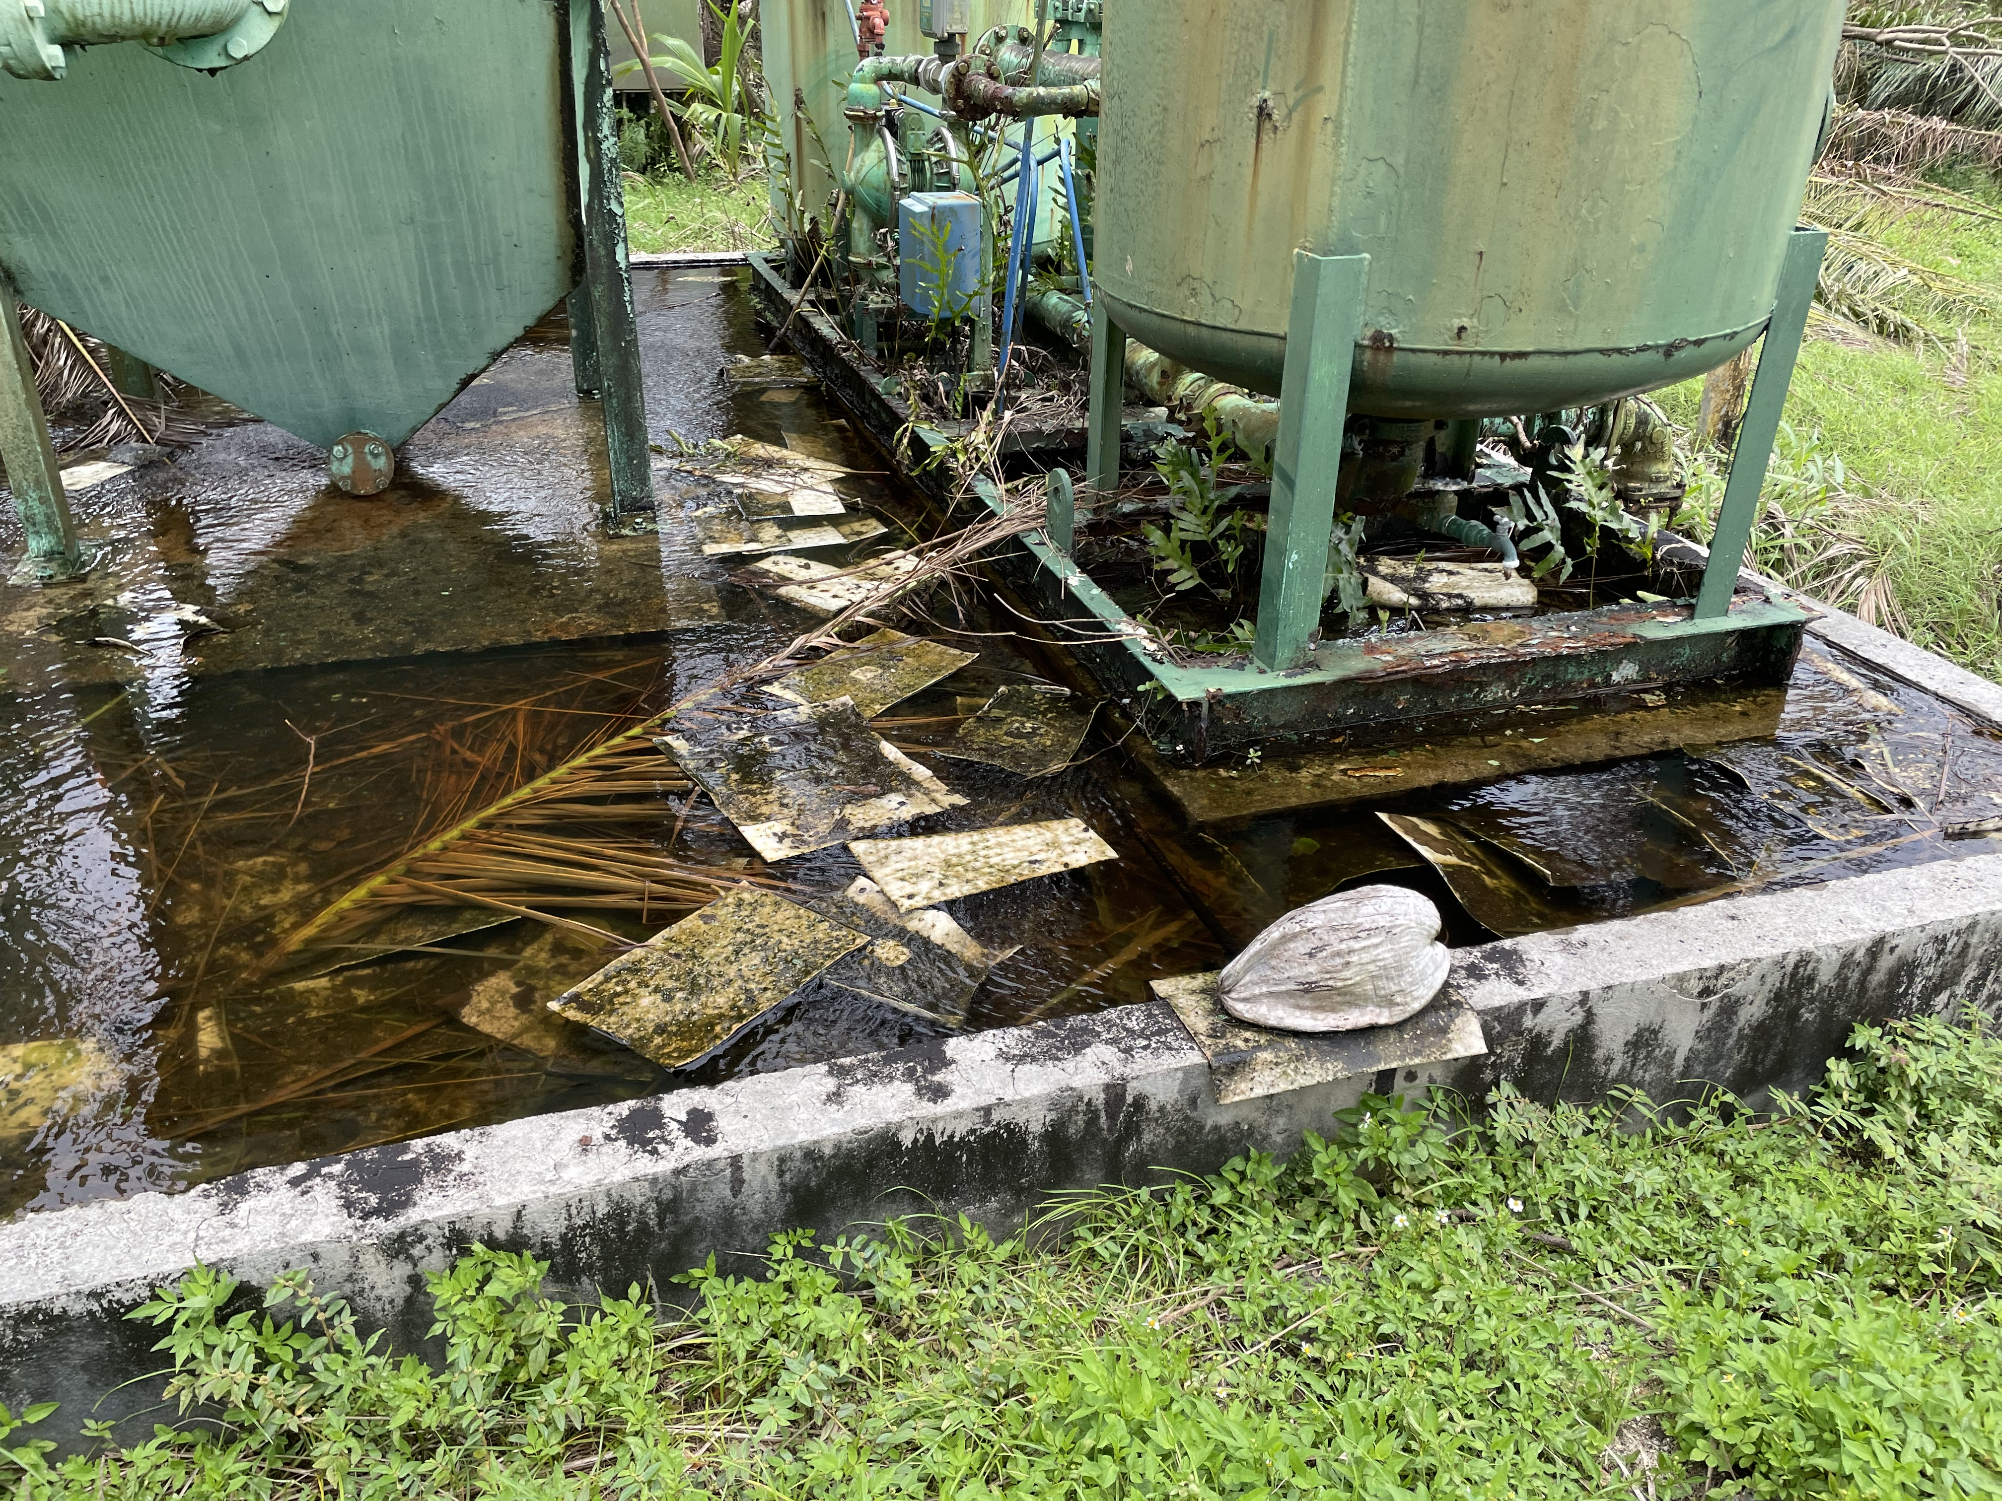
USEPA ESF10
DAMAGE ASSESSMENT OF INDUSTRIAL FACILITIES
Notes:
Part of the effort was damage assessments at over 150 facilities permitted to store hazardous materials.

Slide 8
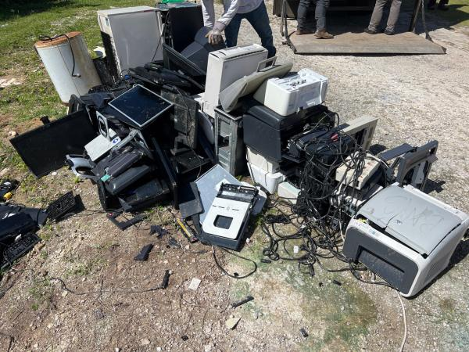
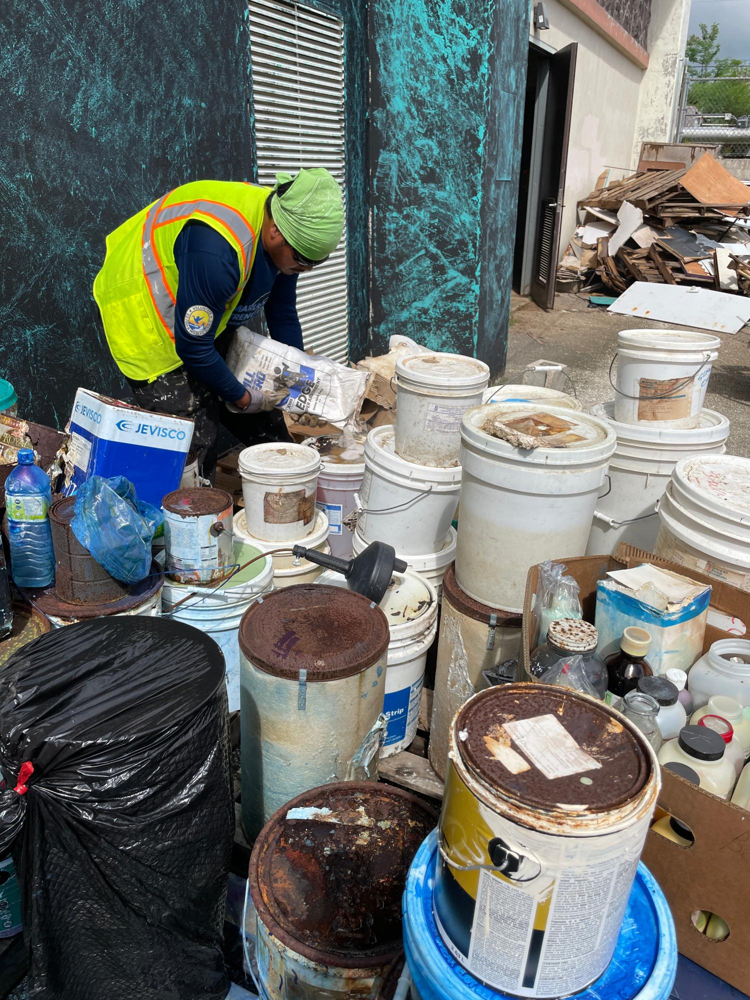
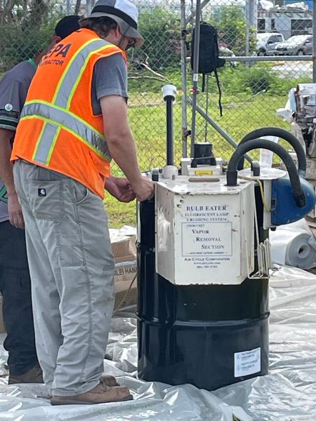
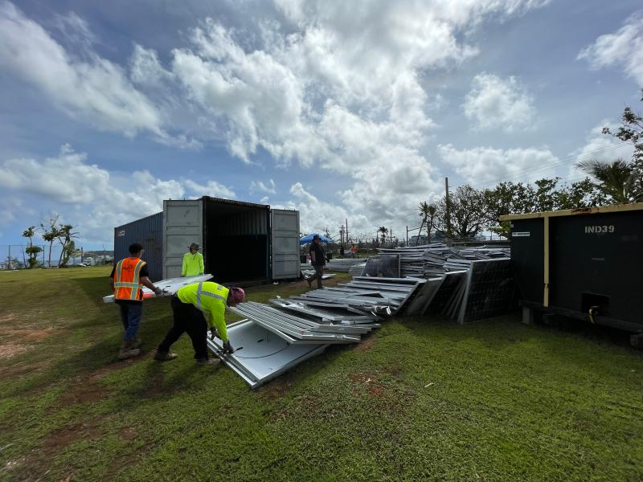
SCHOOLS
Notes:
USEPA and its contractors collected hazardous waste from 41 schools across Guam. From left to right: sorting liquid wastes, including paint and chemicals; preparing a fluorescent light bulb crusher to safely crush bulbs prior to packaging; e-waste and shipping; collecting damaged solar panels

Slide 9
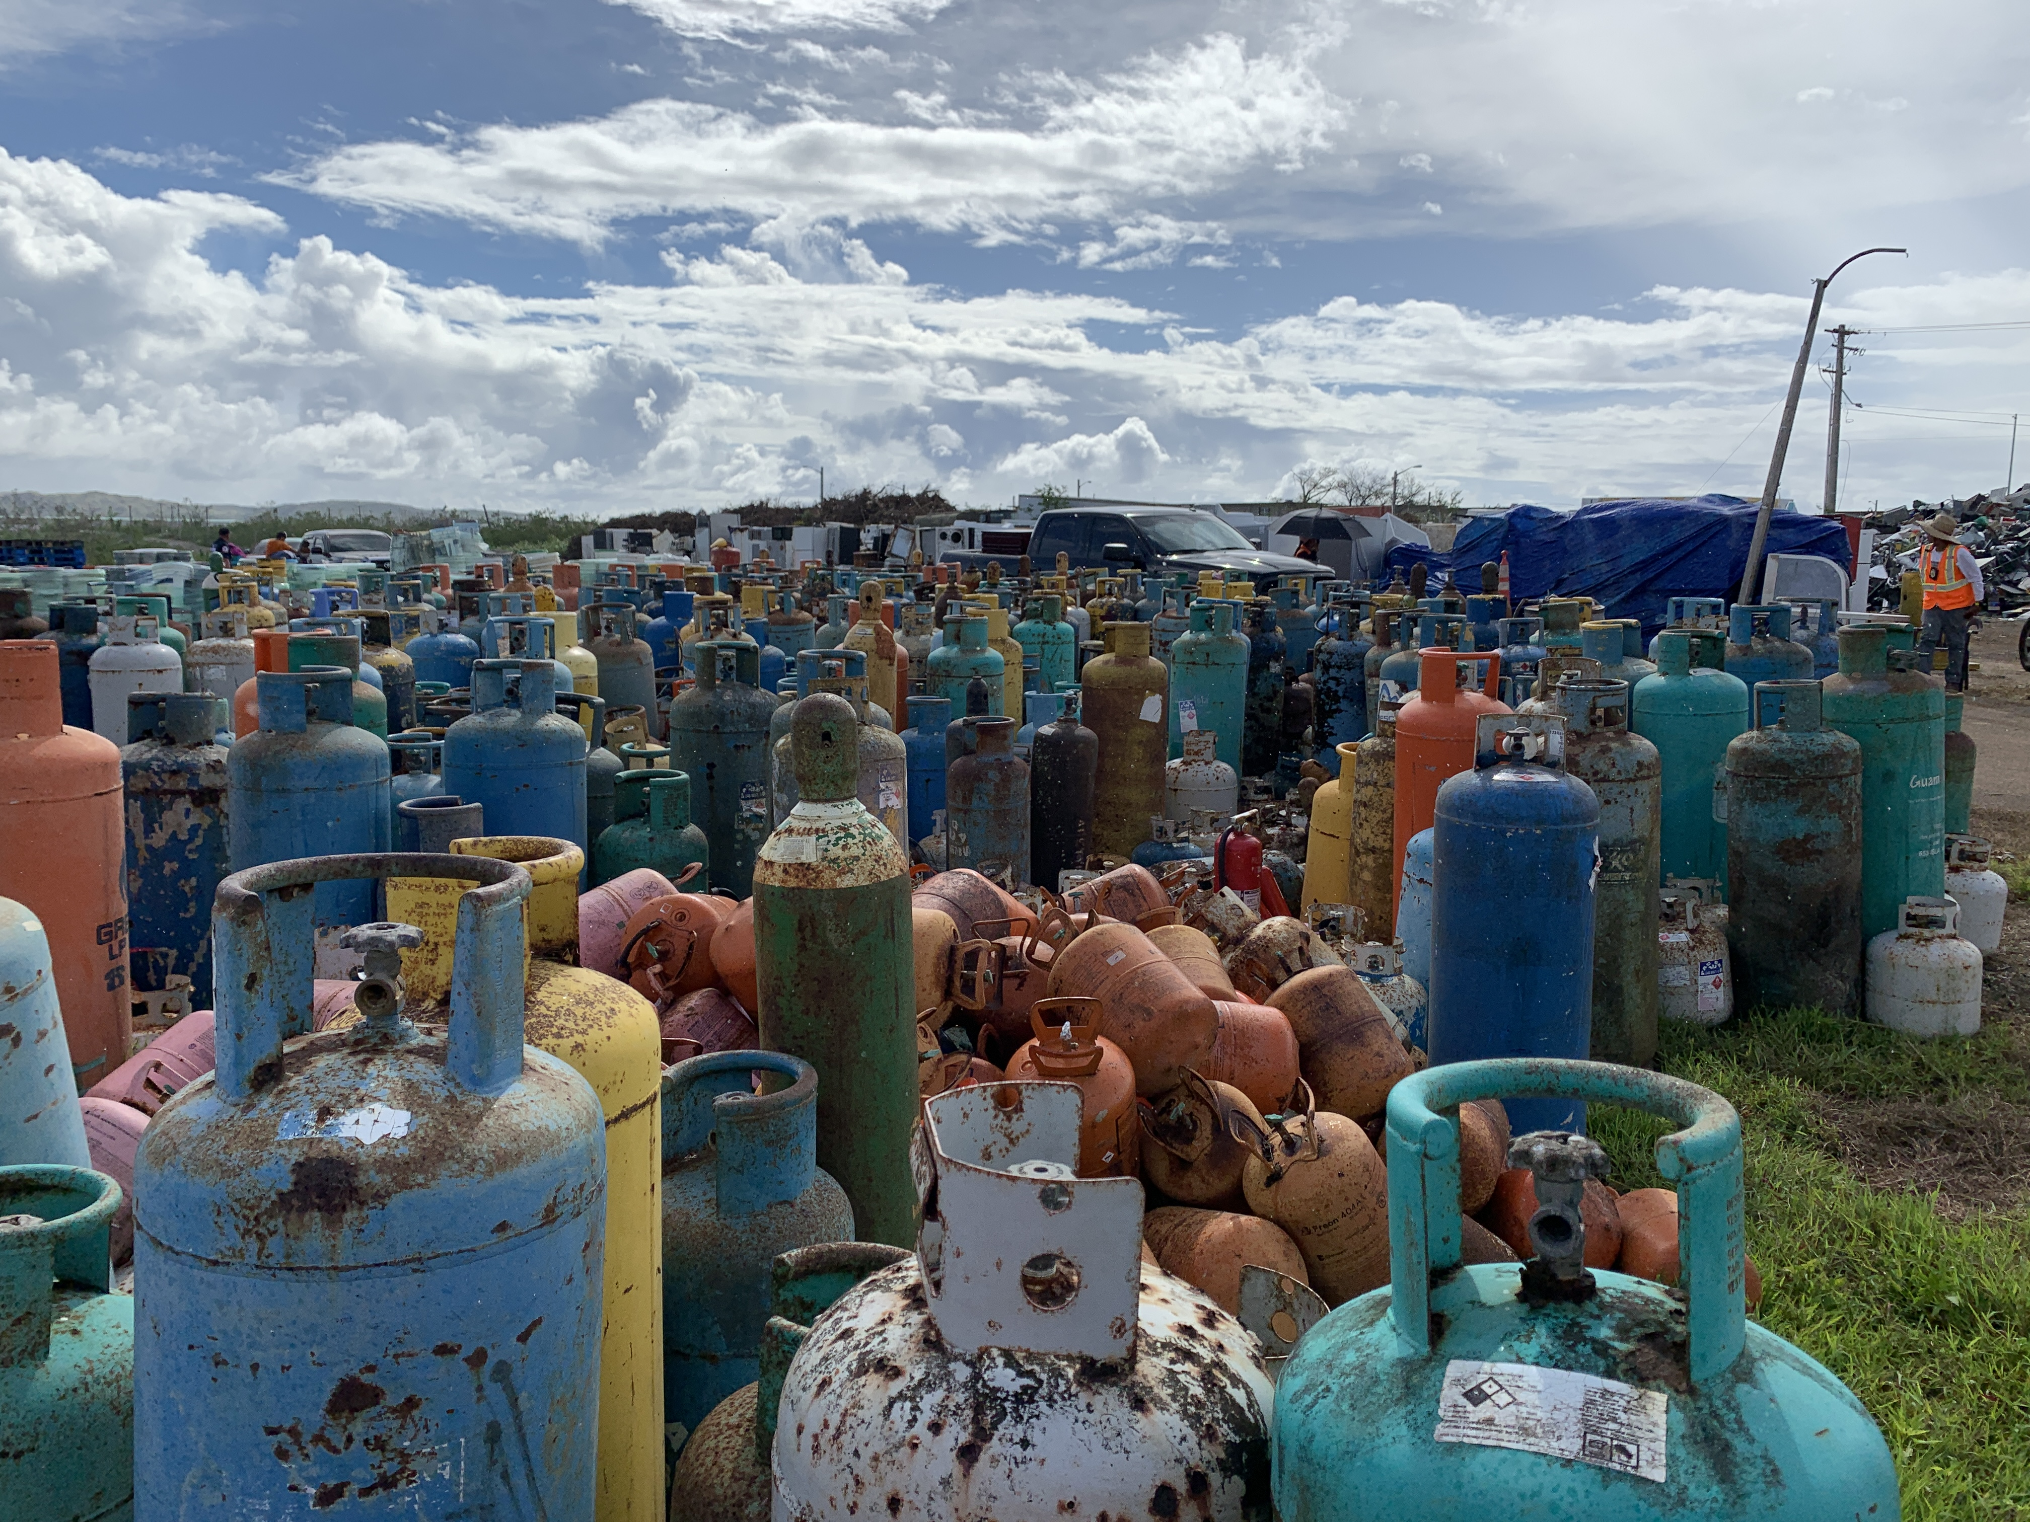
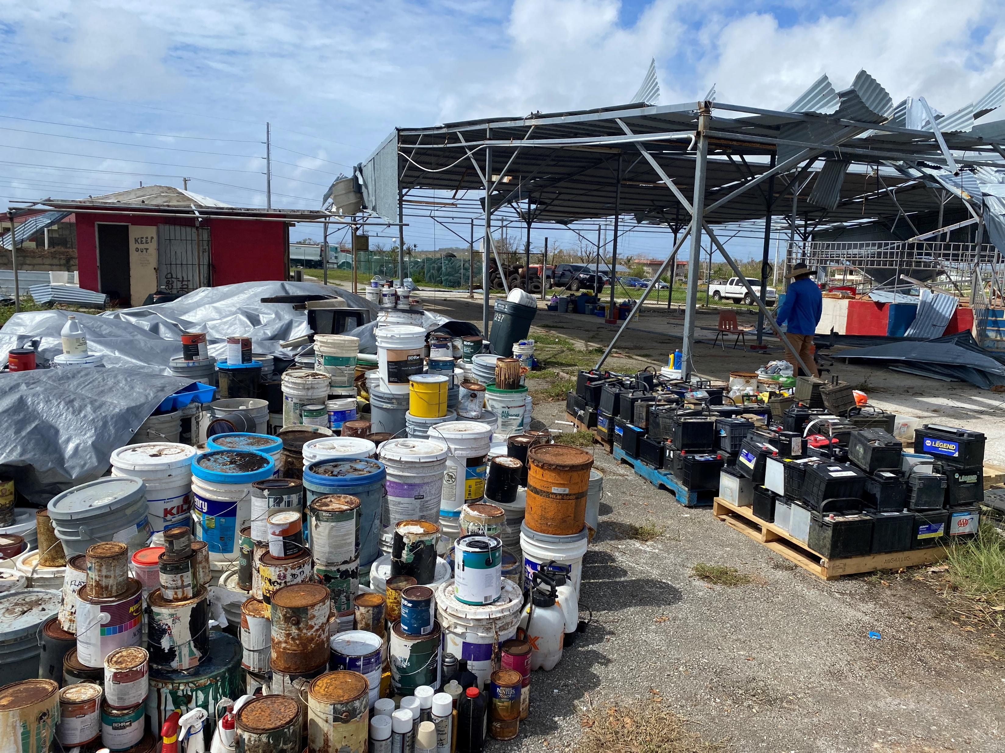
ESF10 HOUSEHOLD HAZARDOUS WASTE
COLLECTION AND DISPOSAL
Notes:
For hazardous waste and oil, EPA's focus, with support from contractors and the U.S. Coast Guard, included the sorting of materials at the three debris collection sites in Dededo, Barrigada, and Tamuning. This included materials like paint, petroleum products, pesticides, fluorescent lightbulbs, batteries, and electronics.

Slide 10
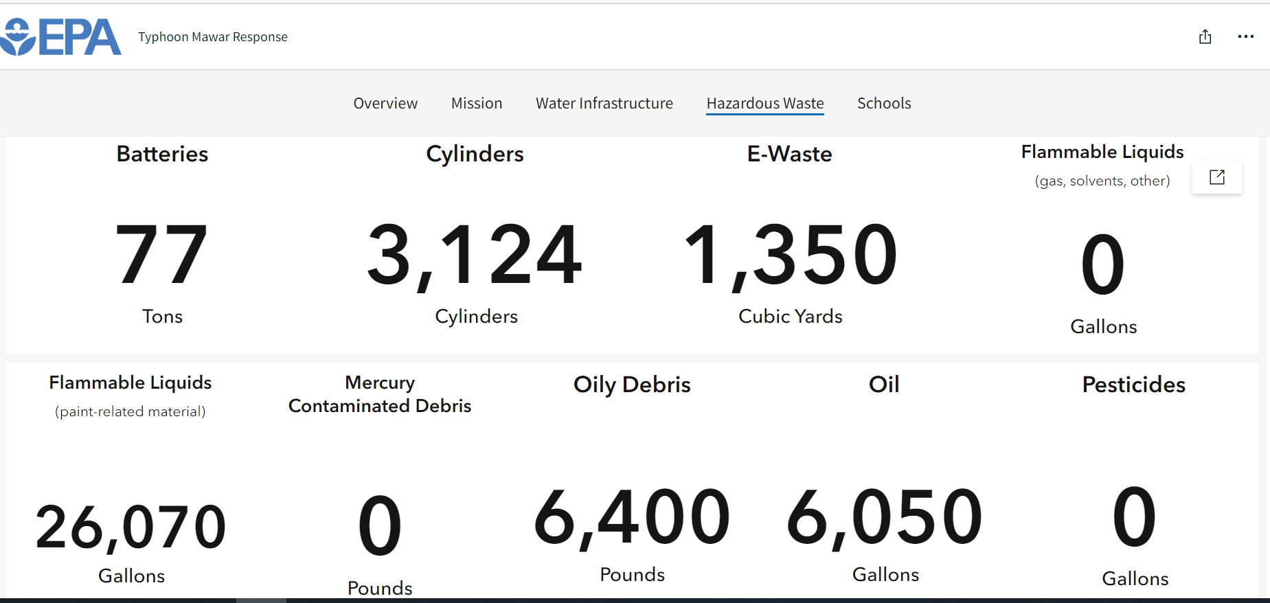
HHW Collection Numbers as of 7/25/2023

Slide 11
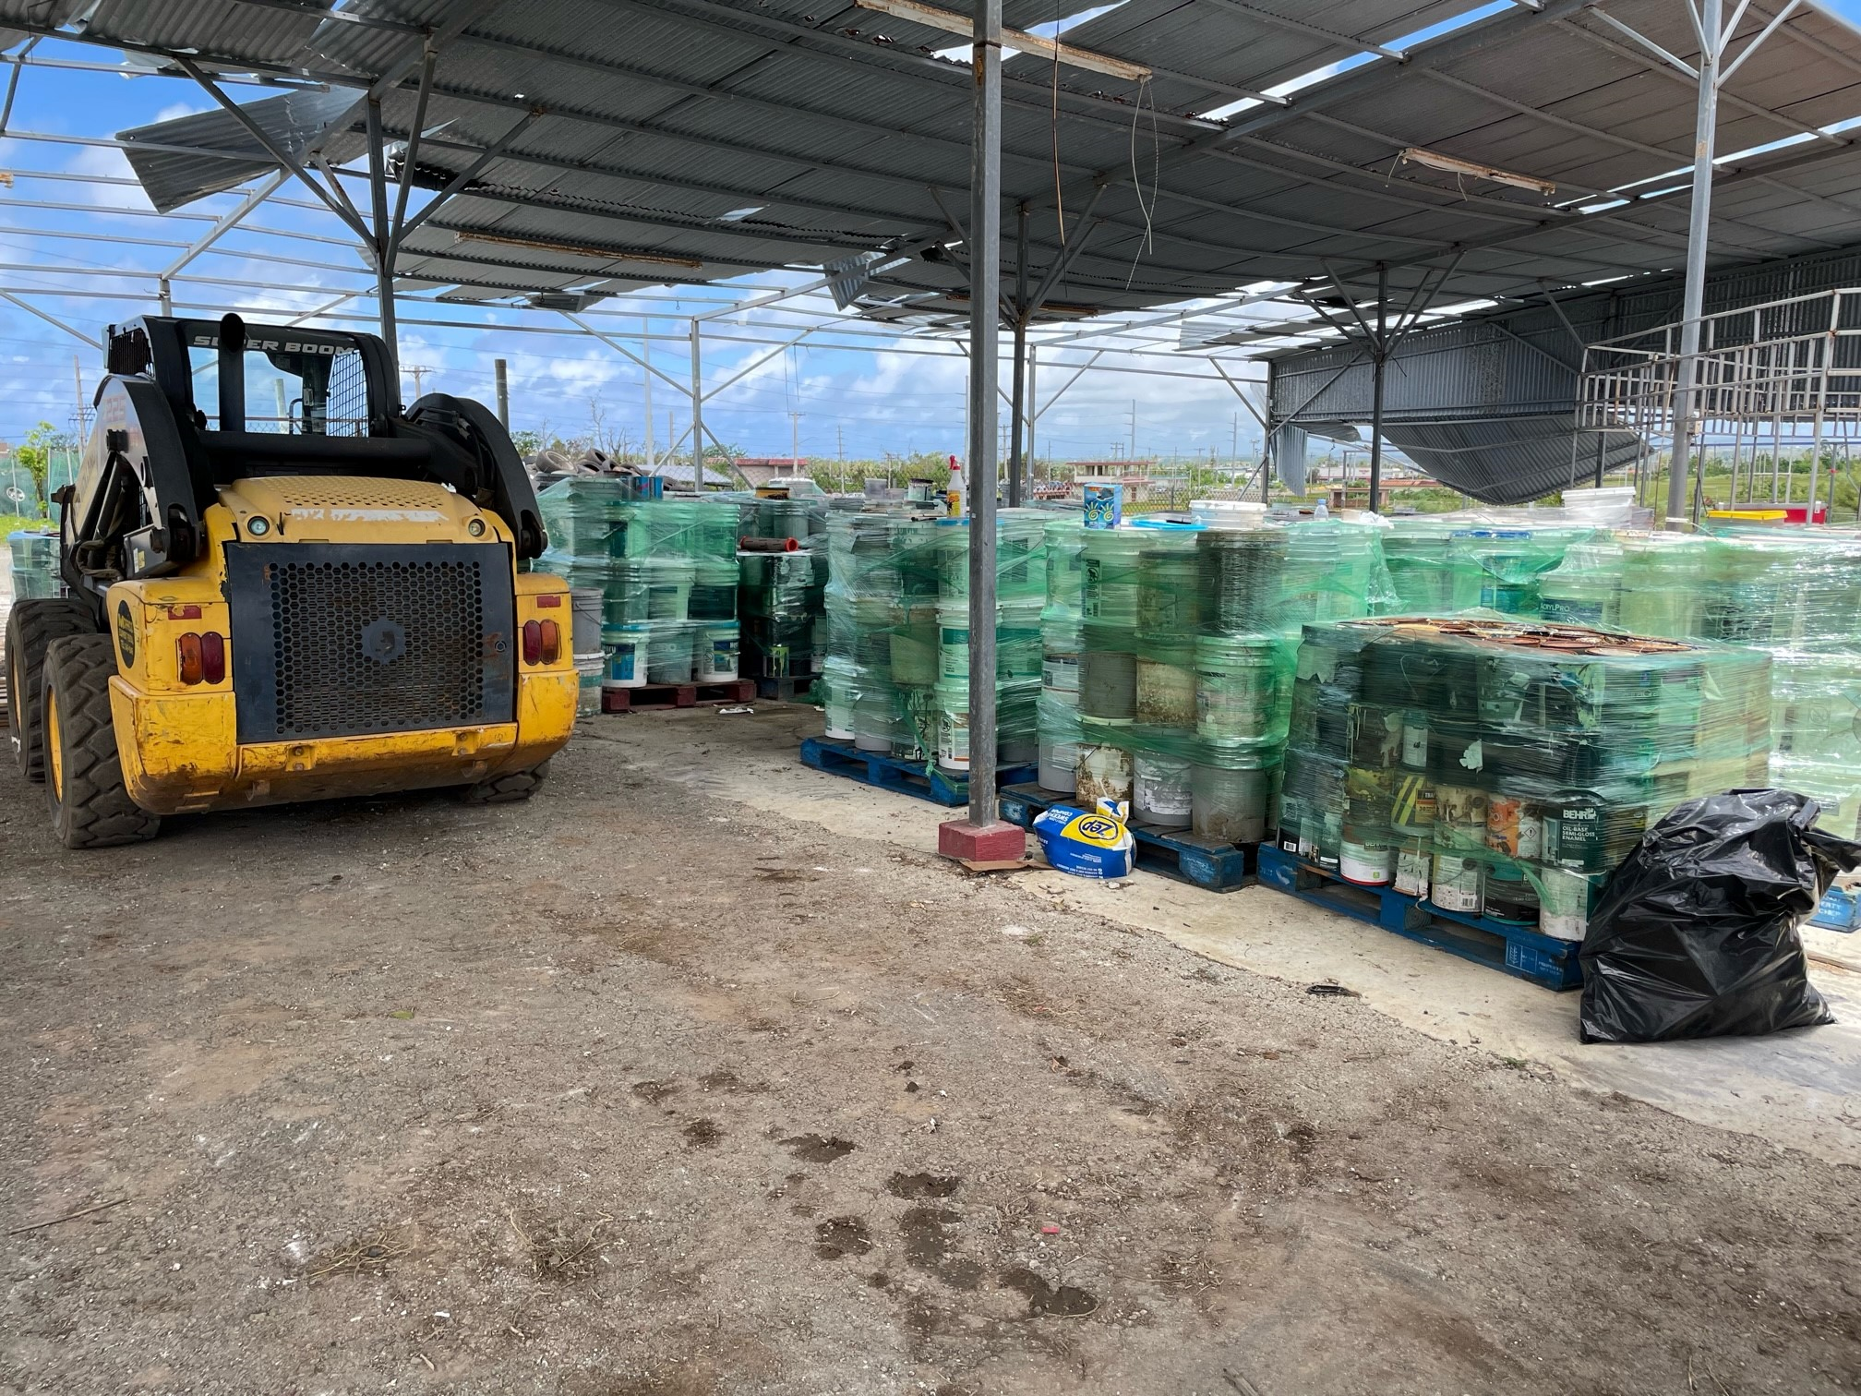
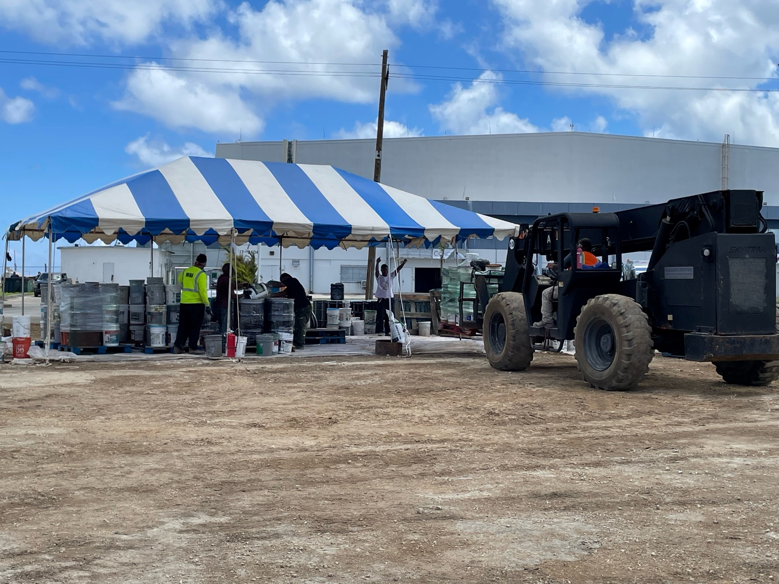
USEPA HHW Staging AREA
Notes:
At the EPA Staging Area, materials from the collection sites are prepared for safe shipment to the mainland for disposal.

Slide 12
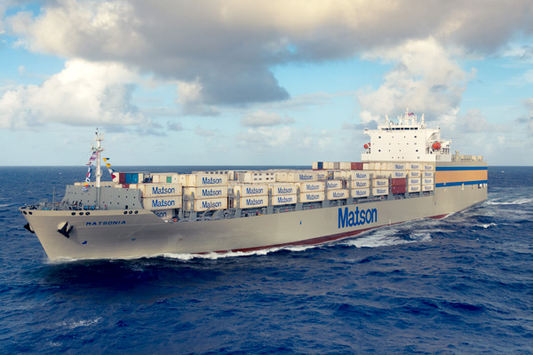
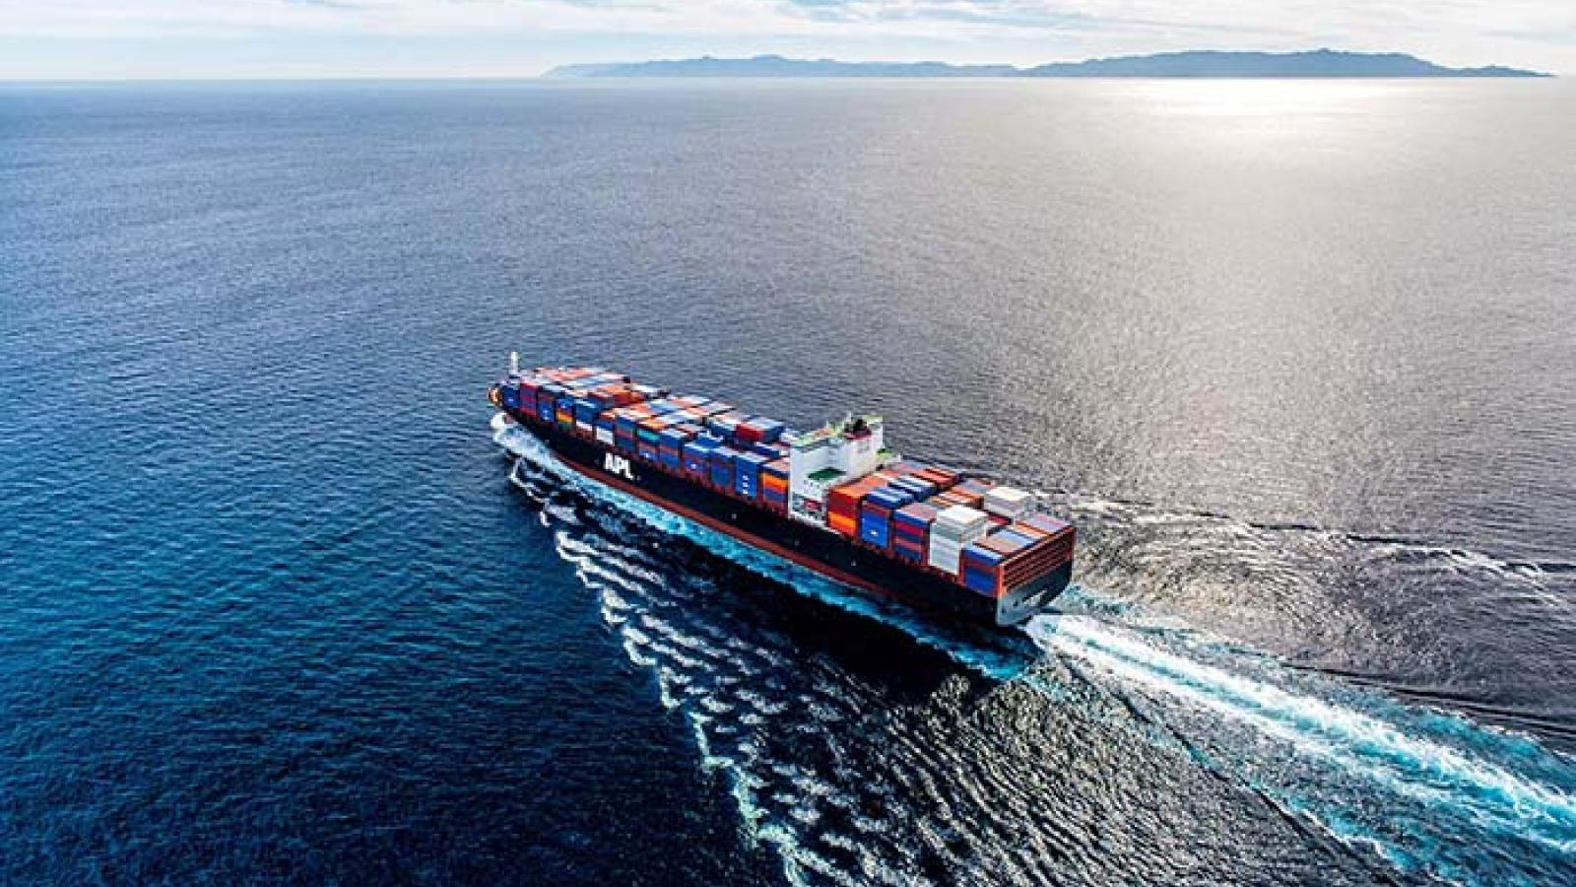
Transportation to disposal sites

Slide 13
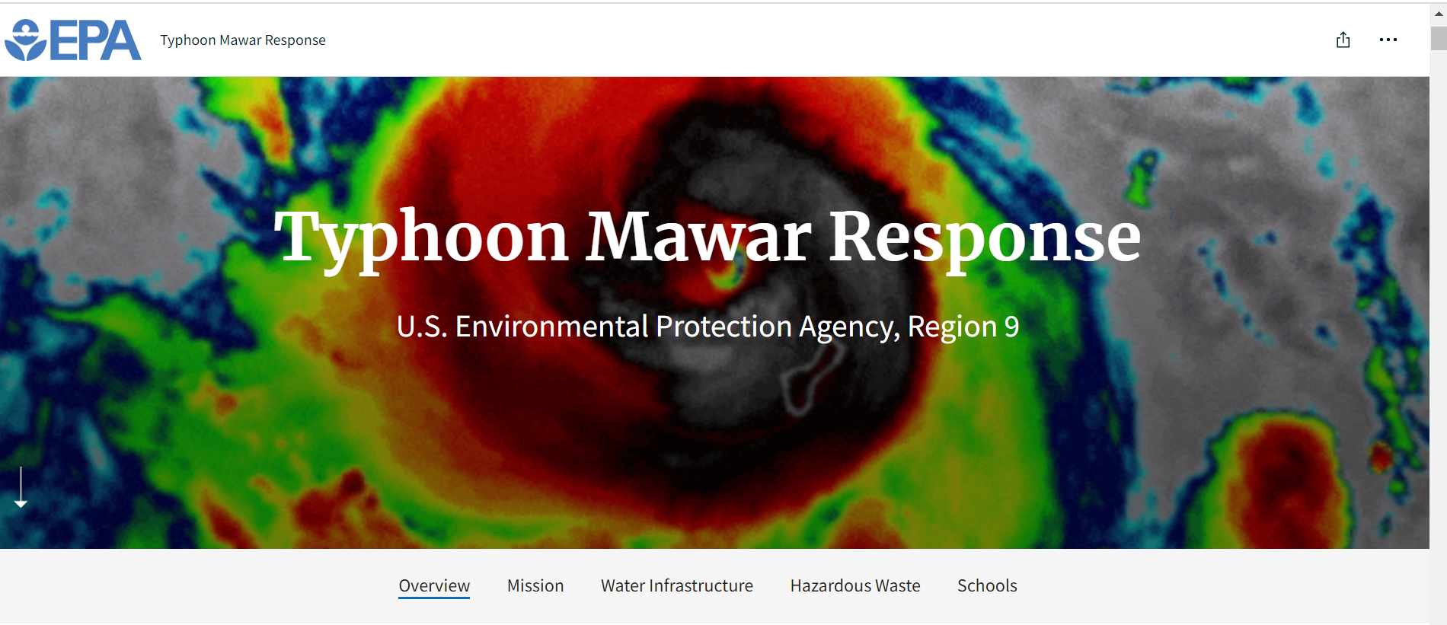
https://storymaps.arcgis.com/stories/09c31338fa254ae1a1f1ebb401f8e10f

Slide 14
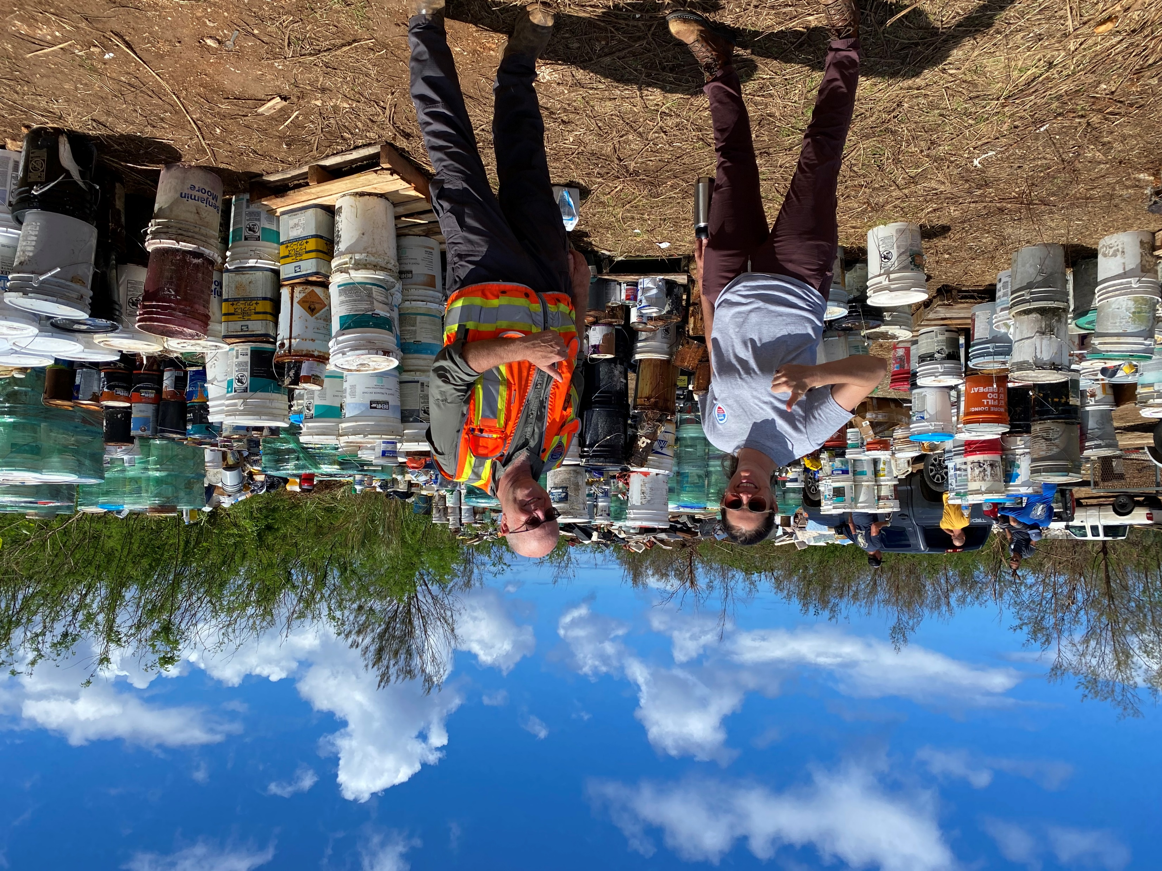
QUESTIONS?

