Slide 1
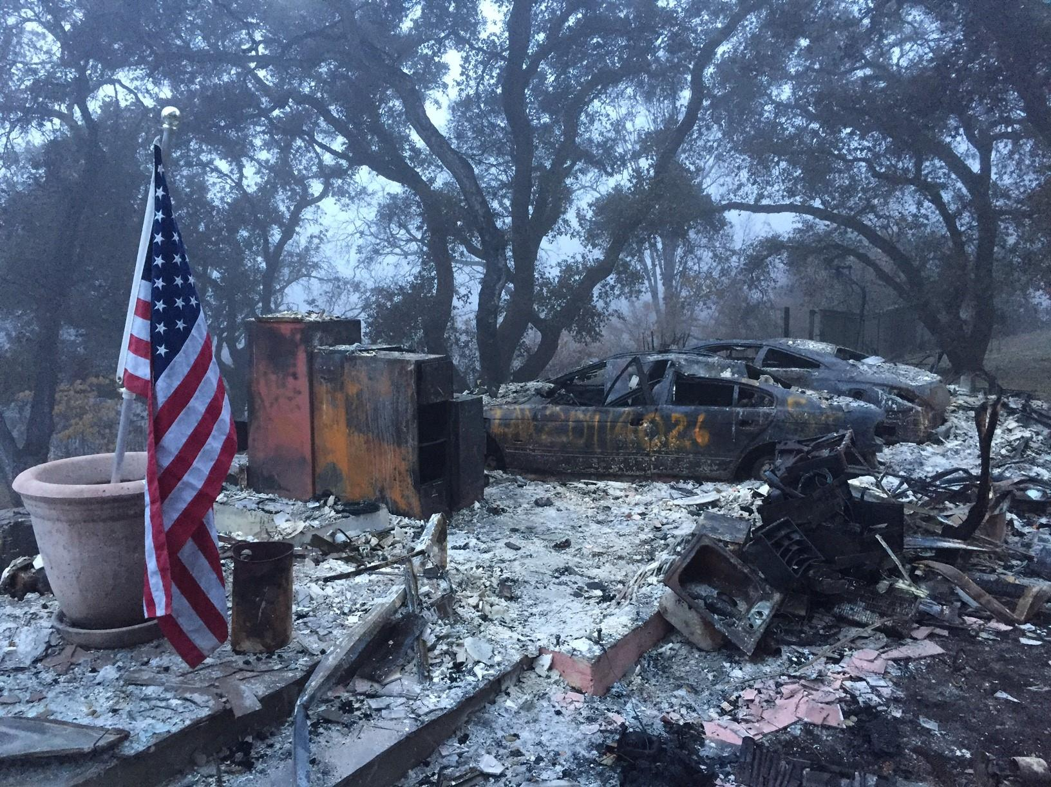
2020 California Fires
COVID-19 Standard Operating Procedures
Olivia Trombadore

Slide 2

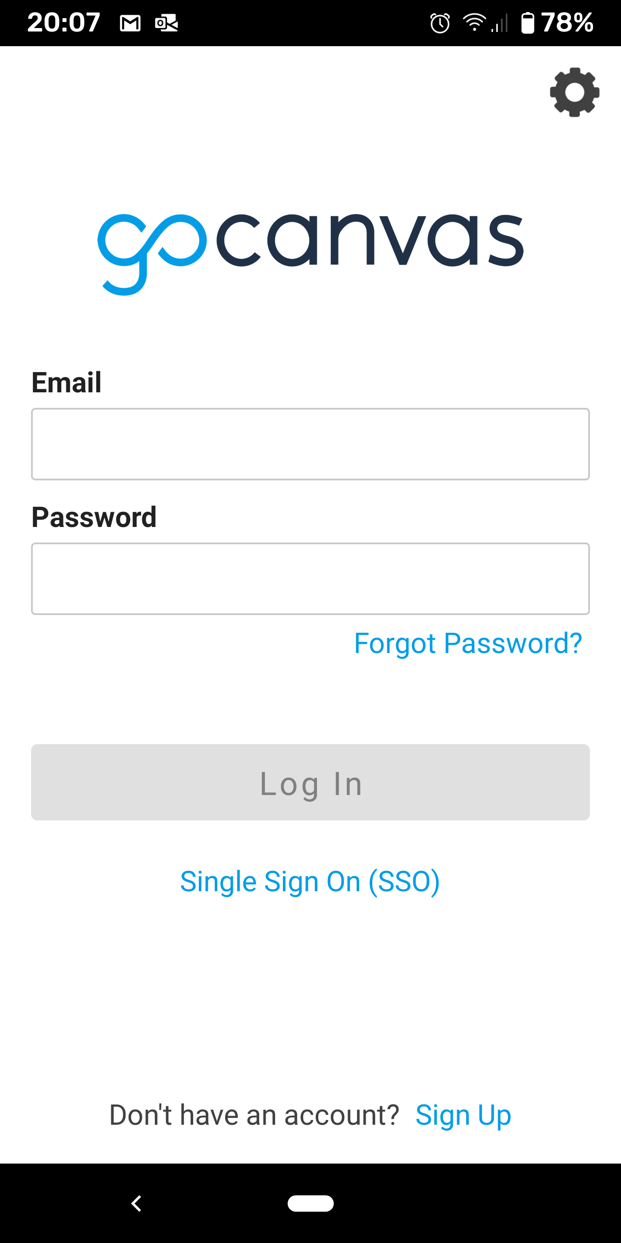
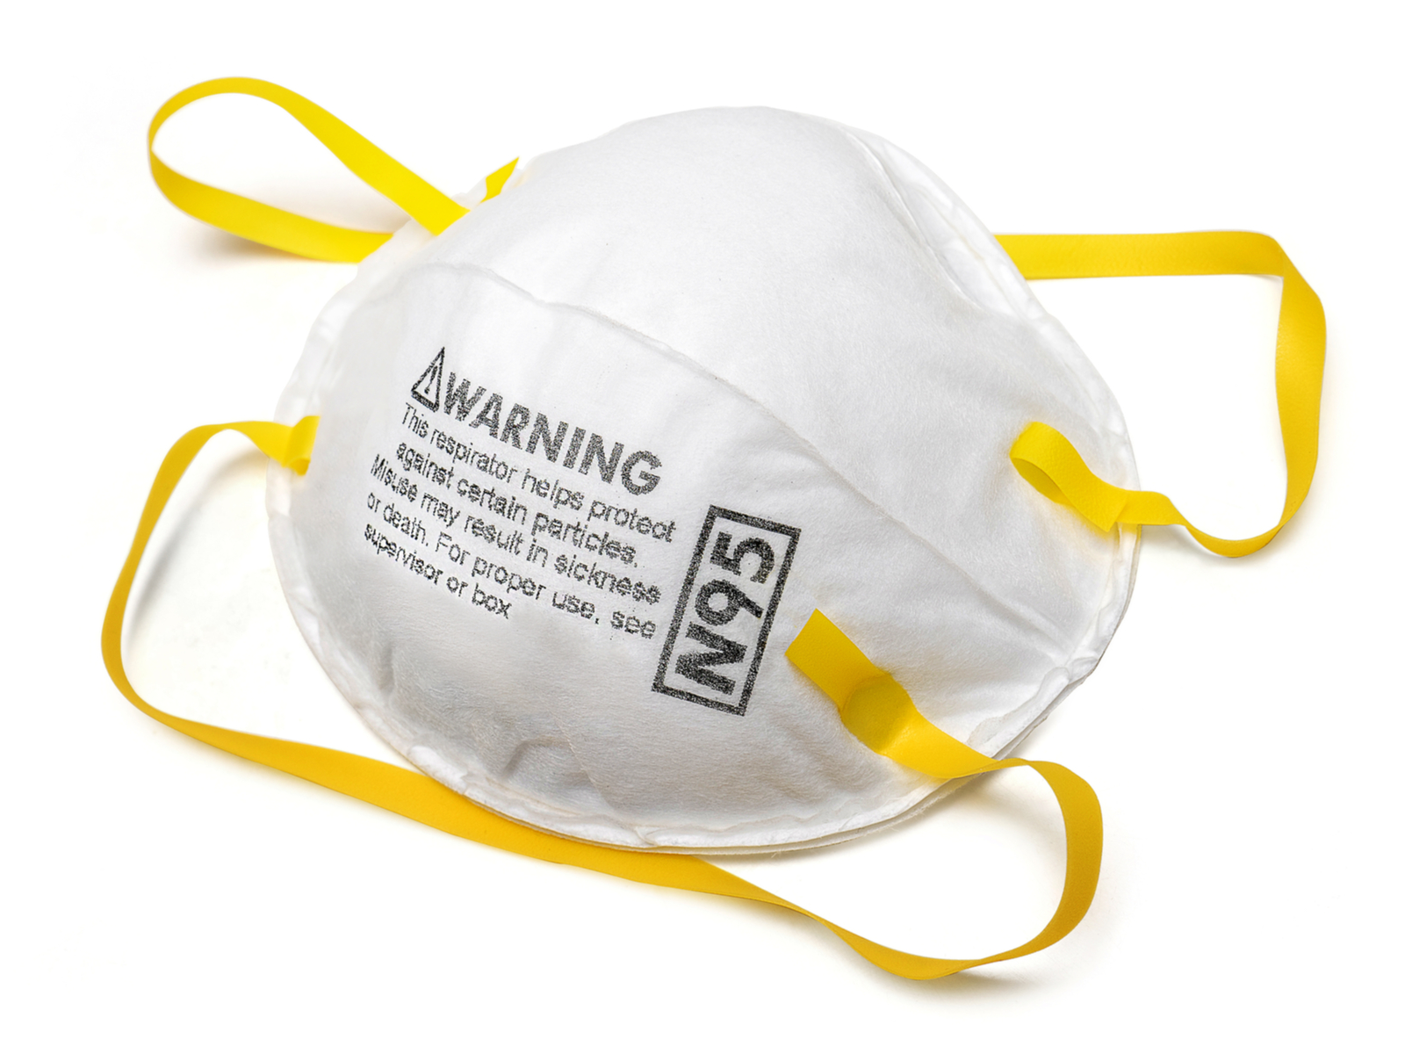
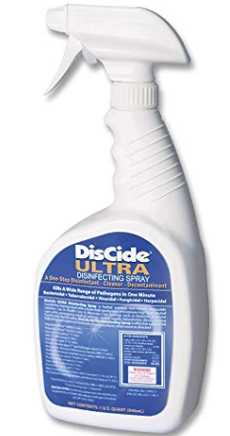
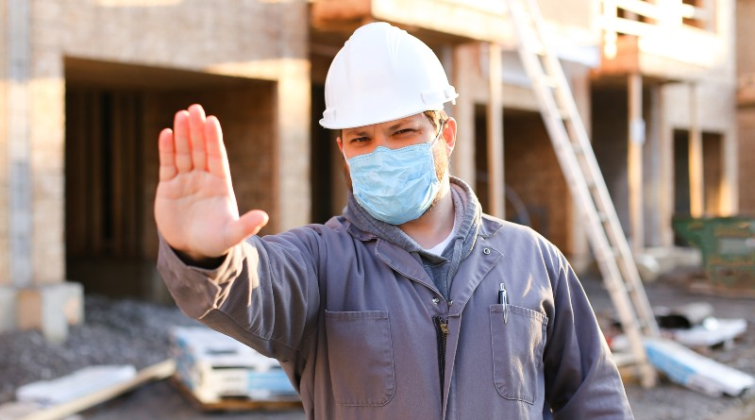

COVID-19
STANDARD OPPERATING PROCEDURES
Social Distancing
COVID-19 Screening
Face Coverings and Personal Protective Equipment (PPE)
Protect the health and safety of responders and communities served.
Disinfection and Sanitation
Enforcement

Slide 3
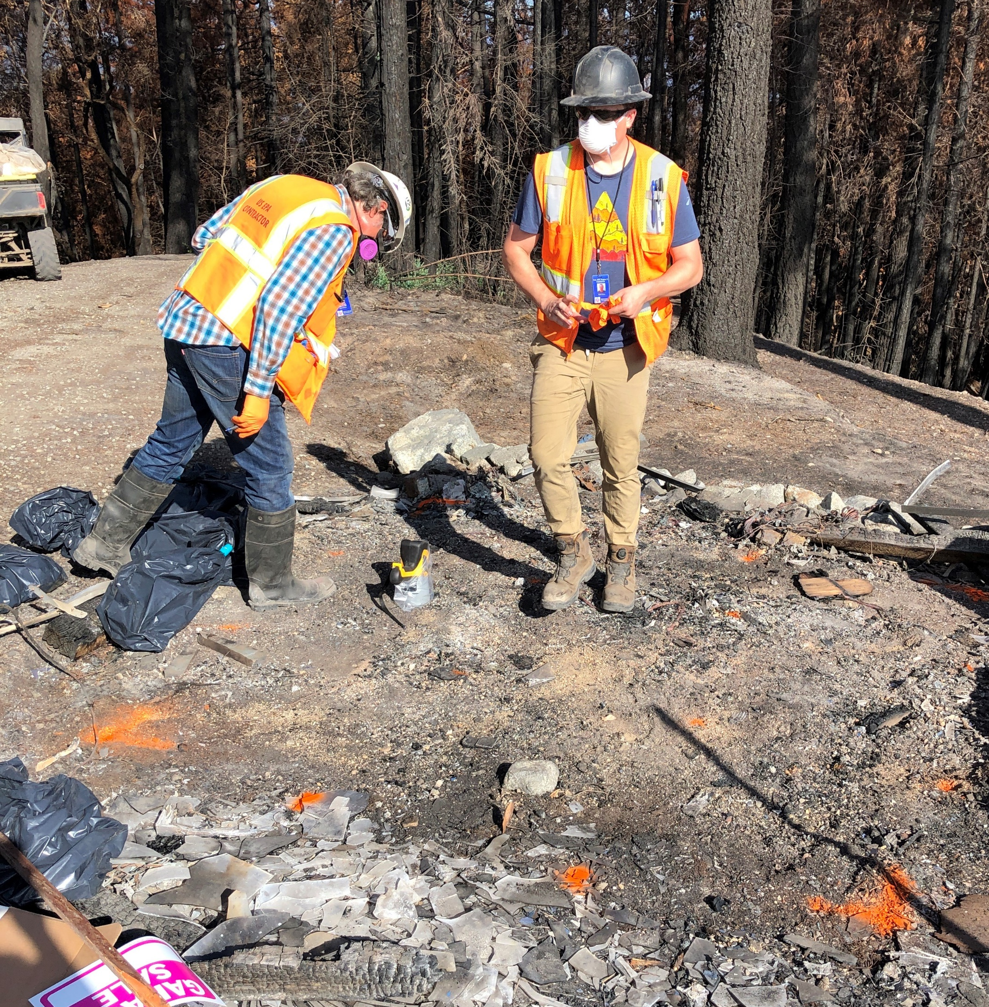
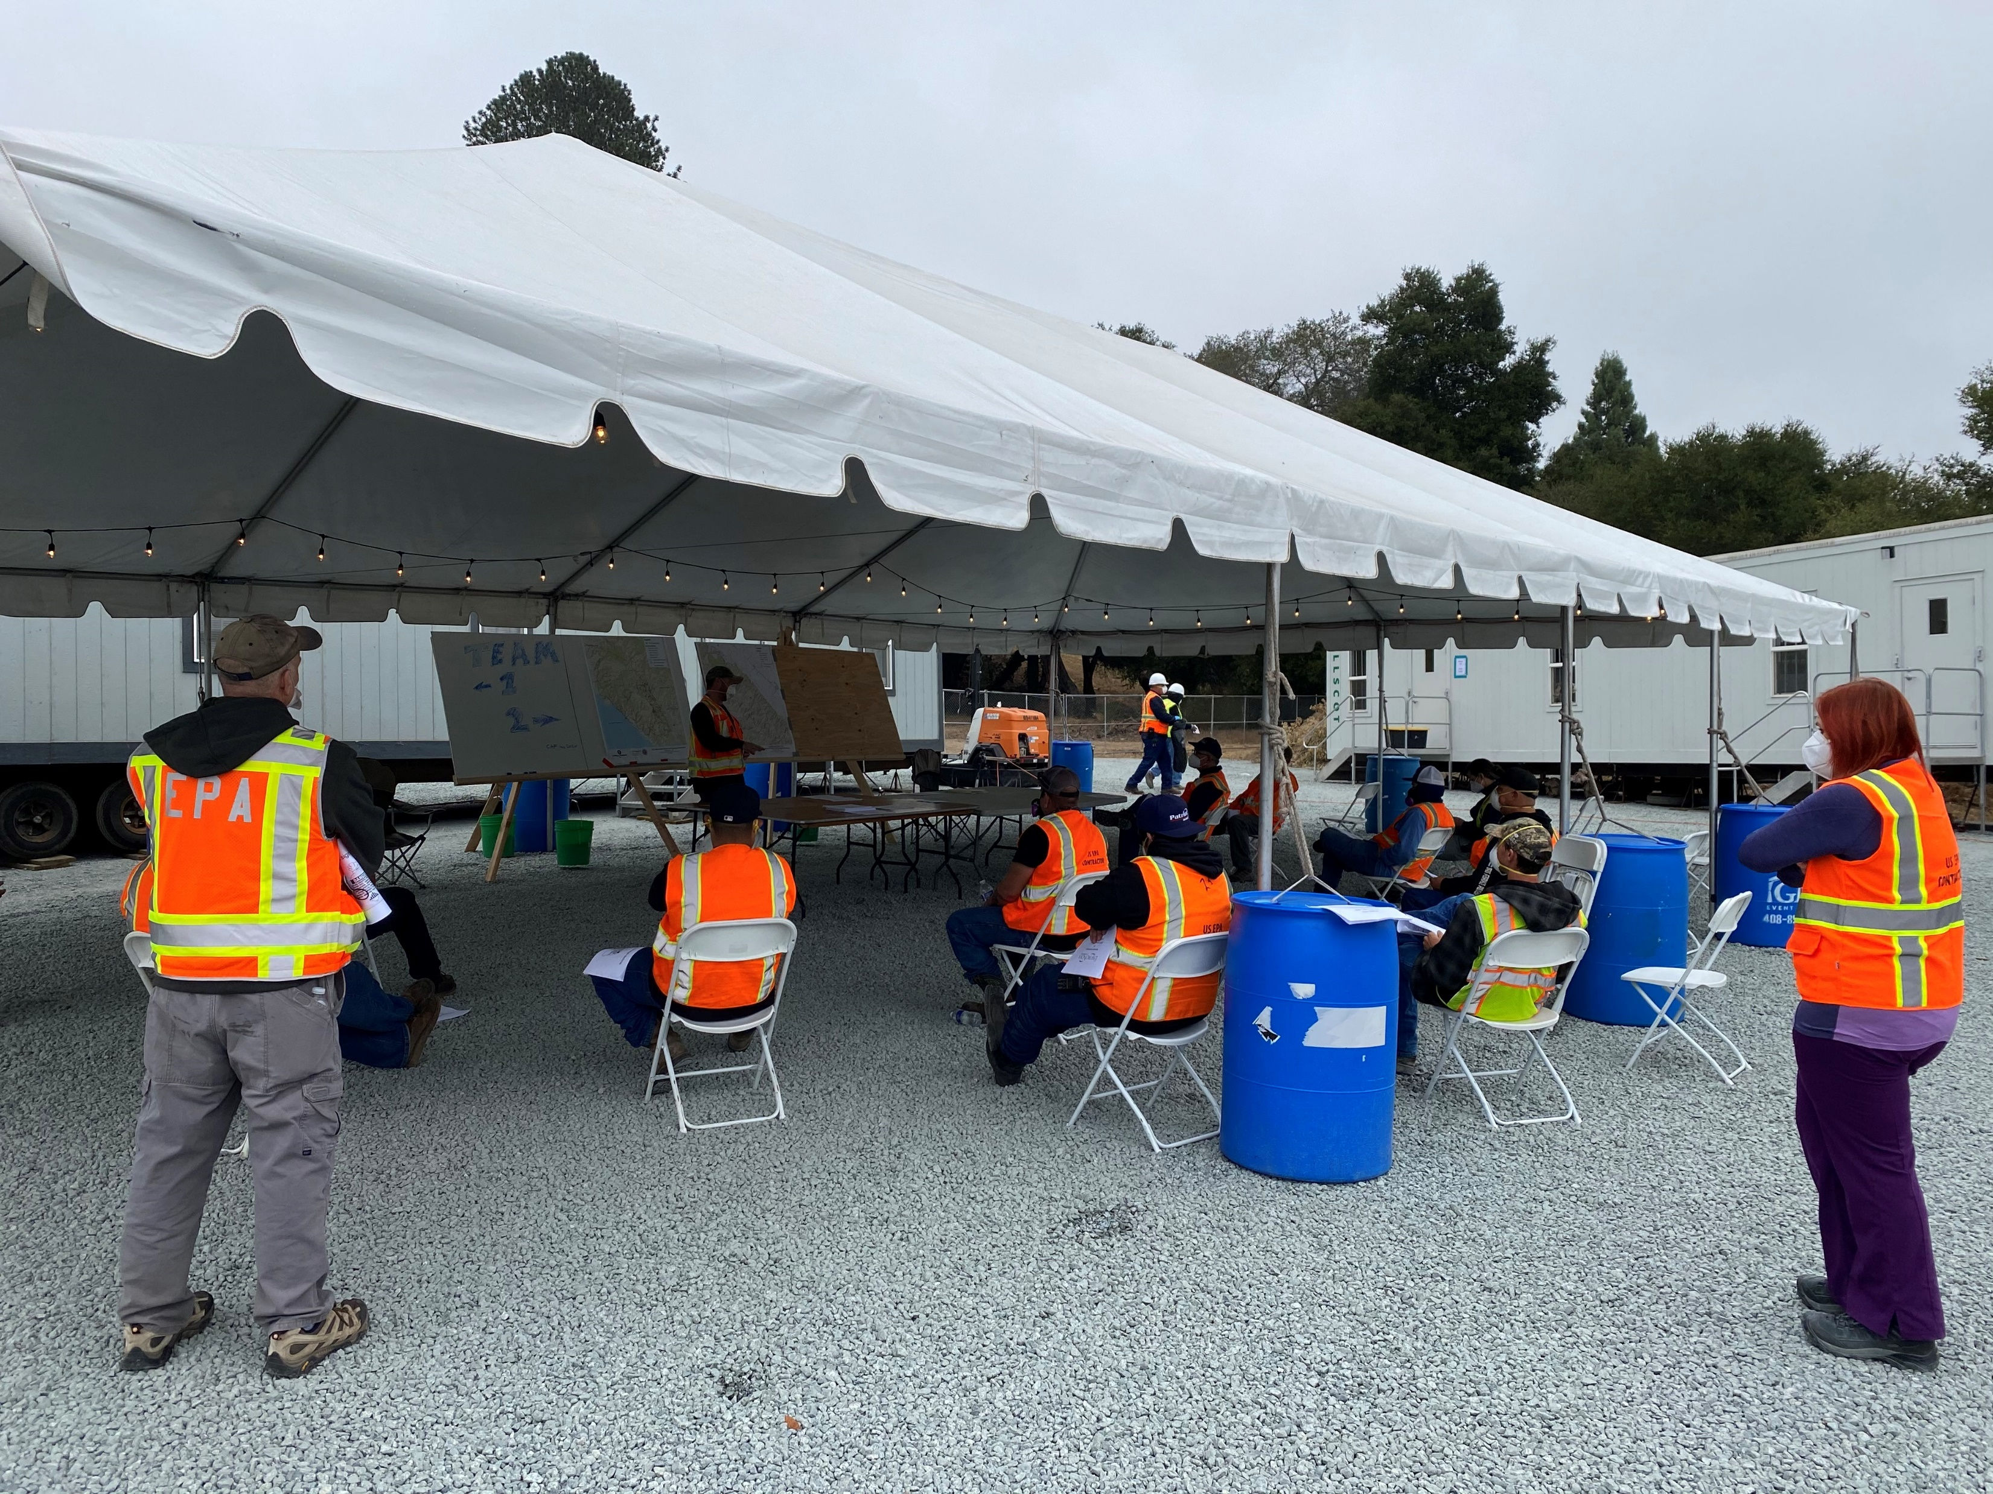

Face Coverings
Face coverings
Outside hot zone, N95 or KN95 masks without
exhalation valves shall be worn
Face coverings must be worn properly

Slide 4

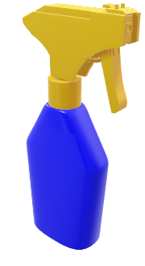
Disinfection and Sanitization
Routinely disinfect all highly touched surfaces
Twice as many wash stations
Increase the frequency of hand
washing
Disinfect hotel room and use
‘do not disturb’ sign

Slide 5

Social Distancing and Pods
Remember…
A POD that sticks together,
stays healthy together
    Stay with your POD during your
      work shift
    Look after your POD-mates

Slide 6
Staging Area Pods
ERRS
EPA
START
Field Team Pods
Division
Division
Division
Task Force Lead
Task Force Lead
Task Force Lead
Task Force Lead
Task Force Lead
Task Force Lead
HHW Team 1
HHW Team 1
HHW Team 1
HHW Team 1
HHW Team 1
HHW Team 1
HHW Team 2
HHW Team 2
HHW Team 2
HHW Team 2
HHW Team 2
HHW Team 2

Slide 7
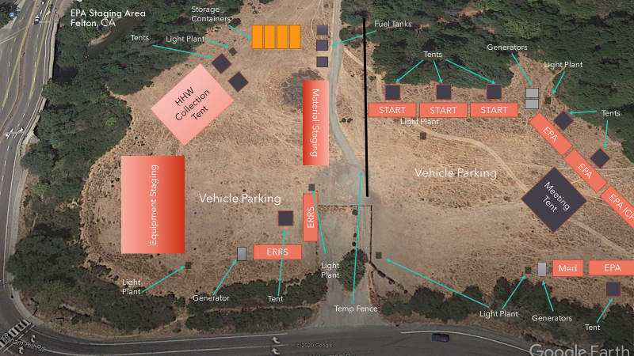
Felton Staging ARea

Slide 8
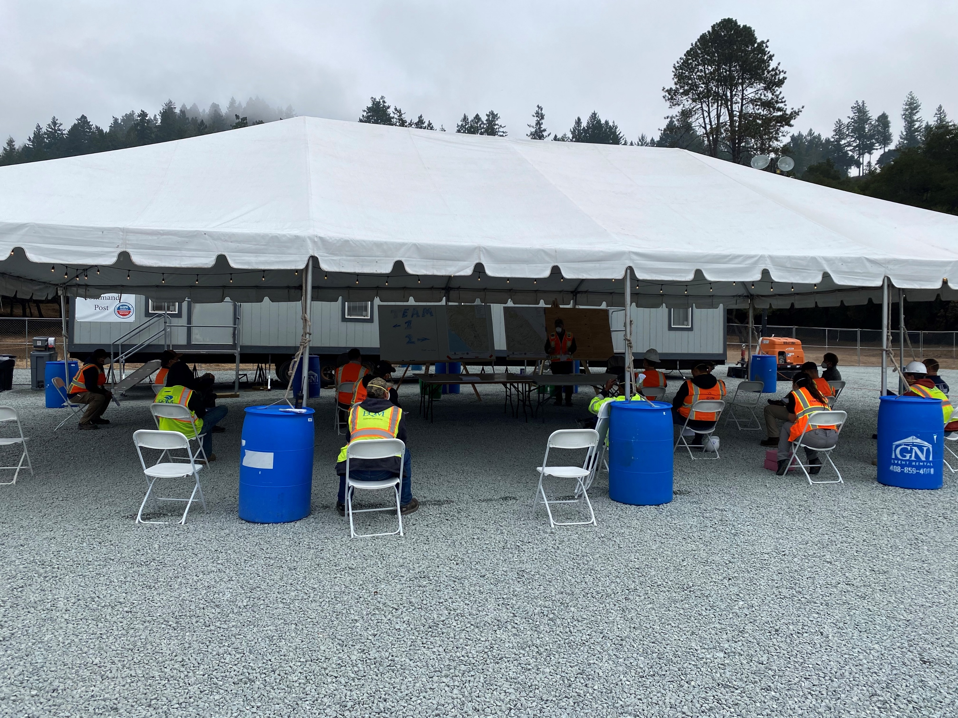
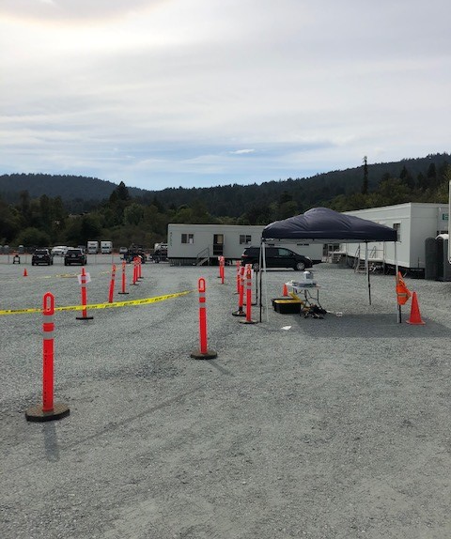
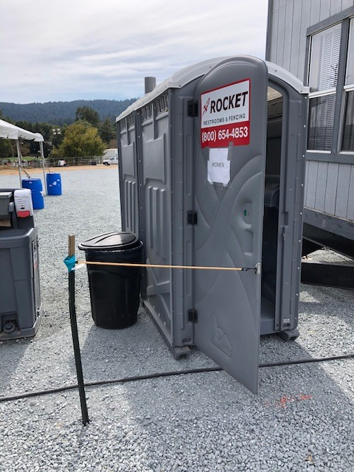
Fig. 1: Porta john doors propped open between uses to increase ventilation.
Fig. 2: Drive through for equipment pick up and drop off.
Fig. 3: Socially distant, first day field briefing at the central staging area.

Slide 9
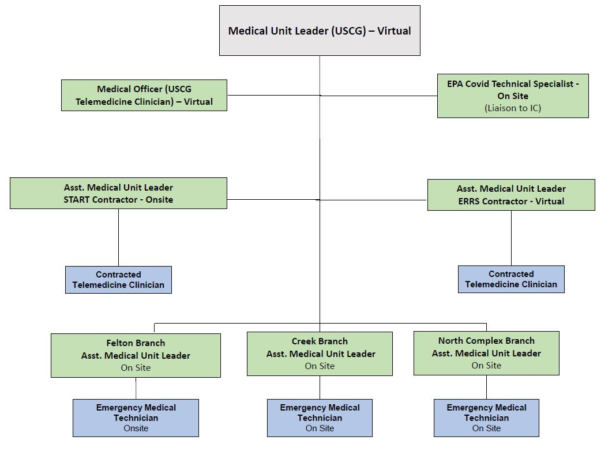
Medical Unit
Notes:
Some of the biggest hurdles were managing confidential information and medical information

Slide 10
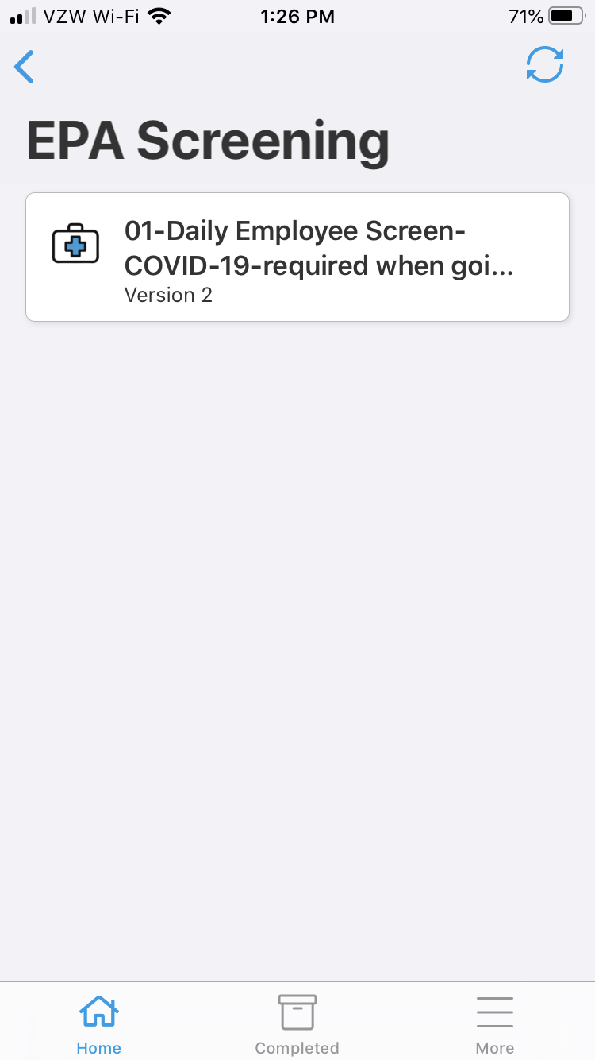
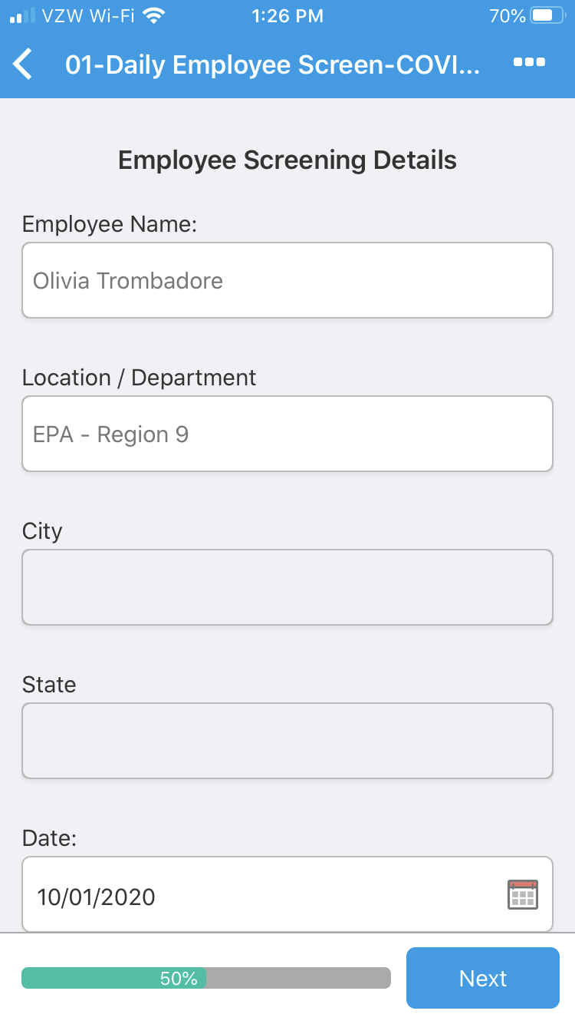
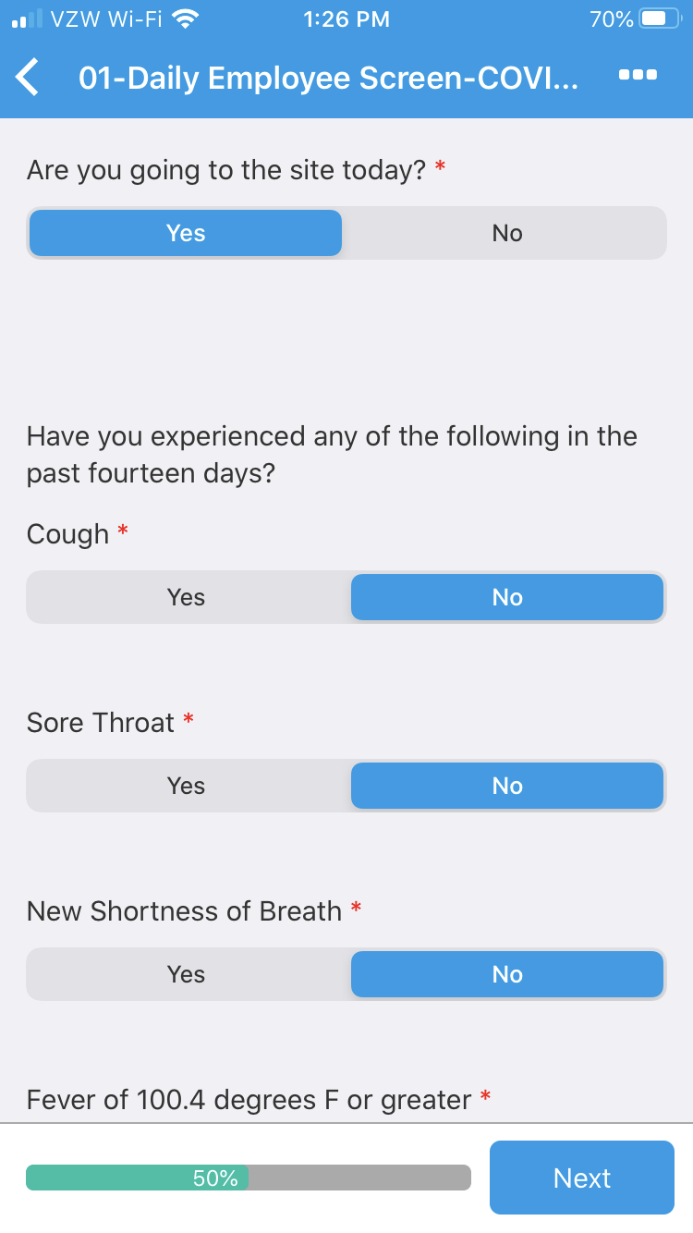

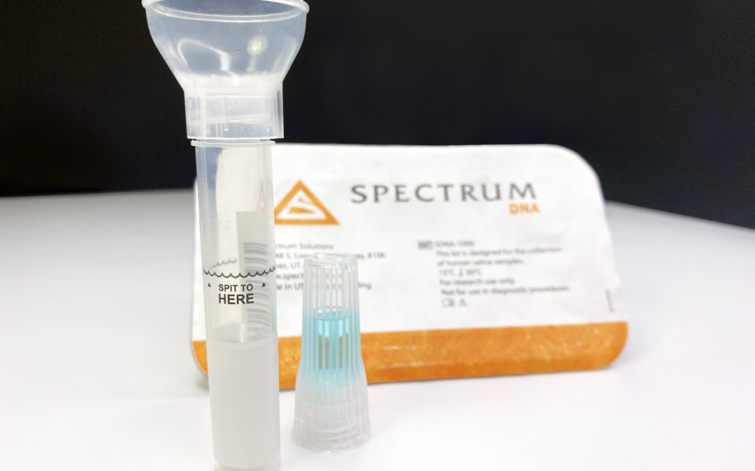
COVID-19
Screening
Qualitative Screening: Symptom Screening
Quantitative Screening: COVID-19 Testing
Pre-deployment
Deployment
Demobilization

Slide 11
Protocol for Individual Displaying Symptoms of COVID-19
Individual is cleared for field work
Individual can return to the field
Screening questionnaire or temperature check are FAILED
Individual is stood down and conducts a telemedicine visit with a doctor through the medical unit.
Individual is not cleared for field work
Individual is tested for COVID-19
Note: CDC defines a fever as 100.4 ⁰F or higher

Slide 12
Protocol for Positive COVID-19 Test
Indeterminate Test Result
Individual is tested again and may continue to work until the second test result is received.
Individual is removed from the response
Medical Unit conducts contact tracing. Close contacts are removed from the field and tested again.
Based on the results of contact tracing, the Medical Unit may send additional individuals/pods for testing as needed.
Single Positive Test Result
Multiple Positive Test results within two weeks
Medical Unit and OPS assess potential for spread among response personnel and need for a safety stand down of operations.
Notes:
*Notes for Positive Protocol COVID-19 Test Flow Chart:
An individual is considered positive for COVID-19 if they have a single positive COVID-19 test.
If an individual receives positive test, they are removed from the response, should seek medical attention as needed, and should work with their supervisors/management to follow their company’s guidance and CDC guidance for handling COVID-19.
If an individual receives a positive test result once they return home, then the Medical Unit will implement contact tracing in the field and send additional individuals/pods for testing as needed.

Slide 13
Results
Response ran from September to December
At peak about 180 field personnel
3000+ tests administered
Positive Cases
  Twelve total cases
  Most cases occurred in the last month when case rates were rising nationally
  Three occurred as part of the demobilization tests in December.
Cases coming from outside the response, not spreading within.
Notes:
-Response ran from September 28-December 12, about 3 months

Slide 14
Questions?
trombadore.olivia@epa.gov
415-243-7750

