Slide 1

U.S. Coast Guard
Sector Honolulu
Oceania Regional Response Team
Virtual Meeting
13 January 2021
Notes:
Note changes in personnel.

Slide 2
Pollution Incident Responses (CY2020)
Sector Honolulu
Notes:
Add chart(s)/verbiage that indicates number of NRC Reports, Actual Discharges/Releases, and Total Gallons/Pounds.

Slide 3
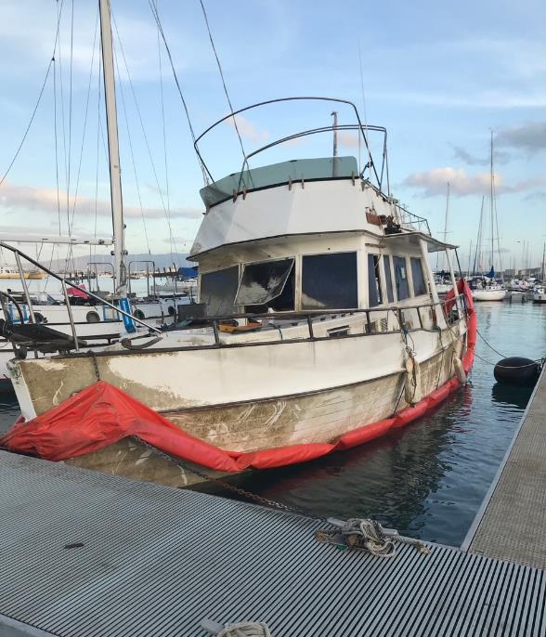
Significant Cases (CY2020)
04Feb20 FV MIDWAY ISLAND, Hilo HI
21Mar20 S/V STEADY BEAT grounding, Waikiki
22Jul20 Hurricane Douglas
23Jul20 Mystery Hydraulic spill American Samoa
08Sep20 P/C TARA sinking in Keehi
28Oct20 Mystery Red Dye Diesel Spill, Honolulu Harbor
19Dec20 OSRV OCEAN INTERVENTION Fire
P/C TARA, 21Sep2020
Notes:
Add chart(s)/verbiage that indicates number of NRC Reports, Actual Discharges/Releases, and Total Gallons/Pounds.

Slide 4
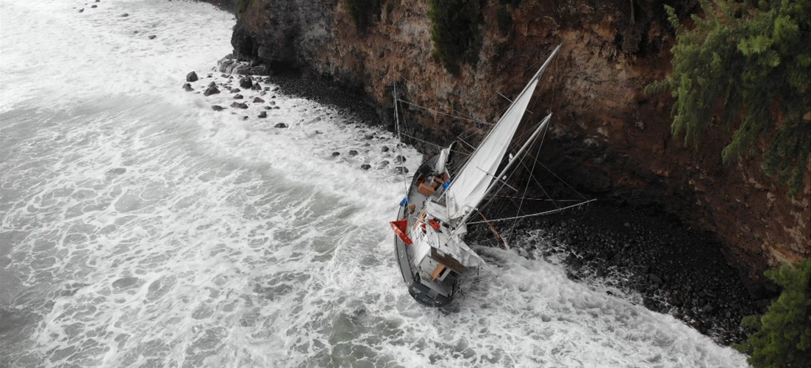
MIDWAY ISLAND, Hilo, Hawai’i
03Feb2020 – 19Mar2020
63’ motor-sailing vessel grounded in vicinity of Ale Ale’a Point, Hilo Bay next to a 120’ cliff
Over 1,352 gallons of diesel/oily waste
Several marine batteries and miscellaneous household hazmat
Notes:
Replicate as necessary to highlight unusual or large cases. Acceptable to re-arrange.

Slide 5
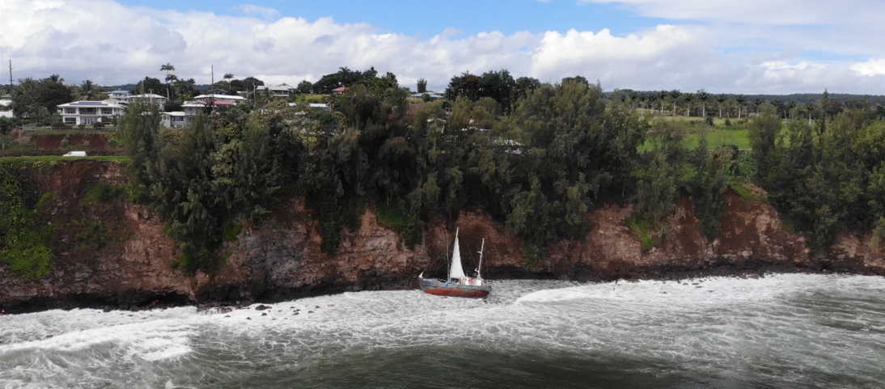
MIDWAY ISLAND, Hilo, Hawai’i

Slide 6
MIDWAY ISLAND, Hilo, Hawai’i
30 gallons of diesel, 5 gallons of lube oil, and 2-5 gallons of hydraulic oil remain on board
FOSC made the decision to stabilize and move the vessel pier side for pollution mitigation
Transfer to state Department of Land and Natural Resources/Division Of Boating and Ocean Recreation
Notes:
Replicate as necessary to highlight unusual or large cases. Acceptable to re-arrange.

Slide 7
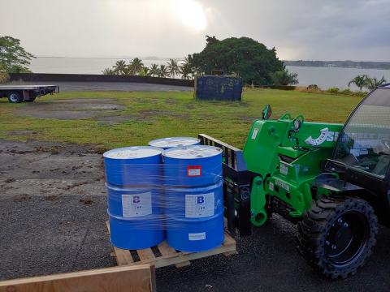
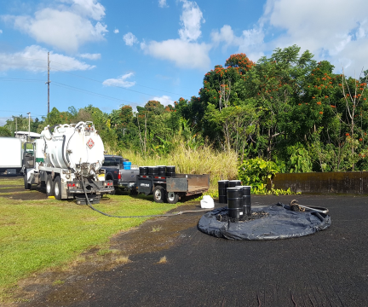
MIDWAY ISLAND, Hilo, Hawai’i

Slide 8
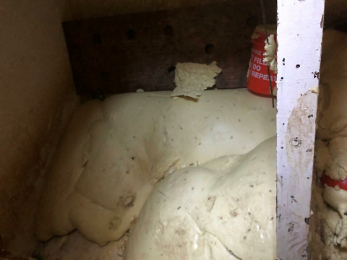
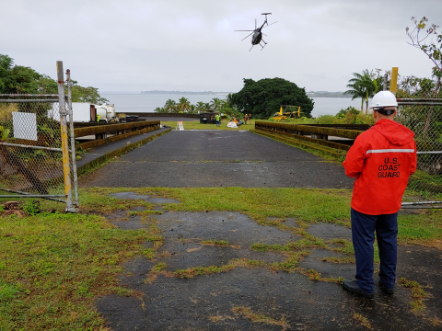
MIDWAY ISLAND, Hilo, Hawai’i

Slide 9
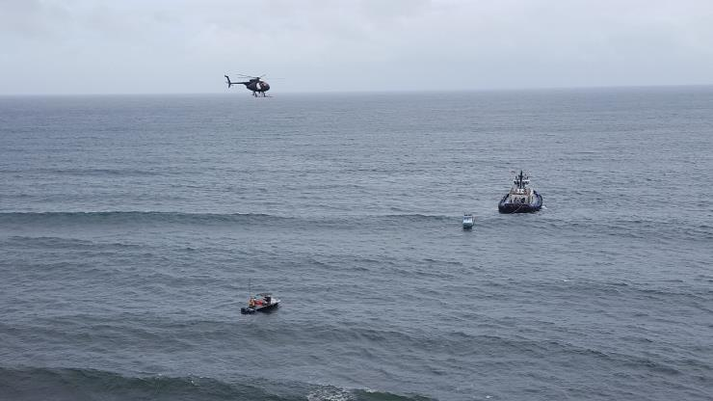
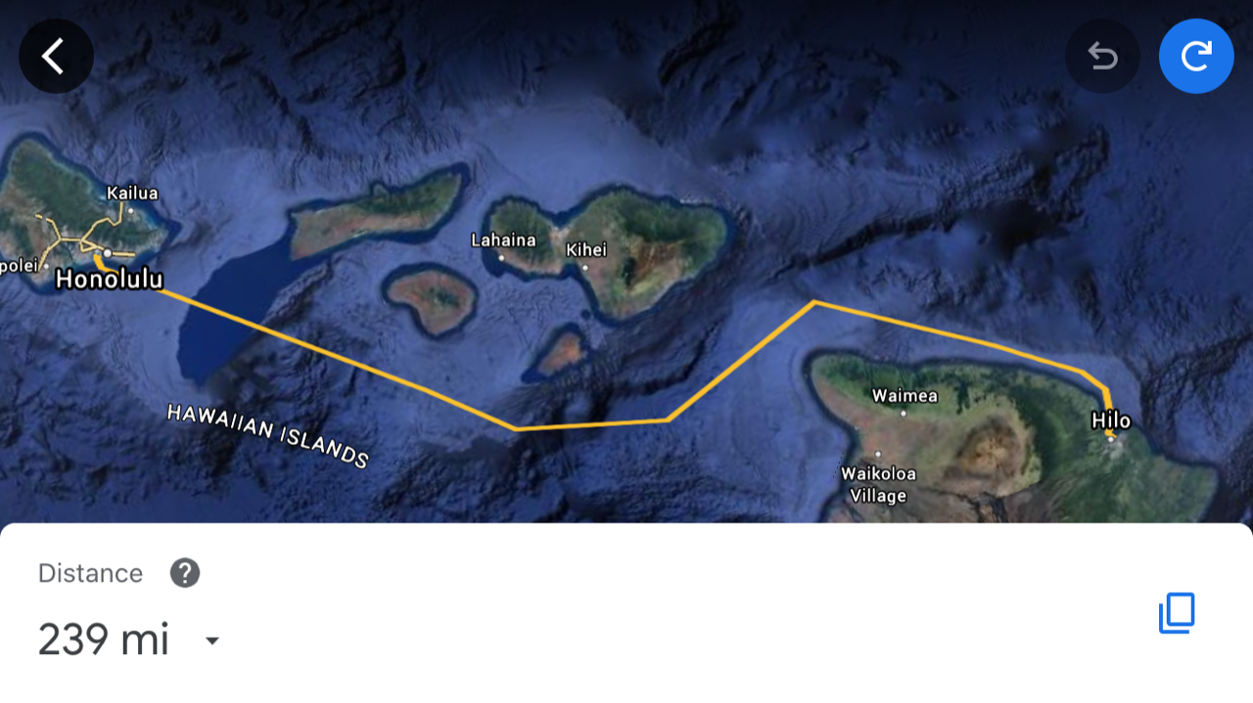
MIDWAY ISLAND, Hilo, Hawai’i

Slide 10
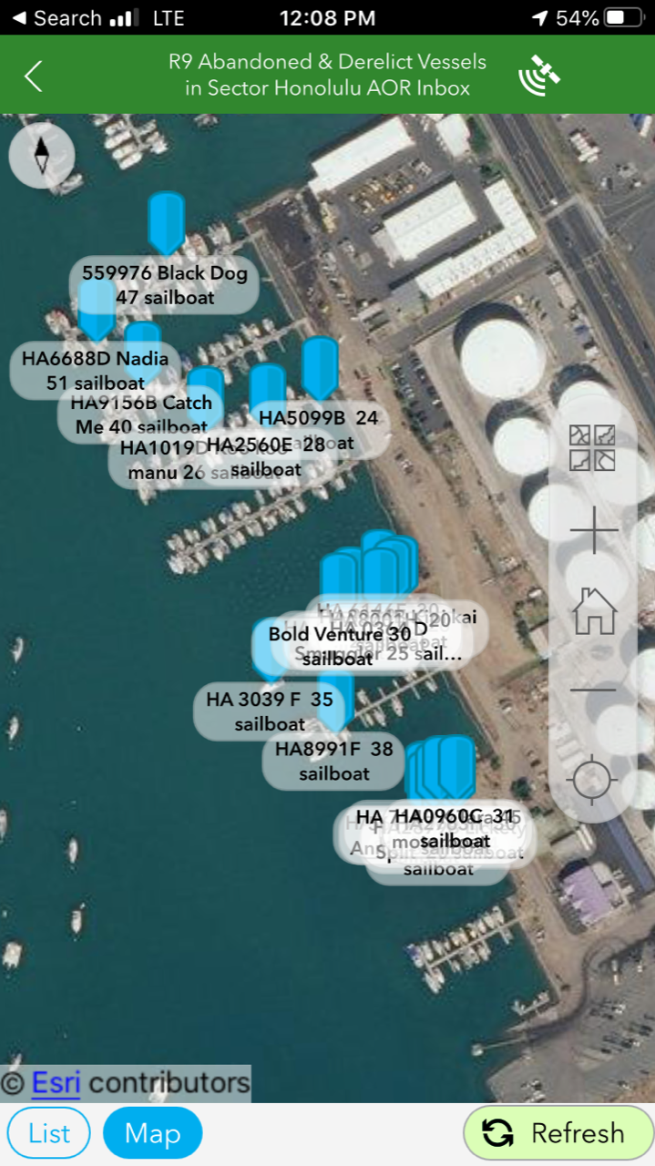
Accomplishments
Built Survey 123 based ADV tracking system in cooperation with EPA, NOAA, and CG AUX; not fully populated due to COVID delays
Successful Wake Island DOD construction project
Renewed of 11 APCs
Dispersant provider increase of services over next several years to nullify need for Alternative in Main Hawaiian Islands.

Slide 11
Training - Exercises - Interagency Engagements
Date | Event | Location
4 Feb 2021 | Area Committee Meeting | virtual
12-16 Jun 2021 | D14 ADDS Drill | Barbers Pt
25-30 Aug 2021 | D14 Response Trailer Drill | Big Island
3-6 Sep 2021 | D14 Response Trailer Drill | Kauai
10-14 Sep 2021 | D14 Response Trailer Drill | Maui
23-27 Sep 2021 | D14 Response Trailer Drill | Honolulu
TBD Nov 2021 | PREP Govt-Led Full Scale Exercise | TBD
Notes:
From last meeting to next.
For upcoming GIUEs, do NOT list the date; note as TBD.
Include local planning and coordination engagements, such as LEPC.

Slide 12

LCDR Jason D Nguyen
Chief, Incident Management Division
808.842.2656
jason.d.nguyen@uscg.mil

Slide 13

U.S. Coast Guard
Sector Guam
Oceania Regional Response Team
Virtual Meeting
13 January 2021
Notes:
Note changes in personnel.

Slide 14
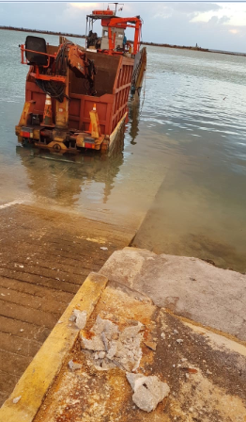
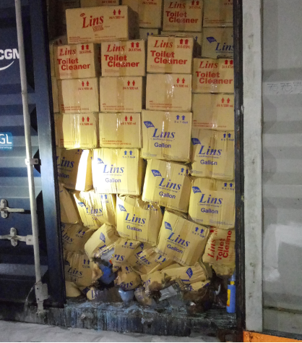
Pollution Incident Responses
Sector Guam
MSD Saipan
38 Cases in Calendar Year 2020
  7 mystery sheens
  Approximately 570 gallons of oil/fuel spilled
  10 cases at PAG Container Yard (no waterway impact)
4 Total Cases
  Two Letters of Warning Issued
Notes:
Add chart(s)/verbiage that indicates number of NRC Reports, Actual Discharges/Releases, and Total Gallons/Pounds.

Slide 15
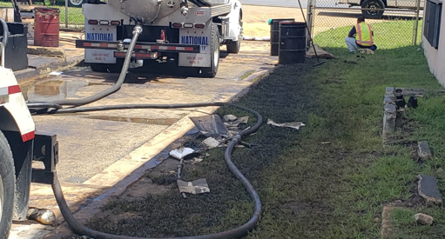
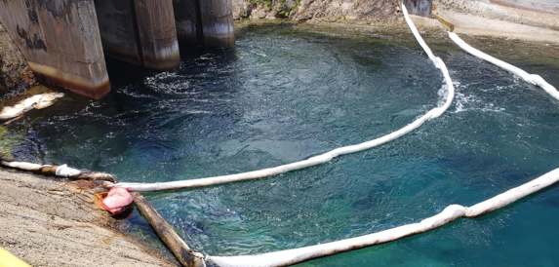
Guam power authority
300 gallons of waste oil
Faulty oily waste separator valve/overflow
Storm drain leaked into water
LOW issued

Slide 16
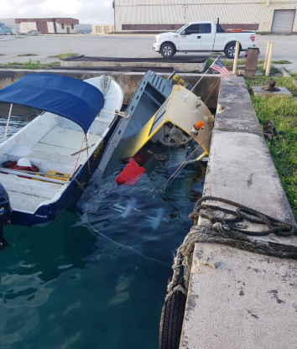
M/V SEA ARK
Discharged sheen of diesel fuel
Sank during heavy rain
Owner SMITHBRIDGE took vessel out of the water
LOW Issued
Notes:
Replicate as necessary to highlight unusual or large cases. Acceptable to re-arrange.

Slide 17
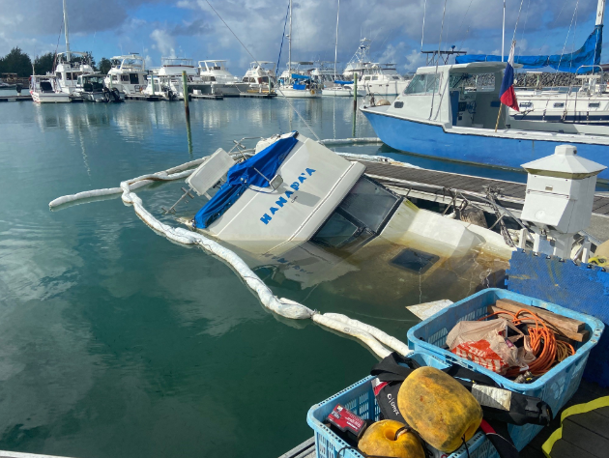
M/V HANAPA’A
Approximately 25 gallons fuel on board
Sank during heavy rain when bilge pump failed to turn on
Admin order issued
Owner attempted to refloat vessel but was unsuccessful
Case federalized
LOW Issued

Slide 18
Training - Exercises - Interagency Engagements
Accomplishments
Outlook
Date | Event | Location
23 JAN 20 | GUIE | Mobil Tinian
20-21 NOV 20 | Navy DLA Oil Spill Training | Virtual/MS Teams
10 NOV 20 | GIUE | Mobil Guam
27 OCT 20 | NOAA Scientific Support Coord. Training | Virtual/NOAA Webex
Date | Event | Location
25-29 JAN 21 | (Mini) MASFO | PAG
15 APR 21 (Planning Mtg 21 JAN 21) | Guam PREP ACP TTX | Guam
26 AUG 21 | CNMI PREP ACP TTX | TBD
TBD | GIUE | TBD
Notes:
From last meeting to next.
For upcoming GIUEs, do NOT list the date; note as TBD.
Include local planning and coordination engagements, such as LEPC.

Slide 19

LTJG Noel Garcia
Incident Management Division Chief
671-355-4903
Noel.L.Garcia@uscg.mil

Slide 20

U.S. Coast Guard
District 14 Response Advisory Team (DRAT)
Oceania Regional Response Team
Virtual Meeting
13 January 2021
Notes:
Note changes in personnel.

Slide 21

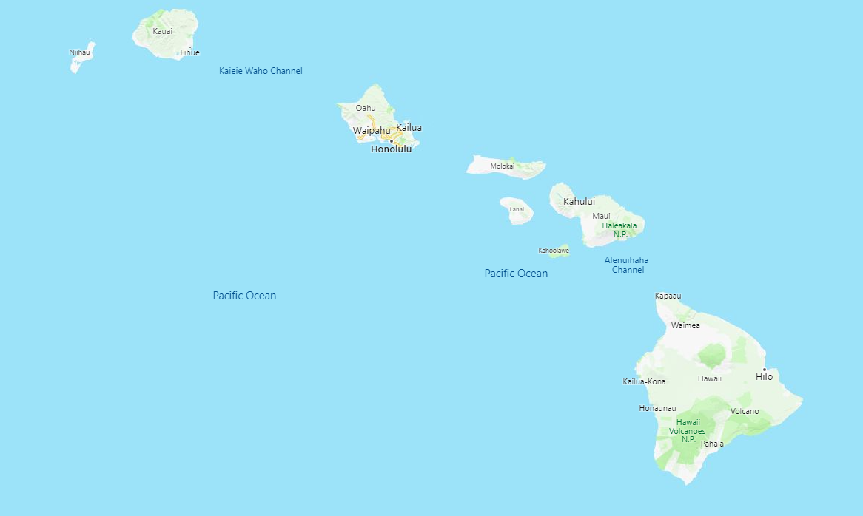
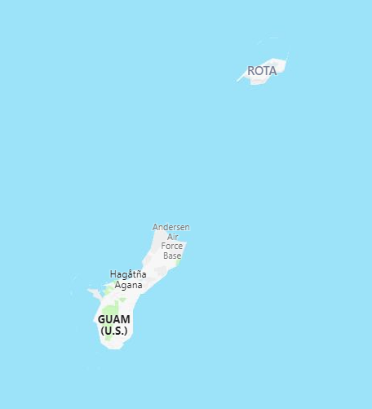
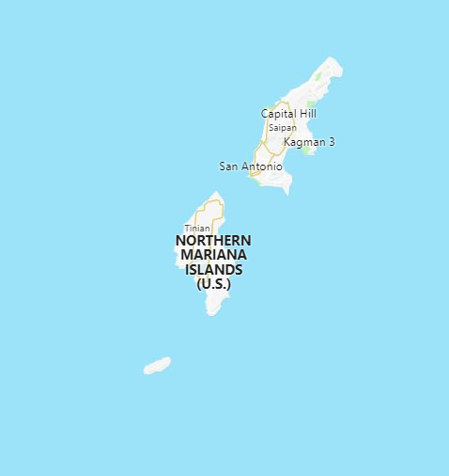

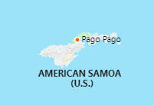
Equipment Laydown & Status
= 07 Response Trailer Locations = 02 VOSS (Guam/AMSAM)
Notes:
Verbally discuss movement of equipment, VOSS/SORS divestiture.

Slide 22
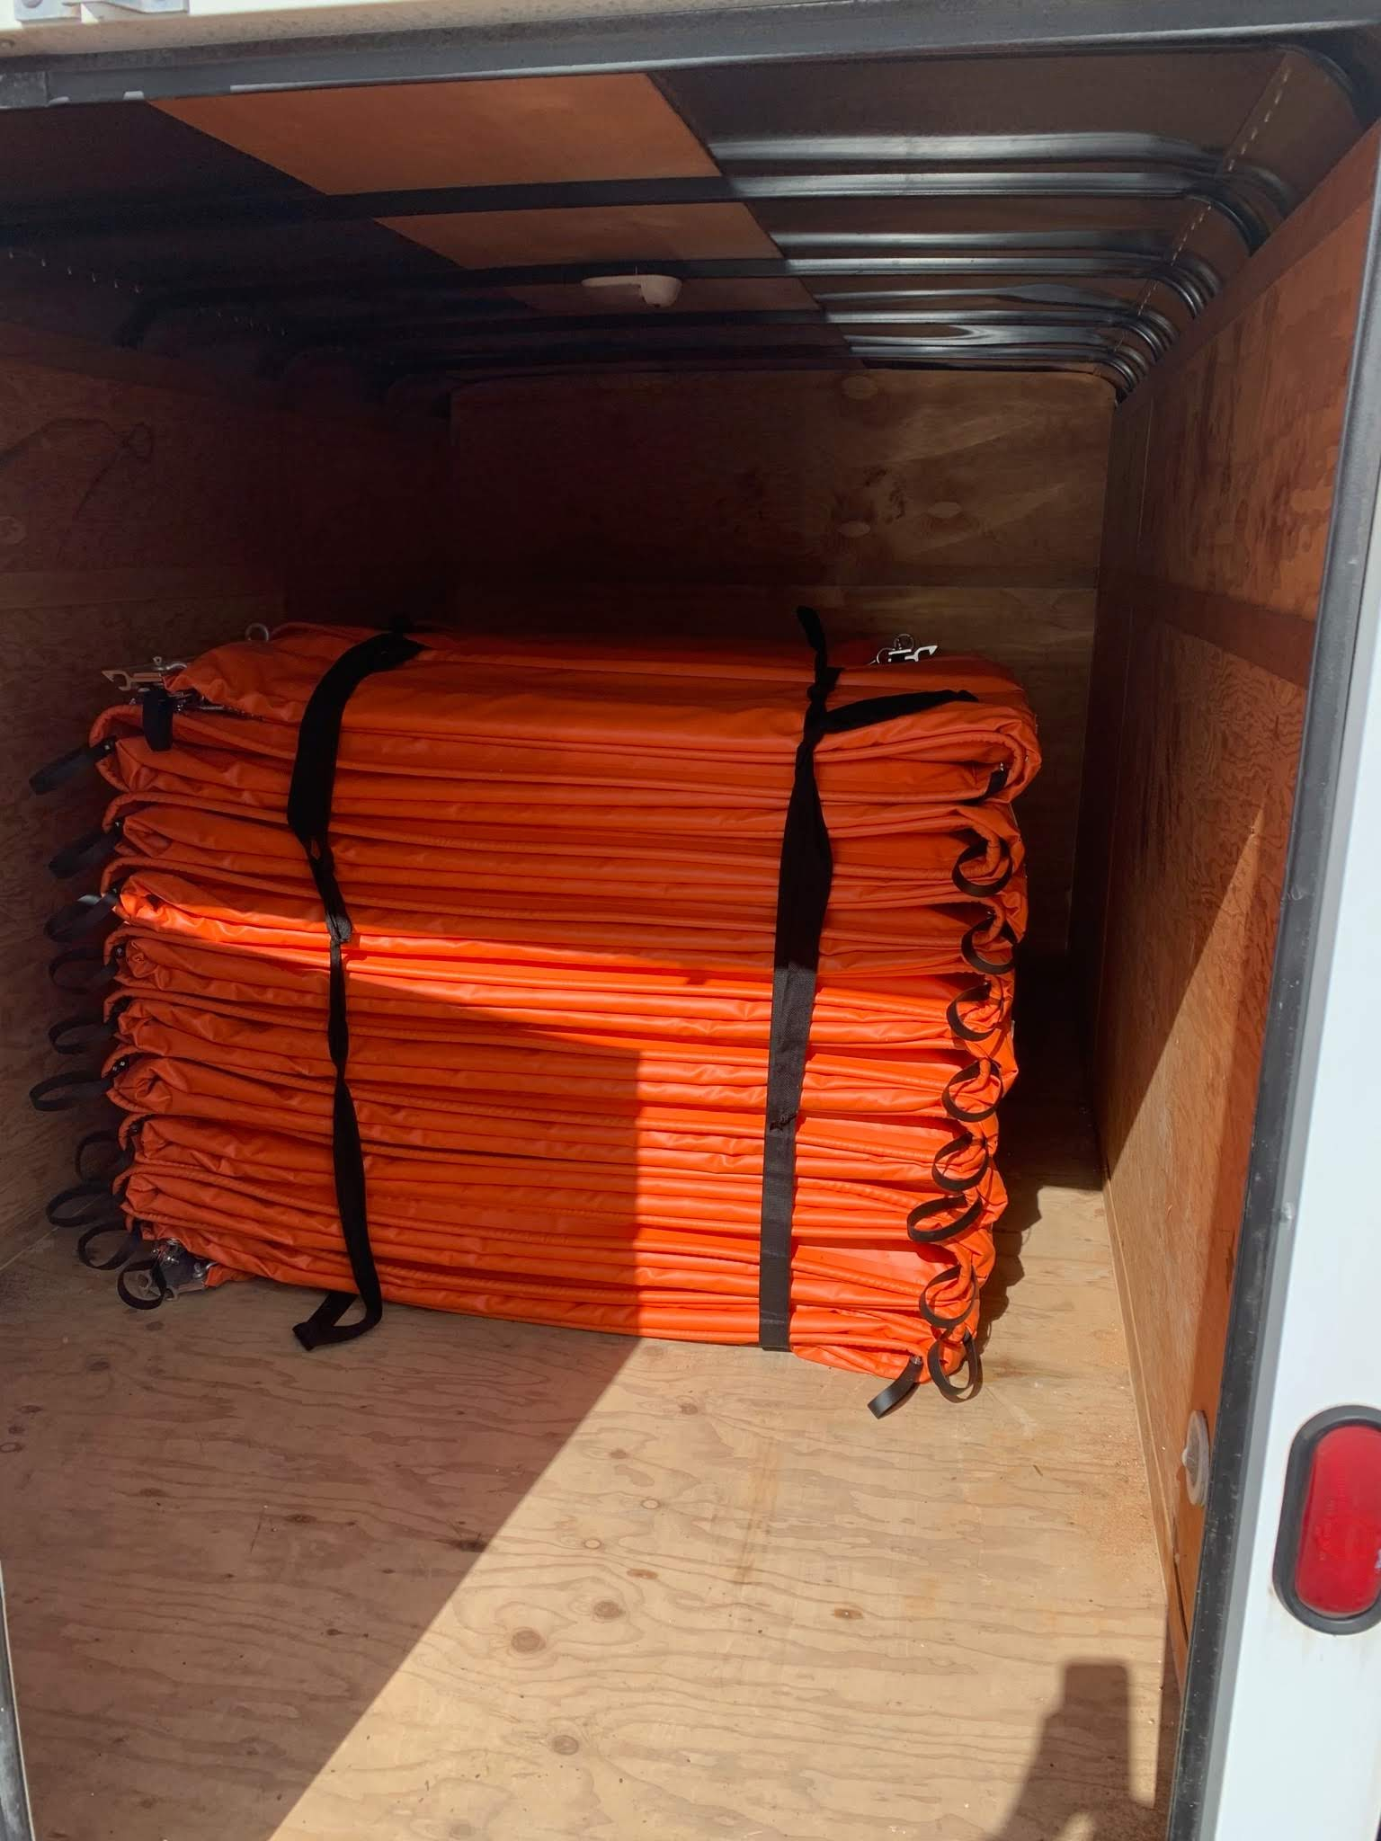
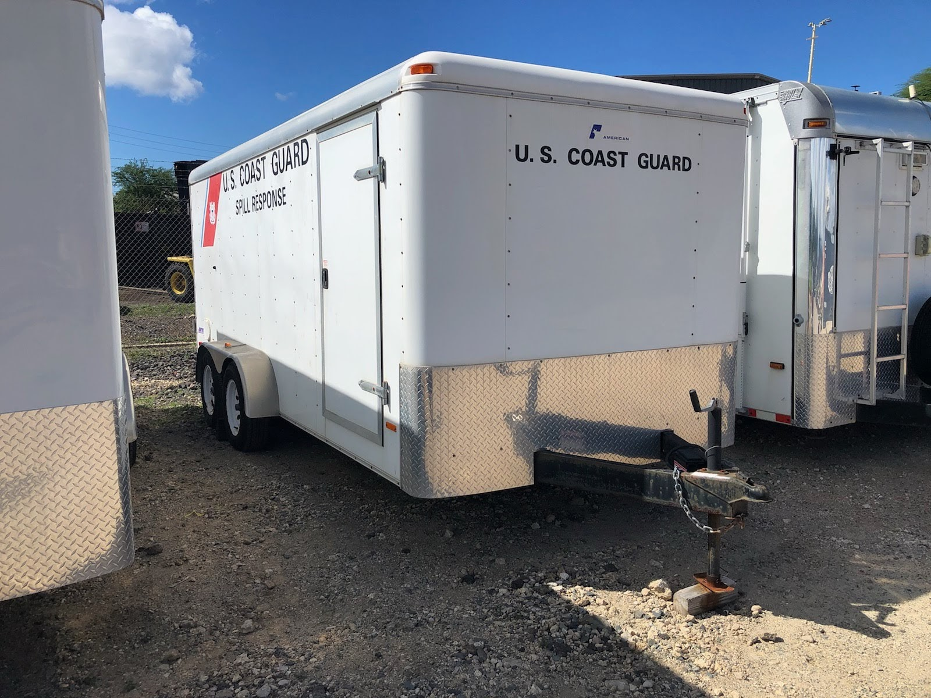
Equipment Laydown & Status
400ft Boom
Sorbent Pads
Anchors
Tool Box
Various PPE

Slide 23
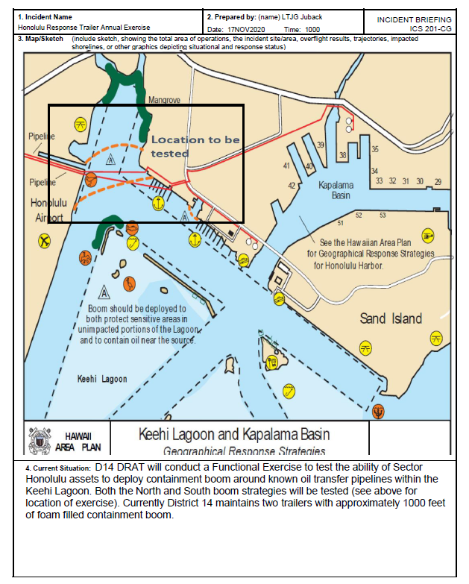
Keehi Lagoon Functional Exercise
Participants: USCG District 14, USCG Sector Honolulu, State of Hawaii DOH Hazard Evaluation and Emergency Response Office
Lessons Learned:
Boom owned by CG only covers 25% of required amount for GRS. GRS will be updated to develop a deflection strategy that can be used initially to reduce impact of pipeline rupture until full strategy can be implemented.
Deployment of strategy is not possible without shallow water craft of line throwing device.
Multiple lessons learned in regards to ESA/EFH consultations, and exercise notification and permit approvals required by State and County; lessons to be added to ACP.
Notes:
Replicate as necessary to highlight unusual or large cases. Acceptable to re-arrange.

Slide 24
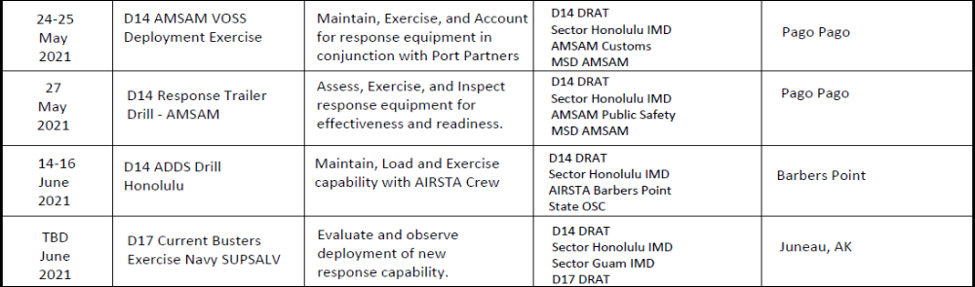
Training - Exercises - Interagency Engagements
Accomplishments
Outlook
Notes:
From last meeting to next.
For upcoming GIUEs, do NOT list the date; note as TBD.
Include local planning and coordination engagements, such as LEPC.

Slide 25
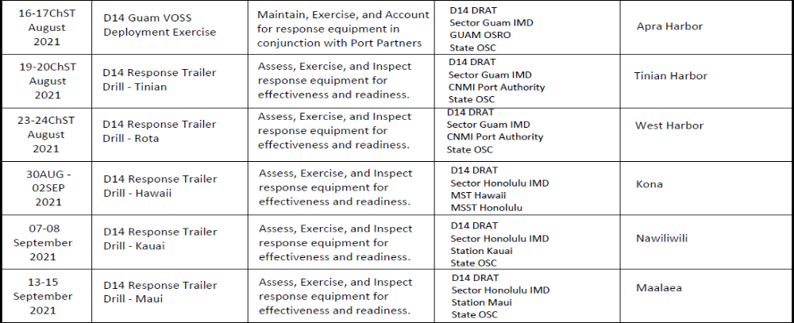
Training - Exercises - Interagency Engagements
Outlook cont.
Notes:
From last meeting to next.
For upcoming GIUEs, do NOT list the date; note as TBD.
Include local planning and coordination engagements, such as LEPC.

Slide 26
LT Eric J. Juback
DRAT Supervisor
808-225-1291
Eric.J.Juback@uscg.mil

