Slide 1

U.S. Coast Guard
Sector Guam
Oceania Regional Response Team
Virtual Meeting
05 May 2021
Notes:
Note changes in personnel.

Slide 2
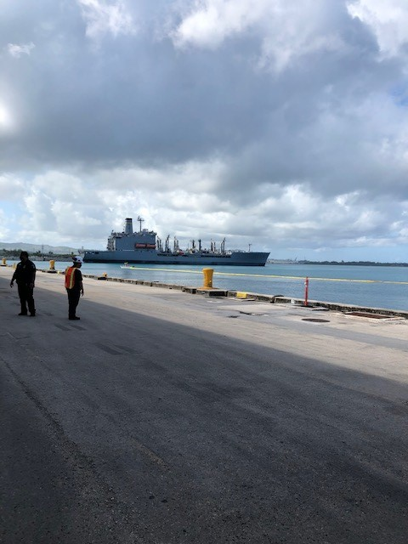
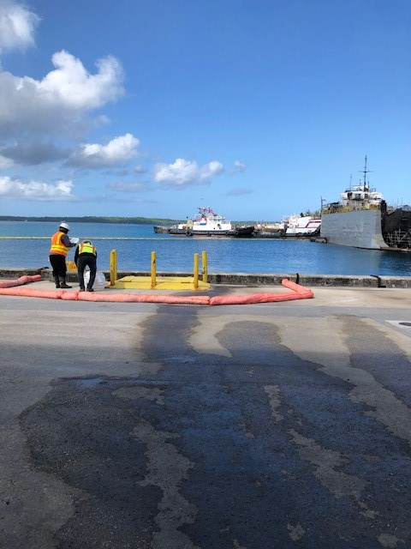
Gov’t Initiated Unannounced Exercise
No major cases
Completion of successful GIUE at IP&E
Validated GRS

Slide 3
Training - Exercises - Interagency Engagements
Accomplishments
Outlook
Date | Event | Location
15 April | ACP TTX | Guam
20 April | GIUE | IP&E
Ongoing | ADVs - Survey 123 | Guam/CNMI
Date | Event | Location
7 May – 11 May | SUPSALV Ex | Honolulu, HI
10 May – 14 May | International Oil Spill Conference | Virtual
July/August | ADV Project | Guam

Slide 4
LTJG Noel Garcia
Incident Management Division Chief
671-355-4903
Noel.L.Garcia@uscg.mil

Slide 5

U.S. Coast Guard
Sector Honolulu
Oceania Regional Response Team
Virtual Meeting
05 May 2021
Notes:
Note changes in personnel.

Slide 6
Training - Exercises - Interagency Engagements
Date | Event | Location
10 Jun 2021 | Area Committee Meeting | virtual
20 Nov 2021 | PREP Govt-Led Full Scale Exercise | TBD
TBD | Govt-Initiated Unannounced Exercises | TBD

Slide 7

LCDR Jason D Nguyen
Chief, Incident Management Division
808.842.2656
jason.d.nguyen@uscg.mil

Slide 8
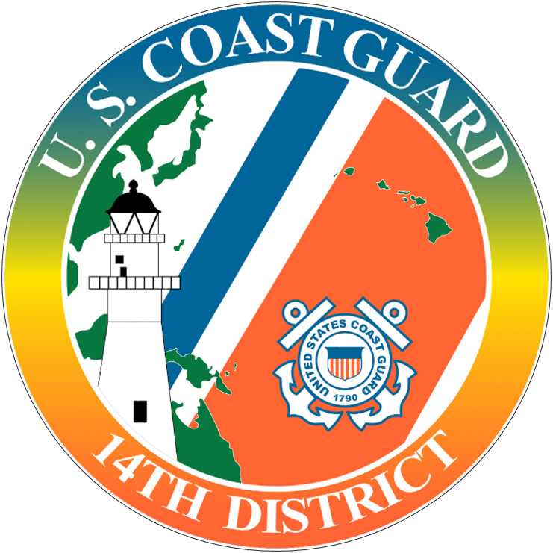
U.S. Coast Guard
District 14 Response Advisory Team (DRAT)
Oceania Regional Response Team
Virtual Meeting
May 2021
Notes:
Note changes in personnel.

Slide 9

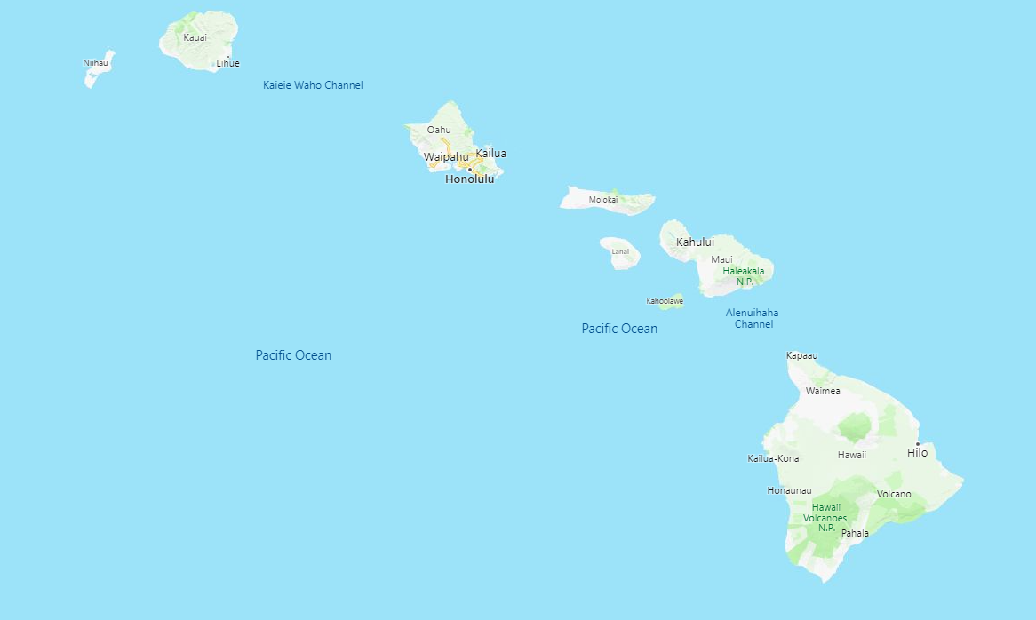
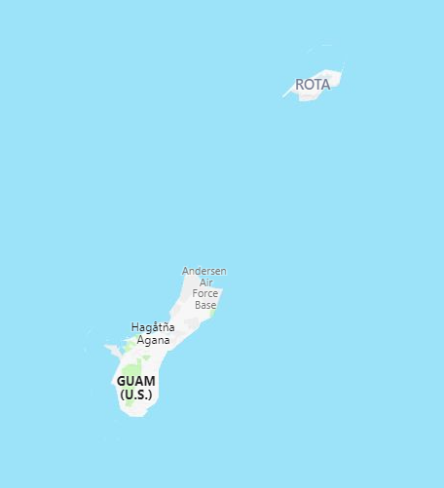
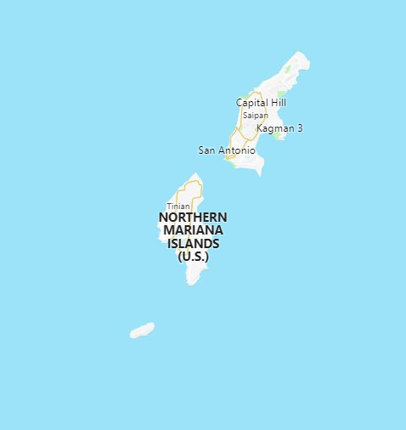

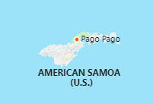
Equipment Laydown & Status
= 07 Response Trailer Locations = 02 VOSS (Guam/AMSAM)
Notes:
Current laydown, VOSS movement still pending should occur in the next month or two / SORS divestiture from USCGC Sequoia.

Slide 10
Training - Exercises - Interagency Engagements
Accomplishments
Notes:
For upcoming GIUEs, do NOT list the date; note as TBD.
Include local planning and coordination engagements, such as LEPC.

Slide 11
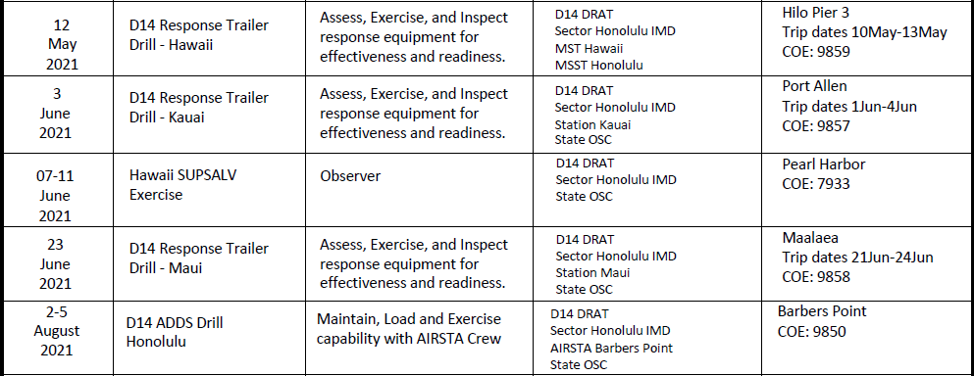
Training - Exercises - Interagency Engagements
Hawaii Exercise Outlook

Slide 12
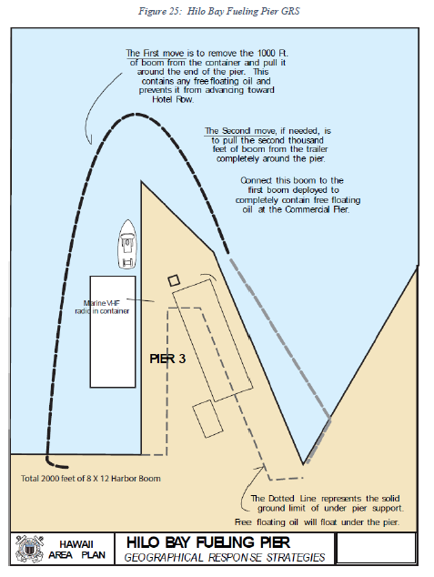
Hilo Fuel Pier Functional Exercise 12MAY21
Participants: USCG District 14, USCG Sector Honolulu, State of Hawaii DOH Hazard Evaluation and Emergency Response Office
Objectives:
Conduct an operational risk assessment and ensure controls are in place to protect responders.
Identify and protect environmentally sensitive areas, including wildlife, habitats, and historic properties.
Test boom deployment capabilities of CG Responders.
Test effectiveness of current strategy.
Evaluate total response time.
Coordinate response efforts in accordance with Federal, State and local partners.
Notes:
Briefly Discuss ESA / EFH efforts

Slide 13
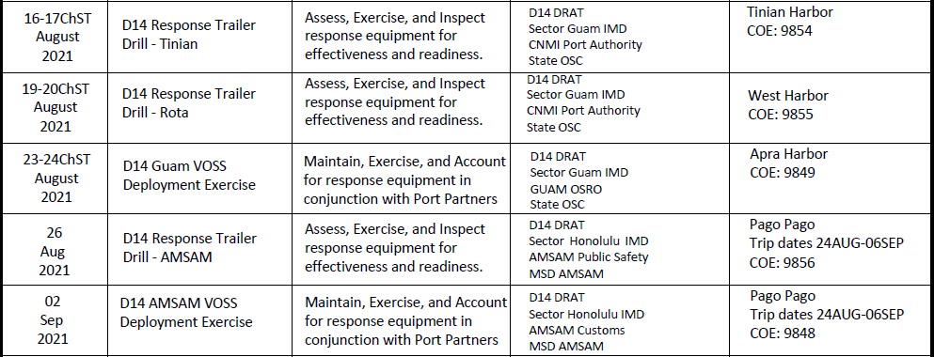
Training - Exercises - Interagency Engagements
Guam / AMSAM Exercise Outlook

Slide 14
LT Eric J. Juback
DRAT Supervisor
808-225-1291
Eric.J.Juback@uscg.mil

