Slide 1
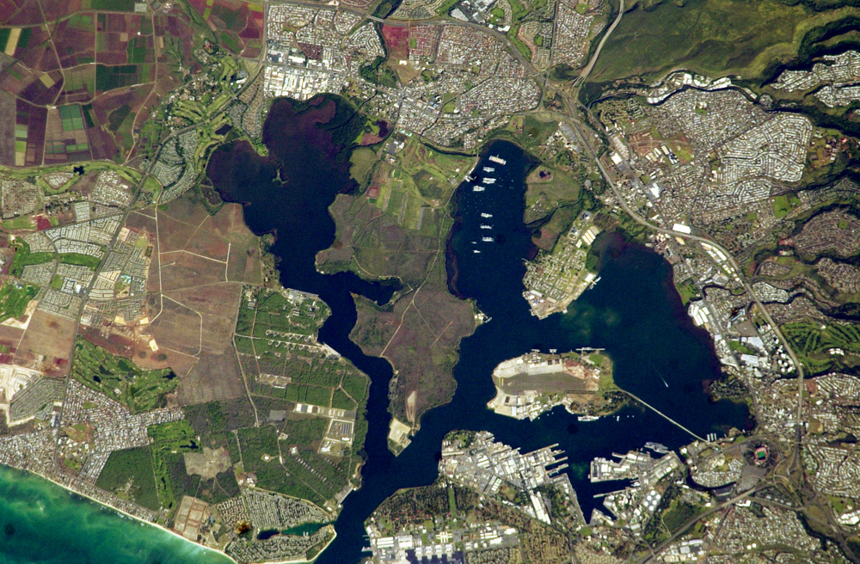
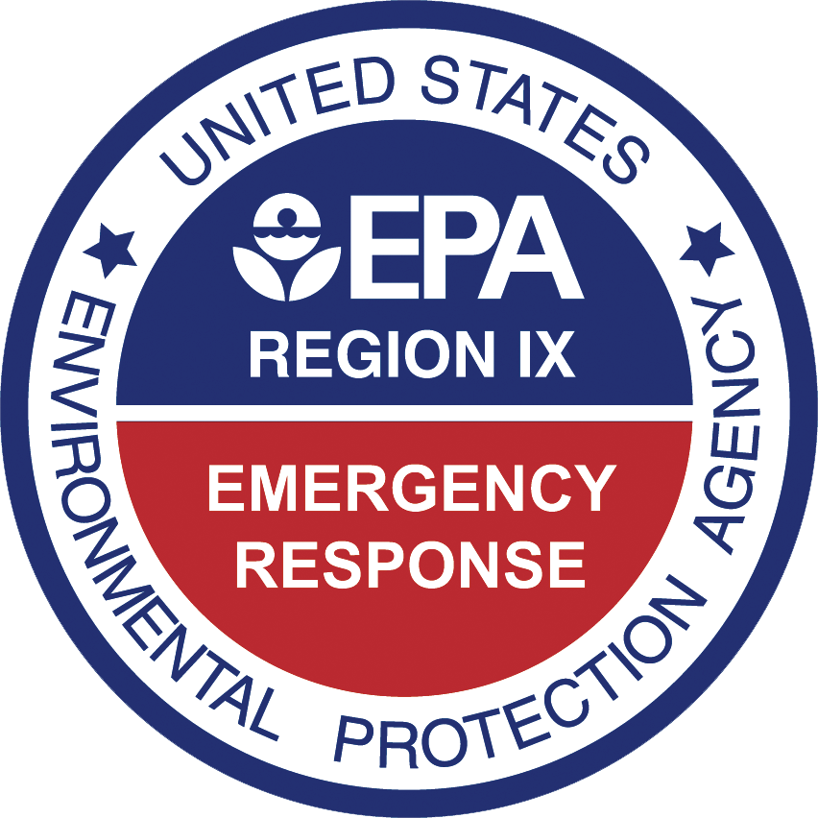
Red Hill Drinking Water Emergency
Joint Base
Pearl Harbor-Hickam

Slide 2
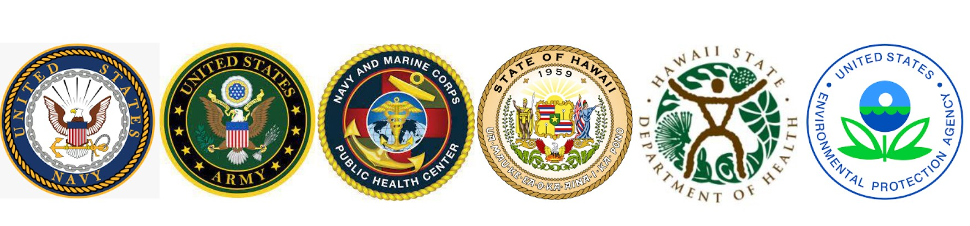
Background
  November 20, 2021 - Release of an unknown quantity of at least several thousand gallons of JP-5 jet fuel in the Adit 3 tunnel of the Red Hill Facility
  November 28, 2021 - First indications that there was a fuel-like odor in drinking water in homes served by the Red Hill Shaft, the well is turned off and the pumps are secured.
  November 29, 2021 – Hawaii Department of Health advises Navy water system consumers not to drink, consume tap water (Drinking Water Advisory)
  December 17, 2021 – Official formation of the Interagency Drinking Water System Team (IDWST)

Slide 3
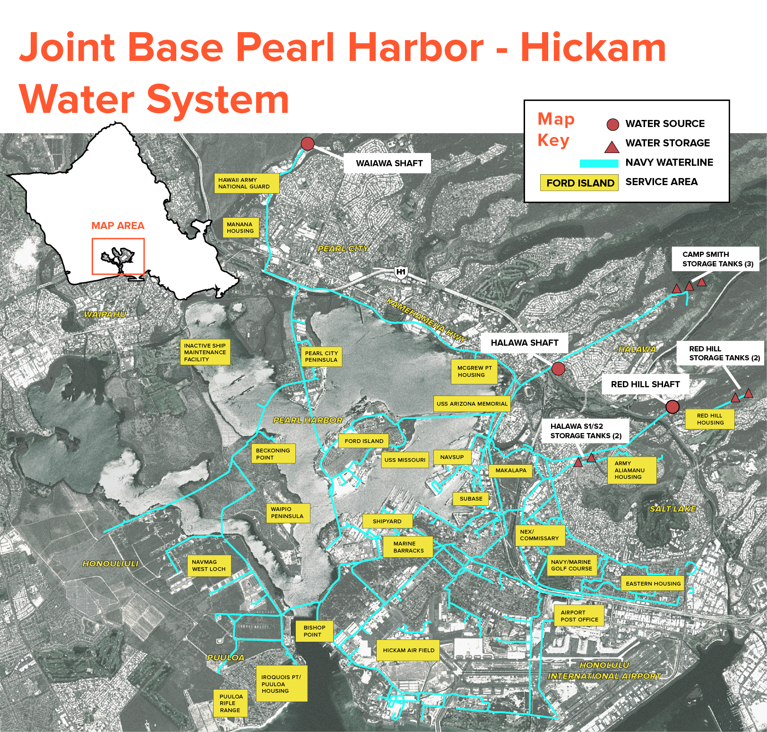

Slide 4
Operational Objectives
Red Hill Shaft
Red Hill Shaft Recovery
Drinking Water System Recovery
Product Skimming and Recovery
GAC System Installation and Operation
Determine Flow Regime at Release Point
Evaluate Pathway/Threat to Nearby Production Wells
Monitor Plume Extraction Progress and Reevaluate
Distribution System Flushing
Residential Structure Flushing
Non-Residential Structure Flushing

Slide 5
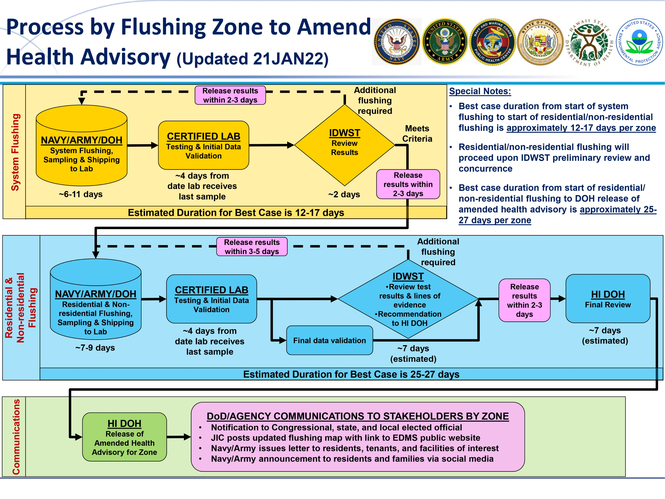

Slide 6
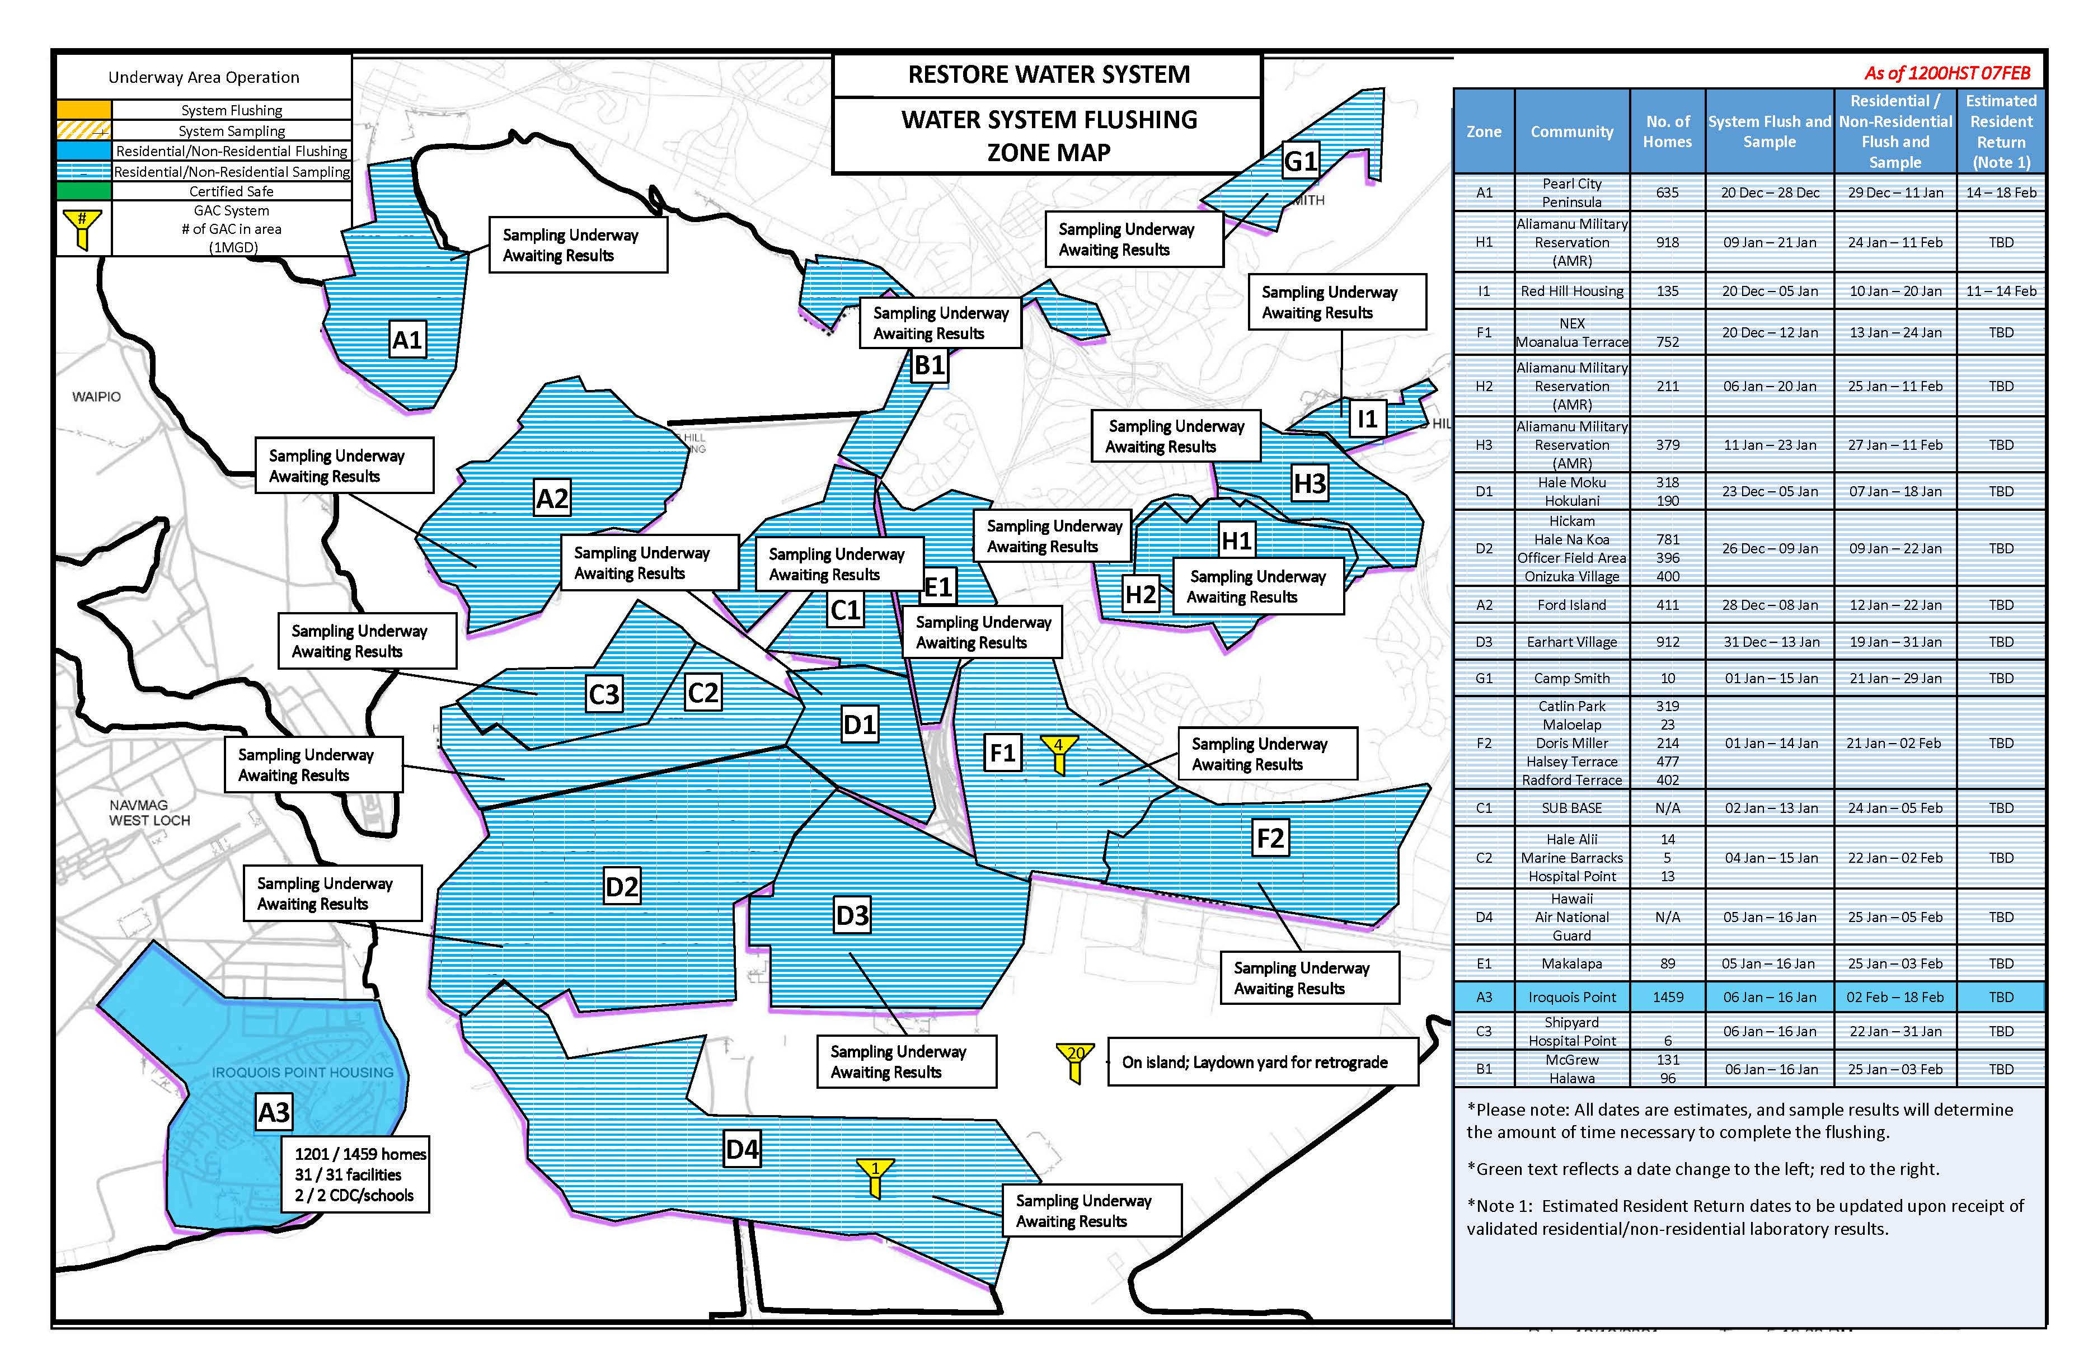

Slide 7
Additional Information
US EPA
  https://www.epa.gov/red-hill/drinking-water-emergency-joint-base-pearl-harbor-hickam-honolulu-hawaii
Navy
  https://www.cpf.navy.mil/JBPHH-Water-Updates/
Facebook (DoD)
  https://www.facebook.com/JBPHH

