Slide 1
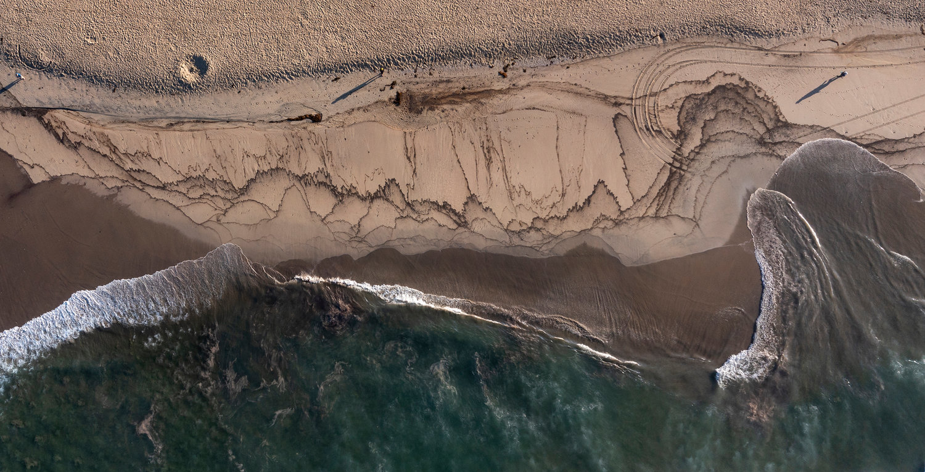


Implementation of the Public Health Assessment Unit in an Oil Response
Example from the Pipeline P00547
2021 Oil Spill Incident
Huntington Beach, California
Ben Castellana, Ph.D.
Public Health Assessment Unit Leader
On-Scene Coordinator
US Environmental Protection Agency
Region 9
Rachel Fabian, Ph.D.
Public Health Assessment Unit Coordinator
Spill Management Team Coordinator
OSPR
California Department of Fish and Wildlife

Slide 2
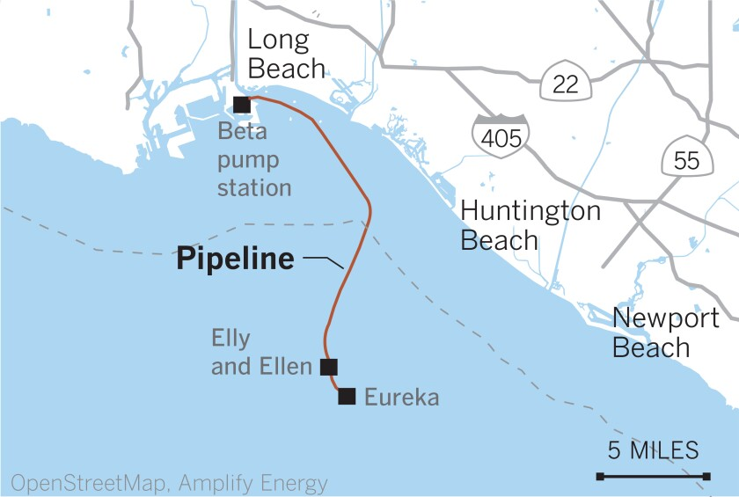
Necessity of PHAU
Spill reported October 2; reported max potential discharge >100,000 gallons

Slide 3
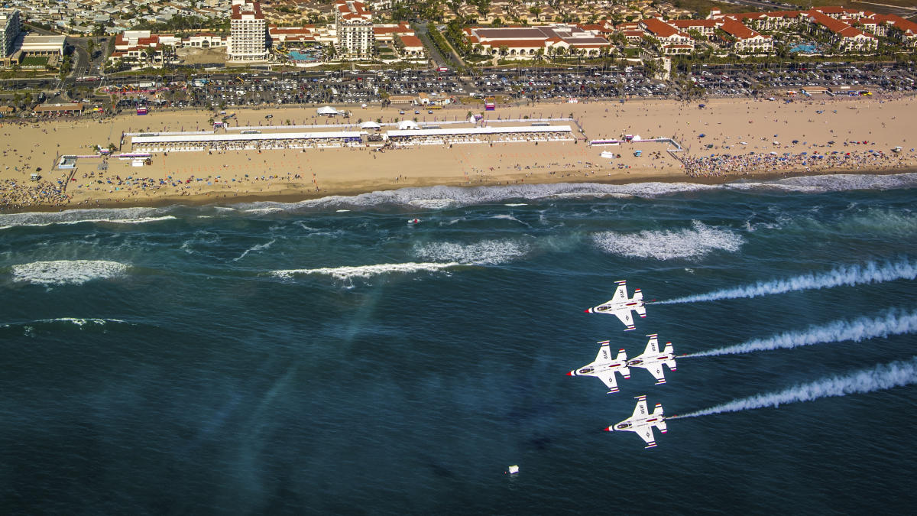
Necessity of PHAU
Spill reported October 2; reported max potential discharge >100,000 gallons
Spill coincided with Great Pacific Airshow.
25,000
^

Slide 4
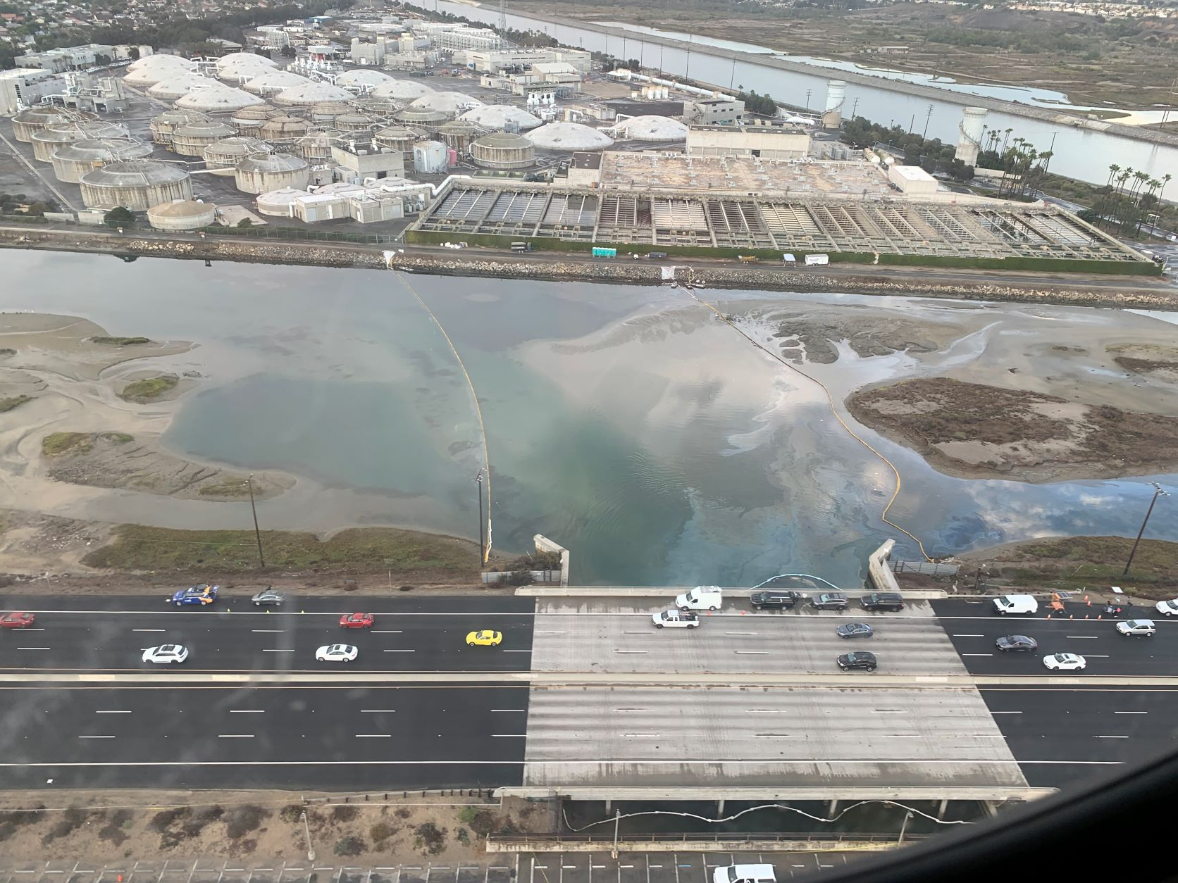
Necessity of PHAU
Spill reported October 2; reported max potential discharge >100,000 gallons
Spill coincided with Great Pacific Airshow.
Orange County Health Officer issued health advisory for residents exposed to oil on 10/3
25,000
^

Slide 5
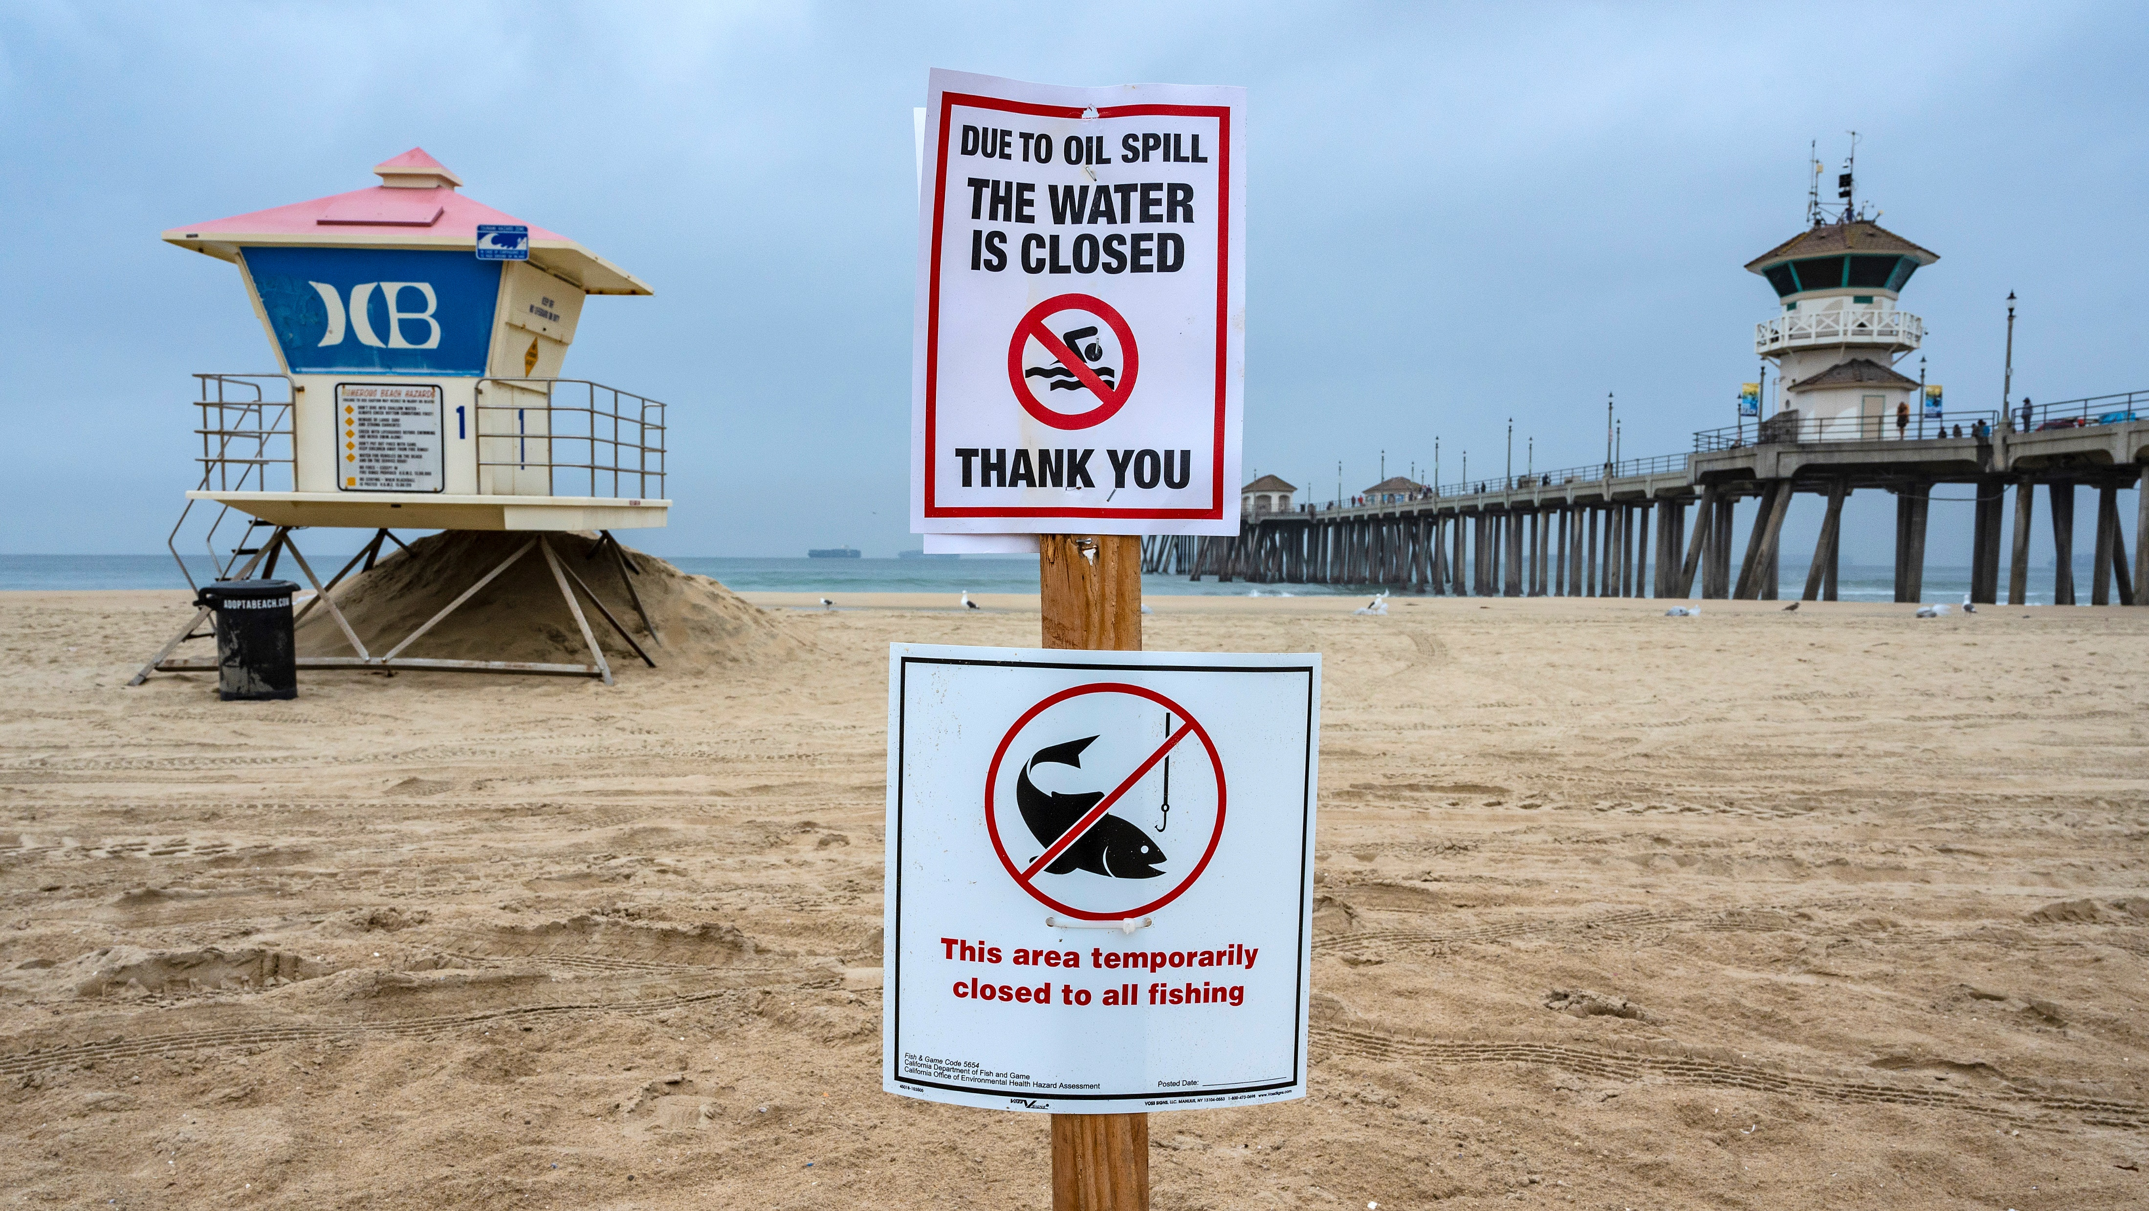
Necessity of PHAU
Municipalities, park districts began closing beaches and harbors on 10/3
CDFW issued a fishery closure on 10/3, expanded on 10/5 and 10/7

Slide 6
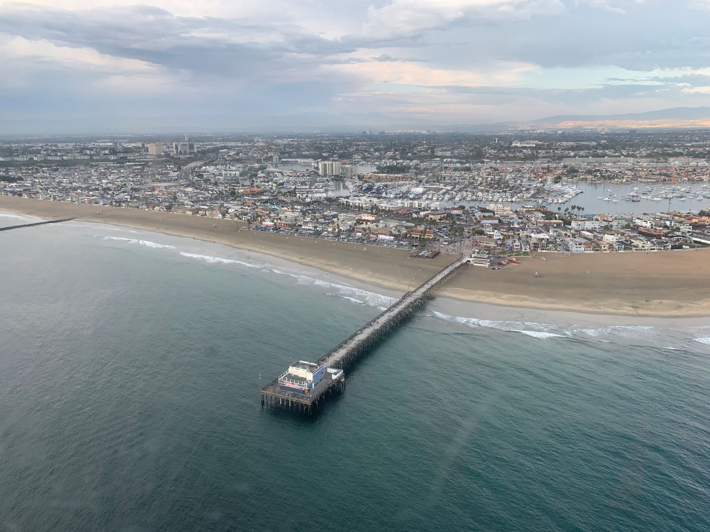
Necessity of PHAU
Intense public and stakeholder interest:
What was being done to assess potential impacts?
How were the response and agencies gathering data to inform health-protective decisions around re-opening?

Slide 7
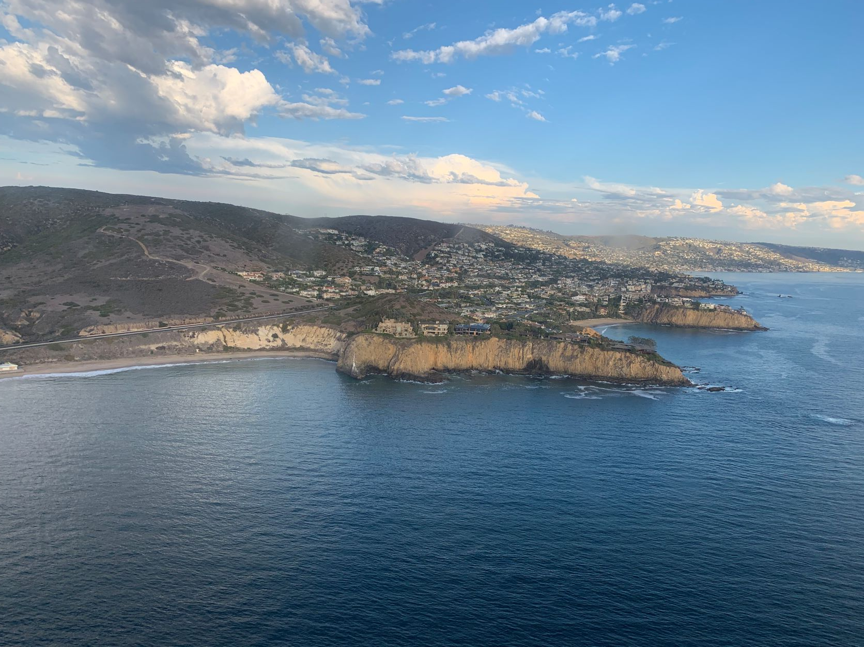
Support for Unified Command Objectives
Ensure the safety of public and response personnel.
Effectively keep elected officials, stakeholders, and public abreast of health and safety info and progress of response efforts.
Maximum support to stakeholder engagement.
PHAU proposed to UC on 10/5 to support these objectives

Slide 8
Pipeline P00547 PHAU Organizational Chart
Planning
Section Chief
PHAU Leader
US EPA
Local Agencies
OC EHD, SD DEHQ, SC AQMD, SD APCD
State/Federal Public Health THSPs
OEHHA, CDPH, RWQCB, OSPR
AIR
Community Air Monitoring Coordinator
South Coast AQMD
WATER/SEDIMENT
Beach and Harbor Re-Opening Coordinator
OC Env. Health Division
SEAFOOD SAFETY
Seafood Safety Coordinator
OSPR, OEHHA

Slide 9
PHAU Function
Planning
Section Chief
PHAU Leader
US EPA
US EPA unit leader provided technical expertise; drafted plans, approved contractor-created plans; etc.
OEHHA and CDPH provided consultation for water/sediment, air results; OEHHA issued statements to inform UC, assist PHAU determinations re: beach exposure risks
OSPR provided unit coordination; served as Seafood Safety subunit coordinator with OEHHA
Local agencies worked directly with contractor (in Safety) for air and water/sediment plans to ensure they would → usable PH data; filled key coordinator roles in Air and Water/Sediment subunits; interpreted data; contributed to reports; etc.
RWQCBs provided input into sampling locations and methods
Local Agencies
OC EHD, SD DEHQ, SC AQMD, SD APCD
State/Federal Public Health stakeholders
OEHHA, CDPH, RWQCB, OSPR
AIR
Community Air Monitoring Coordinator
South Coast AQMD
WATER SEDIMENT
Beach and Harbor Re-Opening Coordinator
OC Env. Health Division
SEAFOOD SAFETY
Seafood Safety Coordinator
OSPR, OEHHA

Slide 10
Air Subunit
SC AQMD served as subunit lead
SC AQMD and SD APCD provided review and input to contractor-led Air Sampling and Analysis Plan for their AORs
Interpreted data, crafted messaging around air monitoring and sampling results
Subunit leader represented PHAU on Liaison agency and elected officials calls
AIR
Community Air Monitoring Coordinator
South Coast AQMD
San Diego APCD

Slide 11
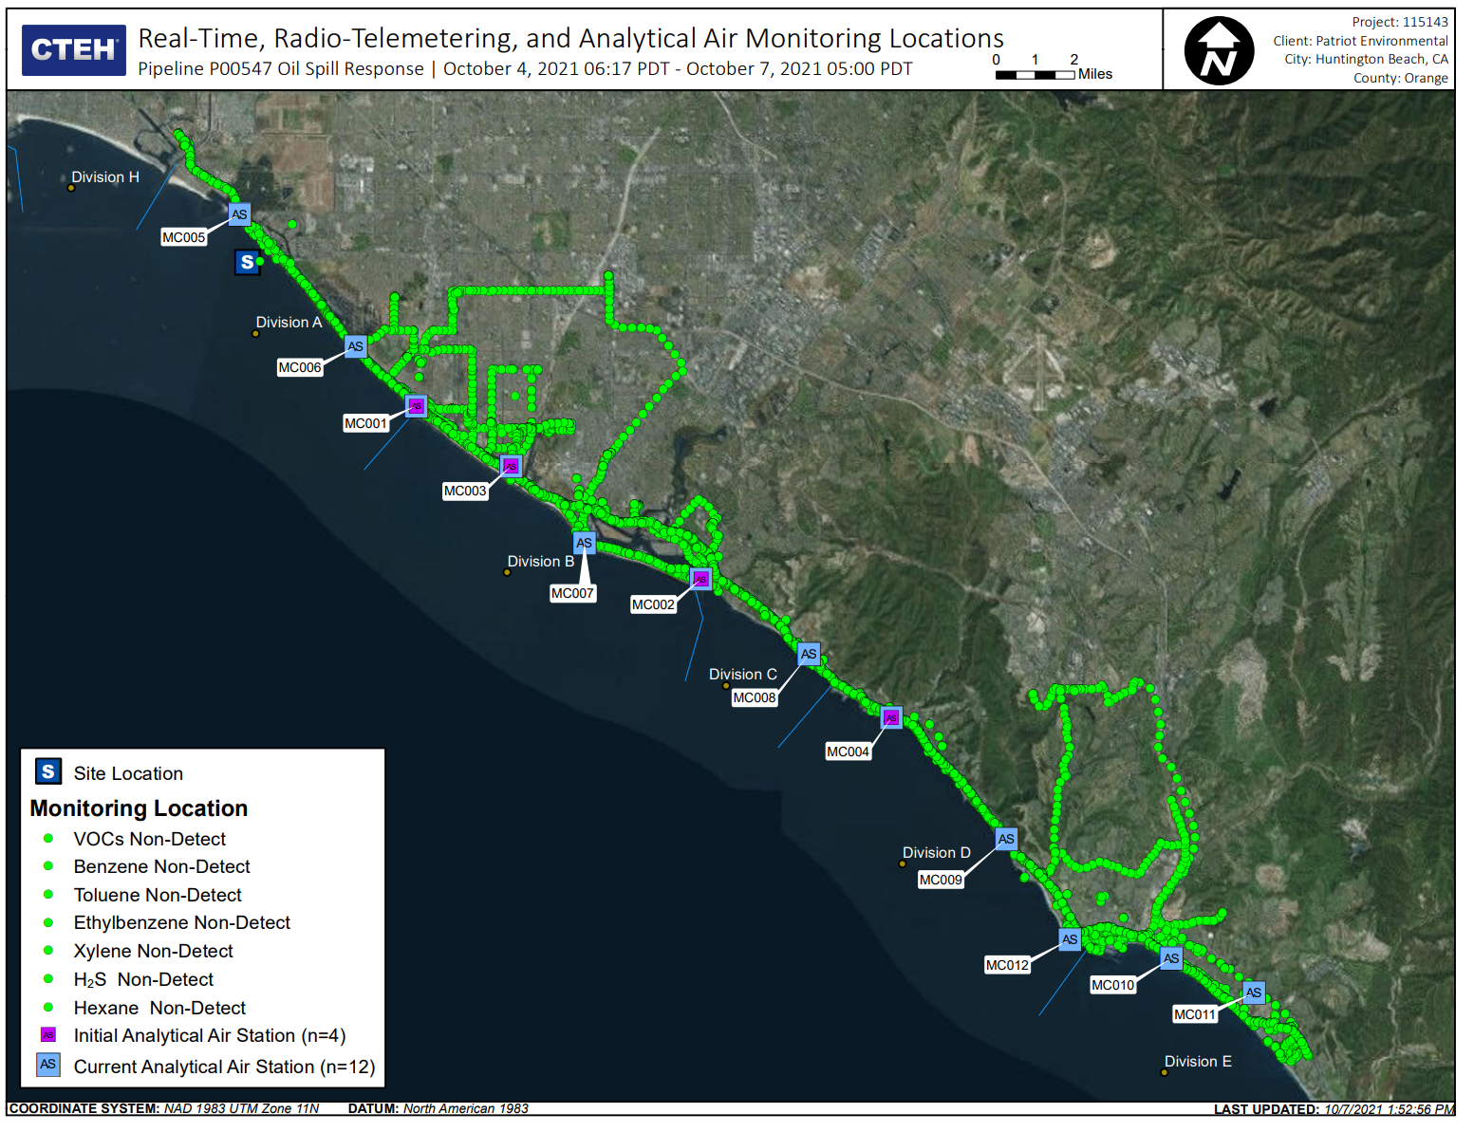
Air Subunit
> 80 air samples from 12 locations in Orange County analyzed
5 air samples from 4 locations in San Diego County analyzed
Roaming air measurement surveys along coast in both counties

Slide 12

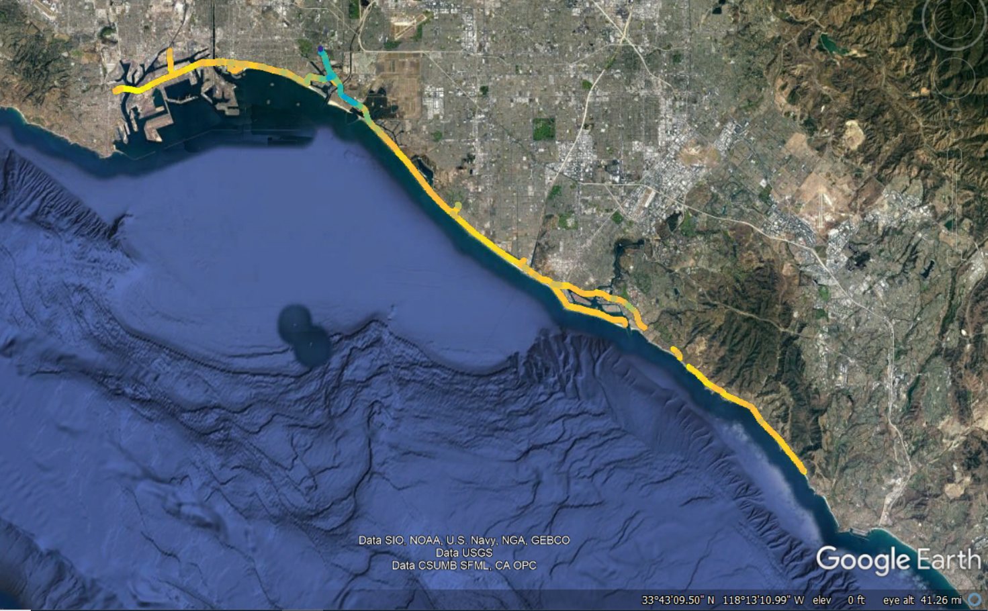
South Coast AQMD Mobile Monitoring (FluxSense)
Measurements done along the shoreline from Long Beach to Dana Point
  Mobile platform with multiple monitors showing a snapshot of air pollutant levels
  Survey for VOCs and specific gaseous air toxics (BTEX)
Mostly typical levels of air pollutants observed
  Some elevated levels of pollutants, including benzene, were observed near the Alamitos Bay Marina, but likely not related to the oil spill

Slide 13
Water/Sediment Subunit
WATER/SEDIMENT
Beach & Harbor Re-opening Coordinator
OC Env. Health Division
SD Dept. of Env. Health & Quality
RWQCB (Santa Ana, SD)
OEHHA
OC EHD served as subunit lead
OC EHD, SD DEHQ, RWQCBs provided review and input to contractor-led Environmental Sampling and Analysis Plan for their AORs
OEHHA toxicologists reviewed proposed SLs & data, provided statements for UC
Subunit leader represented PHAU on Liaison agency and elected officials calls

Slide 14
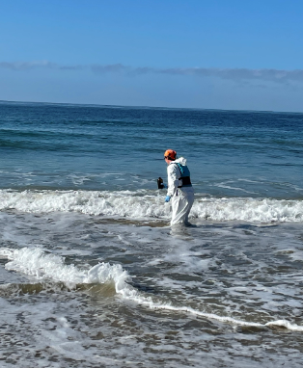
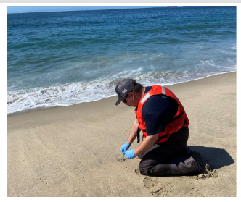
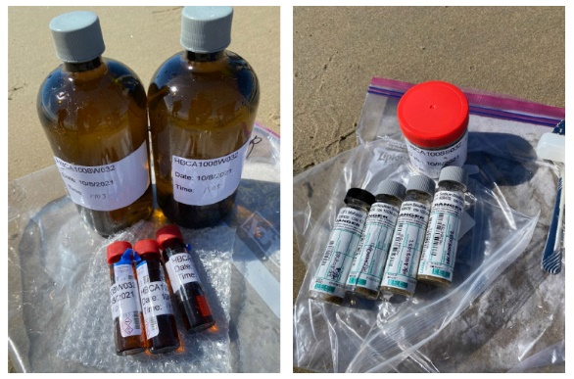
Water/Sediment Subunit
Water and sediment sampled at 54 sites in Orange County from 10/8 to 10/10
44 sites in San Diego County from 10/10 to 10/12
Photos courtesy of CTEH, LLC

Slide 15
Seafood Safety Subunit
OSPR was subunit lead in coordination with OEHHA
Drafted Seafood Safety Sampling and Analysis plans for nearshore and offshore species
Established protocols were developed by OEHHA
Seafood Safety typically coordinated through EU, subunit moved to EU after PHAU demobilized
SEAFOOD SAFETY
Seafood Sampling Coordinator
OSPR
OEHHA

Slide 16
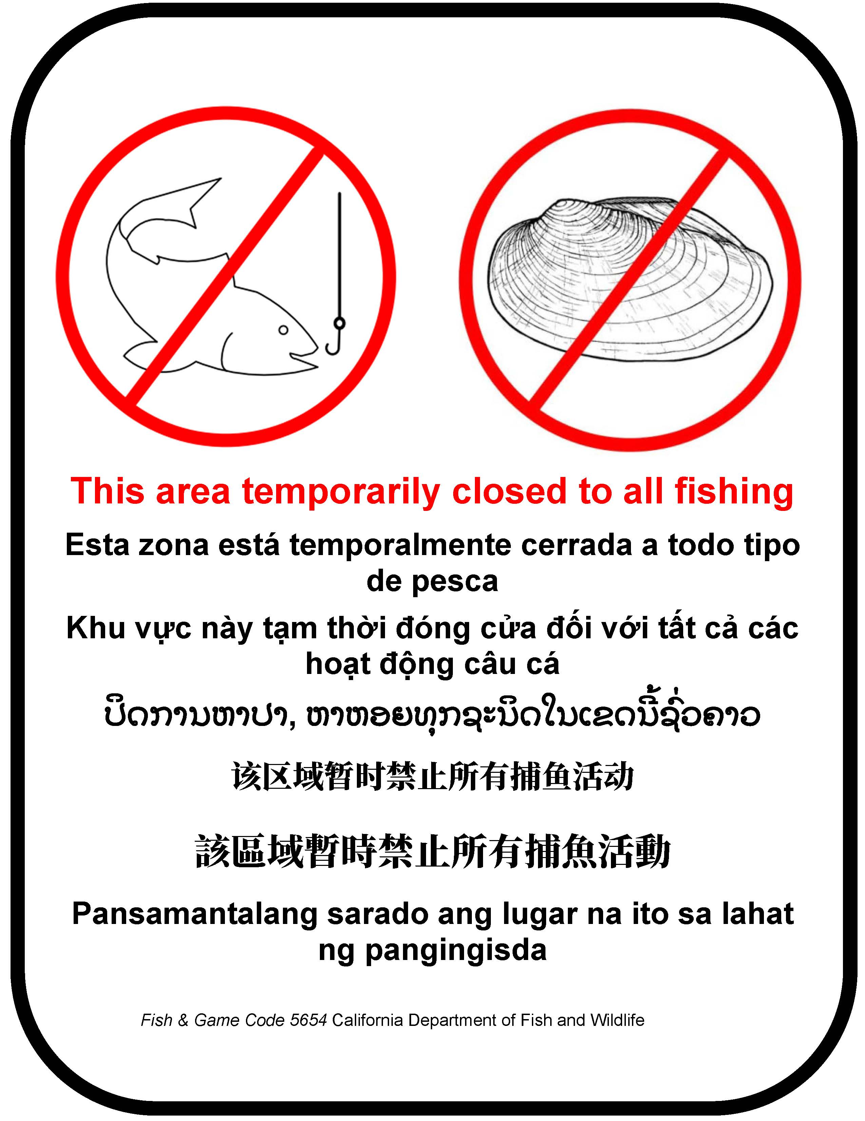
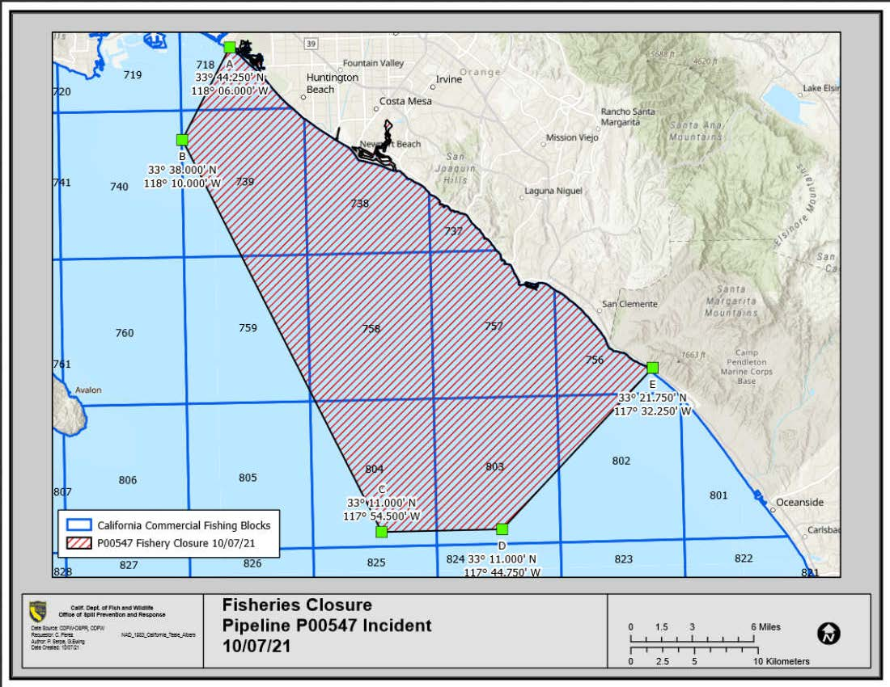
Seafood Safety Subunit

Slide 17
PHAU Deliverables
Produced plans: Emergency Water and Sediment Sampling and Analysis Plan, Source Sampling Plan, Onshore Seafood Safety Sampling and Analysis Plan, PHAU Data Use Plan, PHAU Virtual Transition and Demobilization Plan
Approved contractor-led plans for air monitoring and sampling; environmental sampling and analysis
Data summaries and reports internal to response
PHAU final reports on sampling distributed through Liaison

Slide 18
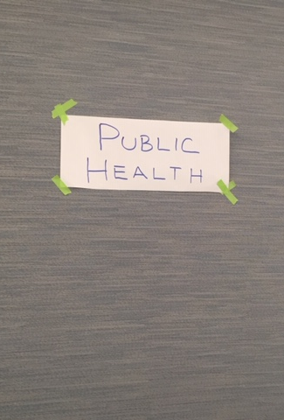
Key Takeaways
Integrated local agencies into the response; input to sampling plans so data were meaningful to public health decisions and advisories
Coordination of plans, data interpretation, and messaging supported UC objectives; provided basis for Orange County Health Officer to issue advice that beaches were safe for recreational use
Participation of health agencies in Liaison calls with agencies, elected officials, and NGOs provided transparency and assurance that appropriate agencies were overseeing sampling efforts to inform public health questions
Effectiveness of PHAU maximized if implemented earlier

Slide 19
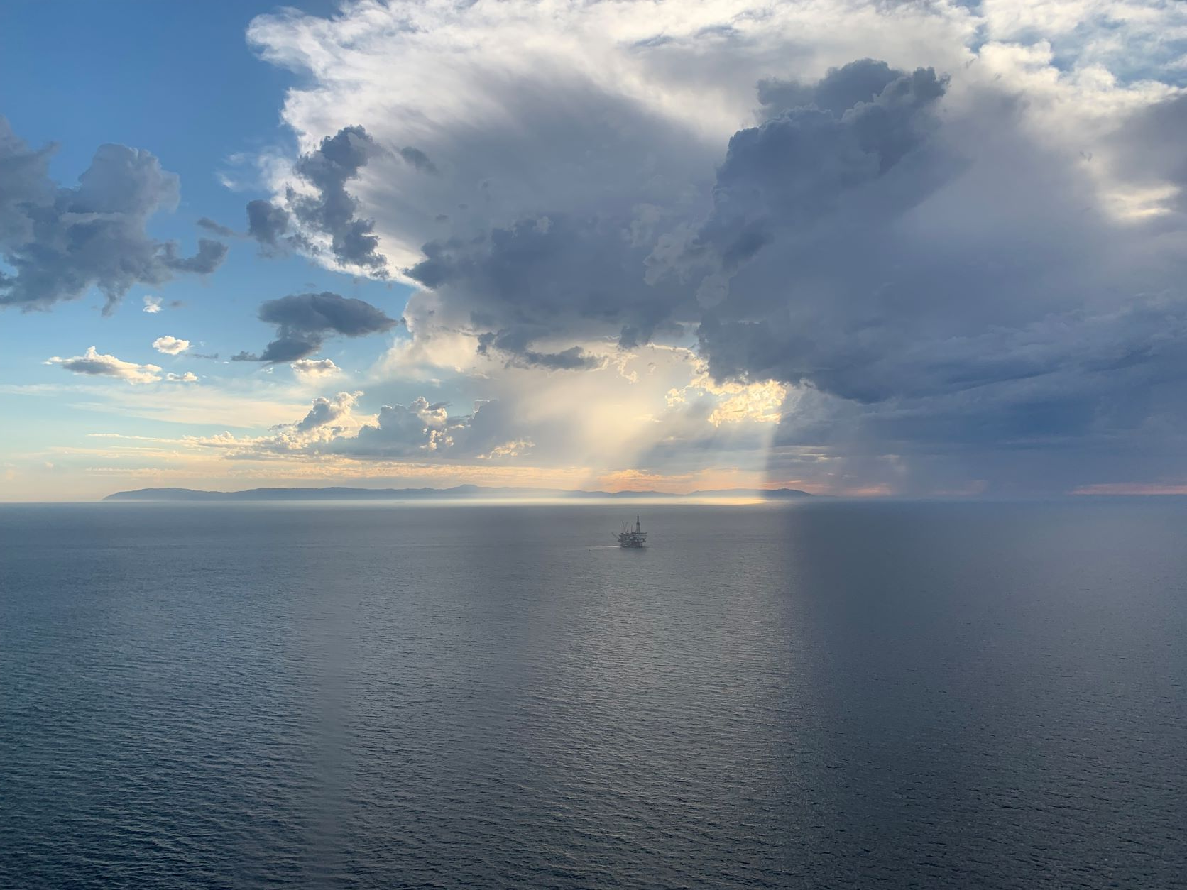
Next Steps
Formalize unit in ACPs, RCP, NCP
Practice in exercises
More to come…

