Slide 1

U.S. Coast Guard
Sector Honolulu
Oceania Regional Response Team
Virtual Meeting
27 October 2021
Notes:
Note changes in personnel.

Slide 2
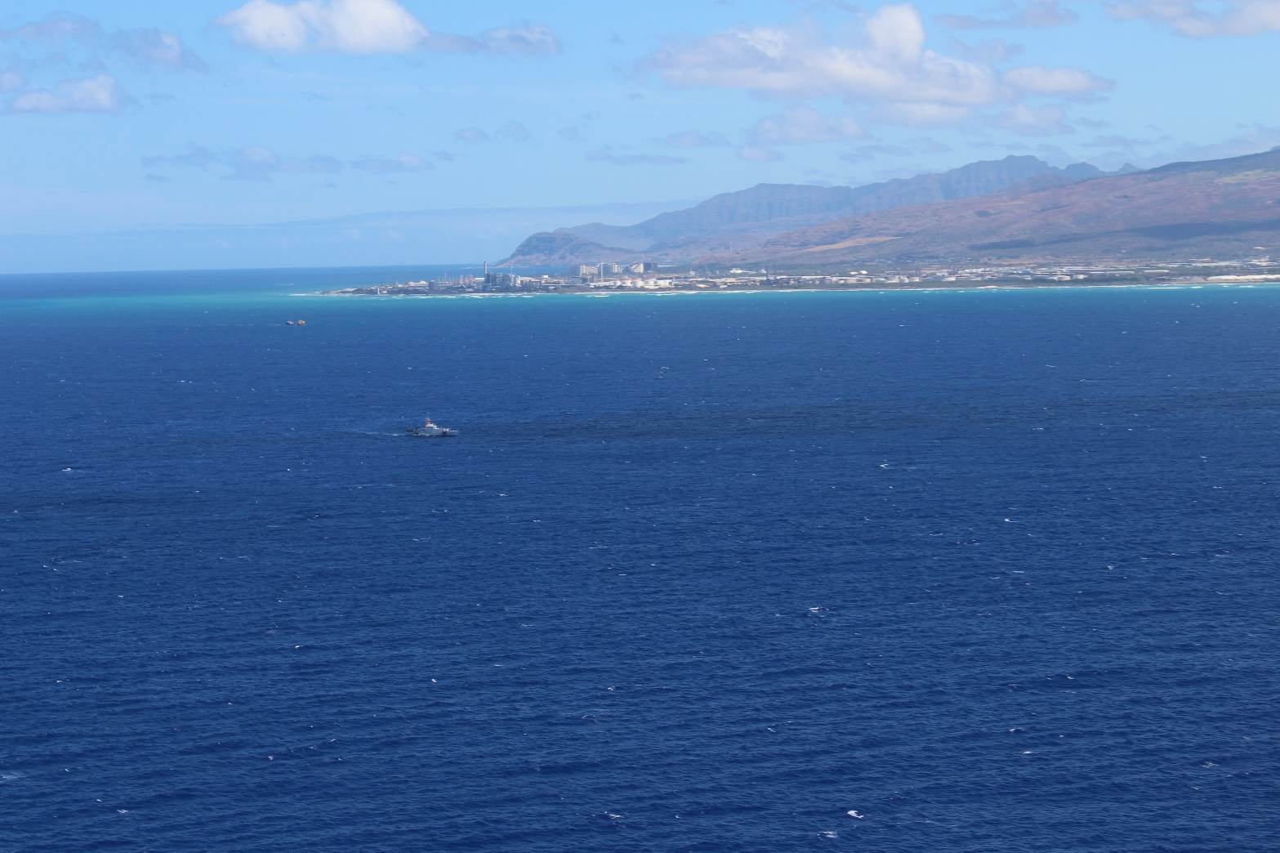
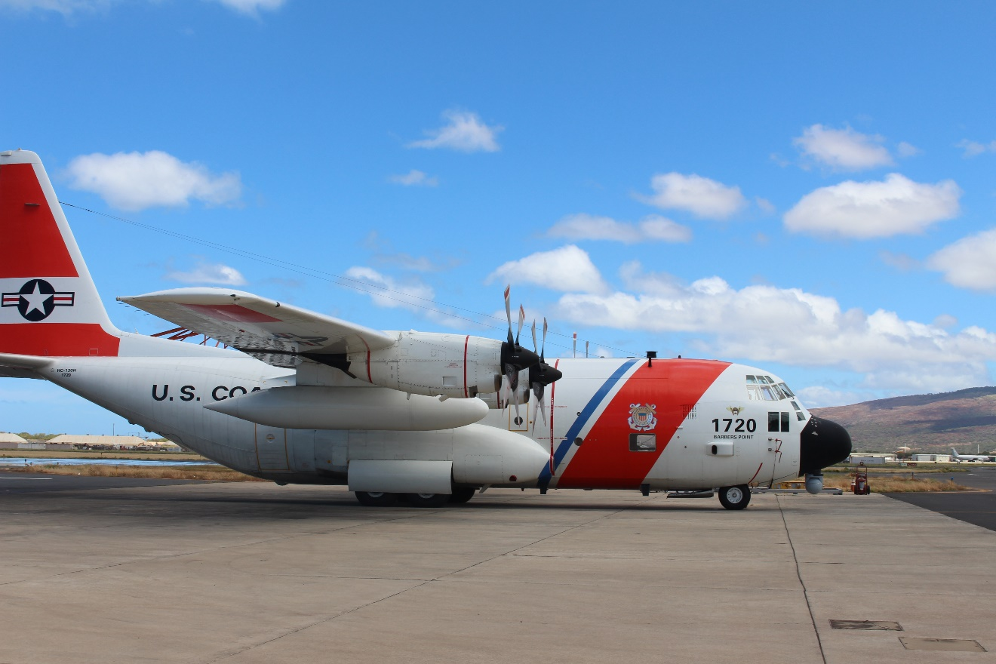
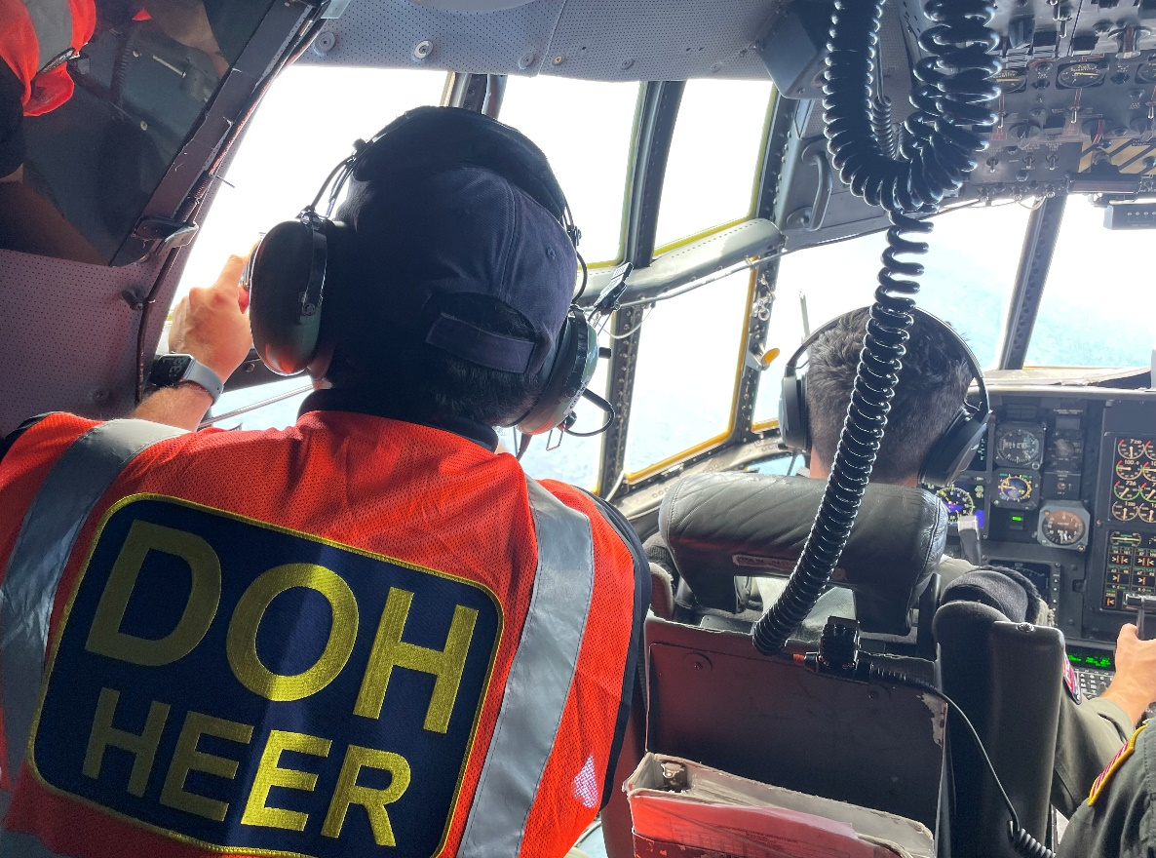
TRANS AIR FLIGHT 810
Commercial 737 reported down 2 miles south of Oahu at 1:40am on July 2, 2021
CG AIRSTA BP and airport firefighters rescued survivors
Estimated 2,000gal of Jet Fuel in tanks
Sector Honolulu deployed USCGC JOSEPH GERCZAK, C-130, & Pollution Responder
A.M. Flight: Sheen discovered offshore near incident site
P.M. Flight: Sheen unable to be verified, likely evaporated and dissipated
Notes:
Replicate as necessary to highlight unusual or large cases. Acceptable to re-arrange.

Slide 3
Training - Exercises - Interagency Engagements
Accomplishments
Outlook
Date | Event | Location
14-16 Dec 2021 | D14 APC Mtg | Sector Hono
TBD March 2022 | PREP Ex | Pearl Harbor
Date | Event | Location
20 May 2021 | GIUE: IES | Honolulu, Oahu
22 Jul 2021 | GIUE: Aloha Pet. | Lihue, Kauai
3-5 Aug 2021 | ADDS Ex | AIRSTA Barbers Pt
28 Sep 2021 | GIUE: Allied Marine | Waianae, Oahu
Date | Event | Location
14-16 Dec 2021 | D14 APC Mtg | Sector Hono
TBD Mar 2022 | PREP Ex | Pearl Harbor
Notes:
From last meeting to next.
For upcoming GIUEs, do NOT list the date; note as TBD.
Include local planning and coordination engagements, such as LEPC.

Slide 4

LCDR Jason Nguyen
Chief, Incident Management Division
808.842.2656
Jason.D.Nguyen@uscg.mil
USCG FOSC Report

Slide 5

U.S. Coast Guard
Sector Guam
Oceania Regional Response Team
Virtual Meeting
27 October 2021
Notes:
Note changes in personnel.

Slide 6
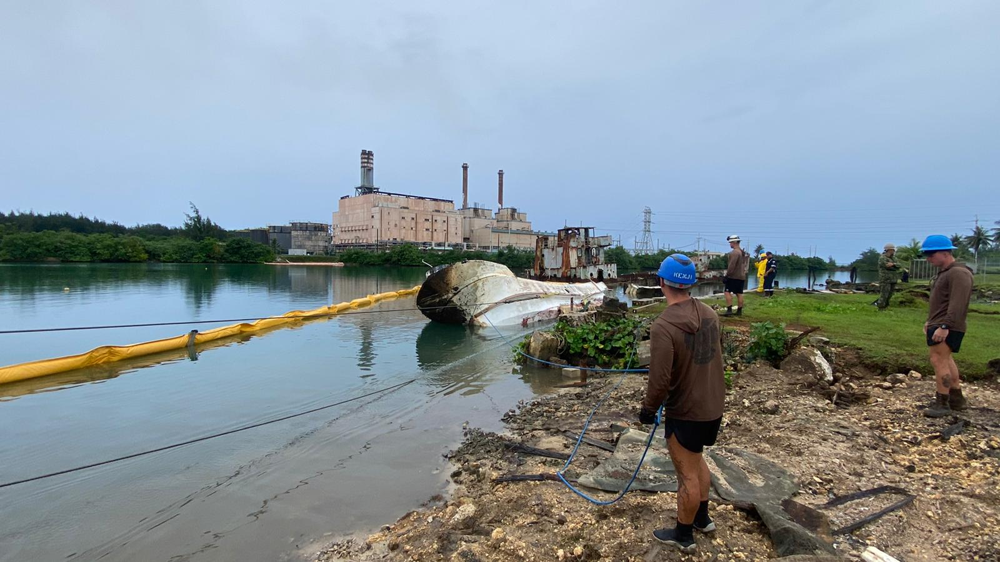
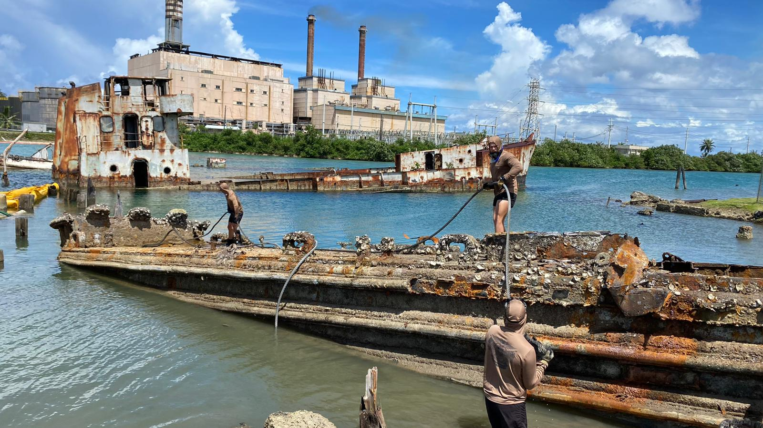
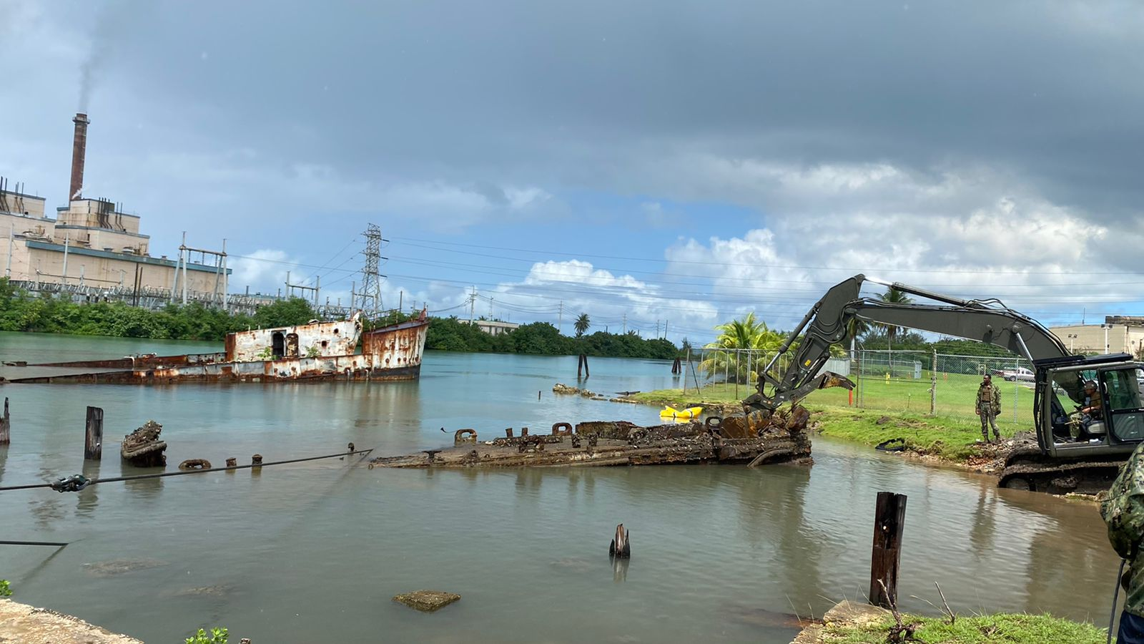
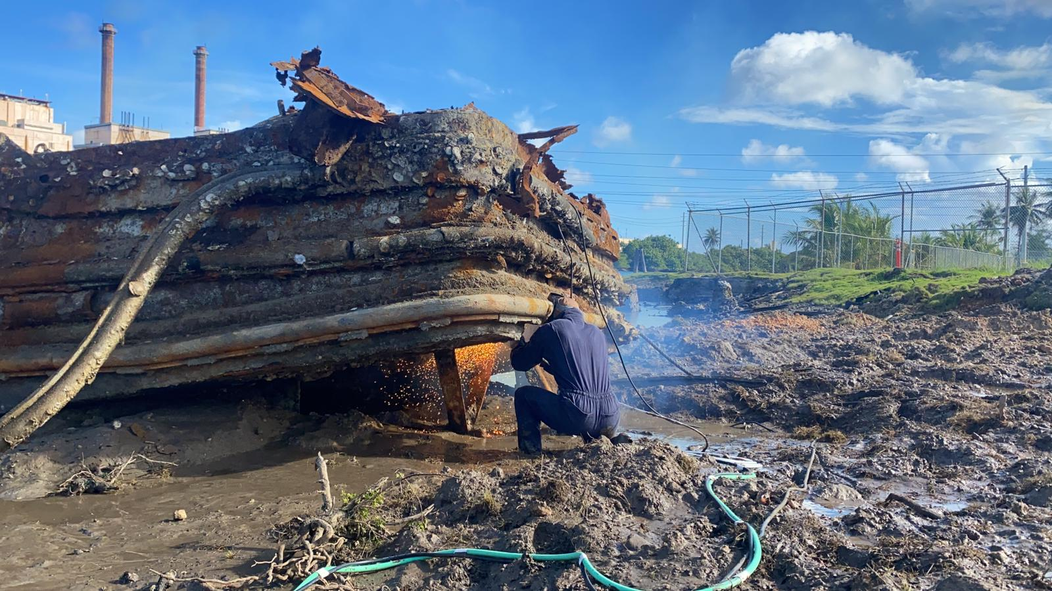
Abandoned Derelict Vessel Remediation Project
Operation commenced 04OCT2021
Plan: Remove 11 ADV’s by 15DEC21
Completed the removal/destruction of four ADV’s to date. Barge in lower right photo is the fifth vessel to be removed from the water. Currently being cut into smaller pieces with exothermal cutting tools for easier transport to debris staging site.
Minimal pollution taking place. A total of 03 NRC reports have been filed by USCG Pollution Responders/FOSCR’s to report sheening from residual oil. Contractor APEC is on-scene daily with resources for quick clean-up and is under the direction of US-EPA
Notes:
Replicate as necessary to highlight unusual or large cases. Acceptable to re-arrange.

Slide 7
Training - Exercises - Interagency Engagements
Accomplishments
Outlook
Date | Event | Location
AUG2021 | SCAT Training | Sector Guam
AUG2021 | DRAT Visit | Sector Guam
SEP2021 | HAZMAT TTX | Virtual
OCT2021 | ICS Training | Sector Guam
Date | Event | Location
NOV2021 | OSROCO FAM | OSROCO
DEC21 | ADV Hot Wash | TBD
TBD | XRF Training with GEPA | TBD
Notes:
From last meeting to next.
For upcoming GIUEs, do NOT list the date; note as TBD.
Include local planning and coordination engagements, such as LEPC.

Slide 8
LTJG Edward M. Oingerang
Chief, Incident Management Division
(671)355-4951
Edward.M.Oingerang@uscg.mil

Slide 9

U.S. Coast Guard
District 14 Response Advisory Team (DRAT)
Oceania Regional Response Team
Virtual Meeting
27 October 2021
Notes:
Note changes in personnel.

Slide 10

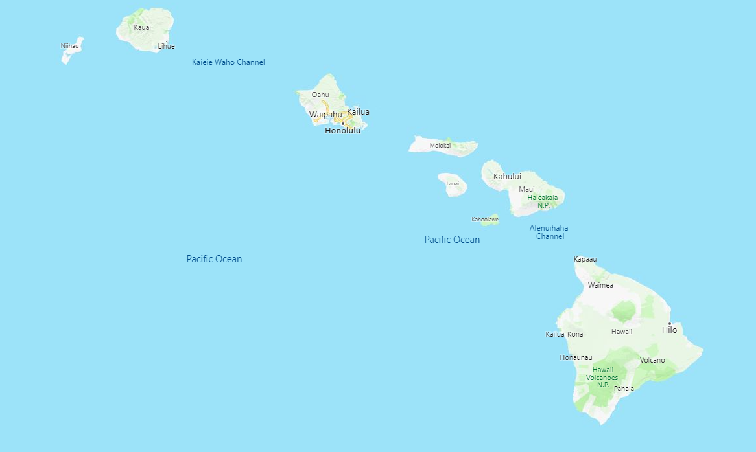
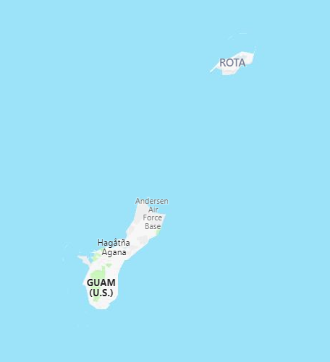
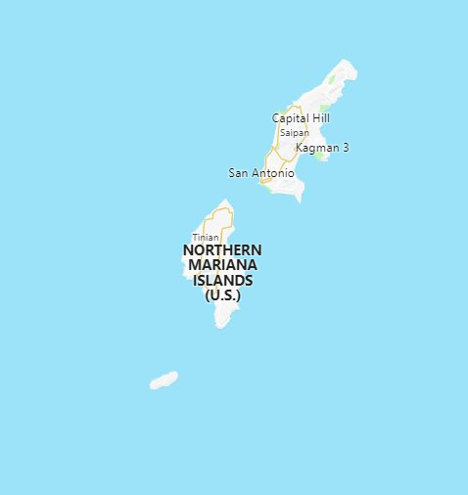
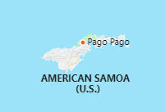
Equipment Laydown & Status
= 07 Response Trailer Locations = 02 VOSS (Guam/AMSAM)
USCG D14 DRAT Report

Slide 11
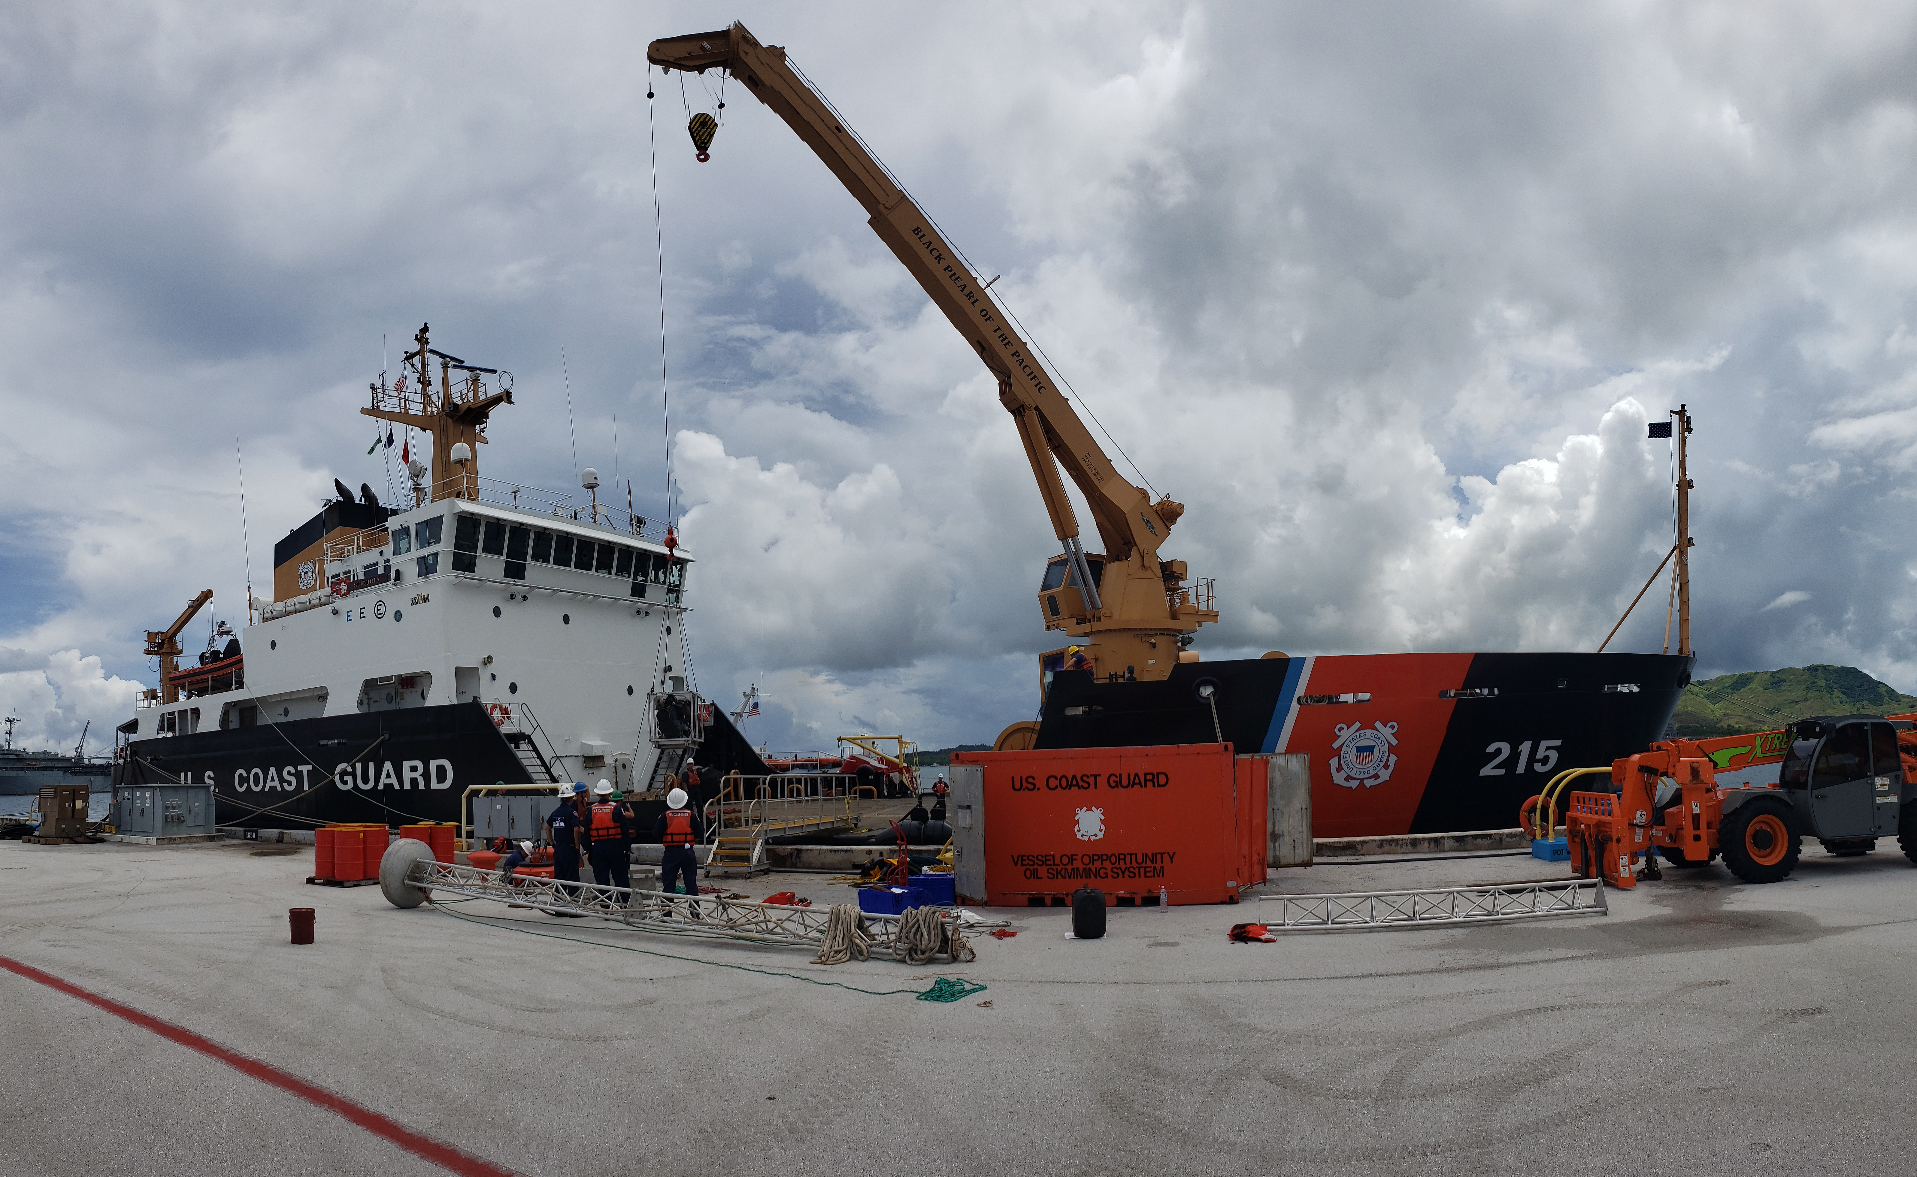
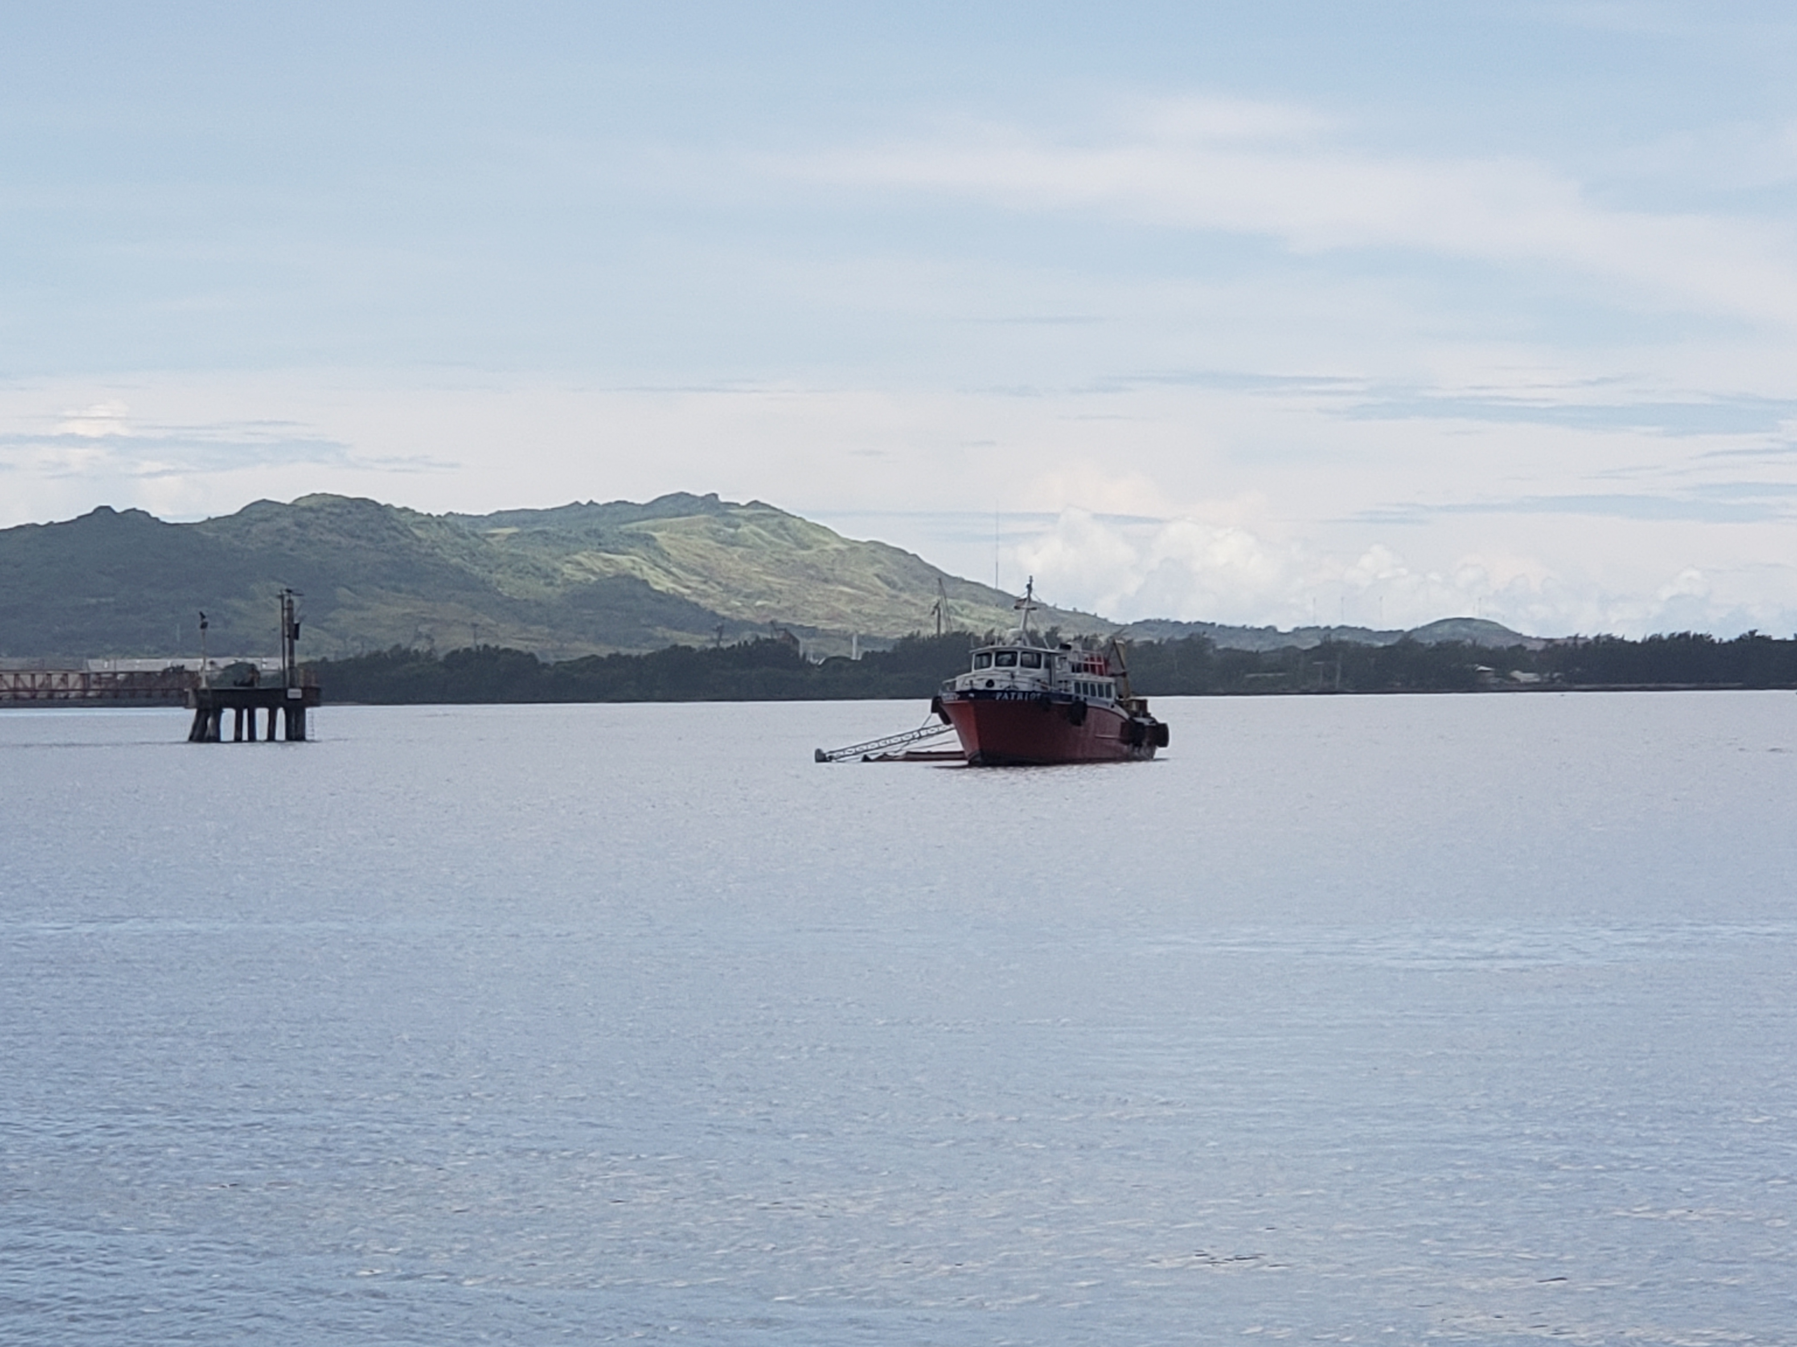
Guam VOSS Functional Exercise 23/24 AUG 21
Participants: USCG District 14, USCG Sector Guam, Pacific Strike Team, USCGC SEQUOIA Guam EPA and Cabras Brothers
Lessons Learned:
ESA/EFH Consultation
Coral Spawning Events
VOSS Storage and Maintenance
VOSS Loading
Communications
VOSS Platform Selection
Pandemic Impacts to Exercises
USCG D14 DRAT Report
Notes:
The completion of pre-spill Endangered Species Act and Essential Fish Habitat consultations, from technical assistance requests to Biological Evaluation (BE) and Essential Fish Habit Assessments (EFHA), required a significant amount of time. Programmatic consultations for proposed actions associated with geographic response strategies should be considered going forward to reduce the workload of Sector and District personnel in advance of exercises or real-world incidents.
When coral spawning events are occurring in the waters of Guam, preparedness activities should not take place to avoid physical impacts to these corals. The Mariana Islands Area Contingency Plan should ensure these spawning periods are noted as a conservation recommendation.
The environmental elements in Guam have tremendous impact on the operability of the VOSS equipment. Extensive maintenance was performed prior to conducting the exercise due to neglect and failure to maintain a preventative maintenance schedule.
The loading of the VOSS requires the use of a crane to lift equipment onto the vessel of opportunity; however, cranes with the required lift rating are limited. The price in 2018 was $8,738.00; in 2019, the cost was $23,822.00; this year, the quote for the same equipment was $40,205.00.
An alternative communications method or source, be it a different brand radio or government owned and provided cell phones for traveling, should be examined as possibilities for remote areas of operation
During the exercise, M/V PATRIOT was used as the vessel of opportunity. This vessel, while ultimately functional, had limited on deck and rail space, making stowing, loading, deploying, and operating the VOSS system difficult. The lack of deck space made for a cluttered work area, rife with trip and fall hazards. Potential use of USCG FRC in future.

Slide 12
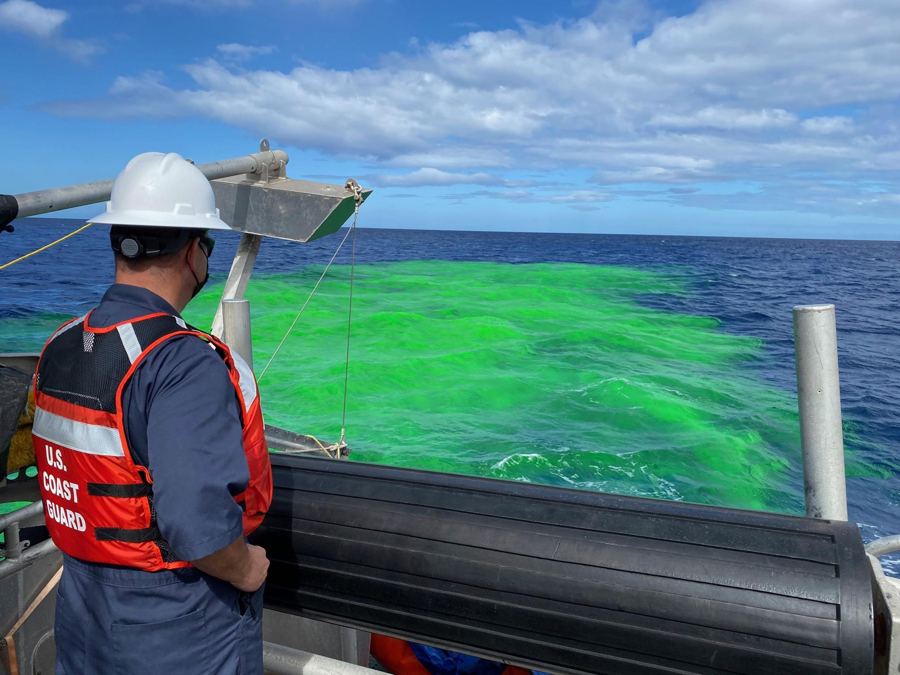
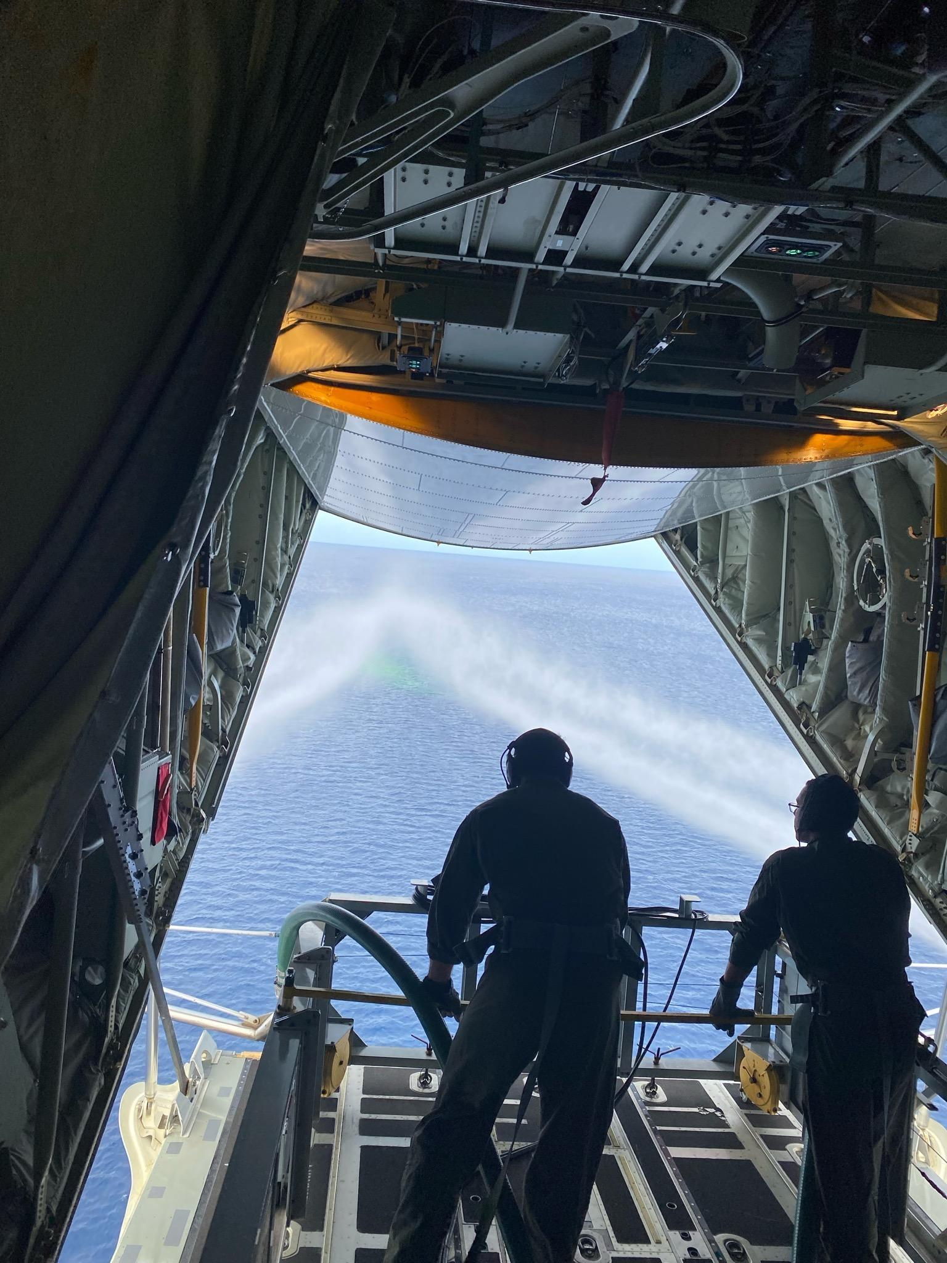
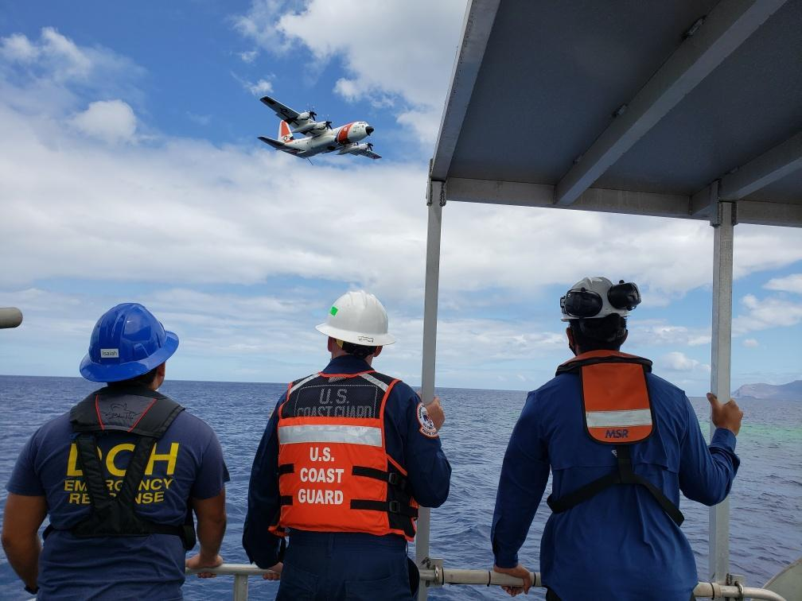
FY21 Equipment Exercise Summary
Completed Exercises:
Hawaiian Islands Preparedness Assessment Verification (PAV) (Hawaii, Maui, Molokai, Lanai, Oahu, Kauai)
Keehi Lagoon, Oahu
Hilo, Hawaii
Ma’alaea Maui
Port Allen, Kauai
Apra Harbor, Guam
Aerial Dispersant
Deployment System (ADDS).
(Pictured)
Canceled Exercises:
Rota, CNMI
Tinian, CNMI
American Samoa
Notes:
Aerial Dispersant Deployment System (ADDS).

Slide 13
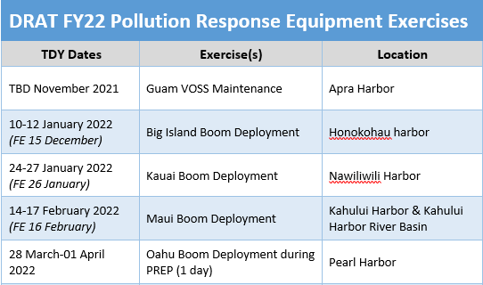
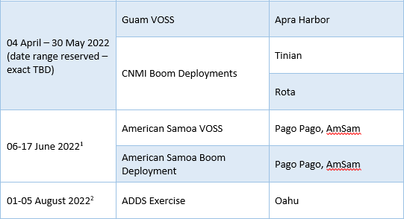
Planned FY22 Equipment Exercises

Slide 14
LT Eric Juback
District Response Advisory Team Supervisor
(808) 225-1291
Eric.J.Juback@uscg.mil

