Slide 1

U.S. Coast Guard Forces Micronesia
Sector Guam
Oceania Regional Response Team
Virtual Meeting
Dec 2023

Slide 2
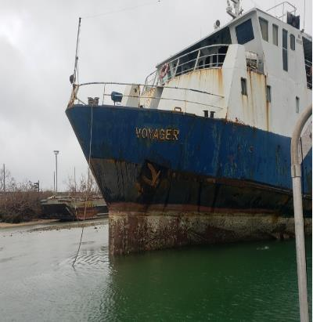
CGFM Sector Guam Cases since last meeting (DEC22)
61 NRC reports (Guam and CNMI)
22 NRC reports impacted waterways
1 Federalized case (M/V VOYAGER)
Notes:
Right: VOYAGER
Center top: Navy vessel 09MAR23
Center bottom: Sumay Marina post MAWAR 25MAY23
Left center: Agat Marina Post MAWAR
Left: Tristar discharge response

Slide 3
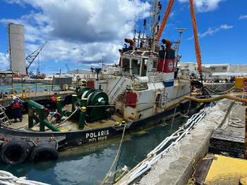
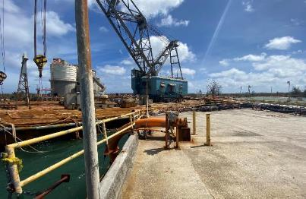
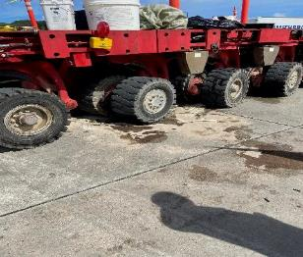
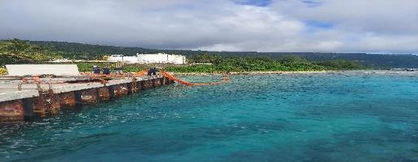
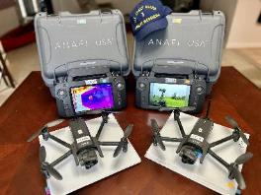
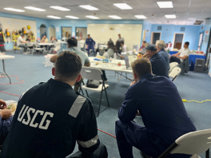
Guam & CNMI notable cases and exercises
Notes:
Top Left: M/V POLARIS
Bottom Left: Upcoming FM/Sector Guam Drone Program
Center top: Barge/pier damage during Typhoon Mawar
Center bottom: Rota Mobil GIUE 06FEB23
Top Right: Heavy Lift Hauler land 21MAR23
Bottom Right: Matson Oil Exercise in Apra Harbor

Slide 4
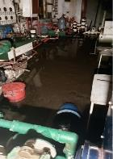
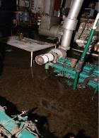
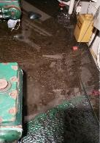
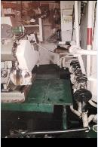
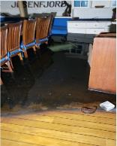
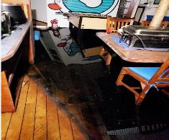
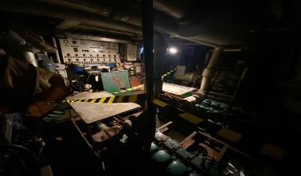
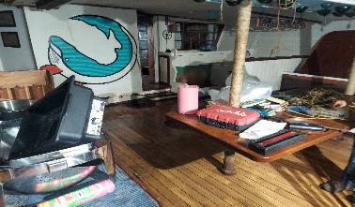
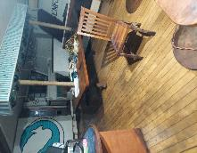
M/V VOYAGER Pollution Response
  Approximately 51,000 gallons of oily waste, 4 cubic yards of oiled debris, 4 drums of oiled sorbent material, and various paints, hazmat, and batteries were removed and disposed of.
Start of
Project
Final
Condition
Notes:
M/V Voyager, Became hard aground after Typhoon Mawar. Federalized case costing approximately $800k, and we removed about 50k of oily water.

Slide 5
Training - Exercises - Interagency Engagements
Accomplishments
Outlook
Date | Event | Location
Feb & Sep 2023 | GIUE | Guam
Sept – Nov 2023 | M/V VOYAGER Pollution Response (Guam EPA, DOA, Aquatic Resources, NOAA) | Guam
Nov 2023 | Matson Oil WCD Exercise | Guam
Date | Event | Location
TBD | 02 GIUEs | TBD
Dec 2023 | UAS Program Creation | Guam/CNMI
Jan 2024 | OSROCO 40 HAZWOPER Training | OSROCO: GUAM
June 2024 | National Preparedness Exercise Program | CNMI
Aug 2024 | National Preparedness Exercise Program | Guam
Notes:
From last meeting to next.
For upcoming GIUEs, do NOT list the date; note as TBD.
Include local planning and coordination engagements, such as LEPC.

Slide 6

LTJG Whip C. Blacklaw
Chief, Incident Management Division
(671) 988-9146
Whip.C.Blacklaw@uscg.mil

