Slide 1
USEPA Region 9
ORRT Meeting
September 2019

Slide 2
Hawai‘i Childhood Lead Poisoning Prevention Program – Aug 2019
Kauai - screen items/conditions at house of 9 month old had elevated blood lead levels
Oahu – surveyed house with multiple children with elevated levels of lead. Identified extensive lead-based-paint throughout the structure (> 5-10% in many in-situ measurements)

Slide 3
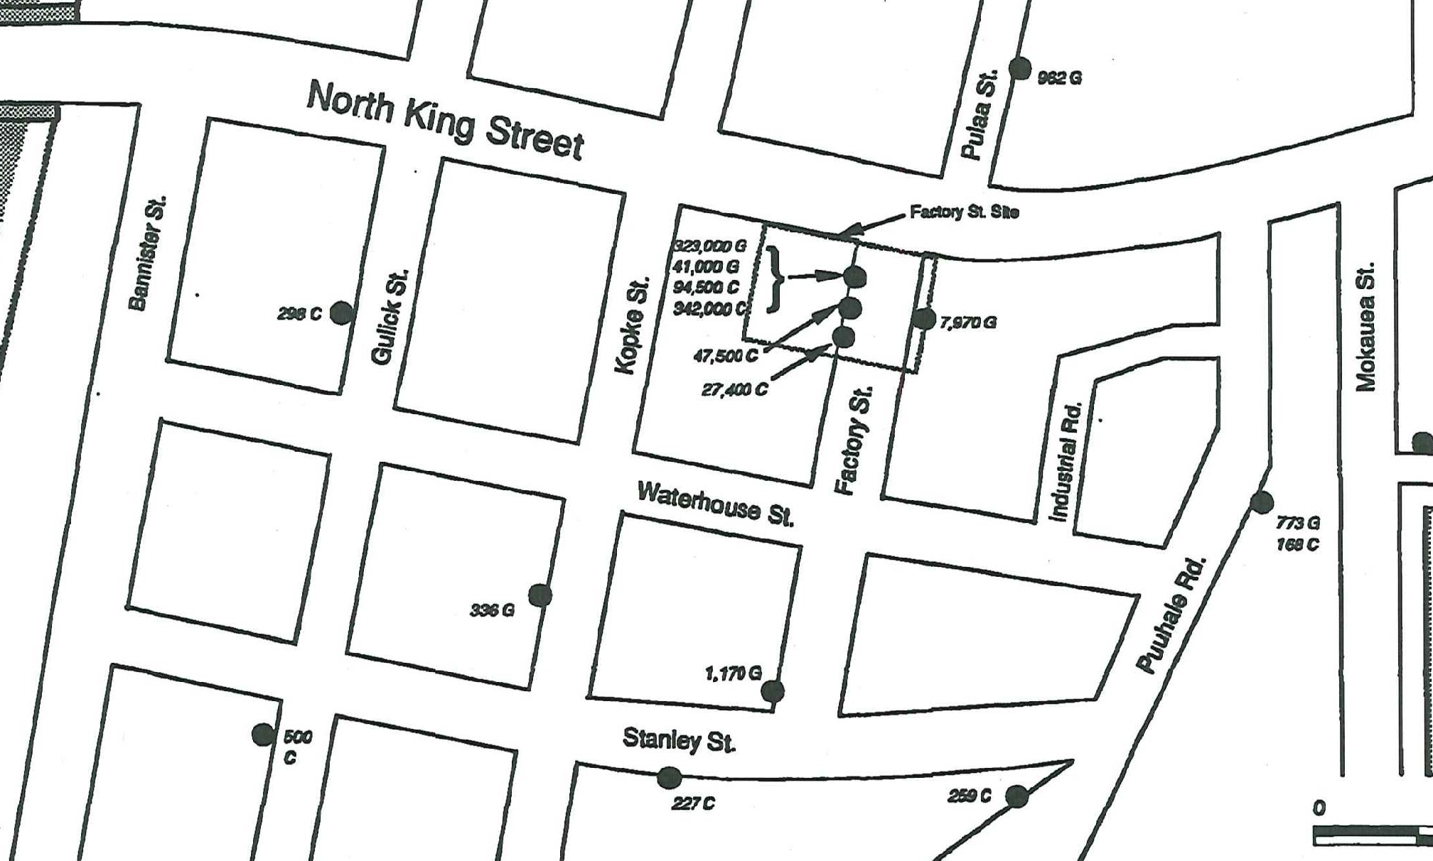
Lead Contamination
(1990s Assessment)
Problem
High lead concentrations in shallow soil
Response
Limited removal and capping
Factory Street – Hawai’i

Slide 4
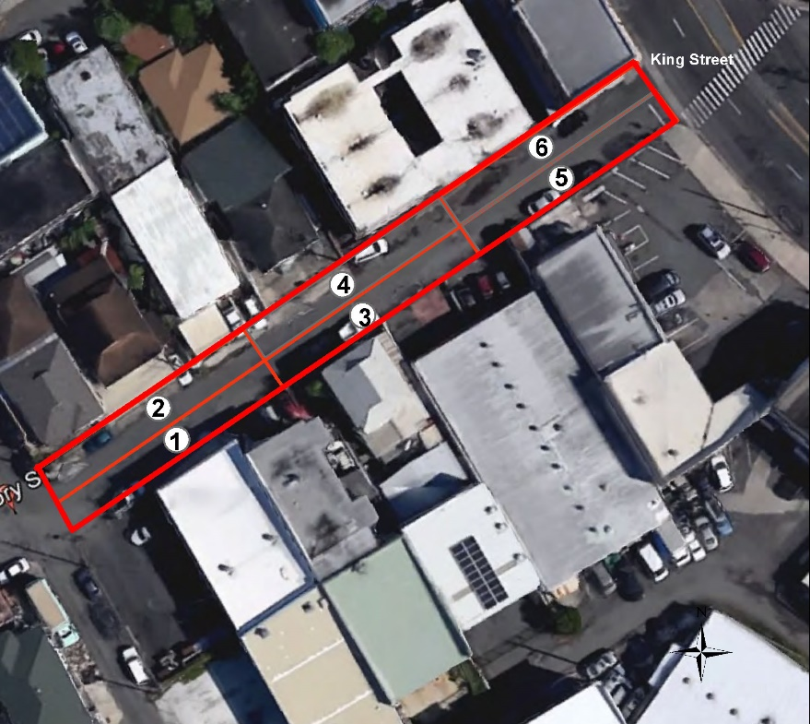
Factory Street
2017 HDOH Assessment
Each DU = 6 Vertical Layers
Thickness
Volume
3
A
0.5 ft
28 yd
B
0.5 ft
3
C
1.0 ft
56 yd
5 ft
D
1.0 ft
E
1.0 ft
6 Lateral Decision Units (DU)Lateral
F
1.0 ft
Assessment Design- Lateral
Assessment Design- Vertical
DU 6, layer A – approximately 25,000 ppm lead, failed TCLP
DU’s 3-6, layers A & B – above 400 ppm lead

Slide 5
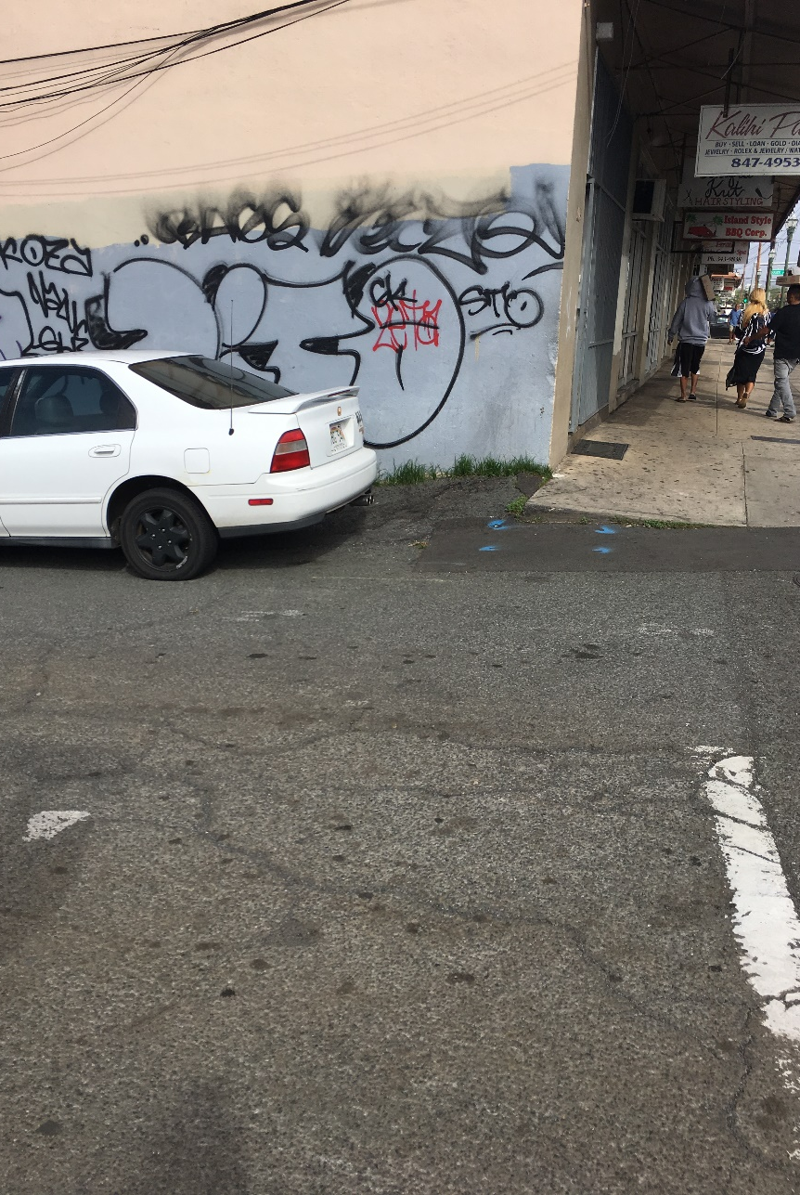
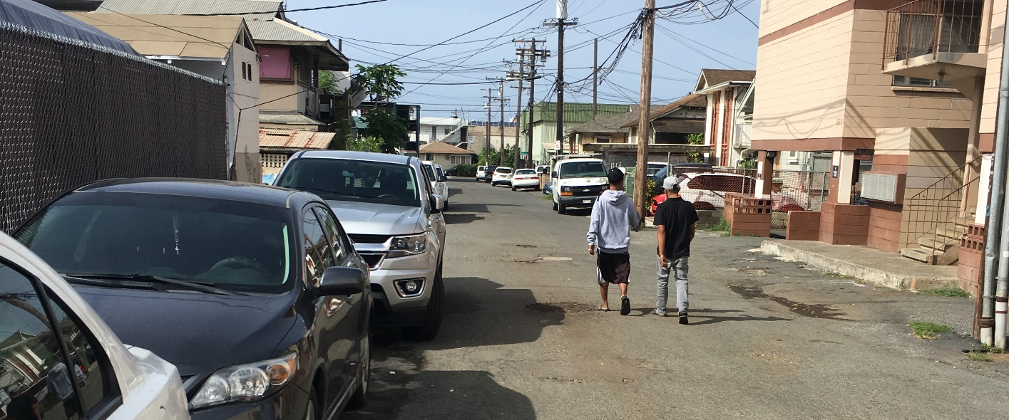
Factory Street – Hawai’i
Aug 2019 - Subsurface borings for geotechnical survey and disposal profiling
Oct 2019 – Removal action
  4 weeks
  Shallow soil removal
  Backfill & paving

Slide 6
Abandoned & Derelict Vessels – Apra Harbor, Guam
10 ADVs in Piti Harbor of Refuge
  GEPA inventory and assessment
  SUPSALV to remove vessels and cut them in pieces
  EPA to address hazmat
    Action Memo being prepared
Other Cooperating agencies
  USCG
  Guam Ports Authority
  NOAA

Slide 7
Agent Orange Investigation - Guam
Referral from Veteran’s Organization
Coordinated effort between NAVFAC, Guam EPA and US EPA
Sampling locations determined from interviews
On base and off base investigation
Coordinated report being prepared
Additional areas may be sampled

Slide 8
Dededo Waste Piles - Guam
Land clearing efforts
Sampling event planned for Fall 2019
  PCBs
  SVOCs
  Pesticides
Determination of Next Steps after Sampling

Slide 9
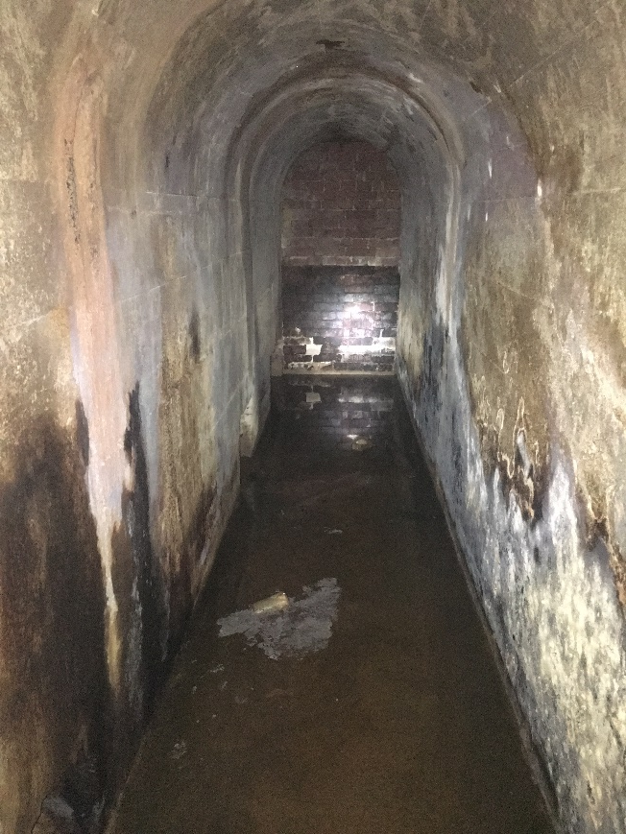
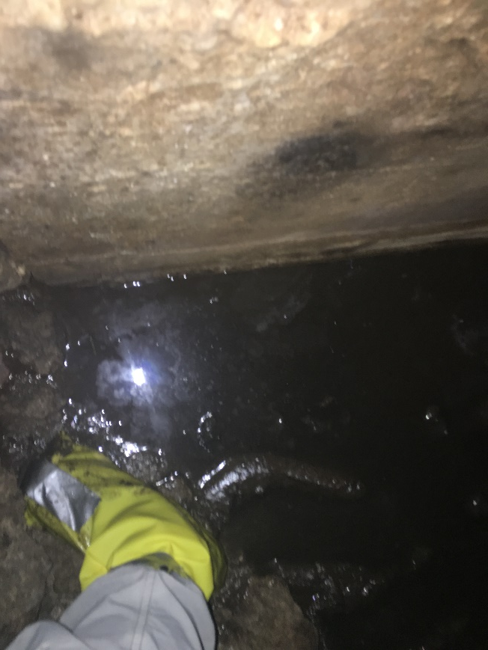
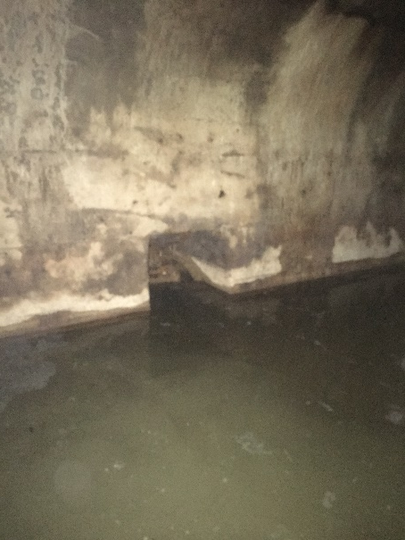
CUC Rota Oil – CNMI
Historic discharges into Pacific Ocean
EPA Response Action - subsurface containment around shoreline
Tunnels found during construction work
Assessed by EPA in Aug 2019

Slide 10
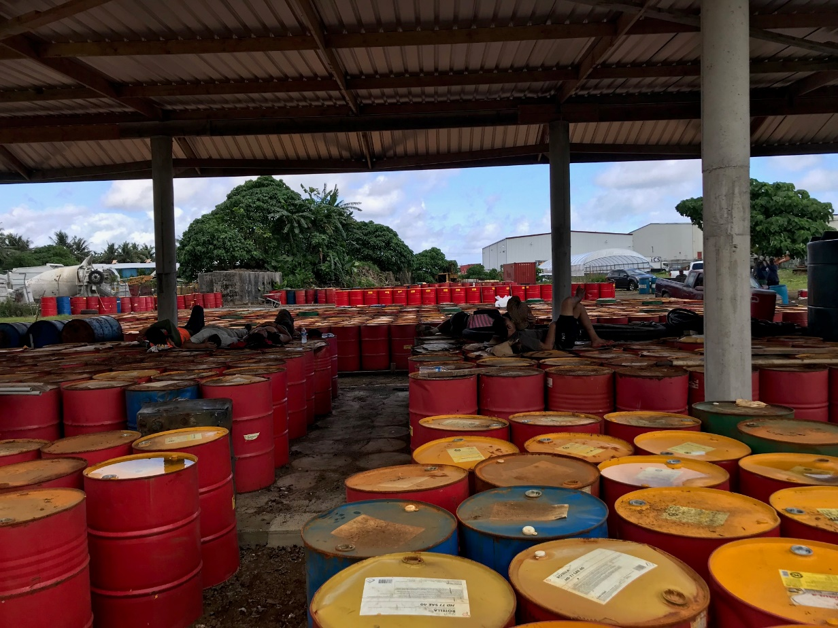
Solar Inc. Drums - American Samoa
• Used oil sent to Starkist Tuna cannery for combustion in boiler;
• In 2018, Starkist stopped receiving used oil due to issues with their new boilers;
• drums in poor shape, no secondary containment.

Slide 11
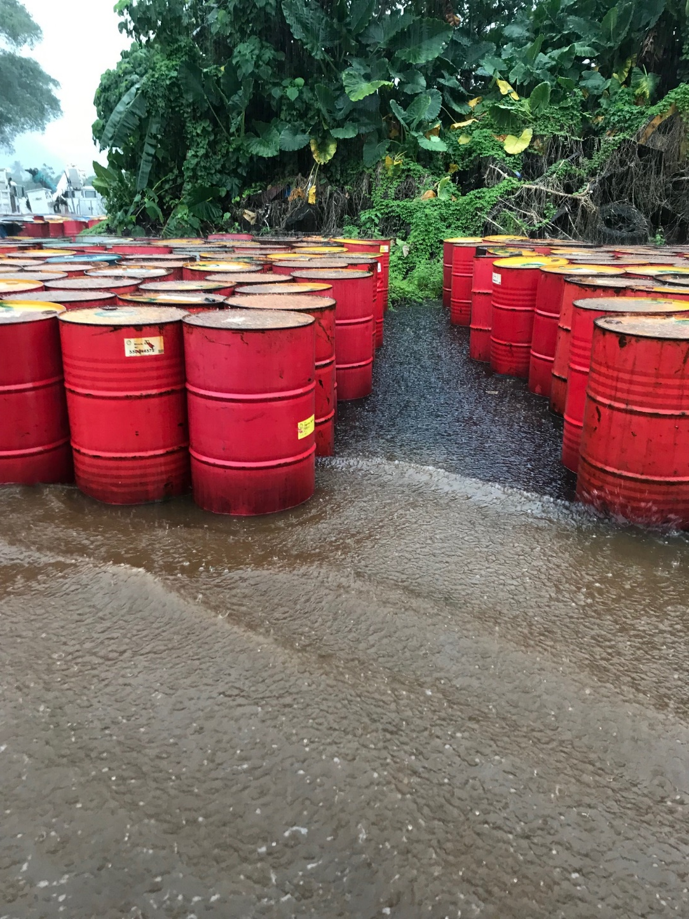
Solar Inc. Drums - American Samoa
• EPA samples to determine waste characterization
• 2000 drums, 9 totes, 5 tanks = approximately 120,000 gallons
• no NPFC funding because no release to waters of the U.S.
• interagency workgroup developing alternatives to address accumulation of material

Slide 12
Other Work - American Samoa
• Waste evaluations and sampling:
  Hospital
  Dept of Agriculture
  Schools
• 5 locations evaluated for Removal – tentatively planned for Feb 2020

Slide 13
Other activities
Staging of equipment and supplies
Planning and preparedness
  Geographic Response Planning
Data and Information

Slide 14
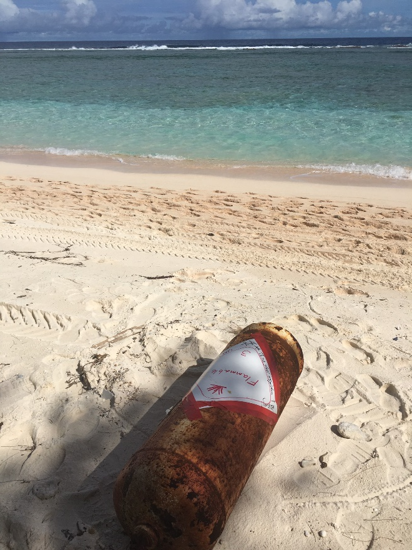
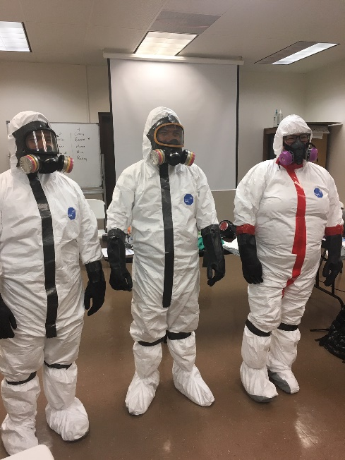
Training
40 hour HAZWOPER – US FWS Guam
  Aug 2019
Inland Oil Spill – DOI
  Nov 2020
Monitoring/Sampling
  planned Spring 2020
Other opportunities

