Slide 1
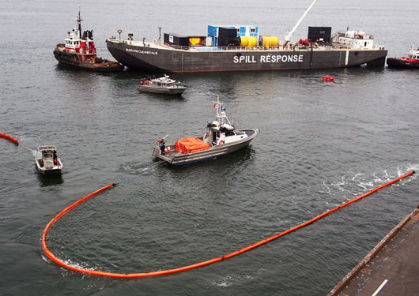
ORRT SPRING MEETING
May 5, 2021, 1400 – 1630 PDT
Welcome & opening comments: ORRT Co-chairs
S/V Midway Island Case Study: MSTC David Jones
Agency Updates
USCG and USEPA Updates
Wrap up
  Summary of key points and decisions, next steps and actions to be taken.
  Alibis

