Slide 1
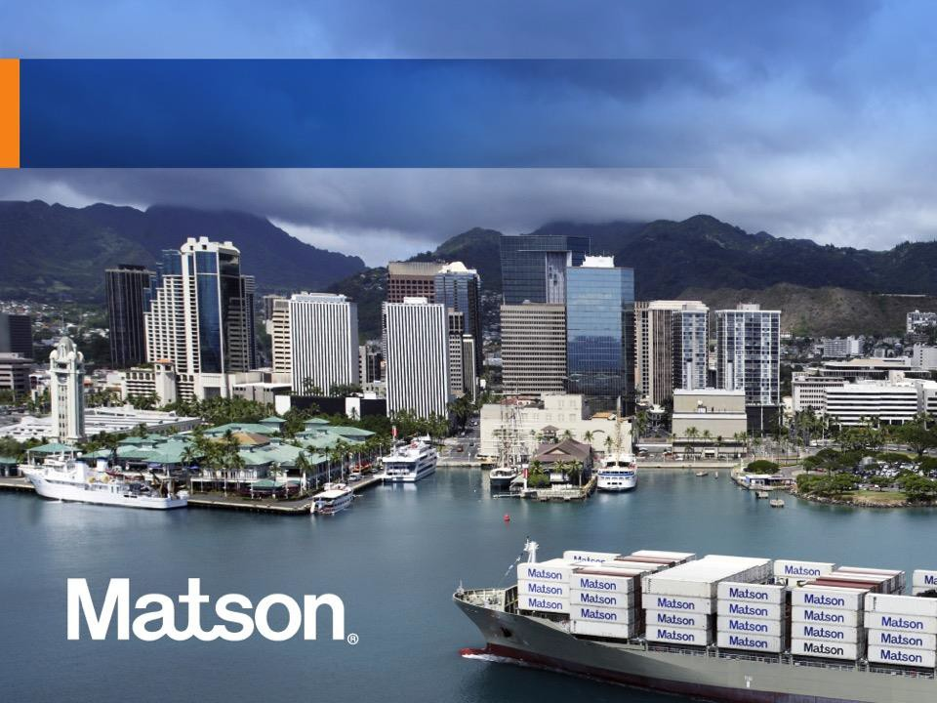


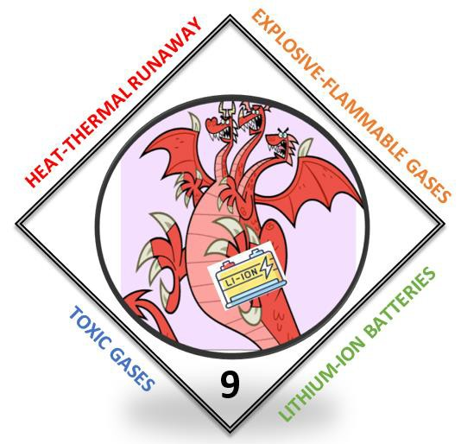
ORRT
June 28, 2023
1 | Enter Presentation Title (in Slide Master)

Slide 2

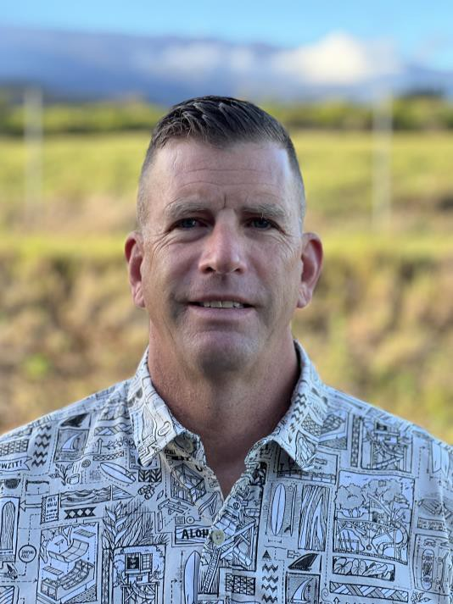
Who Am I?
Greg Jenkins
Matson-Dangerous Goods Specialist, SQES-DG
34 Years in Fire Service and HazMat
Retired-Captain Maui County Fire Dept.- HazMat 10, Kahului., 26 Years
Certified HazMat Specialist
BA Public Administration, University of Hawaii
2 |
Enter Presentation Title (in Slide Master)

Slide 3
Corporate Profile:
Captain William Matson sails his three-masted schooner Emma Claudina to Hilo, Hawaii, marking the beginning of Matson Navigation Company.
Hawaiian Citizen becomes the first vessel to be converted to a full containership in the Pacific.
1882
1960

Slide 4
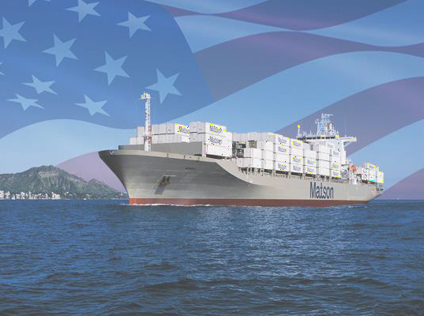
Corporate Profile:
Leading Provider of Ocean Transportation and Logistics Services.

Slide 5
Corporate Profile:
Matson provides a vital lifeline to the domestic non-contiguous economies of Hawaii, Alaska, Guam, and to other island economies in Micronesia.
Matson also provides a premium, expedited service from China to Southern California and provides services to Okinawa, Japan and various islands in the South Pacific.

Slide 6
Corporate Profile:
Matson’s fleet of owned and chartered vessels includes containerships, combination container and roll-on/roll-off (RoRo) ships and custom-designed barges.

Slide 7
Corporate Profile:
Matson logistics, established in 1987, extends the geographic reach of Matson’s transportation network throughout the continental U.S.
1882
1960
1987

Slide 8
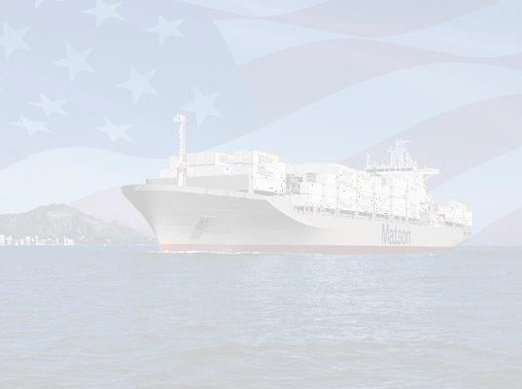
Corporate Profile:
Matson’s integrated, asset-light logistics services include:
Rail intermodal
Highway
brokerage
Warehousing
Freight consolidation
Asia supply chain services
Forwarding to Alaska

Slide 9
Safety, Quality, Environment, and Security (SQES) Department:
Supports Matson’s core values of being a leader in environmental stewardship and making workplace safety the highest priority on land and sea.

Slide 10
SQES Department:
Maintains and manages vessel and shoreside procedures, coordinates vessel and office audits, assists with hazardous cargo, and monitors the company’s overall vessel and shoreside security efforts.
Continually endeavor to better the environments and communities we serve and promote safe work environments.

Slide 11
SQES Department
Encourage all employees to be familiar with our policies and manuals so that there is clear understanding of everyone’ s role in them!

Slide 12
SQES Dangerous Goods (DG) Team:
Multimodal Dangerous Goods Form Review per 49 CFR and IMDG
Shipping Paper Audits (DCM, Stowage Plans, NCB Audits).
Hazardous Waste Shipment Document Review and compliance audits.
Internal and External HazMat Training
Special Projects/Assignments

Slide 13
DG Team Special Projects
Lithium-ion Battery Hazards/Risks
  Leader in Class approval
  Collaboration partnerships
  Early Fire/Smoke Detection
Systems
Fire
Explosive
Atmospheres
Toxicity

Slide 14
DG Team Special Projects
Specialized Firefighting Methods and Equipment
Hydropen
Fire
Blankets
Safe Deployments

Slide 15
DG Team Special Projects
HazWaste Audits/Container Inspections
Explosive Handling Compliance

Slide 16
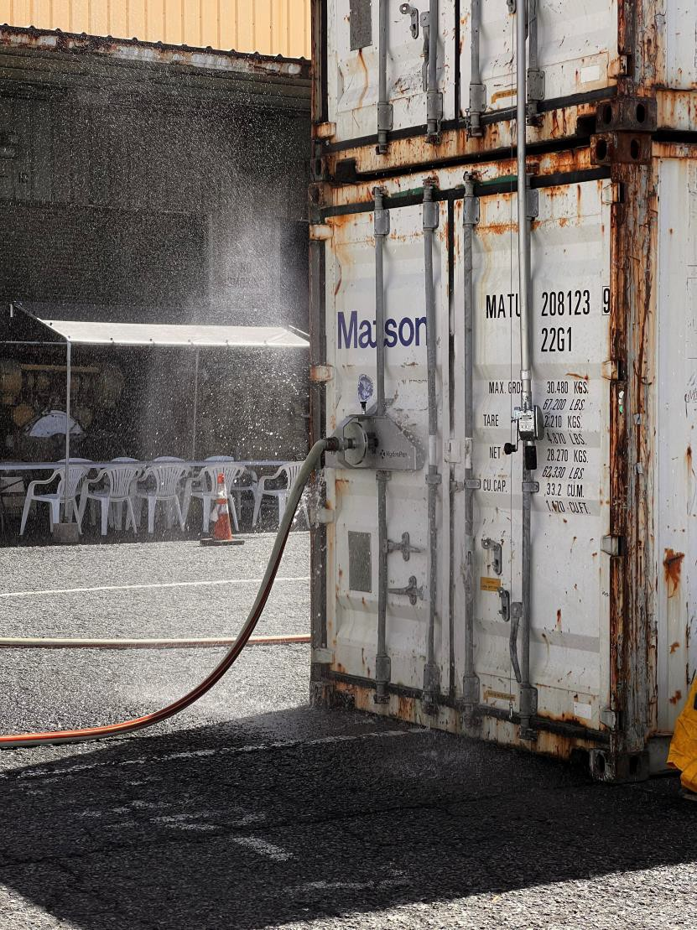
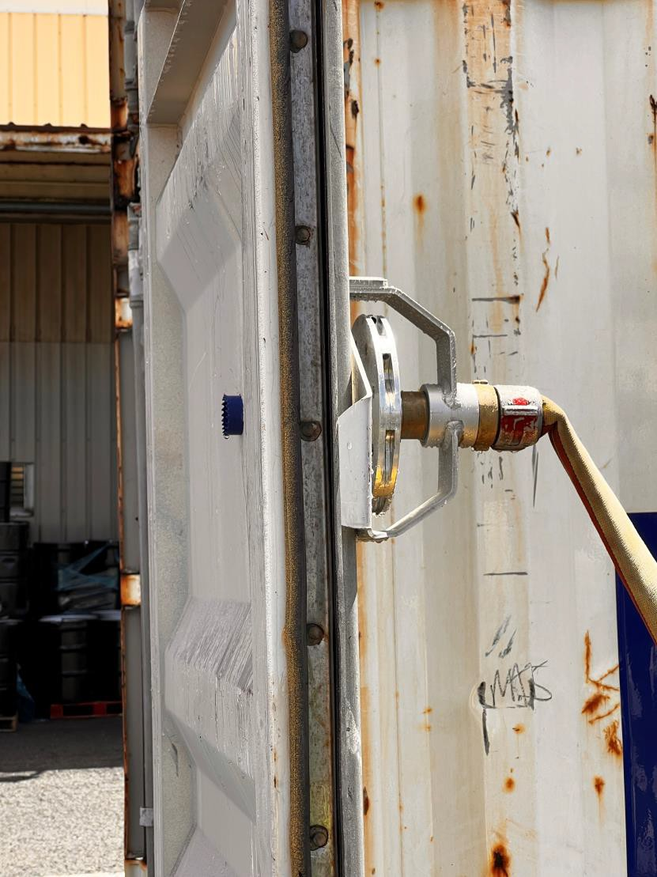
HydroPen-HNL 8.19.22
16 |
Enter Presentation Title (in Slide Master)

Slide 17
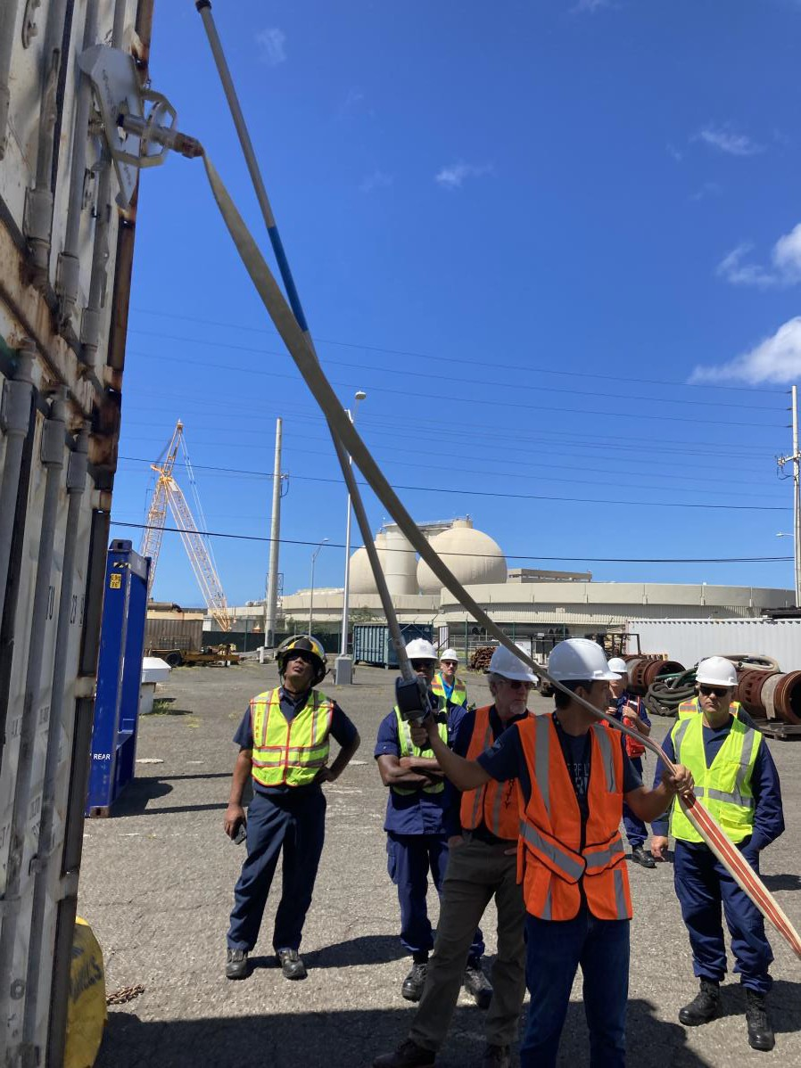
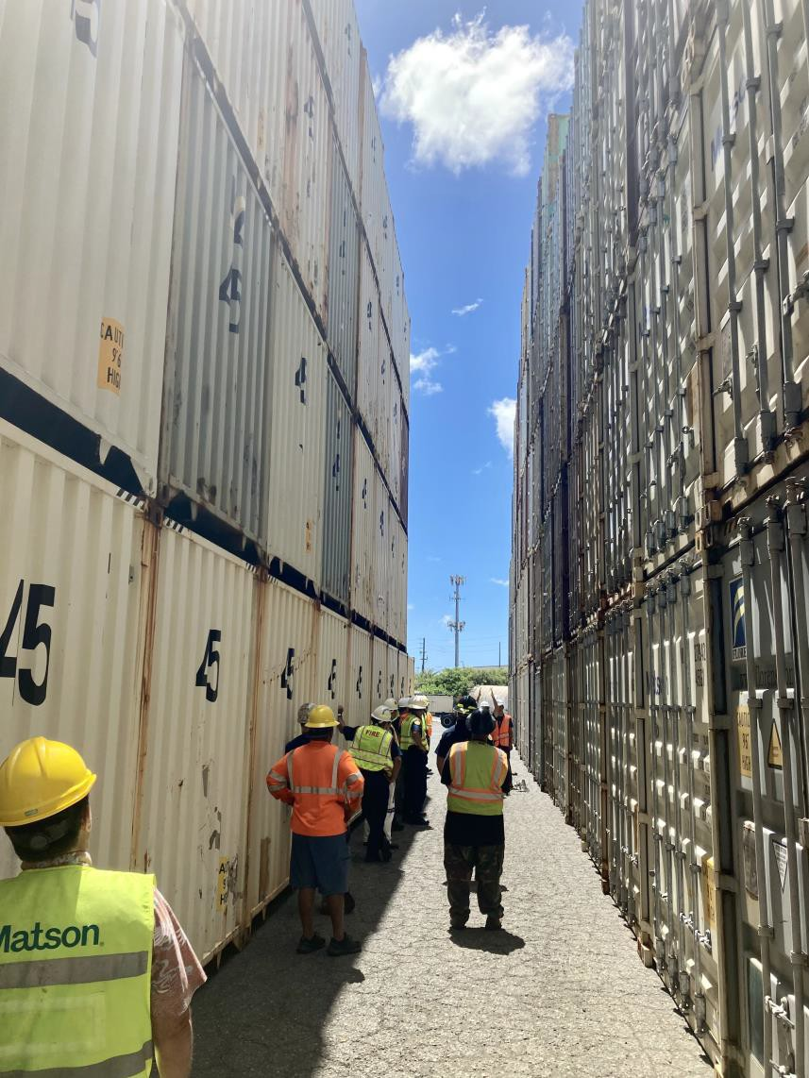
HydroPen-HNL 8.19.22
17 |
Enter Presentation Title (in Slide Master)

Slide 18
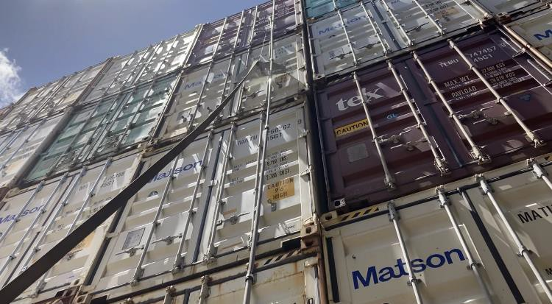
HydroPen-HNL 8.19.22
18 |
Enter Presentation Title (in Slide Master)

Slide 19
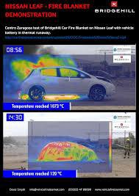
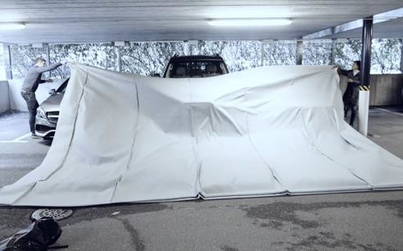
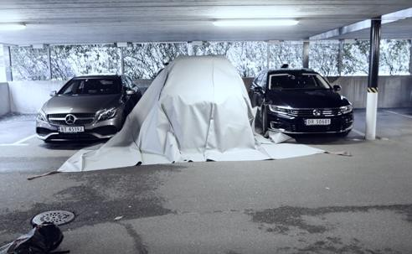
Fire Blankets 2023
19 |
Enter Presentation Title (in Slide Master)

Slide 20
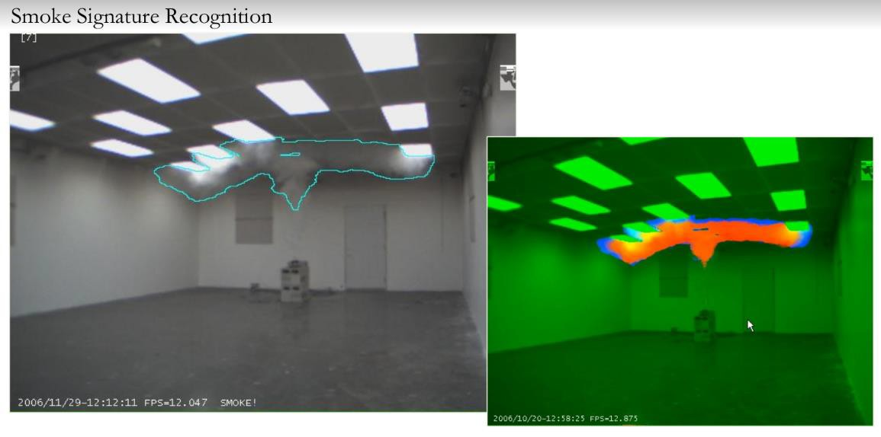
Fike-Matson-USCG HQ 11.4.22
20 |
Enter Presentation Title (in Slide Master)

Slide 21
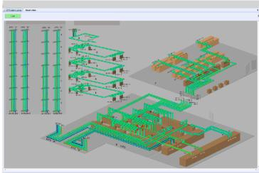
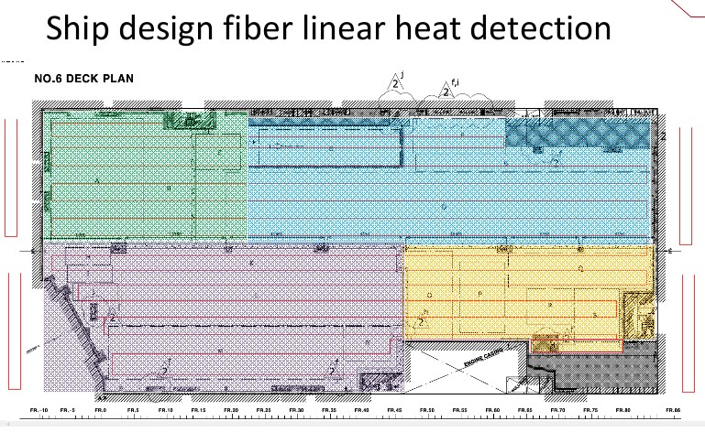
Fike-Matson-USCG HQ 11.4.22
21 |
Enter Presentation Title (in Slide Master)

Slide 22

Other Ongoing & Future State Action Items
Product Fire Protection Engineering
Collaboration
Toxicity research with EPA and Proprietary Tech.
USCG HQ and ABS Review, Collaboration, and Approvals
  Class Spec, 46 CFR Sub. Chapter Q: Additional or Supplemental Equipment or Strategy
Review & Upgrade of Current State of Vessel Fixed Fire Protection Using Water and Dewatering Capabilities by Class Spec.
Review & Install Early Detection Technology
Invent and Build a New Perimeter Cooling Nozzle For RoRo, “Matson Nozzle”
Donate HydroPen w/TRN to Local FDs Serving Matson Terminals
Implement Recommendations for Vessel New Builds and Retrofit Existing Vessels.
Equipment Implementation Balanced With Crew Trust/Training!
Coordinated Fire Plan/Strategy Development with External Stakeholders (Local Fire Dept., State AHJ, USCG, EPA)
22 |
Enter Presentation Title (in Slide Master)

Slide 23
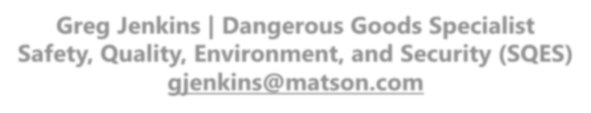
Greg Jenkins | Dangerous Goods Specialist Safety, Quality, Environment, and Security (SQES) gjenkins@matson.com
23 |
Enter Presentation Title (in Slide Master)

Slide 24
ORRT
June 28, 2023
Mahalo Nui Loa!
24 | Enter Presentation Title (in Slide Master)

