Slide 1
Inland Area Planning Strategy Session
Welcome and Introductions
Area Planning Definitions & Process
Inland vs Coastal Jurisdiction
Current Inland and Coastal GRP/ACP Activities
Inventory of Chemical and Oil Risk Discussion
Inventory of Sensitive Site Habitats Discussion
Mapping Resources Discussion
Site Risk Ranking and GRP Strategy
Training and Development Opportunities
Field Trip Opportunity

Slide 2
Area Contingency Planning
Geographic and Partnership Response Readiness for Oil Spills

Slide 3
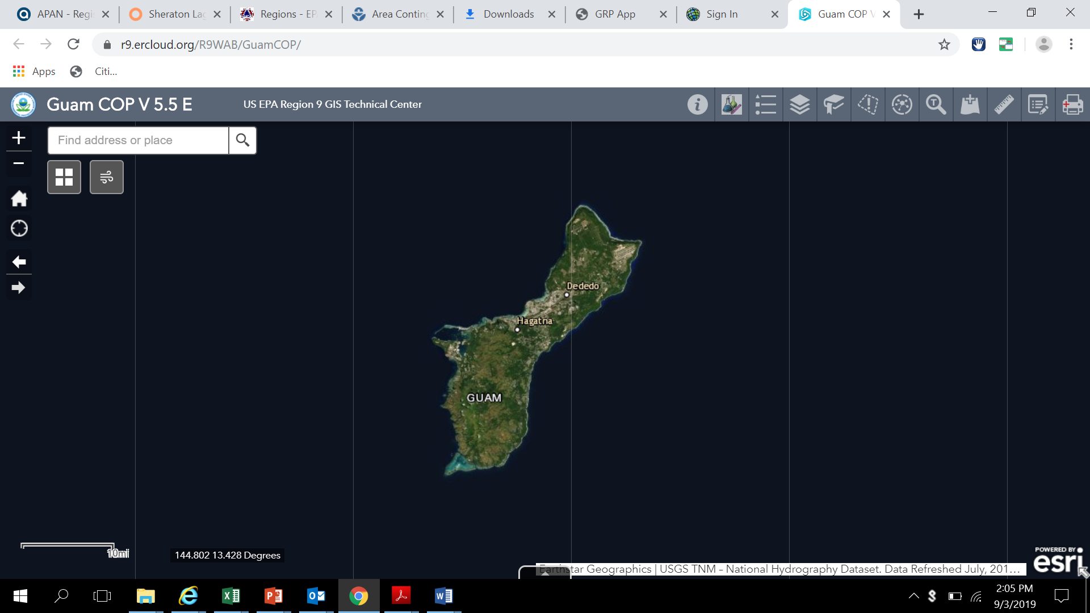
What is an Area Contingency Plan
An ACP is a reference document prepared for the use of all agencies engaged in responding to environmental emergencies in a defined geographic area. The terms ‘Area Contingency Plan’ and ‘ACP’ also encompass the processes for developing and managing Sub-Area Plans and Geographic Response Plans (GRPs), which are more limited in scope than ACPs.

Slide 4
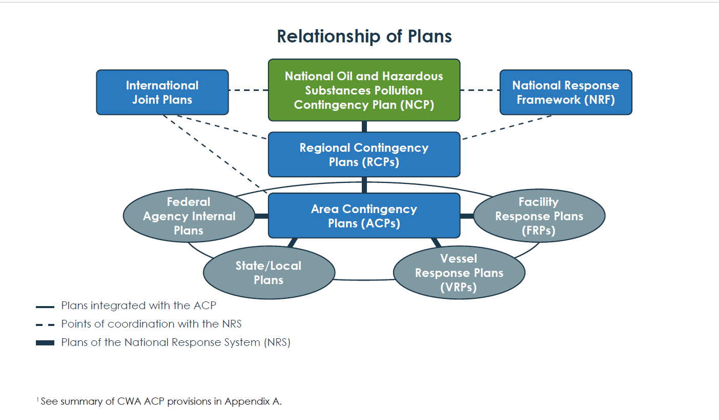
Relationship of ACP to other Plans

Slide 5
What are the statutory and regulatory underpinnings of the ACP?
Clean Water Act (1972): The CWA amended the Federal Water Pollution Control Act (FWPCA) of 1948 and expanded the federal government’s authority to regulate discharges to waterways. The Water Quality Improvement Act, amended by the FWPCA, provided the basis for the National Contingency Plan (NCP). Oil Pollution Act of 1990: The OPA 90 amendment to the CWA established ACP requirements for the NRS to address worst-case discharges of oil and hazardous substances and mandated facility-specific plans (facility response plans (FRPs)) for certain categories of facilities.
Comprehensive Environmental Response, Compensation, and Liability Act (1980): CERCLA established a federal emergency response program to deal with immediate threats from hazardous substances and pollutants or contaminants (excluding petroleum as provided by 42 U.S.C. 9601(14) and (33)) and a remedial response program to deal with hazardous waste sites requiring actions consistent with a permanent remedy.
Emergency Planning and Community Right-to Know Act (1986): EPCRA amended CERCLA by adding requirements for community-based emergency planning, through State Emergency Response Commissions (SERCs), Local Emergency Planning Committees (LEPCs), and public disclosure of hazards associated with certain facilities.
National Contingency Plan (40 CFR Part 300, last substantial amendments in 1994): The NCP is a federal regulation that codifies certain authorities and responsibilities of designated federal agencies for responding to releases of oil, pollutants and hazardous substances. The NCP requires each federal Region, through its Regional Response Team (RRT), to develop RCPs. ACPs exist under the umbrella of the applicable RCP. Executive Order 12580 (1987): Executive Order 12580 implements CERCLA, including delegating lead response authorities to EPA and USCG and requiring the NCP to provide for national and regional response teams (NRT and RRTs).

Slide 6
Why an ACP & Who is responsible?
Under federal law (OPA 90) and regulation (NCP), all U.S. territory is divided into jurisdictional zones for purposes of removal and response actions. The U.S. Coast Guard (USCG) is designated the lead agency for planning and response in the coastal zone and certain major inland water bodies, and EPA is designated the lead for the inland zone, with certain exceptions for areas managed by the Department of Defense (DoD).
When implemented in conjunction with the NCP, the ACP must be adequate to remove a worst-case discharge, and to mitigate or prevent a substantial threat of such discharge from a vessel, offshore facility, or onshore facility operating in or near the area.

Slide 7
How is an ACP developed
An ACP is the product of a collaborative process involving agency stakeholders within the defined area, organized as an Area Committee (AC). Under the direction of the Federal On-Scene Coordinator (FOSC) for its area (33 U.S.C. 1321(j)(4)(B)), the AC is comprised of members from qualified personnel of federal, state, and local agencies, as well as members of federally recognized Indian tribes, where applicable. The AC provides a forum for these agencies to develop cooperative working relationships while identifying issues and challenges through preplanning of joint response efforts, and developing solutions in advance of a response.

Slide 8
What are the benefits of an ACP?
Responding to the immediate circumstances of an environmental emergency can be a challenging task. Overlapping jurisdictions and potentially divergent interests of the parties involved can further complicate the response. The ACP provides a mechanism for planning for these potential complications prior to an incident. The ACP is a useful tool for responders, providing practical and accessible information about who and what they need to know for an effective response.

Slide 9
Where ACP/GRP products most valuable
Risk Inventory
Sensitive Sites Inventory

Slide 10
Inventory of Oil Risks (FRPs)
US Navy Base Guam, Apra Harbor Fuel Division | 13° 27' N 144° 31' E | Piti | 96925 | GU
Cabras Power Plant | 322 Cabras Highway | Piti | 96915 | GU
Cabras Terminal & Casamar Wharf | 1189 Cabras Highway | Piti | 96925 | GU
Naval Supply Systems Command Guam | 1705 Route 1 | Piti | 96925 | GU
Guam Power Authority Cabras Generating Plant Fuel Storage Facility | 178 Cabras Highway | Piti | 96915 | GU
South Pacific Petroleum Corp. | 1118 Cabras Highway | Piti | 96925 | GU
US Navy, Public Works Center, Guam | 13.462215, 144.685551 | Piti | 96915 | GU
US Navy, Fleet Industrial, Guam | 1705 Route 1 | Piti | 96925 | GU
Agat Terminal | Off of Route 2A | Santa Rita | 96915 | GU
Naval Air Station Guam | Gu | Santa Rita |  | GU
Naval Air Station Agana | A.B. Won Pat International Airport | Tamuning | 96913 | GU
Airport Group International, Guam | Route 10A | Tamuning | 96911 | GU
Andersen Air Force Base | Andersen AFB, Guam | Yigo | 96929 | GU

Slide 11
Inventory of Chemical Risks (RMPs & Tier 2 Data)
Facility Name | Facility Street Address | City | State | ZIP
Agat Terminal | Route 2A Santa Rita Industrial Dr | Agat | GU | 96928
Cabras Distribution Terminal | 1118 Cabras Highway | Piti | GU | 96925
Island Equipment Company Gas Manufacturing Plant | 180 Sta. Rita Industrial Drive (She | Sta. Rita | GU | 96915
U.S. Navy Reservoir Booster Pump Station | Bldg. 1282, Lower Harmon Road, Naval Base Guam Munitions Site | Santa Rita | GU | 96540

Slide 12
Inventory of Sensitive Sites and Mapping Discussion

Slide 13
Path Forward
Next Steps
Inland Area Committee?
Site Risk Ranking and GRP Strategy
Training and Development Opportunities
Field Trip Opportunities

