Slide 1
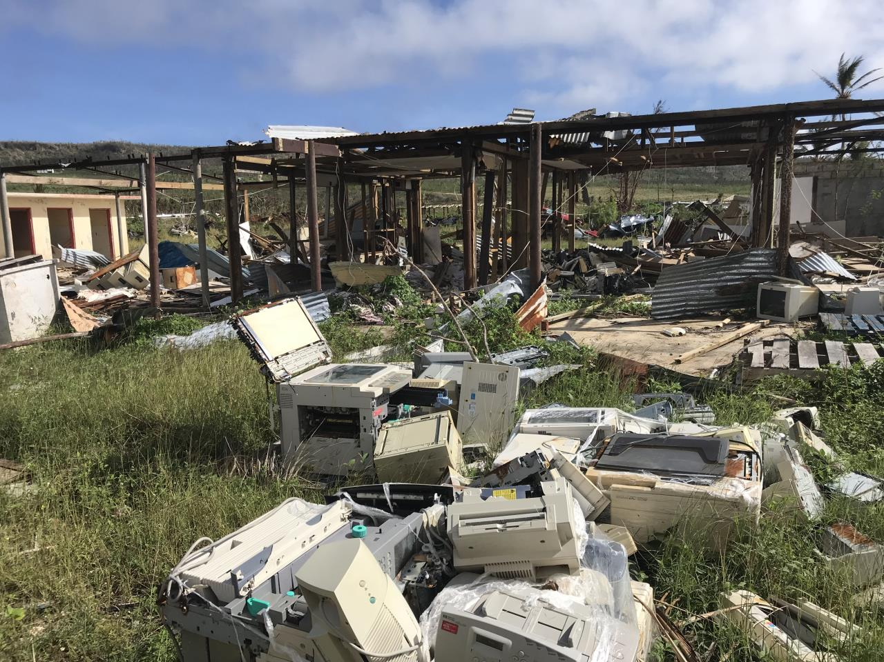
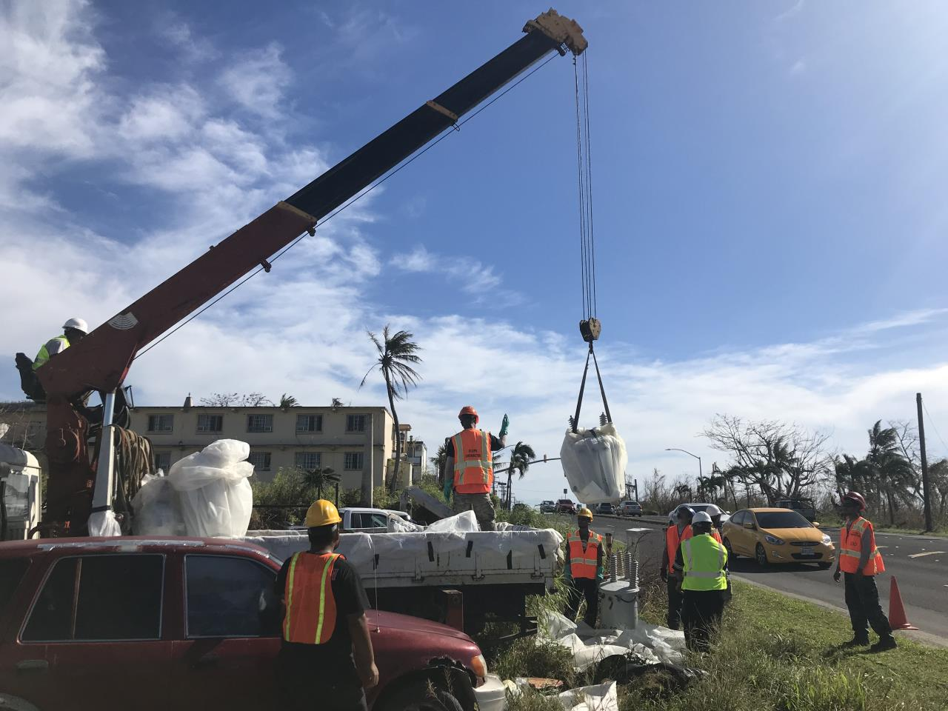
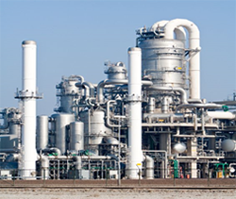
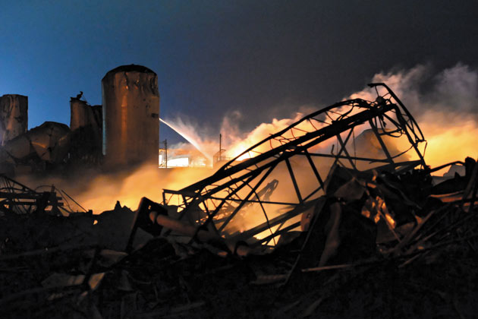

EPA EMERGENCY PREPAREDNESS AND RESPONSE
GUAM SERC/LEPC UPDATE
April 25, 2019

Slide 2

FIRST A LITTLE BACKGROUND CONTEXT….

Slide 3
West Fertilizer Company | West, Texas | April 17, 2013
  15 fatalities and 260+ injuries
  $230 million in insurance-related losses
  $16 million spent on Federal disaster assistance
  $1 million insurance policy held by West Fertilizer Company
Chevron Refinery | Richmond, California | August 6, 2012
  15,000 people sought medical treatment
  $2 million in fines and restitution
  $447 million in increased gas prices passed onto consumers
Deepwater Horizon|Gulf of Mexico| April 20, 2010
  11 workers killed, 17 workers injured
  $21 billion in settlements
  4 million barrels of oil spilled
Source: CSB Business Case for Safety http://www.idevmail.net/assets/chemsafety/CSB_Business_Case_for_Safety_01.pdf

Slide 4
A Persistent Threat….
One dead after ammonia leak at Northampton brewery – A man in his 40s is dead and more than 20 people remain in hospital, one in serious condition, after a gas leak at Carlsberg factory site. The Guardian, November 9, 2016
Authorities said one worker died after an ammonia leak at the Stavis Seafoods Warehouse Wednesday night. Boston Globe, 3/24/16
Chemical Safety Board Deploying to Site of Chemical Release in Atchison, Kansas An investigative team from CSB was deployed to the scene of a chemical release that led to a shelter-in-er for thousands of residents and at least 85 members of the public seeking medical attention 10/24/16
Millard refrigerated paid a $3 million penalty for a 32,000 pound anhydrous ammonia release in 2010 that sickened 152 people in Theodore Alabama. EPA, 6/2/15
Death due to an accidental anhydrous ammonia release onboard a tender boat docked in Sitka, Alaska. Alaska DPH, 7/17/13
Man killed by anhydrous ammonia leak A 59-year-old Nebraska man died Monday night after being exposed to a cloud of anhydrous ammonia that leaked from a pipeline north of Tekamah. Lincoln Journal Star, Oct 18, 2016
Cape Cod cold storage and ice manufacturing paid $225,000 to settle anhydrous ammonia violations EPA, 6/2/15
U.S. Chemical Safety Board Finds Multiple Safety Deficiencies Led to February 2015 Explosion and Serious Near Miss at the Exxon Mobil Refinery in Torrance, California

Slide 5

Environmental Safety
Planning and Preparedness
  1st Responder and Community Right to Know
  SERCs and LEPCs
  Tier II Reporting and Data Dissemination
  Local Emergency Plans and Facility Plans
Prevention
  Compliance Assistance
  Inspections
Response
  EPA On-Scene Coordinators
  Regional Response Team
  Accidental Release Notification
  Training, Communication, Coordination w/Industry, First Responders, Emergency Management Agencies

Slide 6
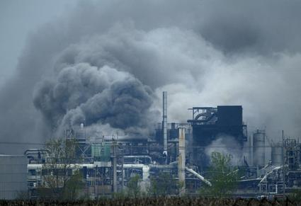

Existing Regulatory Framework
Emergency Planning and Community Right-to-know (EPCRA) requirements Local emergency planning and preparedness, emergency release notification, community right-to-know: provision of hazardous chemical storage inventory and toxic chemical release inventory to the community and first responders
CAA Section 112(r)(1) general duty clause-Facility owner/operators have a general duty to prevent and minimize releases
CAA Section 112(r)(7) Risk Management Program
Territorial/State/local requirements
6
Notes:
The RMP program closely aligns with OSHA’s PSM standard in content, policy interpretations, Agency guidance, and enforcement in order to avoid redundancy, conflict, and extra burden to industry.
The RMP program expands upon the information provided to States and Local Emergency Planning Committees (LEPCs) under EPCRA.

Slide 7
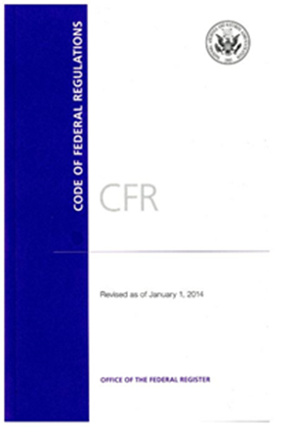
Key Provisions of EPCRA
Emergency Response Planning
  Sec. 301 Formation of SERCs / LEPCs
  Sec. 302 Substances & facilities covered & notification
  Sec. 303 Comprehensive Emergency Response Plans
Emergency Release Reporting
  Sec. 304 / CERCLA 103 Emergency Release Notification
Hazardous Chemical Inventory Reporting
  Sec. 311 (M)SDS
  Sec. 312 Emergency & Hazardous Chemical Inventory Reports
Toxics Release Inventory
  Sec. 313 Form R

Slide 8
Section 301
Establishment of State Commissions, Planning Districts & Local Committees
SERC - State Emergency Response Commissions
TERC - Tribal Emergency Response Commissions
LEPC - Local Emergency Planning Committees
LEPCs include representatives from local government, law enforcement, civil defense, fire fighting, first aid, health, media, community groups, facilities and more

Slide 9

Section 302 / 303
Facility Planning / Emergency Response Plans
Facility Planning - Establish and identify a list of substances and gather information on facilities of most concern for emergency planning and response
Section 303 - Emergency Response Plans must:
  Identify facilities and transportation routes of extremely hazardous substances
  Describe emergency response procedures, on and off site
  Designate a community coordinator and facility coordinator(s) to implement the plan
  Outline emergency notification procedures
  Describe how to determine the probable affected area and population by releases
  Describe local emergency equipment and facilities and the persons responsible for them
  Outline evacuation plans
  Provide a training program for emergency responders (including schedules)
  Provide methods and schedules for exercising emergency response plans

Slide 10
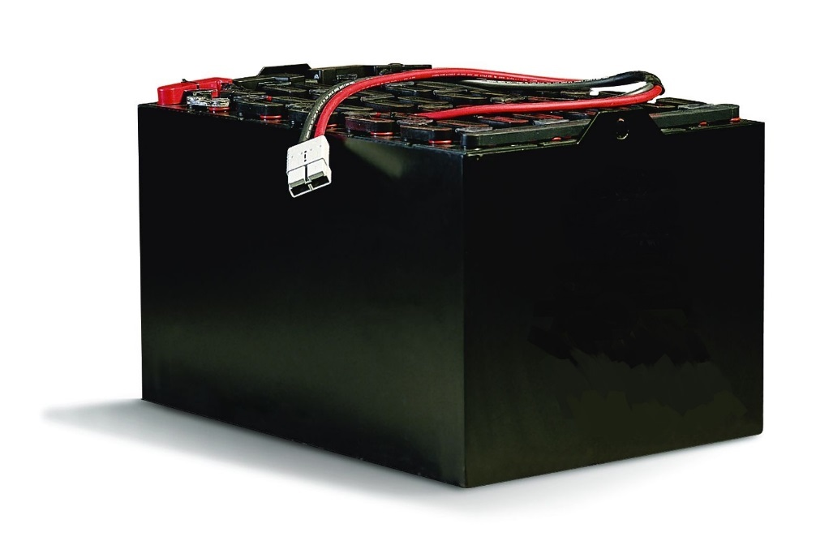
Common EXTREMELY HAZARDOUS SUBSTANCES
EHS Name Threshold Planning Quantity (TPQ)
Ammonia 500 pounds
Chlorine 100 pounds
Sulfuric Acid 1,000 pounds*
Sulfur Dioxide 500 pounds
The TPQ for Sulfuric Acid is 1,000 pounds.
For EPCRA, “have present at any one time an EHS in quantity
equal to or greater than TPQ or 500 pounds, whichever is less.”

Slide 11
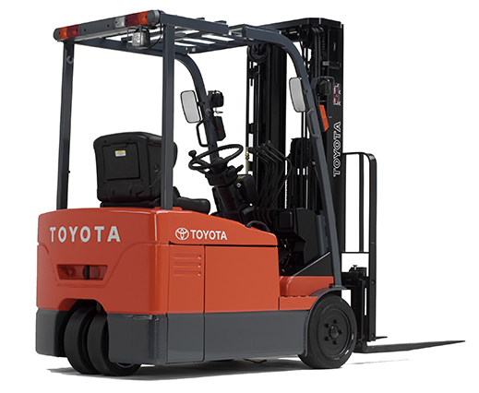
*A rough estimate to calculate sulfuric acid in a battery is to use 18% of the battery’s weight as sulfuric acid (with 70% of its weight being lead).
A typical electric lift truck battery can easily weigh 2,400 lbs., therefore, it could contain as much as 432 lbs. of sulfuric acid and as much as 1,690 lbs. of lead.

Slide 12
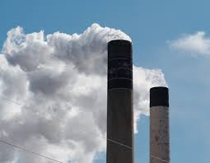
EPCRA 304 / CERCLA 103
Emergency Release Notifications
EPA has the authority to investigate releases
What Chemicals need to be reported
  EPCRA 304: Release of an EHS in quantity equal to or greater than reportable quantity (RQ) & follow-up report
  CERCLA 103: Release of a CERCLA hazardous substance in quantity equal to or greater than reportable quantity (RQ)
Who is responsible for the Release Notification
  Either the owner or operator of a facility gives notice after a release.
  Under EPCRA Section 304 both the owner and operator are responsible if no notification is provided.
Exemptions
  Releases which remain within facility boundaries
  Continuous releases
  Federally permitted releases

Slide 13
EPCRA 304 / CERCLA 103
Emergency Release Notifications
Call Your Local Responders First
Don’t wait until you know you’ve exceeded a threshold to call
Information helps responders
  Know how to respond if they get calls from the public
  Start preparing for deployment if an incident where to escalate

Slide 14
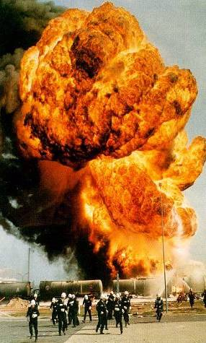
Clean Air Act Amendments (1990)
Section 112(r) prevent them all or stop them small
CAA 112(r)(1) established General Duty Clause
CAA 112(r)(7) Risk Management Program required EPA to:
  77 toxic & 63 flammable substances
  Prevent, detect & respond to accidental releases
  Manage risk management plans (RMPs) submitted by facilities & to make plans available to government officials & public
Also required finalization of OSHA’s proposed Process Safety Management Standard
14
Notes:
14

Slide 15
General Duty Clause
Owners and operators of facilities utilizing hazardous substances have a General Duty to:
  Identify hazards that may result from accidental releases using appropriate hazard assessment techniques,
  Design and maintain a safe facility taking any necessary steps to prevent releases, and
  Minimize the consequences of accidental releases that do occur.
    Note - Not limited to specific list of chemicals or threshold quantities

Slide 16
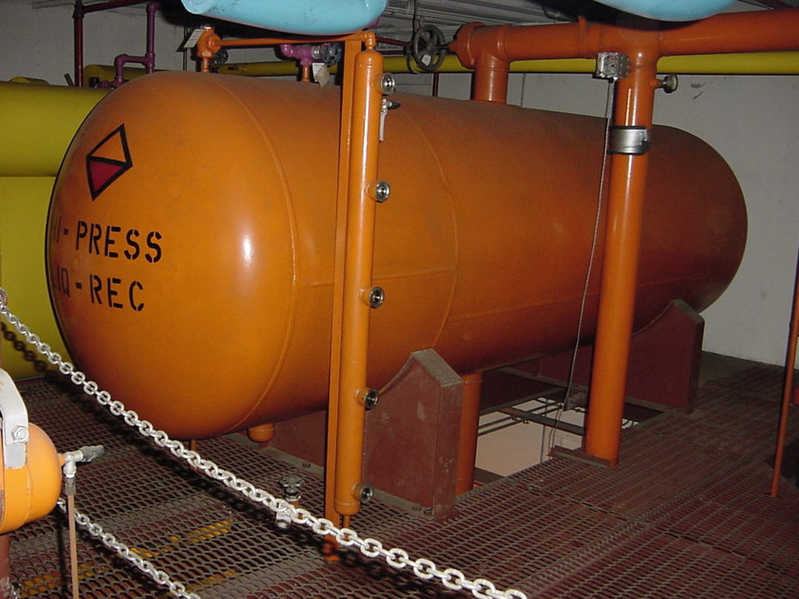
Accident Prevention Program
PSM & RMP Program Level 3
Process safety information
Process hazard analysis
Operating procedures
Training
Mechanical integrity
Management of change
Pre-startup review
Compliance audits
Incident Investigations
Employee participation
Hot work permit
Contractor management
Notes:
16

Slide 17
Highest Frequency Problems NH3 Refrigeration
Inadequately developed/implemented
Equipment not compliant
Standard Operating procedures
Emergency response and planning
Process Hazards Analysis findings not resolved
Annual Inspections and/or 5-year MI audits
Ventilation
Relief system design
Component labeling
Mechanical Integrity: Pressure Relief Valves, Corrosion
The same mistakes are repeated…
When the deficiencies are managed (prevented and mitigated), higher levels of safety and sustainability will occur.

Slide 18
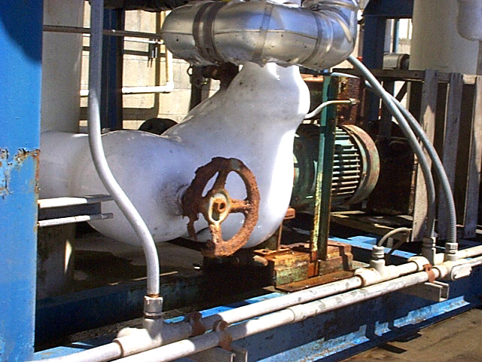

Slide 19
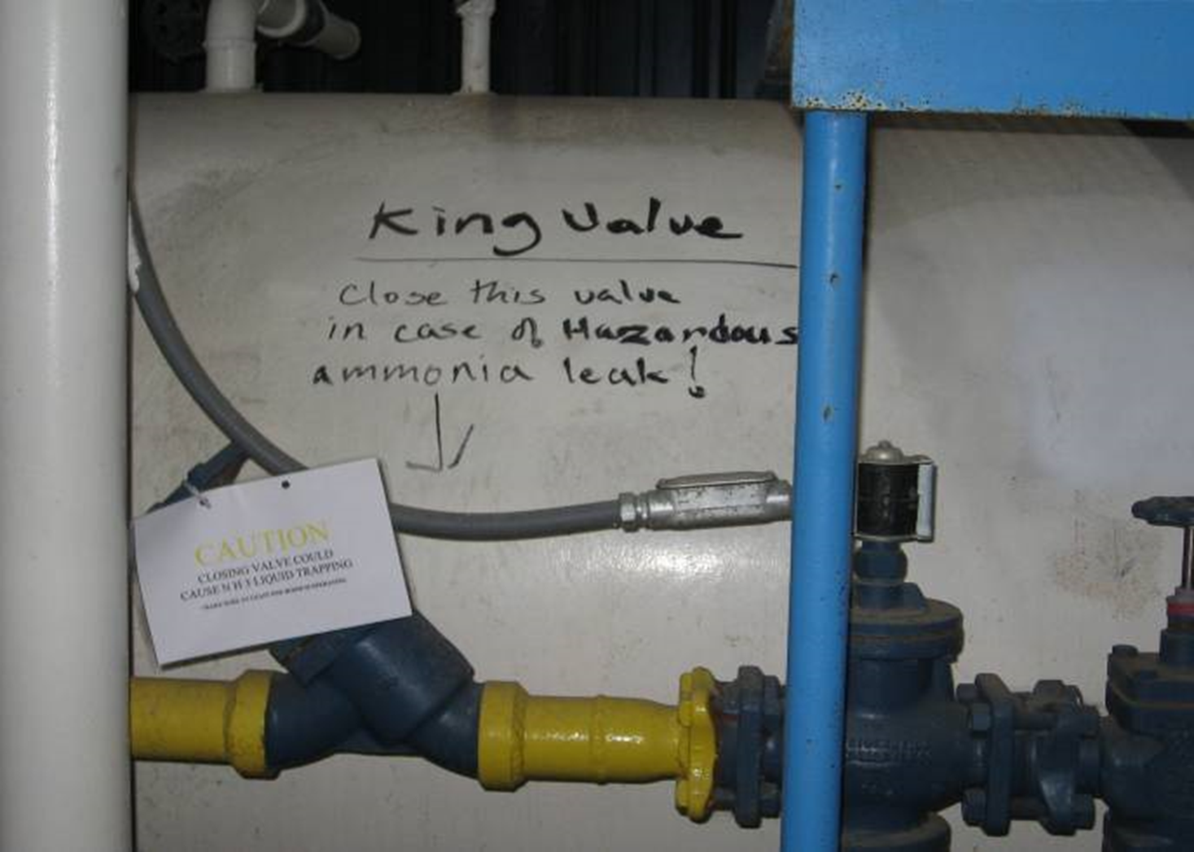
Not a good written emergency shut-down procedure!

Slide 20
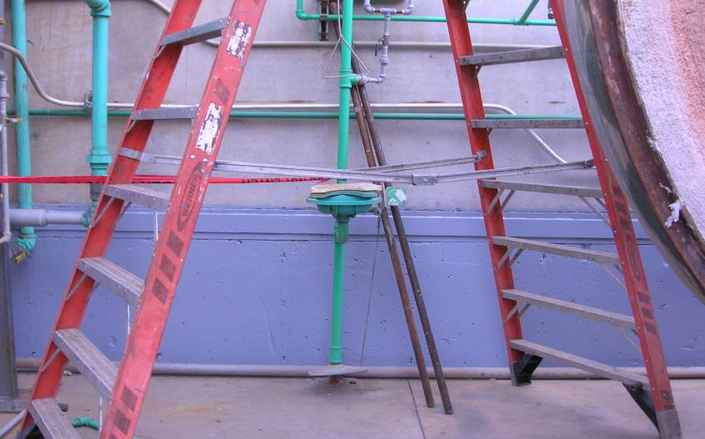
Notes:
This photo show two pumps located underneath the liquid recirculation vessel. The suction side is piped to the vessel and the discharge side to the cooler evaporators. Each pump has shut off valves on the suction and discharge side. The operator made reference to the suction side valve as the king valve. In an emergency the pump is shut down and the king valve is closed.
Both pumps and king valves are imbedded in ice. The valve stem protrudes through the ice to expose the valve handwheel. The area in general show corrosion. The handwheel on one valve is intact but severely corroded. The handwheel on the other valve is in part missing -corroded away. Visual inspection of the pumps and discharge valves was not possible.
Visual inspection of shut-off valves associated with machinery such as compressors and vessels should be included in the operational inspection of such machinery. Any fault such as accidental damage or icing which could prevent the operation of a shut-off valve when required should be corrected promptly.
Reference: International Institute of Ammonia Refrigeration Bulletin 110 Guidelines for Start-up, Inspection and Maintenance of Ammonia Mechanical refrigerating Systems.

Slide 21

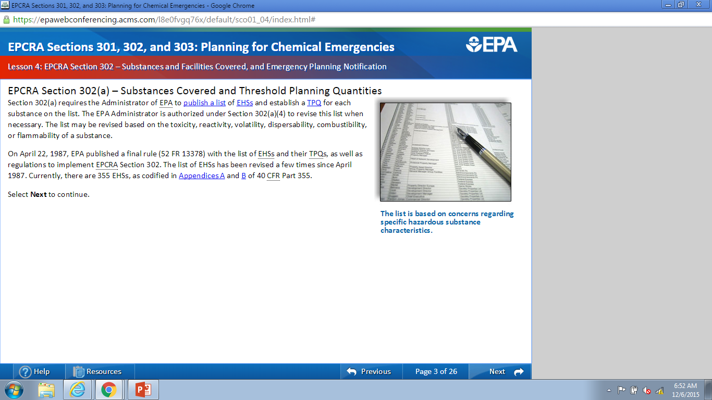
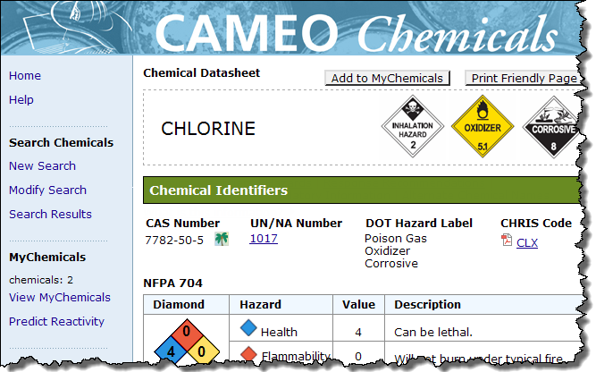

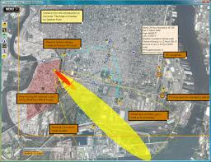
Strengthening Community
Planning, Preparedness, Prevention & Response

Slide 22
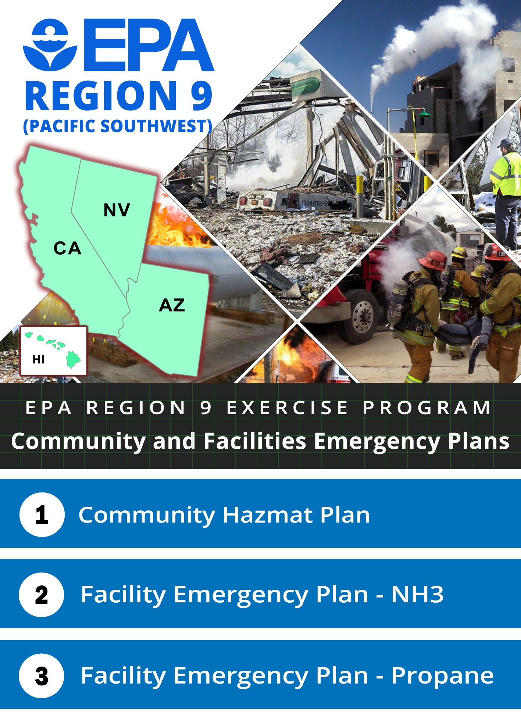
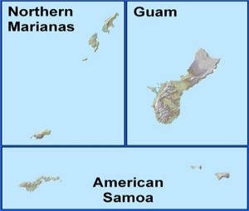
Propane Exercising Facility Plans & Local
Ammonia Emergency Plans
Chlorine
Notes:
Slide Set-Up:
Fill in the Simulation Name and Date at the bottom of the slide.
Player table, name plates
Vests, radios, clipboards, 30-Minute Plans, Workbook
Key Points:
Welcome and thanks to the host
Introduce the Simulation
Players
Facilitators
Technical Experts
Audience

Slide 23
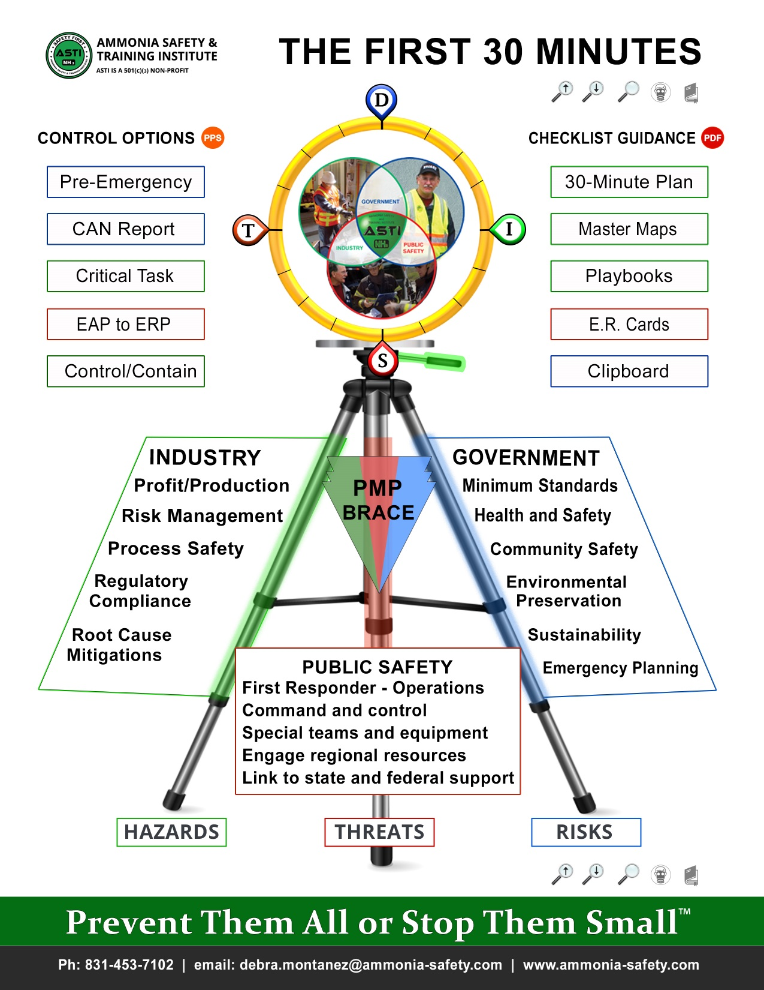

Slide 24
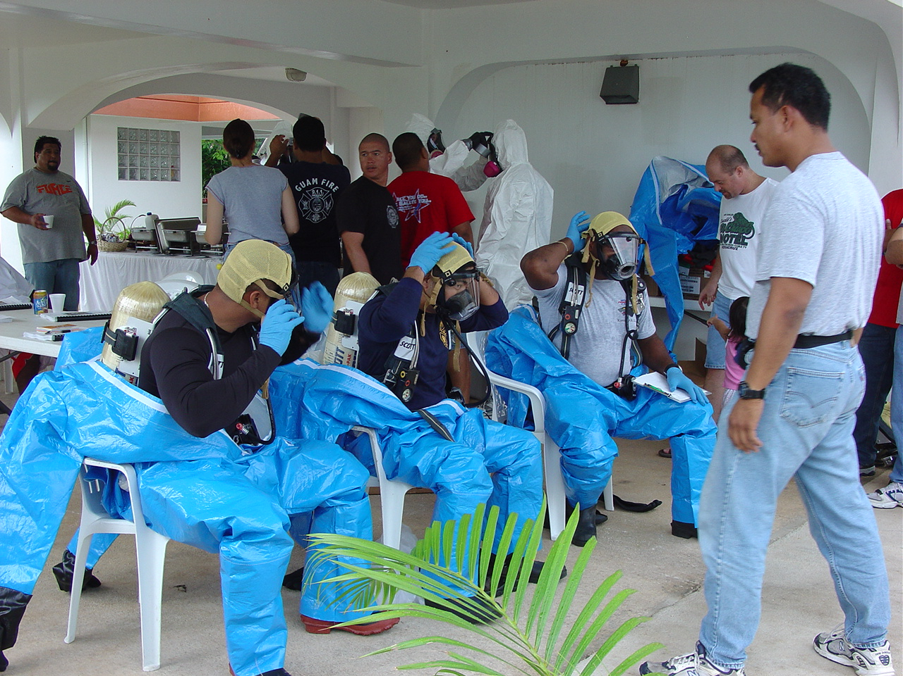
POTENTIAL TRAINING OPPORTUNITIES
A FEW EXAMPLES
Facility Training
Tabletop Exercises
First Responder Awareness
First Responder Operations
Traffic Incident Management System
Incident Command System
HazMat Tech Refresher
Hazard ID and Categorization
FEMA, USCG, USDA, DOI Training

Slide 25
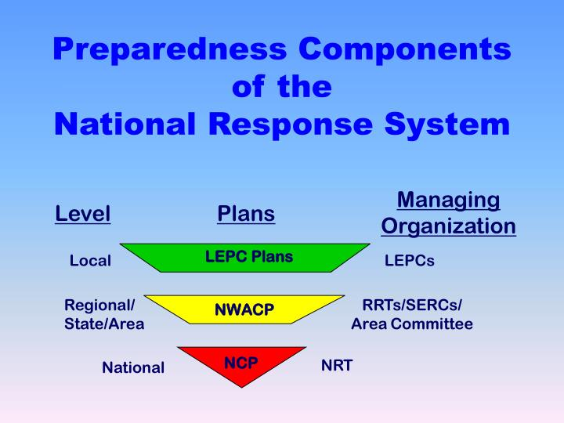

Slide 26
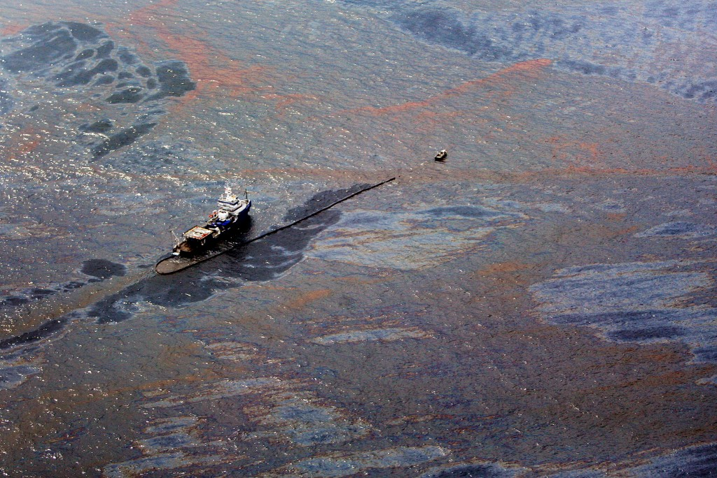
National Contingency Plan (NCP) - Est. 1968
Provides comprehensive system of accident reporting, spill containment, and cleanup
Establishes national response team & regional response coordinators
Focuses on oil spills

Slide 27
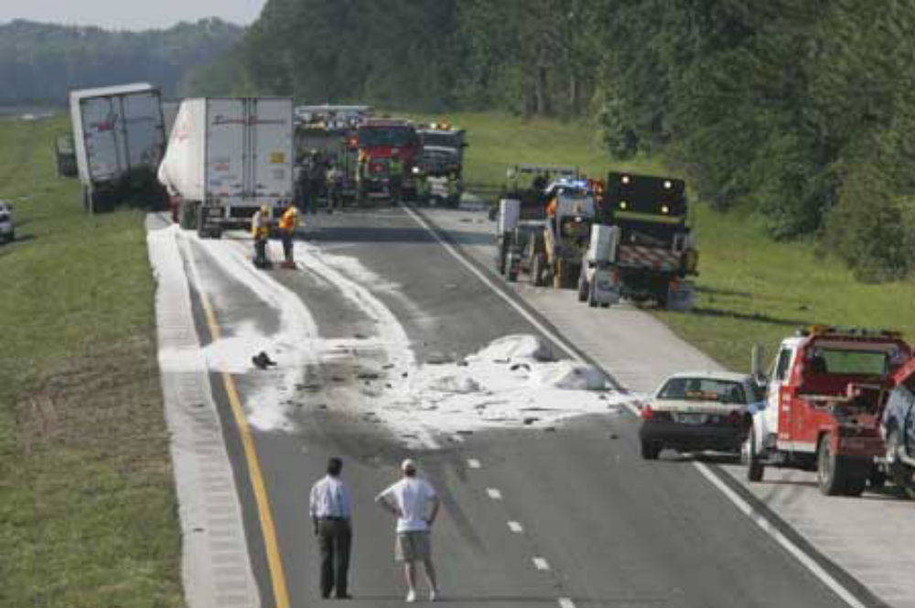
1972 NATIONAL CONTINGENCY PLAN UPATES
The 1972 revisions to the Clean Water Act (CWA) required the NCP to address releases of hazardous substances, as well as oil spills
Additionally, in 1972, the NCP was revised to establish the National Response System (NRS) with its 3 primary core components: the National Response Team (NRT), the RRTs, and On-Scene Coordinators (OSCs)

Slide 28
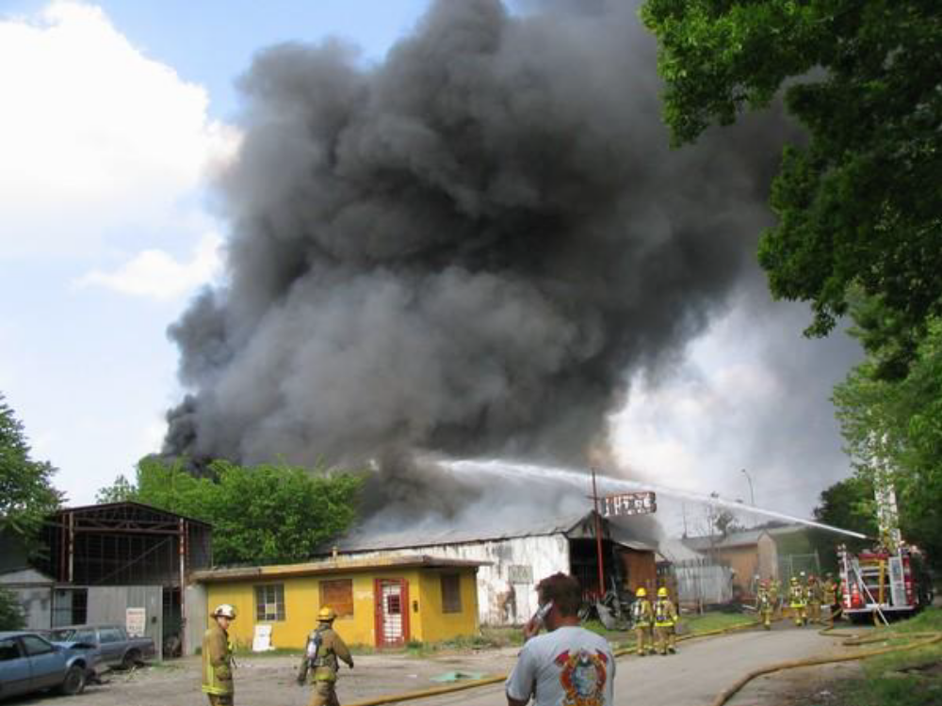
The National Response System (NRS)
The NRS is divided into local, regional, and national organizational levels.
Participants include federal, state, local, and private sector agencies and organizations, with interests in or responsibilities for oil and hazardous materials emergencies.
The NRT and RRTs can access key assets and capabilities of the 15 member agencies of the NRS to support federal agencies, states, and local responders in their efforts to mitigate the danger to public health and the environment from a hazardous release.

Slide 29
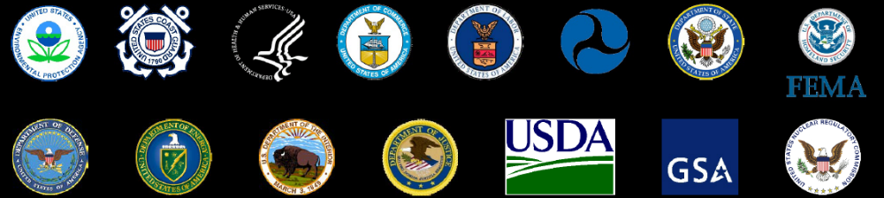
The National Response System (NRS)
The 15 federal agencies of the NRS can provide solutions for effective response to a wide range of pollution incidents, both foreign and domestic.
In addition, each agency can provide access to technical assistance, scientific expertise, logistical support, or coordination capabilities associated with its specific responsibilities and expertise.

Slide 30

The National Response System (NRS) - NRF
When hazardous releases and oil spills are determined to be "Nationally Significant Incidents" under the NCP, the National Response Framework (NRF) is implemented.
Components of the NRS, such as the National Response Team (NRT), are also activated.
The NRF provides coordinating mechanisms to bring in additional agencies and components as they are needed.

Slide 31
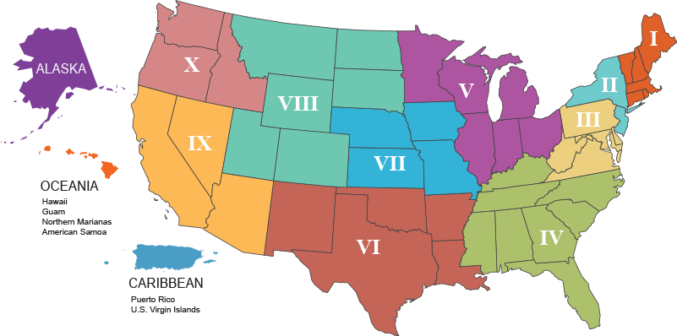
REGIONAL RESPONSE TEAMS

Slide 32

Oceania Regional Response Team (ORRT)
EPA co-chairs the ORRT, with the USCG and provides:
pre-designated OSCs for releases and discharges occurring in the inland zone
expertise on human health and ecological effects of oil discharges or releases of hazardous substances, pollutants, or contaminants; ecological and human health risk assessment methods; and environmental pollution control techniques.
legal expertise on the interpretation of CERCLA and other environmental statutes.

Slide 33
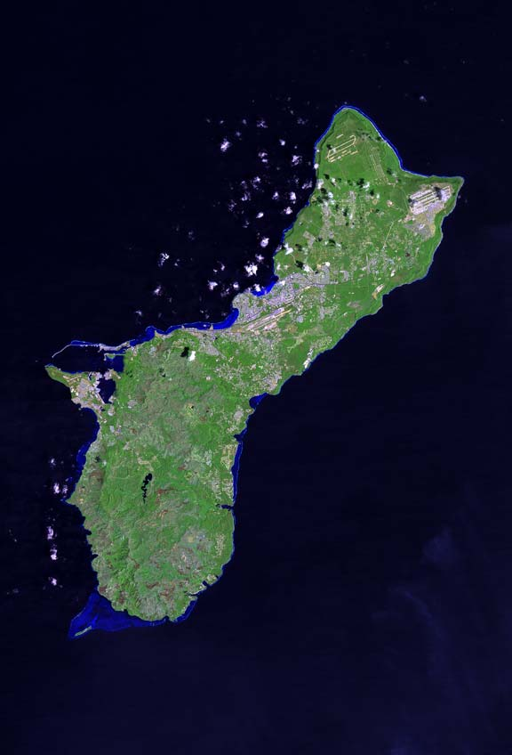
NEXT ORRT MEETING: Guam, Aug 2019?
Aiming to combine training and potential tabletop exercises the same week as the ORRT meeting.
We will be soliciting input on:
  Focus/Theme for the meeting
  Training Ideas
  Draft Agenda

Slide 34
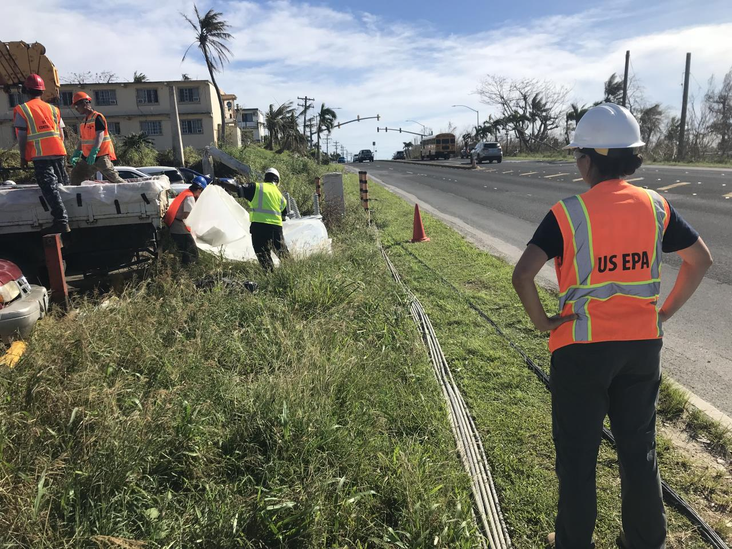
On-Scene Coordinators (OSCs)
OSC is the pre-designated federal official, directing response efforts, and coordinating other efforts, at oil or hazardous substance incidents in accordance with executive powers delegated through law, regulation, executive orders and agency delegations.
The NCP charges the OSC with the responsibility for ensuring immediate and effective response to a discharge or release.
Under the NRS, a major duty of the OSC is to coordinate with state and local response organizations.

Slide 35

SUMMARY
Territorial and Local Capacity is critical.
Planning and preparedness and fundamental training for all constituencies is critical to make sure that everyone is in synch and ready for a variety of incidents.
There is a system in place to provide Federal support for training and exercises and to assist with response to incidents that exceed Territorial and Local capacity.
Participate in SERC/LEPC and align with Oceania RRT.

Slide 36

EPA Contact Information
Jason Musante, OSC, musante.Jason@epa.gov, 213.479.2120
Michelle Rogow, OSC, rogow.michelle@epa.gov, 415-595-8347
Harry Allen, OSC, allen.harryl@epa.gov, 415-218-7406
Bill Jones, ORRT/LEPC Coordinator, jones.bill@epa.gov, 619-235-4776
Report oil or chemical spills
National Response Center: 800.424.8802
Region IX Duty Officer: 800.300.2193

