Slide 1

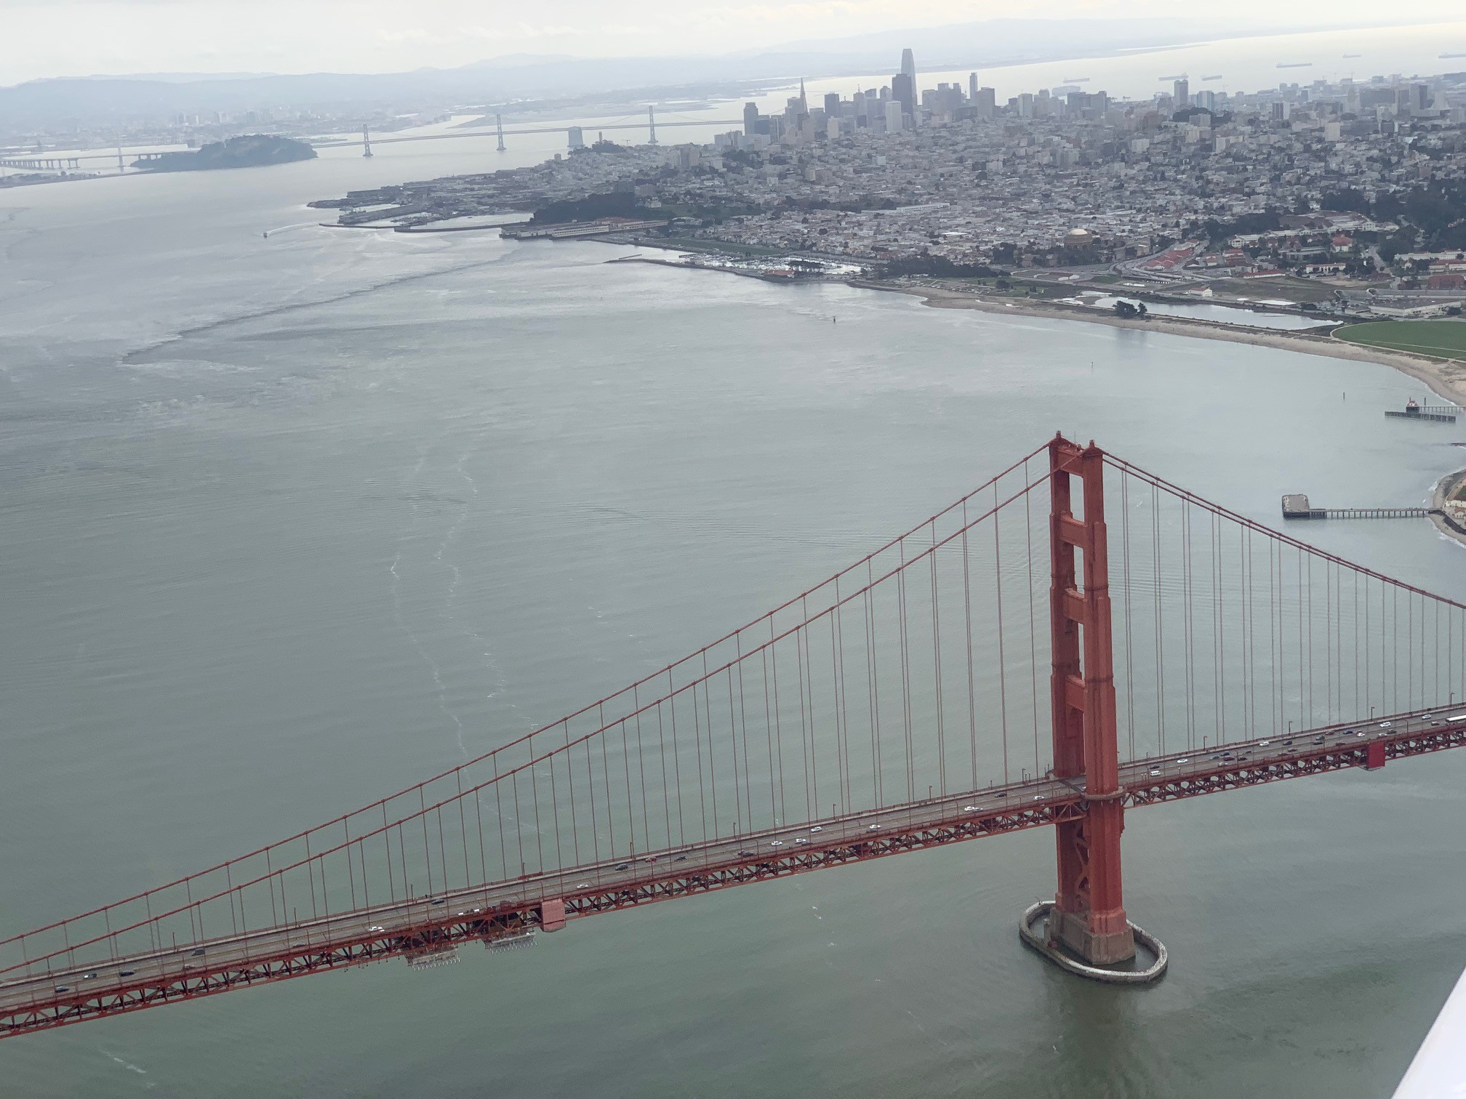

Emergency Response Program
Oceania Regional Response Team
May 5, 2021
Pete Guria
Emergency Response, Planning and Preparedness Branch

Slide 2
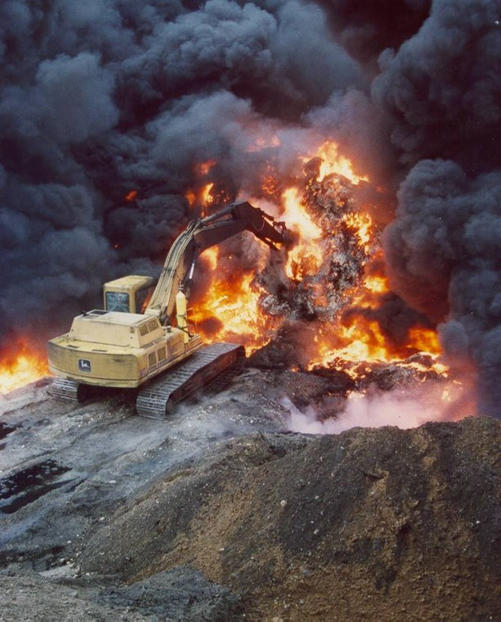

USEPA Update
Emergency Response Planning & Preparedness Branch Staffing Changes
Summary of ER & TCRA During COVID-19
2021 Disaster preparations
UAS Policy Update

Slide 3
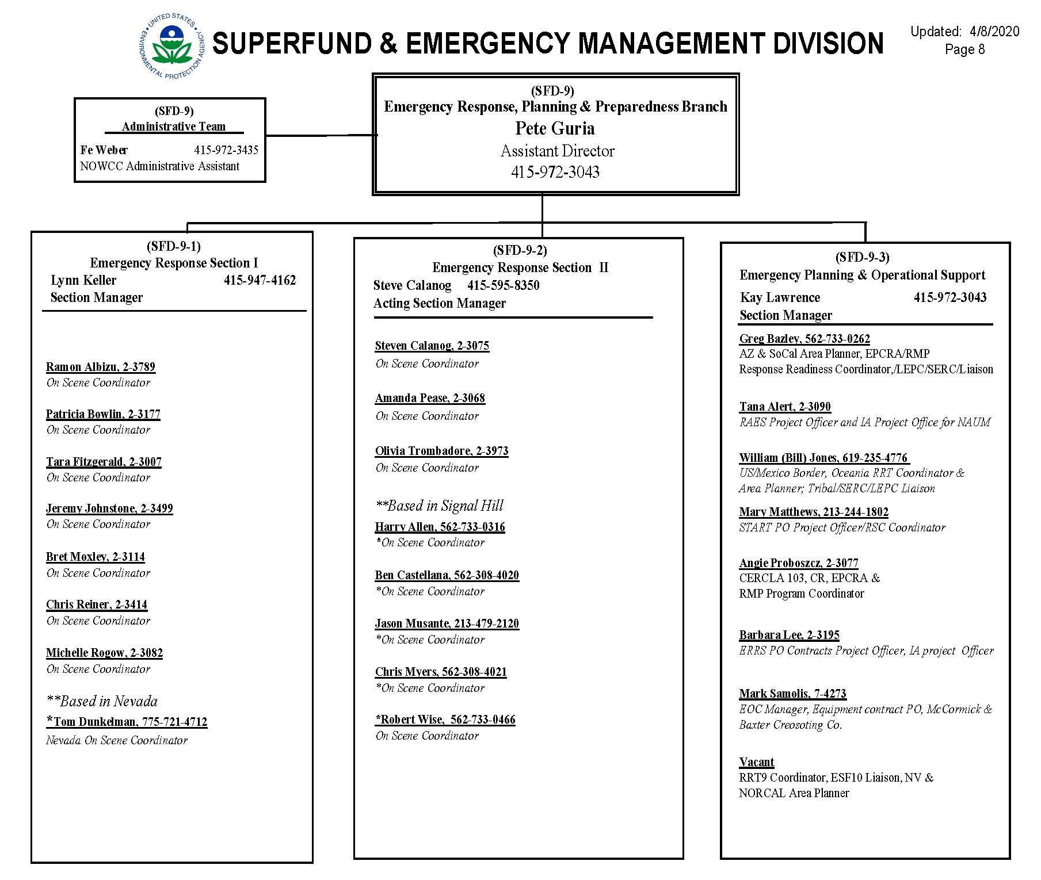
EPA R9 Emergency Response Branch - Staffing
Current Organization:
  Emergency Response I
  Emergency Response II
  Planning/Preparedness
Notes:
ER is one of 4 Branches in SEMD: Tribal land C/U-Remedial Support; CA Site C/U; Fed Facility Site C/U

Slide 4
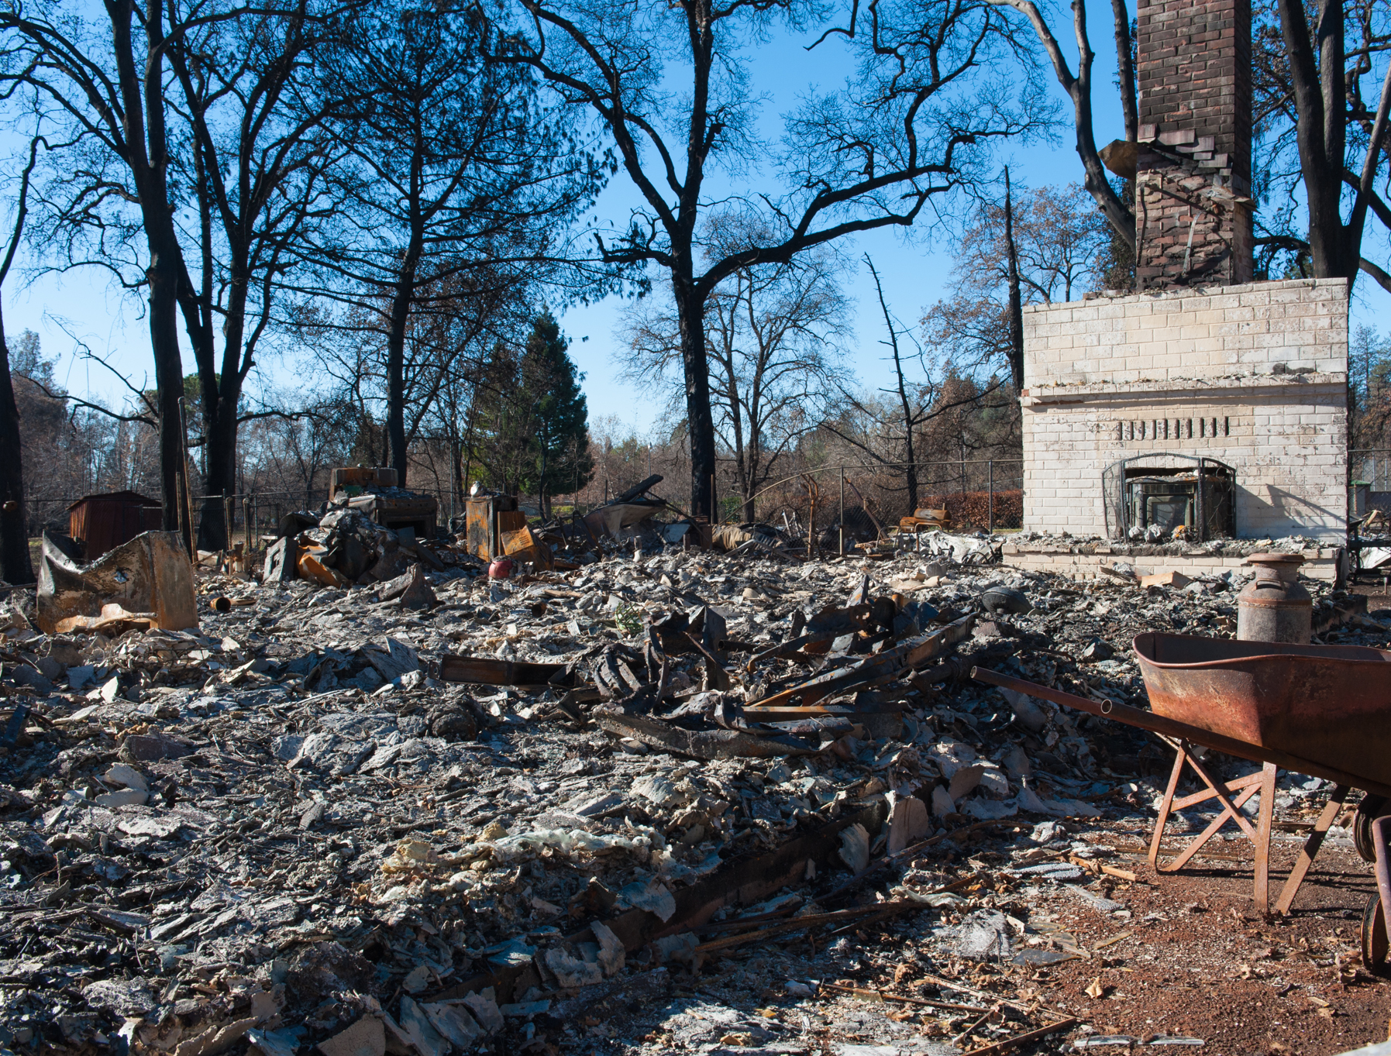
Disaster Response Preparation
Revising 2020 disaster response framework
  Update Health & Safety Protocols per CDC Guidance
  Advance planning with State Partners
  Refining IMT ICP/staffing needs
  EPA Western Regions Collaboration
Notes:
Revisions to implement lessons learned from 2020 WF response
Update H/S Med Unit protocols from revised CDC guidance
ESF coordination with CalEPA/DTSC/CALRECYCLE
Refining needs for virtual/in-person ICP/IMT
western EPA Regions 8, 9, &10 are working together to share their best practices to ensure effective and consistent approach to fire response management throughout the west.

Slide 5
Quick Summary of ER/Time Critical Removal Actions During covid-19
11- ERs
7 - TCRAs
12 – Project Requests for COVID-19 Testing
Notes:
Initiated 11 ER actions, 2-TCRA with 6-planned. 12 projects for COVID-19 testing for response personnel

Slide 6
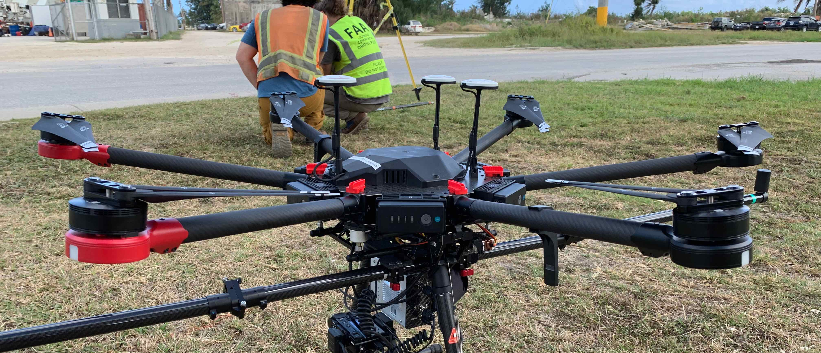
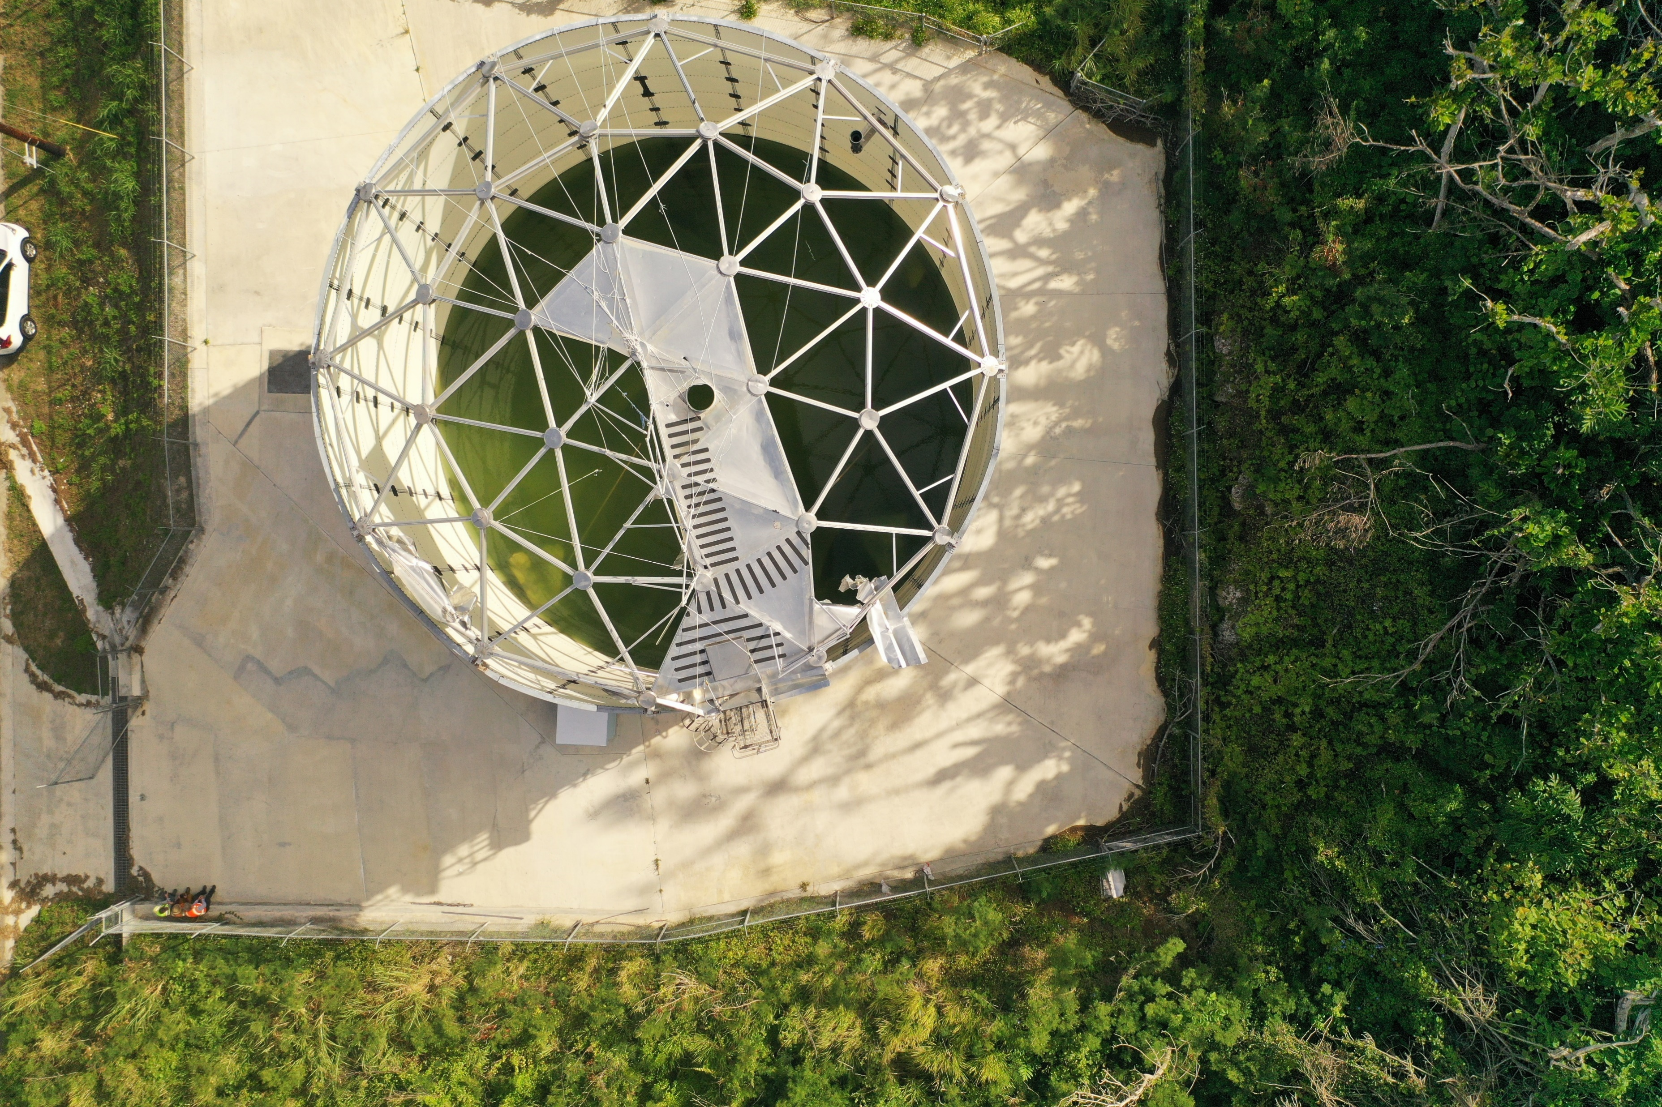
Unmanned Aerial system (UAS) policy
UAS Policy developed
  Signed by the Chief Information Officer 2-Dec-20
  Est. categories for operation & conditions for use
  Requirements for data collection/Mgmt, security, privacy, utilization reporting
  Requires development of UAS Procedures and Training
Notes:
Mention historical use in R9 and expanded use during 2021 WF response.

Slide 7
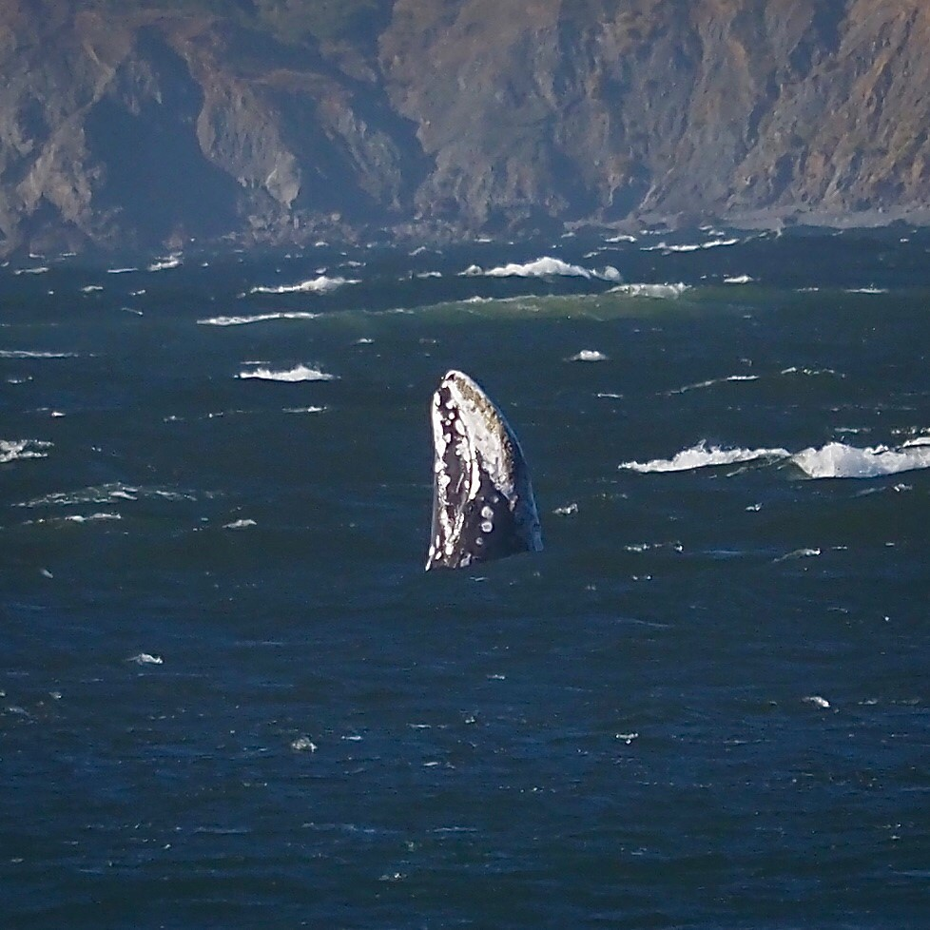
Questions?

