Slide 1
ACP Architecture and MER Initiatives
CDR Matt Richards
Chief of Domestic Preparedness and Planning (CG-MER-4)

Slide 2
CG-MER Priorities and Perspectives
New ACP architecture roll-out; timeline & importance.
New MERPMAN framework; timeline & importance.
MTS emphasis: ACP-SMFF Annex, AMSP-SRPs & MTSRPs; plan connectivity.
Hazardous Substance; planning gap.
Risk Assessment; ensure proper planning scenarios for Coastal Zone.
Area Role; stronger to align with other missions.
Meaningful exercises; risk-based scenario selection and design.
“New” MER; revamped to account for changing response landscape.

Slide 3
New ACP Architecture Roll Out
First major revision in over 25 years; updated policy in Fall w/ 3 yr compliance timeline.
Responder & user friendly.
Establishes national consistency/standardization. Important for plug & play response environment.
Accommodates development of mobile applications; R&D underway.
Promotes establishment/enforcement of long-term accountability.
Facilitate development of 1st ever Coastal AC Planning Handbook.
Announced in MSIB 10-23 and ALCOAST 396/23

Slide 4
Architecture Overview
Part | Title
1000 | General and Administrative
2000 | Geographic Scope & Jurisdictional Boundaries
3000 | Roles & Responsibilities
4000 | Pre-Spill Risk Analyses, Consultations, & Response Strategies
5000 | Response
6000 | Response Resources
7000 | Response Technologies
Notes:
Part 1000 includes topics like AC Management and Adminsitration, ACP Validation and testing, ACP relationship and alignment with other plans (VRPs, FRPs, Local, State, Tribal plans, RCP, and international), ACP Relationship to NRF, ACP relationship to NIMS
Part 2000 includes EPA/USCG line of demarcation, USCG/EPA MOU, Geographic boundaries (COTP boundary), graphic depiction, subareas.
Part 3000 includes general roles and responsibilities, natural resource trustees, support available to the FOSC (special teams).
Part 4000 includes Worst Case Discharge, Pre-spill ESA Consultations, NHPA, Economically Sensitive Areas, Geographic Response Strategies.
Part 5000: pattern of a response, emergency consultations, NIMS, containment and cleanup, funding and cost recovery, HAZSUB, HAZSUB funding and cost recover, response documentation, post spill consultations
Part 6000: Oil Spill OSRO equipment, HAZSUB resources, SMFF resources.
Part 7000: Response technologies (dispersants, In-situ, surface washing agents, SMART protocols, etc.)

Slide 5
Annexes
Annex | Title
Annex A | Mastery Hyperlink Index
Annex B | Risk Analyses/Risk Profile Annex
Annex C | Fish & Wildlife Annex
Annex D | Hazardous Substance Annex
Annex E | Salvage and Marine Fire Fighting Annex
Annex F | Response Tools: Quick Response Guides (QRGs), Checklists, forms, job aids, etc.
Annex G | Voluntary Organizations Assisting in Disaster (VOAD)
Annex H | ESF-10 Annex
Annex I | Ice Operations & Arctic/Cold Weather Response

Slide 6
Annexes (continued)
Annex | Title
Annex J | Space Operations
Annex K | Air Operations & UAV Support
Annex L | Unconventional Oil Spill Response
Annex M | Tribal Annex
Annex N | Swift Water Response Operations
Annex O | International Coordination and Relationship to International Plans

Slide 7
New MERPMAN Framework
4 Pillars of MER
Sequential structure
Threads relevant policy aspects of plans/planning into the different phases (pillars).
Concurrent Clearance: Fall
Notes:
“4 Pillars of MER”; compartmentalizes all MER functions into equally important and necessary phases of work.
Sequential structure (Admin/Trng > Planning > Preparedness > Response) better aligned w/ staffing assignments at field level
Threads relevant policy aspects of plans/planning into the different phases (pillars). Example: ACPs need to be developed (PLANNING); validated & tested (PREPAREDNESS); & activated/implemented (RESPONSE).
Concurrent Clearance: Fall

Slide 8
MTS Emphasis and Connectivity of Plans
MTS is national lifeblood and sustainment critical to national security & resiliency.
As per DHS National Infrastructure Protection Plan, CG lead federal agency responsible for protecting the MTS.
Timely & effective response >> faster recovery >> greater national resiliency. This is Homeland Security!
Unify CG planning efforts to ensure optimized ops posture in all-hazards MTS environment.
Anticipate SMFF Annex added to all coastal ACPs.
Notes:
Unify CG planning efforts to ensure optimized ops posture in all-hazards MTS environment. Includes AMS plans such as Salvage Response Plans, MTS Recovery plans, etc.
Anticipate SMFF Annex added to all coastal ACPs.
MTS is national lifeblood (critical infrastructure, energy, economic, ecological, cultural, recreation/tourism) and sustainment critical to national security & resiliency.
As per DHS National Infrastructure Protection Plan, CG lead federal agency responsible for protecting the MTS.
Timely & effective response >> faster recovery >> greater national resiliency. This is Homeland Security!
Ex: M/V Golden Ray & Newark, NJ vessel fire/responder deaths.

Slide 9
Hazardous Substance
CWA/NCP requires FOSC to plan for & respond to oil or hazsub.
Propensity to avoid, but major safety concern.
Although we rarely conduct actual response to hazsub, we must plan, coordinate & train.
Anticipate Hazsub Annex added to all coastal ACPs.
Has always been in COMDTINST, just not “enforced.”
East Palestine, OH train derailment. EPA
Paulsboro, NJ train derailment. USCG

Slide 10
Risk Assessment
Always required, just neglected over time.
Anticipate Risk Analysis Annex added to all coastal ACPs.
Important for AC to routinely assess threats/vulnerabilities & prioritize planning preparedness activities.
Fundamental to response planning. ACP must be crafted around planning scenarios.
Broad scope. NOT limited to CG regulated facilities.
Coastal Zone definition (Line of Demarcation) key in identifying planning targets.

Slide 11
Area Role
Formally integrate PAC/LANT into decision making process.
CG-MER is a policy/program office. PAC/LANT are “operational commanders” that execute, monitor & enforce compliance w/ policy.
Strengthen/reinforce military ethos into MER culture:
  Use Chain of Command
  Resolve issues at lowest level
Areas provide amplifying/additional guidance & requirements to policy.
New PACAREA position hired.

Slide 12
Improvement Plan
CG NRP drafts passback memo
Passback memo identifies "Improvement Actions"
Reviewed by Area & District
Sector develops improvement plan
Improvement plan approved by Area

Slide 13
Meaningful Exercises
Risk Based Scenario Selection and Design
Area Committee Involvement
Exercise and Training Subcommittee?
Notes:
All Area Exercises must be Coast Guard led and focus on testing and evaluating the contents of ACP. Industry plans may be exercised concurrently, so long as the ACP is the primary focus of the exercise.
The Coast Guard must serve a primary role with respect to exercise design and planning . However, other area stakeholders (including industry) may play a prominent supporting/partnering role in exercise design/planning and may serve as the host of a Coast Guard area exercise.
Coast Guard participation only in an exercise designed and led by other stakeholders does not satisfy Area exercise requirements.
Exercise scenario selection and design should be strategic and consider the entire four- year cycle. Consideration should be given to gaps, sensitivities and risks as identified by the Area Committee. It is highly recommended that a training and exercise subcommittee be established to maintain a risk-based exercise planning program.

Slide 14
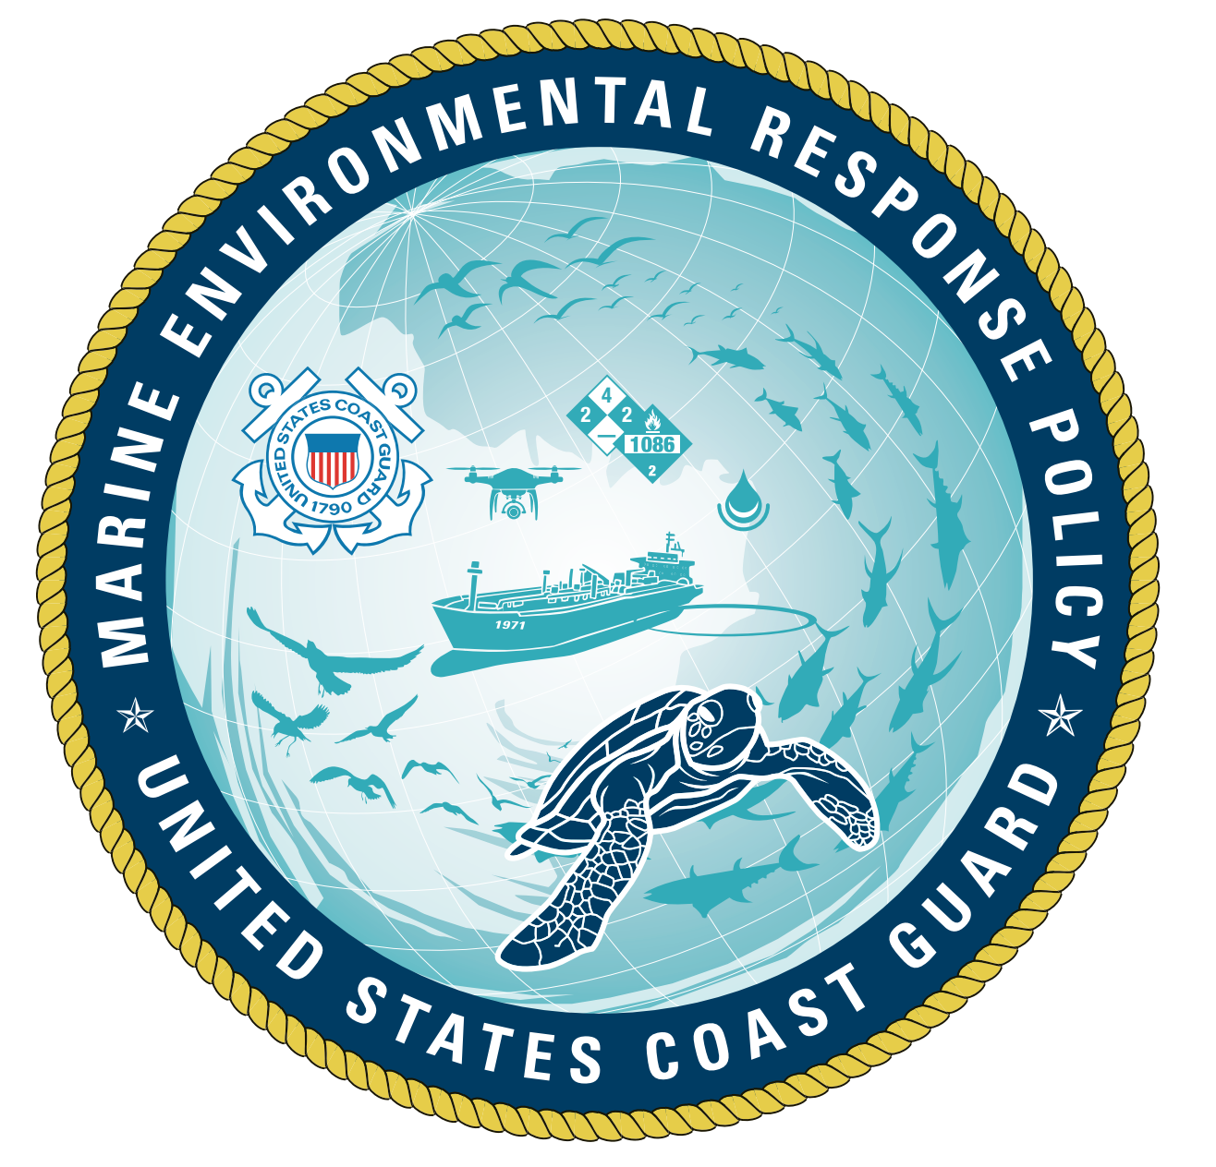
"New" MER
Revamped to account for changing response landscape.
New MER organization structure; 4 divisions.
New Logo!
Strategic Planning Efforts.
Strategy now a formal MER function (MER-3). .
Draft MER Strategic Plan completed; ready for routing.
Action planning and priorities driven by strategic planning.
Business Administration and Management instruction (MER SOP) forthcoming. Will include communication, outreach, and engagement protocols.

