Slide 1
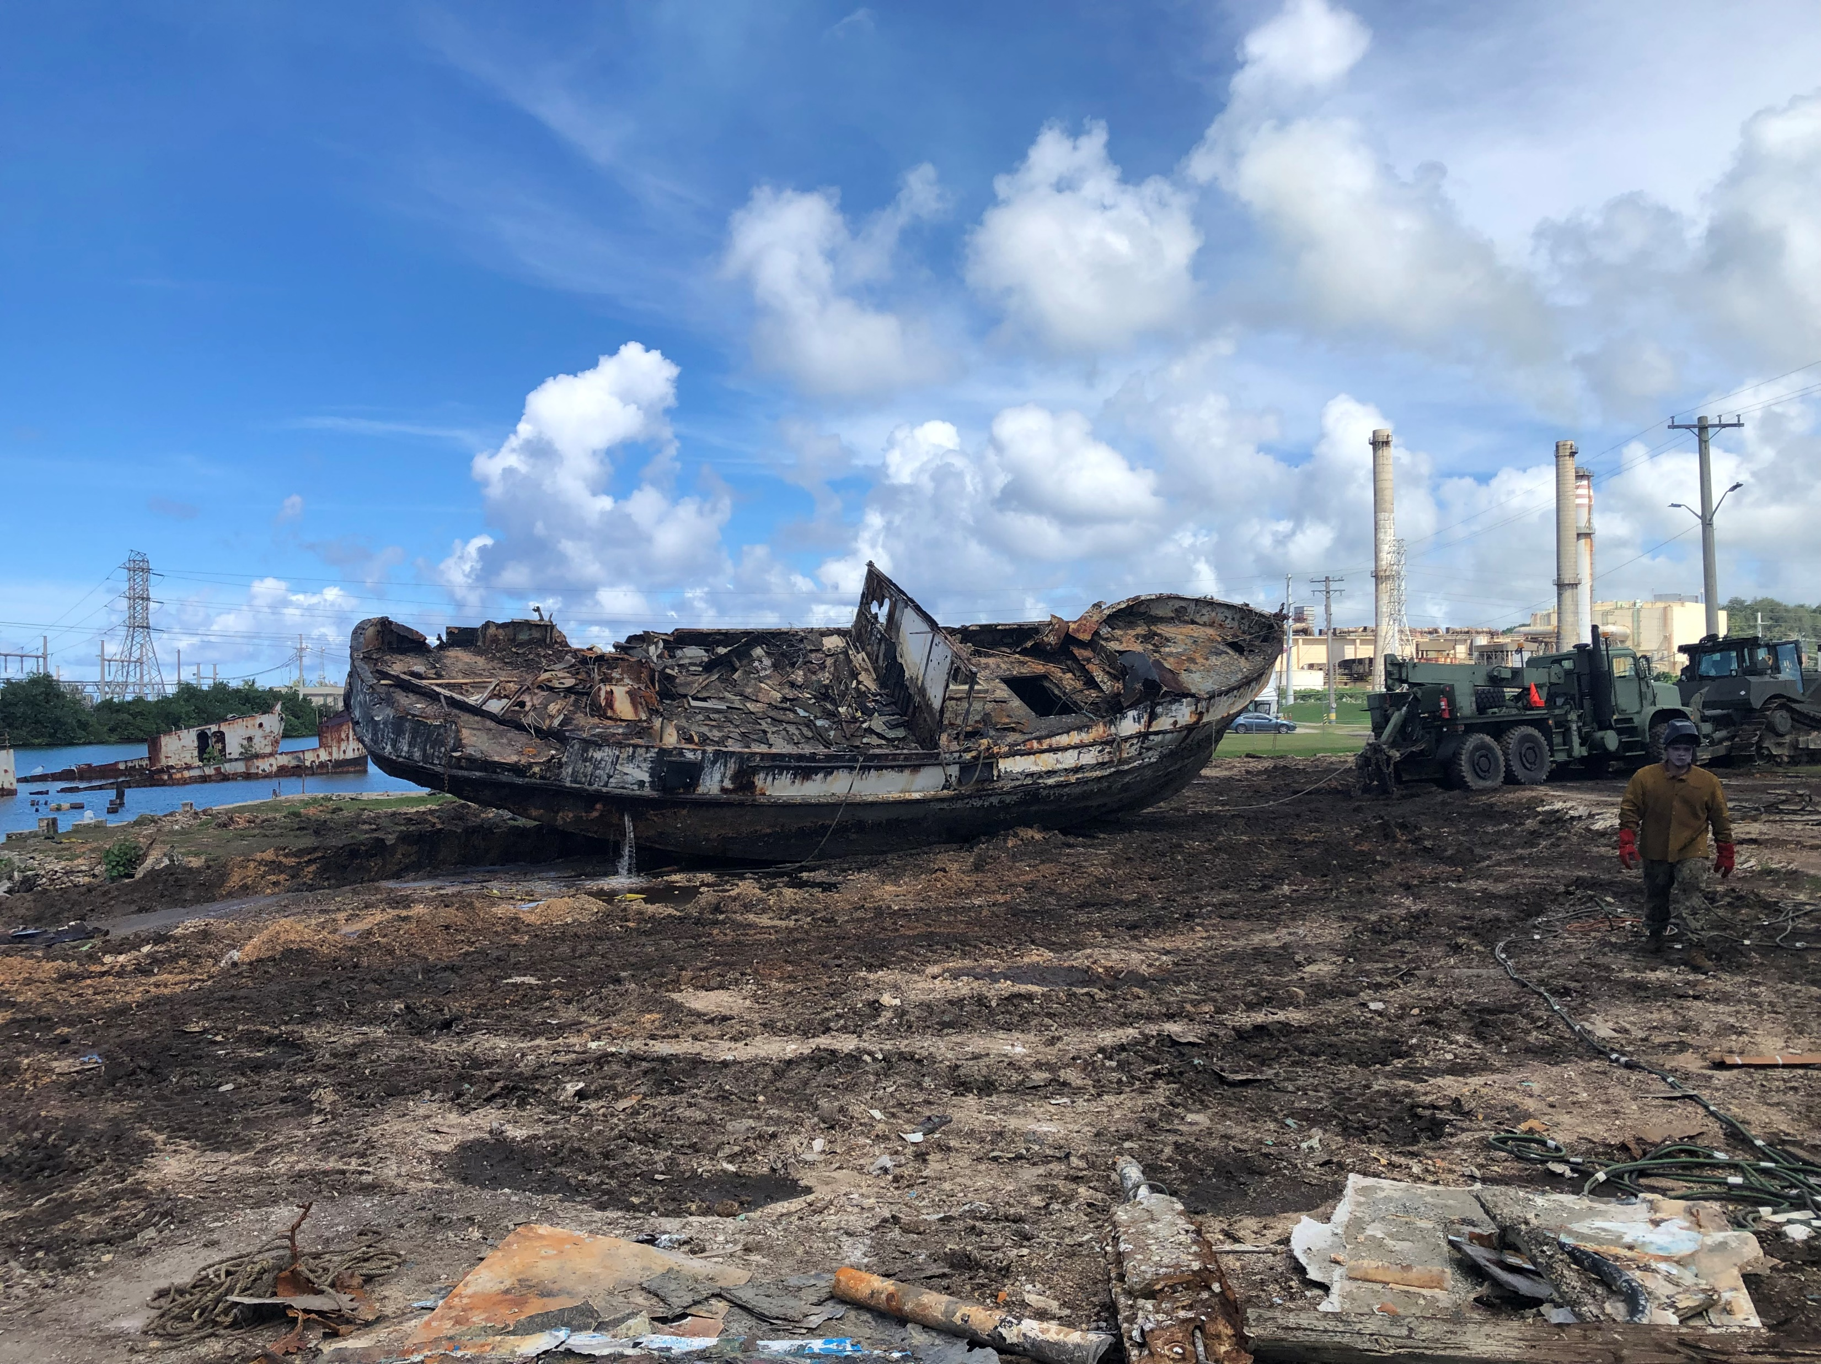
Oceania Regional Response Team Meeting
Superfund Response and Technical Assistance in the Pacific Islands
February 2022

Slide 2
Multi-Site Chemical Removal, American Samoa (OSC Reiner)
Waste chemicals will be evaluated, categorized, and neutralized on-site or packed for transportation and disposal
Waste located at:
  LBJ Hospital
  Dept of Agriculture
  Multiple High Schools
  American Samoa Community College
Work pending COVID-19

Slide 3
FAS Chemical Waste Removal (OSC Reiner)
Removal of chemical wastes and other hazardous materials from labs and other facilities in Freely Associated States
Republic of the Marshall Islands, Federated States of Micronesia (Yap), Palau
US Department of State funded EPA to conduct this work for disaster resiliency
Work pending COVID-19

Slide 4
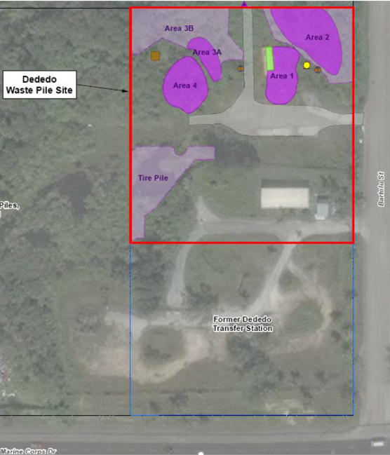
Dededo Waste Piles, Guam (OSC Johnstone)
Site of former transfer station and private solid waste recovery operations
Main contaminant is Pb above RCRA hazardous waste levels
  PCBs (<50 ppm)
Next Steps
  Coordination with GEPA Targeted Brownfields Assessment
  Cultural Resources Survey
  Spring 2022 waste pile segregation and additional characterization

Slide 5
Harbor of Refuge ADVs, Guam (OSC Allen)
10+ ADVs in Piti, Harbor of Refuge were targeted for salvage
  US Navy requested by Gov Guam to remove vessels
  EPA to address haz waste and provide equipment and supplies. USCG is FOSCR
USN salvage team completed removal of 10 vessels. A new team has begun work on the 11th (a former military landing craft).
  EPA has profiled haz waste for disposal with Waste Management on CONUS. Guam Power and Port of Guam are coordinating debris disposal.

Slide 6
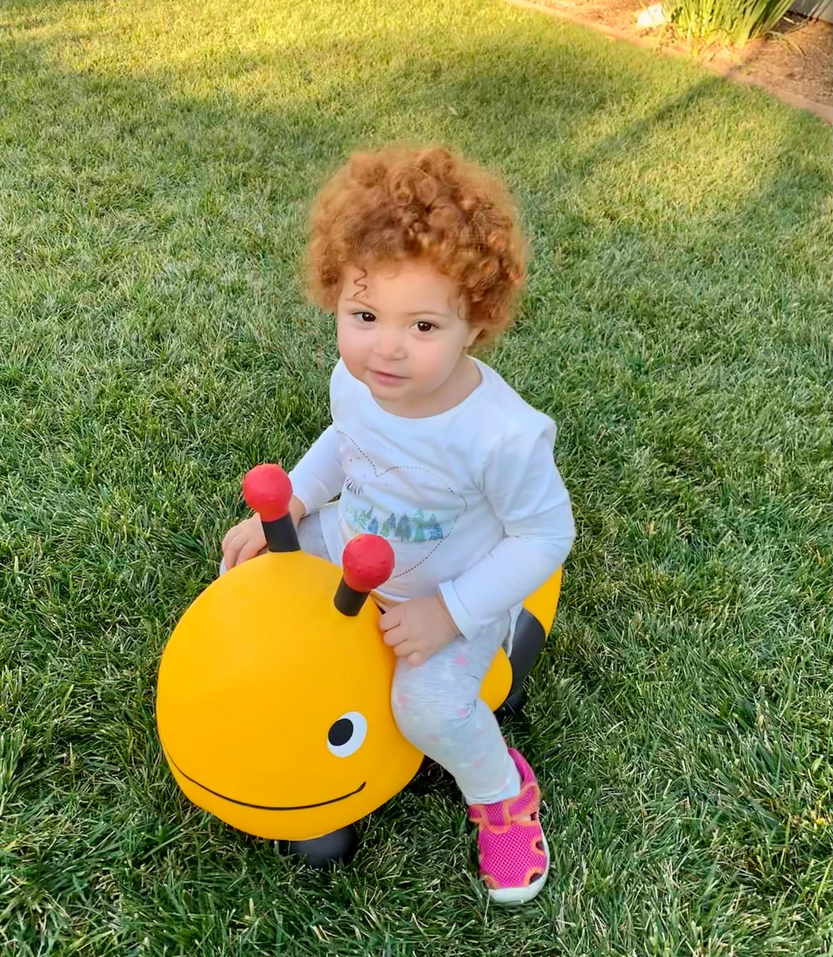

Malia 18 months

Slide 7
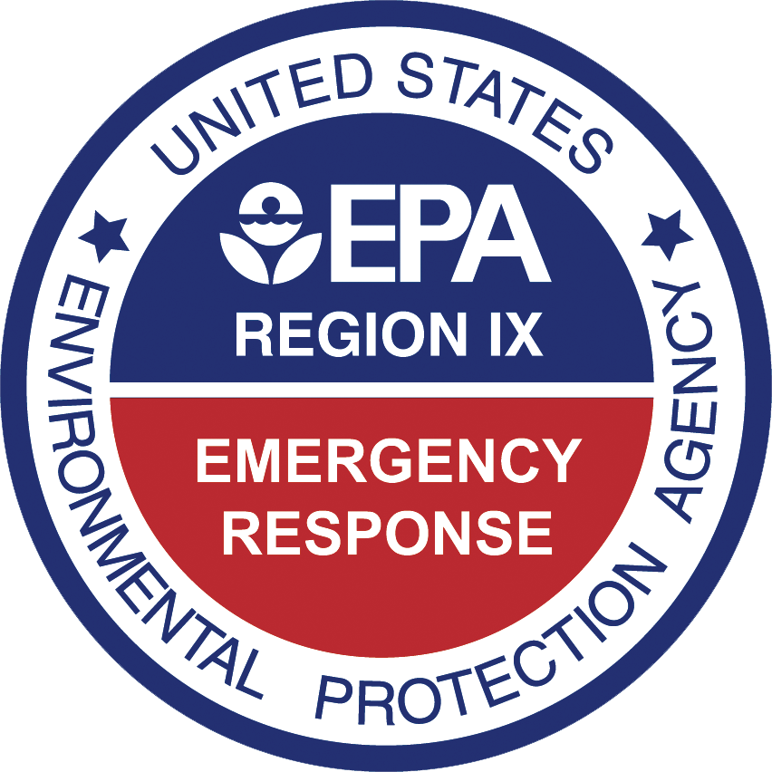
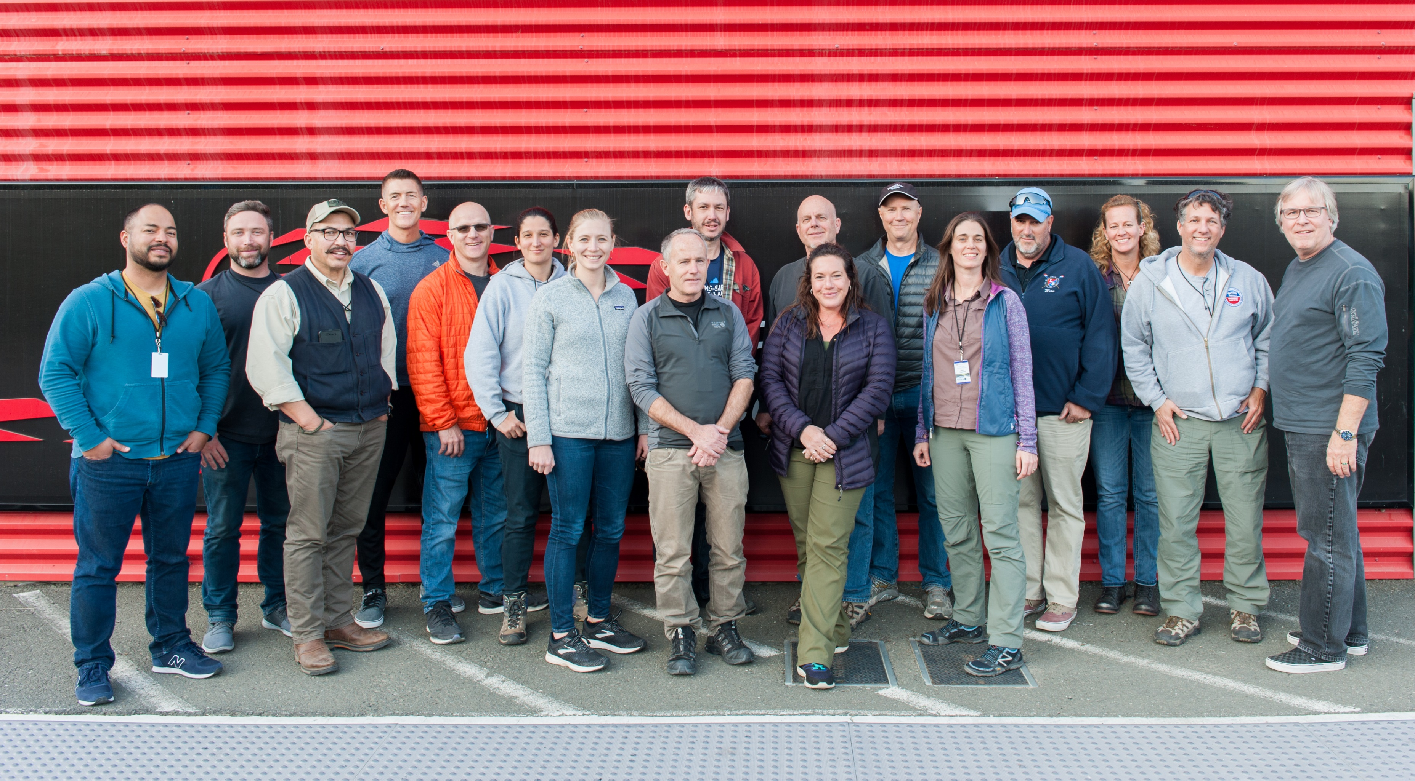
Questions?

