Slide 1
AGENDA
ORRT FALL MEETING
Welcome & opening comments: ORRT Co-chairs
Harbor of Refuge Abandoned and Derelict Vessels Presentation – Harry Allen, FOSC, USEPA
State and Territorial Partner Agency Updates
Federal Agency Partner Updates
USCG and USEPA Updates
Wrap up
  Summary of key points and decisions, next steps and actions to be taken.
  Alibis

Slide 2
Harbor of Refuge ADVs, Guam (OSC Allen)
10+ ADVs in Piti, Harbor of Refuge are targeted for salvage
Gov Guam request to US Navy to remove vessels resulted in approval of an Innovative Readiness Training mission
EPA providing salvage equipment/supplies and hazardous waste disposal under an Action Memo
Collaboration partners include: Guam EPA, Guam Power Authority, Port Authority of Guam, USN, USCG, NOAA, and EPA
Work started October 2021

Slide 3
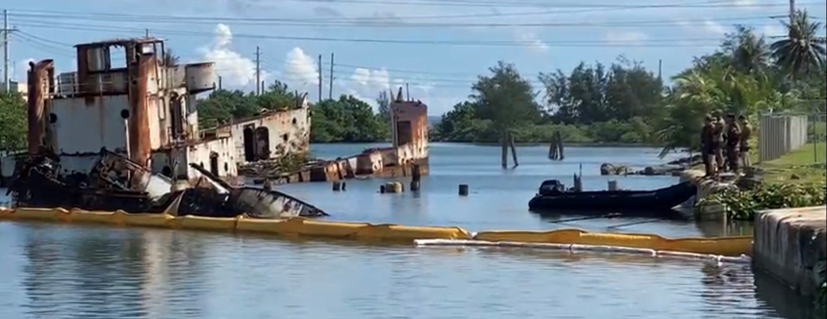
Oceania Regional Response Team Meeting
Superfund Response and Technical Assistance in the Pacific Islands
October 2021

Slide 4
Multi-Site Chemical Removal, American Samoa (OSC Reiner)
Waste chemicals will be evaluated, categorized, and neutralized on-site or packed for transportation and disposal
Waste located at:
  LBJ Hospital
  Dept of Agriculture
  Multiple High Schools
  American Samoa Community College
Work delayed until 2022

Slide 5
FAS Chemical Waste Removal (OSC Reiner)
Removal of chemical wastes and other hazardous materials from labs and other facilities in Freely Associated States
Republic of the Marshall Islands, Federated States of Micronesia (Yap), Palau
US Department of State funded EPA to conduct this work for disaster resiliency
Work delayed until 2022

Slide 6
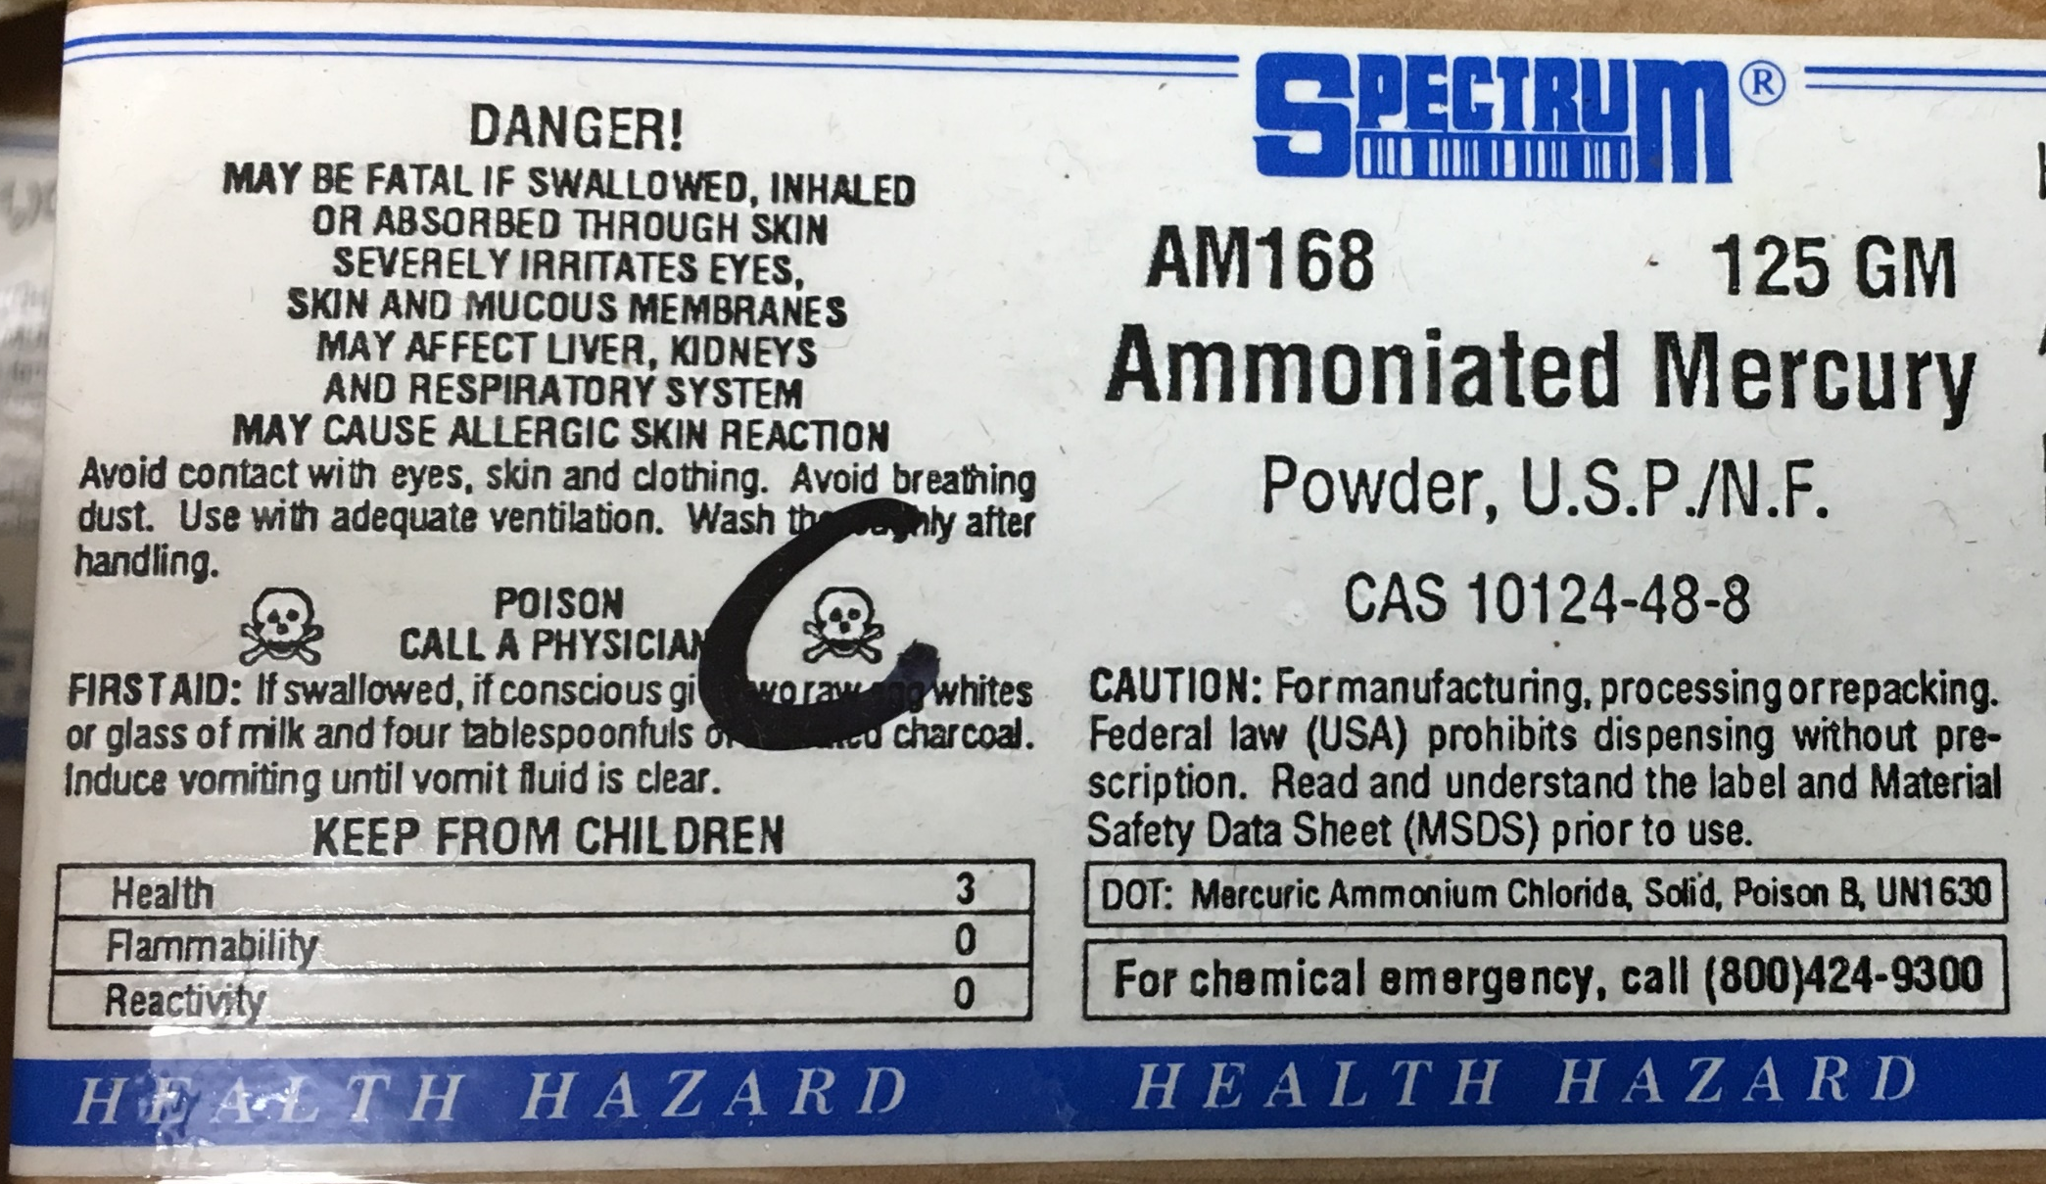
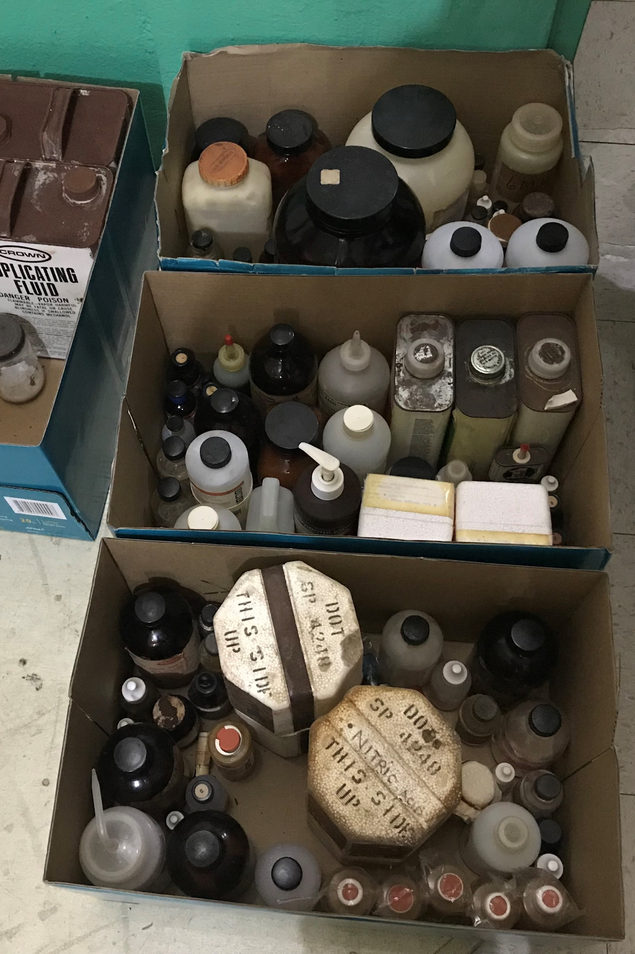
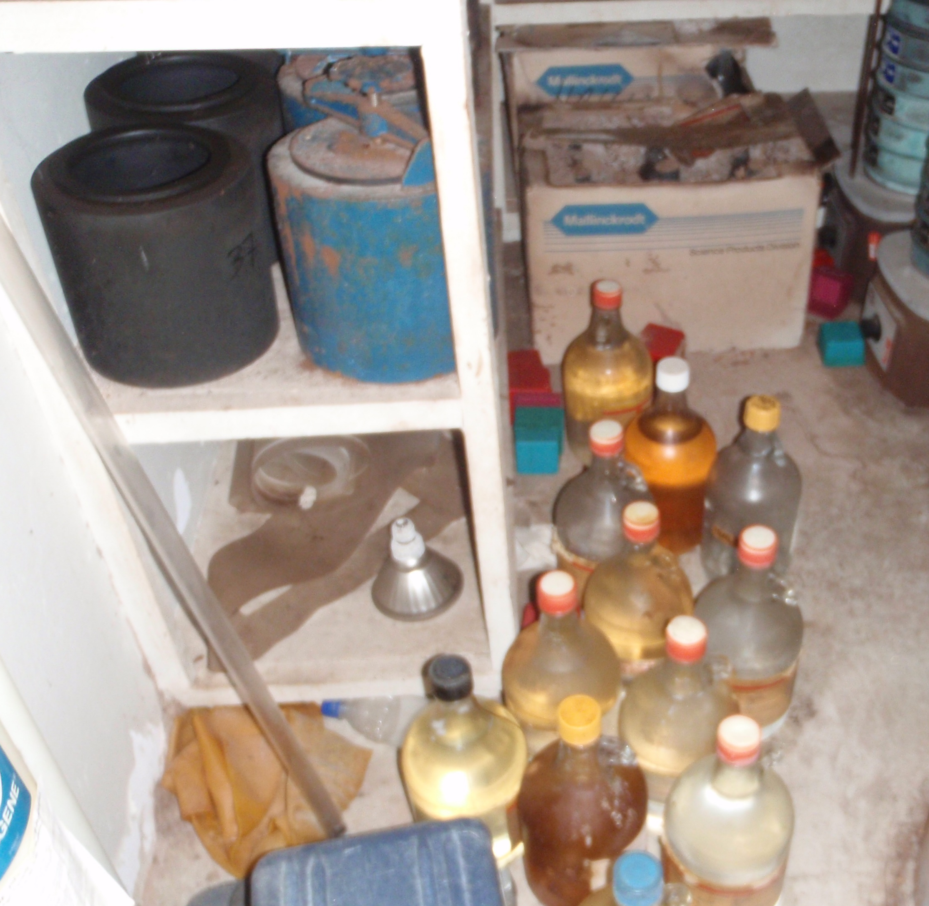
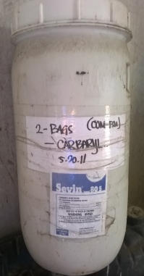
Chemical Waste at Planned Sites

Slide 7
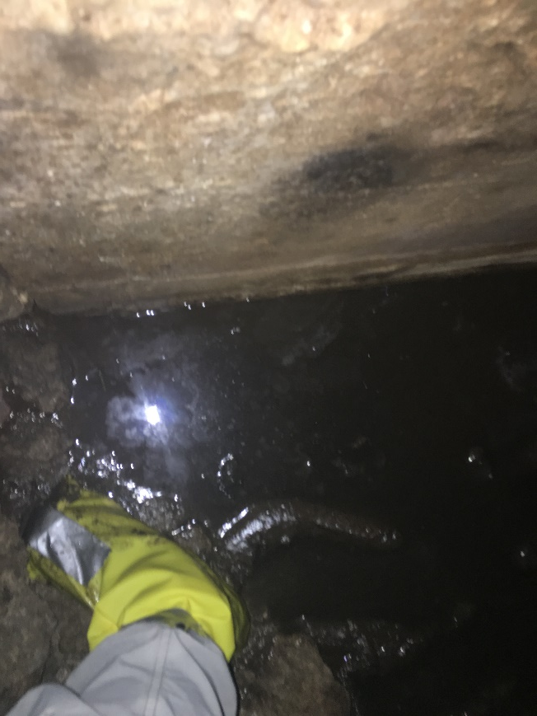
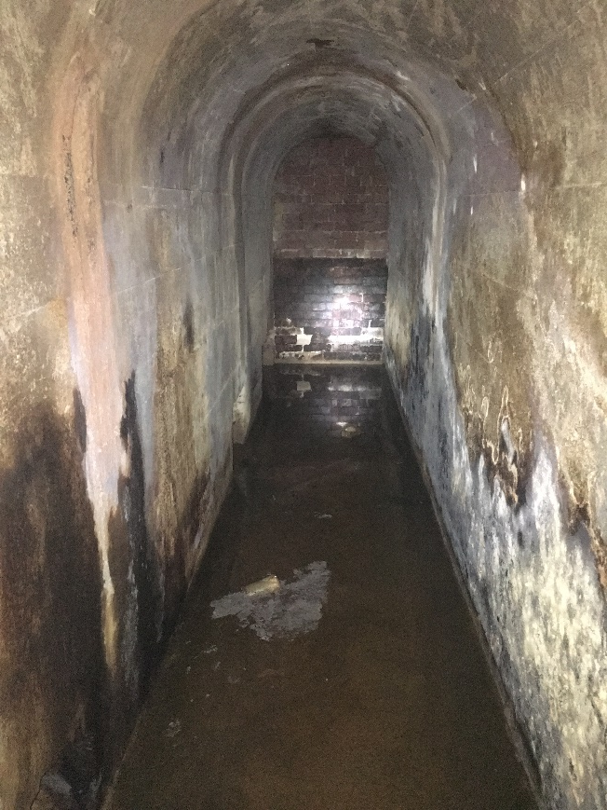
Rota Tunnels Site, CNMI (OSC Rogow)
Historic discharges into Pacific Ocean
EPA Oil Response Action - subsurface containment around shoreline
Tunnels found during construction work
Sampled by EPA in 2020
Oil contaminated with lead
SFD Action Memo funded
Work delayed until 2022

Slide 8
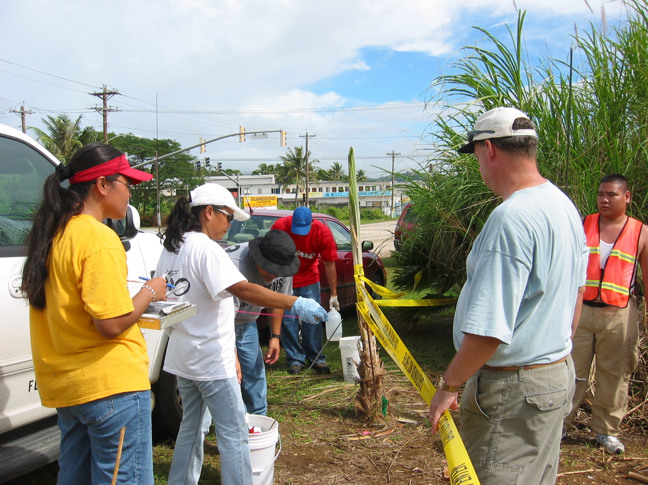
KV-1 Site, CNMI
As Lito, Saipan
(OSC Rogow)
Aviation Fuel in drinking water aquifer
15 groundwater monitoring wells
Plume grows in dry season
Plan for mitigation being worked on by EPA
Additional funding added
Work delayed until 2022

Slide 9
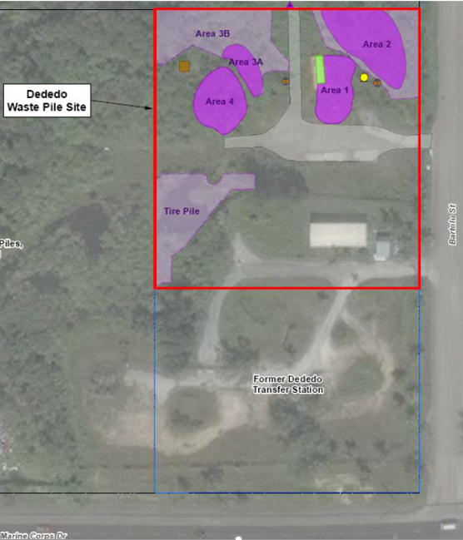
Dededo Waste Piles, Guam (OSC Musante)
Site of former transfer station and private solid waste recovery operations
Main contaminant is Pb above RCRA hazardous waste levels,
  PCBs (<50 ppm)
Action memo approved
Removal action planned for 2022

Slide 10


HAPPY HALLOWEEN!
(Malia 15 months!)

Slide 11

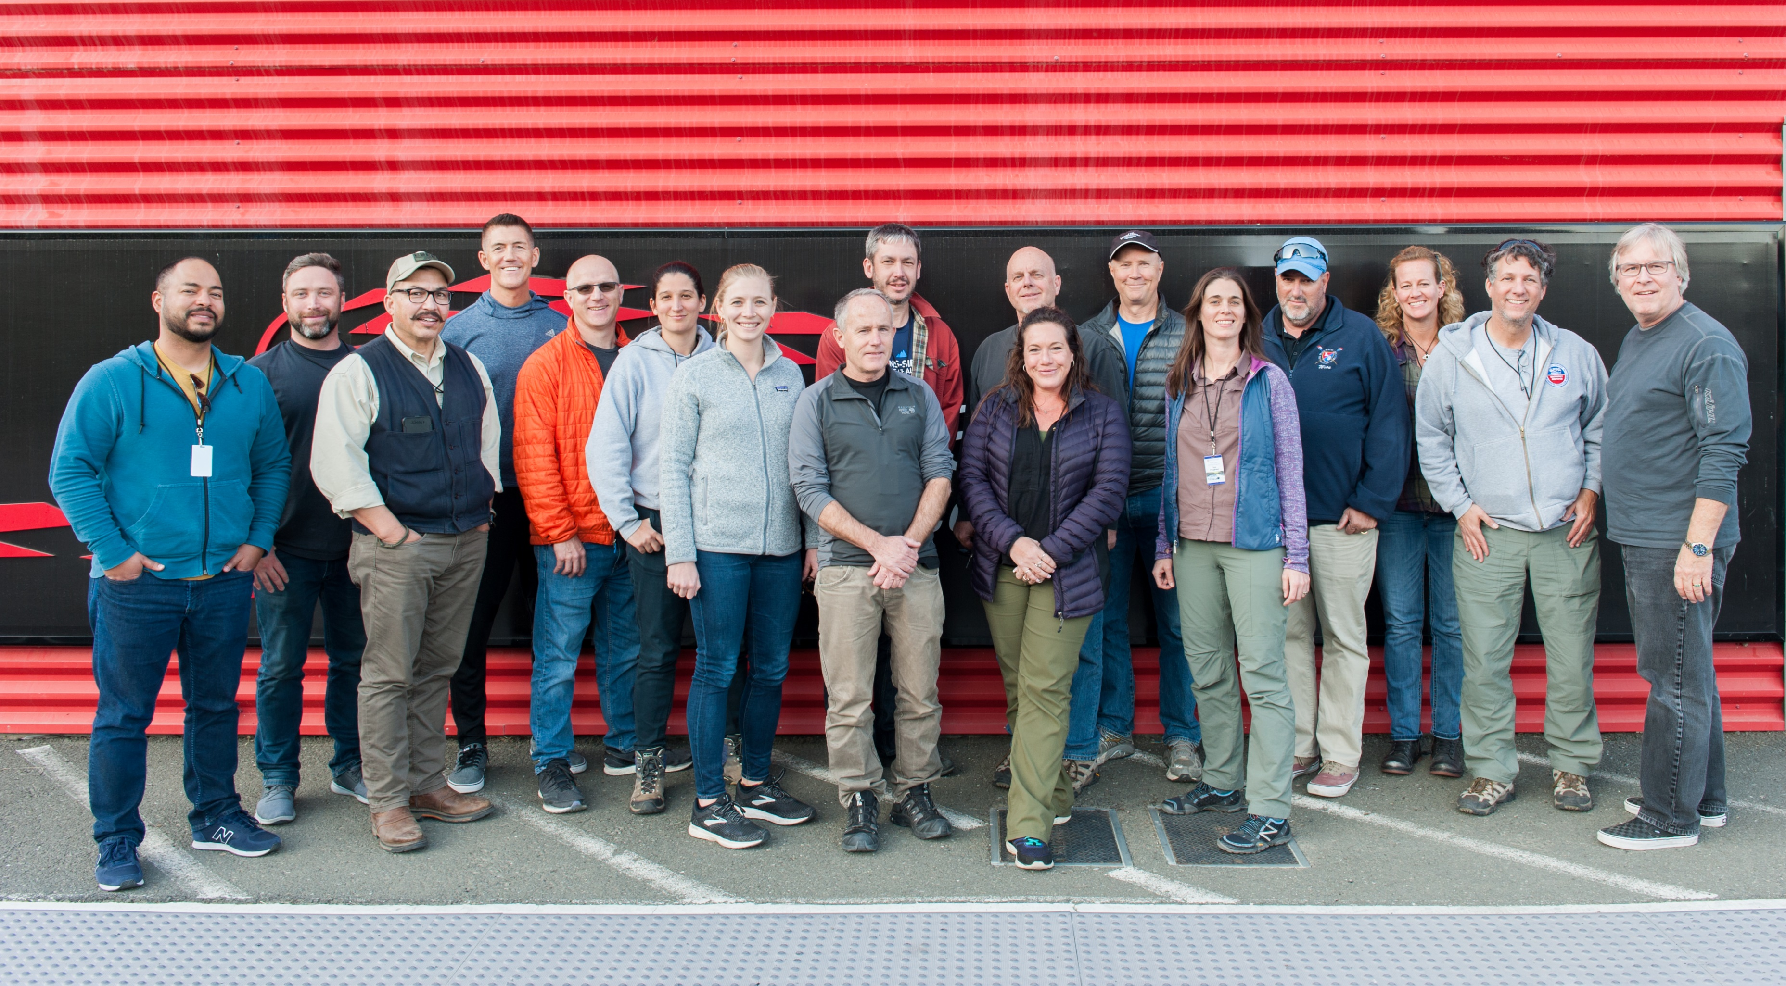
Questions?

